Slide 1
How Does HNOSS Operate?
Rocío Santiago Kern

Slide 2
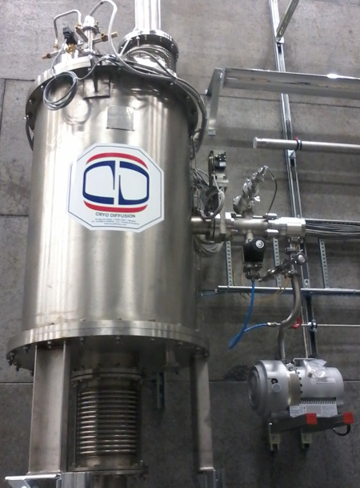
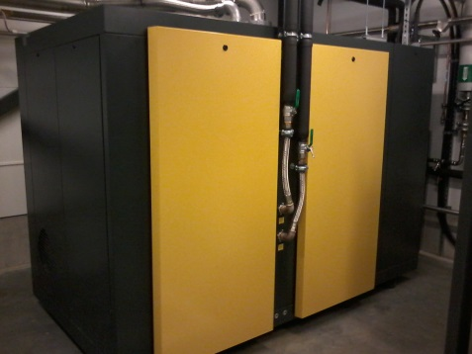
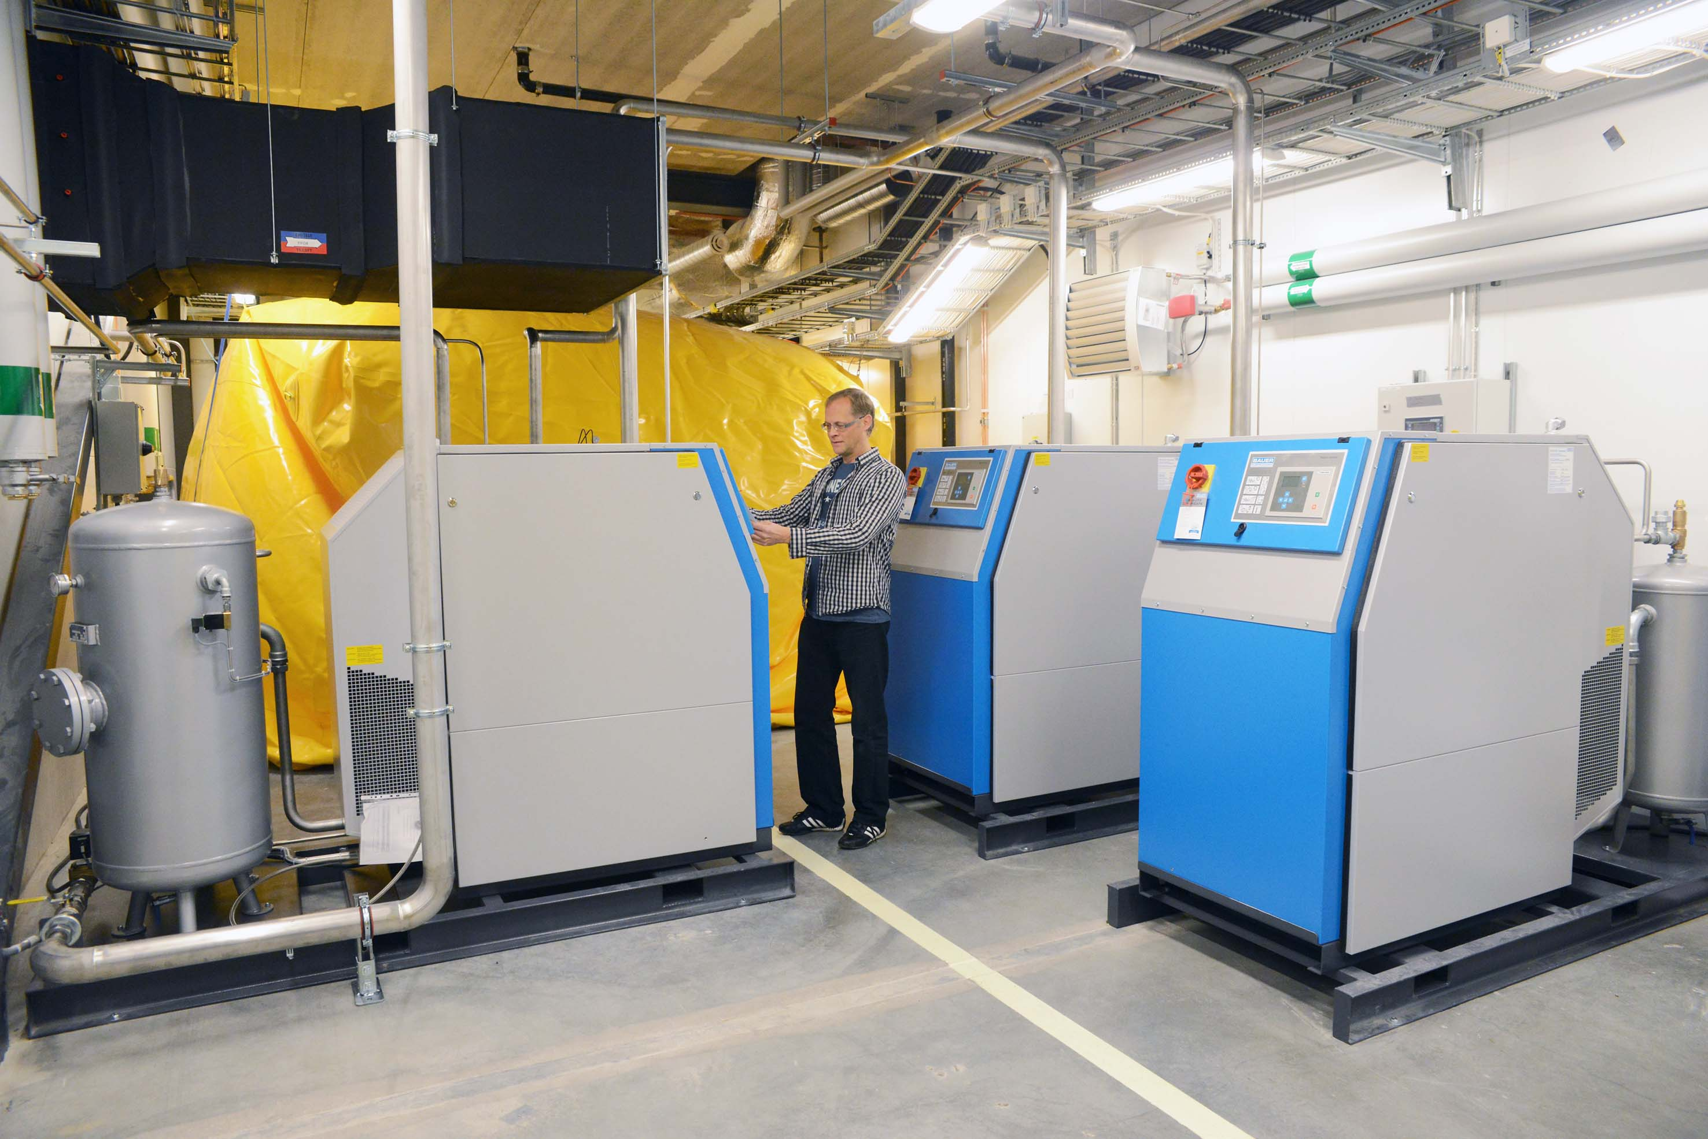
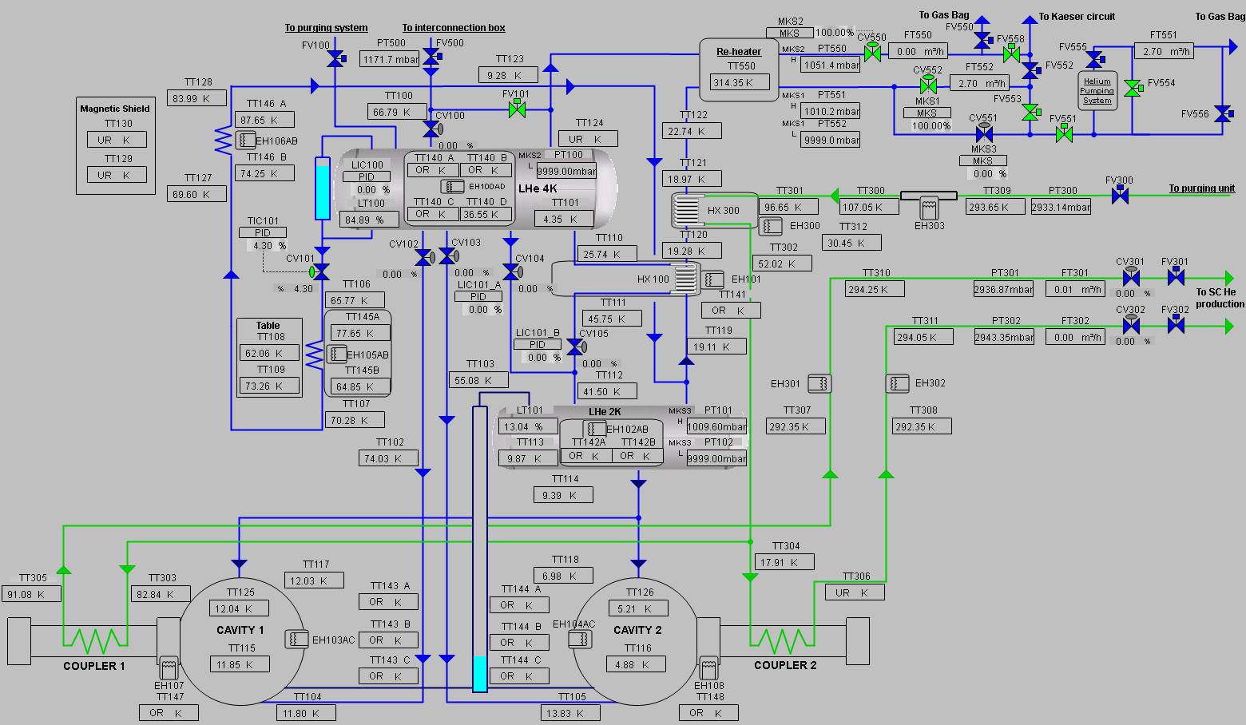
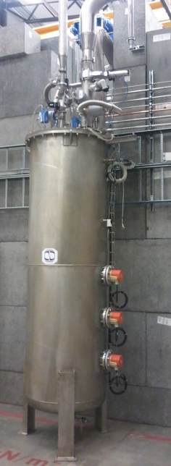
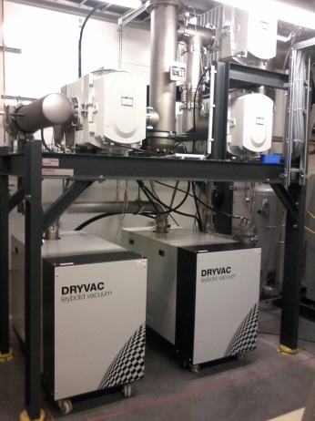
Schematic

Slide 3
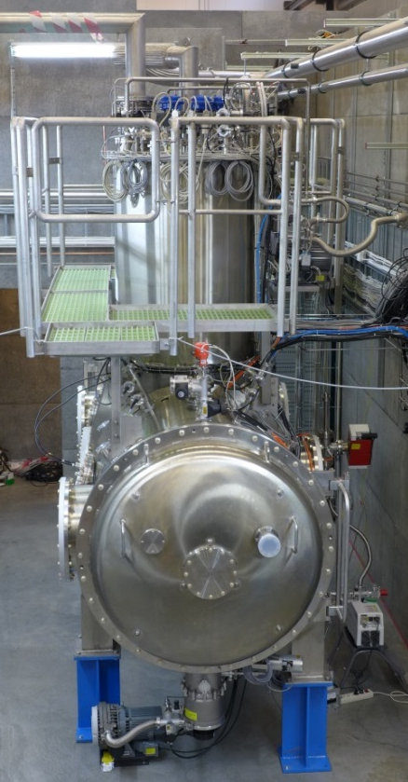


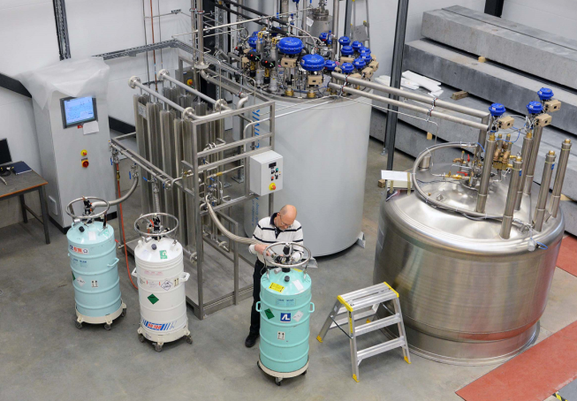
System Overview
GHe from 4K tank
GHe from 2K tank
LHe + LN2
4K operation
LHe + LN2
2K operation
”Clean” GHe

Slide 4
Modes of operation (temperature)
4K tank:
  only 4K operation
    Exhaust to Kaeser (inlet pressure 1.05 bara) or gasbag
2K tank:
  4K operation (through CV104)
    Exhaust to Kaeser (inlet pressure 1.05 bara) or gasbag
  2K operation (through CV105) → any T between 4.2K and 1.8K
    Exhaust to gasbag

Slide 5
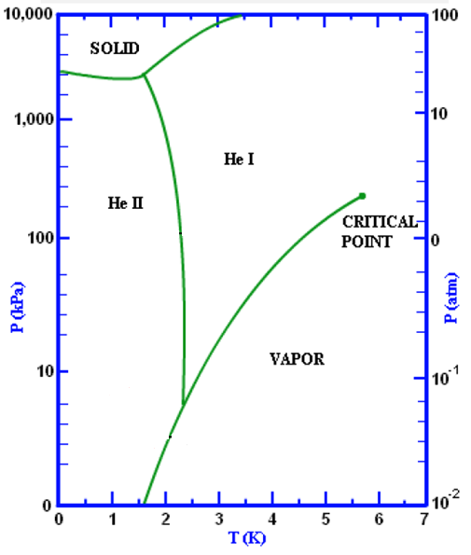
Modes of operation (temperature)
How can we reduce the LHe temperature?
P_{atm} , 4.5K
X
Reduce P
20 mbar, 1.8K
X

Slide 6
What are the different steps to have the cavities cold from room temperature?

Slide 7
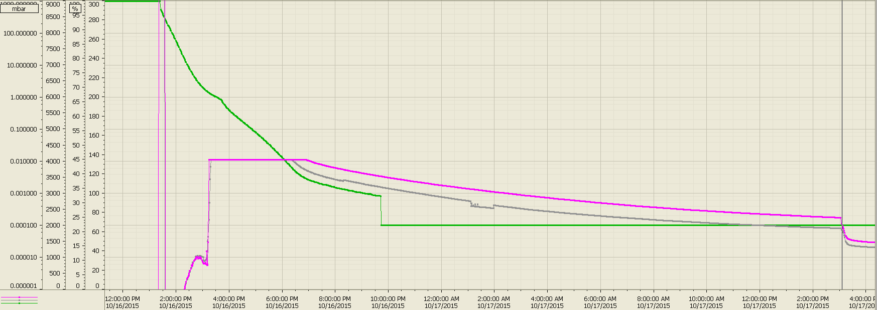
1st Step: Pumpdown to 10⁻⁴ mbar
As soon as we close HNOSS, the pump down of the system can start
Done on both ICB and HNOSS
Time depends on the volume to be pumped, what is inside the volume and for how long have the materials inside the volume been exposed to air
Thus ICB pumpdown time is much smaller than HNOSS’
Time for HNOSS (with two cavities inside):
  13 h to reach high 10⁻⁴ mbar
  25 h to reach low 10⁻⁴ mbar
Time for the ICB:
  3 h to reach low 10⁻⁴ mbar
  Note: the reason to choose 10⁻⁴ mbar as a high limit for pumping is because below this pressure the flow of cryogens (LHe and LN₂) is possible.

Slide 8
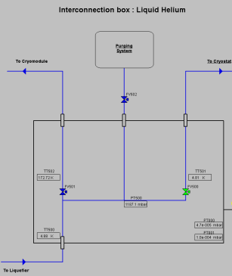

2nd step: Sequences 0-2
While the system is being pumped, we take the time to purge all LHe lines, divided into ”groups”. This means
  Evacuating the lines (P_{final}=5 mbar)
  Closing a valve and see if the pressure increases → if it does there is a leak -> not good
  Pressurizing the lines (P_{final}=1080 mbar)
  Closing a valve and see if the pressure decreases → if it does there is a leak -> not good
This procedure is done to avoid having air/water particles in the system that would freeze and create unwanted and dangerous plugs
Sequences involved:
  Sequence 0: transfer line (TL) between the LHe dewar and the ICB
  Sequence 1: 4K and 2K circuits in HNOSS
  Sequence 2: Supercritical He circuit (ScHe, green circuit in GUI)
Note: the lines after the reheater are not part of the purging process.

Slide 9
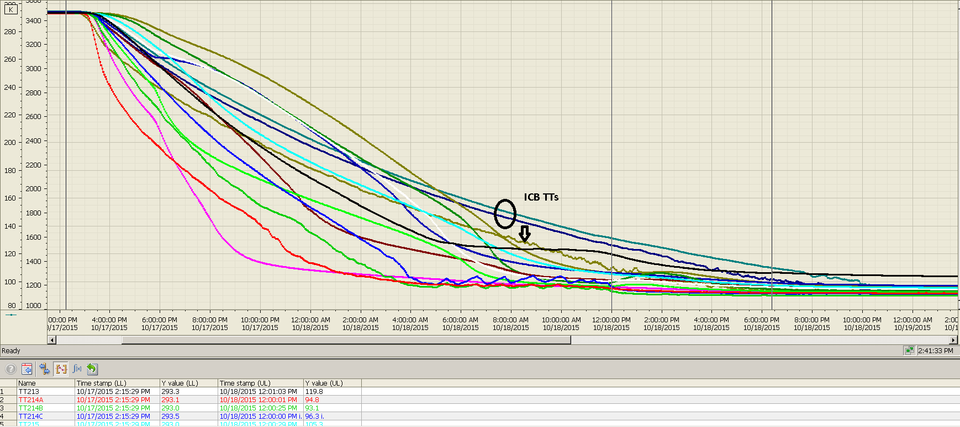
3rd Step: Cool thermal shields (LN₂)
Done on both ICB and HNOSS with LN₂
Time depends on what is in contact with the shields: piping, cabling, etc. Usually this time does not vary since all the main piping is already in place for all experiments
The ICB’s thermal shield should cool faster than HNOSS’ (some minor problems involved for which this is not so)
Time for HNOSS:
  22 h until all sensors in the shield are below 120 K
  28 h until all sensors (except the top flange) in HNOSS’ shield are below 100 K
Time for ICB (as should):
  6 h until all sensors in the shield are below 100 K

Slide 10
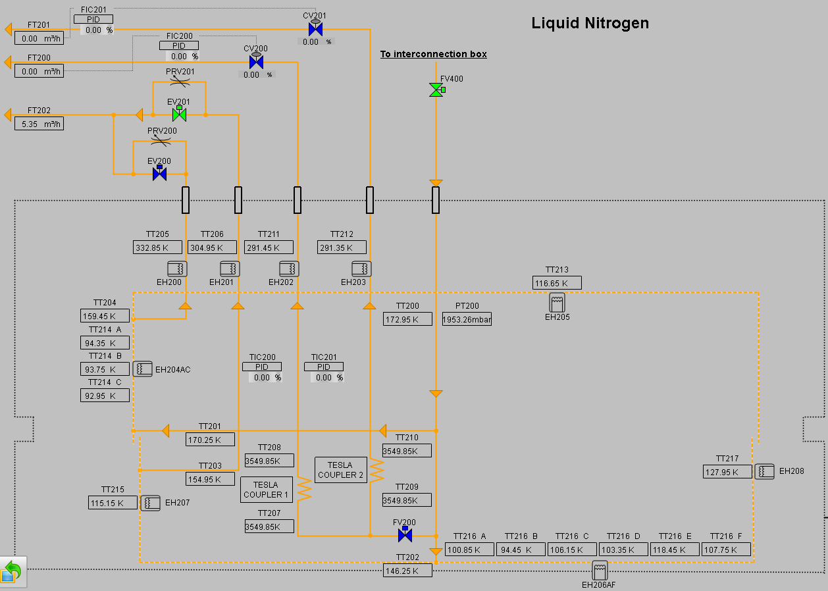
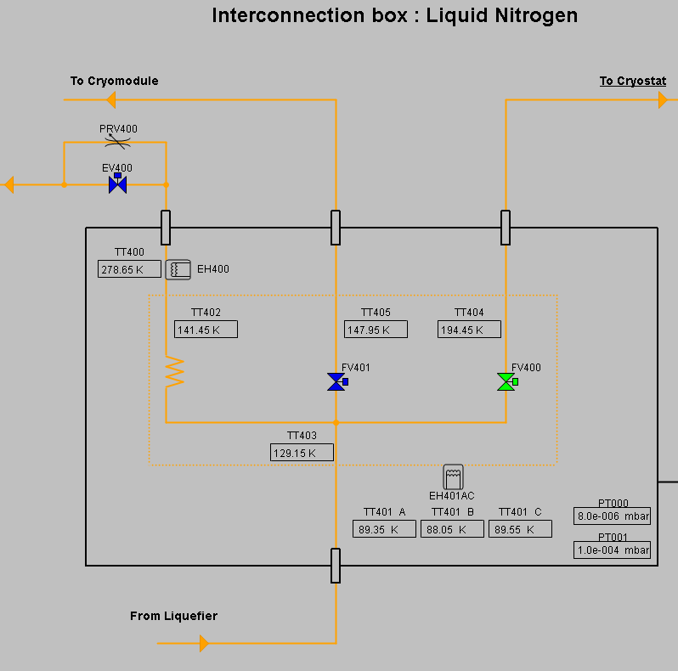
Sequences 3A and 3B
Sequence 3A takes care of cooling the ICB’s thermal shield
Sequence 3B takes care of HNOSS’ shield and its divided into two circuits: one for the cryostat and one for the valvebox (VB)
Since this is done with LN₂ and there is no shortage of such cryogen, all outlets are, at the moment, letting the vapours out inside the bunker (which might also explain the O₂ depletion alarms in the bunker…)

Slide 11
4th step: Cooldown TL and 4K tank (LHe)
LHe + LN2
For HNOSS only (the ICB only has a couple of valves)
Once we have the cavities well isolated from the environment (vacuum and cold thermal shield), the TL that delivers the LHe and the 4K tank can be cooled
The cooling of the 4K tank is finished once the desired level in the tank has been reached
Time: 3 h - 4 h, including the cooling of the transfer line (TL) between the LHe dewar and HNOSS
4K tank
LHe + LN2

Slide 12
Sequence 5 and 6
To cool down the TL and the 4K tank, there is a direct connection between the LHe dewar and the 4K tank (and of course the Kaeser or the gasbag)
Once the 4K tank is at the desired level (LT100) the sequence switches to another state: filling of the 4K tank
  Intermittently: in this case the transfer line is re-cooled again before every refill to avoid a big evaporation of LHe due to the difference in temperature
  Via regulation: the filling valve (CV100) is constantly opened
This state will be kept until the sequence is stopped

Slide 13
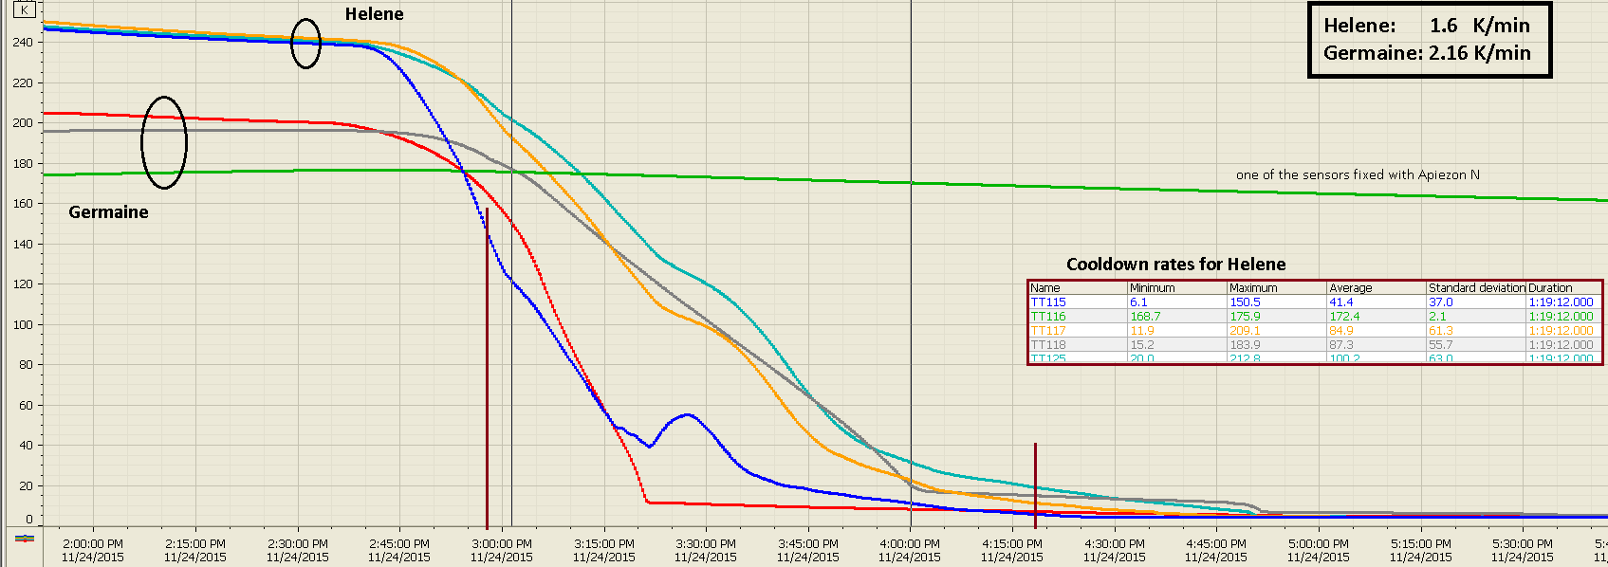
5th step: Cooldown of the cavities (LHe)
It can start before the 4K tank is full.
Since the cavities are isolated, when the (first) cooldown starts the temperature of the cavities is below room temperature, ca. 290K for Germaine and 260 K for Helene.
The cooldown of the cavities is finished once the 2K tank has reached the desired level
From then on, the 2K tank will be filled from above.
Cooling rates (calculated as the time it takes to cool from 150 K to 20 K, which is the ”danger zone”) when both cavities are in HNOSS:
  Germaine: 2.15 K/min
  Hélène: 1.60 K/min
  Note: several definitions for the danger zone, aka Q-disease zone, exist. According to IPNO, the cooling must be fastest between 150 K and 20K.

Slide 14
Sequence 7
The cooling is done from below (the 2K tank is the last part that fills) using LHe at 4.2 K from the 4K tank
The cooling takes place via two valves (CV102 and CV103, one for each cavity) that are opened 100% during cooldown
The cooldown of the cavities is finished once the 2K tank has reached the desired level
From then on, the 2K tank will be filled from above (CV104 or CV105 depending on the mode of operation)

Slide 15
6th step: Choose mode of operation
This only affects the 2K tank
Note 1: these values are from run #7 (Helene). They GREATLY depend on
  what is connected to the 2K tank
    One or two cavities
    Table (in the current setup the table might give 20 W)
  If there is a continuous filling of the tank or not and how good the regulation is
Note 2: the 2K pumps available cooling power (90W at 1.8K) is for the complete system, so if we have 30 W in static losses, then only 60 W are available for power dissipated in the cavities.
 | 4K mode | 2K mode (4.5K ≤ Cavities ≤ 1.8K)
Filling of 2K tank (valve) | Intermittent (CV104) | Intermittent (CV105)
 | Continuous (CV104) | Continuous (CV105)
LHe consumption (steady state, w/o table) | 4 W | 10-12 W
GHe exhaust | Kaeser/Gasbag | Gasbag
Extra efforts |  | Need ca. 1.5 h after switching off 2K pumps to leave a stable situation

Slide 16
Sequence 8 or 9 (and 10)
Sequence 8 is for 4K operation
  Pressure can be regulated via CV552
Sequence 9 is for 2K operation (through the 2K pumps)
  Pressure is regulated via CV551
Sequence 10 is for cooling the power couplers with ScHe via an independent circuit

Slide 17
7th step: Do measurements
Now the fun for the RF team starts!
BUT
The limitations are:
  The liquefier: we cannot get more than what the liquefier gives (ca. 120 l/h considering regeneration of ”dirty gas”, aka gas from the gasbag)
  The gasbag: the volume is limited to 90 m³ (real volume 100 m³). The three compressors have a total throughput of 75 m³/h.
  If running in 2K mode, the 2K pumps: max. 90W at 1.8K but overheating might reduce this value (working on this)
So…when we have to ask the RF team to stop the measurements, is because, at least, one of these links is in trouble
Also, the system is not completely error-free
  Working on fine tuning parameters in every run
  New bugs found on the system

Slide 18
8th step: Warmup and isolate
Sequence 12A and 12B take care of warming up the ICB and HNOSS, respectively
  Heaters placed on all circuits start intermittently until a certain temperature (T_{room}) is reached
When warmup is complete HNOSS’ and ICB’s vacuum pumps are stopped and the vacuum broken using dry GN₂
Sequence 13 isolates the system
  Once the system is warm and we want to take out the cavities, we isolate the system between the ICB and the reheater to avoid air going into the main equipment (Kaeser and gasbag)

Slide 19
Other sequences
Sequence 11 ”Standby 40K”
  The system keeps the cavities cycling between a certain temperature (usually 20K, not 40K) and 4K
  This sequence is used when
    Thermocycles are desirable
    LHe consumption needs to be reduced
Sequence 20 ”Semi-automatic sequences”
  Will automatically move from one sequence to the next
  Completely automated (little input from the operator)
  Means we might be able to use it in 20 years

Slide 20
Time summary
On average (and for HNOSS)
  Close HNOSS: 4 h
  Pumping: 24 h
  Thermal shield cooling: 25 h
  Cooldown of TL and 4K tank: 4 h
  Cavities cooldown to 4K: 7 h
  Total (w/o margin) = 64 h (over 2.5 days)
  Note: the cavities’ sensors will show that the cavities are at a certain temperature (4K, 2K, 1.8K, etc.) BUT it might take up to two days to have steady state, i.e. cavities certainly at that temperature (not only the sensors)
After this, one can choose the temperature of operation for the 2K tank

Slide 21
Summary
From start of closing HNOSS to cavities at final temperature (only sensors): over 2.5 days IF everything goes well
The 2K tank can operate at any temperature between 4.5K (1300 mbar) and 1.8K (16 mbar)
Main problems: LHe production, gasbag and 2K pumps
Documentation:
  The experiments are divided into runs
    each run (run #Z) stars as soon as HNOSS is closed and ends when HNOSS is opened
    A ”subrun” (#ZA, #ZB,…) starts when HNOSS has been warmed up deliberately (close to room temperature) but has not been opened
  Information about the runs (cooldown rates, heat loads, problems encountered/solved, etc.) can be found in dfs:
Freia\freia-drop\08 Equipment\Cryostat01_HNOSS\10 Operation and Maintenance

Slide 22
Future Tests
Germaine with FPC
  Test alone in HNOSS?
  Install Hélène as well?
From the cryogenics point of view
  There is no advantage having both cavities installed
  But there are some disadvantages
    Cooling rate will not be as fast
    2 W - 4 W more heat loads at low temperature (not a lot)
    Not possible to measure Germaine heat loads at diferent temperatures

Slide 23
Any doubts/requests/inquiries?

