Slide 1
TIME DOMAIN CHARACERIZATION OF HIGH POWER RF PULSED SOLID STATE AMPLIFIERS FOR LINEAR ACCELERATORS
L. Hoang Duc, V. Goryashko, R. Ruber, A. Rydberg, J. Olsson, D. Dancila
FREIA Laboratory, Uppsala University

Slide 2
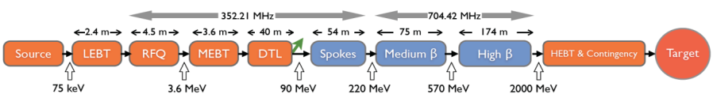
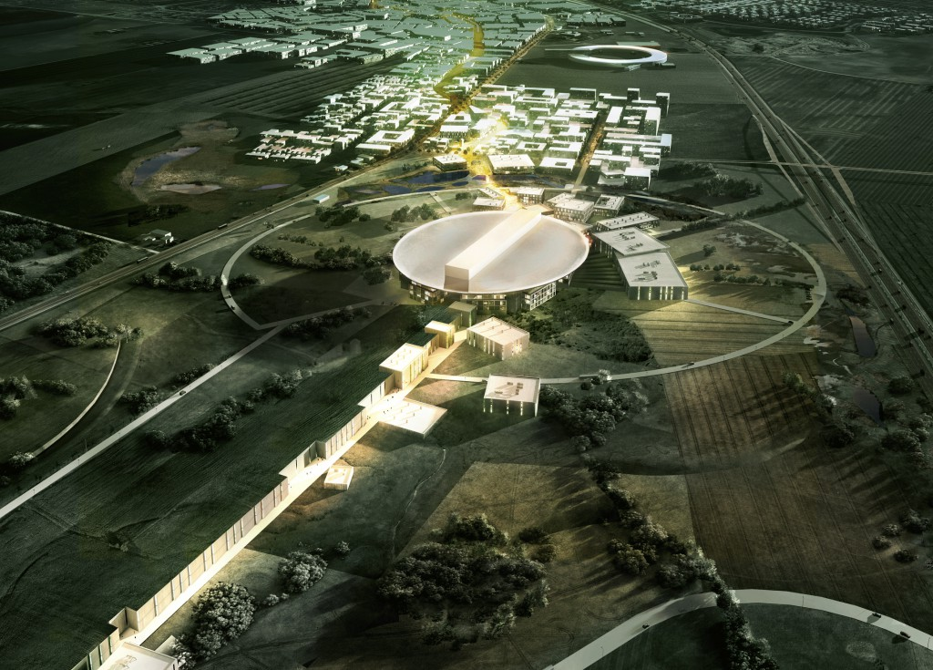
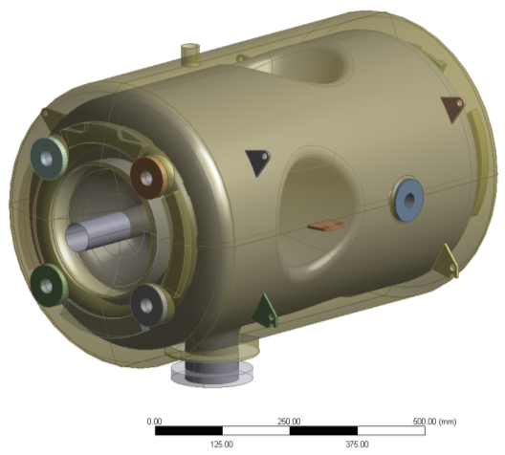
RF Development at FREIA
Facility for Research Instrumentation and Accelerator Development
Schematic of ESS Linac
Superconducting Spoke Linac
Specifications for Spoke amplifier:
Frequency = 352 MHz
Power = 400 kW
3dB band-width ≥ 250 kHz
Pulse width = 3.5 ms
Pulse repetition rate = 14 Hz
FREIA’s responsibilities:
Developing RF test stand for ESS spoke cavities.
Testing prototype spoke cavities.
ESS construction in Lund
SRF Cavity
(Superconducting)

Slide 3
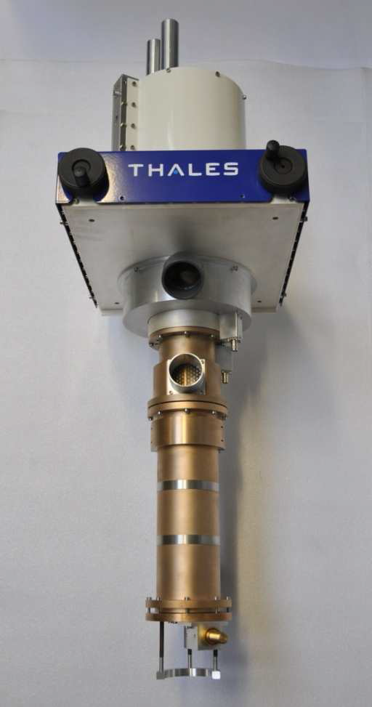
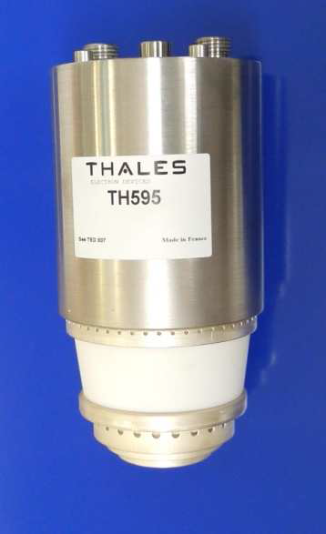
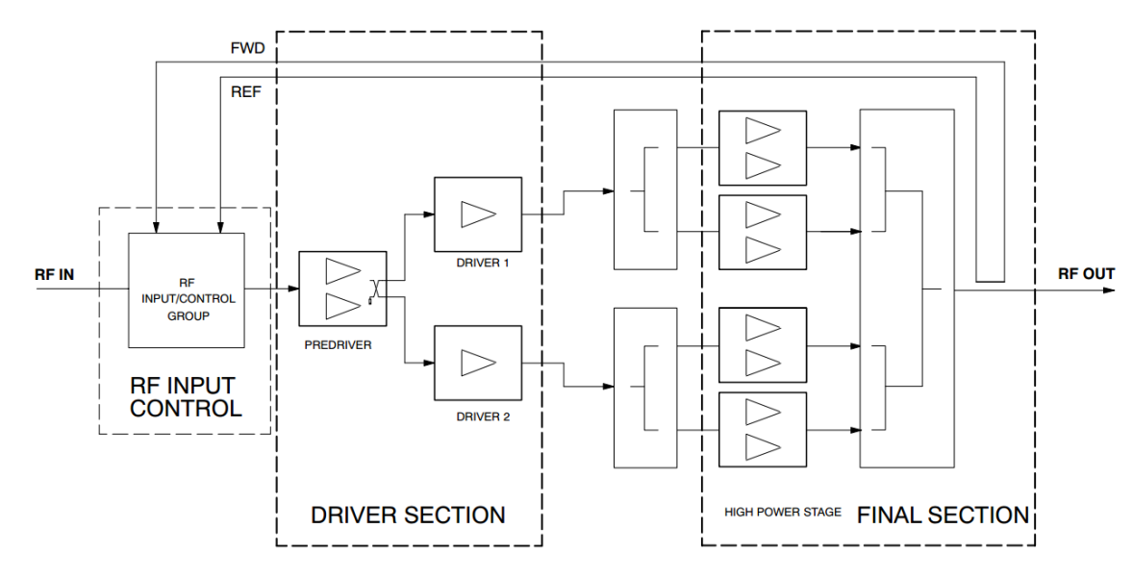
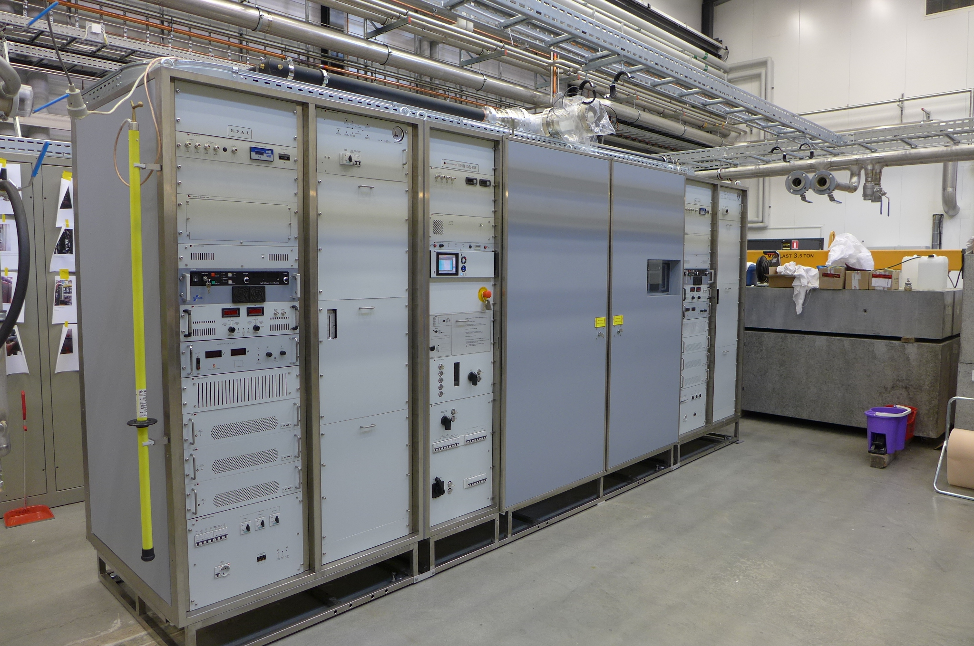
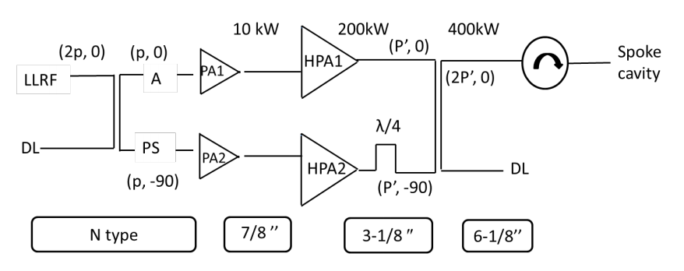
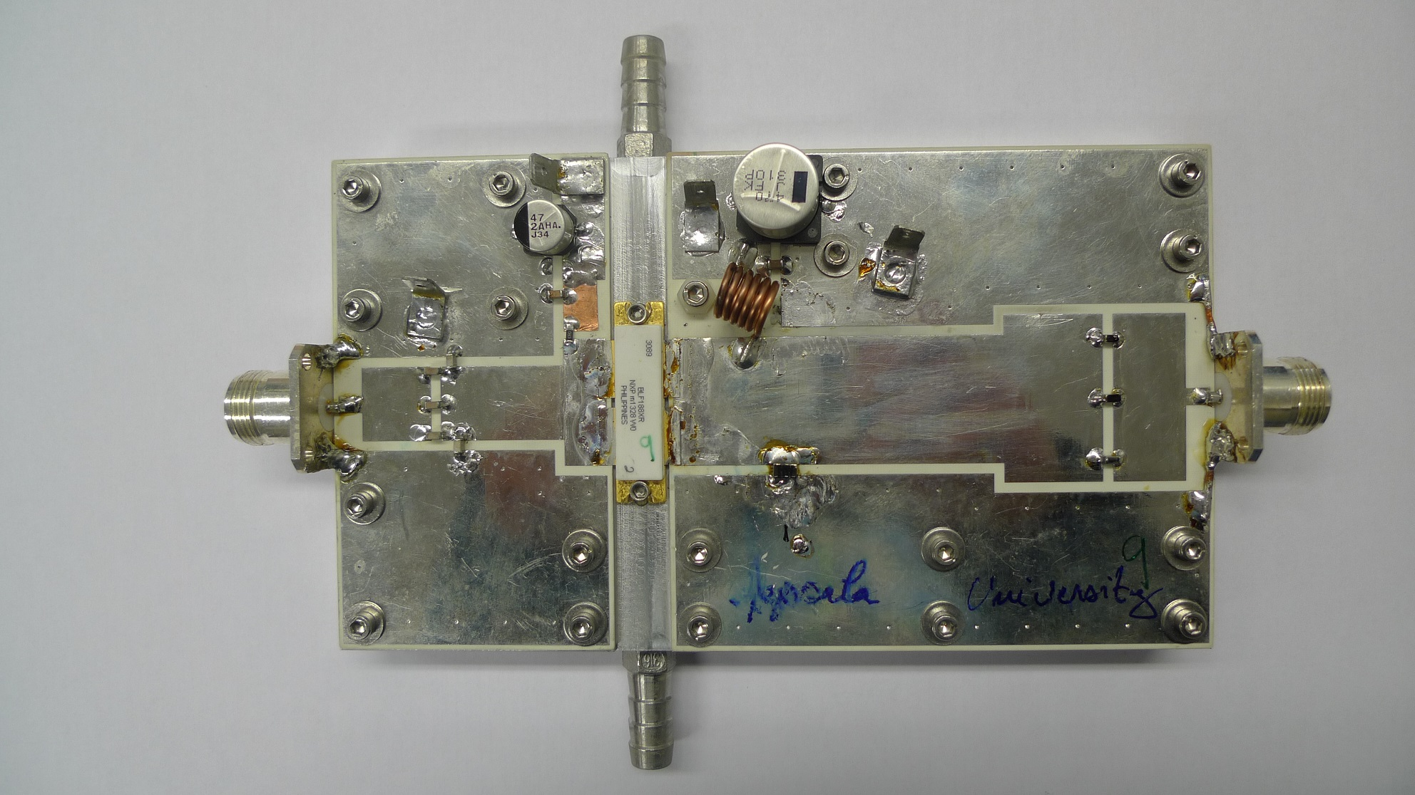
The Tetrode-based Power Station
Spoke
Cavity
Tetrode-based
Based on 2xTH-595, water+air cooled
Solid-state pre-amplifier
In-house development:
Optimizing 1 kW transistor modules
Power combining methods
10 kW prototype amplifier

Slide 4
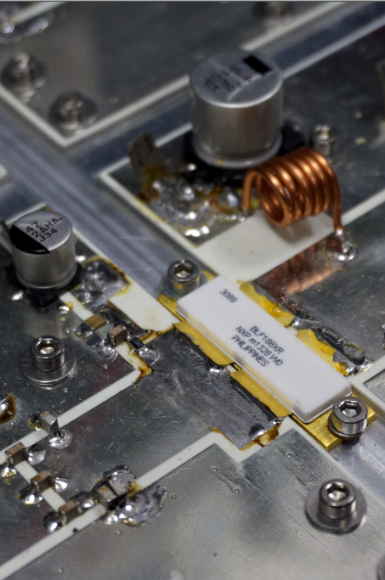
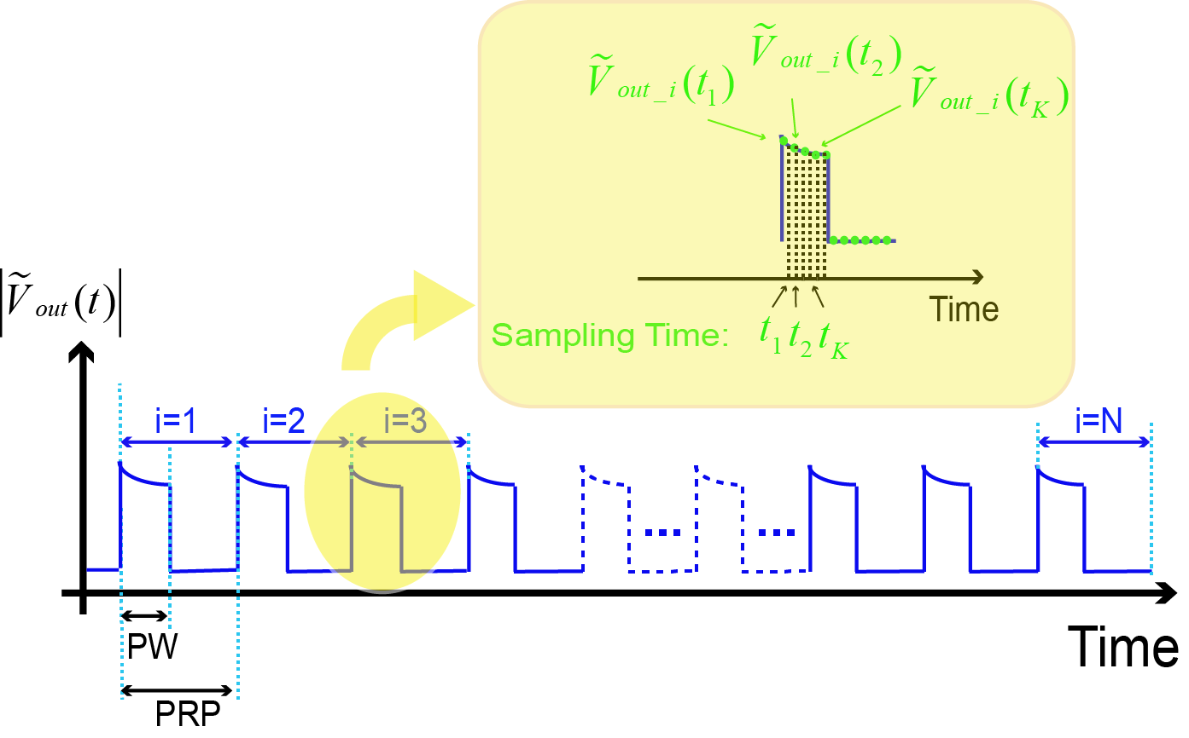
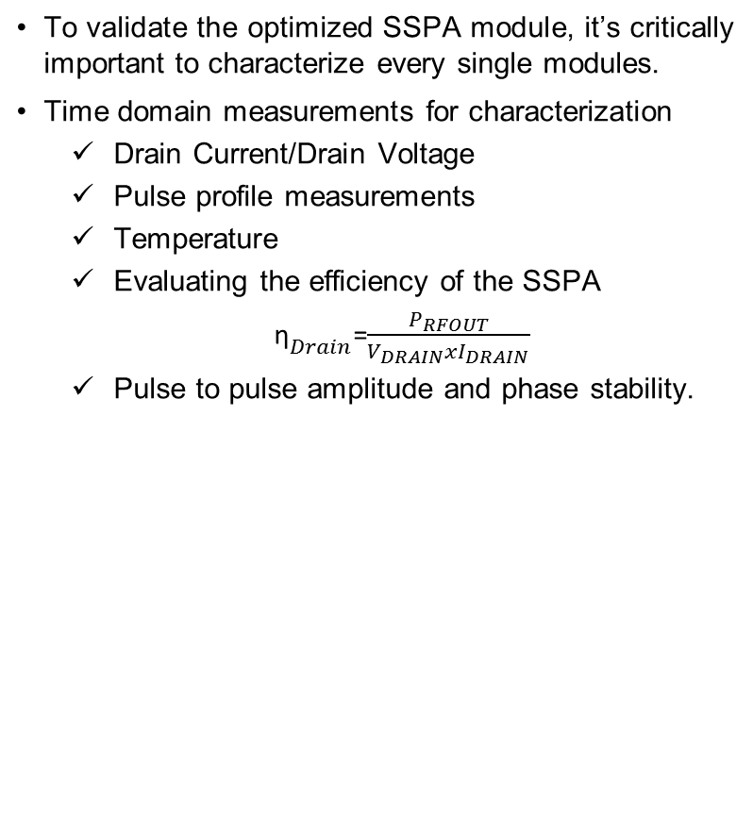
Why do we need a monitoring circuit?
To validate the optimized SSPA module, it’s critically important to characterize every single modules.
Time domain measurements for characterization
  Drain Current/Drain Voltage
  Pulse profile measurements
  Temperature
  Evaluating the efficiency of the SSPA
  ${\text{η}}_{Drain}$=$\frac{P_{RFOUT}}{V_{DRAIN}xI_{DRAIN}}$
  Pulse to pulse amplitude and phase stability.

Slide 5
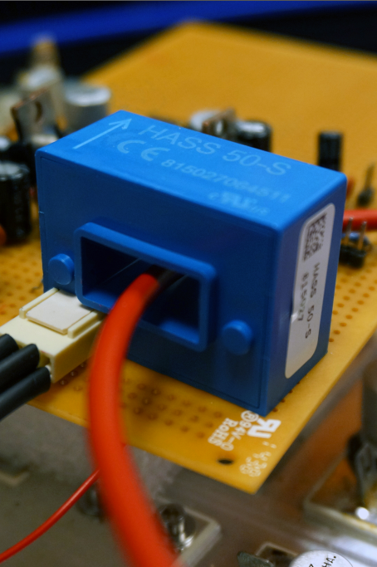
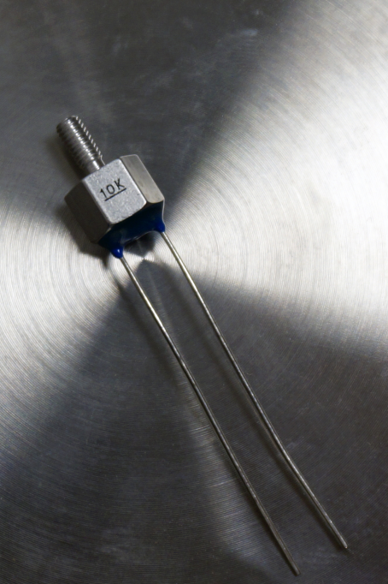
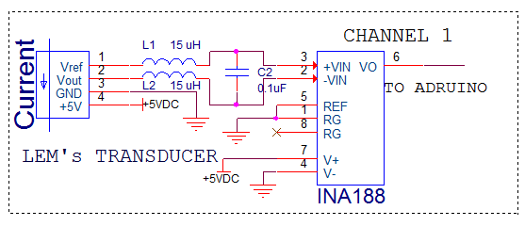
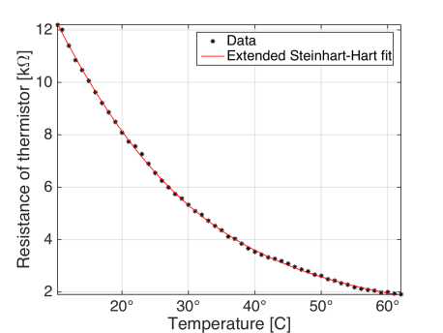
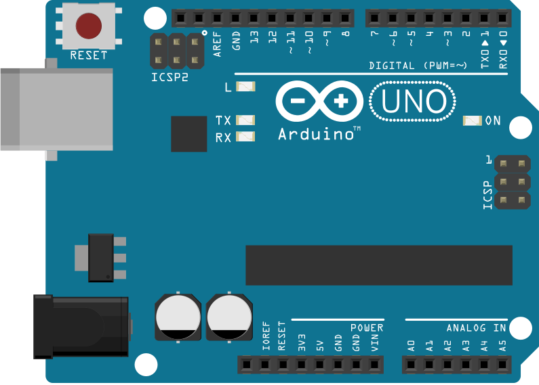
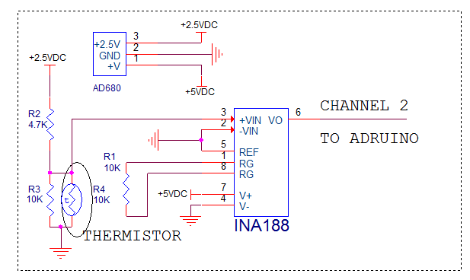
Solutions for The Monitoring Circuit
LEM’s transducer HASS 50-S
  Hall effect principle
  Fixed offset and gain
  Small size, low cost, easy to install
  Immunity to interference
  1% accuracy
Good solution to replace the Fluke’s probe
NTC Thermistor
Low cost
High sensitivity to Temp
Non-linear Characteristic
Calibration Requirement
To Arduino
Current Measurement Module
To Arduino
Temperature Measurement Module
Arduino as a Processing Unit

Slide 6
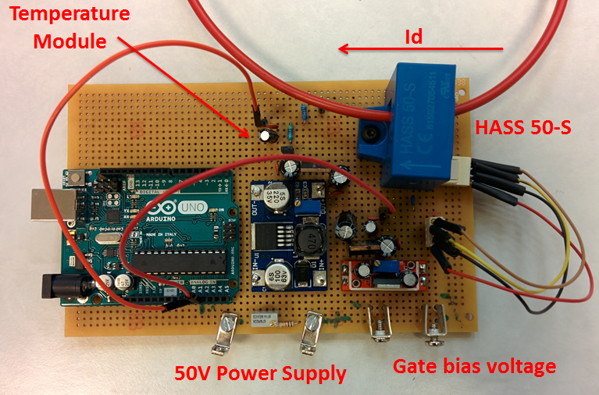
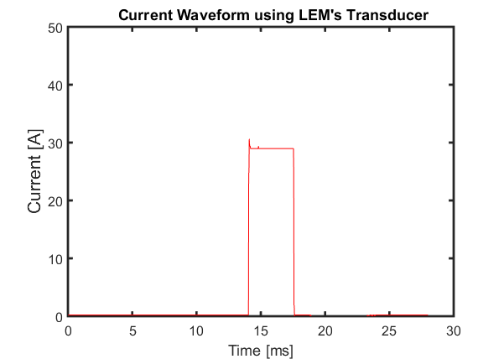
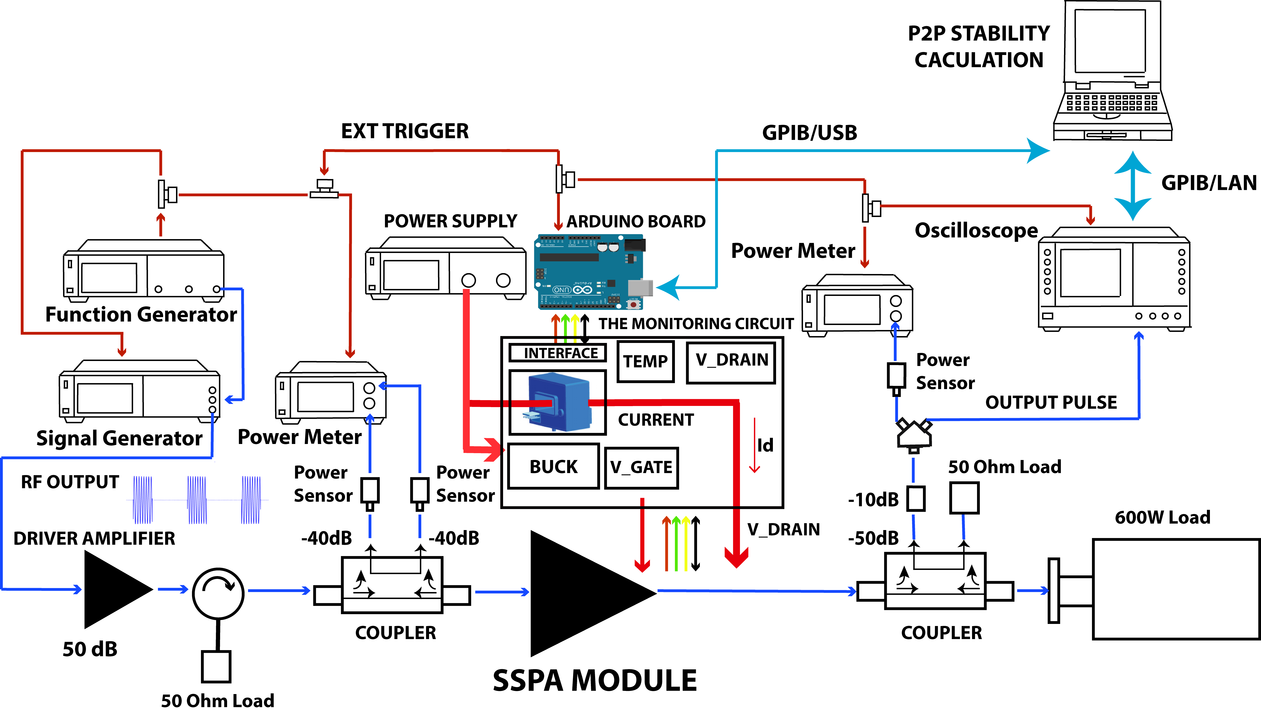
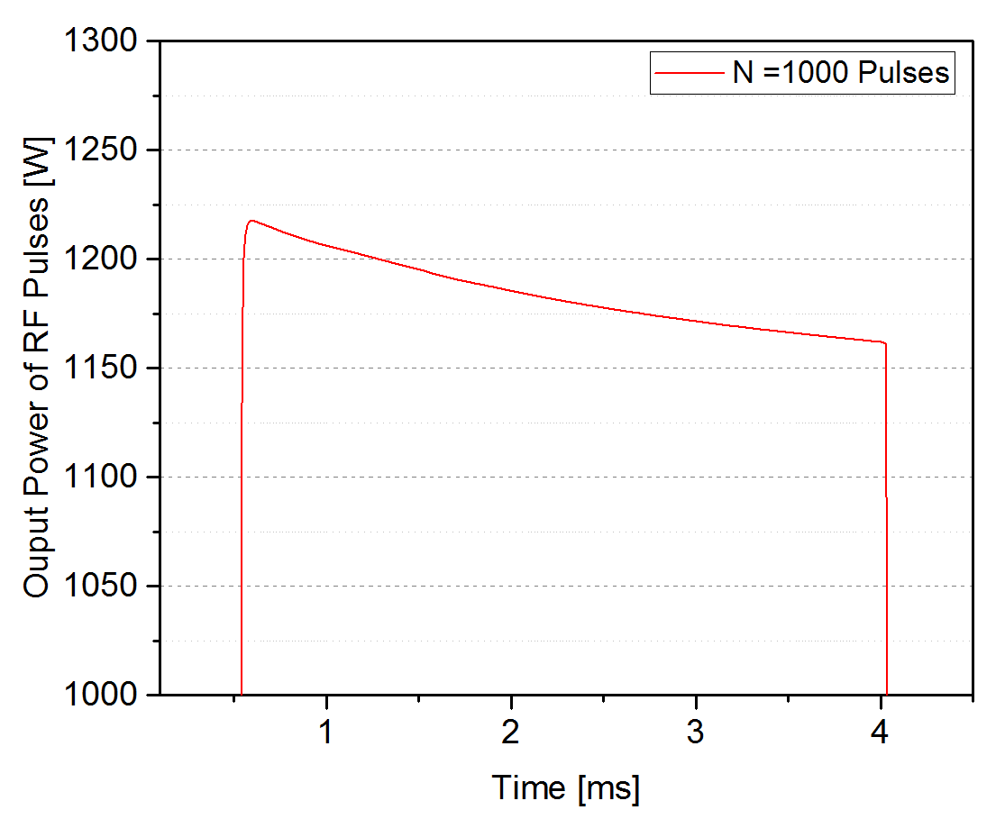
The Time Domain Characterization Setup
Pulsed current output

Slide 7
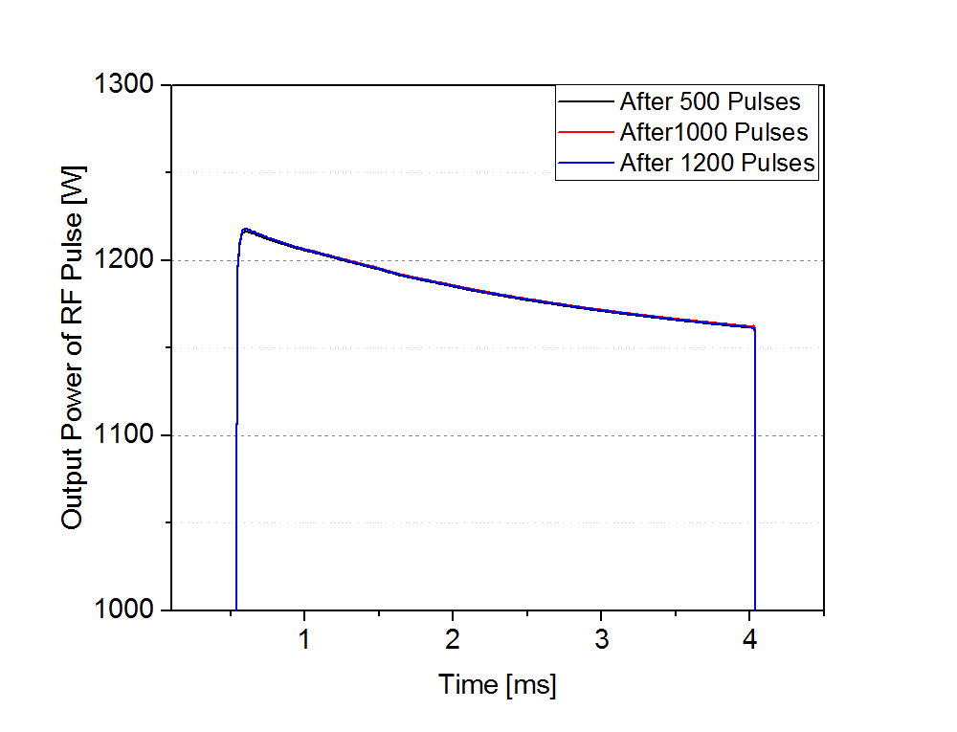
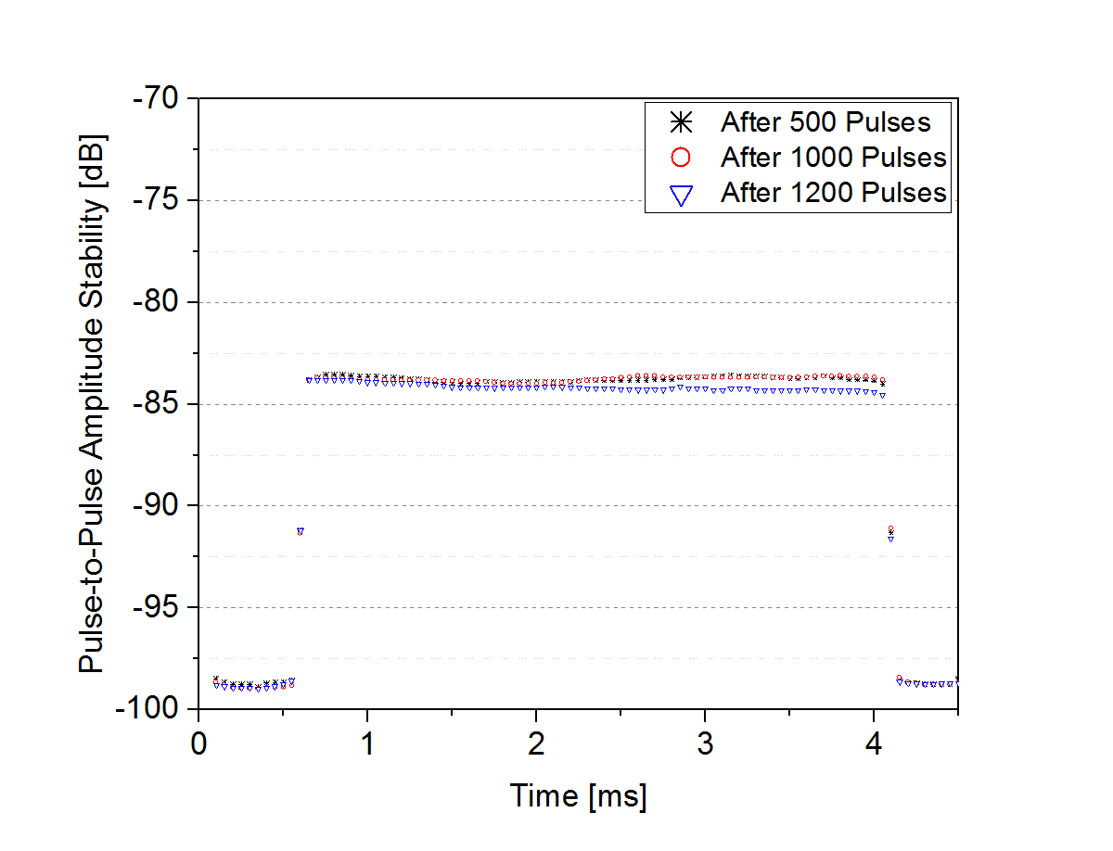
-85dB amplitude stability at 1.2 kW output
0.2 dB Droop in RF waveform
-85 dB amplitude stability

Slide 8
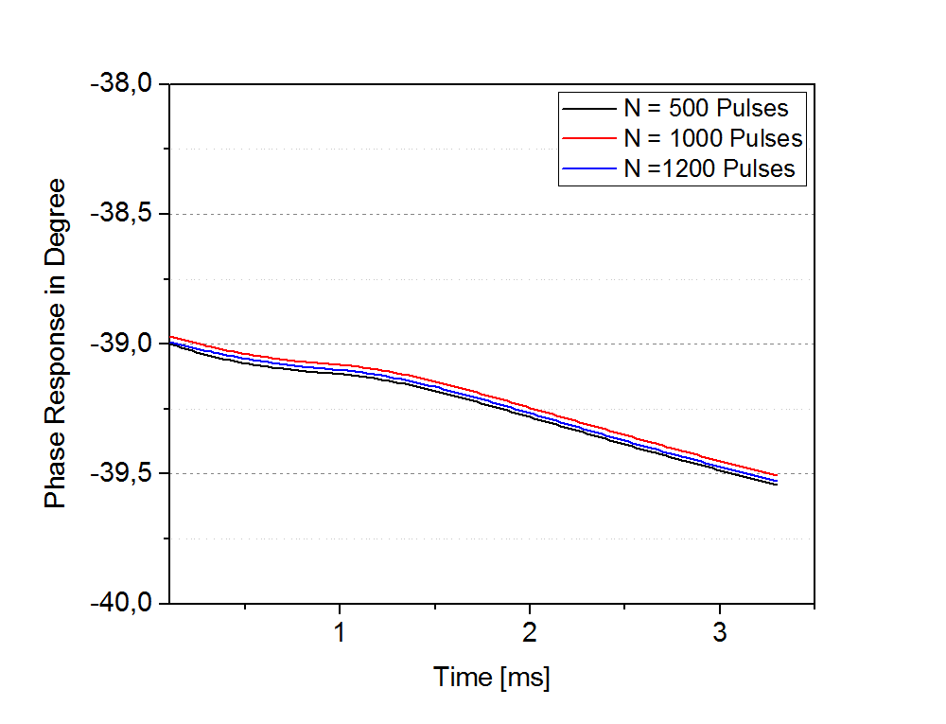
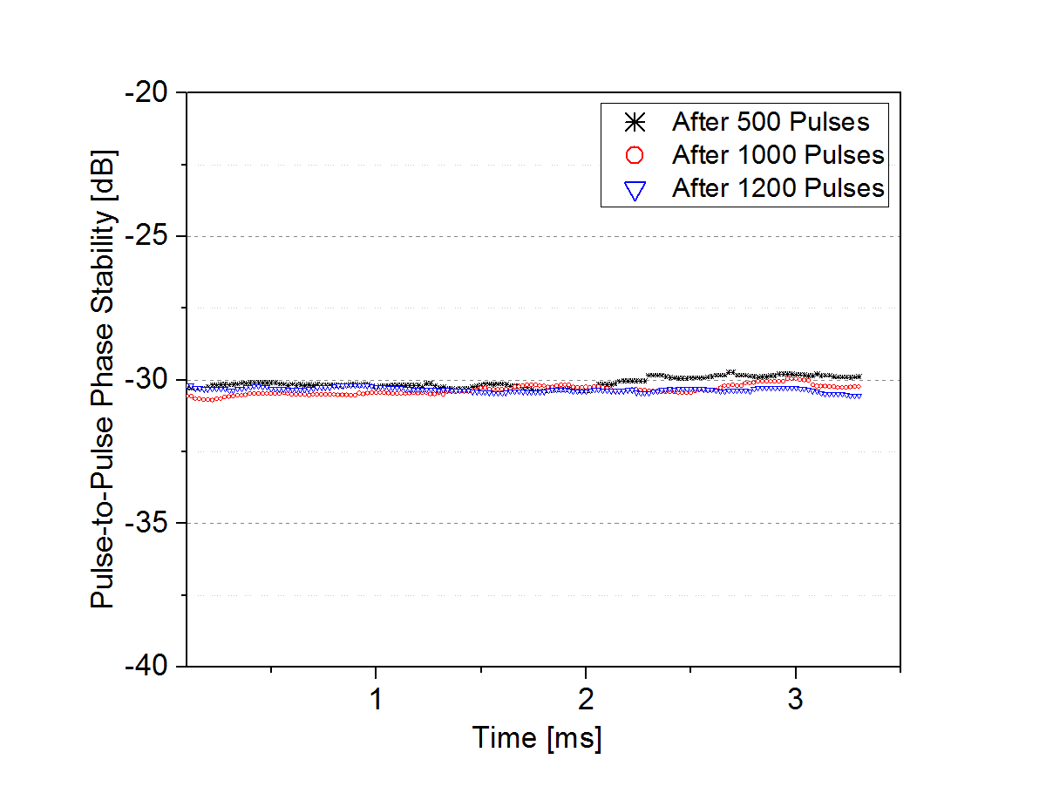
-30dB phase stability at 1.2 kW output
Insertion phase is measured -39
-30 dB phase stability

Slide 9
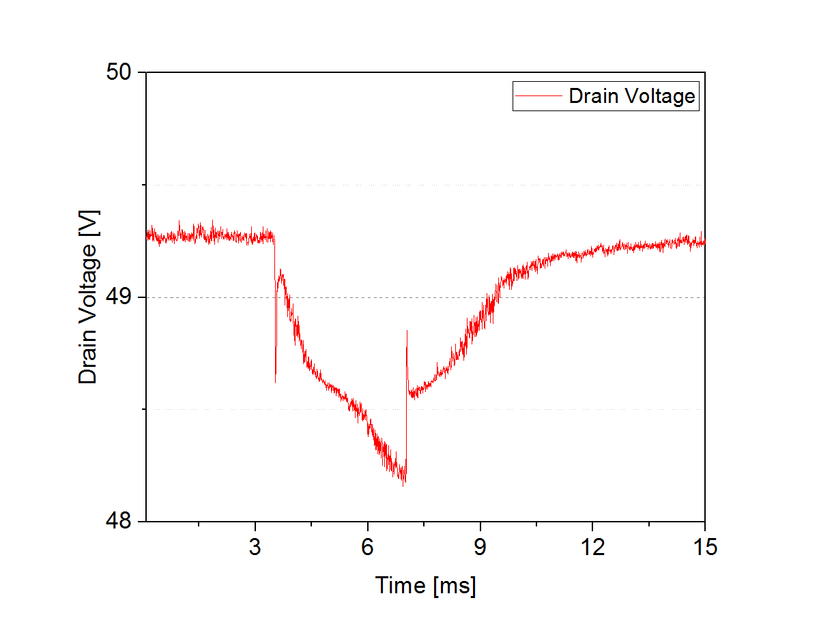
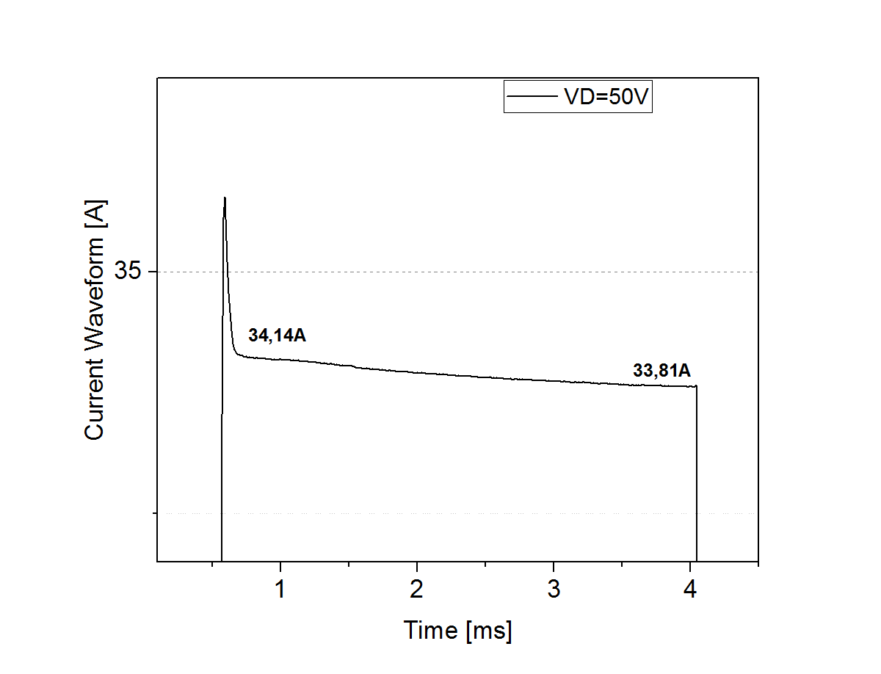
Drain Voltage and Current Measurements
Droop around 1V at 1.2 kW
5% overshoot in current waveform

Slide 10
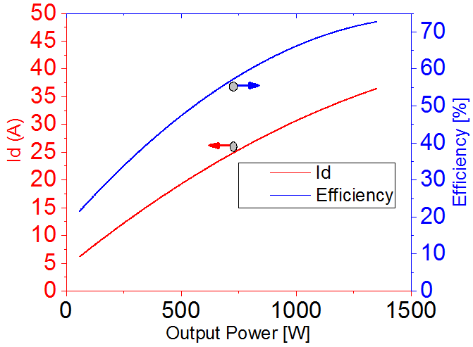
Efficiency is 70% at 1.2 kW output power

Slide 11
CONCLUSION
THANK YOU!

Slide 12
QUESTION?

