Slide 1
Uppsala University Contract UH2015/09 - UA2016/05 Job nr. 5973
Vertical Cryostat GERSEMI

Slide 2
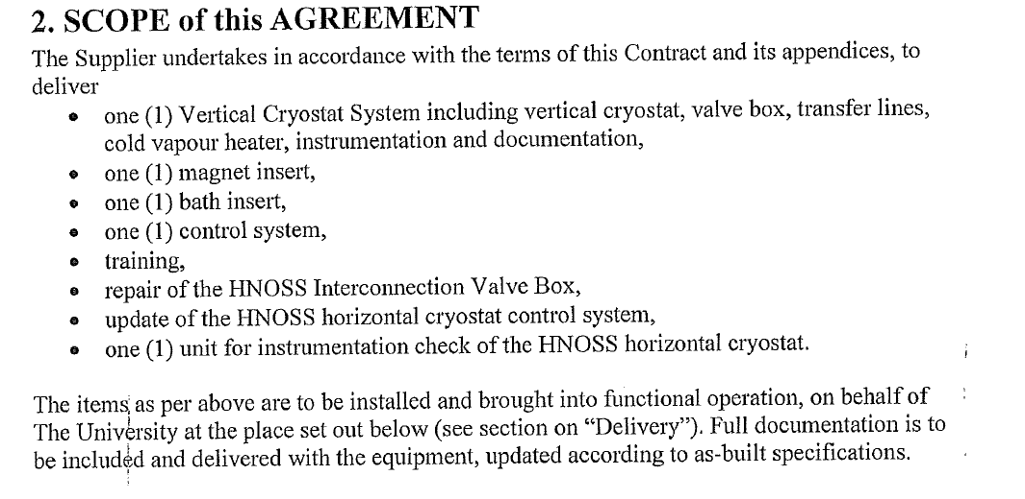

Slide 3
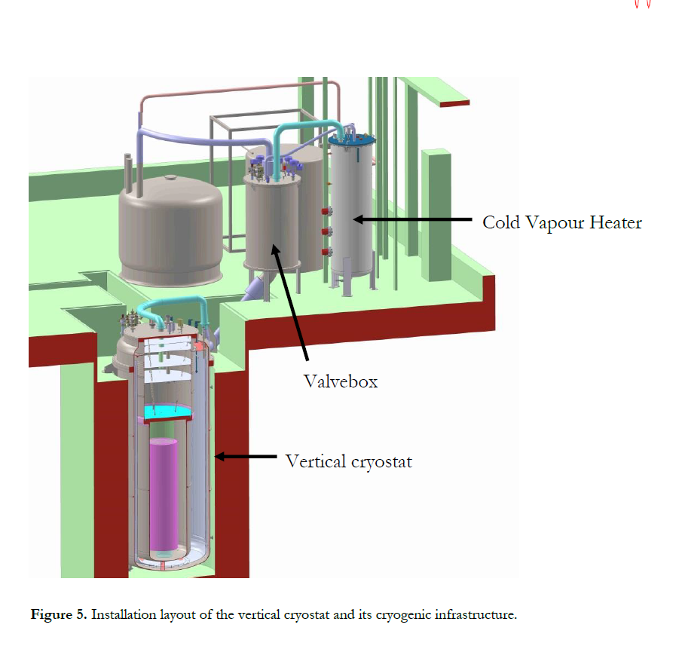
GENERAL ARRANGEMENT

Slide 4
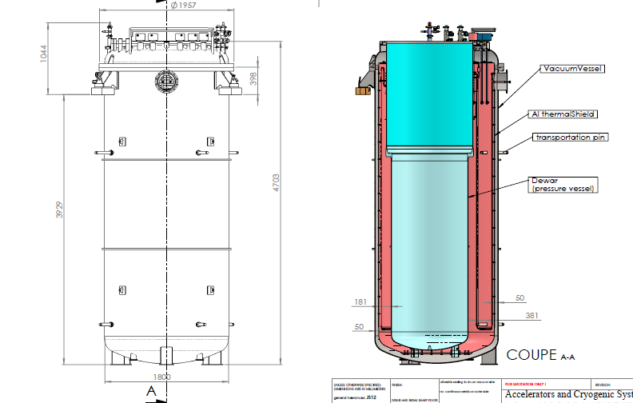
DEWAR

Slide 5
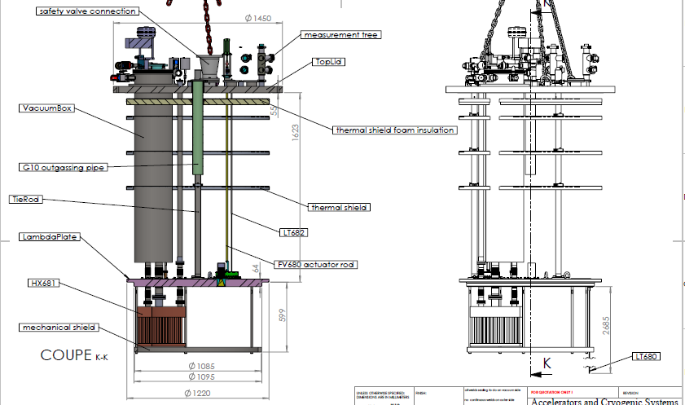
MAGNET INSERT

Slide 6
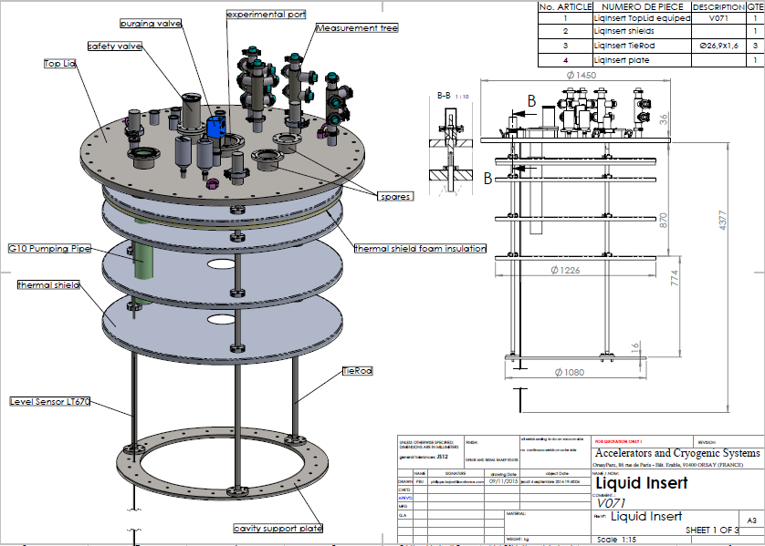
BATH INSERT

Slide 7
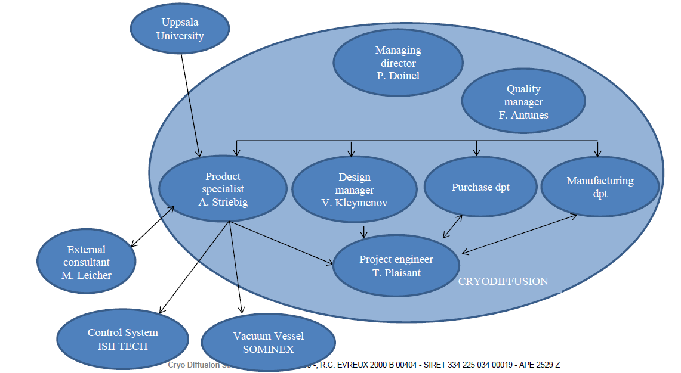
QA (1/5)

Slide 8
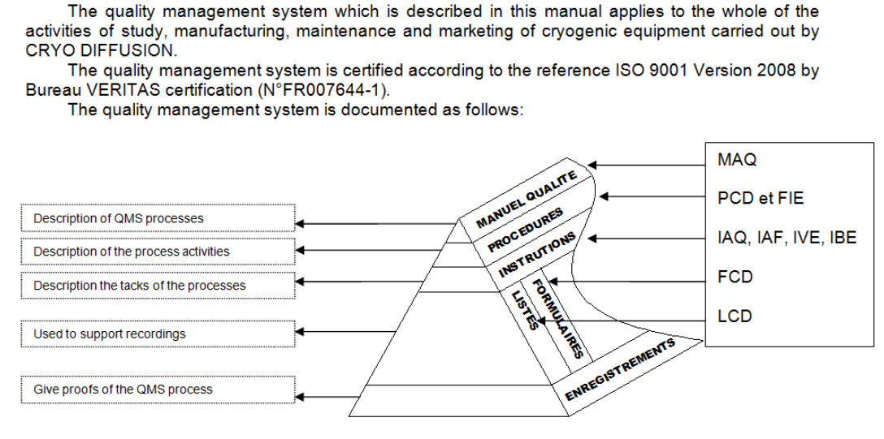
QA (2/5)

Slide 9
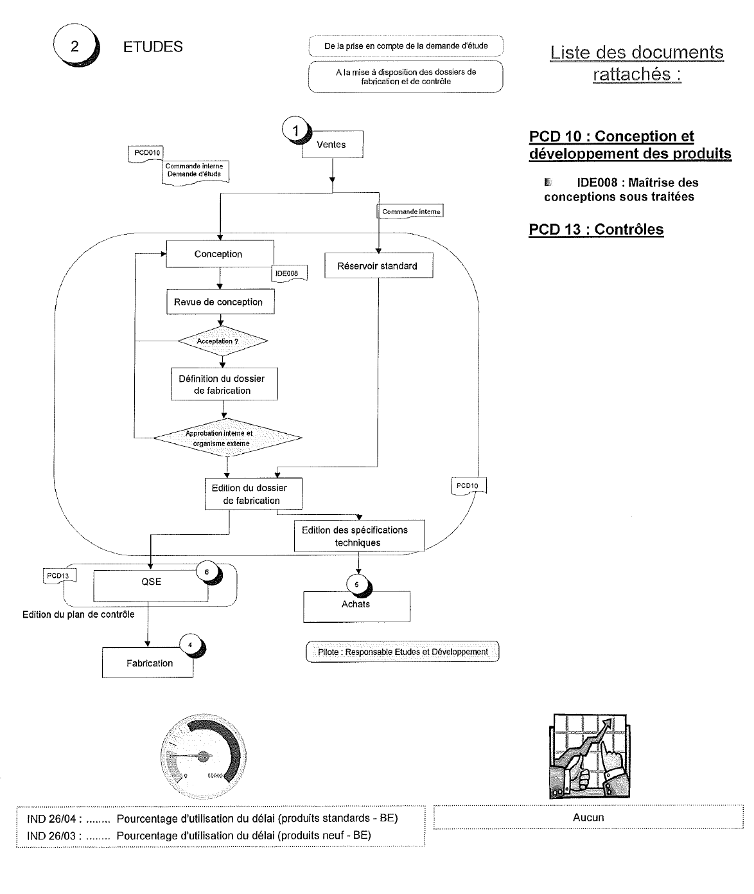
QA (3/5)

Slide 10
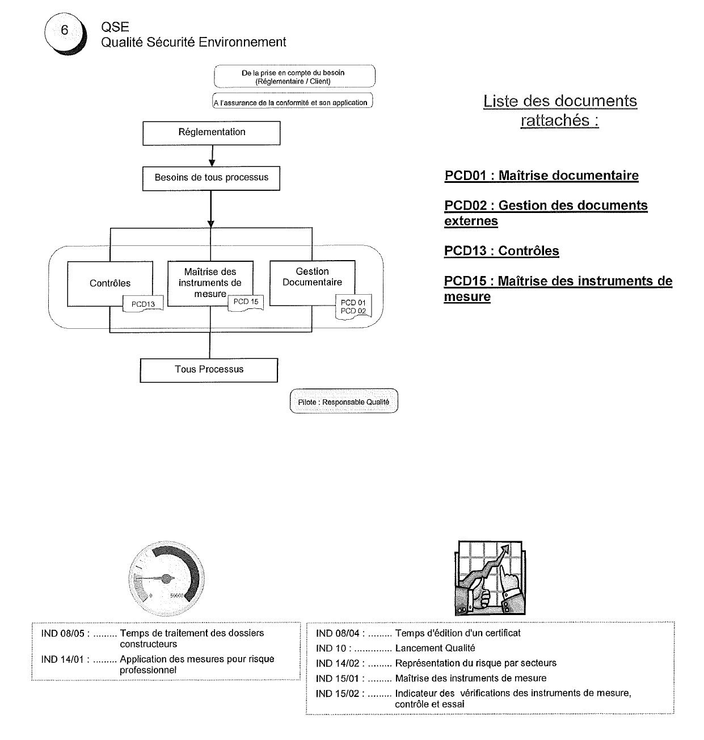
QA (4/5)

Slide 11
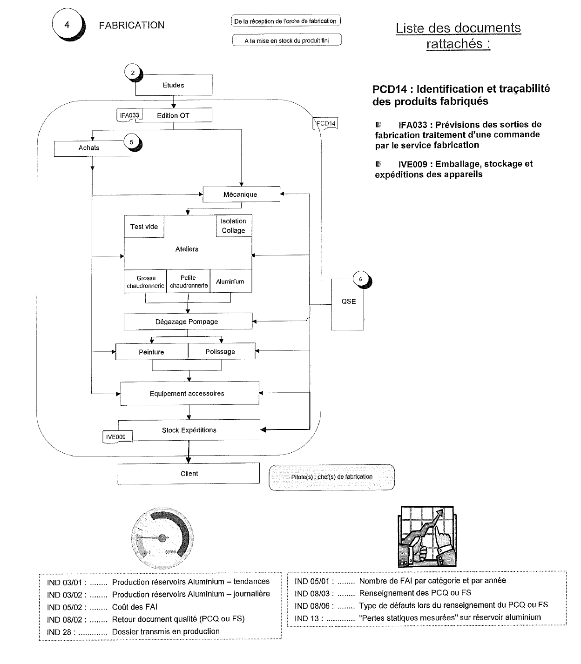
QA (5/5)

Slide 12
Resources
Project:
1 x Product specialist (General overview including SC)
1 x Project Engineer (CD’s core scope)
Design:
1 x Solidworks station
2 x SolidEdge stations
Quality:
1 x Welding expert (IWE)
1 x Documentation officer
Manufacturing:
1 x Foreman
3 x Dedicated teams (1 for dewar, 1 for inserts, 1 for valves box, lines and misc.)

Slide 13
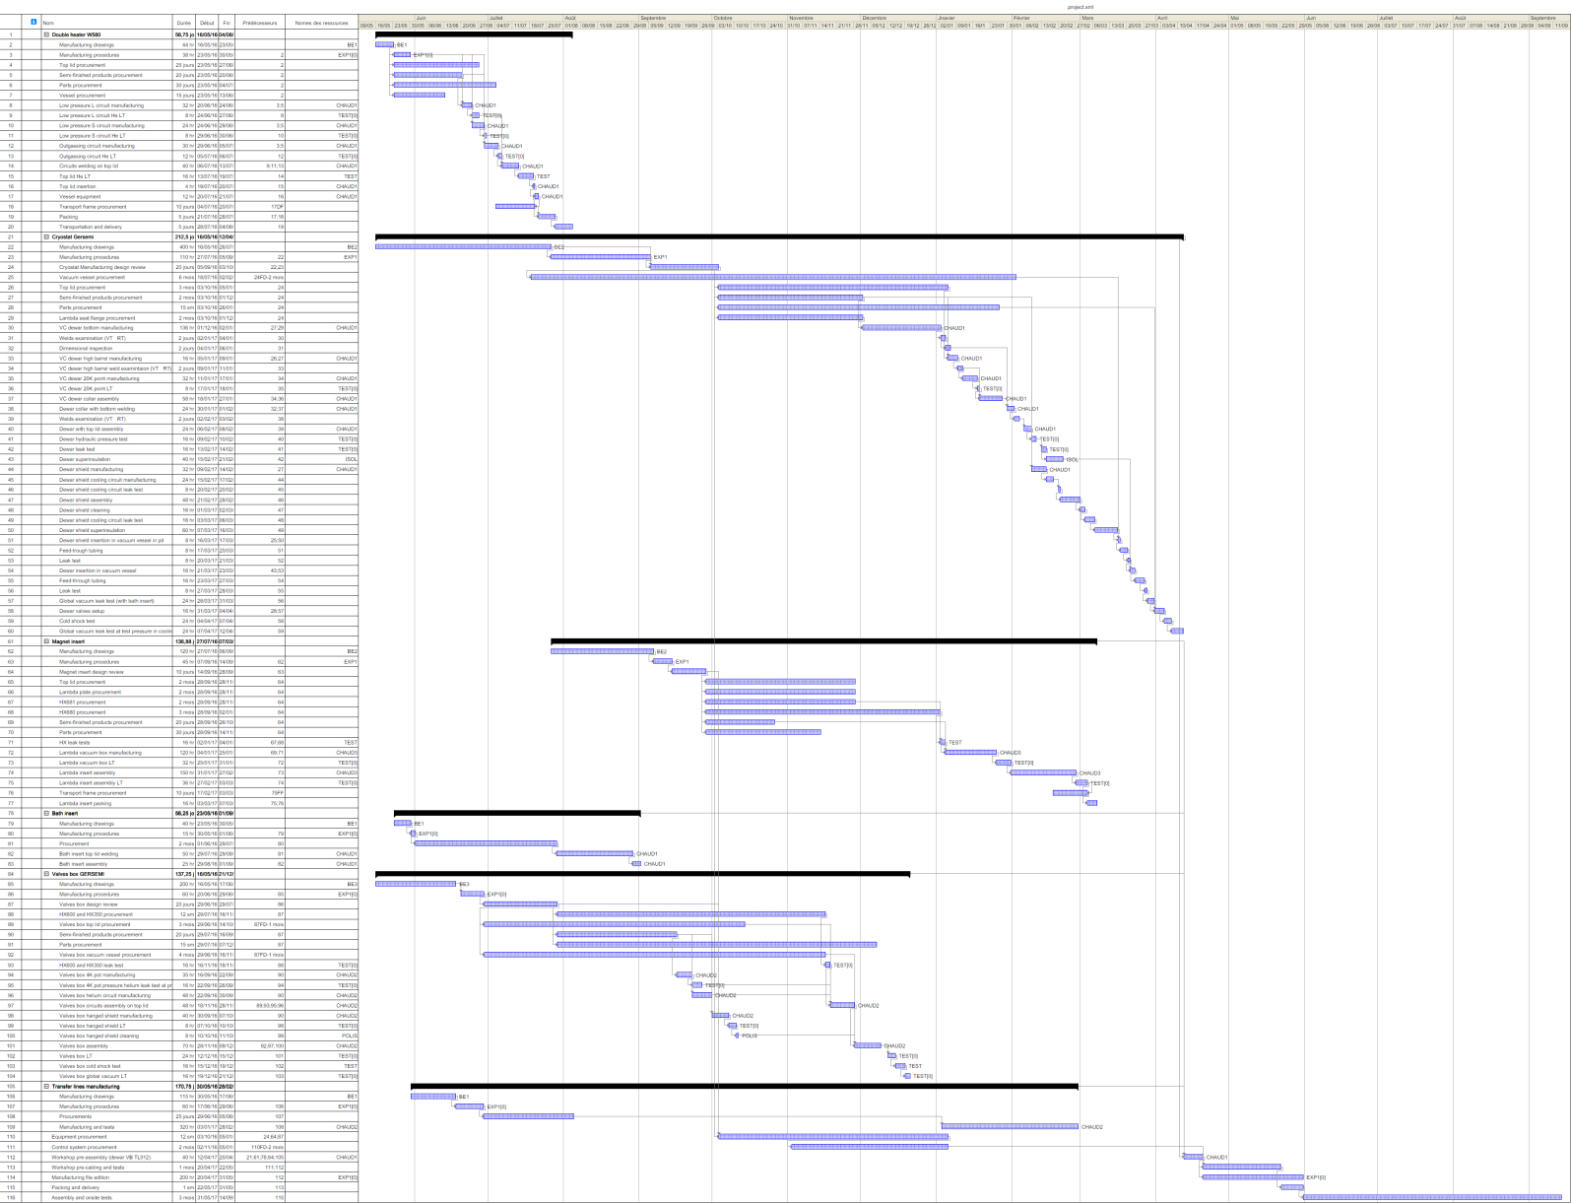
Planning

Slide 14
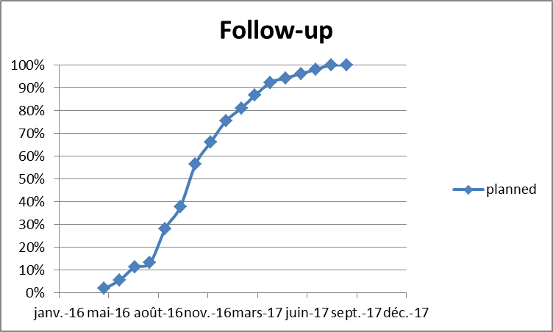
Monthly Progress reports
PHOTO
IPN
DIAGRAM
WP1 heater / design 0% / total 0% / pending: 3D input model
WP2 cryostat / design 0% / total 0% / pending: 3D input model
WP5 valves box / design 0% / total 0% / pending: 3D input model
WP status
SC status
Subcontracting status: none

