Slide 1
Contract Description
Kick-Off Meeting UH2015/06
(vertical cryostat, Gersemi)
Rocío Santiago Kern

Slide 2
Main Goals (1/4)
One (1) valve box
(not exhaustive list)
  Thermal shield
  All valves (cryogenic, room temperature, safety)
  Heat exchanger
  4K tank
  Piping
  Instrumentation
One (1) vertical cryostat (not exhaustive list)
  Vacuum vessel
  Cold vessel (pressure vessel)
  Thermal shield
  All valves (cryogenic, room temperature, safety)
  Piping
  Instrumentation

Slide 3
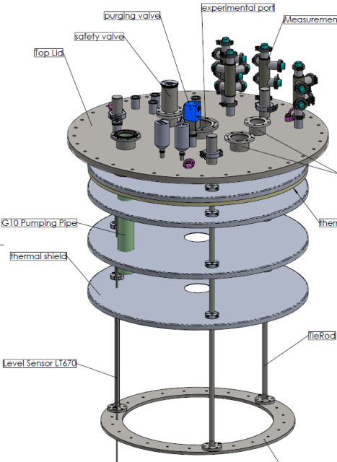
Main Goals (2/4)
One (1) magnet insert
  Planar thermal shields
  All valves (cryogenic, room temperature, safety)
  Two (2) heat exchangers
  Vacuum container
  Piping
  Instrumentation
  Two (2) transfer lines
One (1) bath insert
  Planar thermal shields
  All valves (cryogenic, room temperature, safety)
  Piping
  Instrumentation

Slide 4
Main Goals (3/4)
One (1) cold vapor heater
  Piping
  Instrumentation (FREIA team will put it in place)
  To be delivered early November 2016
Seven (7) transfer lines
  L010: LHe (single)
  L011: LN2 (single)
  L012: LHe and LN2 (four cryogenic lines)
  L016: GHe (single)
  L017: GHe (single)
  L018: GHe (single)
  L021: LHe (single)
  Lengths not final

Slide 5
Main Goals (4/4)
Instrumentation
  Temperature sensors (all types)
  Pressure sensors
  Flowmeters
  Heaters (all types)
Burndy connectors
Control system
  See Konrad Gajewski’s presentation

Slide 6
Extra Points to Consider (not exhaustive)
Aluminum type 6082-T6 to be used for thermal shield but not for the piping.
Label all pipes inside the VB, VCS and inserts
Teflon spacers where necessary to avoid heat inleaks
Special attention during cold tests for leakage (LHe and LN2 pipes)
All temperature sensors that are doubled must also be in placed and connected (note the extra wiring in the connectors and the control cabinet)
The chosing of a welding point or VCR connections must be agreed upon before manufacturing
All sensors and their connectors must be individually labeled, even if not directly accesible, with both PID and calibration numbers. For every sensor, a picture showing position and both labels will reduce errors when documenting.
Quality control: Implementation throughout the complete project
All parts must be cleaned prior to assembly

Slide 7
Deliverables (not exhaustive)
Apart from those specified in the Technical Specifications document, special mention to the following:
  Quality plan before every step of the process
  All manufacturing drawings, as-built. These must include:
    the sensor positions for all types of equipment included in the instrumentation
    All instrumentation in general
    Pipe labels
  All stp files from the manufacturing drawings
  All documentation given in pdf format must be formatted so that searching within the document is possible
  All manuals and/or data from purchased equipment (sensors, valves, controllers, flowmeters, etc.)
  Protocols followed and results from all tests (leak, pressure, cold, first assembly, etc.)
  Pumpdown curve and data after first assembly with each insert

Slide 8
Q&A?

