Slide 1
Vertical cryostat
Final Design
Cryogenic and mechanical configurations
ACS – P. Bujard, J.P. Thermeau
10 th May 2016

Slide 2
Outline
Cryogenic Studies – JPT
- Saturated or pressurized baths,
Tests of superconducting cavities,
- Cryostat used as vacuum vessel,
- Cryostat in liquid helium operations,
Tests of superconducting magnets,
Cryostat in pressurized liquid helium operations.
Specifications to finalize.
Mechanical Studies – PB
- General view of the vertical cryostat facilities,
Valve box,
Cryostat,
Lambda Insert,
Helium gas heater,
Latest documents.

Slide 3
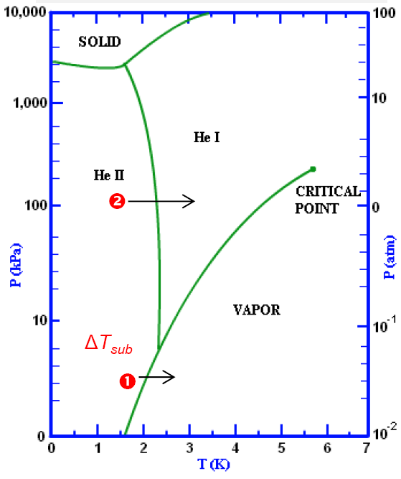
Saturated or pressurized baths
Two possibilities to operate in superfluid helium:
with saturated liquid helium
with pressurized liquid helium
Power density in turbulent flow:

Slide 4
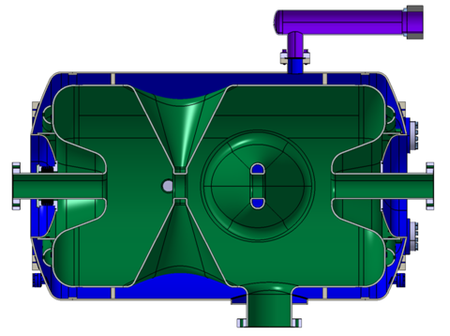
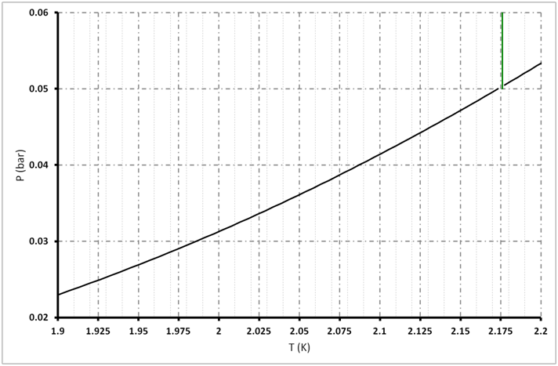
Saturated liquid helium bath
609 mm
SUPERFLUID
(He II)
λ line
150 mm
λ point
Bottom of the cavity
Margin: 75 mK
488 mm
Top of the cavity
Margin: 25 mK
Bi-phase pipe
GAS
Advantages:
High level of heat transfer in superfluid helium (Kapitza thermal resistance limitation),
High level of temperature stability by pressure regulation,
Simple mechanical design.
Disadvantages:
Small temperature margin, the temperature of the cavity walls are closed to the saturated temperature, ΔT = f(ρ x g x h),
h = 0.2 m, Δp ≈ 3 mbar ⇒ ΔT ≈ 40 mK
High quantity of liquid helium operates in sub-atmospheric condition.

Slide 5
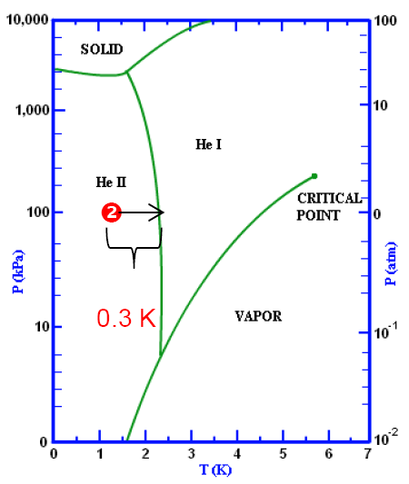
Pressurized liquid helium bath
Advantages:
High level of heat transfer in superfluid helium
(Kapitza thermal resistance limitation),
Temperature margin of ≈ 0.3 K,
Better electrical isolation than at low pressure
Main Helium baths operate at a pressure higher than the atmospheric pressure (no plug with frozen air).
Disadvantages:
Complex mechanical design,
Complex cryogenic design (pressurized helium bath cooled with a heat exchanger and saturated superfluid helium, …).

Slide 6
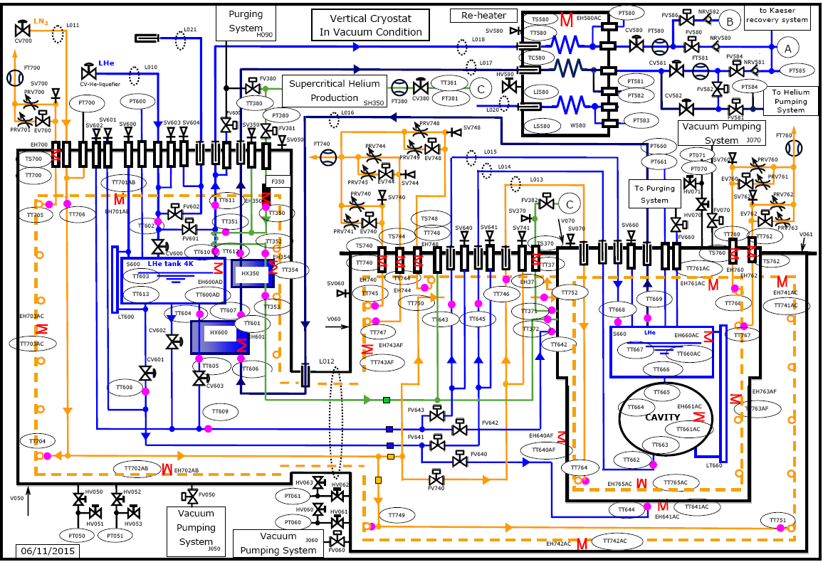
Tests of superconducting cavities - Cryostat as vacuum vessel
Specifications:
Operating pressure: 5 mbar to 1.5 bar,
Temperature range: 4.5 K to 1.6 K,
Cryogenic power: 90 W at 1.9 K.
Thermal losses of the Valve Box and Cryostat:
LN2 circuits: 20 + 50 = 70 W
4 K circuit (VB + line): 2 + 2 = 4 W
2 K circuit (Cryostat + line): 1 + 2 = 3 W
Cryostat in vacuum condition
This configuration allows similar operations which can be made with the horizontal cryostat.

Slide 7
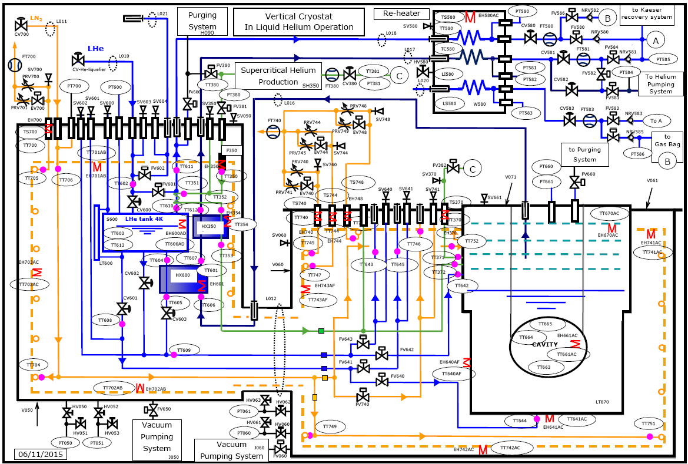
Tests of superconducting cavities Cryostat in liquid helium operations
Specifications:
Operating pressure: 5 mbar to 1.5 bar,
Temperature range: 1.6 K to 4.5 K,
Cryogenic power: 90 W at 1.9 K.
Thermal losses of the Valve Box and Cryostat:
LN2 circuits: 20 + 50 + 100 = 170 W
4 K circuit (VB): 2 W
2 K circuit (Cryostat): 5 W
Neck thermalization
LN2, 85 K: 100 W,
Supercritical helium, 20 K: 0.1 g/s,
4 K thermal losses:
2 W.

Slide 8
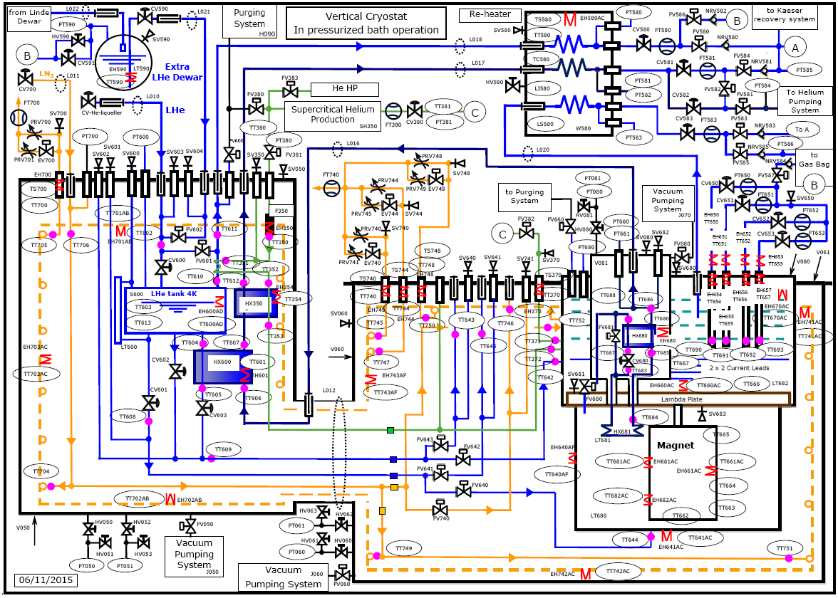
Tests of superconducting magnets Cryostat in pressurized liquid helium operations
Specifications:
Operating pressure: 1 bar to 5 bar,
Temperature range: 4.5 K to 1.6 K,
Cryogenic power: 90 W at 1.9 K.
Thermal losses of the Valve Box and Cryostat:
LN2 circuits: 20 + 50 + 100 = 170 W
4 K circuit (VB): 2 W
2 K circuit (Cryostat + Lambda plate): 5 + 15 = 20 W
Neck thermalization
LN2, 85 K: 100 W,
Supercritical helium,
20 K: 0.1 g/s,
4 K thermal losses: 2 W.
HX681 (1 m²)
Saturated helium: 1.8 K,
Power (design): 120 W,
Bath temperature: 1.86 K
(ΔT maxi: 60 mK)

Slide 9
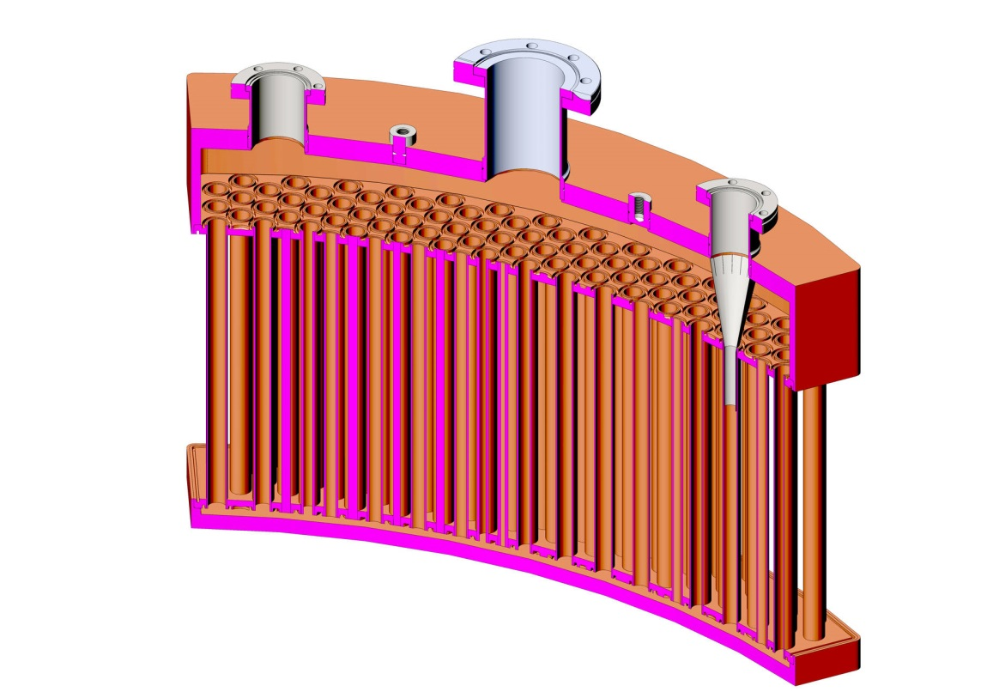
Cryogenic power limits - Heat Exchanger HX681
Low pressure circuits specifications:
Operating pressure: 16 mbar (10 mbar to 1 bara),
Operating temperature: 1.8 K (1.6 K to 4.5 K),
Cryogenic power (design): 120 W at 1.8 K,
Inner pipe surface: 1m².
Low pressure inside the heat exchanger
Atmospheric pressure circuits specifications:
Operating pressure: 1.2 bara (1 to 5 bara),
Operating temperature: 1.85 K (1.6 K to 4.5 K),
Cryogenic power (design): 120 W at 1.85 K.
He II
Bath
He II
He II
Bath
Atmospheric pressure outside the heat exchanger
Pressurized helium bath
T(K)
Temperature of the pressurized helium bath
Copper pipe
1.86 K
Power available for the magnet tests:
90 W (1.85 K) - Lambda leak - thermal losses ≈ 70 W
1.8 K
Kapitza ΔT
Temperature inside HX681

Slide 10
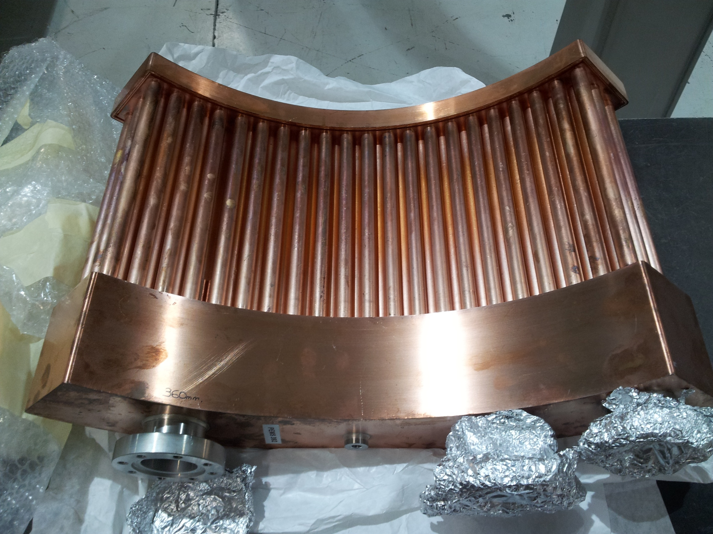

Slide 11
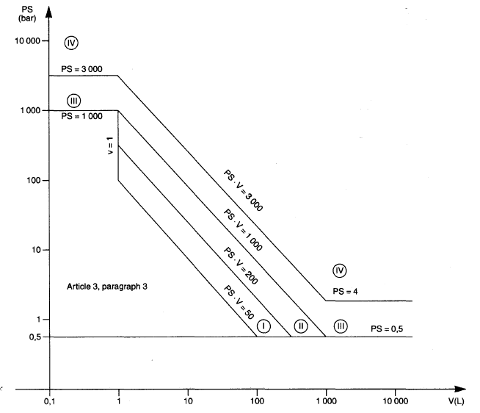
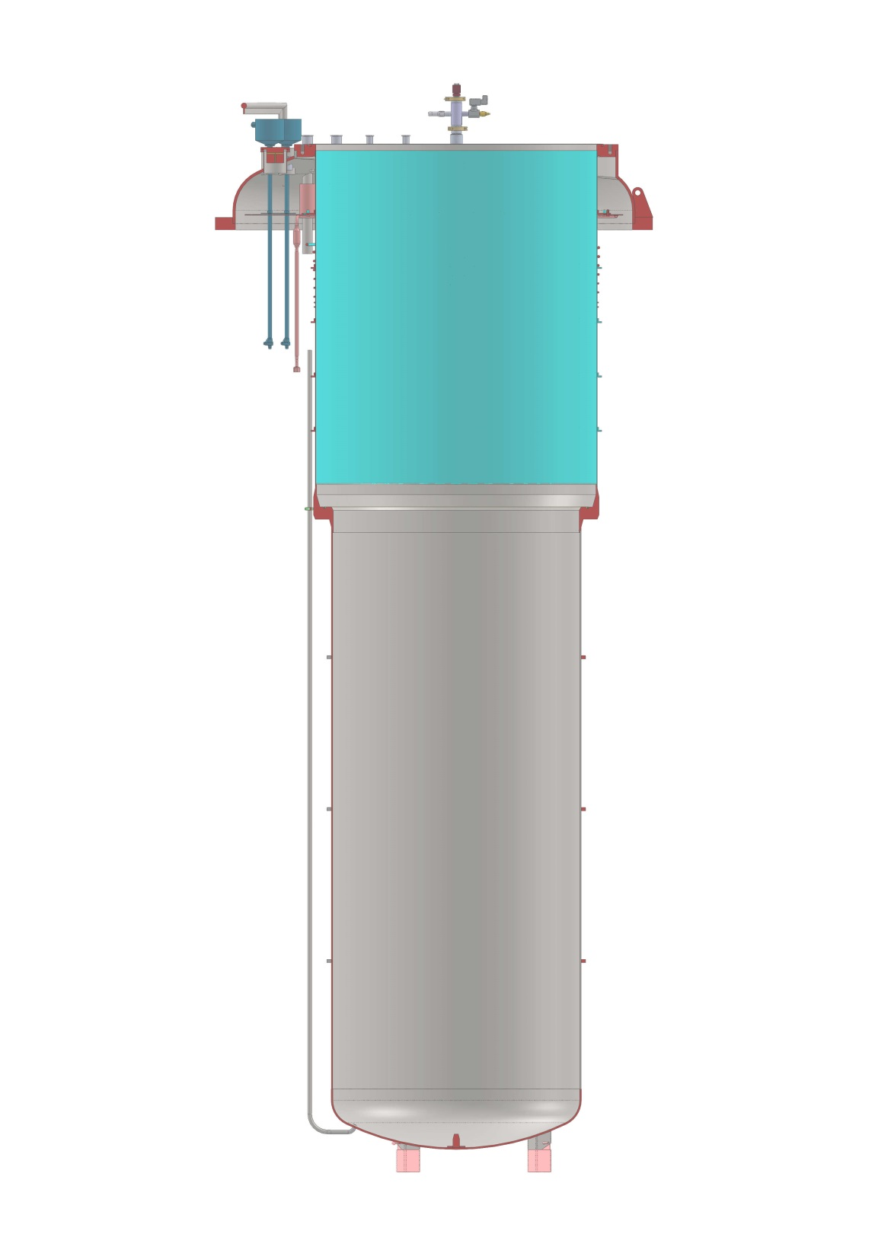
Pressure vessel
Dimensions:
height ~ 4.5 m
diameters: 1.1 to 1.25 m
Volume: 4.8 m³
Pressure vessel of category III, MAWP ≈ 4 barg
4.8 m³
Specifications:
Maximum allowable operating pressure: ≈ 4 barg,
Hydraulic test pressure: 7.15 bara,
The mechanical calculations refer to EN13445 and EN13458 norms
Norms:
EN13458: Cryogenic vessels
EN13455: Unfired Pressure vessels

Slide 12
Specifications to finalize
Pressure vessel specifications:
Maximum allowable operating pressure: ≈ 4 barg,
Hydraulic test pressure: 7.15 bara,
The first mechanical calculations refer to EN13445 and EN13458 norms
Define the norms for the manufacturing and the final calculations.
Impact on the existing facilities and necessary developments:
Helium liquefier and its LHe storage
Cryogenic power at 1.85 K and the Helium pumping system
The magnet quenchs and the helium recovery system,
New cryostat with its own control system, the links with the horizontal cryostat and the other equipments.
HX681, Low pressure circuits specifications:
Operating pressure: 16 mbar (10 mbar to 1 bara),
Operating temperature: 1.8 K (1.6 K to 4.5 K),
Inner pipe surface: 1m² (minimum value).
Define the needs for the cryogenic power at 1.8 K.
Magnet test specifications (next meeting at CERN):
Cool down sequence: thermal gradient, speed, …
Operating temperatures: 1.8 K to 80 K,
Define all sequences needed for the tests (electrical tests at 80 K, superconducting measurements at 4.5 K and 1.8 K, …),
Define the specifications for the cryogenic sequences (cryogenic and electrical power, instrumentation, …

Slide 13
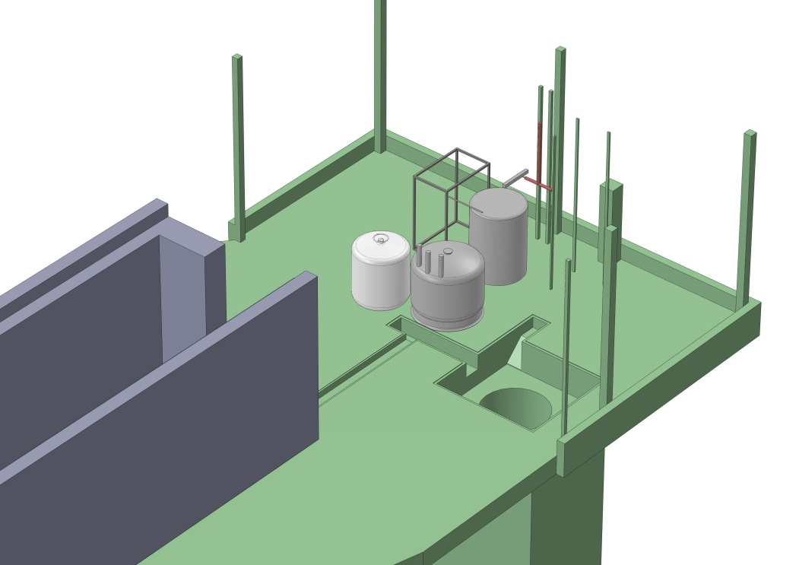
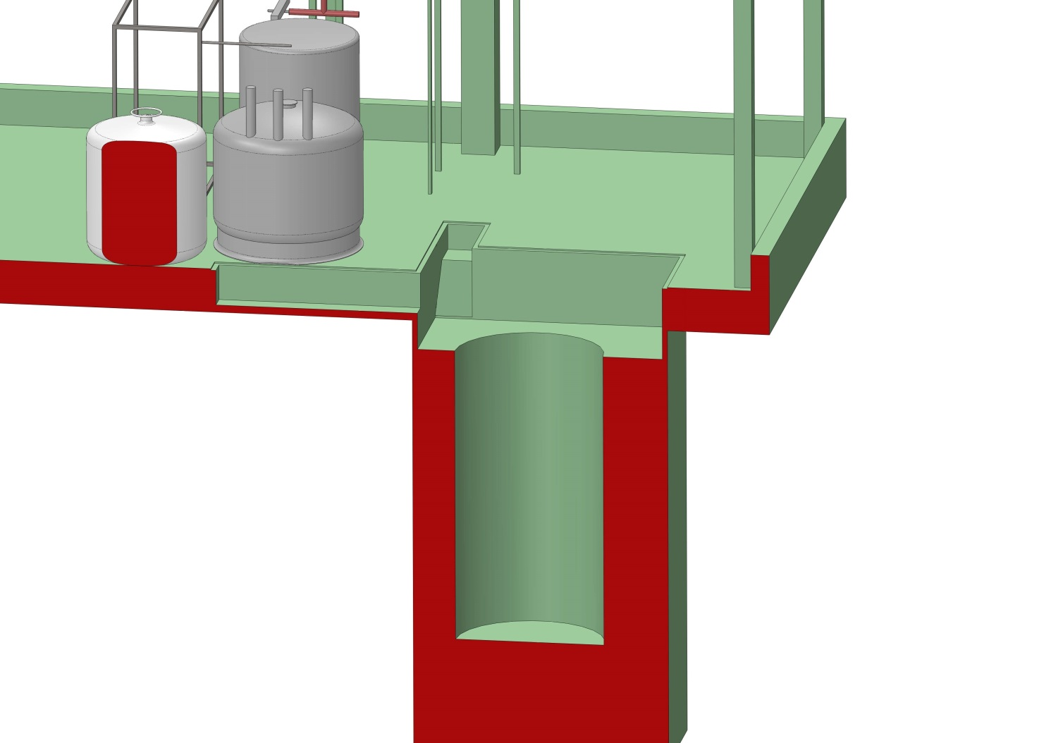
FREIA Hall
Gersemi hole:
3.3x3x1m
+
Ø2x4m

Slide 14
Global scheme
Filling station
Liquefier
Hnoss Reheater
Valve Box
Additional bottle
Liquefier Dewar
Gersemi cryostat

Slide 15
Valve Box
GHe pumping-port
Supercritical GHe Pre-cooling Hx
4K pot
LHe sub-cooling Hx
Body: Ø1000x2375
Overall height: ~2700
Weight: 1075kg
80K shield
Ø1100

Slide 16
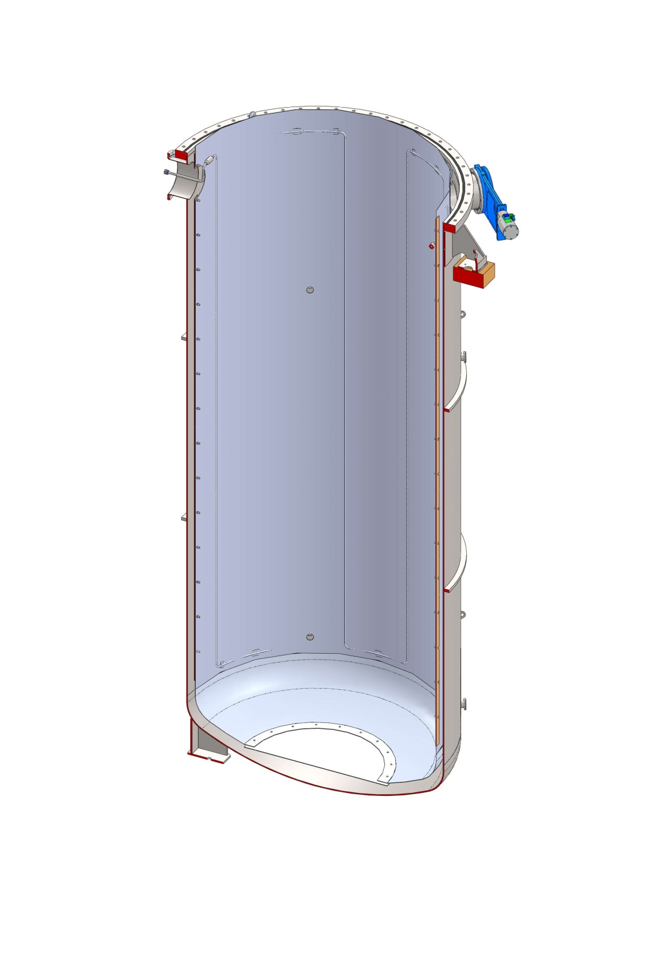
Vacuum Vessel
vacuum pumping-port
Ø1957
Multi line port
Hanging shoulder
15x20mm rib
Body:Ø1957x4330
Weight:2188kg
80K shield
2mm thick
ID: ~1650
inner height: 4200
main vessel
Ø1800
8mm thick
ID : ~1784
inner height : ~4300

Slide 17
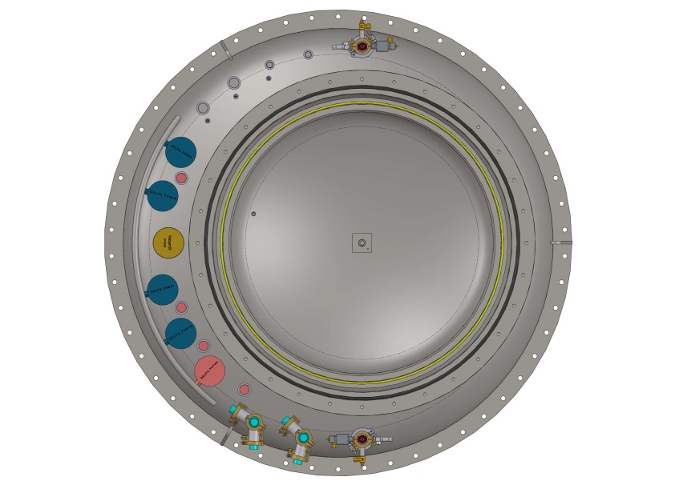
Dewar: “Pressure Vessel”
Ø1450
Ø1957
neck
3mm thick
ID: 1256
inner height: 1595
Lambda seat
55mm thick
IDs: 1250 & 1100
Ø1278x220
15x20mm rib
Overall height ~4770
Weight:1598kg
main vessel
Ø1118
6mm thick
ID : 1106
inner height : 2875
Cool down line
Dished head
Ø1120
8mm thick
ID : 1104
Centering pin

Slide 18
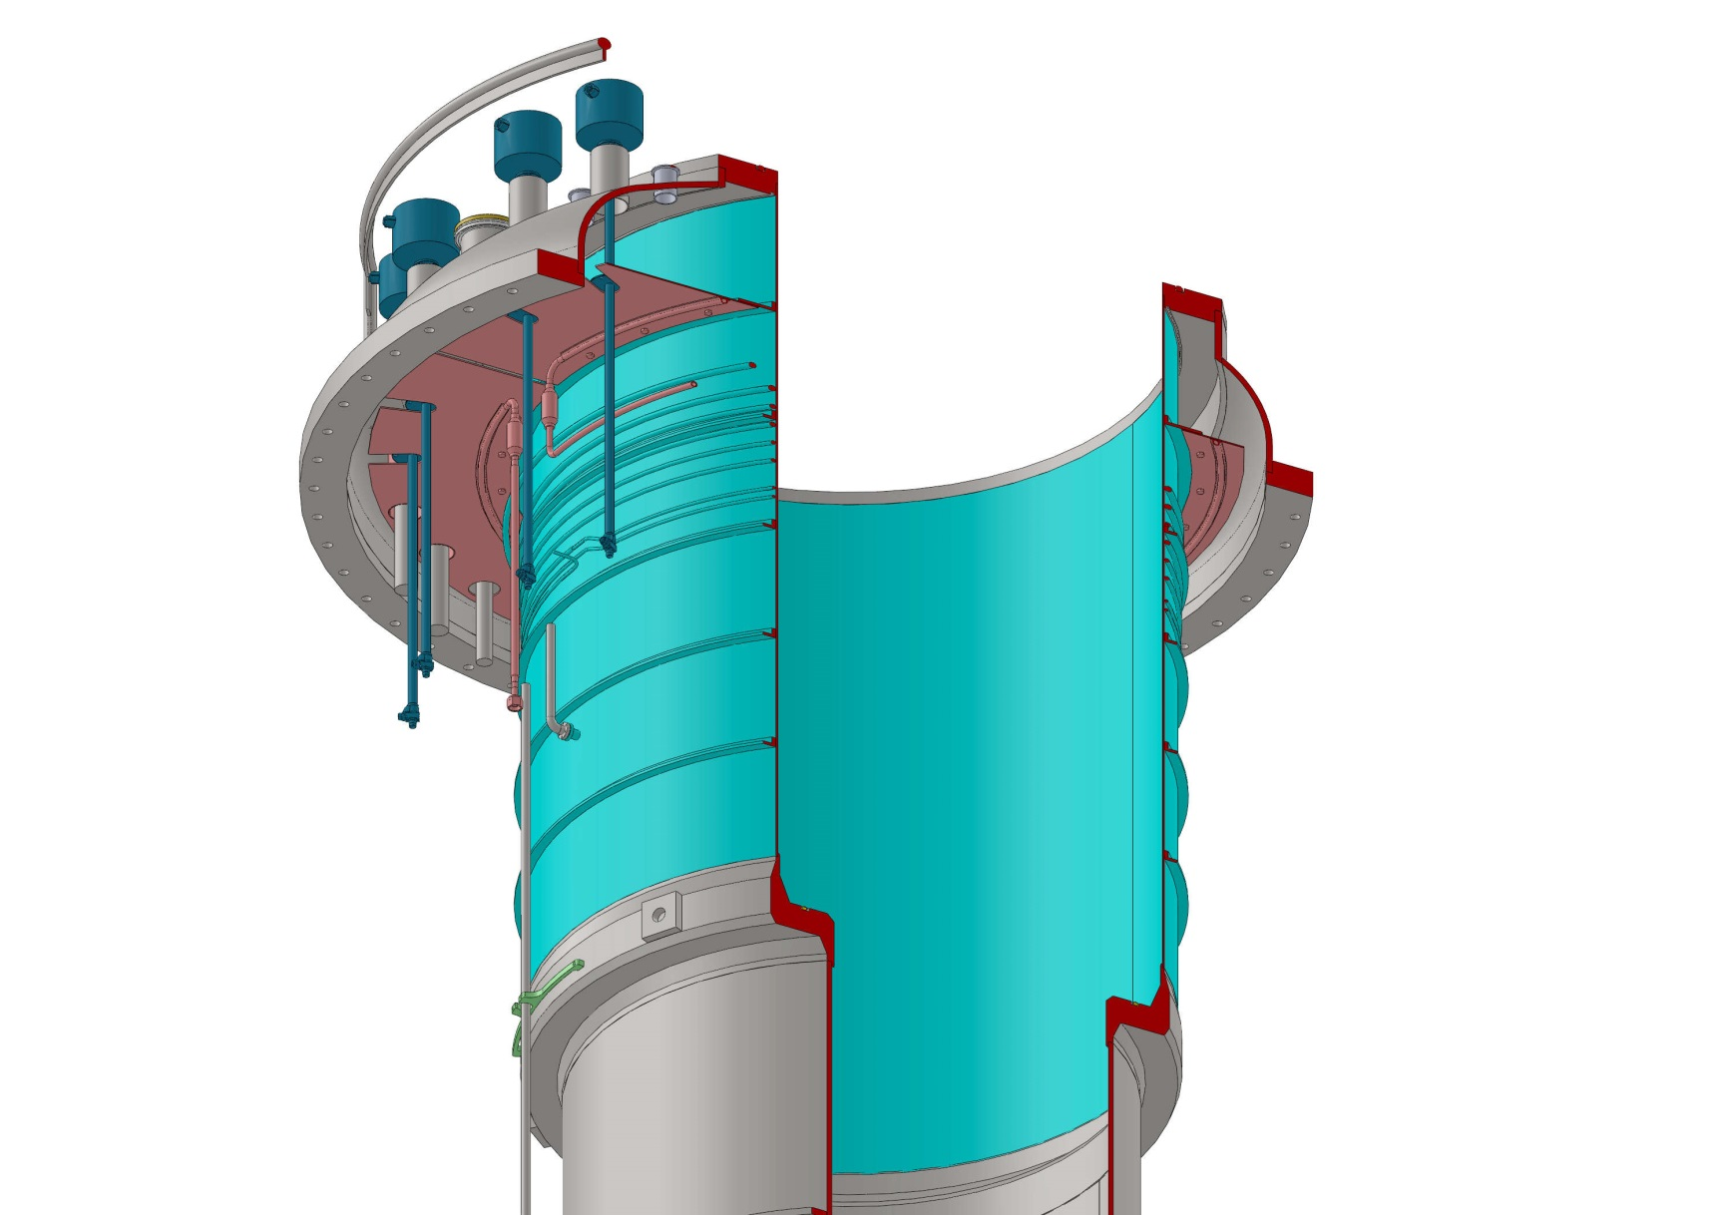
Dewar: neck details
control valves
Mechanical shield
thermal stiffener
6mm thick
20x60 angle
Vacuum safety valve
Collar shield
3mm thick 6082 alloy
Supercritical Ghe circuit
thermowells
LN2 circuit
Filling line
stiffener
6mm thick
20mm angle
Centering port
(shipment)

Slide 19
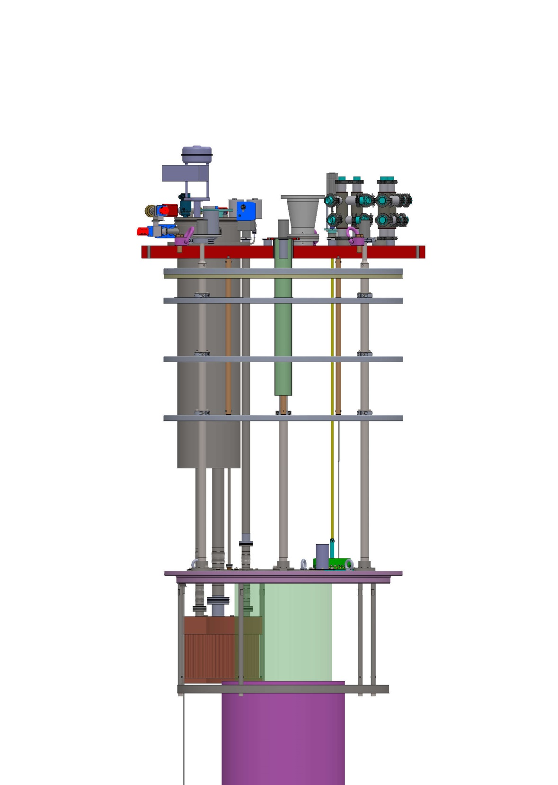
Lambda Insert: top flange new design for hydraulic test 7.15 bara
Flange: 406kg
Thickness: 23mm
Height: 168
Flange: 756kg
Thickness: 65mm

Slide 20
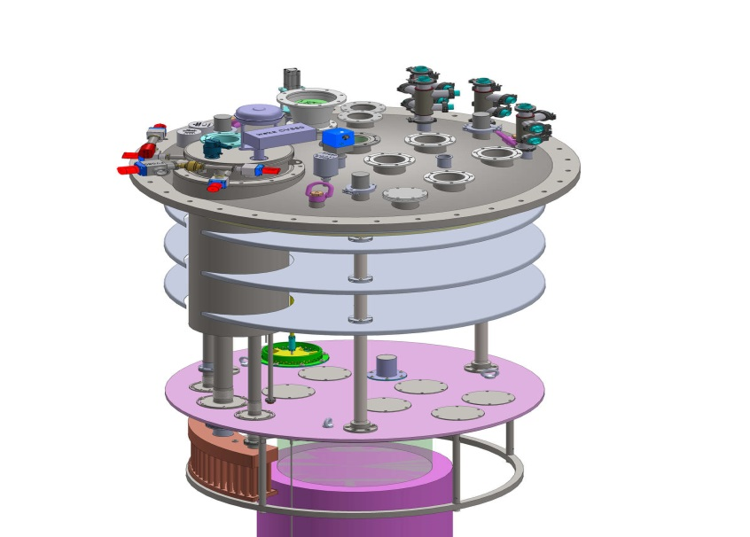
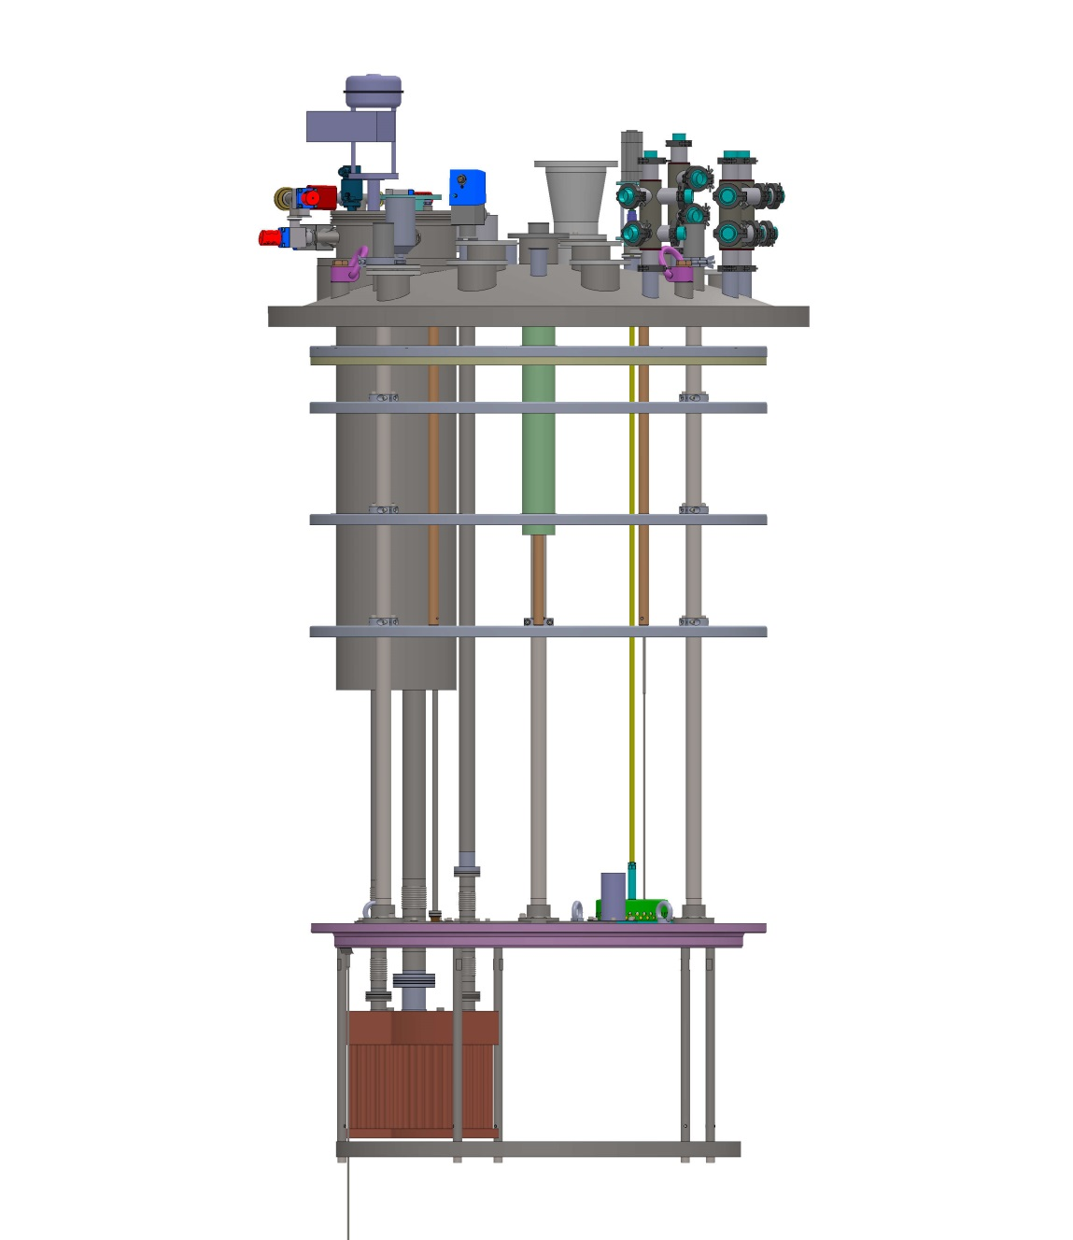
Lambda Insert
Ø1450
SV680 3bar
Open bath outgassing
Thermal shields
Vacuum Box (HX680+JT valve)
Titanium TieBeam Ø42,4x3,2 H1563
FV680/SV681 100mbar
pumping
SV683 300mbar
Level probe
filling
Lhe subCooler Hx681
Level probe
Mechanical shield

Slide 21
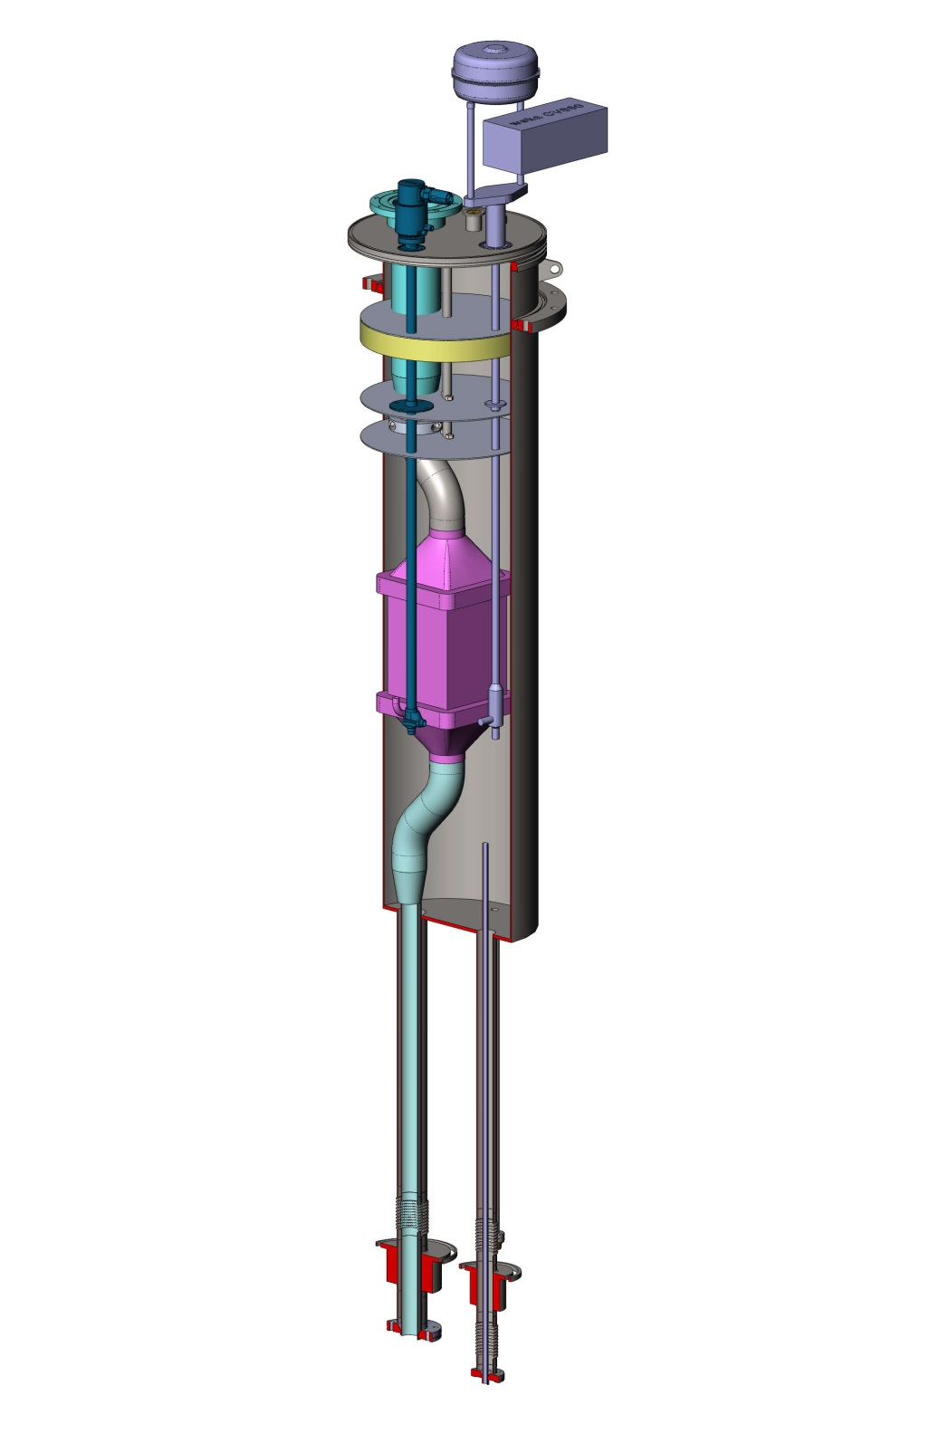
Vacuum Box - HX681
Pumping port
Inner surface ~1m²
43kg
Level port
Ø354
Height 1283
HX680
Filling port
Filling valve
Pumping port
JT valve
pumping
130 pipes 14/16
Radius: 400&535
H340mm
filling
H:820

Slide 22
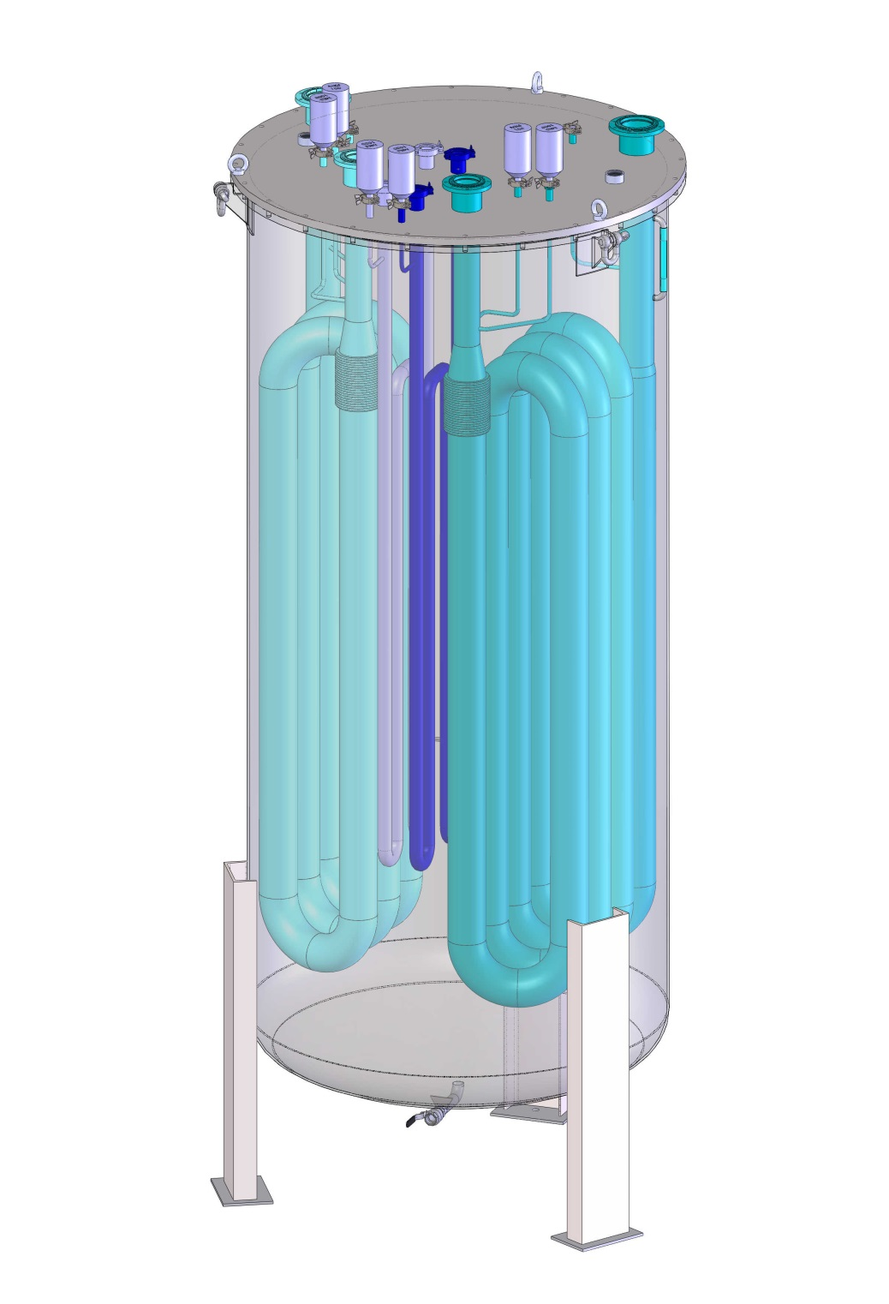
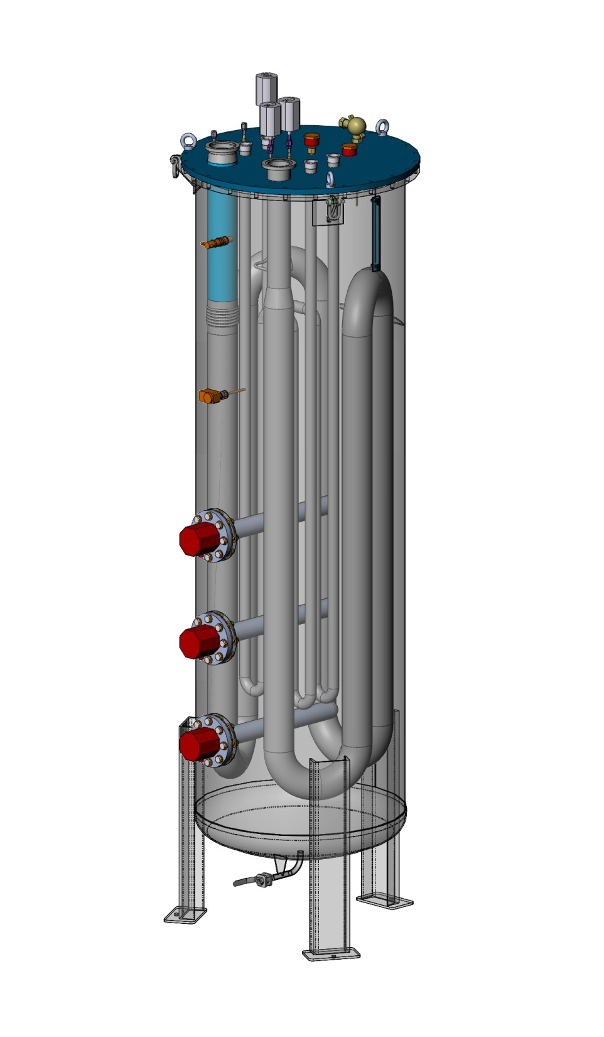
Double Reheater - Hnoss Reheater
Lines adaptation to study !!
Ø1250
H2993mm
Weight 1140kg
2 low pressure circuits Ø114
3 atm pressure circuits : Ø60
Ø800
H2993mm
Weight 670kg
1 low pressure circuit Ø114
2 atm pressure circuits : Ø40

