Slide 1
FREIA Status Report
Follow-up Meeting UH2015/06
(vertical cryostat, Gersemi)
Rocío Santiago Kern

Slide 2
Ongoing work at FREIA
Working on the interfaces for the new TLs
LN2 line modification
TL from ICB to ESS CM
Two (2) exhaust TLs from CM to FREIA’s recovery system
Ongoing discussions with CERN regarding the magnet and the cavity inserts
Preparing HNOSS for the arrival of Germaine (double spoke) with power coupler in August
Testing of the 2nd RF power station

Slide 3
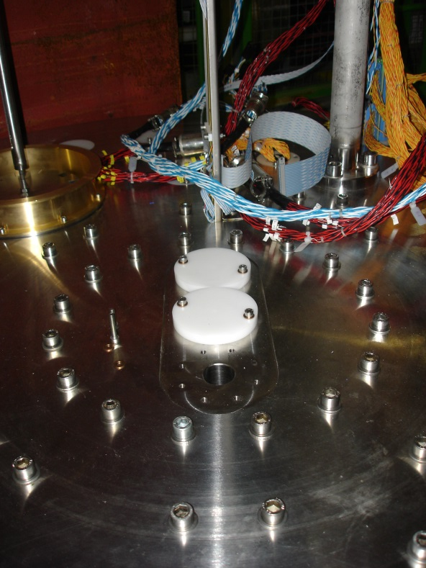
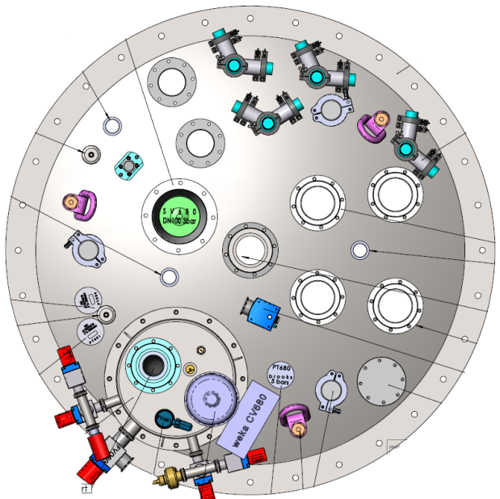
Input from Magnet Workshop at CERN (1/3)
No need for 80 K measurements: no need to redefine piping to accomplish this temperature in the VCS
Need more openings in the top flange and in the
λ-plate
Missing
burst disk
mole shafts (x3)
In general, add as many feedthroughs as possible (on both top flange and through λ-plate)

Slide 4
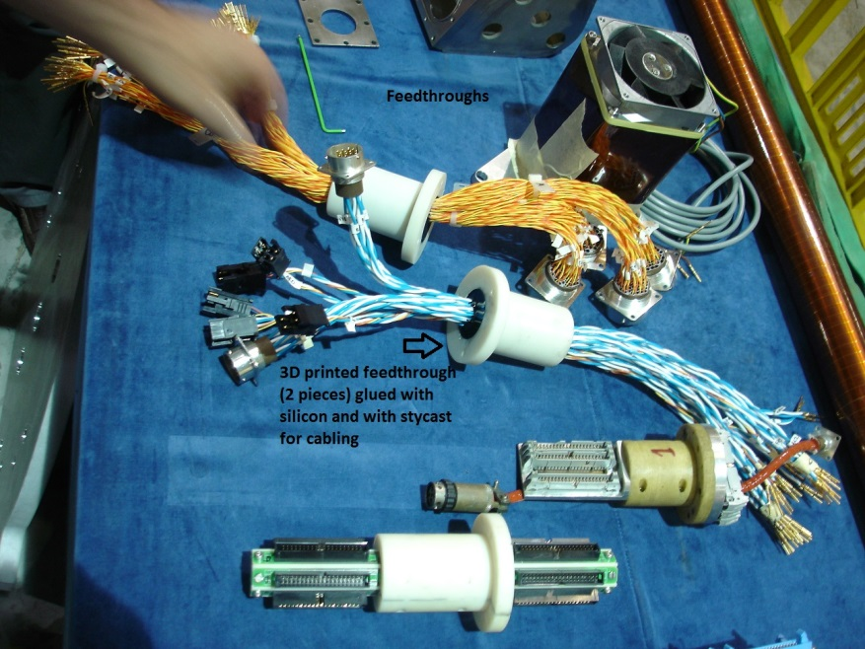
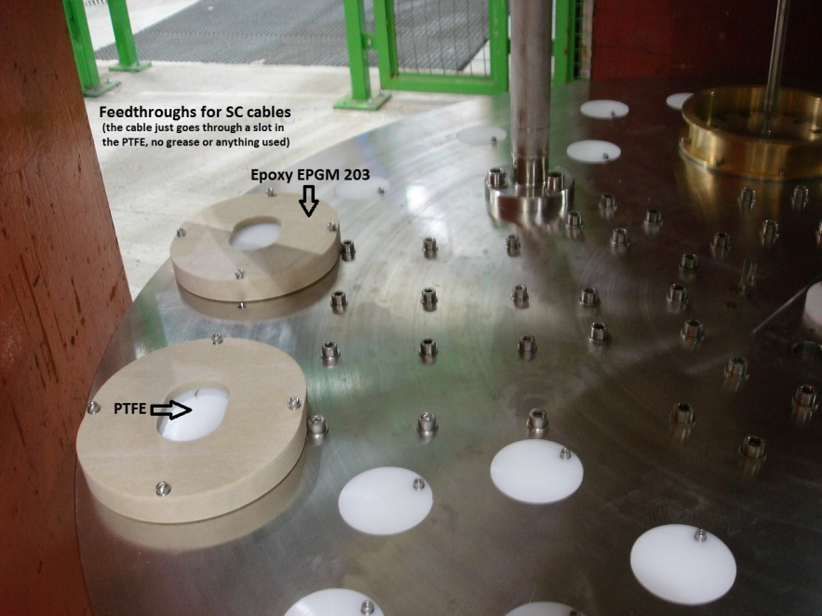
Input from Magnet Workshop at CERN (2/3)
The weight of the insert is very important
The crane will be upgraded to max. 7 ton
The magnet weight is 5.2 ton
Thus the insert containing all equipment (current leads, connectors, valves, etc) must be lower than 1.8 ton
The flatness of the round collar where the λ-plate sits and the λ-plate itself (0.1 mm) is an issue
For the round collar first weld and then machine
The feedthroughs are also an issue and grease must not be used

Slide 5
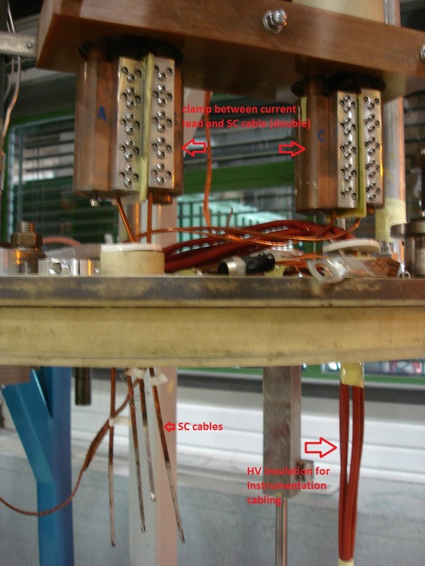
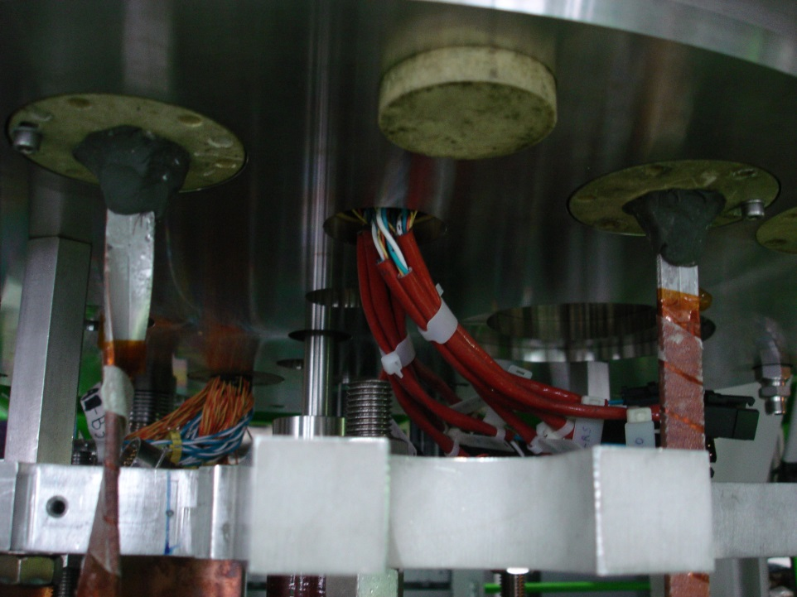
Input from Magnet Workshop at CERN (3/3)
Because of necessary HV tests for the magnet:
All equipment in contact with magnet and ground must be able to withstand 500V, but have to be tested at 3 kV for at least one minute
Proper HV insulation is needed
It must be possible to remove all connections from the top of the insert
All subsystems (VB, VCS, heater,…) must be properly grounded

Slide 6
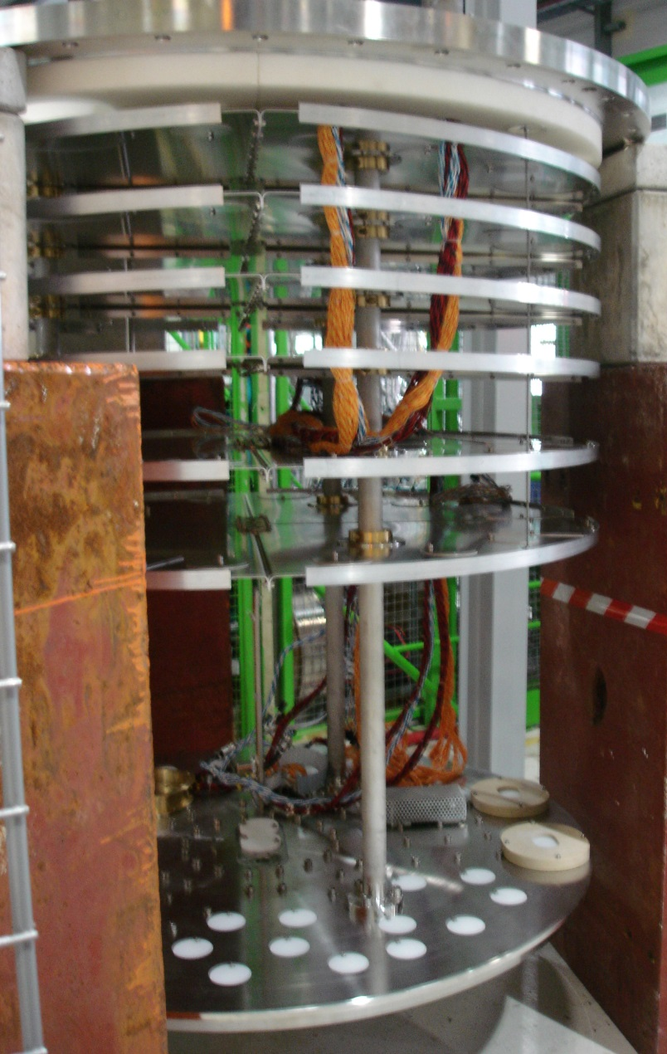
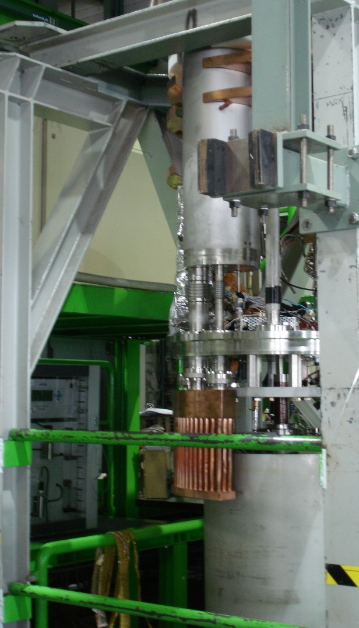
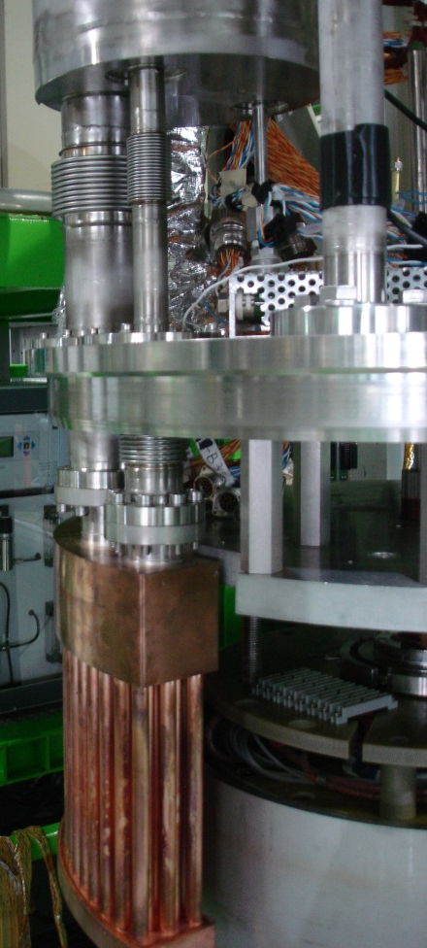
Some Pictures from SM18 (1/2)

Slide 7
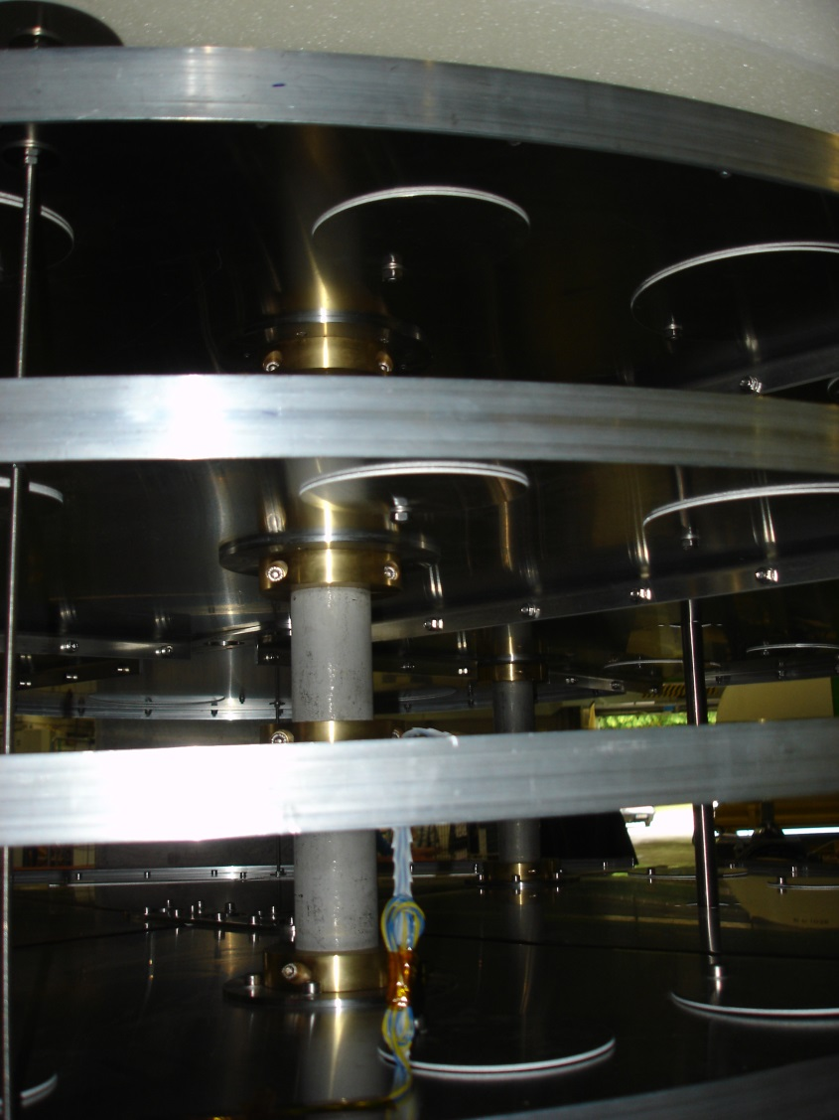
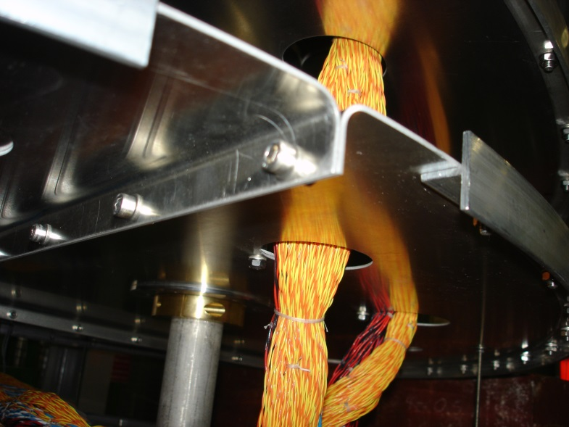
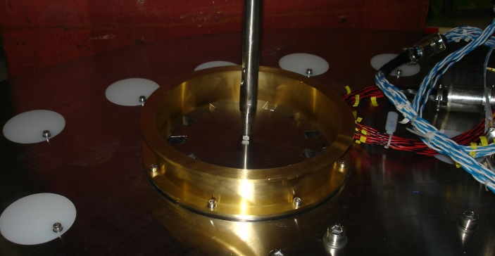
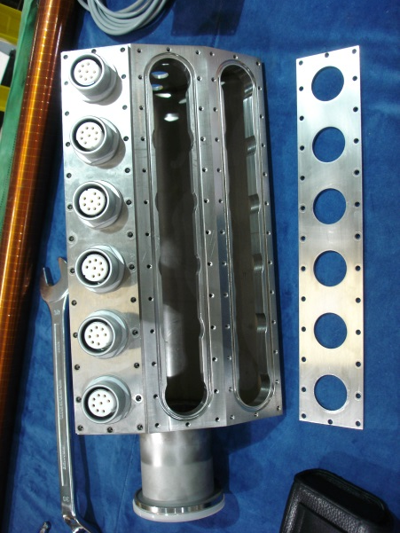
Some Pictures from SM18 (2/2)

Slide 8
Q&A

