Slide 1
High Luminosity
Large Hadron Collider
Roger Ruber
FREIA Laboratory
Dept. Physics and Astronomy
Uppsala University
FREIA Project Meeting - 26 September 2016

Slide 2


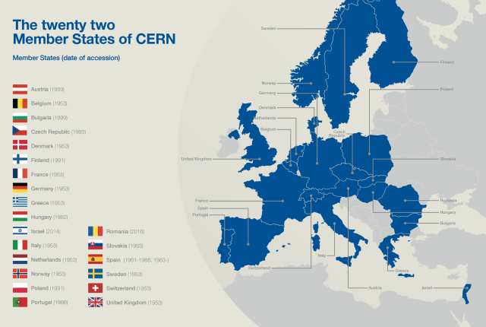
CERN
European Organization for Nuclear Research
Founded in 1954, today 22 Member States
About 11’000 users from all over the world
~ 1100 MCHF annual budget
2250 staff members + 1000 associates + 1000 external services

Slide 3
CERN’s Mission
Research & Discovery
  to push forward the frontiers of knowledge
  E.g. the secrets of the Big Bang … what was the matter like within the first moments of the Universe’s existence?
Technology
  R&D, application and transfer
  E.g. new technologies for accelerators and detectors; Information technology - the Web and the GRID; Medicine - diagnosis and therapy
Training
  scientists and engineers of tomorrow
Collaborating
  Unite people from different countries and cultures

Slide 4
CERN Physics Research Program
ISOLDE and REX-HIE: ‘Online’ separation of isotopes
  to study special radioactive nuclei; possible to post-accelerate
AD: antiproton decelerator
  provide ‘cold’ antiprotons to make and trap anti-hydrogen; then do spectroscopy
n-TOF: low energy ‘spallation’ neutrons
  dump high intensity proton beam in lead target and use low energy ‘spallation’ neutrons (kinetic energy measured by ‘time of flight’) for high precision measurements of nuclear reactions
Extracted PS beam:
  also used for other ‘fixed target’ experiment measuring the lifetime of π⁺π⁻ ‘atoms’
Extracted SPS beam:
  used to create polarized μ beam for deep inelastic scattering experiment (COMPASS)
LHC: high energy proton-proton and proton-ion collissions
  to study elementary particles, fields and their interactions; experimental exploration of the Terascale

Slide 5
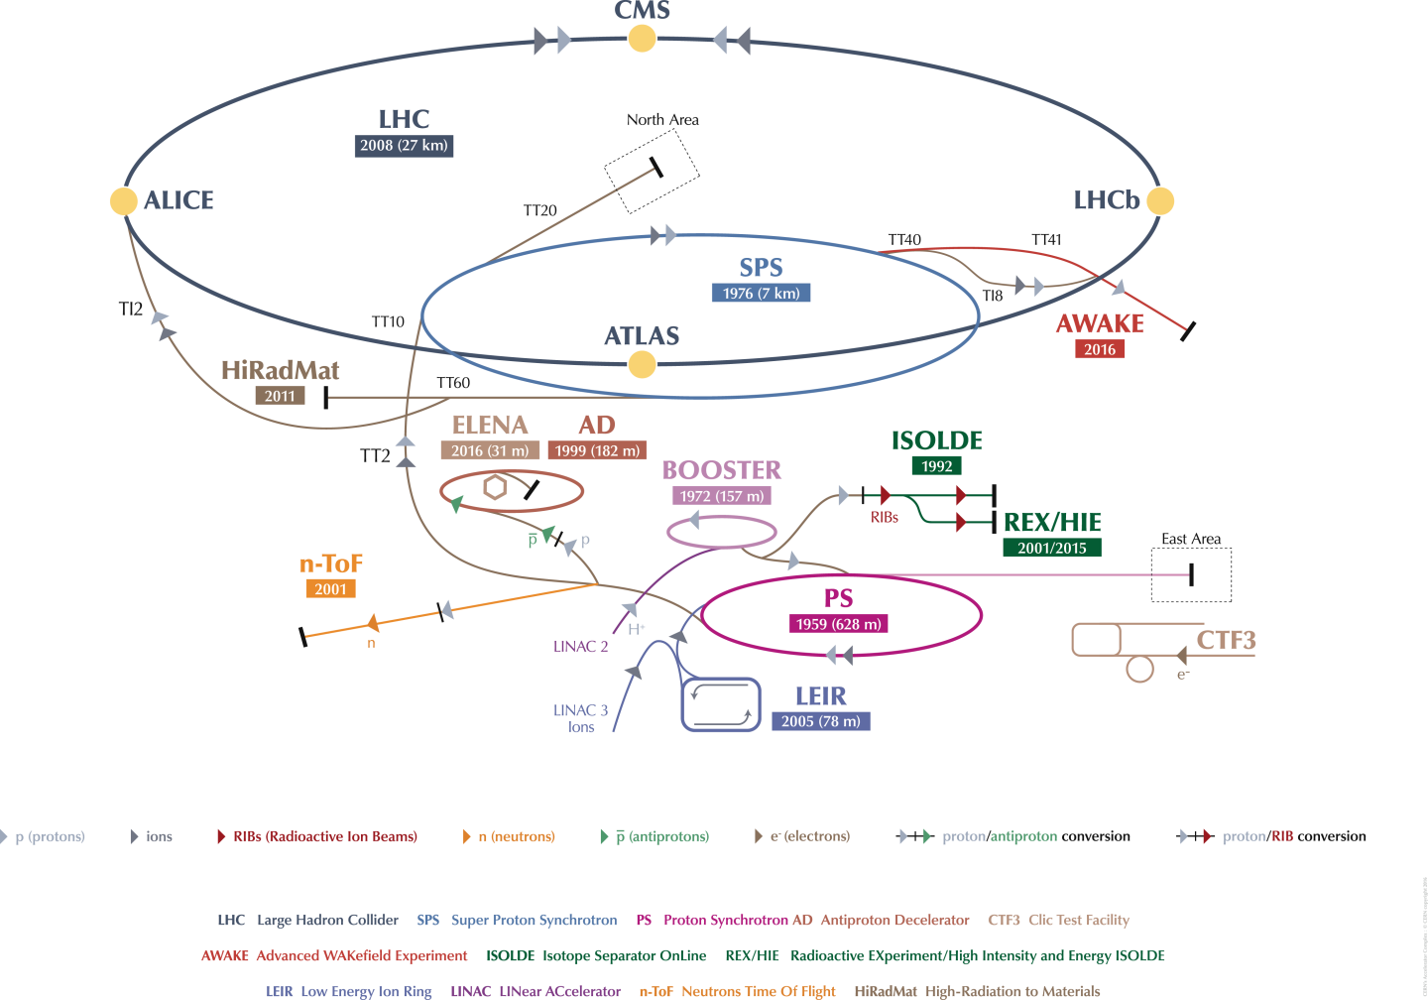
CERN Accelerator Complex

Slide 6
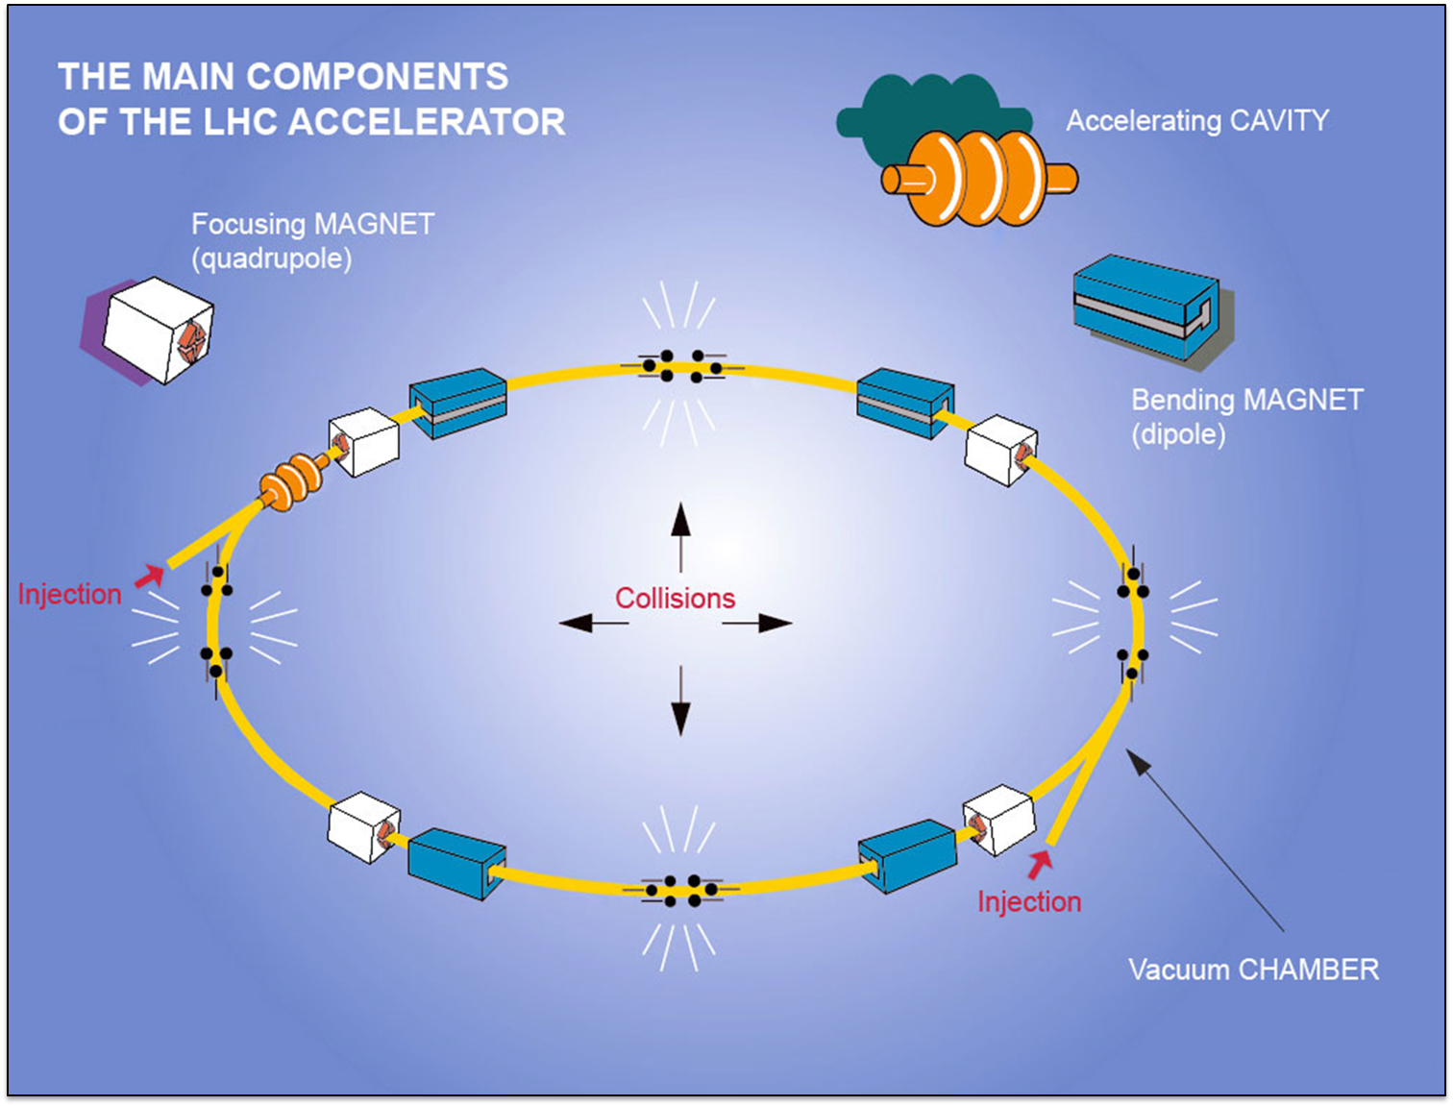
Large Hadron Collider
27 km, p-p at 7+7 TeV
  3.5+3.5 in 2008, 4+4 in 2012, 6.5+6.5 TeV in 2015

Slide 7
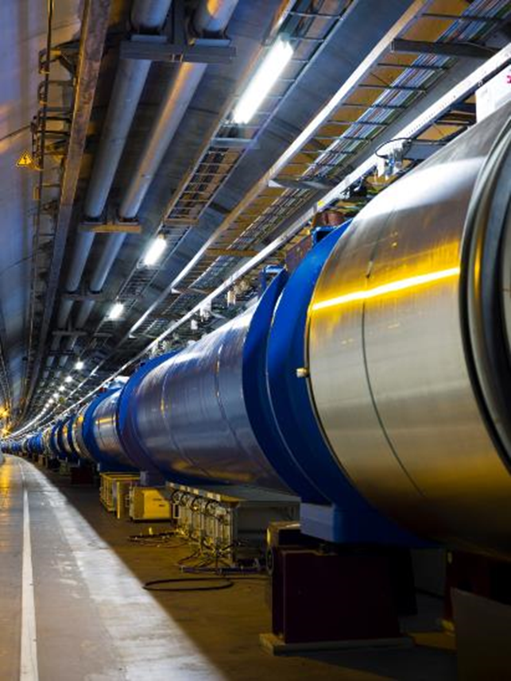
LHC Dipoles
Twin Superconducting Dipoles
Dipole line in the ring
1232 x 15 m Twin Dipoles
Operational field 8.3 T @11.85 kA
(9 T design)
HEII cooling at 1.9 K
  3 km circuits
  130 tonnes He inventory
Field homogeneity of 10-4
  bending strength uniformity better then 10-3.
  field quality control (geometric and SC effects) at 10-5.

Slide 8
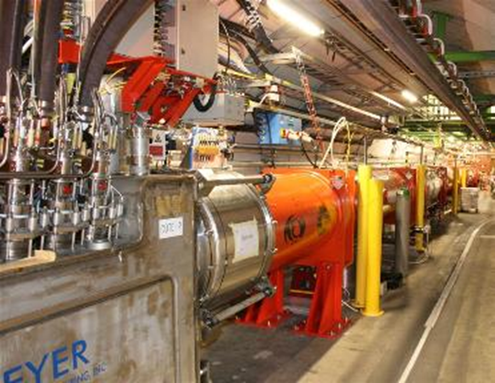
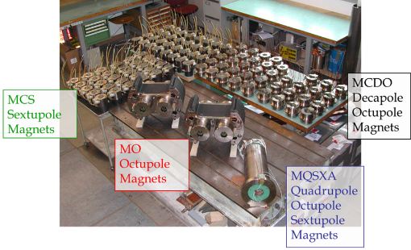
Quadrupole And Other Magnets
392 Main Quads
  Two-In-One rated for a peak field of 7 T.
About 100 other Two-in-One MQs
32 MQX (low-β) single bore
  for luminosity design L=1·10³⁴ cm⁻²s⁻¹,
  70 mm apertures, about 8 T peak field
A «zoo» of 7600 «small» Sc magnets
  correctors and higher order magnets
Large detector magnets
  ATLAS toroid – 25 m long (1.2 GJ)
  CMS solenoid – 12 m long (2.5 GJ)

Slide 9
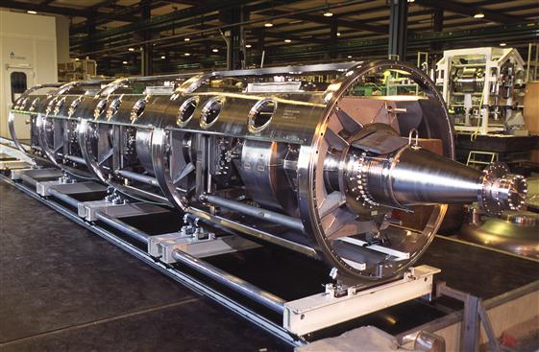
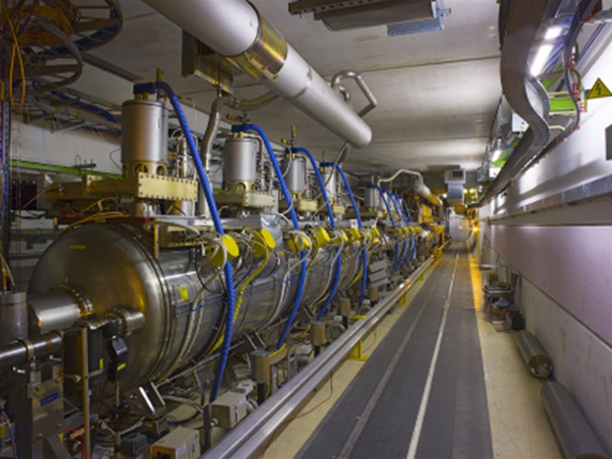
Radio Frequency Acceleration
400 MHz standing wave RF
Nominal gradient 5.5 MV/m
  nominal 2MV per cavity
  up to 3 MV at 8 MV/m
Single cell cavities
  16 cavities total,
  4 cavities per cryomodule,
  2 cryomodules per beam.
Sputtered niobium design
(like LEP)

Slide 10
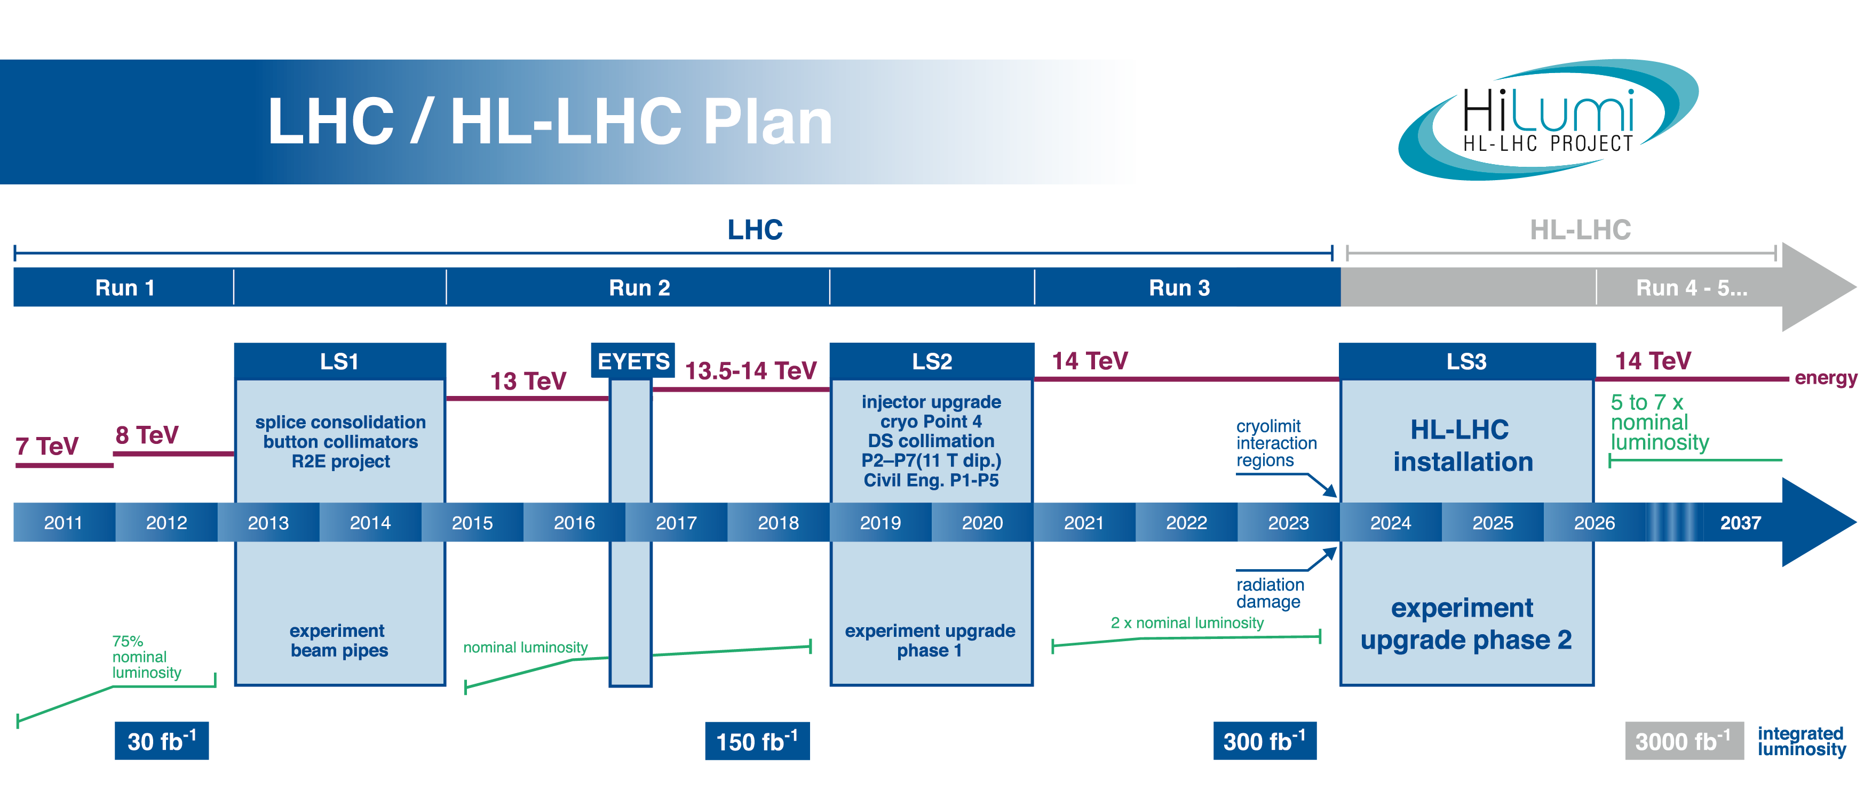
Why Upgrading LHC
0.75 10³⁴ cm⁻²s⁻¹
50 ns bunch
high pile up ∼40
1.5 10³⁴ cm⁻²s⁻¹
25 ns bunch
pile up ∼40
1.7-2.2 10³⁴ cm⁻²s⁻¹
25 ns bunch
pile up ∼60
Technical limits to lumi increase (Machine & Experiments)
50 ⇒ 25 ns

Slide 11

High Luminosity LHC Project
Started in 2010 as EC-FP7 design study
From FP7 HiLumi LHC Design Study application
The main objective of HiLumi LHC Design Study is to determine a hardware configuration and a set of beam parameters that will allow the LHC to reach the following targets:
A peak luminosity of L_{peak} = 5×10³⁴ cm⁻²s⁻¹
with levelling, allowing:
An integrated luminosity of 250 fb⁻¹ per year, enabling the goal of L_{int} = 3000 fb⁻¹ twelve years after the upgrade.
This luminosity is more than ten times the luminosity reach of the first 10 years of the LHC lifetime.

Slide 12
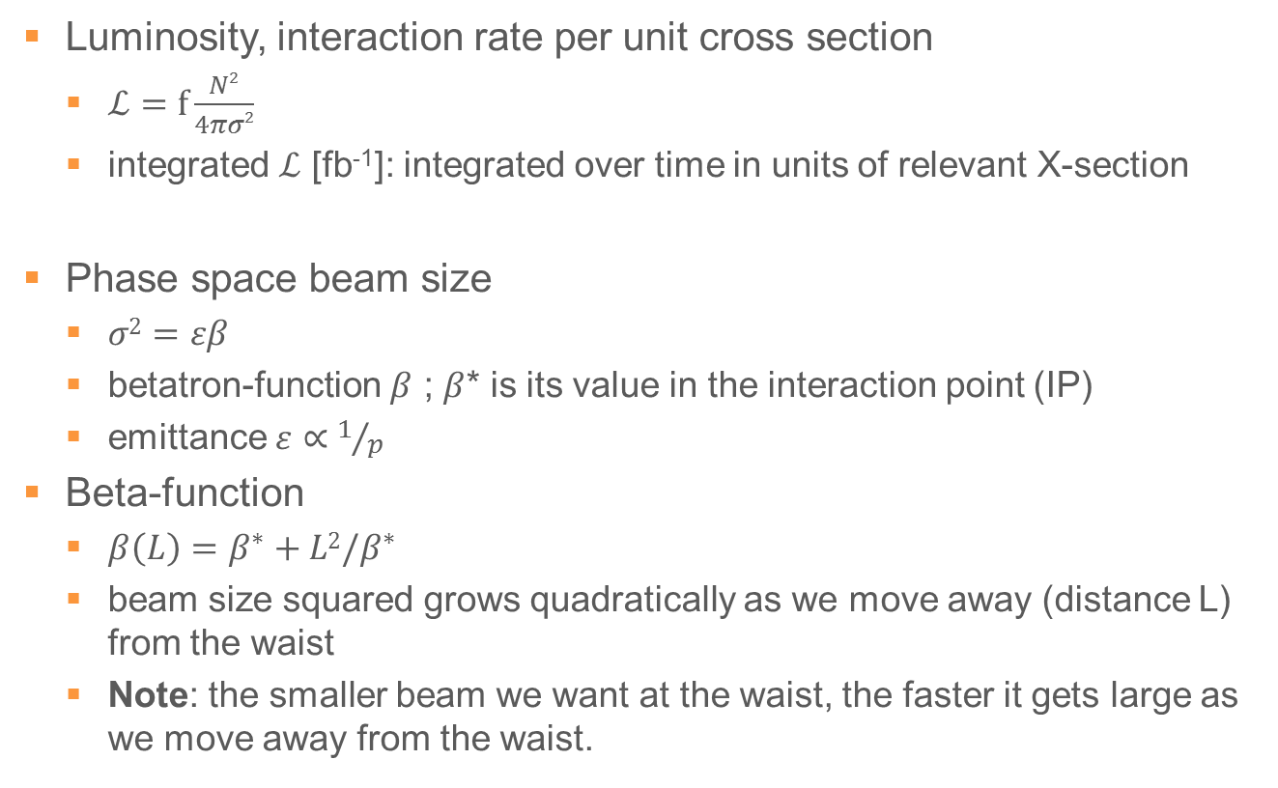
Common Terms
Luminosity, interaction rate per unit cross section
  $ℒ=f\frac{N2}{4πσ2}$
  integrated $ℒ$ [fb⁻¹]: integrated over time in units of relevant X-section
Phase space beam size
  $σ2=εβ$
  betatron-function $β$ ; $β$* is its value in the interaction point (IP)
  emittance $ε∝1/p$
Beta-function
  $β\left(L\right)=β^{∗}+L2/β^{∗}$
  beam size squared grows quadratically as we move away (distance L) from the waist
  Note: the smaller beam we want at the waist, the faster it gets large as we move away from the waist.

Slide 13
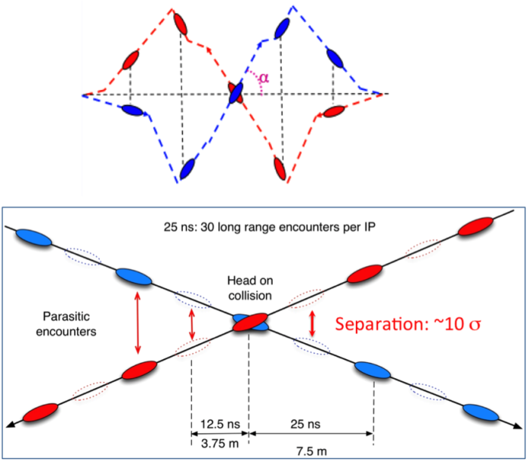
HL-LHC Main Upgrade Idea
Want to
  increase the beam brightness
    classic solution is to reduce β*
Beam envelop
  dark = 2σ; light = 12σ,
  emittance = 3.5 μm
Collimators
  for charged (TAS)
  neutral particles (TAN)
  protect SC magnets from
  collision debris
  reduction of background
  to experiments

Slide 14
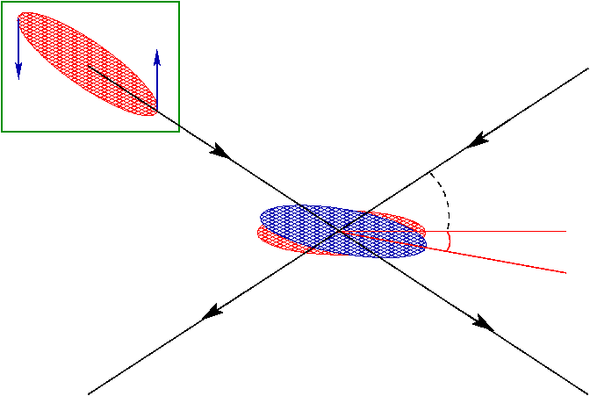
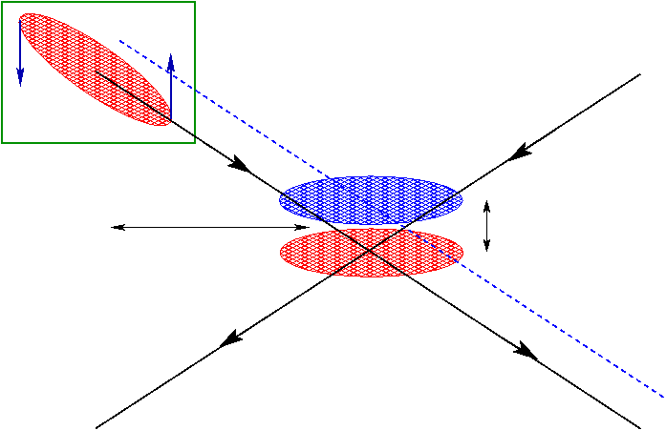
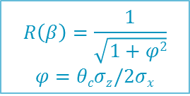
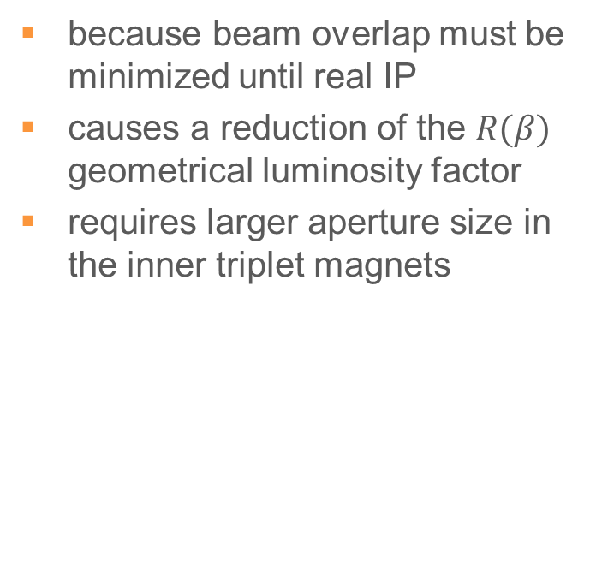
Crabbing
Drawback of small β*
is a large crossing angle
Compensate with crab cavity
because beam overlap must be minimized until real IP
causes a reduction of the $R(β)$ geometrical luminosity factor
requires larger aperture size in the inner triplet magnets
and replace inner triplet magnets to increase the aperture
$$R\left(β\right)=\frac{1}{\sqrt{1+φ2}}$$
$$φ=θcσz/2σx$$
Amplitude jitter
Phase jitter

Slide 15
HL-LHC Parameters
CERN-2015-005, Table 1-1
Parameter |  | LHC | HL-LHC 25 ns | HL-LHC 50 ns
Beam energy | [TeV] | 7 | 7
N_{b} |  | 1.5x10¹¹ | 2.2x10¹¹ | 3.5x10¹¹
N_{b} |  | 2808 | 2748 | 1404
N_{total} |  | 3.2x10¹⁴ | 6x10¹⁴ | 4.9x10¹⁴
Beam current | [A] | 0.58 | 1.09 | 0.89
Crossing angle | [μrad] | 285 | 590 | 590
β* | [m] | 0.55 | 0.15 | 0.15
ε_{n} | [μm] | 3.75 | 2.50 | 3
Peak luminosity w/o crab | [cm⁻²s⁻¹] | 1.0x10³⁴ | 7.2x10³⁴ | 8.4x10³⁴
Virtual luminosity w/ crab | [cm⁻²s⁻¹] | (1.2x10³⁴) | 19.5x10³⁴ | 21.4x10³⁴
Levelled luminosity | [cm⁻²s⁻¹] | - | 5.0x10³⁴ | 2.5x10³⁴
Events/crossing |  | 27 | 138 | 135
Levelling time | [h] | - | 8 | 18

Slide 16

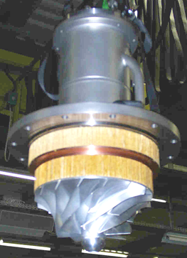
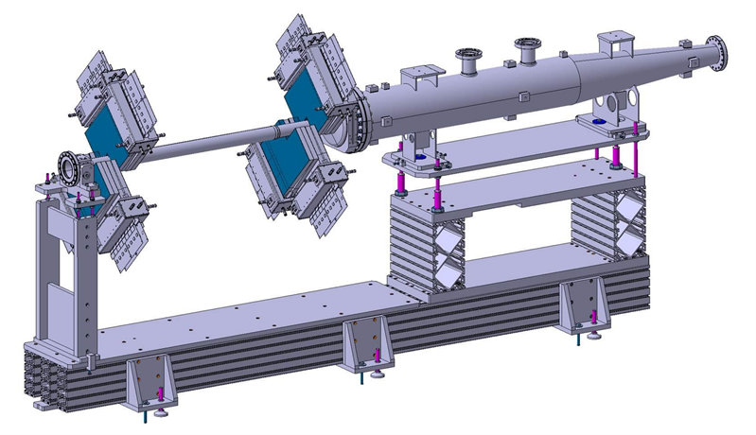
FP7-HiLumi classified as «success story» by EC
Cryogenics
Upgrade at P1/4/5
Beam Instrumentation
Beam Gas Vertex profile monitor (BGV);
cryogenic beam loss monitor;
new stripline & electro-optical BPMs

Slide 17
HL-LHC project breakdown structure

Slide 18
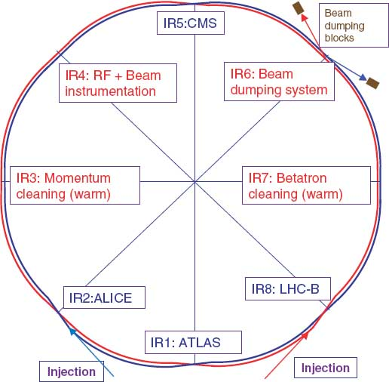
HL-LHC Interaction Region
Four interaction regions for experiments
  two (IR1/5) to be upgraded
Purpose
  separate the two counter-rotating beams transversely
  mitigate parasitic crossings
Experiment IR equals (one side)
  60 m focusing channel
  21 m drift space
  20 m dipole channel

Slide 19
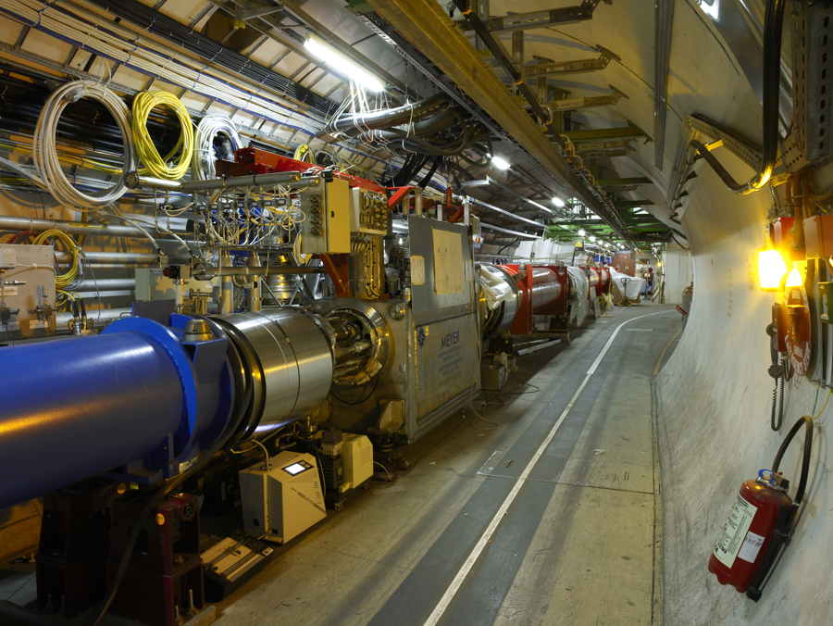
Looking Towards The Collision Point

Slide 20
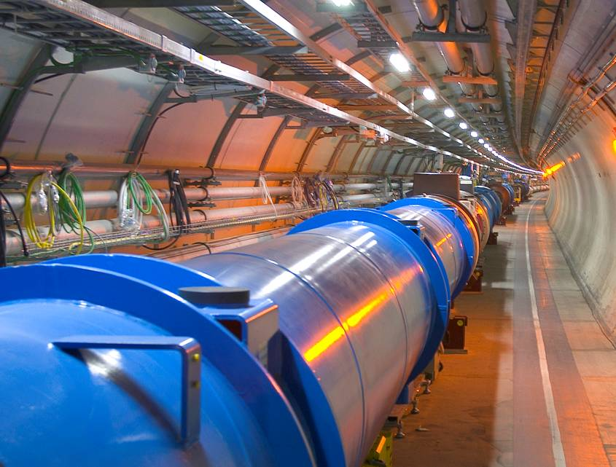
Looking Over The Shoulder

Slide 21
Conceptual Layout IR Region
IR Region of LHC
IR Region of HL-LHC

Slide 22
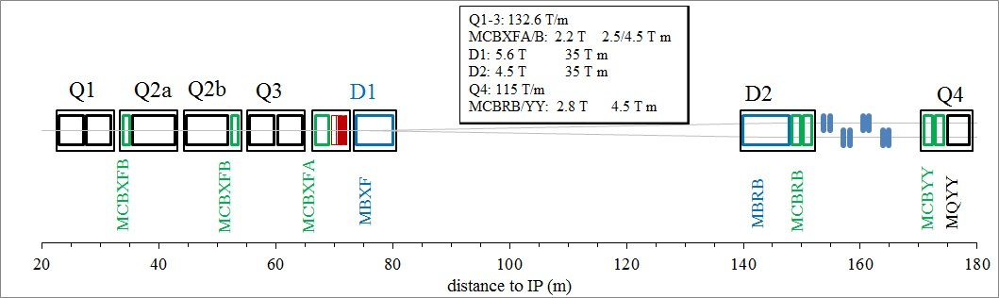
HL-LHC Lay-out of the IR
IR zone has in different strategic points corrector magnets of dipolar field, giving corrections on the horizontal or on the vertical plane.
MCB corrector magnets (in “green”)
ACSC crab cavities (in “blue”)
proposed to be tested at FREIA.
crab
cavities
ACSC

Slide 23
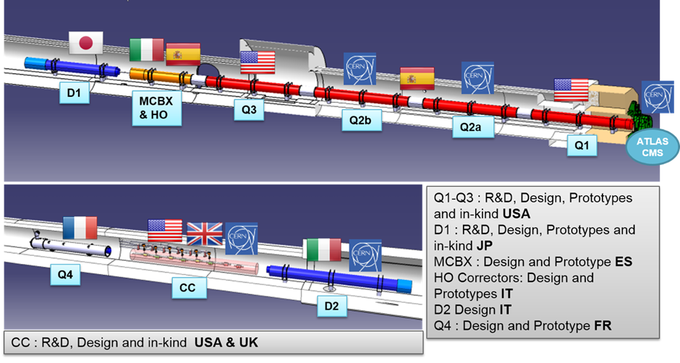
WP3: Interaction Region Magnets
Inner Triplet at ATLAS & CMS

Slide 24
What Is Special
Magnet apertures of triplet, D1, correctors are large
  Larger forces
  At the limit of what is reasonable with the given cryostat (and tunnel) size
Triplet quadrupoles:
  Nb₃Sn cable: Power-in-Tube (PIT), Restack Rod Process (RRP)
  US design split in two 4.2 m long magnets,
  CERN opted for making a 7.15 long magnet
Nested correctors:
  even though the field is only 2 T in each plane, the magnet is not trivial
  mechanics and double collaring is the challenge

Slide 25
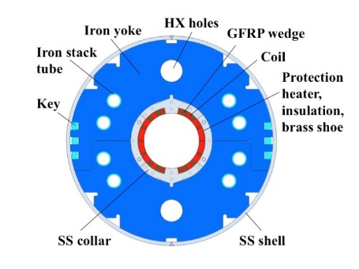
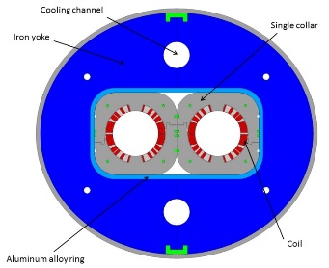
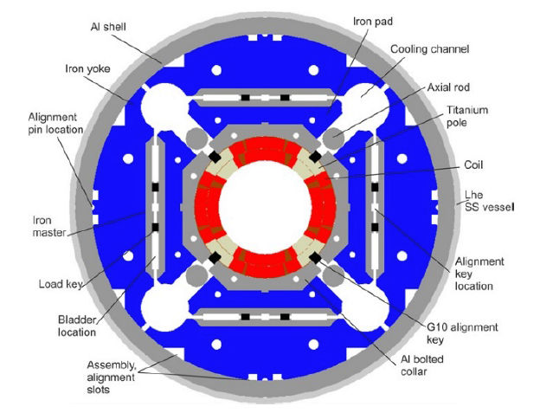
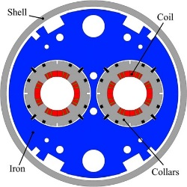
Dipoles & Quadrupoles
D1 separation dipole, by KEK (JP)
  5.6 T, 150 mm aperture (6.6 T peak field)
  short model prototype reached 300 A less
  than nominal after 9 quenches at 1.9 K
D2 recombination dipole, by INFN (IT)
  4.5 T, 105 mm aperture (5.1 T peak field)
  short model prototype test in 2017
Q1/Q2/Q3 triplet quadrupole
  140 T/m, 150 mm aperture (12.1 T peak field)
  based on Nb₃Sn cable
Q4 quadrupole, by CEA Saclay (FR)
  115 T/m, 90 mm aperture (6.3 T peak field)
  short model prototype test end 2017

Slide 26
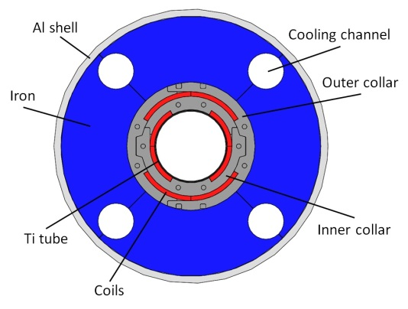
Q1-Q2-Q3 ORBIT CORRECTORS
MCBXFA, MCBXFB
Possible test at FREIA
Nested orbit corrector , by CIEMAT (ES)
  2.1 T, 150 mm aperture (4.2 T peak field)
  prototype test 2018 (~1 year delay in design)
MAGNET CHARACTERISTICS
Integrated into | Q2a, Q2b | CP
Magnet name | MCBXFB | MCBXFA
I nom (kA) | 1,6
I max ( 2*I nom) | 3,2
Max Diameter(mm) | 630,0
Max Length (mm) | 1500 | 2100
Max Energy magnet (kJ/m) | 160,0
Inductance (mH/m) | 46,0/99
Dump (Ohm) | 0,3
Protection Heater | Maybe
nr of magnets | 10 | 5
OPERATION TEMPERATURE : 1.9 K
Inner an Outer magnets are powered INDIVIDUALLY

Slide 27
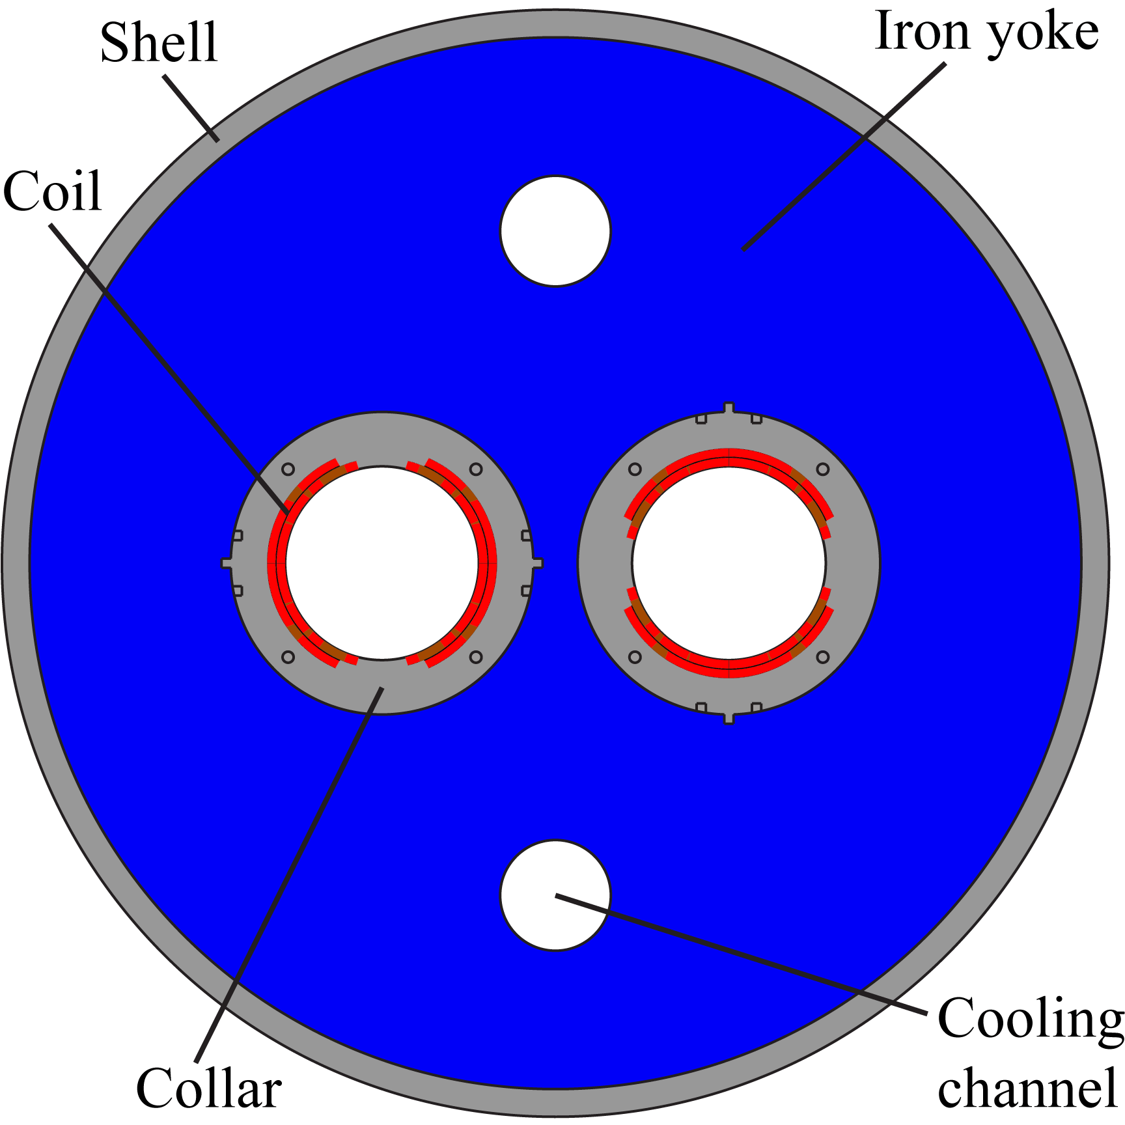
Q4-D2 ORBIT CORRECTORS
MCBRD, MCBRYY
Possible test at FREIA
Double aperture orbit corrector, by CERN
  3.0 T, 100 mm aperture (3.8 T peak field)
  prototype by 2017
MAGNET CHARACTERISTICS
Integrated into | D2 |  | Q4
Magnet name | MCBRD |  | MCBYY
I nom (kA) | 1,7
I max ( 2*I nom) | 3,4
Max Diameter(mm) | 630,0
Max Length (mm) | 1600
Max Energy magnet (kJ/m) | 78,0
Inductance (mH/m) | 29
Dump (Ohm) | TBC
Protection Heater | Maybe
nr of magnets | 10 | 10
OPERATION TEMPERATURE : 1.9 K
The two apertures are powered INDIVIDUALLY

Slide 28
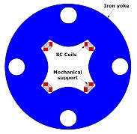
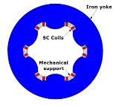
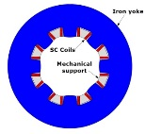
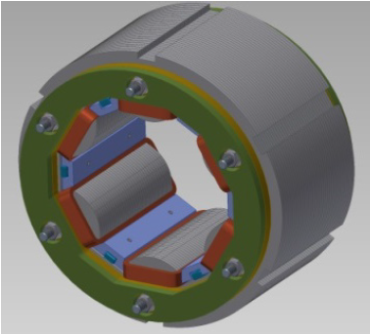
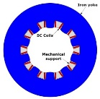
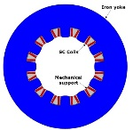
Zoo of Higher Order Correctors
Superferric design, by INFN (IT)
  NbTi racetrack coils provide ampere-turns
  iron yoke provides field shape
  2 to 3 T peak field, 150 mm aperture
  100 to 850 mm coil length
  first sextupole tested Feb. 2016
sextupole

Slide 29
WP4: Crab Cavities & RF
Boundary conditions
  aperture size 84 mm
  max cavity radius ≤ 145 mm
  nominal deflecting voltage 3.4 MV per cavity
  resonance frequency 400.79 MHz
Main design options proposed
https://indico.cern.ch/event/136807
  4 Rod Crab Cavity (4RCC), Lancaster Univ.
  Double Quarter Wave (DQW), BNL
    most advanced design
  Radio Frequency Dipole (RFD),
  ODU and SLAC
  Compact Coated Cavity (CCC),
  CERN and Politecnico di Torino

Slide 30
Compact Nb-on-Cu Coating Cavity
SRF2015-THPB048
Shape based on ridged waveguide resonator
  with wide open apertures to provide access to the inner surface of the cavity for coating
  provides natural damping for HOMs
  rather low longitudinal and transverse impedances
Advantage of Nb-on-Cu coating
  higher surface resistance (RF-loss) but lower quenching probability
  possibility for more complex and accurate shape by using modern CNC 5-axis milling than solid Nb sheet technology
  reduced sensitivity for microphonics and Lorenz force detuning
Parameter
E_{max} | [MV/m] | 30
B_{max} | [kA/m] | 25
R/Q | [Ohm]
U_{stored} | [J]

Slide 31
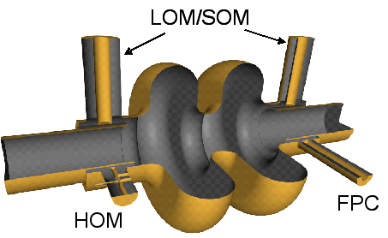
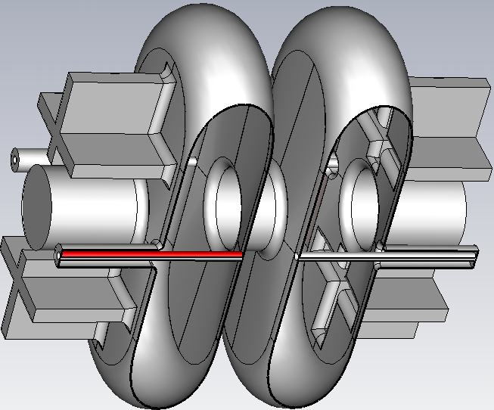
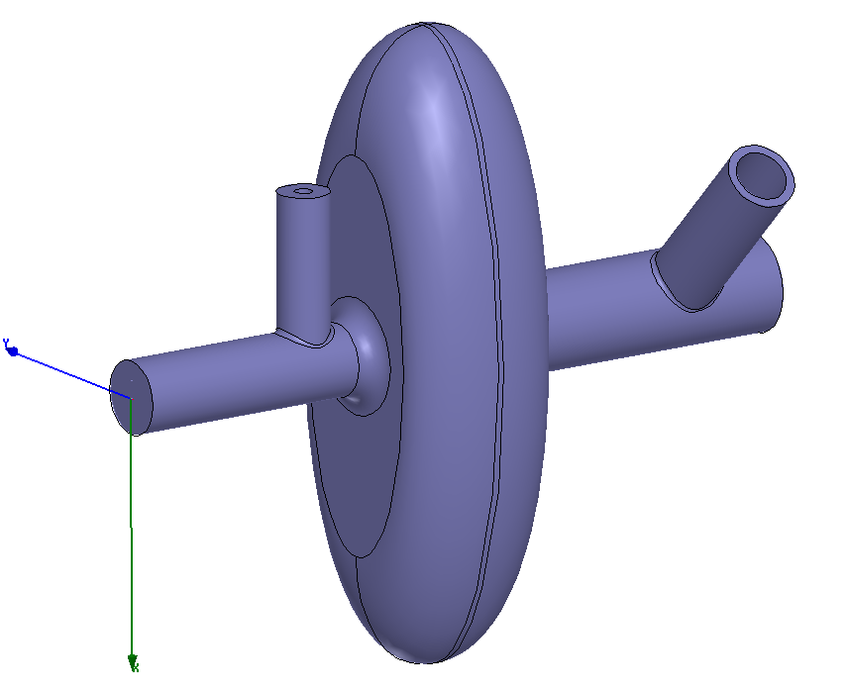
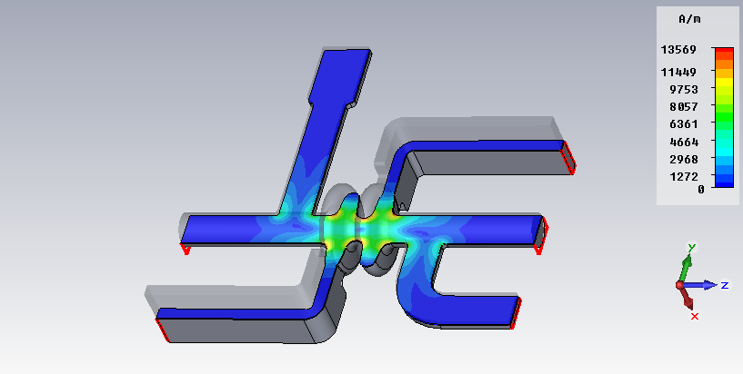
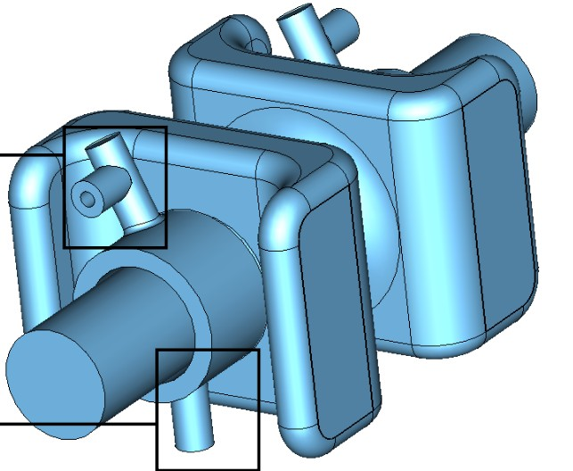
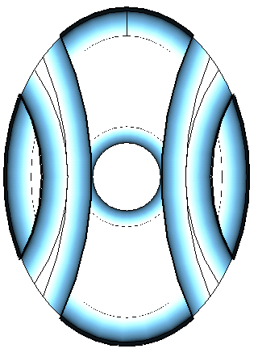
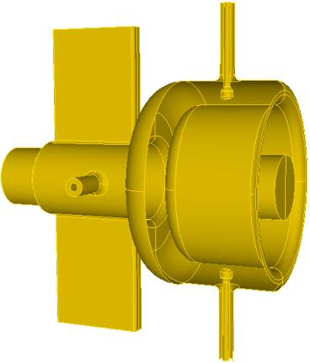
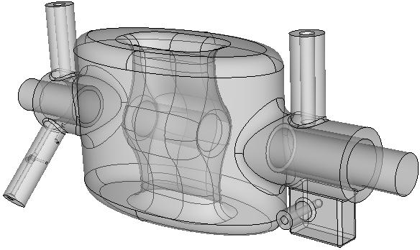
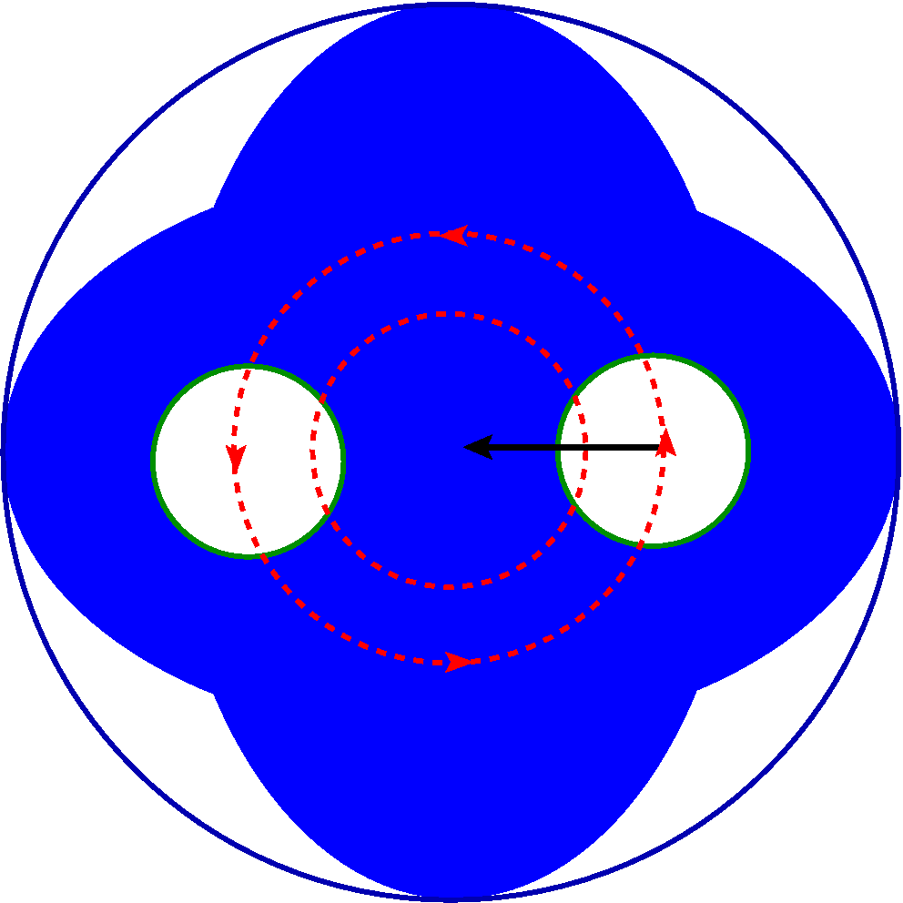
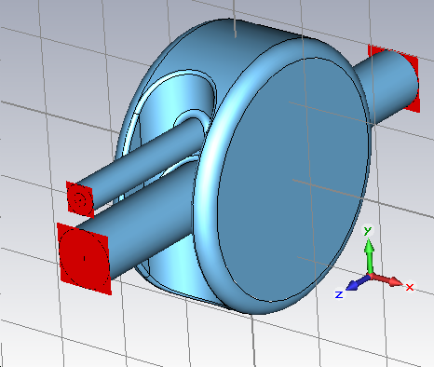
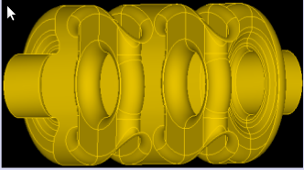
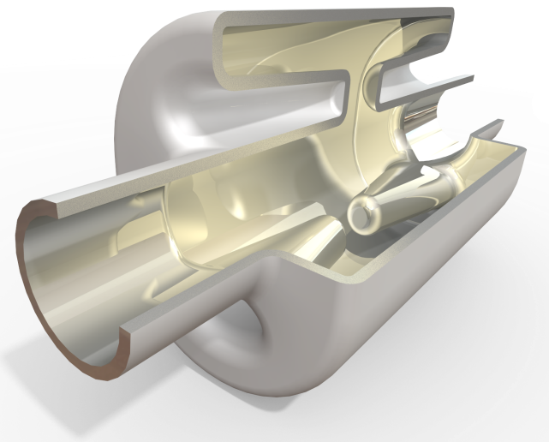
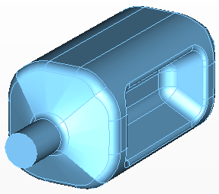
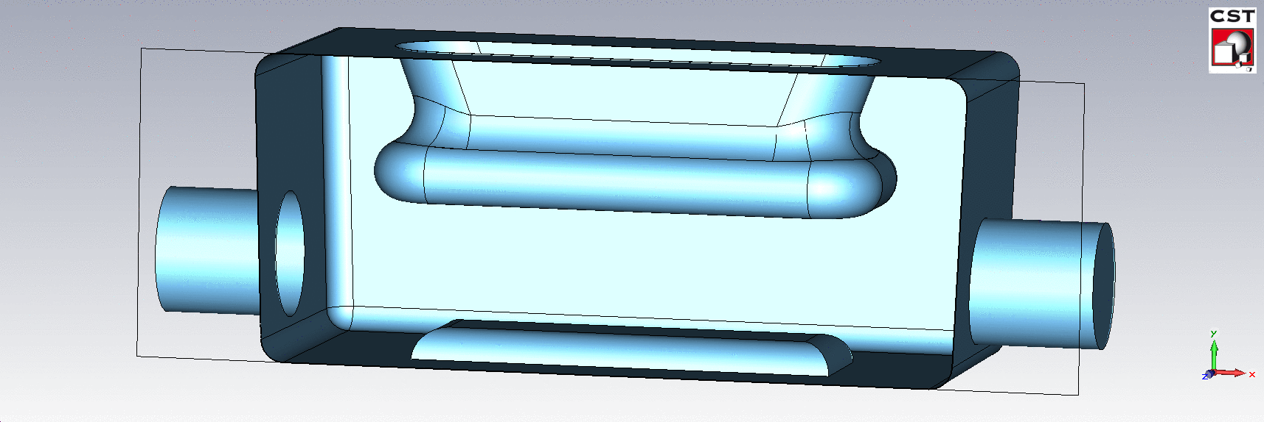
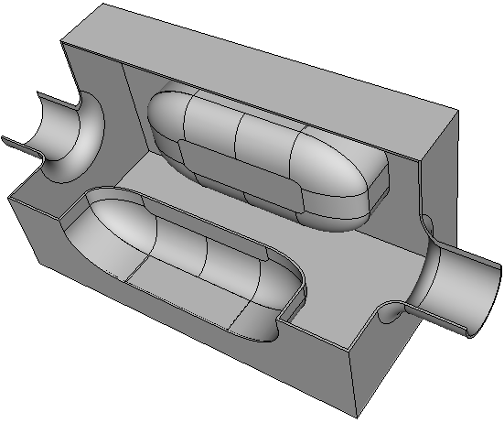
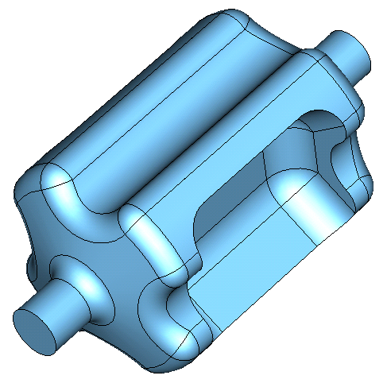

Crab Cavity Design Evolution (~4yr)
Development of new concepts
(BNL, CERN, CI-DL-LU, FNAL, KEK, ODU/JLAB, SLAC)

Slide 32



Double Quarter Wave Cavity λ/4 TEM Resonator
Design by BNL
Equipped with
3 HOM couplers
E-field
Parameter
f_{fund} | [MHz] | 400
f_{HOM} | [MHz] | 579
E_{max} | [MV/m] | 44
B_{max} | [mT] | 60
R/Q | [Ohm] | 400
U_{stored} | [J] | 12
B-field

Slide 33




Radio Frequency Dipole (RFD) λ/2 TEM Resonator
Design by ODU and SLAC
Two λ/4 resonators → λ/2
  HOM (TE₁₁-like) for deflection
  bar length ~λ/2
Parameter
E_{max} | [MV/m] | 33
B_{max} | [mT] | 65
R/Q | [Ohm] | 287
U_{stored} | [J]
E-field
B-field

Slide 34



4 Rod Crab Cavity (4RCC)
Four co-linear λ/4 TEM Resonators
Design by Lancaster University
Conical resonators for mechanical stability
Deflection mode is HOM
Parameter
E_{max} | [MV/m] | 32
B_{max} | [mT] | 60.5
R/Q | [Ohm] | 915
U_{stored} | [J]

Slide 35







Cavity Tuning
Warm frequency tuning limited by tuning fixture
Limiting factor is the strength of NbTi fixture and weld
  CERN (NbTi), USLARP (Nb with reinforced shape)
Nb fixture with helicoil
DQW Pre-tuning: $≥0.3$ mm permanent deformation
RFD: $∼1.4$ mm (7000 kN elastic limit)

Slide 36


Transmission Lines
Specific transmission lines are being developed to allow expansion due to thermal cycles
In case of full reflection at the load, maximum standing wave and voltage along the line will be up to twice the nominal forward voltage
  Vtotal = Vf + Vr
  With full reflection
    Vr = Vf
    So Vtotal = 2 Vf and Pmaximum = 4 Pf
The source is the HOM, the load is at the air side
In case of a load failure, there will be full reflection back to the HOM
Steps to keep the correct impedance
Sliding contacts for thermal variation
Test Box

Slide 37


Cryomodules
magnetic shield inside cavity helium vessel
DQW
RFD

Slide 38
Crab Cavity Tests
Possible test at FREIA
2 Cavities in 1 cryomodule in SPS to demonstrate
  deflection action and verification of cavity control,
  operation without crab cavity action (“invisibility” to the beam),
    by counter-phasing two cavities or by de-tuning,
  non-correlated operation,
    trigger quench in one without inducing quench in the other,
  that the crab cavities are a high availability RF system,
  performance of crab cavities with high intensity beam,
  effect of crab cavity noise to the beam,
    may trigger the necessity of a wide-band feedback system including pick-ups and kicker elements,
  test techniques for beam-based crab cavity qualification in HL-LHC.
1 or 2 Cavities in HNOSS to study
  fast failure (quench) modes including non-correlated operation,
  prototype tetrode based amplifier system (IOT system is new baseline).

Slide 39
Planning
Tests (FREIA)
YETS – 8 weeks
EYETS – 14 weeks
2015
2016
2017
2018
2019
2020
2021
2022
2023
2024
2025
2026
YETS
EYETS
YETS
Run 2
LS2
Run 3
LS3
Run 4
SPS test prototype (2 CM)
Preparation
Tests (DQW)
Tests (RFD)
LHC pre-series (2 CM)
LHC series production (8 Mod)
Fabrication & tests
Installation

Slide 40
WP4: Additional RF System Upgrades
Under Discussion
Harmonic RF system
  200 MHz sub-harmonic system will improve the luminosity by
    improved capture efficiency of longer SPS bunches with very high intensity (note: SPS works at 200 MHz)
  800 MHz higher harmonic system to reduce beam-induced heating, intra-beam scattering, improve longitudinal beam stability by
    changing the bunch profile
    increasing the synchrotron frequency spread
Transverse damper
  transverse feedback system to damp beam oscillations originating from injection and/or impedance
  preserve beam intensity and emittance
  present system bandwidth 20 MHz, increase might be useful for HL-LHC

Slide 41
WP7: Machine Protection
PhD Student at HEP/FREIA
Stored energy ~700 MJ per beams
  2.2x10¹¹ p/bunch, 25 ns bunch spacing, 2748 bunches, 7 TeV
  for LHC it is ~362 MJ per beam
Uncontrolled beam loss can cause severe damage
  nominal LHC beam can penetrate 20 m long copper block
  accident could happen if extraction kickers deflect at incorrect angle
Necessary to
  review LHC damage studies with new parameters
  extend to new failure scenarios related to
    optics modifications
    new hardware components: crab cavities, wire scanners

Slide 42



WP11: 11 T Dipole
a pair of 11 T dipoles will replace some 8.3 T main dipoles (MB)
  space for additional collimators in the dispersion suppressor regions
  6.252 m long and straight, Nb₃Sn cable
  trim coil to correct for field difference with MB
  below nominal current
By-pass cryostat
15'660 mm
11 T dipole cold mass
Space for Collimator
Interconnect

Slide 43
WP17: Civil Engineering
Point 1
Point 5

Slide 44
With material from the
HL-LHC Collaboration and especially
L. Rossi, M. Bajko, R. Calaga,
J. Delayen, E. Montesinos
HL-LHC web site: http://hilumilhc.web.cern.ch/
This work is supported by
Uppsala University and CERN
In collaboration with
Dept. Physics and Astronomy and Dept. Engineering Sciences, Uppsala University
Accelerator and Cryogenic Systems, Orsay, France

