Slide 1
High Power RF Solid State Amplifiers at FREIA
Dragos Dancila, Long Hoang Duc, Magnus Jobs, Vitaliy Goryashko, Anders Rydberg, Jörgen Olsson, Roger Ruber and Tord Ekelöf
Oct. 4 – meeting with Scandinova
FREIA Laboratory, Uppsala University

Slide 2
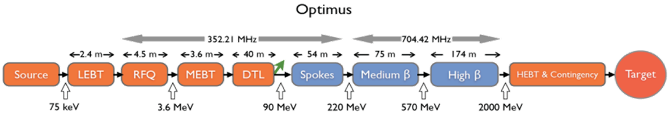

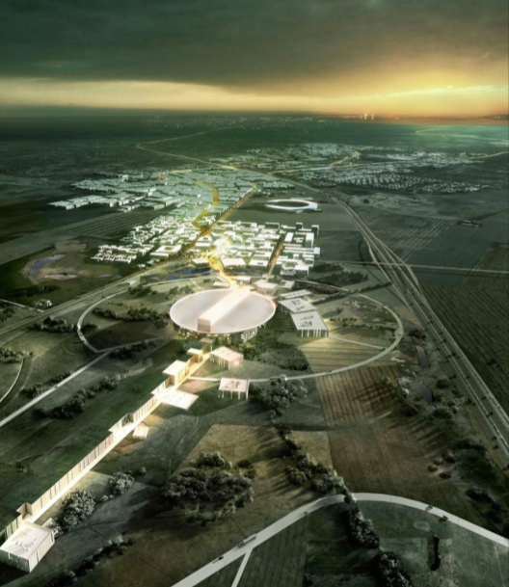
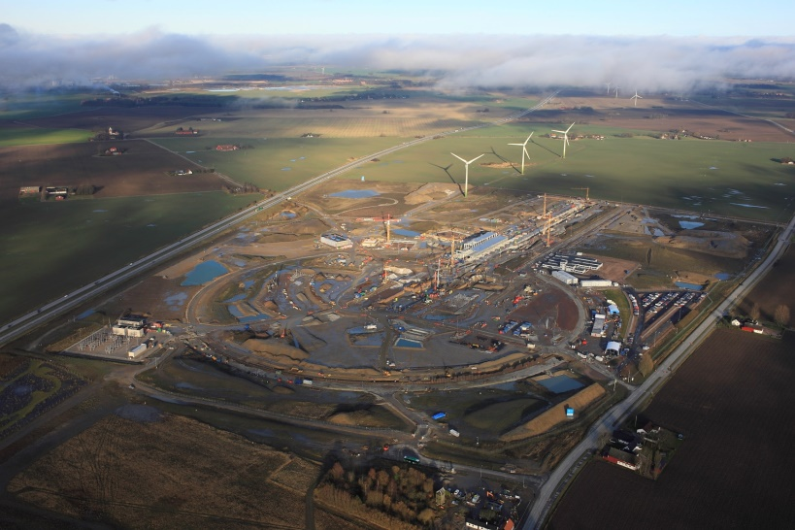
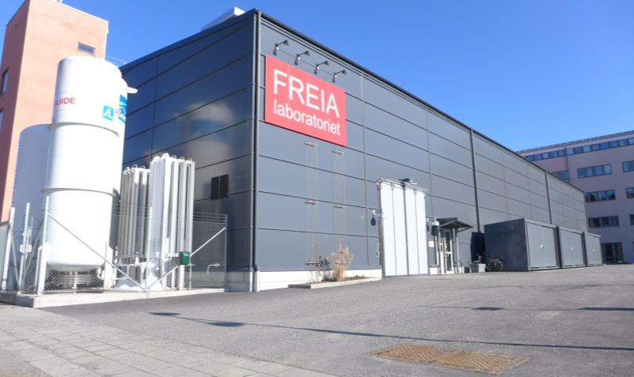
RF Source Development - FREIA
Testing prototype superconducting accelerating cavities (26 SC in final LINAC), cryomodules and high power RF stations
  High power RF stations at ESS specifications
  352.21 MHz, 400 kW, 14 Hz, 3.5 ms, 200 kHz bandwidth
ESS - Lund
Uppsala University

Slide 3
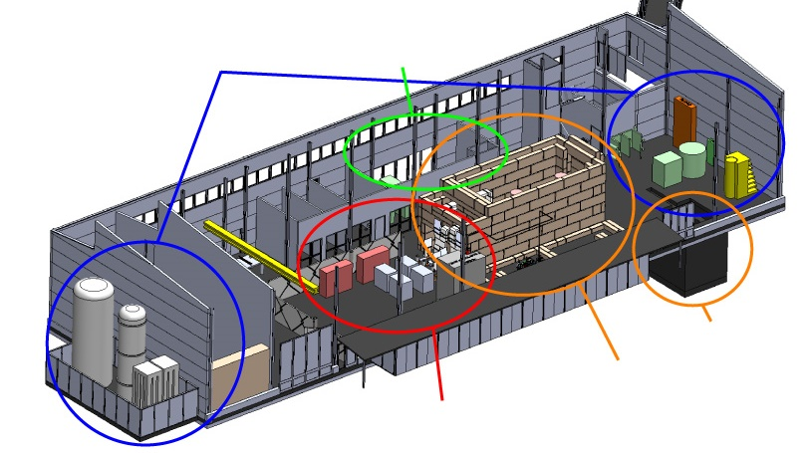
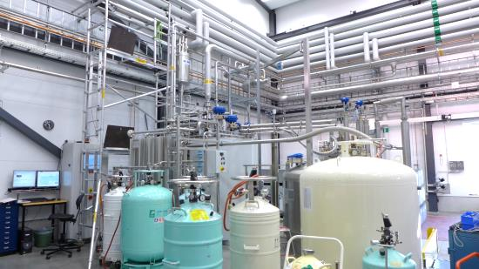
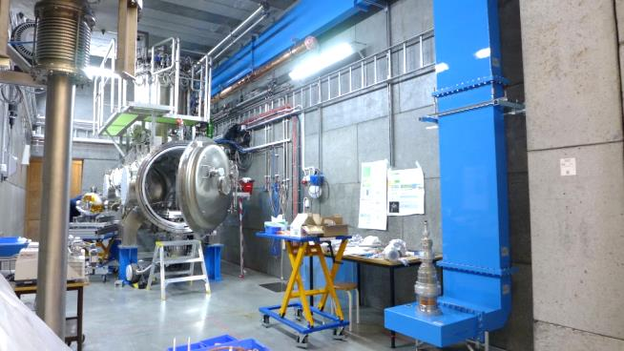
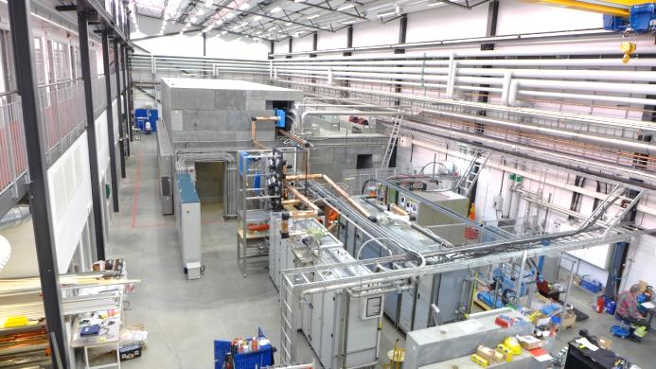
FREIA Uppsala
Cryogenics
Liquid Nitrogen
Helium liquefaction (150 l/h)
2000 l storage dewar
RF Power Stations
Spoke Cavity
Operating at 352.21 MHz
Q > 10⁹
Operating gradient 9 MV/m
Horizontal Cryostat
Control System
Operating at 1.8 to 4.5 K
16 mbar pressure
400 kW 3.5 ms pulses at 14Hz
Dual TH595 tetrodes
Load pull
Closed-loop LLRF system
Cryogenics control

Slide 4
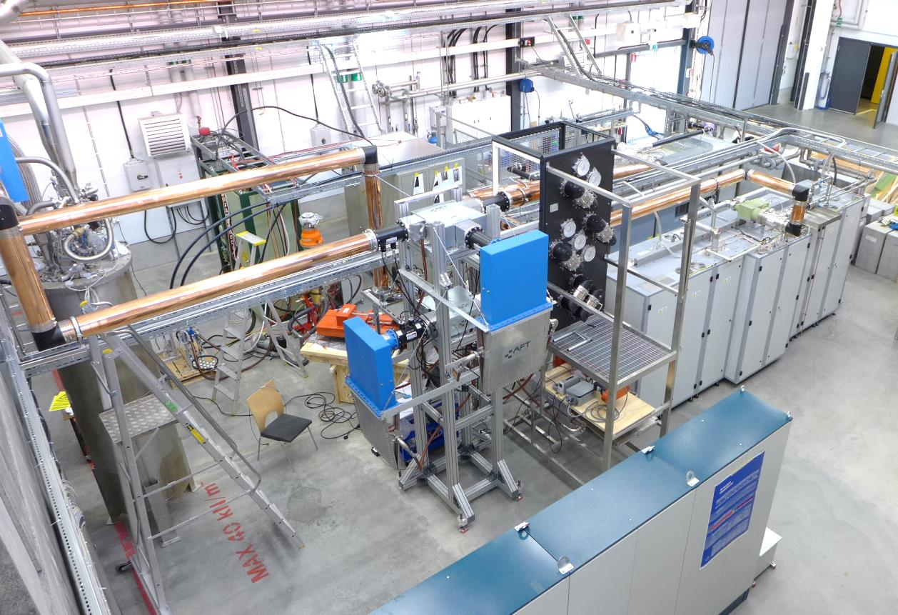
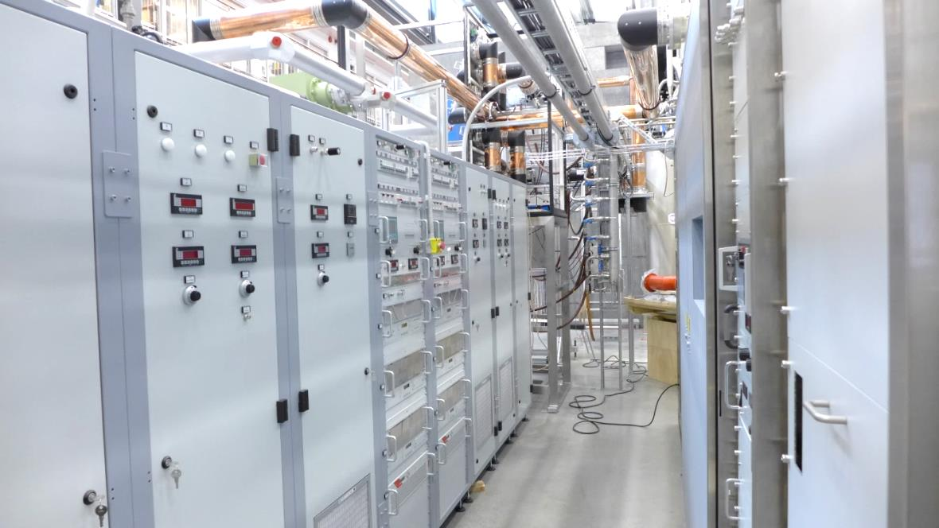
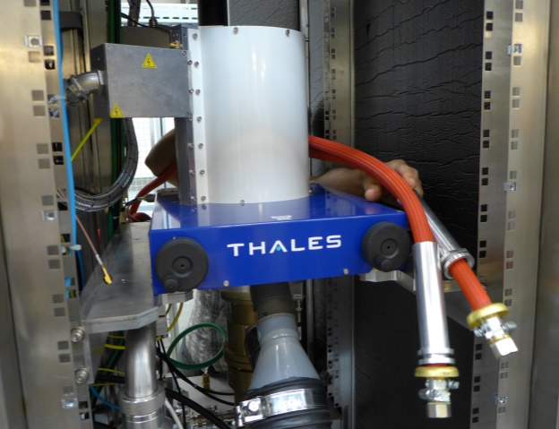
400kW RF Stations
Tetrode based (Dual TH595)
400 kW 3.5 ms pulses at 14Hz
20 kV 40 A anode power supplies
Class AB
Cost Efficient/Reliability
Efficiency a key-parameter

Slide 5
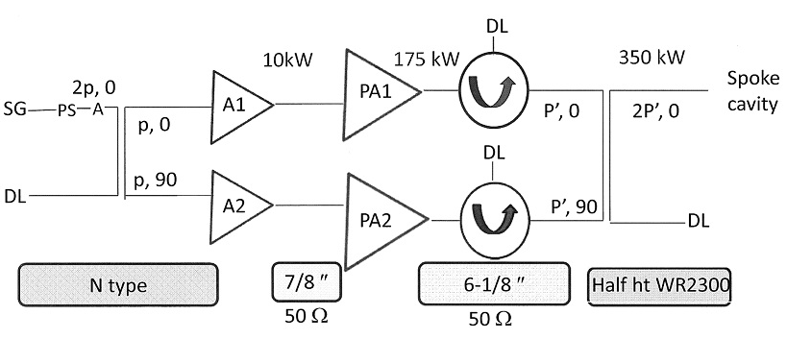
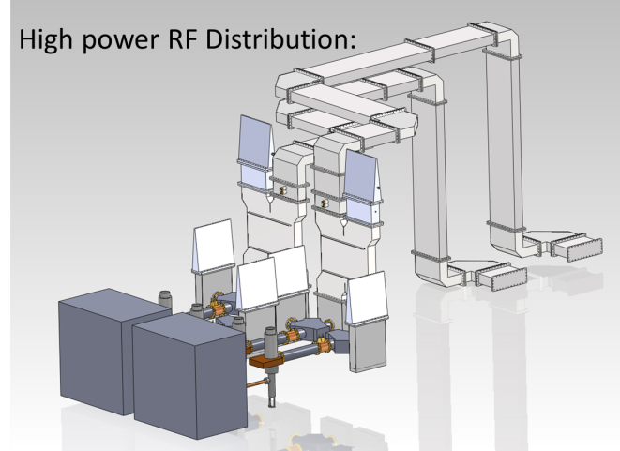
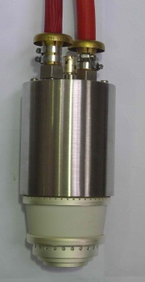
RF Power Station – SSA
200kW
400kW
No presurization and ferrite dummy loads
Power Distribution at 3 levels
  Half height WR2300: 400kW
  6-1/8 inch, 50 Ω coax: 200 kW
  7/8 inch, 50 Ω coax: 10 kW
Pre amp. Efficiency: 50 - 55 % (class AB)
Amp. Efficiency > 67 % (class AB)
TH 595

Slide 6
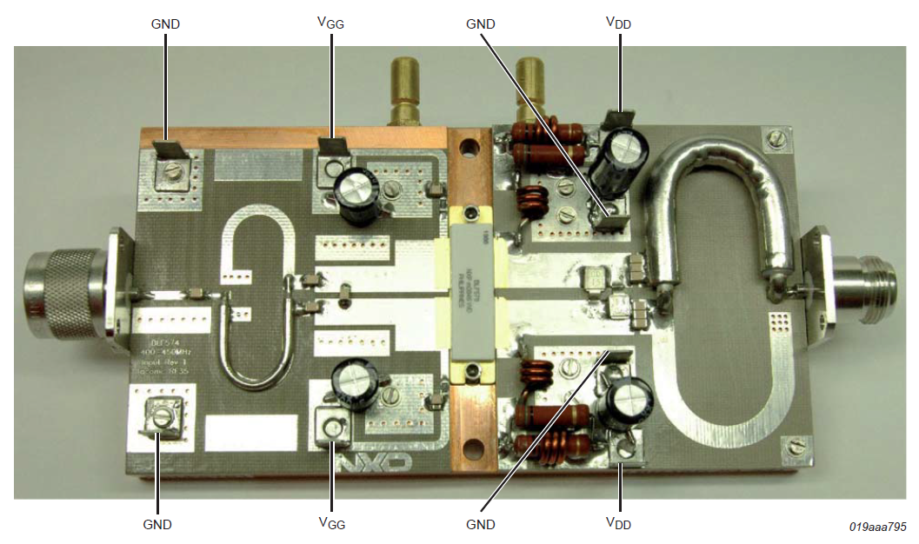
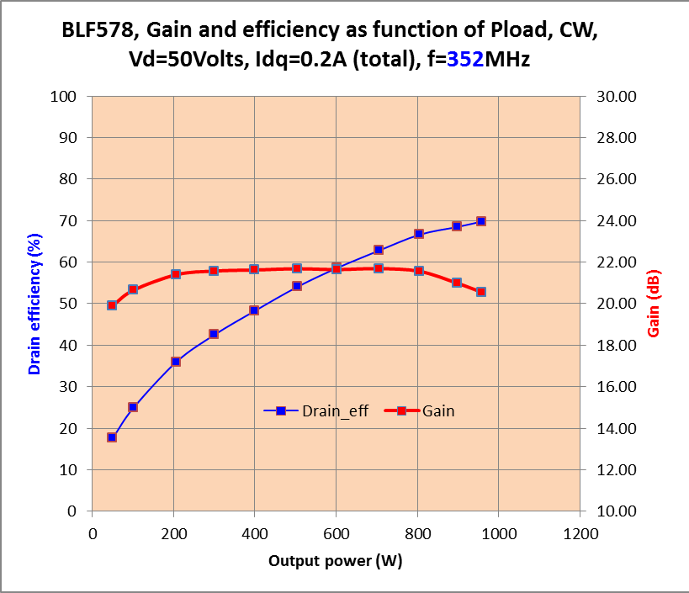
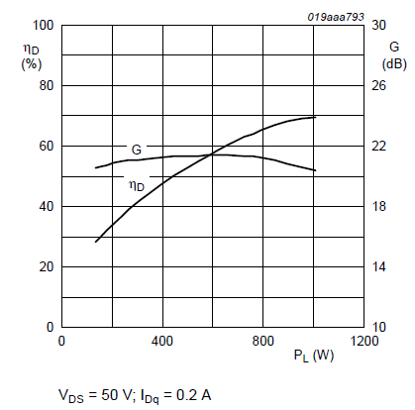
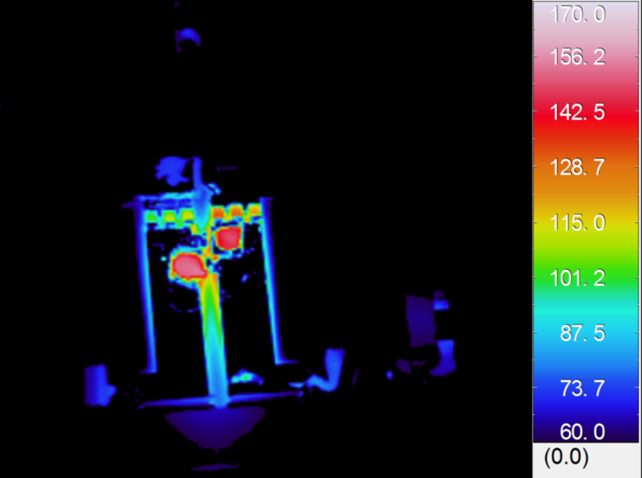
SSA research: collaboration with NXP(now Ampleon) and ESRF
AN10967 is a demo board designed and manufactured by NXP for the BLF578 LDMOS transistor.
push-pull configuration, class AB
delivering 1000 W in CW
  Max efficiency: 70%
  Gain: 20 dB
  Highest temp spot: 145C (15l/min water)

Slide 7
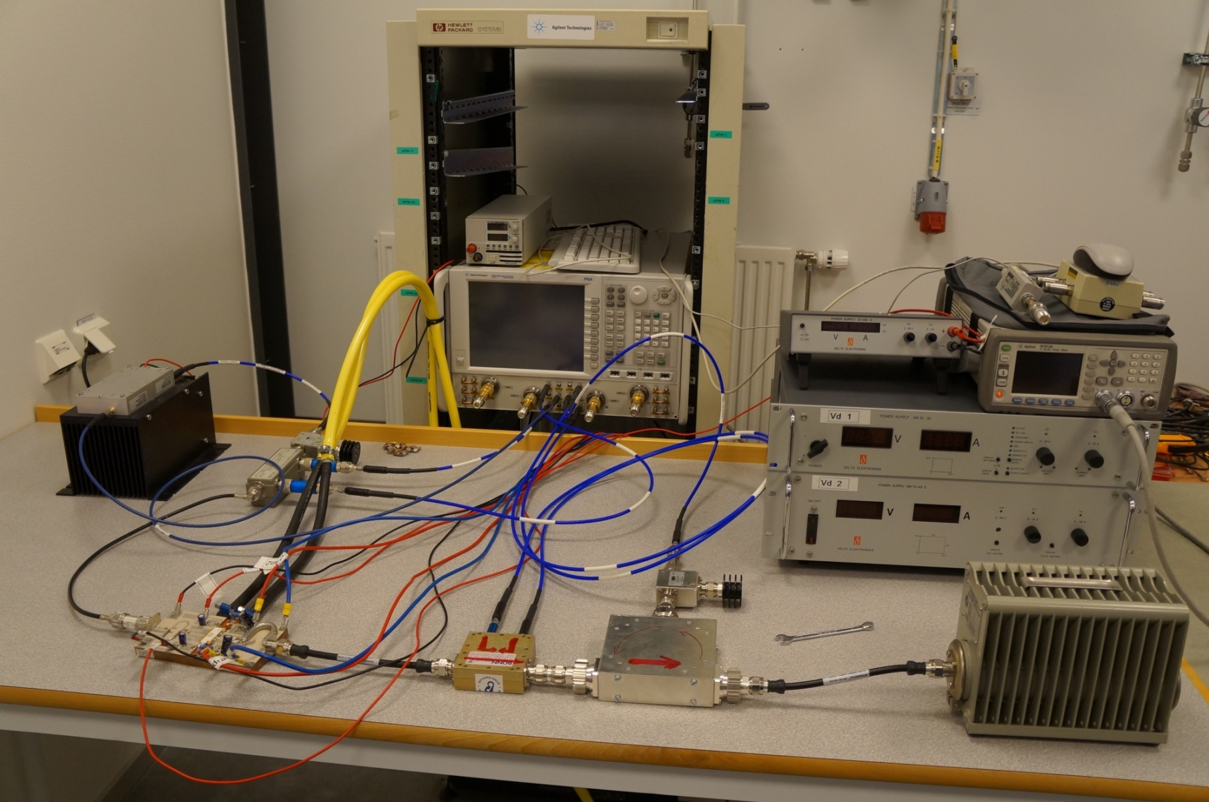
1kW level Hot S-parameters measurements (pulsed)

Slide 8
1kW level Hot S-parameters measurements (pulsed)
S3
S1
R1
A
B
R2
S2
-12 dBm
<-35 dBm
20 dBm
<10 dBm
-10 dBm
-20 dBm
-70 dBm
-40 dBm
att.
10 dB
att.
25 dB
att.
25 dB
att.
30 dB
att.
0 dB
<20 dBm
pre-amp.
50 dB
10 dBm
<-10 dBm
10 dBm
<-40 dBm
<40 dBm
40 dBm
13 dBm
-40 dBm
40 dBm
40 dBm
60 dBm
60 dBm
bidirectional coupler
27 dB
10 dBm
bidirectional coupler
50 dB
60 dBm
circulator
100 W
SSA module
20 dB
dummy load
150 W
reference planes,
calibration planes

Slide 9
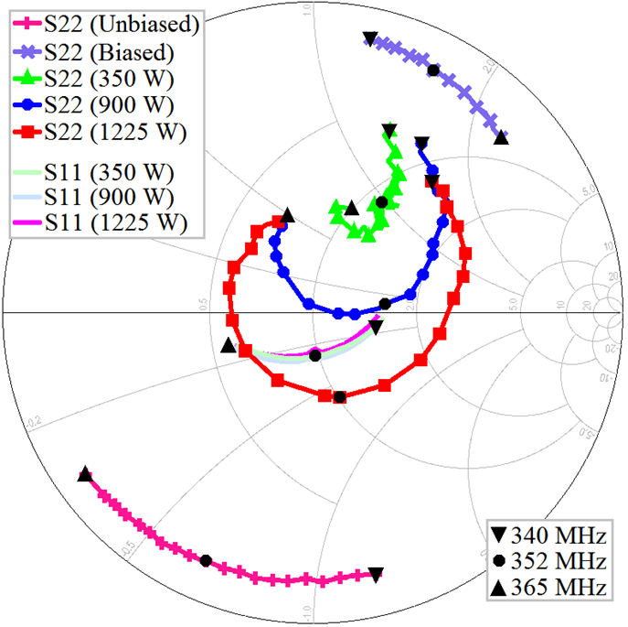
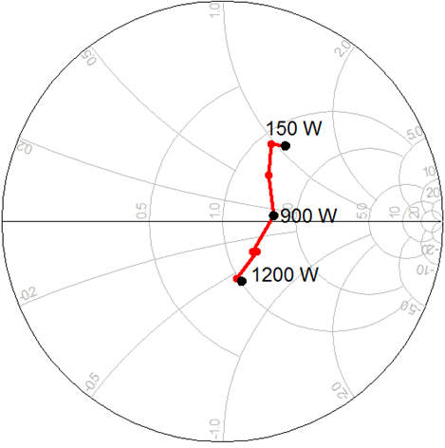
1kW level Hot S-parameters measurements (pulsed)
@ 352 MHZ
Using Hot S-parameters measurements we can characterize the output impedance at different output power levels.
The impedance is changing quite dramatically with the output power and this needs to be taken in to account for power combination.
(BLF578 measurements realized in pulsed mode with ESS parameters)

Slide 10
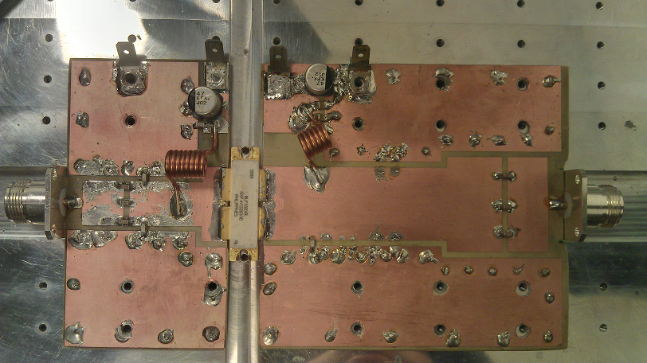
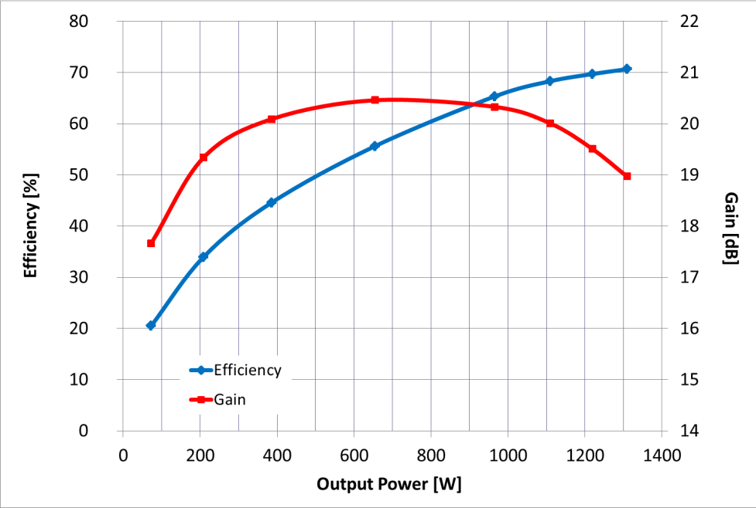
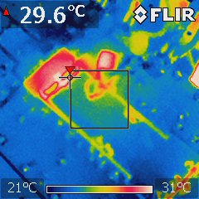
SSA development at UU: single ended RF power amplifier – 1250 W and 70% efficiency
Tested in pulsed mode with ESS characteristics (14 Hz, 3.5 ms) delivering up to 1300 W.
  BLF188XR - excellent ruggedness
  Max efficiency: 71%
  Gain: 19 dB (at 1.5 dB comprsession )
  Highest temp spot: 30 ⁰C (15l/min water)
  Excellent nonlinear behavior: second harmonic at -34dBc - no balun

Slide 11
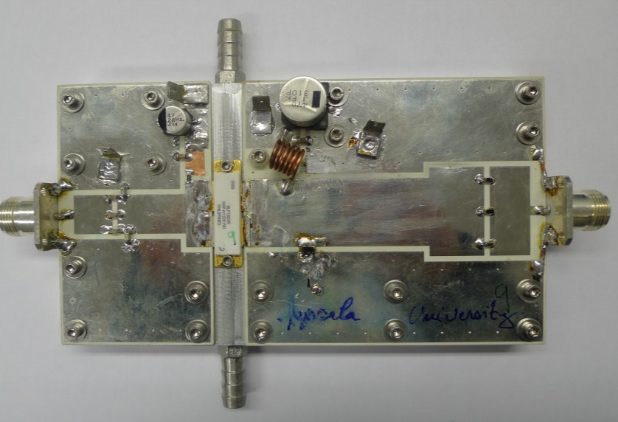
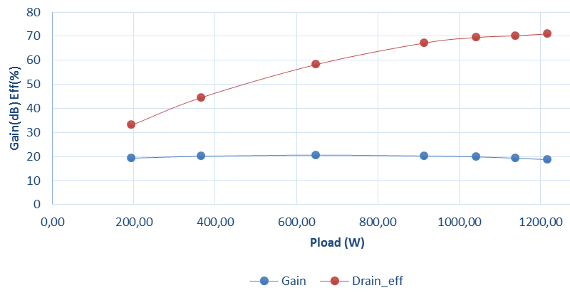
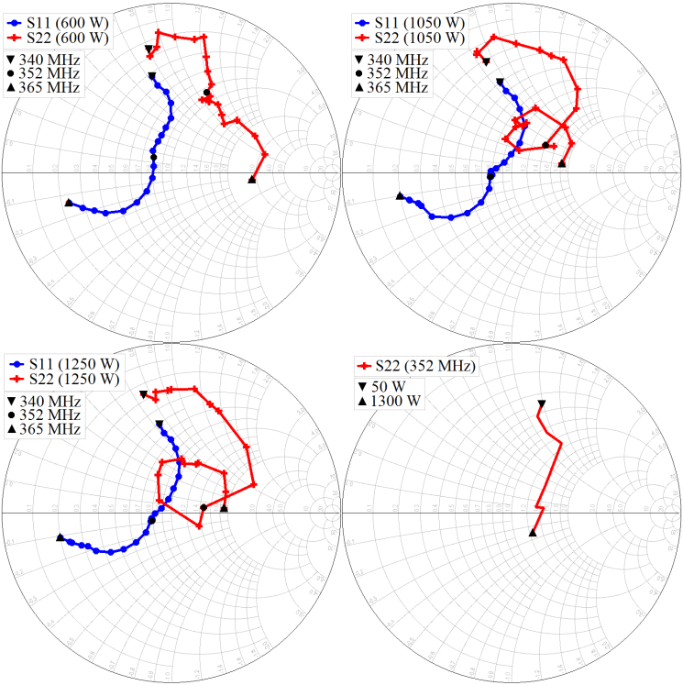
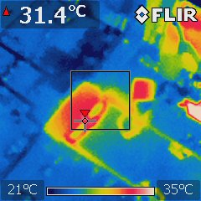
Single ended RF power amplifier – 1250 W and 70% efficiency – 8 amplifiers for 10 kW demonstrator
quiescent drain current, I_{Dq}=0.1 A and drain voltage, V_{DS}=50 V.
temperature rises for only few degrees, to about 30⁰C
Hot S-parameters measured at different output power at 352MHz

Slide 12
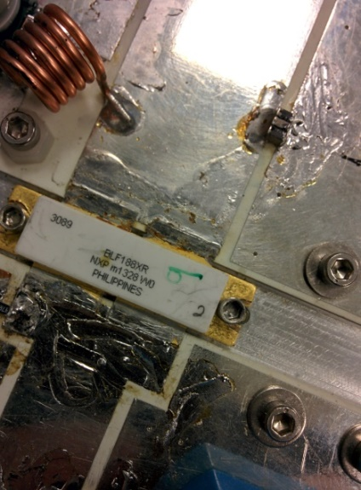
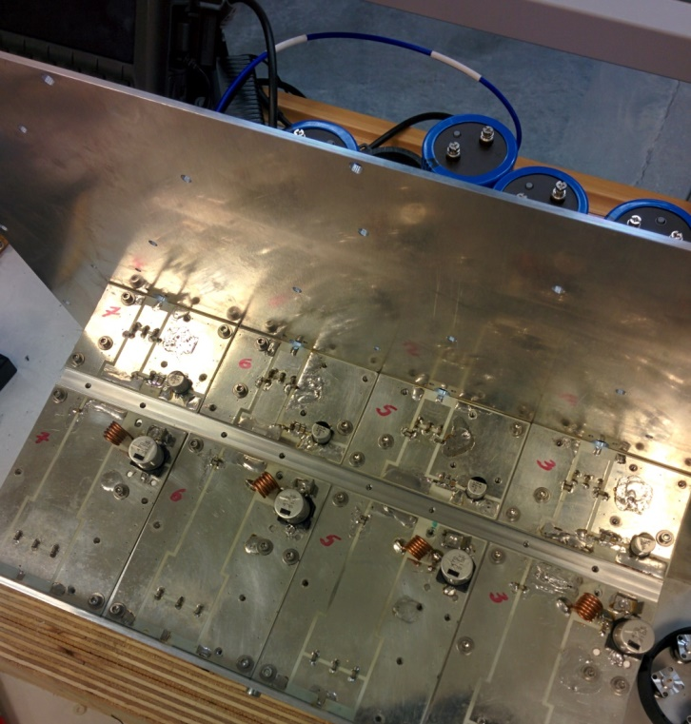
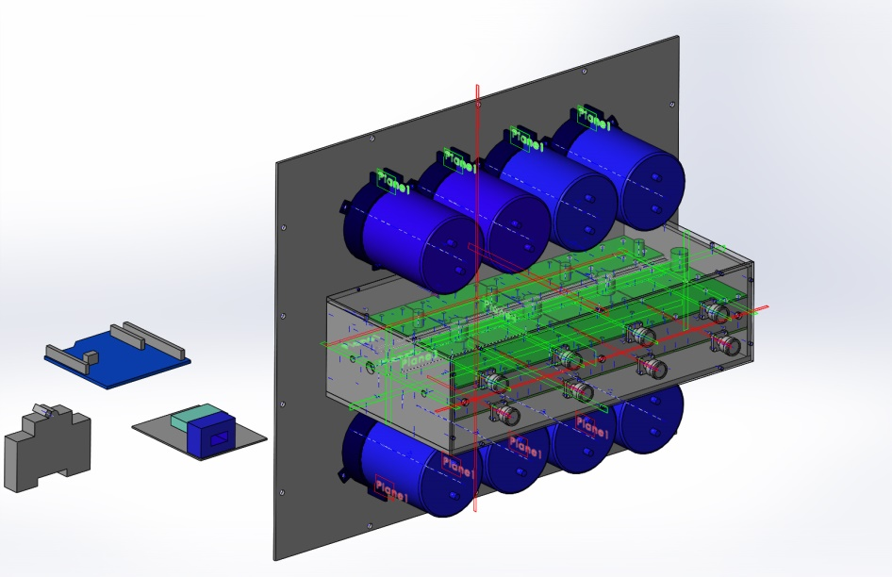
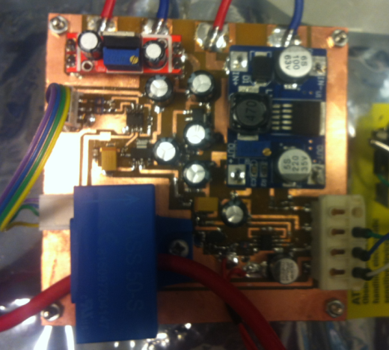
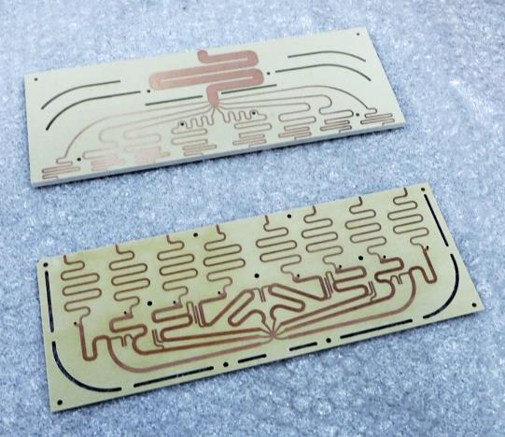
10 kW – SSA demonstrator
capacitor bank
8 x 1.25 kW
Combiners
Planar and WG
Monitoring circuits:
drain voltage
drain current
temperature

Slide 13
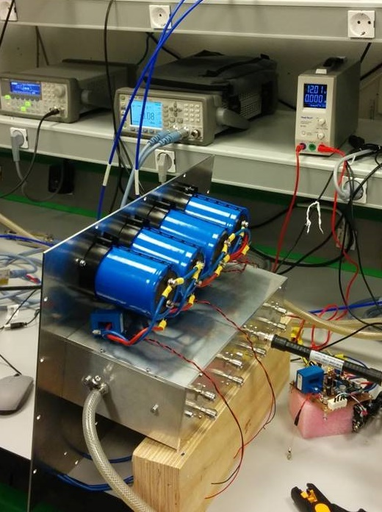
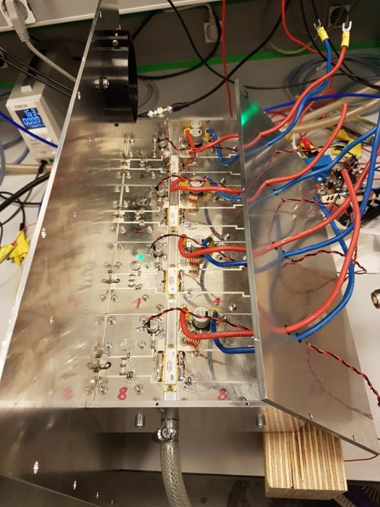
10 kW amplifier under construction

Slide 14
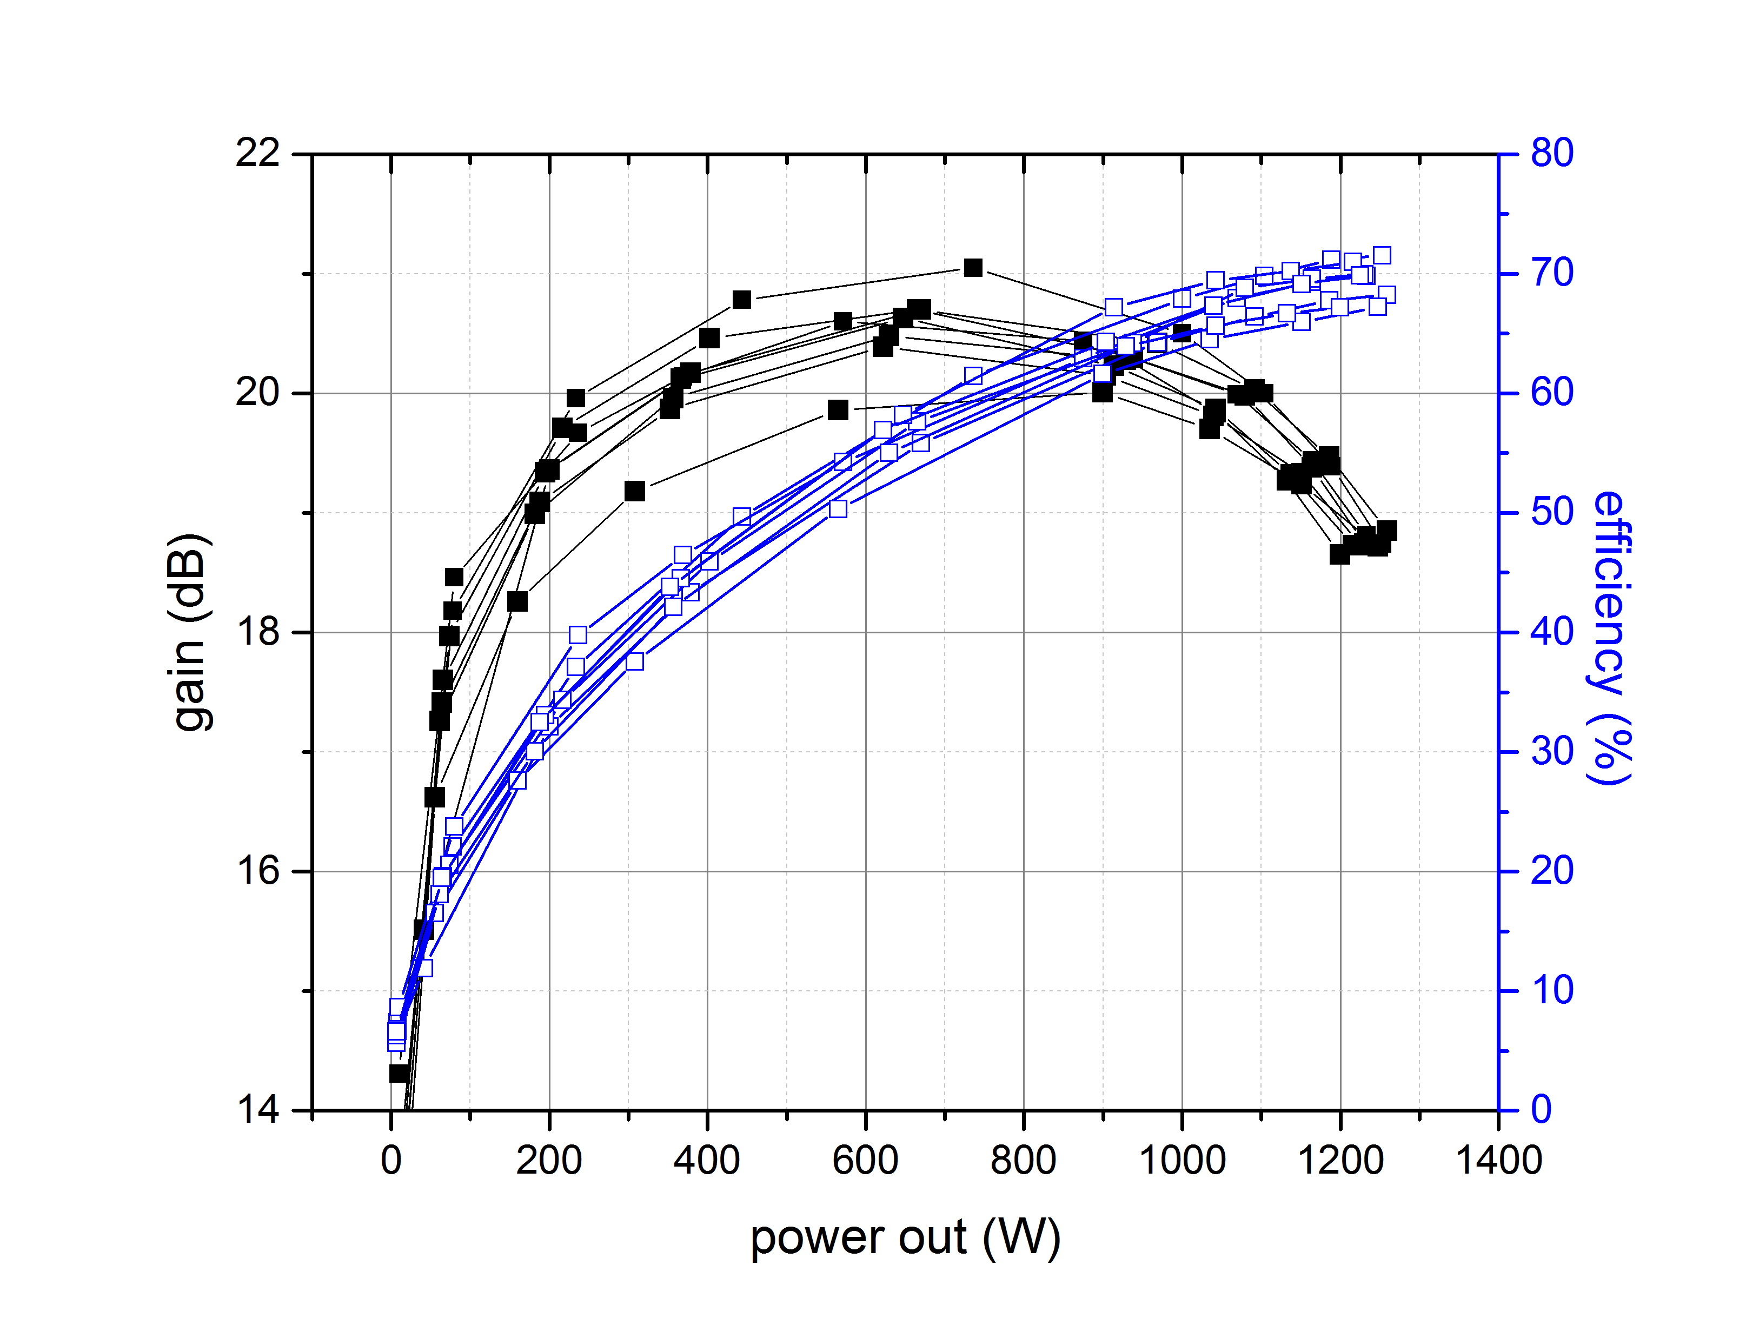
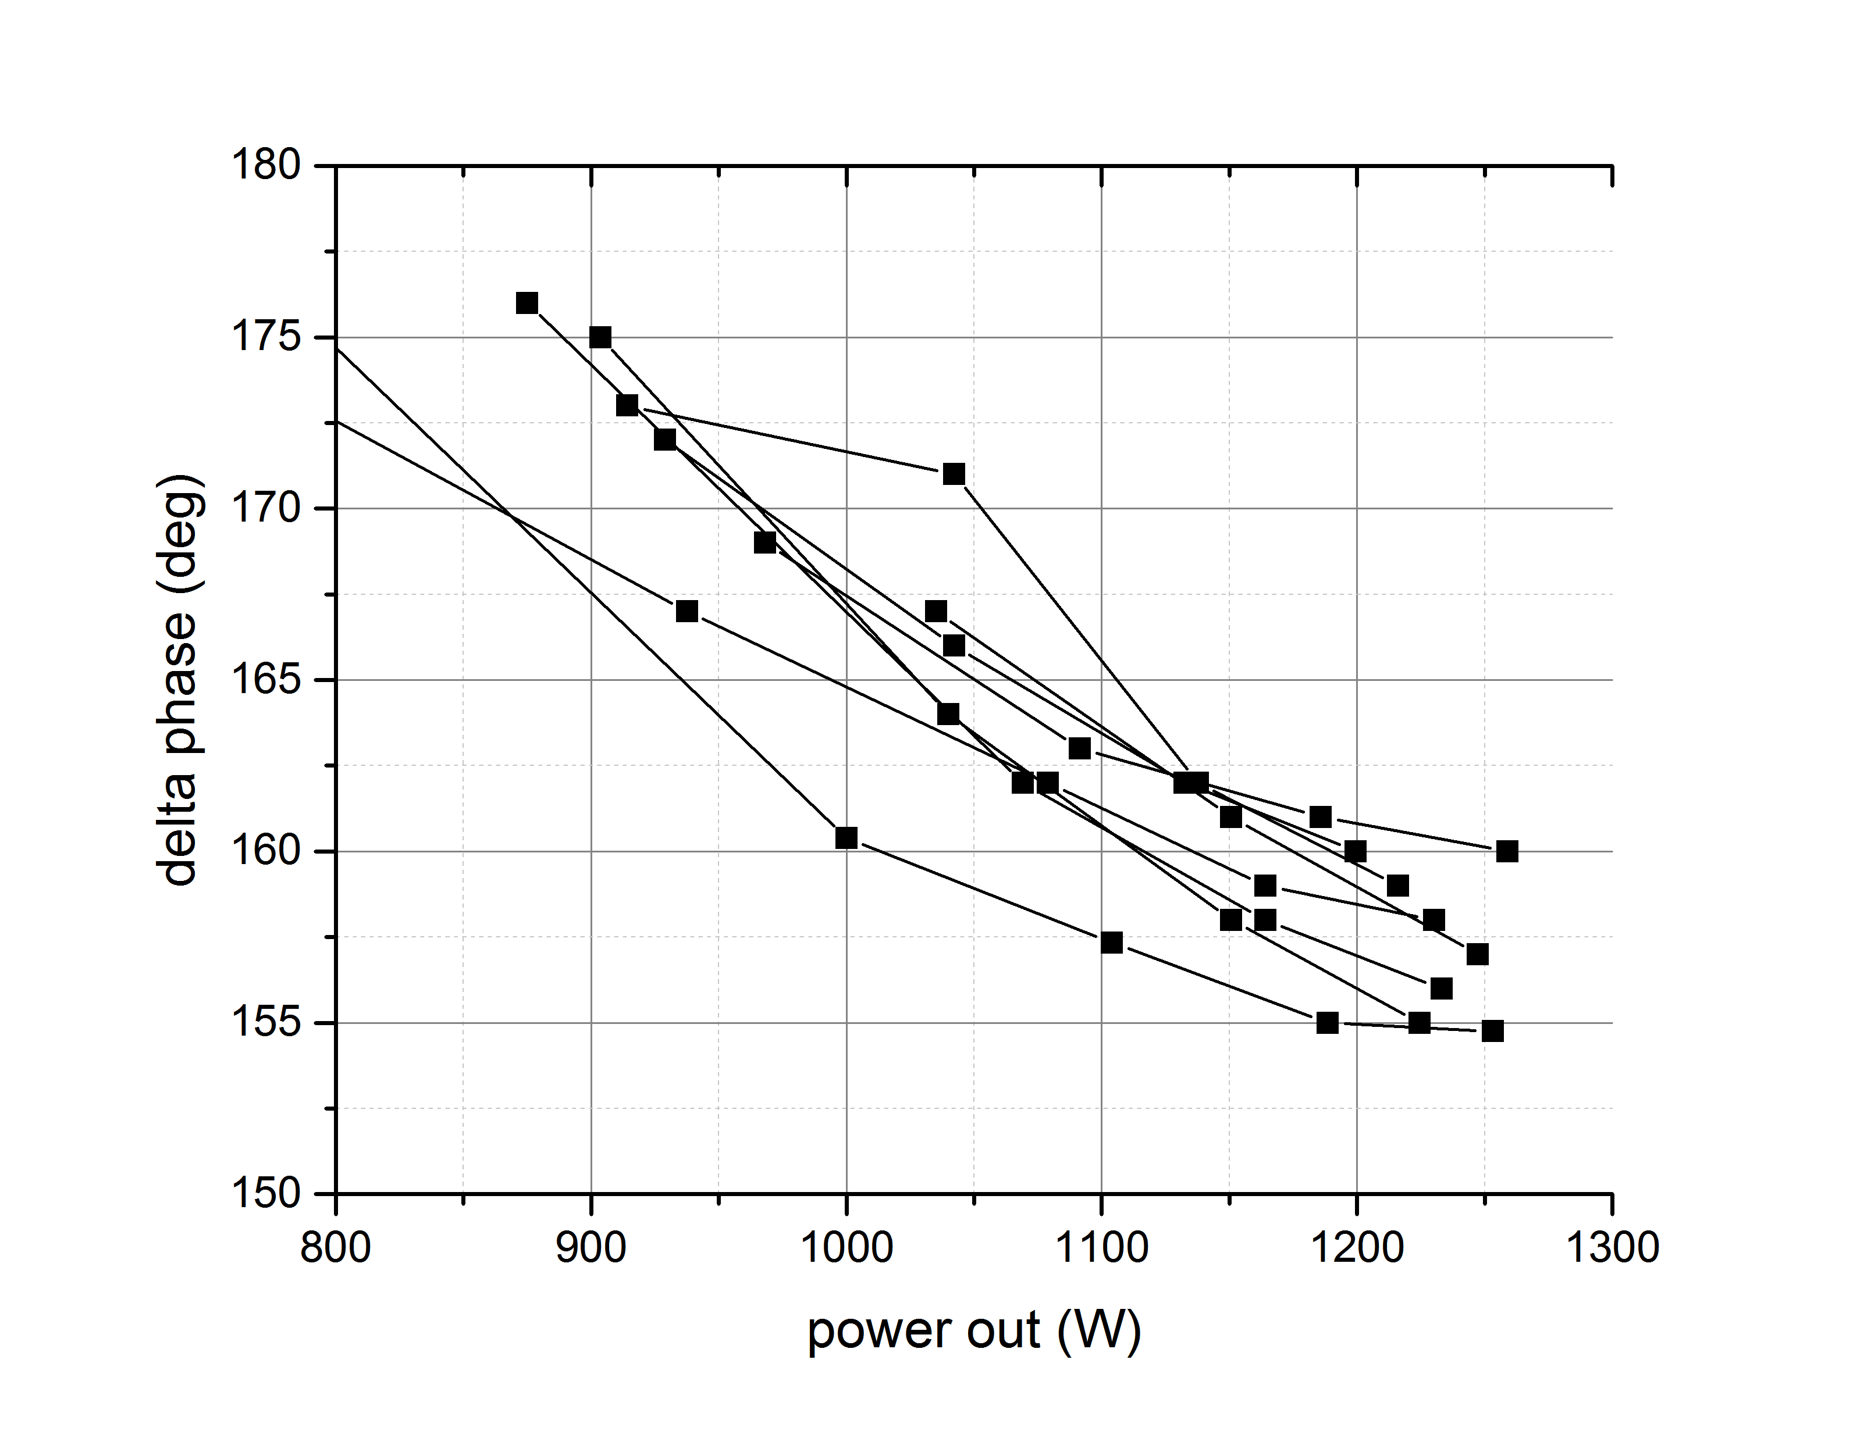
Drain efficiency and phase of the 8 modules of the 10 kW amplifier demo
A small variation in both gain (< 0.5 dB) and phase (< 5⁰) is measured for the 8 modules of the 10 kW demonstrator.
Efficiency is around 70% at 1250 W (pulsed conditions 14 Hz, 3.5 ms)
Phase measurements performed using the hot S-parameters set-up.

Slide 15
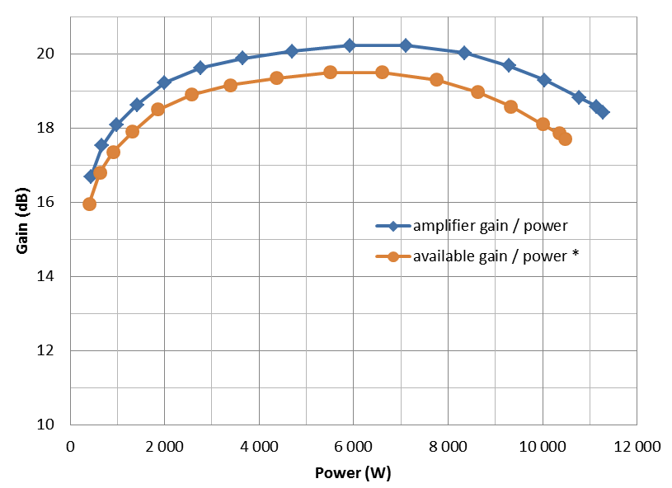
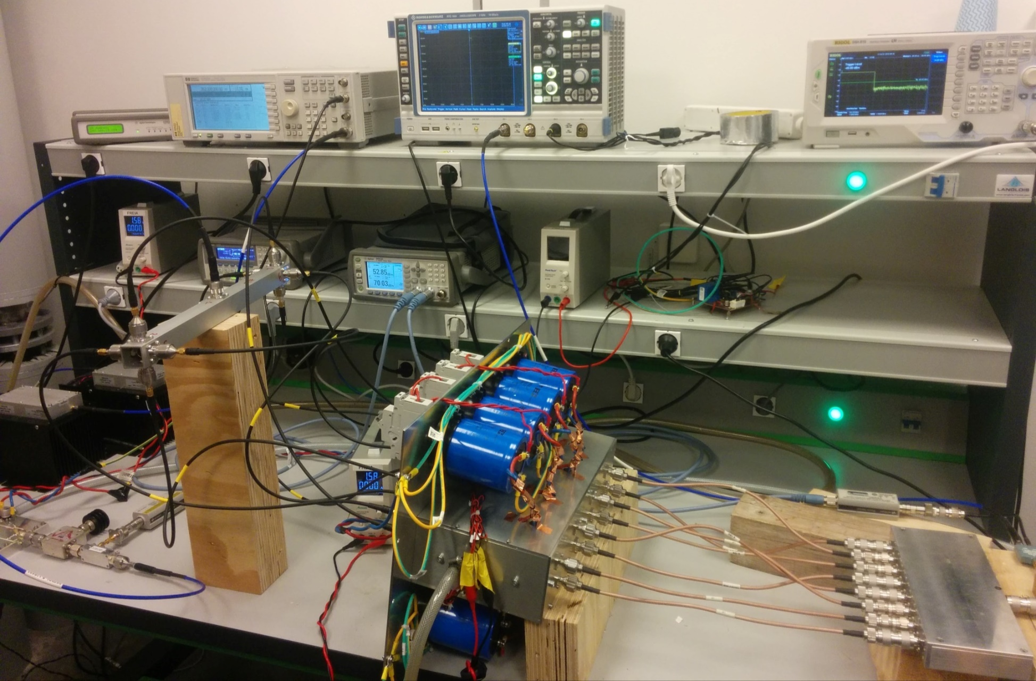
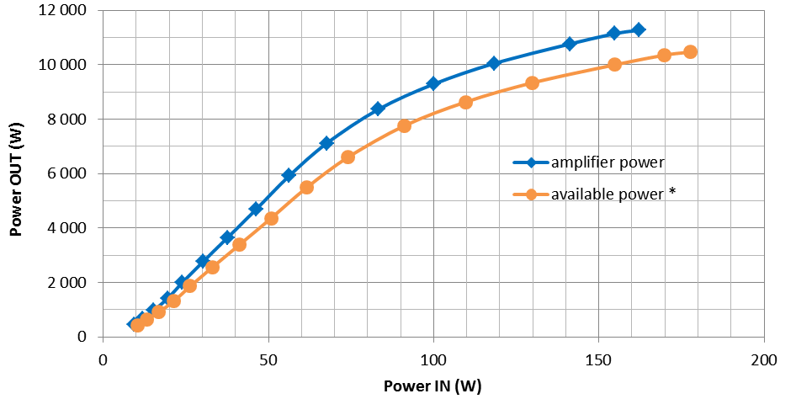
10 kW 352 MHz amplifier
* splitting & combination losses : 0,72 dB
quarter wave type splitter/combiner
pre-amplifier #1
amplifier
8 modules
pre-amplifier #2
1 module
Gysel type splitter/combiner

Slide 16
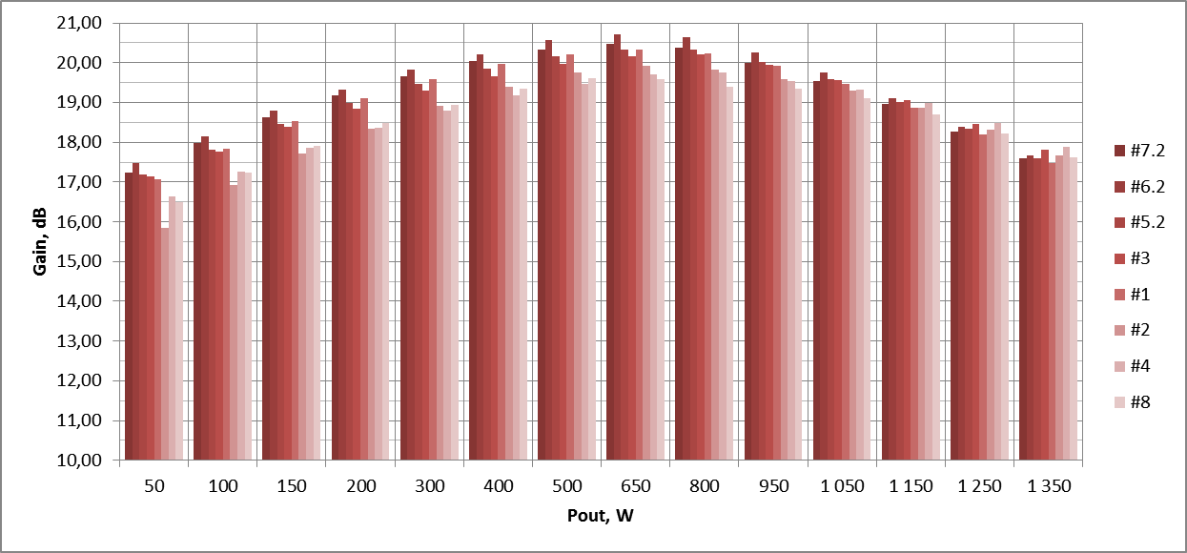
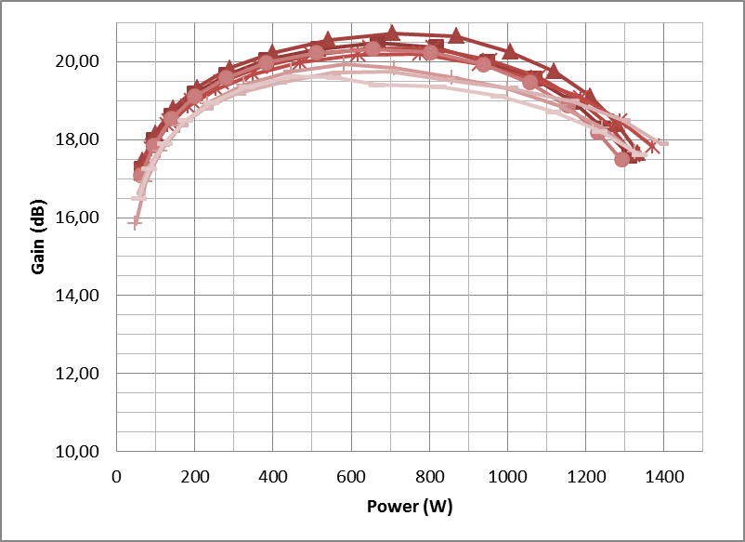
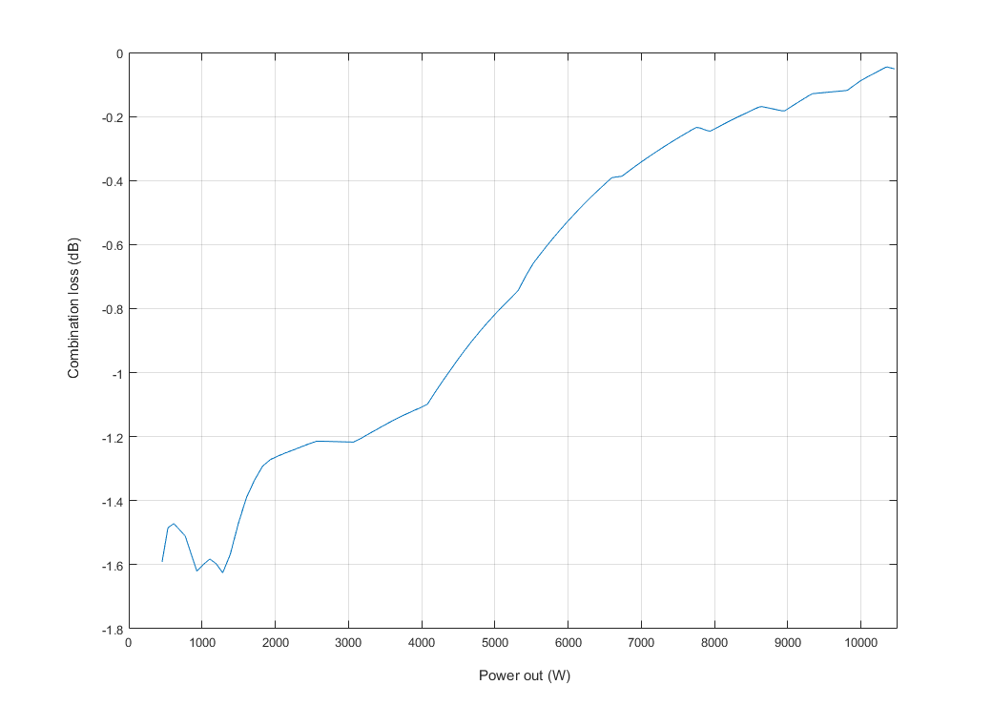
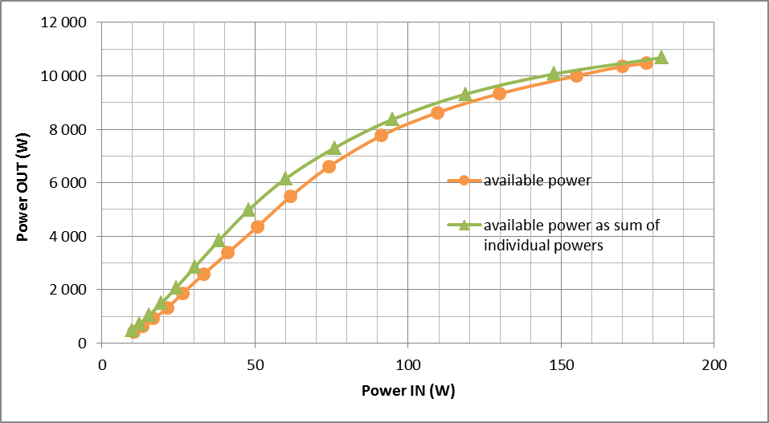
Spread among the 8 amplifiers
Power combination losses are reduced at high power levels due to the good balance among the 8 amplifiers.

Slide 17
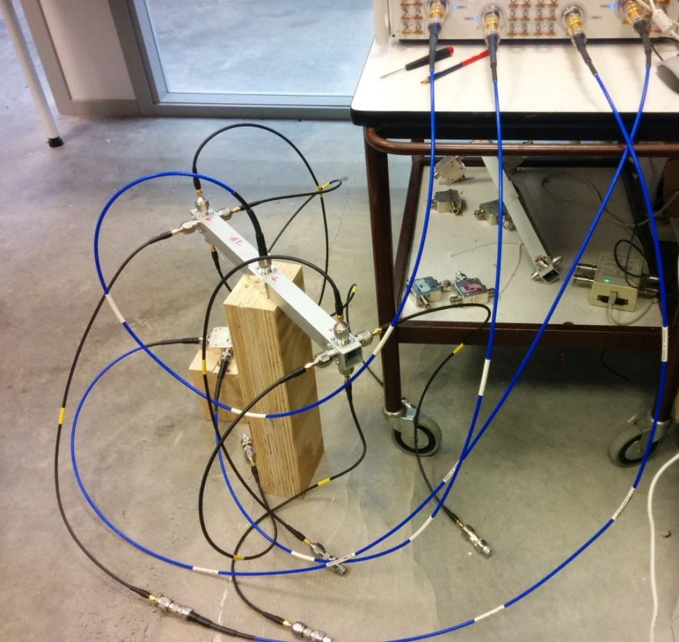
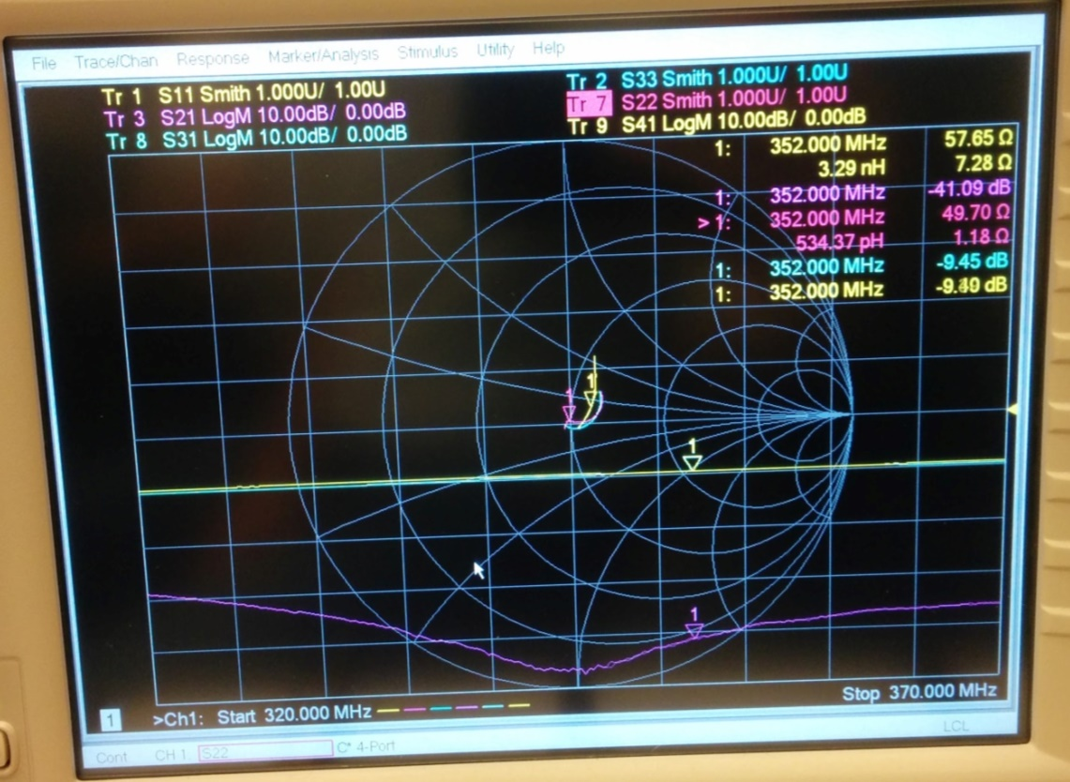
8:1 λ/4 splitter/combiner
1:8 splitter connected to 8 loads.
Circulator is used to measure RL
RL is at -41 dB level
we can deduce the RL of the combiner at -32 dB

Slide 18
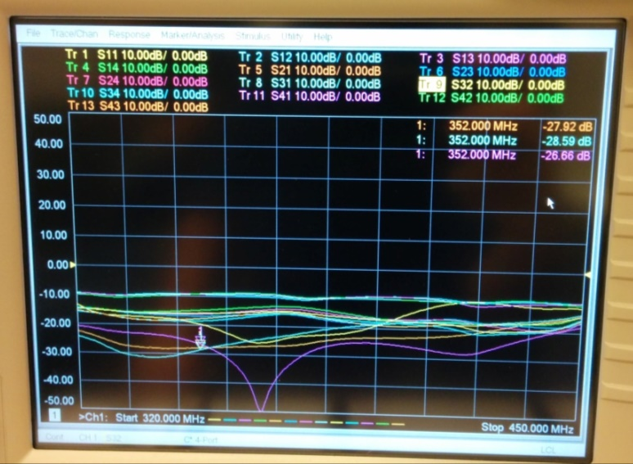
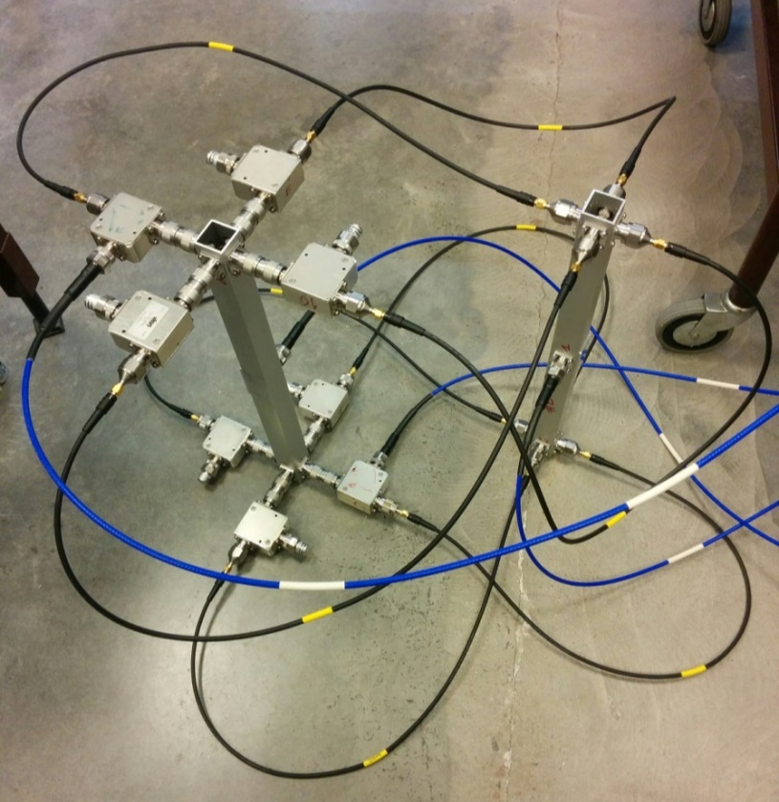
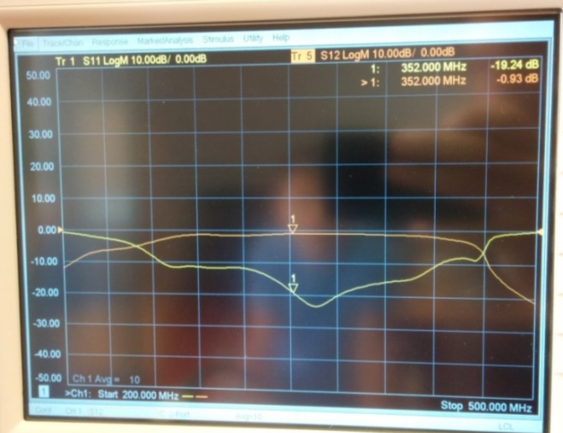
8:1 λ/4 splitter/combiner
RL is at -28 dB level
considering 1:8 splitting/combination
we can deduce the RL of the combiner at -17 dB
higher RL due to slightly phase and amplitude imbalances
Measured IL 0.93 dB
(with cables 0.3 dB and circulator 0.2 dB)
we deduce the
splitter/combiner
IL = 0.2 dB
1:8 splitter connected with circulators
to the 8:1 combiner

Slide 19
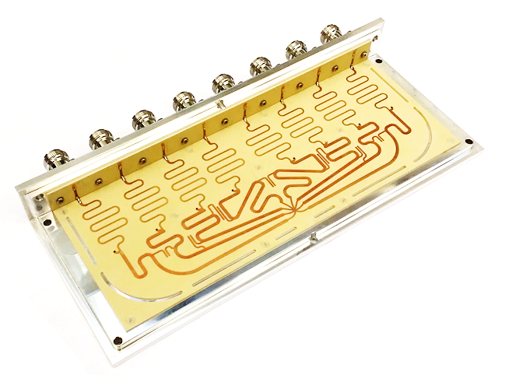

Gysel Combiner
Aluminum Casing
High Integration Factor
Integrated Loads
Easily Reproducible
Average Insertion Loss (IL): 0.2dB
Peak Power (Tested): 10 kW
Measured Performance
 | 1 | 2 | 3 | 4 | 5 | 6 | 7 | 8
Phase [deg] | 121 | 117 | 117 | 120 | 120 | 117 | 117 | 121
Mag [dB] | -9.24 | -9.32 | -9.24 | -9.16 | -9.19 | -9.27 | -9.29 | -9.15
 | 1 | 2 | 3 | 4 | 5 | 6 | 7 | 8
1 | -21* | -24.7 | -23.7 | -24.2 | -24.1 | -23.7 | -23.4 | -22.7
2 |  | -24* | -27.5 | -26.8 | -26.3 | -24.8 | -24.9 | -23.6
3 |  |  | -21* | -26.4 | -27.3 | -25.2 | -24.9 | -23.3
4 |  |  |  | -23* | -30.6 | -27.1 | -26.1 | -24.1
5 |  |  |  |  | -25* | -26.2 | -26.5 | -24.2
6 |  |  |  |  |  | -25* | -27.1 | -23.7
7 |  |  |  |  |  |  | -26* | -24.9
8 |  |  |  |  |  |  |  | -26*

Slide 20





Gysel Combiner
Phase Balancing
line coupling compensates parasitic coupling
$$U_{out}e^{−j(ωt+θ)}=U_{0}e^{−jωt}+U_{1}e^{−j(ωt+γ)}$$
$$efficiency=1−\left(α−α^{2}\right)∗\sin^{2}(\frac{γ}{2})$$
$$phase=−atan(\frac{sin(γ)}{\left(1/α−1\right)+cos(γ)})$$

Slide 21



FREIA development: 100 kW non-resonant power combiner with door-knob couplers
can handle
1 MW pulsed
D = 50 cm
7/16 inch input connector
3-1/8 inch
output connector
h = 3 cm
at 352.2 MHz
IL is 0.3 dB
i.e. 6% losses
at 352.2 MHz
RL is 24 dB
i.e. 0.5% reflection
V.A. Goryashko, D. Dancila, A. Rydberg, R. Yogi & R. Ruber (2014): A megawatt
class compact power combiner for solid-state amplifiers, Journal of Electromagnetic Waves and Applications, DOI: 10.1080/09205071.2014.962187
Notes:
Measured parameters agree very well with the design values.
The combiner is broadband.

Slide 22

Collaboration
LLRF and control system
Power splitting +
Power combiner
RF modules
(new transistors
new packaging
intelligent modules)
Connectors
RF + DC + water
(Capacitor tank)
ACDC convertors +
power supply
Business perspective:
commercialisation
distribution
Water cooling system
(thermal aspects)

Slide 23



Strategy for power combining – v1
10 kW tile
8 SSA modules
Gysel combiner
& splitter 8:1
400 kW station
with major components developed at FREIA
300 W pre-amplifier
1 SSA module
1 SSA 25 W amplifier
Standard WR 2300 for high power combining; broadband design, ultra high power handling capability;
high isolation to avoid the need for circulators at each input port
4 x 12
120 kW
480 kW
1.2 meter

Slide 24


Strategy for power combining – v2
480 kW
Coaxial combiner 12:1
400 kW station
with major components developed at FREIA
0,6 meter
40 kW
Quarter wave combiner 4:1
(see Legnaro 4-ways)
12 x
10 kW tile
8 SSA modules
Gysel combiner
& splitter 8:1
12 x 4
300 W pre-amplifier
1 SSA module
1 SSA 25 W amplifier

Slide 25
Strategy for power combining – v3
400 kW
Coaxial combiner 40:1
400 kW station
with major components developed at FREIA
0,6 meter
40 x
10 kW tile
8 SSA modules
Gysel combiner
& splitter 8:1
300 W pre-amplifier
1 SSA module
1 SSA 25 W amplifier

Slide 26

Conclusions
A single ended high RF power Solid-State Amplifier was successfully designed and manufactured producing 1.25 kW with an efficiency of 70% at 352 MHz, in ESS operational mode (14 Hz, 3.5 ms). This is a simple and robust design minimizing manufacturing cost towards mass fabrication and industrialization. Joint UU - Ampleon application note.
Measurement methods have been developed and implemented allowing hot S-parameters measurements.
A small variation in both gain (< 0.5 dB) and phase (< 5⁰) is measured for the 8 modules of the 10 kW demonstrator under construction at FREIA.
A 10 kW demonstrator, using 8 modules is finalized at FREIA. Monitoring circuits and power combiners are under development.
Strategy for the near future: highly efficient class E amplifiers at 100 MHz for GE’s cyclotron nucleotides production – Eurostars application; possibly 400 MHz (for CERN crab cavity tests); development and amplifier design of Latch-Free LIGBT/IGBT high power transistors at UU – Comheat AB (compared with LDMOS, saturation current is presently 15-30 times higher).
Joint UU - Ampleon application note on BLF188XR’s site

