Slide 1
Weather Station
PHYSICS PROJECT WITH A RESEACH BASIS 5c
Frida Bäfverfeldt
Supervisor: Volker Ziemann

Slide 2
Introduction
Why does FREIA need a weather station?
- Weather effects measurements
(pressure vessels etc)
Why am I the one building this device?
- Physics project with a research basis 5c
What will I talk about today?
- Hardware and software. Sensors -> Device -> Control system

Slide 3
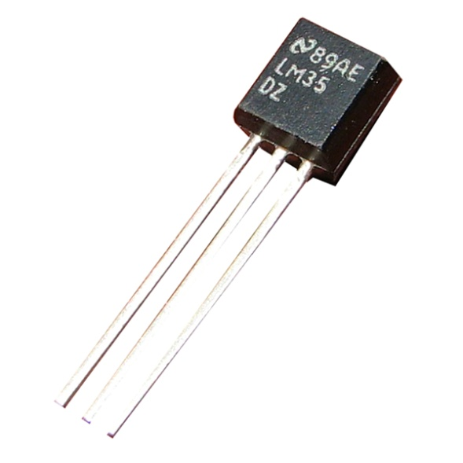
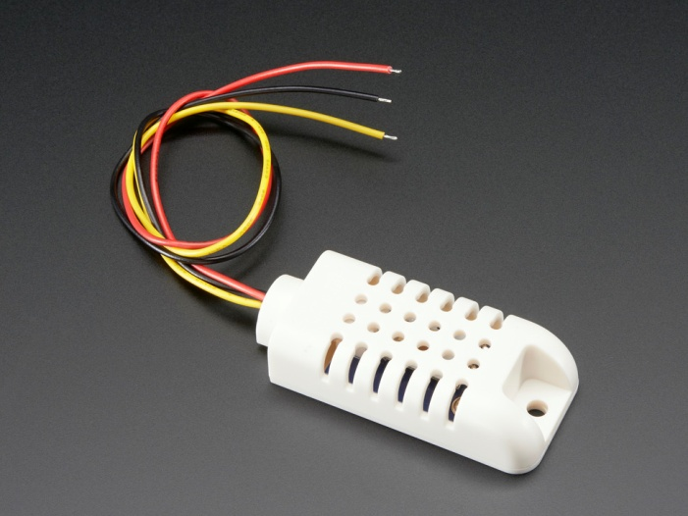
Sensors
LM35 – Temperature (Analog signal)
DHT22 – Relative Humidity & Temperature (Proprietor Digital protocol)
BMP280 – Pressure & Temperature (I2C Standard)

Slide 4
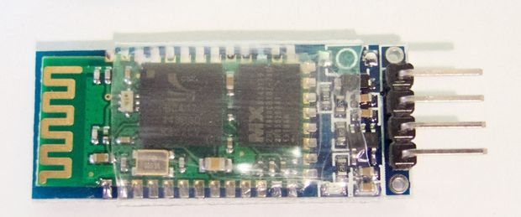
Processor and Communication
Communication within the device
- I2C, analog, etc
Arduino!
Communication to/from device
- Serial (RS-232)
USB cable
HC-06 bluetooth module

Slide 5
Circuit diagram

Slide 6
The finished weather station
HC 06
”Arduino”
BMP280
DHT22
LM35

Slide 7
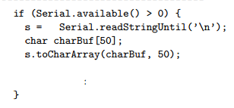
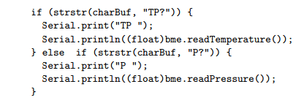
Software - Arduino
Arduino language: based on C/C++
An executable program only needs two functions to run. setup() and loop().

Slide 8
Communication
EPICS

Slide 9
Results MATLAB

Slide 10
Results EPICS

Slide 11
THANK YOU FOR YOUR ATTENTION
Questions?
Full report available at: http://www.diva-portal.org/smash/get/diva2:974843/FULLTEXT01.pdf

