Slide 1
Uppsala University Contract UH2015/09 - UA2016/05 Job nr. 5973
Vertical Cryostat GERSEMI
2nd follow-up meeting
25/10/2016

Slide 2
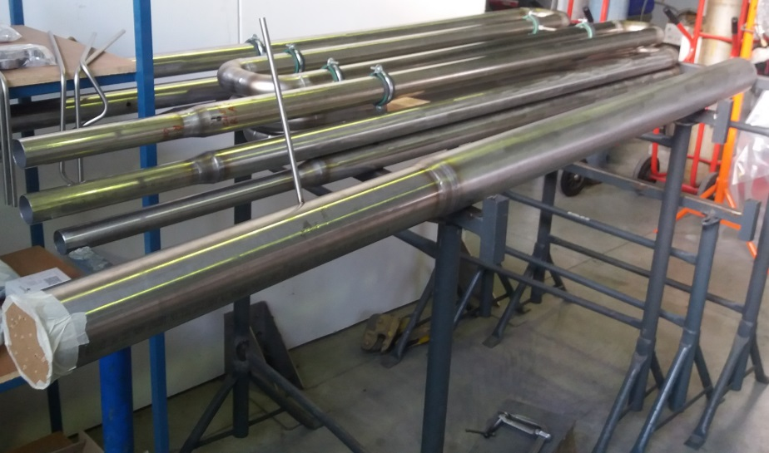
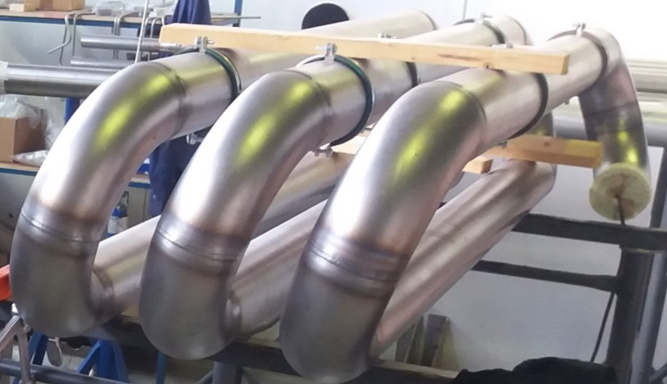
JOB STATUS
WP1: double re-heater
Planned status:
To termination 80%
Initially planned task: manufacturing 50%
Actual status:
To termination 65%
Actual task: manufacturing 25%
On critical path: external vessel delivery on W47
Delivery target W50

Slide 3
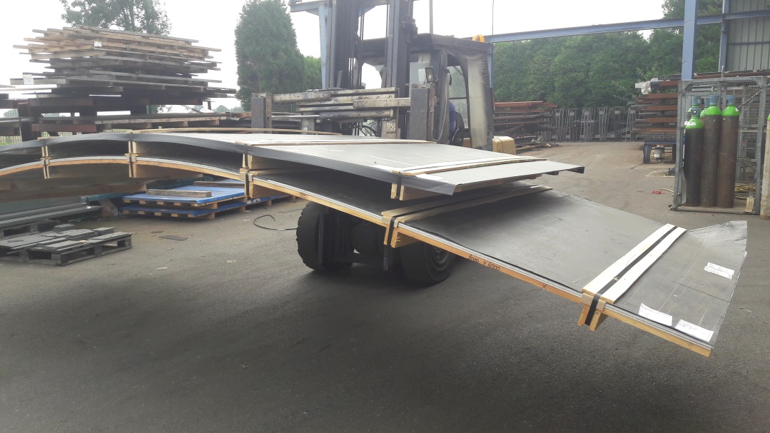
JOB STATUS
WP2: cryostat
Planned status:
To termination: 44%
Initially planned task: Vacuum vessel procurement 80%
Actual status:
To termination: 36%
Actual tasks:
Vacuum vessel procurement 75%
Manufacturing drawings 50%
On critical path: Vacuum vessel procurement
Manufacturing start date: W1/2017
Manufacturing end date: W20/2017

Slide 4
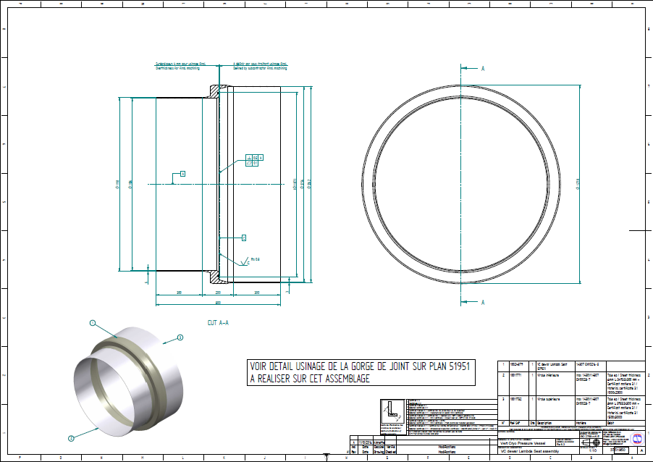
JOB STATUS
WP2: cryostat
Vacuum vessel: ready to be manufactured at SOMINEX
Lambda Plate: will be machined and finished at EFINOR
Dewar: Manufacturing dimension submitted by CD to ACS for validation

Slide 5
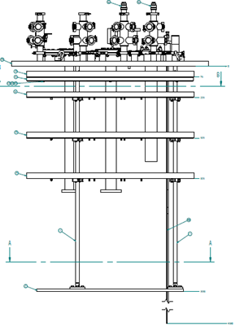
JOB STATUS
WP3: magnet insert
Planned status:
To termination: 33%
Initially planned task: manufacturing procedures: 100%
Actual status:
Design to be given by CERN
Deadline for design: S49/2016
WP4: bath insert
Planned status:
Finished
Actual status:
Manufacturing design completed
Manufacturing end date: W03/2017

Slide 6
JOB STATUS
WP3: magnet insert
Inputs to be given by CERN (required power)
WP4: bath insert
Burndy connector implemented
Level sensor in two parts
Insulation in Klegecell
Safety valve design

Slide 7
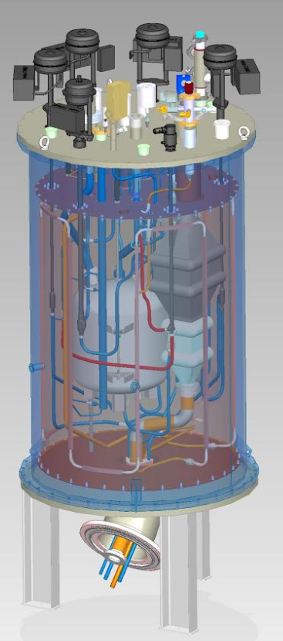
JOB STATUS
WP5: valves box
Planned status:
To termination: 80%
Initially planned task:
Procurement 80%
Manufacturing 10%
Actual status:
To termination: 45%
Actual tasks:
Manufacturing drawings 50%
Procurement 80%
On critical path: Manufacturing drawings
Manufacturing start date: W1/2017
Manufacturing end date: W8/2017

Slide 8
JOB STATUS
WP5: valves box
Control valves by WEKA: ready to be delivered
Stop valves by VELAN (extra KV): in manufacturing
Stop valves by SELFA (low KV): in manufacturing
Heat exchanger by DATE: in manufacturing
Vacuum vessel by SOMINEX: manufacturing drawings in review by ACS

Slide 9
JOB STATUS
WP6: transfer lines
Planned status: manufacturing design 0%
Actual status: manufacturing design 0%
Start date: W49/2016

Slide 10
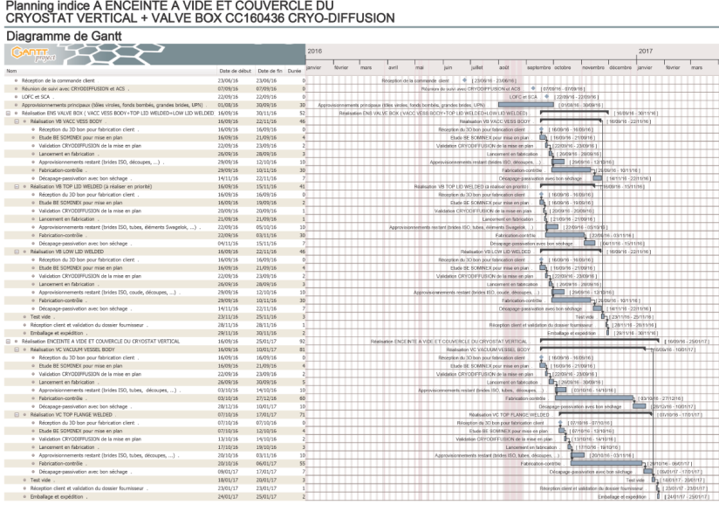
JOB STATUS
Subcontracting
Control system:
Start date November 2016
Vacuum containment:
Delivery date @ Cryodiffusion December 2016
Cabling (internal + feedthrough)
January 2017 (CD needs Cernox sensor calibrated)
HNOSS after-sales
ICB:
Leak detected on LN2 circuit, only during cooldown
Supposed on Al/SS transition on lower thermal screen
Transfer line received:
No leak detected
1x DN40KF port added
Control system:
MKS controller and valve tested by ISII-Tech
VAT solution found
Problem on MKS valve detected by ISII-Tech and investigated by CD: closed limit swith failed.

Slide 11
JOB STATUS
Procurement:
Cryogenic valves to be delivered December 2016
Cryogenic HX to be delivered December 2016
Cernox sensors (?)
Other material defined and reviewed by ACS on W40/2016: final list to be released

Slide 12
JOB STATUS
Procurement:
Other material:
Butterfly control valves: VAT
Vacuum valves: VAT
Pressure sensors: BROOKS
Vacuum sensors: Pfeiffer (model to be confirmed)
Temperature sensors: Cernox
Flowmeters: BROOKS
Film heaters: Winkler (test to be done by ACS)
Gas heaters: Vulcanic with helical finned copper tube
Level sensors: AMI
Cryogenic valves
WEKA: Control Valves
VELAN: High KV stop valves
SELFA: Low Kv stop valves

