Slide 1
Gersemi Cryostat
Mechanical analysis
2nd Follow-up meeting – 25th October 2016
ACS – P. Duthil

Slide 2
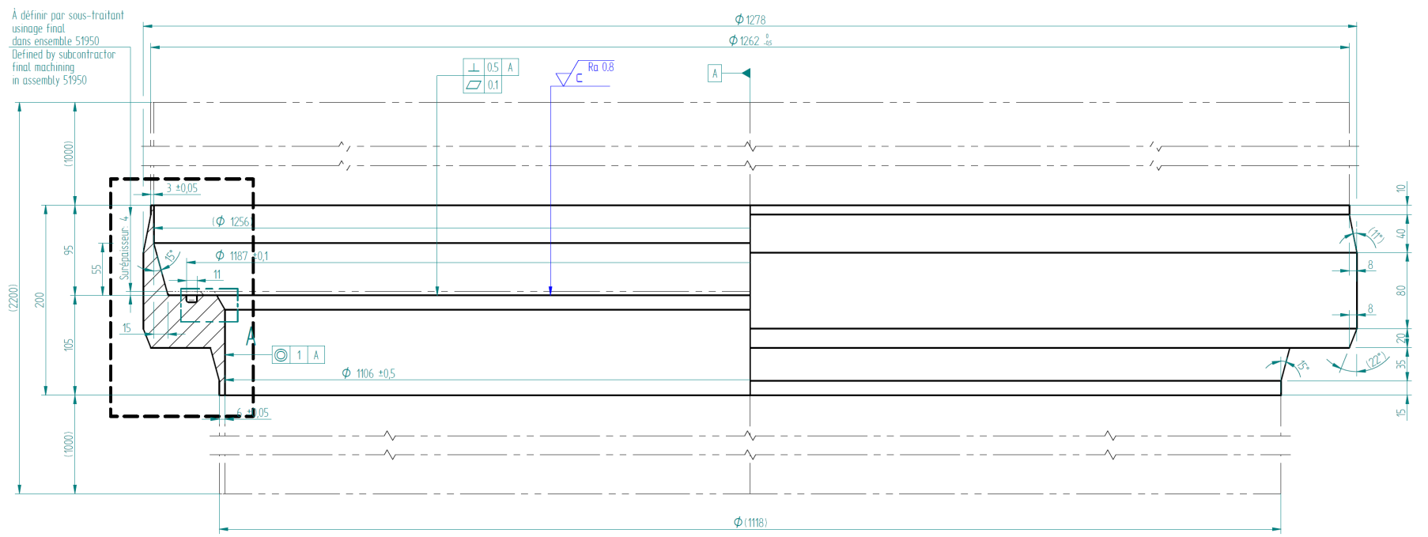
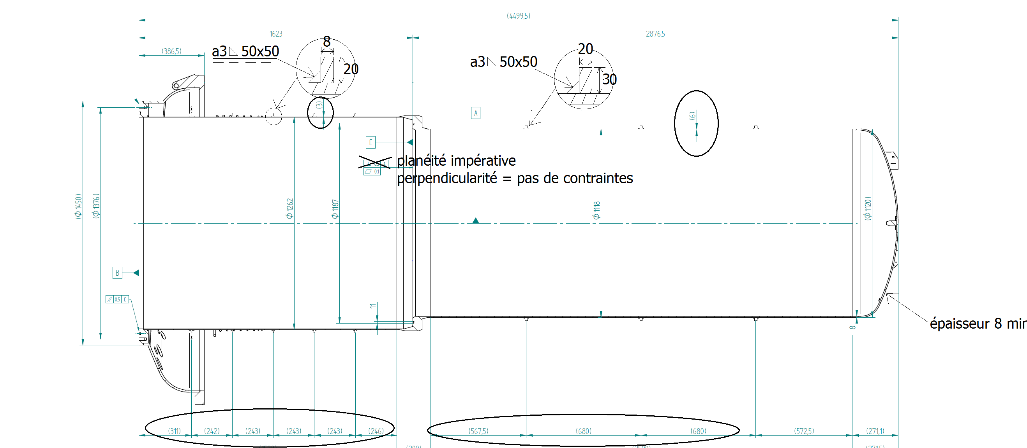
Vertical cryostat Geometry 1/2
CAD geometry
8
60
4
40
Ports

Slide 3
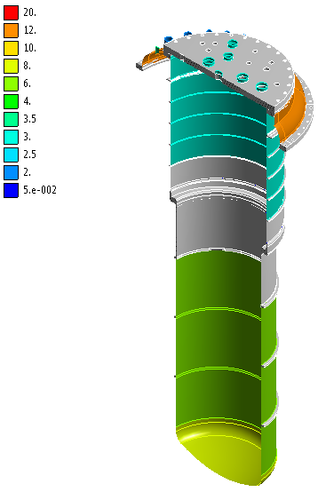
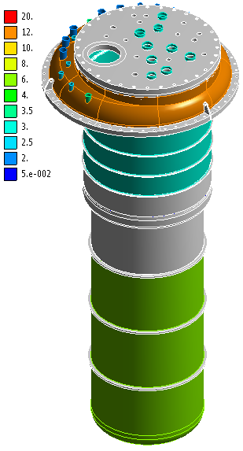
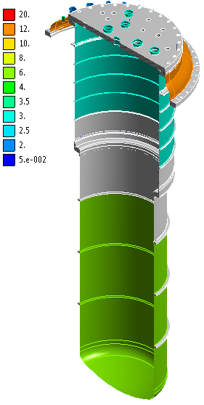
Geometry 2/2
FEM geometry
Mesh elements
Coloured: shells elements (coloured by thicknesses expressed in mm)
Grey: solid elements
Two thickness considered for the bottom dish end:
6 mm: min. measured thickness;
8 mm: nominal thickness

Slide 4
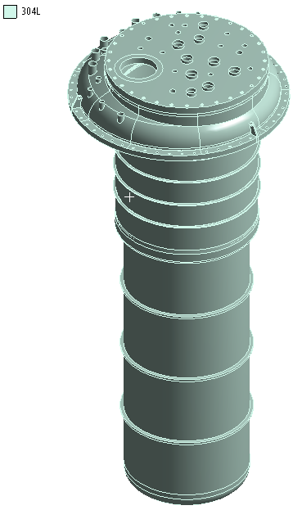
Material 1/3
Model
AISI 304L (1.4306 / X2CrNi19-11)
E = 190 000 Mpa
= 0.305
ρ = 7 900 kg/m³

Slide 5
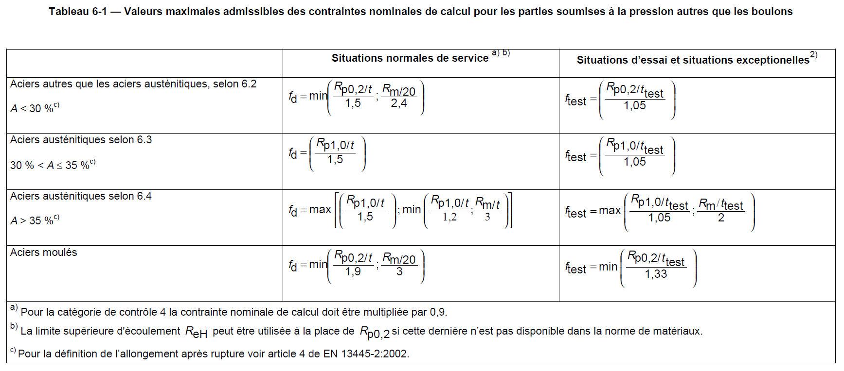
Material 2/3
Pressure Equipment Directive 2014/68/EU
EN 10028-7
Proof strength: R_{p1,0} = 240 Mpa @ room T° (= pressure test T°)
Tensile strength: R_{m} ≥ 500 Mpa @ room T° (= pressure test T°)
Elongation after fracture: A ≥ 45 %
EN 13445-3 (p35)
⇒ f_{d 304L} = 166 MPa
⇒ f_{test 304L} ≥ 250 MPa

Slide 6
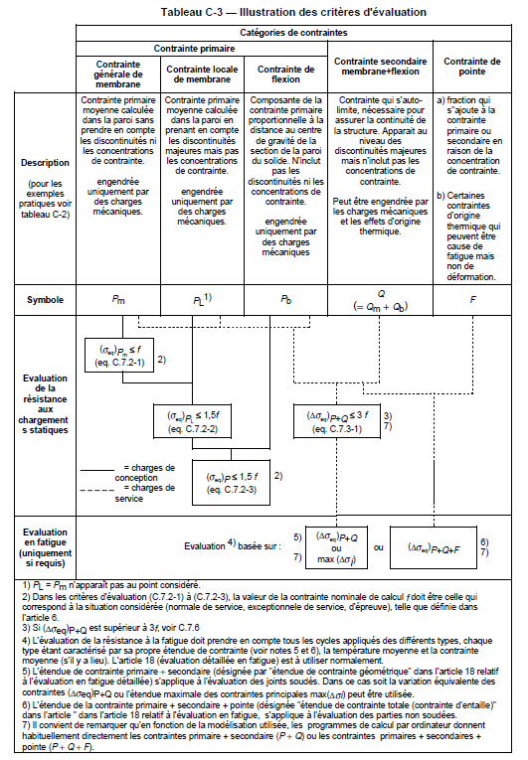
Material 1/3
Pressure Equipment Directive 2014/68/EU
EN13445-3
p565
⇒ for normal pressure operation (i.e. for MAWP = Ps):
for the membrane stresses
(=neutral fibre of the shell elements):
- for areas away from the shape discontinuities:
f = f_{d} (cf. §2.2 for f_{d}) ➔ s_{max} membrane < 166 MPa
- for areas near shape discontinuities:
f = f_{d} x 1.5 ➔ s_{max} membrane < 249 MPa
for the bending stresses: f = f_{d} x 1.5
➔ s_{max} bending < 249 MPa

Slide 7
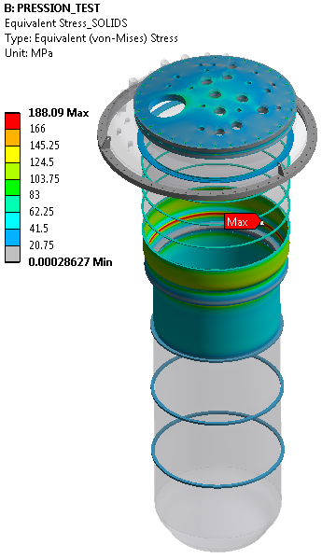
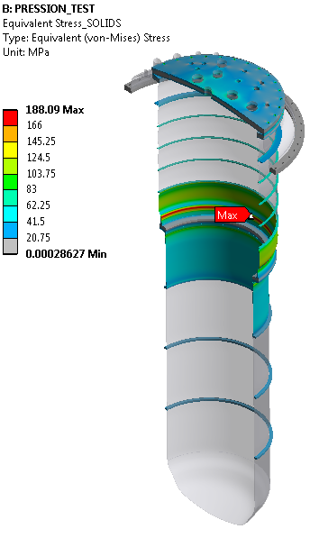
Internal pressure
Pressure test of the dewar
EN13458:
Ptest = 1.43 x (Ps + 0.1) = 1.43 x (0.4 + 0.1) = 0,715 Mpa with Ps = MAWP
For the pressure test: no vacuum inside the vacuum vessel but atmospheric pressure around the dewar ⇒ pressure of 0.615 Mpa applied on the inner surfaces of the dewar
Calculated stresses in solid elements:

Slide 8
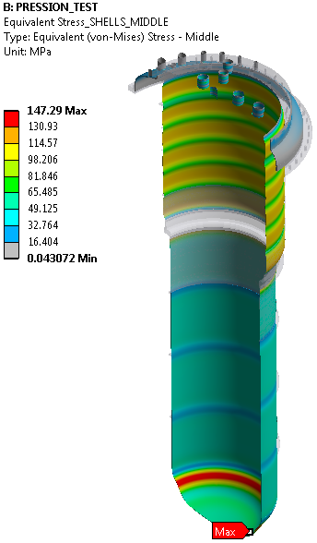
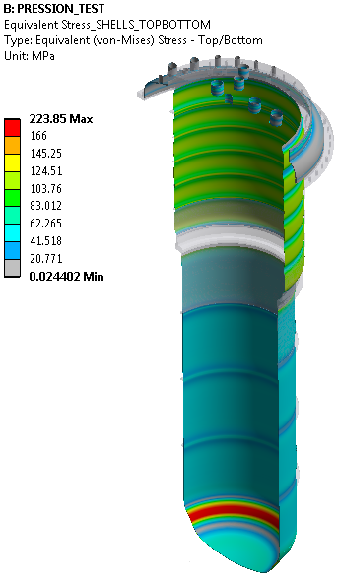
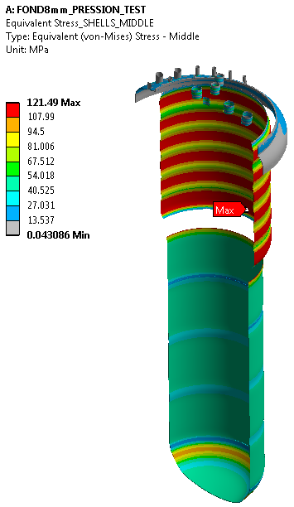
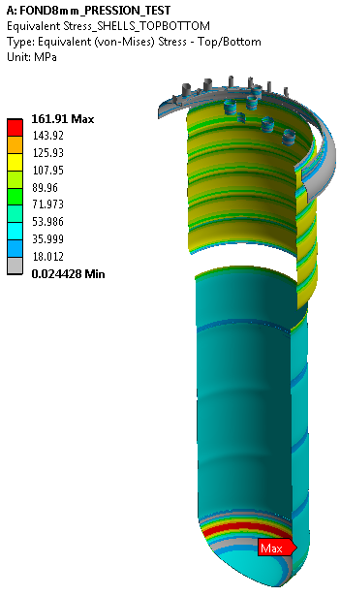
Internal pressure
Pressure test of the dewar
Calculated stresses in shell elements:
6 mm thick bottom dish end:
8 mm thick bottom dish end:
Membrane stress
Membrane
+ bending stress
Membrane stress
Membrane
+ bending stress

Slide 9
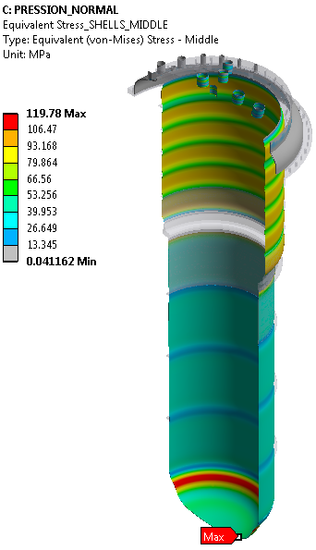
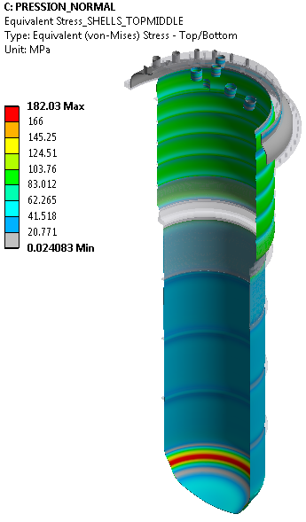
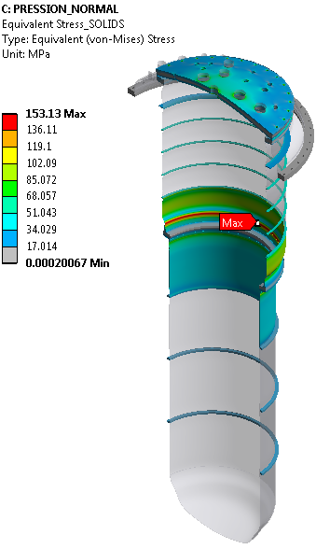
Internal pressure
Nominal operation of the dewar
Pressure only
Ps = MAWP = 4 barg
Vacuum inside the vacuum vessel
⇒ pressure of 0.5 Mpa applied on the inner surfaces of the dewar
Stresses
in solid elements:
Stresses in shell elements:
6 mm thick
bottom dish end:
Membrane stress
Membrane + bending stress

Slide 10
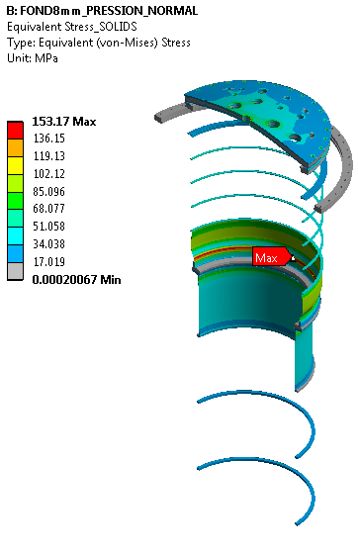
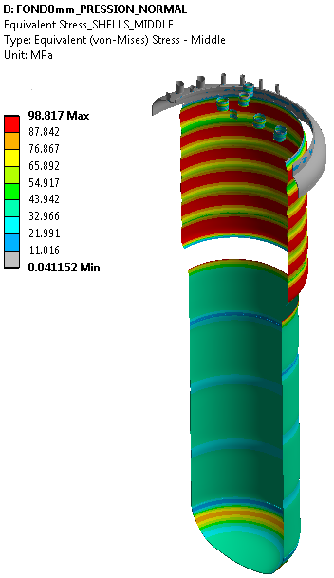
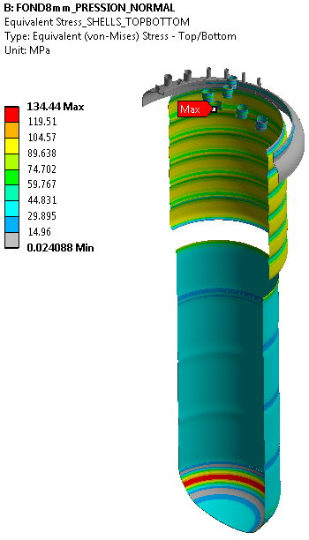
Internal pressure
Nominal operation of the dewar
Stresses
in solid elements:
Stresses in shell elements:
8 mm thick
bottom dish end:
Membrane stress
Membrane + bending stress

Slide 11
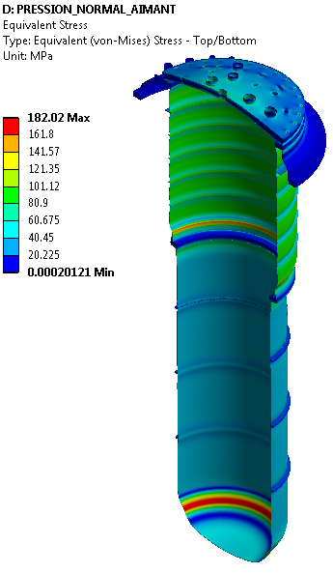
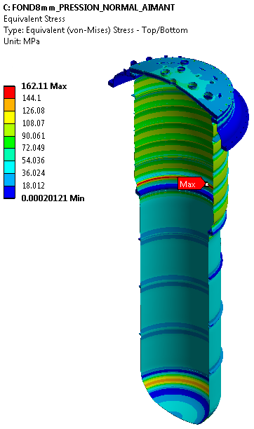
Internal pressure
Nominal operation of the dewar
Pressure + Mass of the magnet
Ps = MAWP = 4 barg
60 000 N applied on the lambda set
Stresses in all elements:
6 mm thick
bottom dish end:
8 mm thick
bottom dish end:

Slide 12
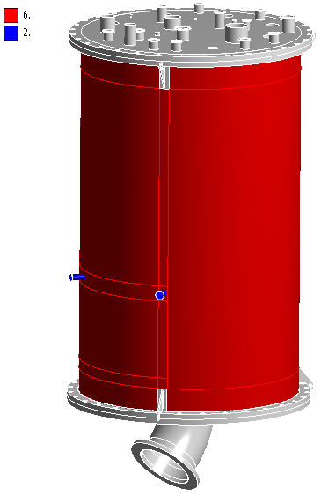
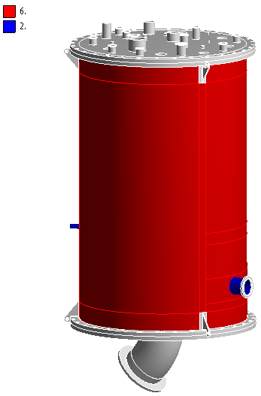
Valve Box Geometry 1/1
FEM geometry
Mesh elements
Coloured: shells elements (coloured by thicknesses expressed in mm)
Grey: solid elements
Thicknesses of some solid elements:
Top lid: 25 mm
Bottom lid: 25 mm
Flanges: 25 mm

Slide 13
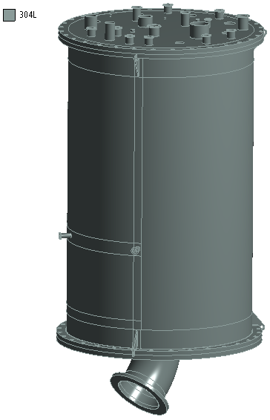
Material 1/3
Model
AISI 304L (1.4306 / X2CrNi19-11)
E = 190 000 Mpa
= 0.305
ρ = 7 900 kg/m³

Slide 14
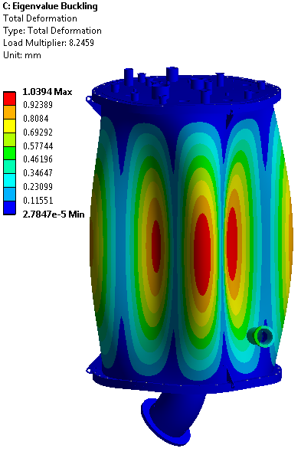
External pressure
Linear buckling due to pressure forces only
gravity and masses are not taken into account here (nor the reaction of the support pods on the floor – see report 1)
⇒ First linear buckling mode for a critical pressure of 0,82 MPa

Slide 15
Thank you for your attention
CSP12
28 Novembre 2014

