Slide 1
Gersemi Cryostat
Mechanical and cryogenic configurations
2nd Follow-up meeting – 25th October 2016
ACS – P. Bujard, J.P. Thermeau, F. Dieudegard

Slide 2
Outline
Cryogenic and mechanical Studies
Cryostat design,
Valve box,
Liquid insert,
Lambda Insert,
Specifications and equipments,
Cryogenic schemes modifications.

Slide 3
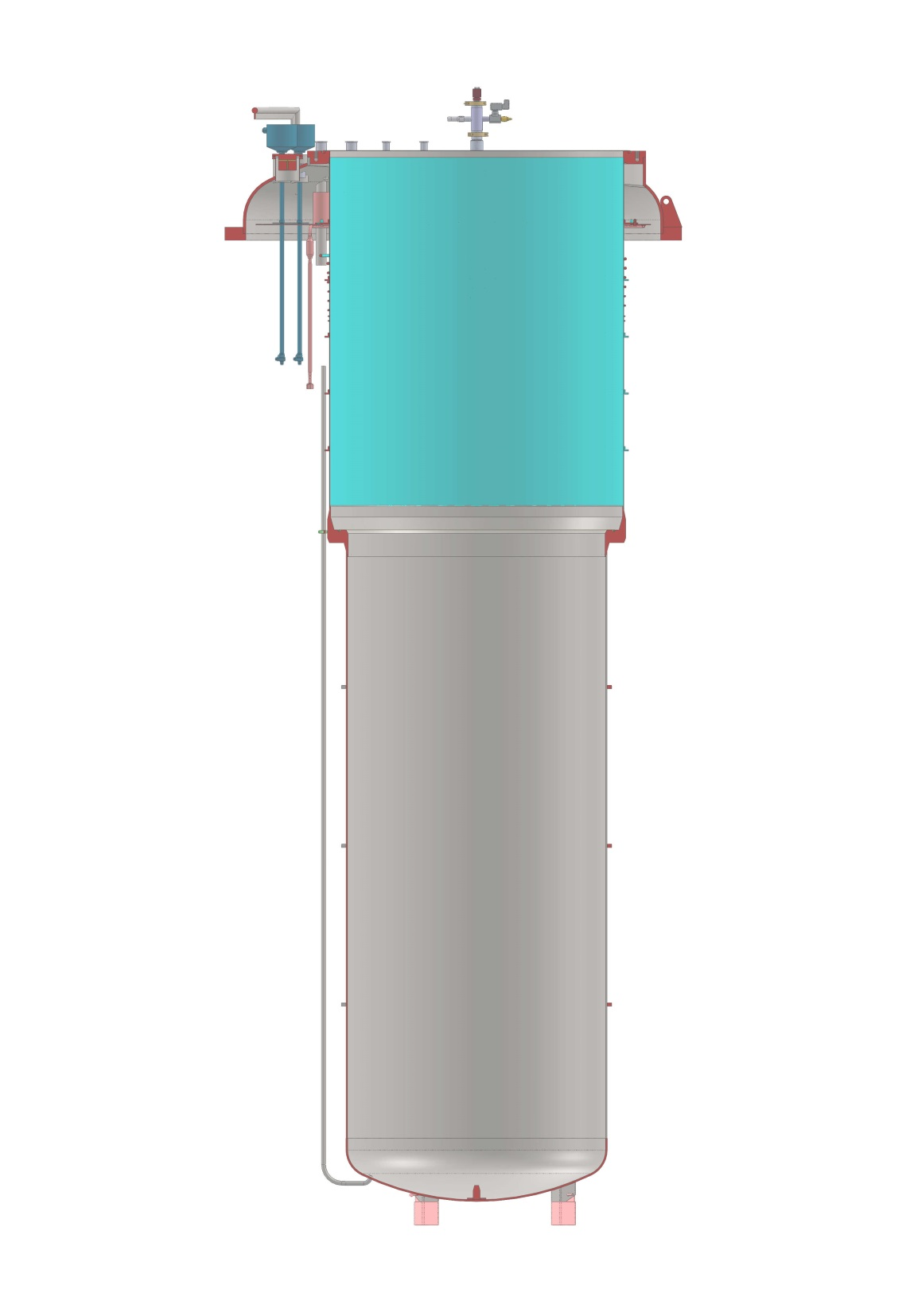
Cryostat design
Mechanical design:
The design of stiffeners are modified to simplify the manufacturing,
Two safety valves (1”, 3.9 barg) are added to protect the pressure vessel,
The flatness of the Lambda seat must be better than 0.1mm,
The final mechanical design is validated by numerical calculations.
Thermal screens:
An aluminum design defined,
The cylindrical upper part will be manufacturing in copper.
Specifications:
Maximum allowable operating pressure: ≈ 3.9 barg,
Hydraulic test pressure: 7.15 bara,
The manufacturing norms is defined : EN13458

Slide 4
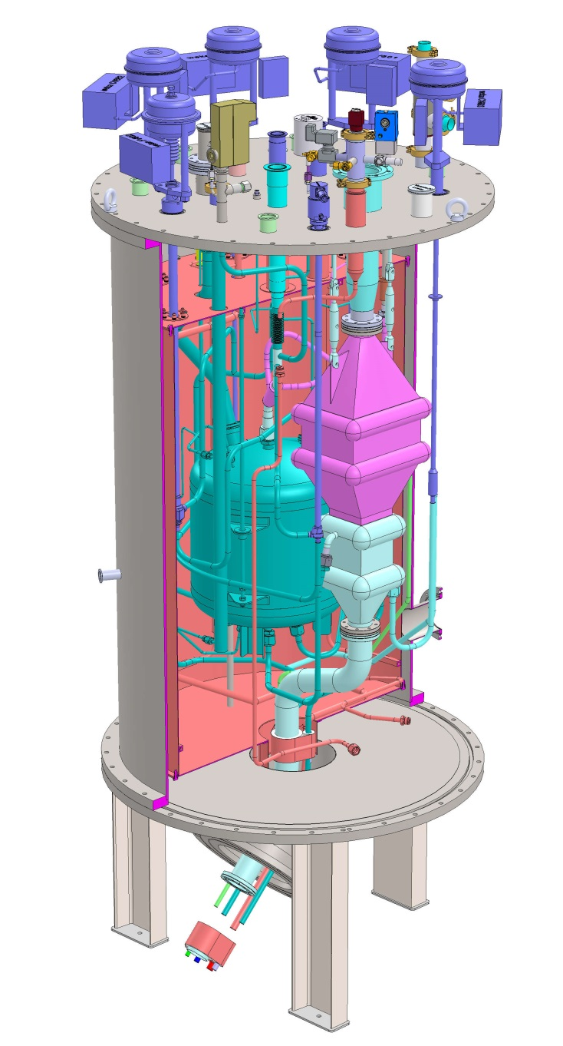
Valve Box
Mechanical design:
The 3D piping design is done,
The thermal shield is copper designed.
Heat Exchangers:
2 different exchangers (DATE) welded together.

Slide 5
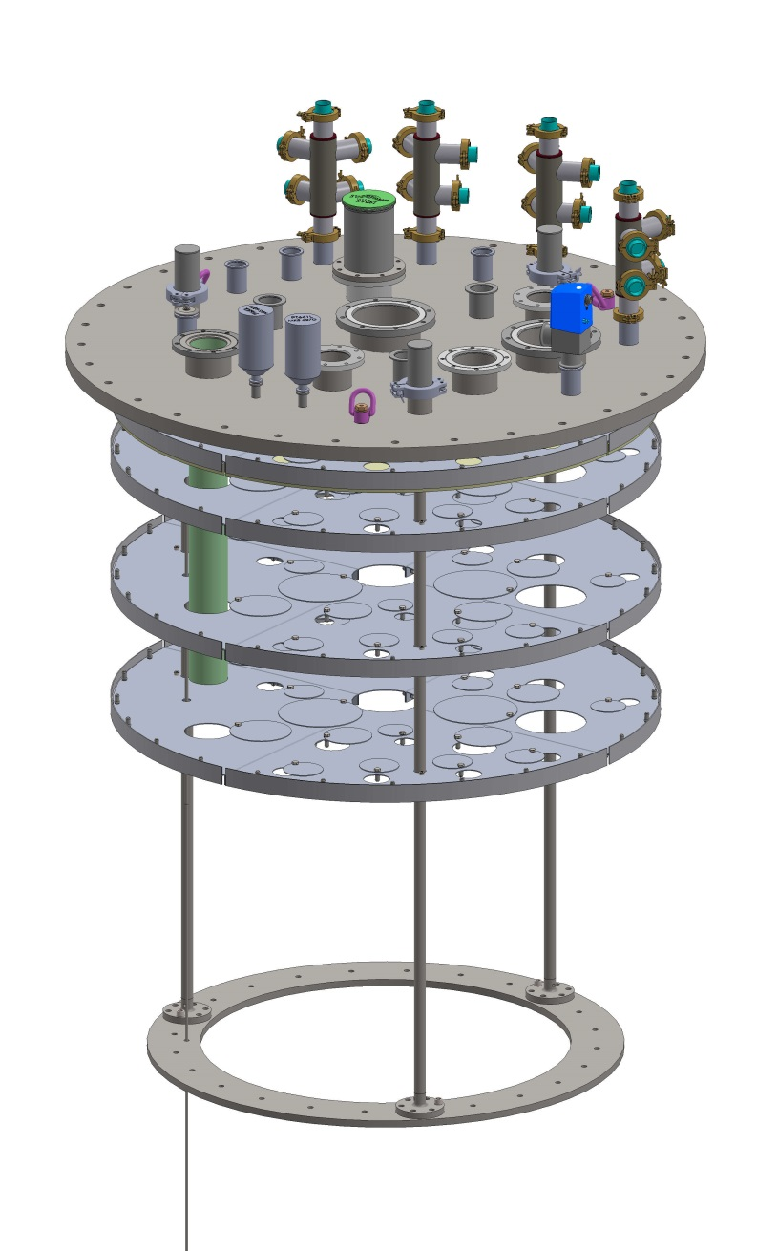
Liquid Insert
Mechanical design:
The level probe (3.2m) is composed of two probes of 1.6 m.
Two pumping lines (DN63 and DN100) for the cavity vacuum will be installed,
An ACS low pressure safety valve has been defined to operate at 0.7 barg, this safety valve could be connected to the recovery helium system.
CD has improved the initial design of the low pressure safety valve.
CD drawings to be checked.

Slide 6
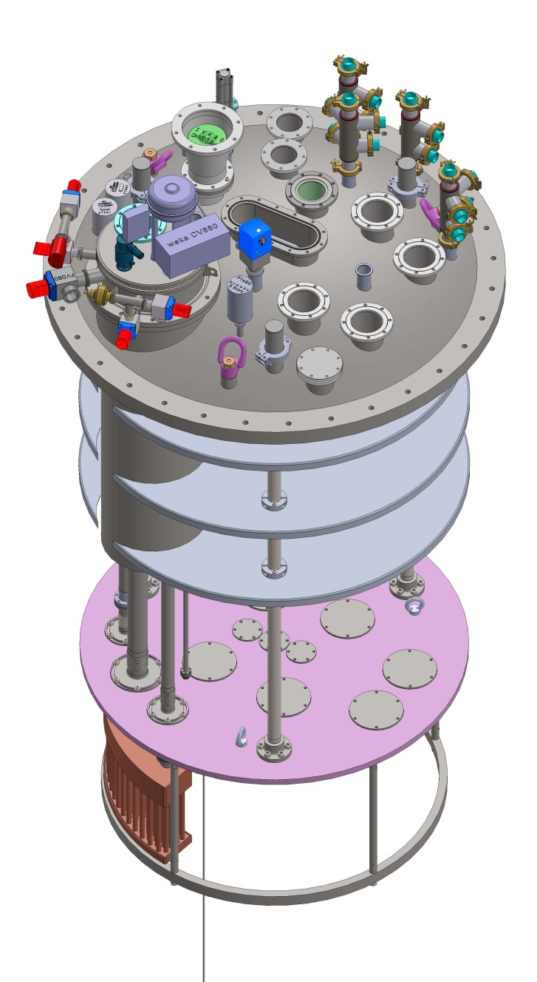
Lambda Insert : several modifications
Mechanical design:
Several modifications must be made to install the magnetic measurement system.
(Ø and axis distance in magnet design?)
Current leads requirements to define final ports design.
Access holes to design on the thermal shields,
- The low pressure safety valve operates at 2.5 barg,
HX681 design to be discussed (full copper, excepted the flanges, silver brazing and TIG welding).

Slide 7
Specifications and equipments
The specifications of main equipments are defined excepted the instrumentation of the four current leads,
The electrical heaters of Minco will be replaced by the Winkler heaters,
The Minco Pt100 thin films are used to measure the temperature of the electrical heaters,
ACS will test the Winkler heaters in vacuum and cryogenic conditions,
A VAT control valve has been tested by ISII-Tech, this kind of butterfly valve could be used to replace the MKS valves,
The Brooks pressure sensors will replace the MKS sensors used to regulate the pressure of helium bath,
Two kinds of Brooks pressure sensors will be used :
- the capacitance manometers in the range from 0 to 100 Torr and 0-1000 Torr : CMX45,
- the pressure sensors in the range from 0 to 2 bars and 0-7 bars : Solidsense II,
The mass flowmeters will replace the gas counters but the range of measurement will be reduced (1/50 instead of 1/500).

Slide 8
Cryogenic schemes
- The new cryogenic scheme and the nomenclature included the equipment modifications are available.
The modifications concerned :
The cryogenic superfluid line used for the vacuum insert (no bayonet) : L015,
The new safety valves of the cryostat cold vessel : SV642, SV643,
The level probe of liquid insert composed of two probes : LT660, LT661,
The level probe of vacuum insert composed of two probes : LT670, LT671,
Magnet insert, the level probe of pressurized 2 K bath composed of two probes: LT680, LT681,
Magnet insert, the level probe of heat exchanger HX681 : LT683 instead of LT681.

