Slide 1

Oscillation results and plans from the T2K experiment
Patrick Dunne for the T2K Collaboration
NUFACT 2017

Slide 2
Outline
The T2K Experiment
Structure of T2K oscillation analysis
New results from data to date
Future prospects

Slide 3
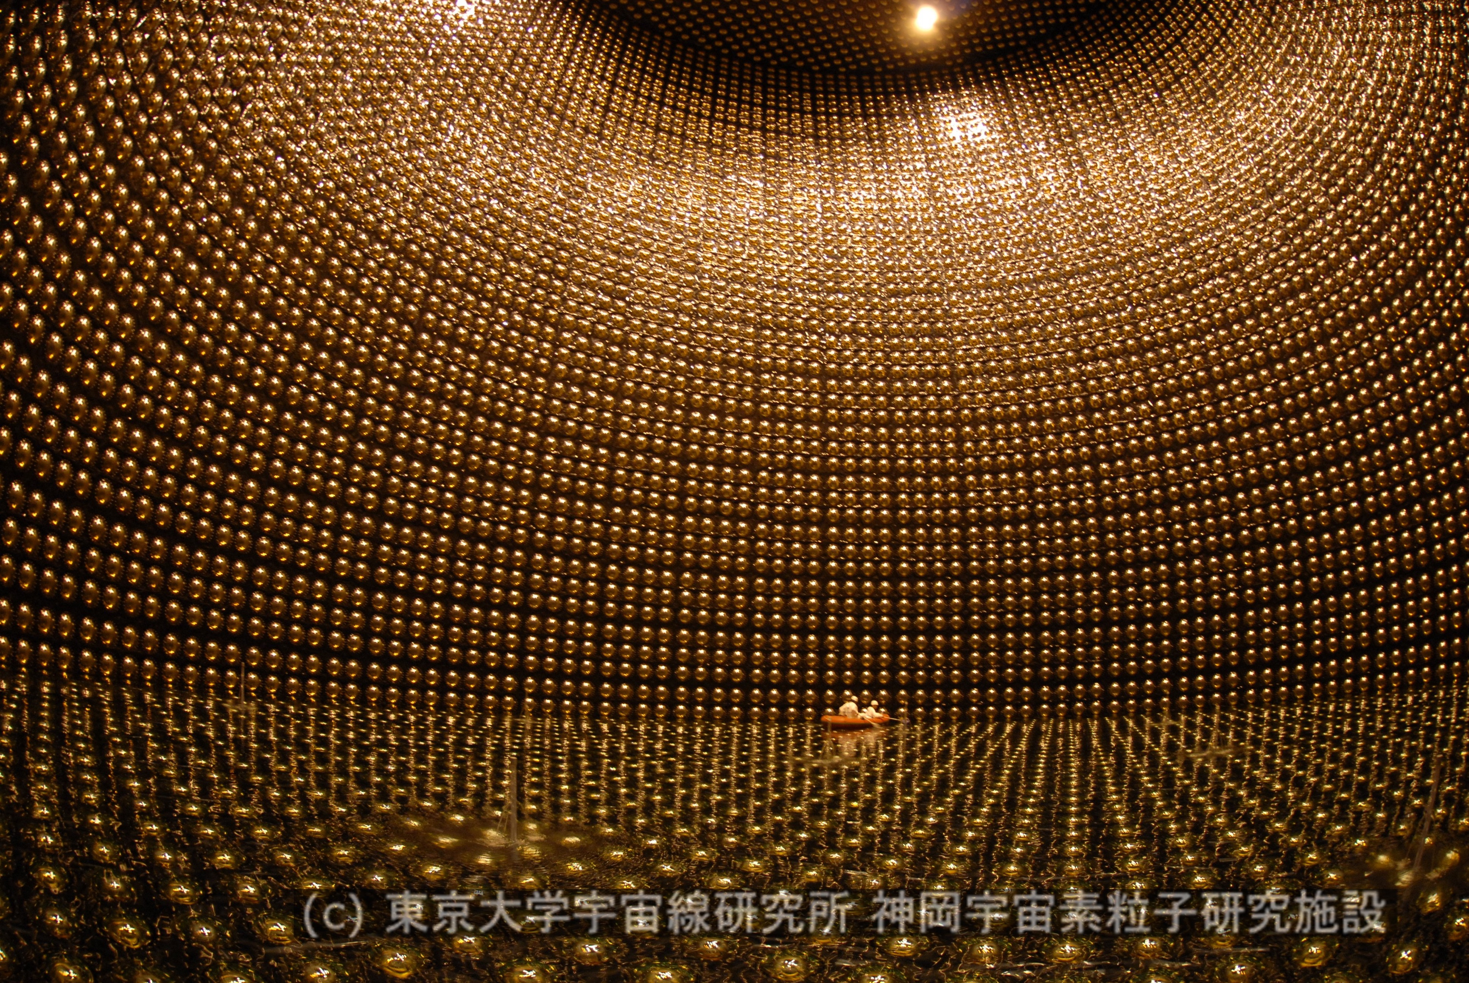
The T2K Experiment
Muon (anti) neutrino beam generated at J-PARC and sent to Super-K 295 km away
Near detector complex 280m from target constrains flux and cross-section uncertainties
Details in Jiae Kim’s plenary yesterday
Super-K
Kamioka
ND280
295 km
J-PARC
Tokai
Notes:
Add more details of ND and SK slides to here and check with Jiae

Slide 4
Neutrino oscillations at T2K
ν_{μ} disappearance
Muon (anti)neutrino disappearance
  Location of dip determined by Δm²₂₃
  Depth of dip determined by sin²(2θ₂₃)
Electron (anti)neutrino appearance
  Leading term depends on sin²(θ₂₃), sin²(θ₁₃)
  and Δm²₂₃
  Sub-leading dependance on δ_{CP}
    δ_{CP} = π/2: fewer neutrinos, more anti-neutrinos
    δ_{CP} = -π/2: more neutrinos, fewer anti-neutrinos
  Matter effects give dependence on mass hierarchy
ν_{e} appearance

Slide 5
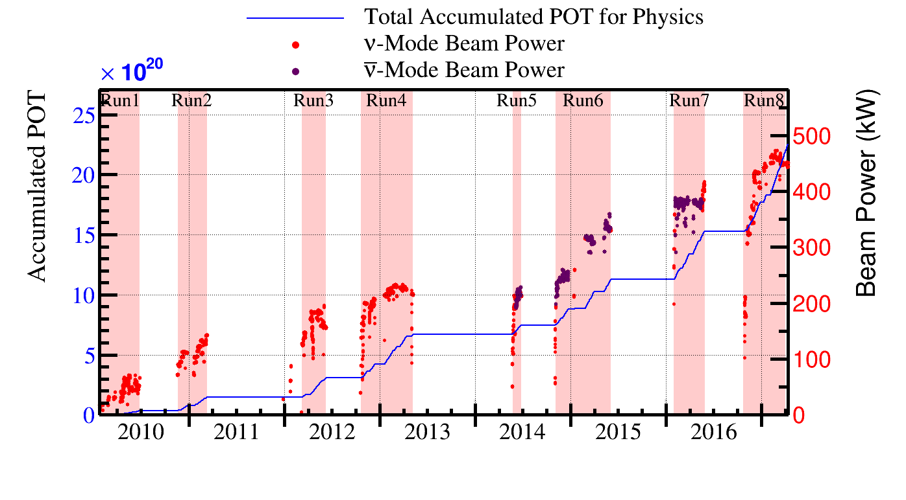
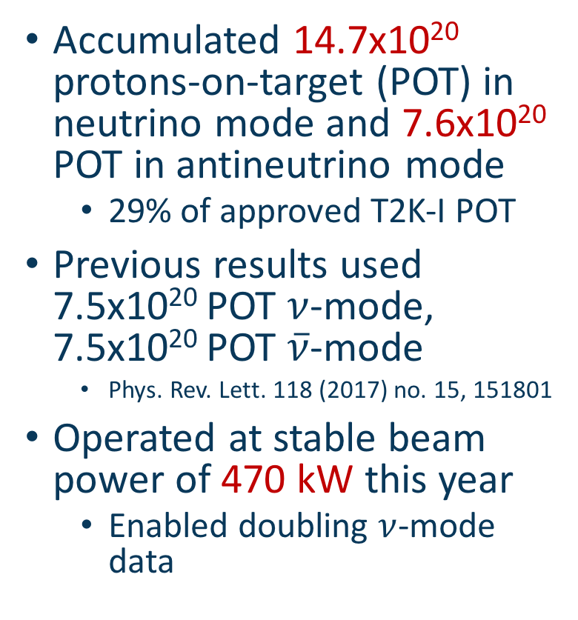
Beam operation
Accumulated 14.7x10²⁰ protons-on-target (POT) in neutrino mode and 7.6x10²⁰ POT in antineutrino mode
  29% of approved T2K-I POT
Previous results used 7.5x10²⁰ POT $ν$-mode, 7.5x10²⁰ POT $\overline{ν}$-mode
  Phys. Rev. Lett. 118 (2017) no. 15, 151801
Operated at stable beam power of 470 kW this year
  Enabled doubling $ν$-mode data

Slide 6
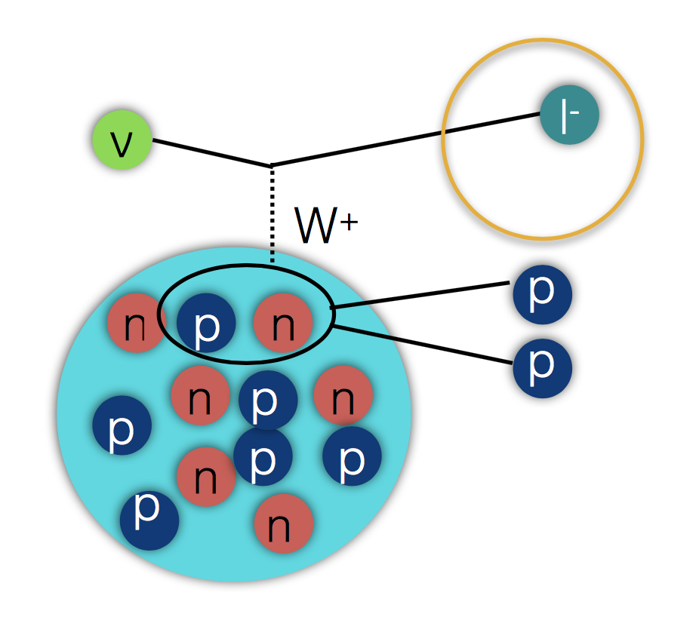
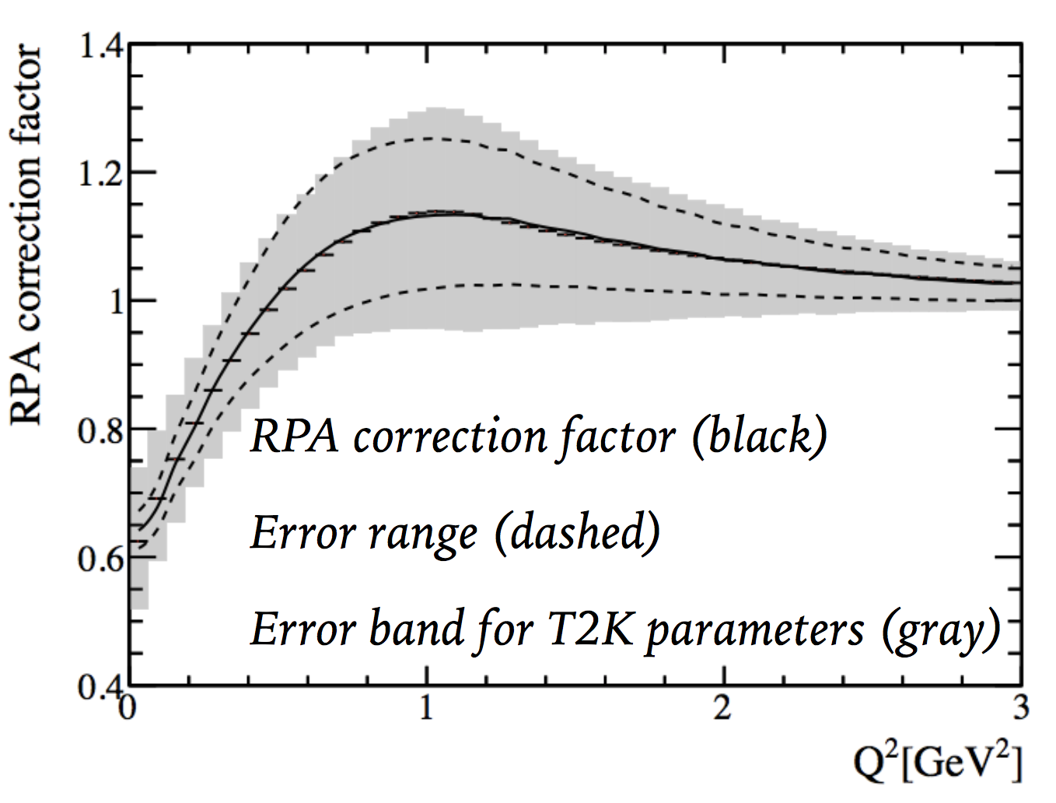
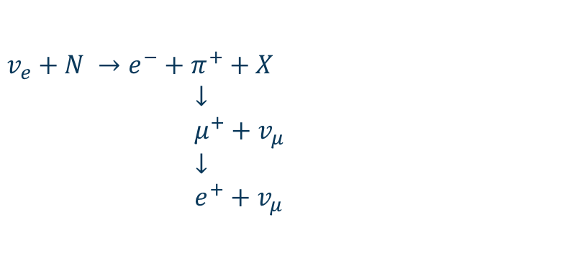
Changes for this year
New fiTQun SK reconstruction algorithm has been used
  Allows ~20% increase in fiducial volume (FV)
This year we added a sample targeting
CC1pi interactions
  Require one electron ring and an additional decay electron
  Last summer’s analysis used 4 samples all targeting CCQE
Cross-section model updated
  Improved uncertainties to multi-nucleon interactions (2p2h) and long range nucleon correlations (RPA)
  Details in Keigo Nakamura’s talk yesterday
$$v_{e}+N →e^{−}+π^{+}+X$$
$↓$
$μ^{+}+$ $v_{μ}$
$↓$
$e^{+}+$ $v_{μ}$

Slide 7
Event rate prediction framework
Hadron Production Data
Interaction rates
ND280 Detector Model
Flux Model
INGRID/Beam Monitor Data
Cross-section Model
Oscillation fit
Detector uncertainties
External Cross-section Data
Super-K Detector Model
Construct model to predict event rates and distributions
Constrain models using appropriate data
Add likelihood penalty for deviating from these constraints to fit
Oscillation Parameters
Super-K Atmospheric Data

Slide 8
Fitting to data
Hadron Production Data
Near detector fit
ND280 Detector Model
Flux Model
INGRID/Beam Monitor Data
Cross-section Model
ND280 Data
External Cross-section Data
Far detector fit
Super-K Data Samples
Two approaches used for fitting:
  Use ND data fit to constrain flux and cross-section models first then fit far detector
    Computationally easier
    Makes more assumptions
  Perform simultaneous fit of both detectors
    Computationally more demanding
    Makes fewer assumptions
Super-K Detector Model
Oscillation Parameters
Super-K Atmospheric Data

Slide 9
Fitting to data
Hadron Production Data
ND280 Detector Model
Flux Model
INGRID/Beam Monitor Data
Simultaneous fit
Cross-section Model
ND280 Data
External Cross-section Data
Super-K Data Samples
Two approaches used for fitting:
  Use ND data fit to constrain flux and cross-section models first then fit far detector
    Computationally easier
    Makes more assumptions
  Perform simultaneous fit of both detectors
    Computationally more demanding
    Makes fewer assumptions
Super-K Detector Model
Oscillation Parameters
Super-K Atmospheric Data

Slide 10
T2K analyses: Bayesian vs Frequentist
T2K has three separate analysis frameworks: two frequentist, one Bayesian
Bayesian analysis does joint near/far detector fit, frequentist analyses fit near detector first and propagate
All three able to construct frequentist confidence intervals for comparisons
  Very good agreement is seen
Bayesian analysis shows posterior probability density
(high values mean more likely this is the “correct” parameter value)
Frequentist analyses show Δχ²
(low values mean better agreement with the data for this parameter value)
Notes:
Slide 17 maybe backup

Slide 11
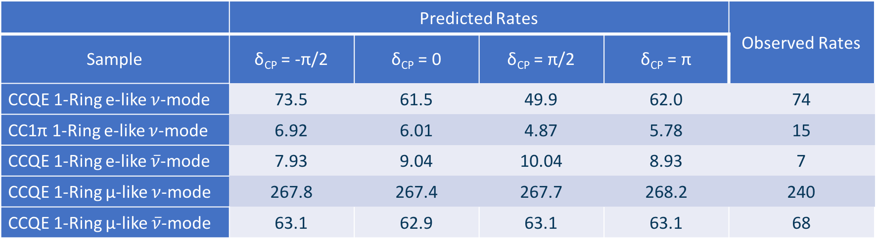
Predicted and observed Super-K event rates
 | Predicted Rates |  |  |  | Observed Rates
Sample | δ_{CP} = -π/2 | δ_{CP} = 0 | δ_{CP} = π/2 | δ_{CP} = π
CCQE 1-Ring e-like $ν$-mode | 73.5 | 61.5 | 49.9 | 62.0 | 74
CC1π 1-Ring e-like $ν$-mode | 6.92 | 6.01 | 4.87 | 5.78 | 15
CCQE 1-Ring e-like $\overline{ν}$-mode | 7.93 | 9.04 | 10.04 | 8.93 | 7
CCQE 1-Ring μ-like $ν$-mode | 267.8 | 267.4 | 267.7 | 268.2 | 240
CCQE 1-Ring μ-like $\overline{ν}$-mode | 63.1 | 62.9 | 63.1 | 63.1 | 68
Other oscillation parameters at previous best fits: maximal θ₂₃
Number of events observed generally agrees with oscillated predictions
  e-like sample rates are most consistent with δ_{CP} = -π/2 hypothesis
  μ-like sample rates consistent within statistical and systematic errors
  CC1π rate shows large upwards fluctuation
    p-value for fluctuation of this size in at least 1 of 5 samples: 11.9%
Notes:
p-value for fluctuation of this size in one sample: 2.5%

Slide 12
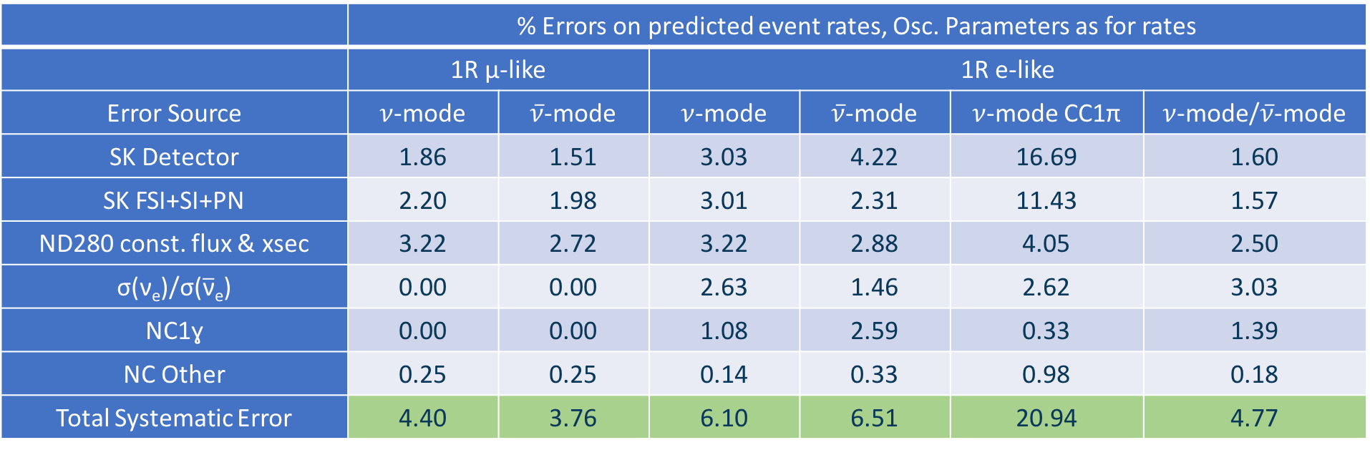
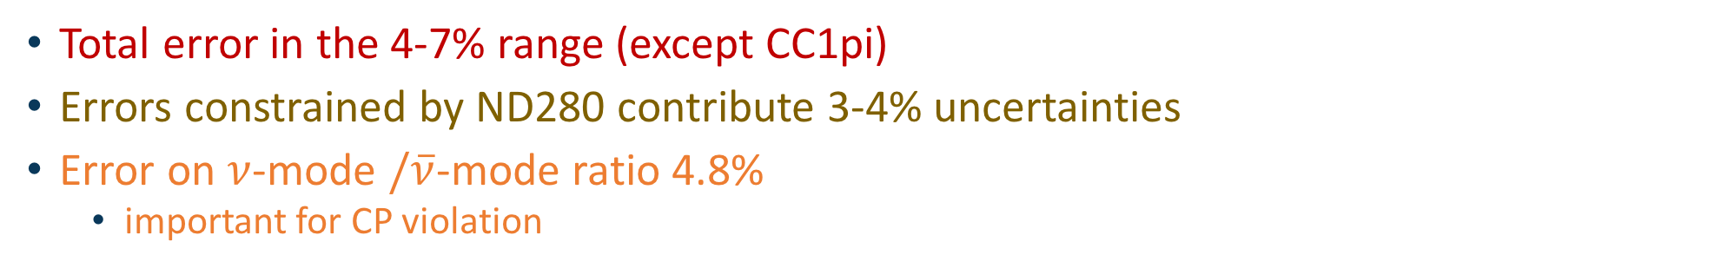
Size of systematic uncertainties
 | % Errors on predicted event rates, Osc. Parameters as for rates
 | 1R μ-like |  | 1R e-like
Error Source | $ν$-mode | $\overline{ν}$-mode | $ν$-mode | $\overline{ν}$-mode | $ν$-mode CC1π | $ν$-mode/$\overline{ν}$-mode
SK Detector | 1.86 | 1.51 | 3.03 | 4.22 | 16.69 | 1.60
SK FSI+SI+PN | 2.20 | 1.98 | 3.01 | 2.31 | 11.43 | 1.57
ND280 const. flux & xsec | 3.22 | 2.72 | 3.22 | 2.88 | 4.05 | 2.50
σ(ν_{e})/σ($\overline{\text{ν}}$_{e}) | 0.00 | 0.00 | 2.63 | 1.46 | 2.62 | 3.03
NC1ɣ | 0.00 | 0.00 | 1.08 | 2.59 | 0.33 | 1.39
NC Other | 0.25 | 0.25 | 0.14 | 0.33 | 0.98 | 0.18
Total Systematic Error | 4.40 | 3.76 | 6.10 | 6.51 | 20.94 | 4.77
Total error in the 4-7% range (except CC1pi)
Errors constrained by ND280 contribute 3-4% uncertainties
Error on $ν$-mode $/\overline{ν}$-mode ratio 4.8%
  important for CP violation

Slide 13
Sensitivities

Slide 14
Set A sensitivity
T2K samples only
T2K samples only
Integrate out sin²θ₁₃ dependence
Impose reactor constraint on sin²(2θ₁₃) (PDG 2016)
T2K +reactor constraint
T2K +reactor constraint
Integrate out sin²θ₁₃ dependence

Slide 15
Comparison to Summer 2016 sensitivity
2016 T2K +reactor constraint
2017 T2K +reactor constraint

Slide 16
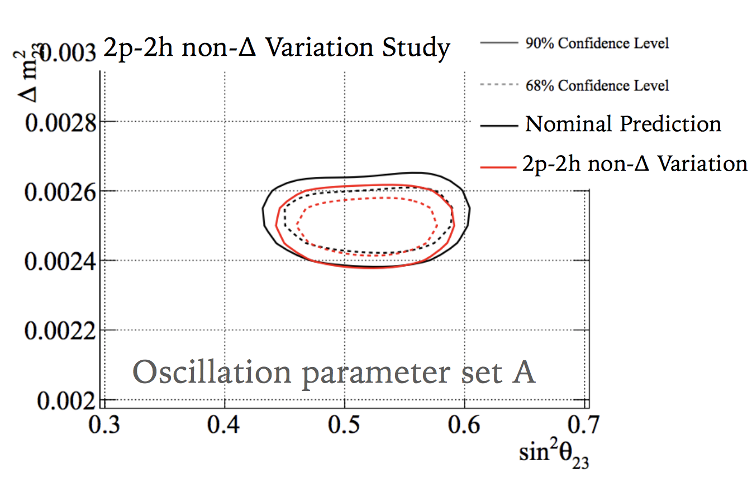
Fake data
Check robustness of results to neutrino interaction model by using our model to fit
``fake data” generated with two methods
  `Data-driven’: assign differences between current
  model and ND280 data to one interaction mode and refit
    Effect seen on sin²θ₂₃ and Δm²₂₃
  Model choices: generate data using other models implemented in generator but not used in oscillation analysis and refit

Slide 17
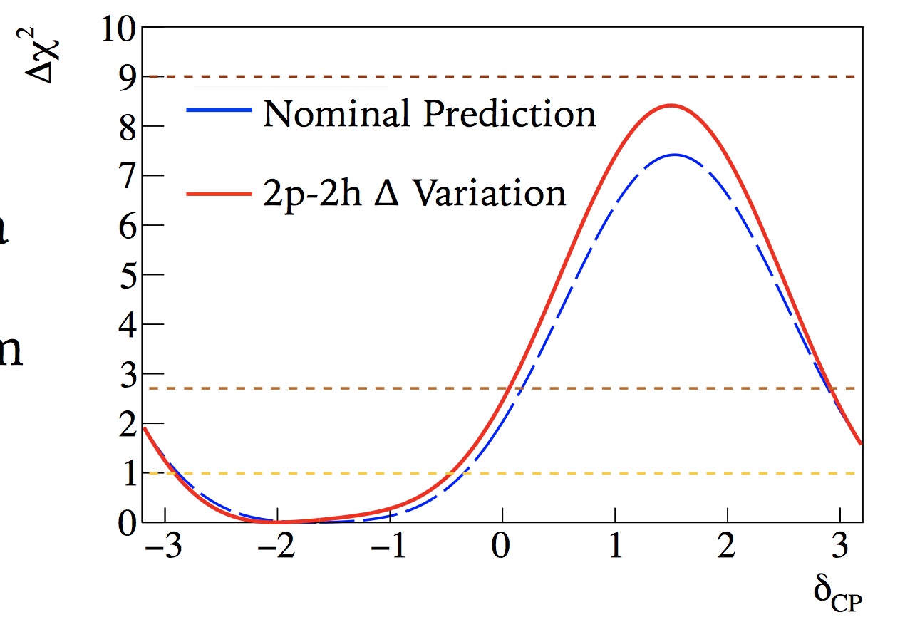
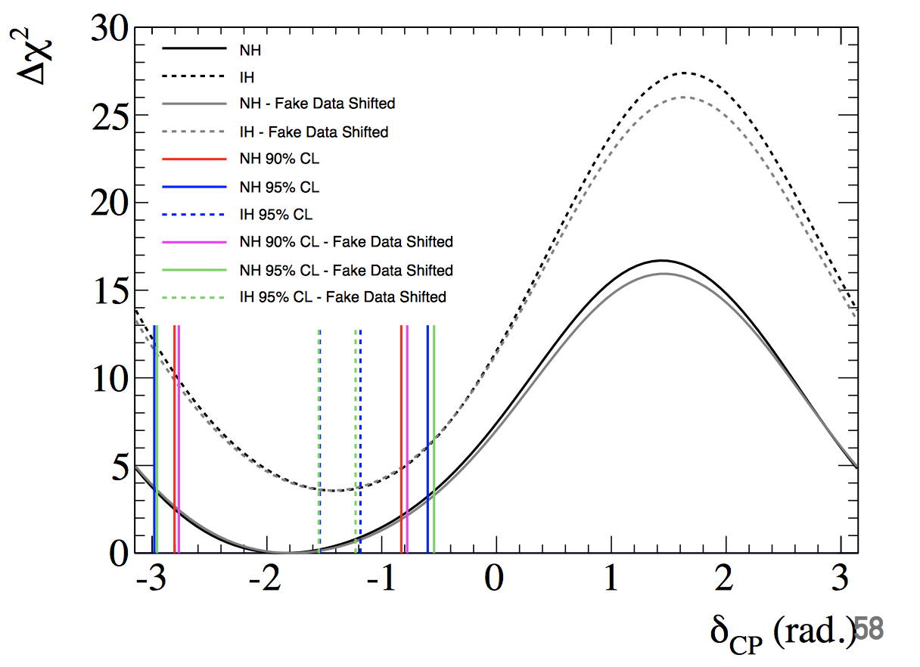
Impact on δ_{CP}
Need to check how changes to Δχ² from fake data studies affect statements on δ_{CP}
Take Δχ² difference observed in fake data study (top plot) and shift observed Δχ² in data (bottom plot) by that amount
Impact on δ_{CP} intervals is small
sin²θ₂₃ and Δm²₂₃ results presented with caveat that the systematic error model may be updated
Notes:
Maximum difference in confidence interval midpoint was 1.7%
Maximum difference in interval size was 2.3%

Slide 18
Data results

Slide 19
Appearance parameter constraints
T2K data only
T2K +reactor constraint
T2K value for sin²θ₁₃ is consistent with PDG 2016 average (0.0219)

Slide 20
δ_{CP} Constraint
T2K data only
T2K +reactor constraint
CP conserving values outside 2σ (95.4%) interval for T2K+reactor constraint

Slide 21
Constraint vs sensitivity
Observed constraint stronger than predicted sensitivity
Studied how likely this was to happen
Generated many toy data sets with statistical and systematic fluctuations around δ_{CP}=-π/2, normal hierarchy (NH)
Ran fits to these spectra to determine δ_{CP} constraint
Observed constraint falls within 95.45% for most δ_{CP} points
30% of experiments exclude δ_{CP} = 0 at 2σ
25% of experiments exclude δ_{CP} = π at 2σ
Normal hierarchy
Inverted hierarchy

Slide 22
Octant and hierarchy preferences
Bayesian framework has natural way to express preference for binary choices: Bayes factors
B=P(option 1)/P(option 2)
Bayes factor for NH vs IH: 6.6
Bayes factor for upper vs lower octant: 3.6
Both classified as ”substantial/positive” on Jeffreys/Kass & Rafferty scale but not yet decisive
Systematics may change due to fake data studies
T2K +reactor constraint
Posterior probabilities (T2K + reactor constraint)
 | sin²θ₂₃<0.5 | sin²θ₂₃>0.5 | Sum
NH (Δm²₂₃>0) | 0.193 | 0.674 | 0.868
IH (Δm²₂₃<0) | 0.026 | 0.106 | 0.132
Sum | 0.219 | 0.781

Slide 23
Future plans
T2K-II
T2K target POT is 7.8x10²¹
T2K-II is a proposal to extend target to 20.0x10²¹ POT by ~2026
  Upgrade Main Ring power supply to increase from 0.4->1 Hz running
  Beam power increase up to 1.3 MW
Other beam and detector upgrades
Neutrino horns will run at 320 kA from next year
  Reduces wrong sign contamination in antineutrino mode
ND280 will be upgraded to improve high-angle acceptance
  More similar to SK improving cross-section constraint
SK will be refurbished during Summer 2018 to allow Gd addition in 2019/2020
  Gd enables neutron tagging
Notes:
ND upgrade ~2021/22

Slide 24
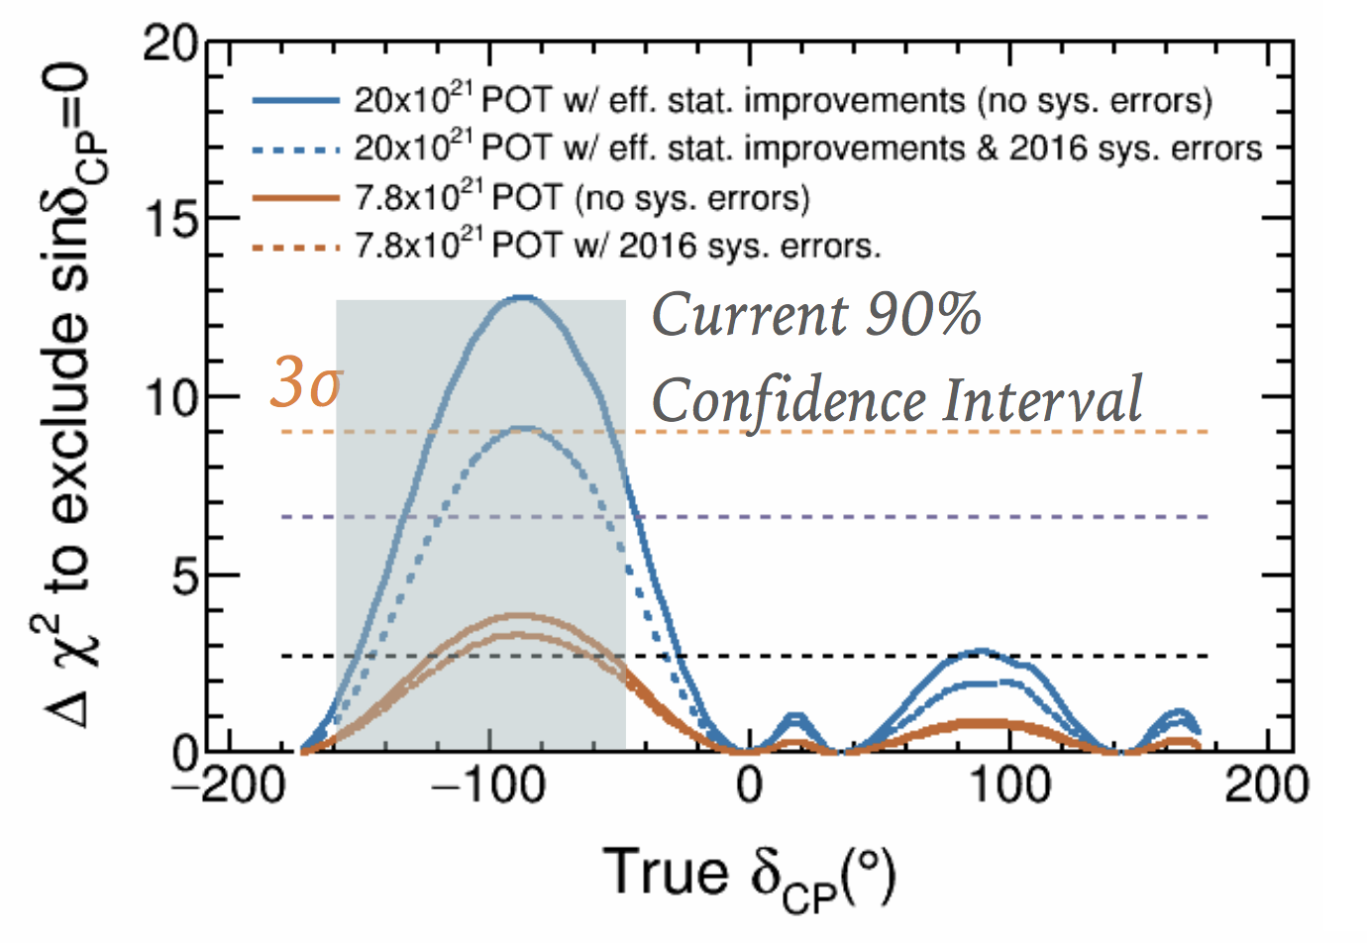
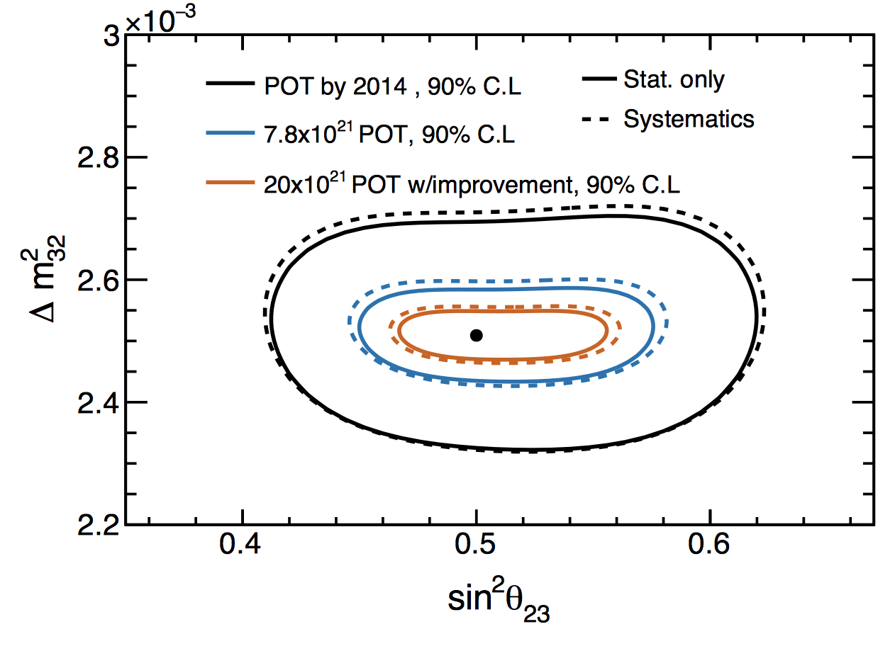
T2K-II sensitivity
If current preferred δ_{CP} is true T2K-II has potential for 3σ discovery
Size of systematic uncertainties has large effect on sensitivity
Notes:
Assumes equal nu/nubar running

Slide 25
Summary
T2K neutrino mode data has doubled since Summer 2016
SK reconstruction improved and additional samples added
  Increases number of events per POT by ~30%
With new analysis CP conserving values of δ_{CP} are excluded at 2σ in both Bayesian and frequentist frameworks
T2K-II proposal plans to collect 20x10²¹ POT
  Gives 3σ sensitivity to favourable δ_{CP} values
  Actively looking for new groups to join
Exciting program of oscillation physics to look forward to!
T2K +reactor constraint

Slide 26
Backup

Slide 27
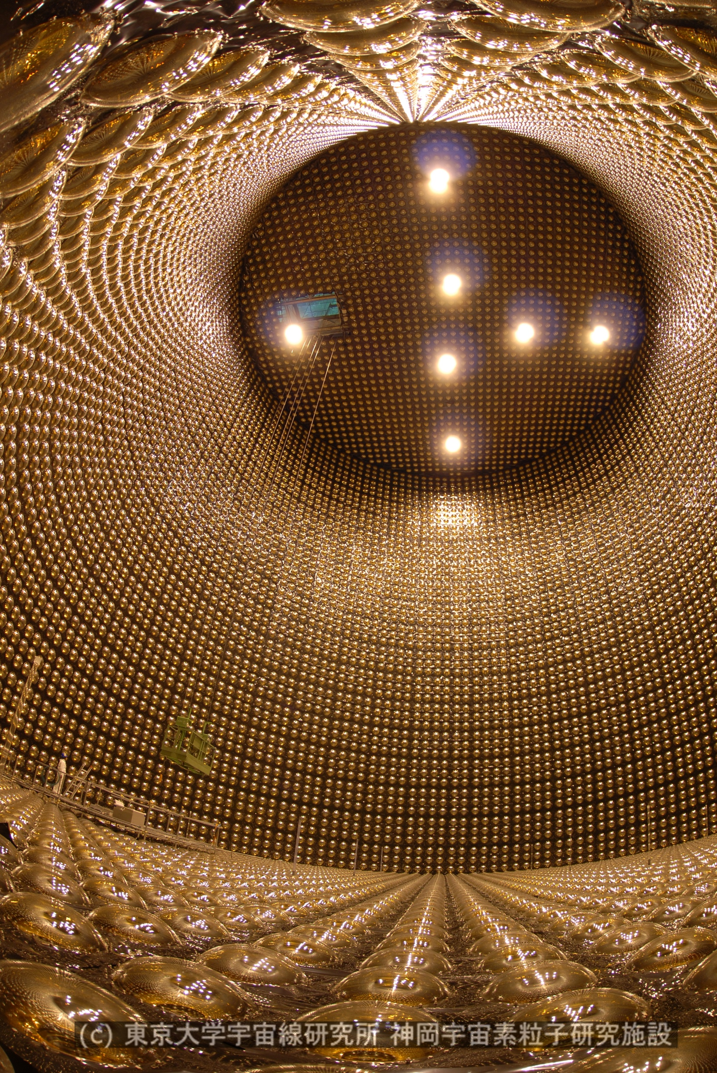
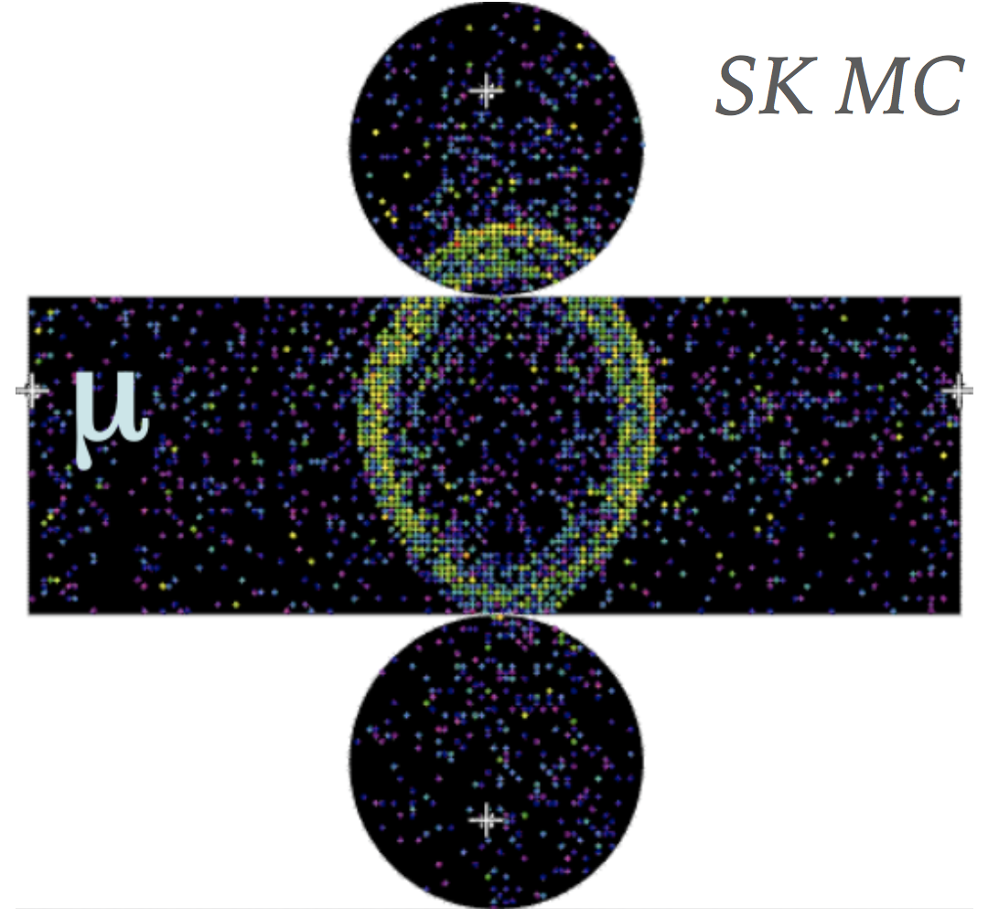
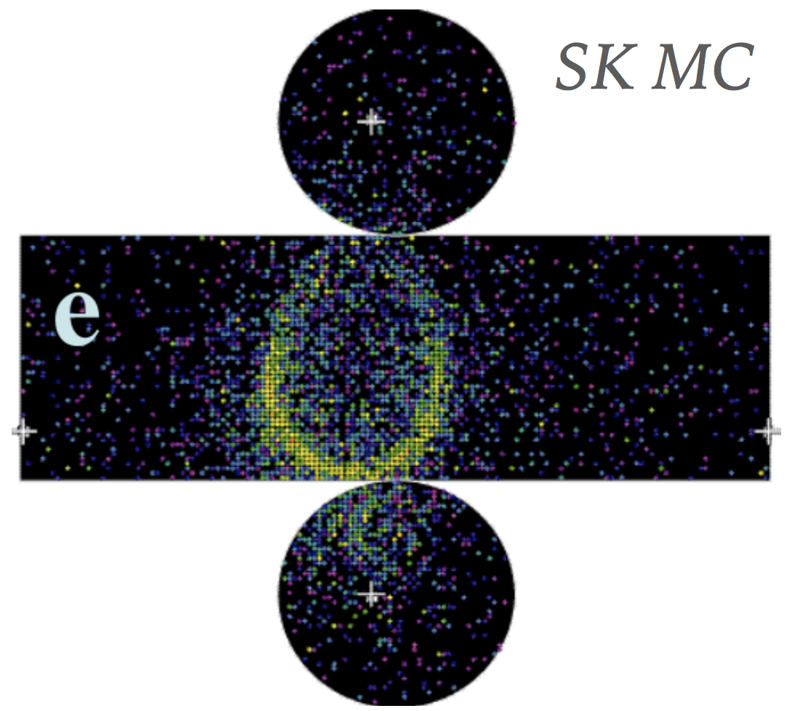
Super-K
50 kton water-Cherenkov detector
11,000 20” PMT inner detector
  40% photo-coverage
2,000 8” PMT outer detector
  Cosmic veto/exiting particles
Not magnetised
Particle ID via Cherenkov ring pattern:
  Muons produce sharp rings
  Electrons scatter more
  → fuzzier rings

Slide 28
Near detectors
INGRID
On-axis detector
Monitors beam direction and constrains flux
Design beam direction tolerance 1 mrad
Achieved <0.5 mrad
ND280
2.5º off-axis (same as Super-K)
Two fine-grained detector (FGD) targets
  FGD1 – Active carbon target
  FGD2 – Active carbon and passive water layers
Magnet + three TPCs
  Particle charge + momentum from curvature
  Particle ID From dE/dx – 0.2% mis-ID rate
Constrains cross-section and flux uncertainties

Slide 29
Off-axis beam concept
Want as much flux as possible at oscillation peak (~0.6 GeV)
Use 2.5º off-axis beam:
  Off-axis phase space gives maximum energy for neutrinos from pion decay at a given angle
  Gives narrower peak in flux
  Removal of high-energy component suppresses NC backgrounds

Slide 30
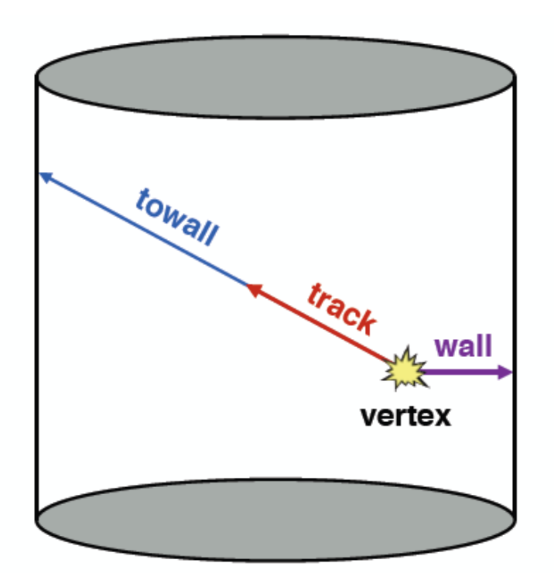
Changes for this year – SK reconstruction
Previous T2K analyses used “APFit” Super-K reconstruction algorithm
  For this result fiTQun algorithm has been used
  For each event chooses event kinematic/topology hypothesis that maximises likelihood
  Full charge and time information in likelihood leads to improved
  signal/background discrimination
Improved reconstruction performance enables increased
fiducial volume
  Previously required vertices to be >2m from detector wall
  Now optimise cut on “wall” and “towall” for each sample to
  minimise statistical and systematic errors
  Provides ~20% increase in fiducial volume (FV)
Notes:
New algorithm better signal/background recon increase 20% in FV rest in backup
Combine with next slide

Slide 31
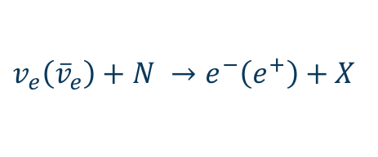


Changes since last summer – SK samples
Last summer’s result used 4 Super-K samples
  Neutrino mode:
    1 μ-like ring, ≤1 decay electron
    1 e-like ring, 0 decay electrons
  Antineutrino mode:
    1 μ-like ring, ≤1 decay electron
    1 e-like ring, 0 decay electrons
  All four samples target charged-current quasi-elastic (CCQE) interactions
This year we also include neutrino mode sample targeting CC1π interactions
  Neutrino mode: 1 e-like ring, 1 decay electron
  No antineutrino mode due to π⁻ absorption
Combination of new sample and increased FV
equates to 30% increase in event rate for same
POT in neutrino mode
$$v_{μ}\left({\overline{v}}_{μ}\right)+N →μ^{−}\left(μ^{+}\right)+X$$
$↓$
$e^{−} \left(e^{+}\right)+$ ${\overline{v}}_{e}\left(v_{e}\right)+v_{μ}\left({\overline{v}}_{μ}\right)$
$$v_{e}\left({\overline{v}}_{e}\right)+N →e^{−}\left(e^{+}\right)+X$$
$$v_{e}+N →e^{−}+π^{+}+X$$
$↓$
$μ^{+}+$ $v_{μ}$
$↓$
$e^{+}+$ $v_{μ}$

Slide 32
Changes to model this year – Cross section
NEUT neutrino interaction MC generator has been significantly improved in recent years:
  New tune of pion production model to external hydrogen and deuterium data
  Inclusion of multi-nucleon scattering processes: Valencia 2p-2h model
  (Phys. Rev. C83 (2011) 045501)
  Improvements to the CCQE model:
  Included the effect of long-range nucleus correlations (calculated using random phase approximation, RPA)
This analysis includes new parametrisations of the uncertainties on 2p-2h and RPA modelling

Slide 33
more on ν_{μ} disappearance
ν_{μ} disappearance probability in vacuum
T2K: L = 295 km, E_{ν} peaks at ~ 0.6 GeV -> sin²Δ_{solar} ~ 0, sin2Δ_{atm} ~ 0
Leading-term
Next-to-leading
ν_{μ} disapp. probability depends on sin²2θ₁₃ sin²θ₂₃ to second order
-> Can be used in combination with known sin²2θ₁₃ to resolve the θ₂₃ octant

Slide 34

ν_{e} appearance probability with 1st order matter effect
Leading including matter effect
CP conserving
CP violating
Solar
Matter effect (small)
replace δ by –δ and $a$ by $−a$ for $P(\overline{ν_{μ}}→\overline{ν_{e}})$

Slide 35
Oscillation parameters used for predictions
  Evaluated sensitivity by fitting spectrum expected for certain oscillation parameters if no statistical or systematic fluctuations
  Define two sets of oscillation parameter values:
 | Set A | Set B
sin²θ₁₂ | 0.304 | 0.304
sin²θ₂₃ | 0.528 | 0.45
sin²θ₁₃ | 0.0219 | 0.0219
Δm²₁₂ | 7.53x10⁻⁵ eV² | 7.53x10⁻⁵ eV²
Δm²₂₃ | 2.509x10⁻³ eV² | 2.509x10⁻³ eV²
δ_{CP} | -1.601 | 0

Slide 36
Set B sensitivity
Set A: sin²θ₂₃=0.528, δ_{CP} = -1.601
Set B: sin²θ₂₃=0.45, δ_{CP} = 0

Slide 37
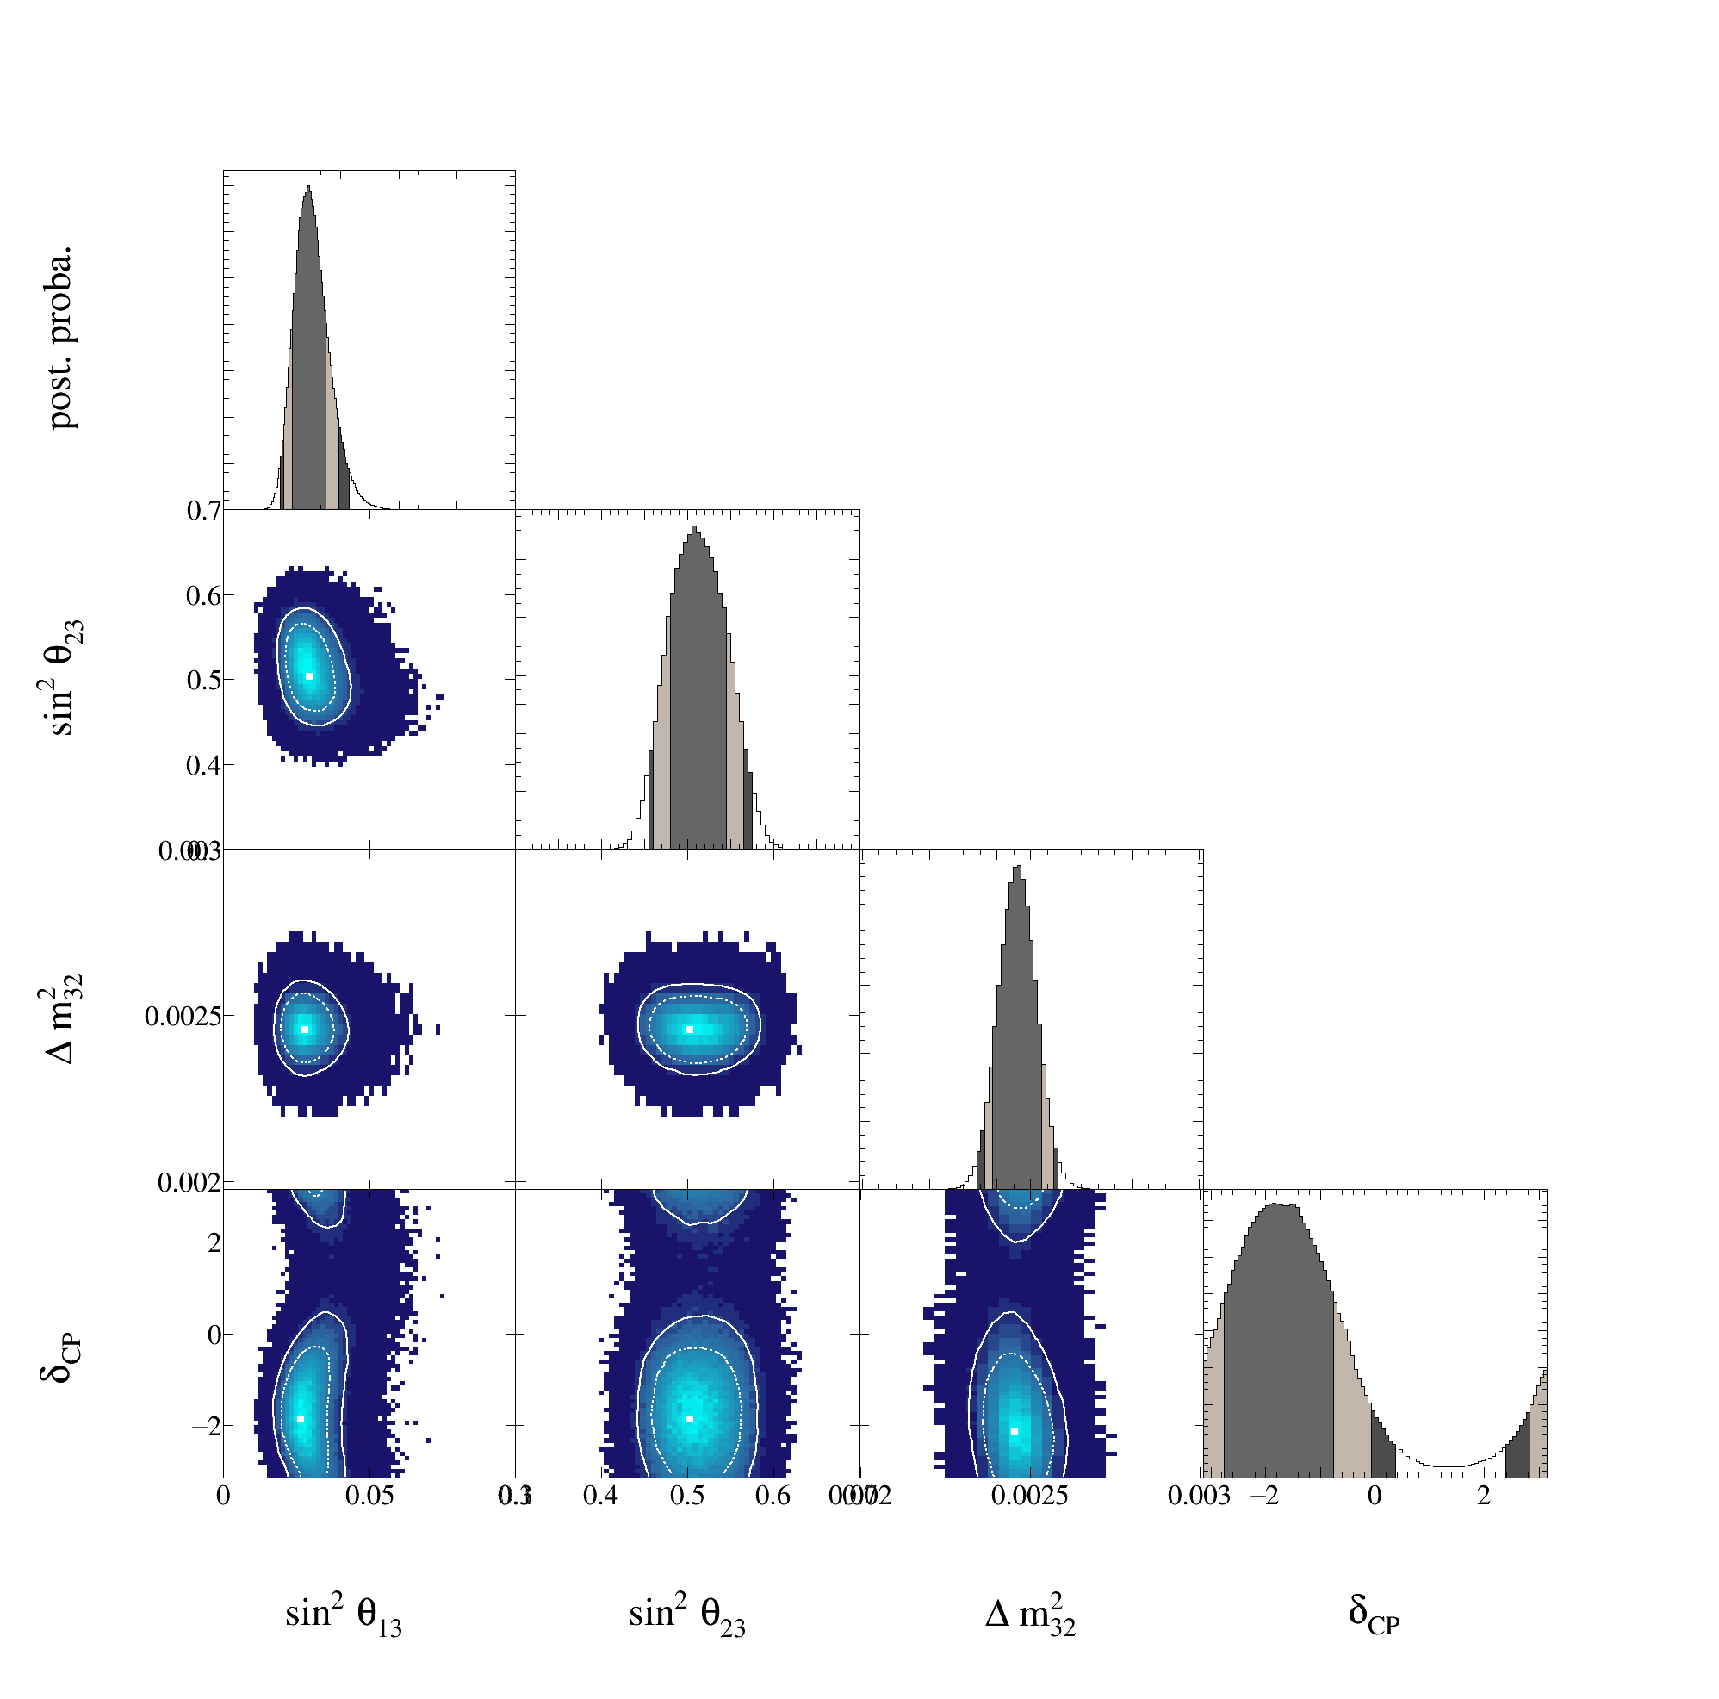
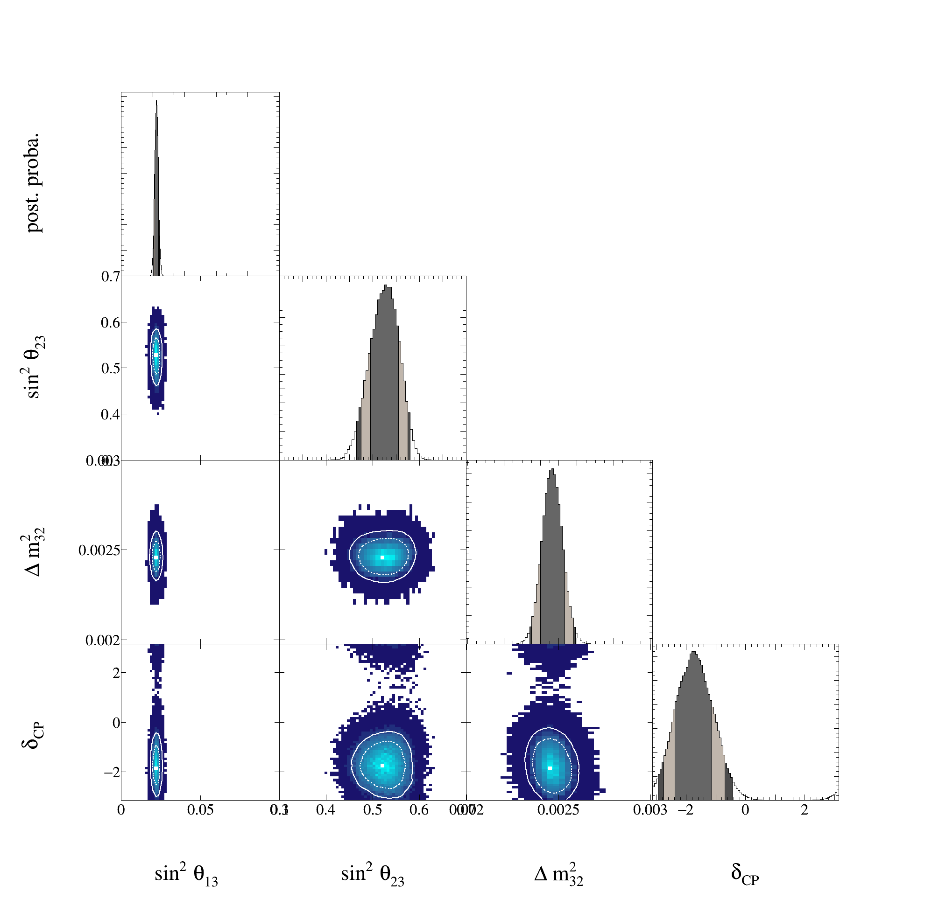
Triangle plots
T2K data only
T2K +reactor constraint
MaCh3 plots of all variable combinations

Slide 38
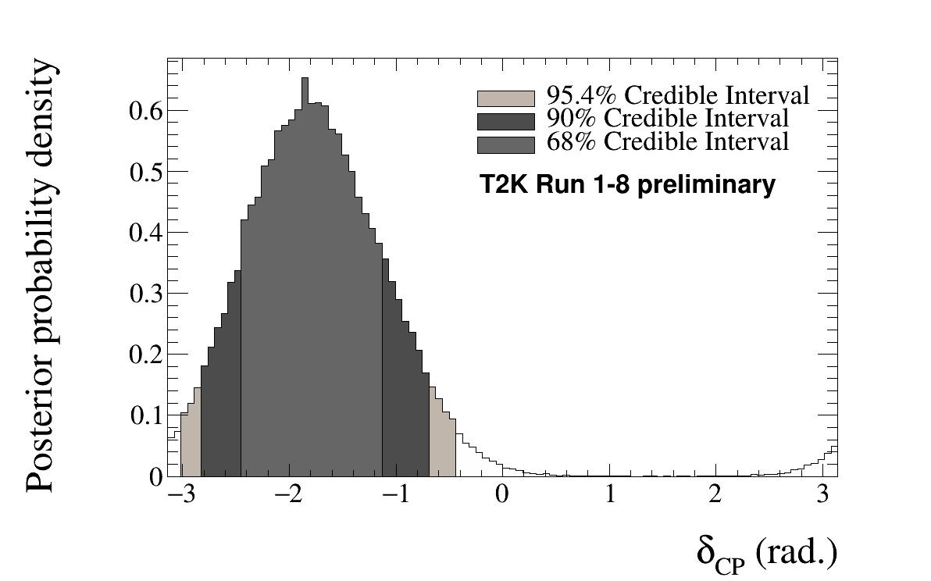
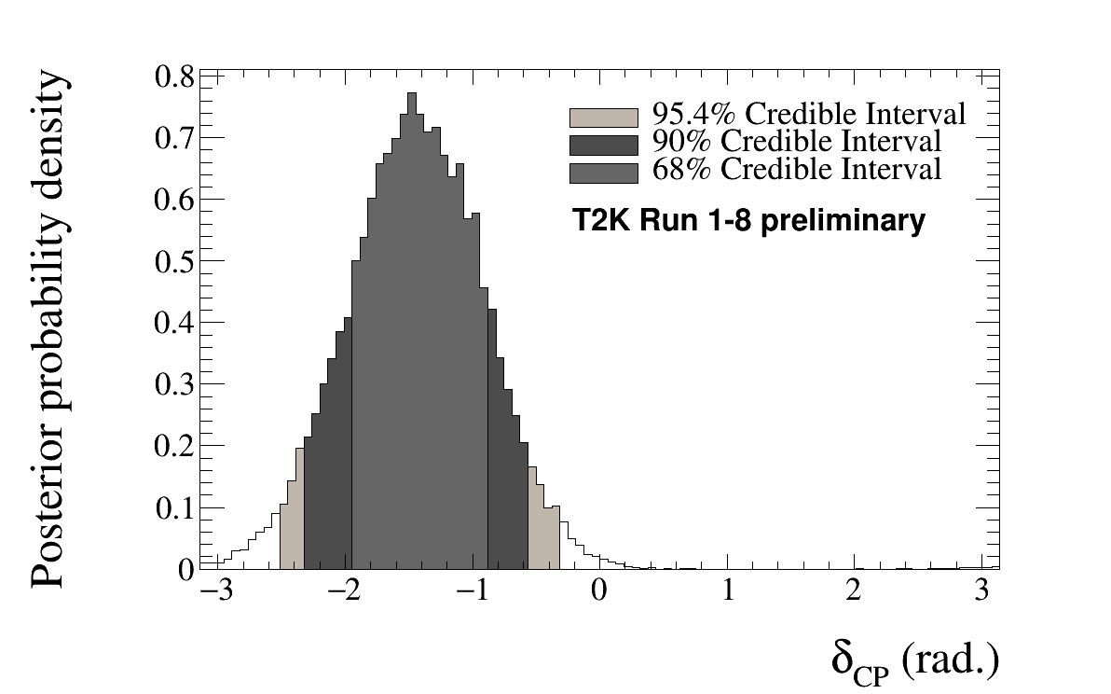
Dcp split by hierarchy- T2K+reactor
Normal hierarchy
Inverted hierarchy
Dcp limits for each hierarchy separately

Slide 39
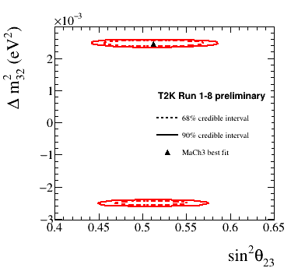
T2K data only disappearance parameters

Slide 40
Biprobability plots
Andy’s biprobability plots

Slide 41
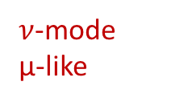

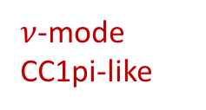
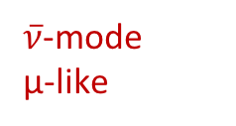
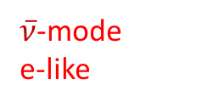
Spectra
$ν$-mode
e-like
$ν$-mode
μ-like
$ν$-mode
CC1pi-like
Spectra for each of the 5 samples at SK
$\overline{ν}$-mode
μ-like
$\overline{ν}$-mode
e-like

Slide 42
Plan to deal with fake data
Investigating further to see if differences seen between data and MC are a physical effect we should include an uncertainty for
δ_{CP} results not affected
sin²θ₂₃ and Δm²₂₃ results presented with caveat that the systematic error model may be updated
In future we plan to address ambiguity between interaction modes with:
  Use of 4π acceptance samples at ND280 to better match SK acceptance
  Studies of hadronic recoil system through proton reconstruction
  Near detector upgrades to improve model constraints

