Slide 1
A hearty welcome from the local organizing committee!

Slide 2
NUFACT2017 is the nineteenth in the series of yearly international workshops which started in 1999 and which until now was called International Workshop on Neutrino Factories. Over the years the Workshop has come to include all current and future accelerator and also reactor based neutrino projects, including also muon projects, not only the Neutrino Factory project, and the NUFACT name has there fore been changed to mean: Workshop on Neutrinos from Accelerators The workshop plenary program is set up by a Scientific Program Committee and the parallel sessions by five very active Working Groups: Working Group 1: Neutrino Oscillation Physics Working Group 2: Neutrino Scattering Physics Working Group 3: Accelerator Physics Working Group 4: Muon Physics Working Group 5: Neutrinos Beyond PMNS. The workshop program is available at https://indico.uu.se/event/324/

Slide 3
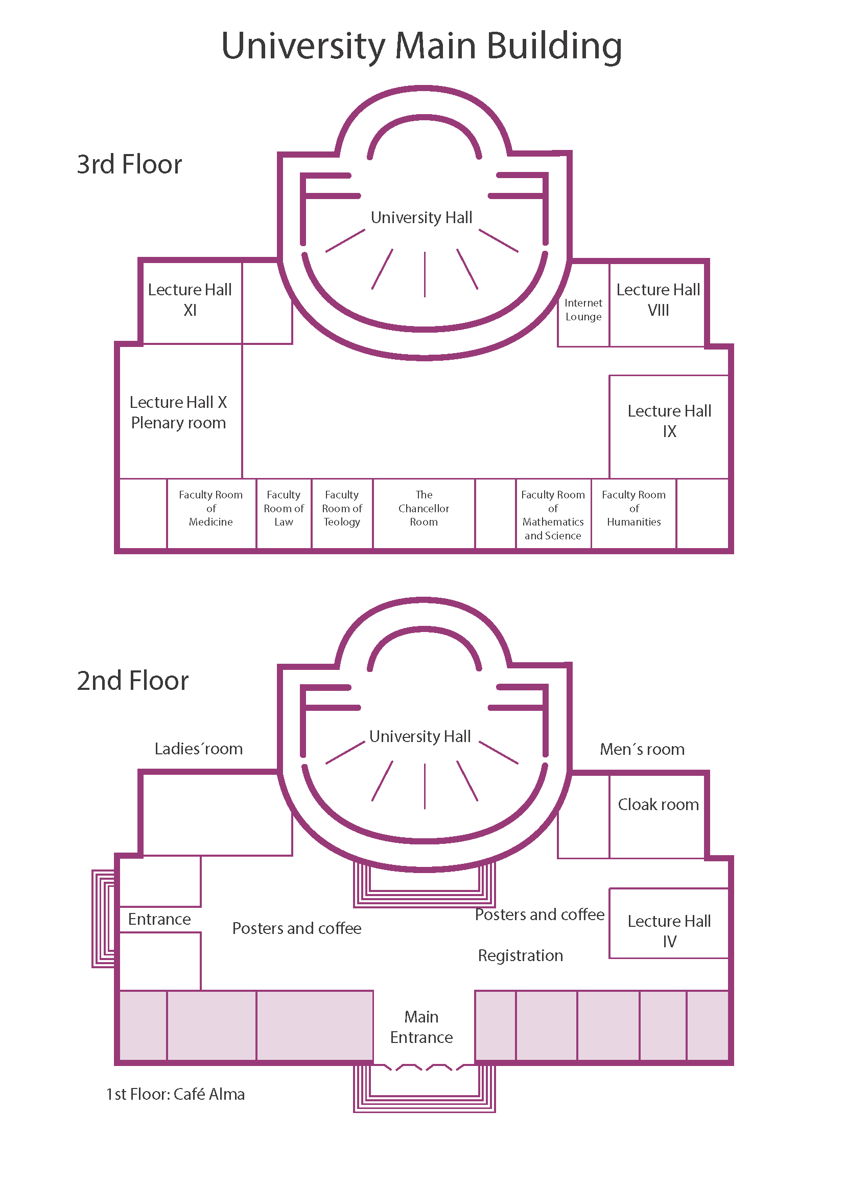
University Main Building - Plenary sessions are in Hall X - WG1 parallel sessions in Hall X -WG2 parallel sessions in Hall IX - WG3 parallel sessions in Hall IV - WG4 parallel sessions in Hall VIII - WG5 parallel sessions in Hall XI All Halls are on the upper floor, except Hall IV which is on the ground floor - Coffee on ground floor - Posters on ground floor - Gent’s room entrance on ground floor - Ladie’s room entrance on ground - Almas Café one stair down from ground floor - Welcome Reception on upper floor
Upper level
WG5
WG4
Plenary
WG2
Ground floor
WG3

Slide 4
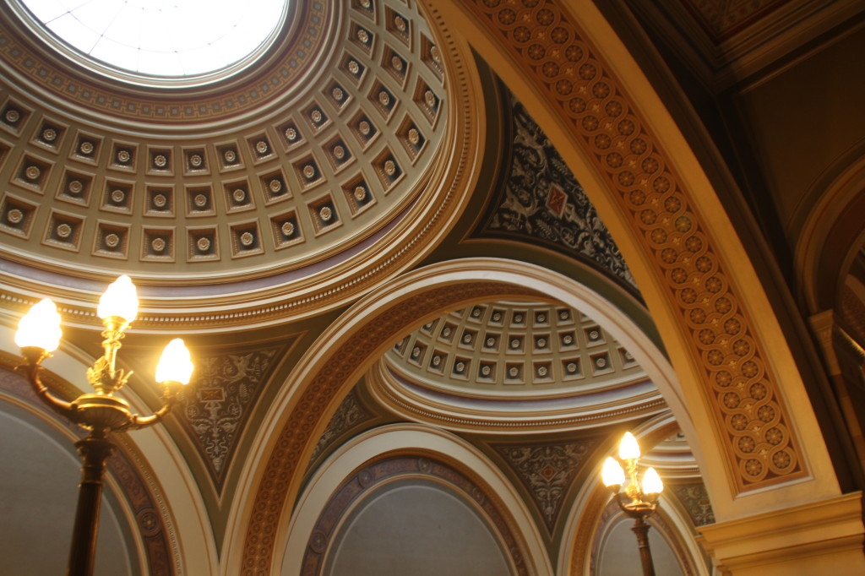
Technical information - Speaker laptops are available in all 5 session Halls. Speakers: please upload your presentations via the NUFACT2017 web site https://indico.uu.se/event/324/ as soon as possible. Please try the upload process already today so that we can fix access right etc before the time is too short. We will not accept local uploading from a USB-key - Access to internet via WiFi: 1. Use Eduroam 2. If you do not have access to Eduroam, look up UpUnet-S and log in at https://netlogon.student.uu.se , then click on User group ”Gästidentitet/Guest identity”and use the user–ID and password that you have received at the reistration desk.

Slide 5
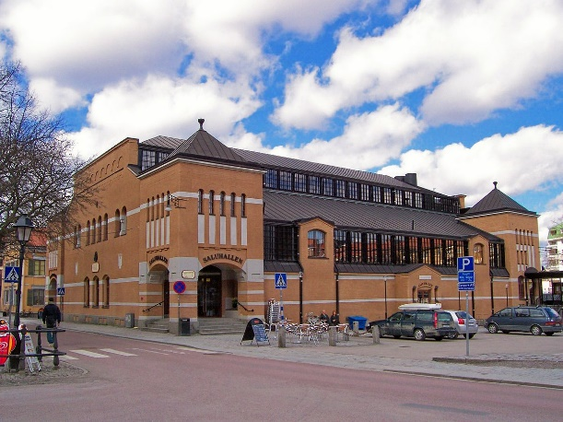
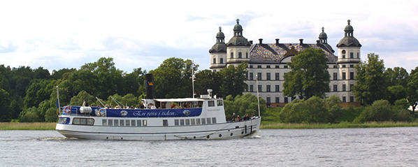
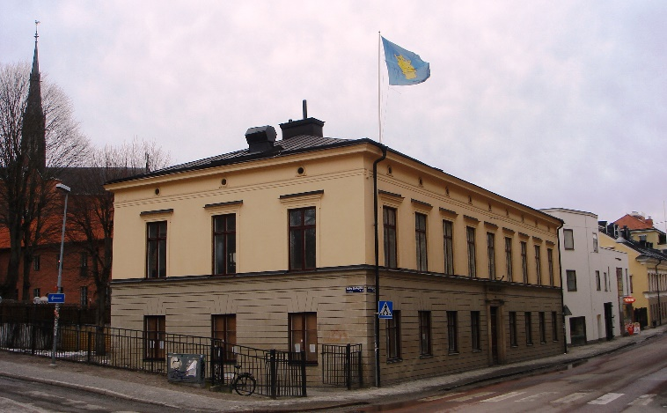
Social activities - Lunch each day at 12:30-14:00, maps with the location of restaurants and cafés available at the registration desk - Welcome reception, Monday at 18.00-19.00 in the Faculty Rooms on the upper floor gallery in the University Main Building - Excursion, Wednesday at 12:30-19:00, meeting point: Islandsbron, about 20 minutes walk from University Main Building. Lunch will be served on the boat. Deptature at 13.00. Be on time! - Dinner, Friday at 19:00 at Stockholms Student Nation, Drottninggatan 11, about 5 minutes walk from the University Main Building

Slide 6
Map of central Uppsala
A map on which you will find the locations of social activities and of a few near restaurant can be collected at the registration desk
Confernce venue
Uppsala University Main Building, Biskopsgatan 3
Social programme
2. Boat excursion on Sept 27 from Uppsala Harbour at Islandsbron
3. Worshop dinner on Sep 29 Stockholm Nation, Drottninggatan 11
A few nearby restaurants and cafés
Café Alma in the Uppsala University Main Building
Katedralcaféet, Domkyrkoplan 7
Janken and Feskarn in Saluhallen, S:t Eriks Torg 8
Ristorante Villa Romana, Gamla Torget 4

Slide 7
Safety information
In case of Emergency, please follow Emergency exits.
After exiting the building gather behind the University on the other side of the street Övre Slottsgatan
Follow instructions from staff with yellow vests and listen to speakers voice
Smoking is only allowed outside the building at a minimum distance of 15 metres from the building.

Slide 8
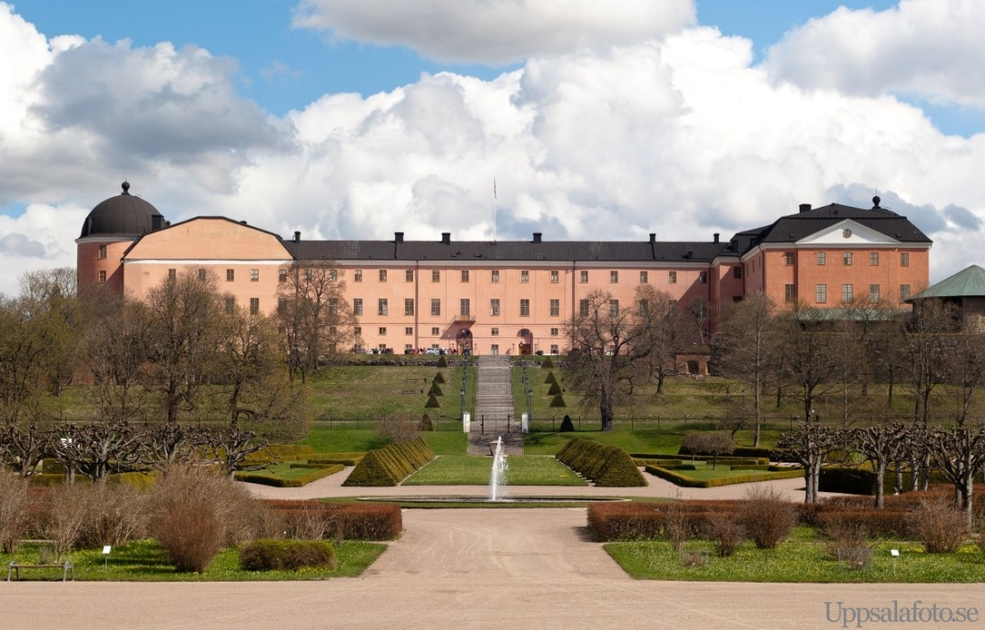
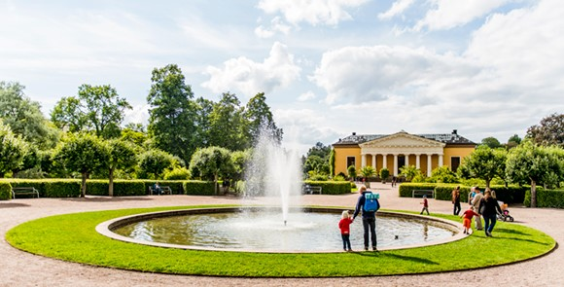
We hope that you will enjoy a fruitful NUFACT worshop and a pleasant stay in Uppsala!
Uppsala Castle
Uppsala Botanical Garden

