Slide 1
Future High Power Proton Drivers for Neutrino Beams
Ciprian Plostinar
NuFact’17 – Uppsala, Sweden
24 September 2017

Slide 2
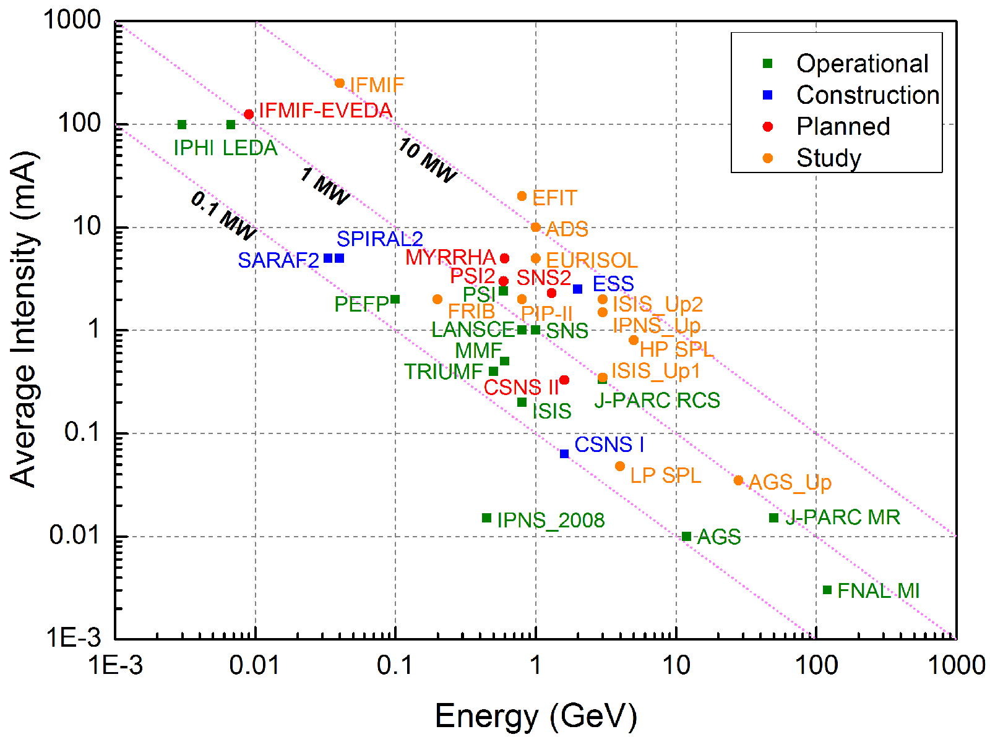
The Big Picture:
Global Demand for High Power Beams

Slide 3
The Big Picture:
Global Demand for High Power Beams
Spallation Neutron Sources
  ISIS (UK), SINQ@PSI (CH), SNS (USA), J-PARC (JP), LANSCE (USA), CSNS (CN), ESS (SE)
Radioactive Ion Beams (RIB)
  FAIR@GSI (DE), FRIB (USA), EURISOL (Europe), ISOLDE (CH), RIKEN (JP), SPIRAL2 (FR), SPES (IT), SARAF (IL), etc.
Material Irradiation Facilities (MIF)
  IFMIF-EVEDA, IFMIF and FAFNIR(Global effort).
Secondary Beams (Neutrino/Muon/Kaon Factories)
  Linac4/SPL@CERN (CH), PIP-II at Fermilab, (IDS-NF (Global effort), UKNF (UK))
Accelerator Driven Subcritical Reactors (ADSR).
  ADS (CN), MYRRHA (BE), ThorEA (UK).
Accelerator Driven Transmutation of Radioactive Waste (ATW)
  TRASCO (IT)
Accelerator Production of Tritium (APT).
  APT@LANL (USA)

Slide 4
The Neutrino Factory
Courtesy of C. Prior

Slide 5
The Past
Several studies, global effort:
  FNAL, RAL, CERN, etc.
International Scoping Study (ISS) of a Future Neutrino Factory and Superbeam Facility
  Accelerator Working Group (AWG)
  International Design Study (IDSNF) - ISS Successor
  EUROnu
Multiple merits
  Identified potential technical solutions
Proton driver
  What is the optimum beam energy/repetition rate/bunch length/beam power/etc.?
  What is the preferred hardware configuration: linac, synchrotron, FFAG rings…?
Develop and adapt existing facilities vs green-field solutions
Identified synergies between neutrino factory drivers and proton accelerators used for spallation neutron sources.
The ISS Accelerator Working Group et al., 2009, JINST 4 P07001

Slide 6
@RAL
ISIS MW Upgrades and Neutrino Beams
  A common proton driver
J. Thomason and J. Pasternak, WEPS105, Proc. of IPAC2011, San Sebastian, Spain.

Slide 7
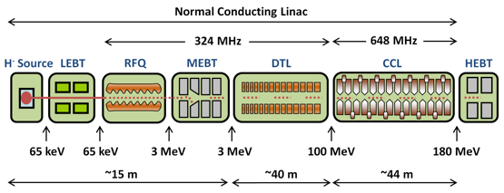
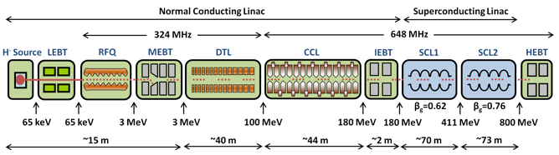
@RAL
C. Prior and G. Rees, “RAL Proton Driver Studies for a Neutrino Factory”, RAL Internal Report, 2011.
C. Plostinar et al., WEPC041, Proc. of IPAC2011, San Sebastian, Spain.

Slide 8
@CERN - SPL
F. Gerigk (Ed.), “Conceptual Design of the Low-Power and High-Power SPL”, CERN–2014–007.

Slide 9
@FNAL – ProjectX
S. Holmes (Ed.), “Project X Reference Design Report June 2013”, June 2013.

Slide 10
“R&D Needs”
Significant progress
  Accelerator Front End
  High-gradient cavities
  Injection
  FFAG Development and Prototyping
  Fast beam chopping
  Etc.
Important issues:
  Beam loss: “The whole machine should be designed for very low uncontrolled beam loss to permit hands-on maintenance”.
  Space-charge: “Continued development and testing of tracking codes adequate for this parameter regime are also important”
  Etc.
See B. Freemire, “Accelerator R&D Toward Proton Drivers for Future Particle Accelerators”, Tuesday 26 Sep., WG3

Slide 11
The Future
Japan
  J-PARC, KEK
China
  IMP, IHEP, CiADS, CSNS
Europe
  ESSnuSB
North America
  PIP-II
Others

Slide 12

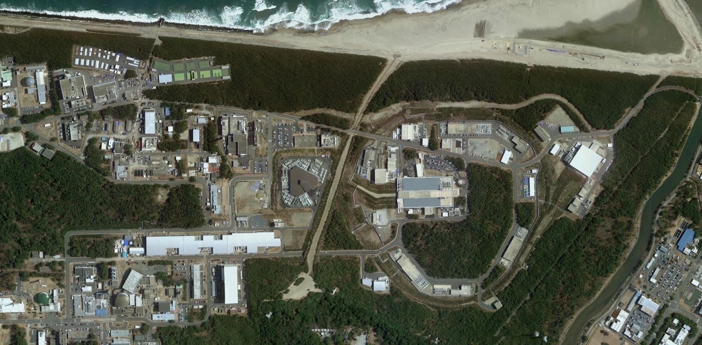
J-PARC Accelerators
High Intensity Proton Accelerators
400 MeV Linac, 3 GeV RCS, 30 GeV MR
Facility to use the secondary beams
Operated by Japan Atomic Energy Agency (JAEA) and High Energy Accelerator Research Organization (KEK)
Main Ring (MR)
Circumference 1567.5 m
Three-fold symmetry
Imaginary Transition γ lattice
Injection Energy 3GeV
Extraction Energy 30 GeV
Beam Power
  470 kW (Present)
  750 kW (Design)
Beam Loss Localization
Less radioactive
Rapid Cycling
Synchrotron
(RCS) [3 GeV]
Hadron Hall
LINAC [400 MeV]
Material and Life
Science Facility
(MLF)
Main Ring (MR)
[30 GeV]
Neutrino
Facility
Courtesy of Y. Sato

Slide 13
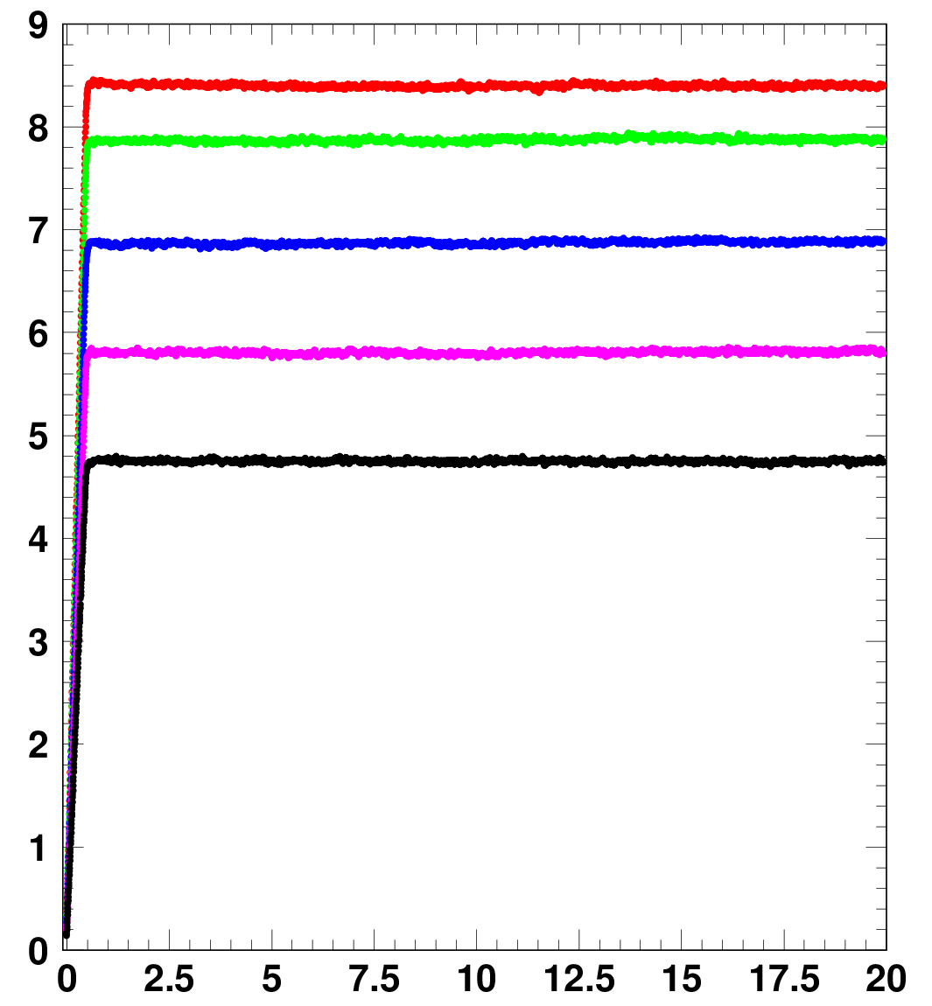
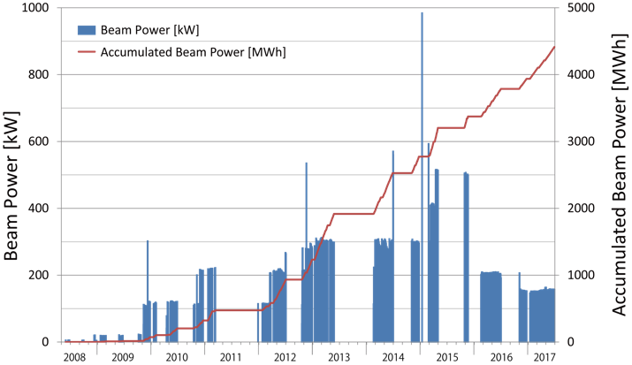
J-PARC Accelerators – Beam Power History
1 MW demonstration (4.2x10¹³ ppb) was successfully performed - RCS.
500 kW max. achieved for user operation
After replacing the Hg-target in the 2017 summer, beam power will be recovered.
Beam loss is well controlled up to 1 MW eq.
8.41 x 10¹³ ppp:1010 kW-eq.
7.86 x 10¹³ :944 kW-eq.
6.87 x 10¹³ :825 kW-eq.
5.80 x 10¹³ :696 kW-eq.
Number of particles / pulse (x10¹³)
4.73 x 10¹³ :568 kW-eq.
RCS 1 pulse includes 2 bunches
Courtesy of Y. Sato
Time (ms)

Slide 14
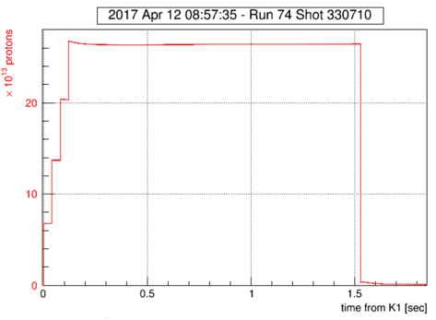
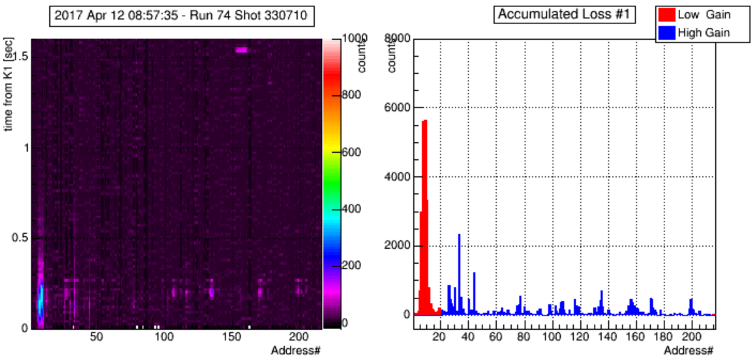
J-PARC - High Intensity Beam Study
The MR has capability to achieve >1MW with the high repetition rate operation.
High Gain =Low Gain x8
  Betatron tune (21.35, 21.45)
  2nd harmonic rf
Extracted beam : 2.64 e14 ppp
Total beam loss ~ 1.7 kW
 | Protons per pulse | Bunch number | Repetition period (sec) | Beam power (kW) | Beam loss (kW) | Notes
1 | 2.64e14 | 8 | 2.48 | 511 | 1.7 | measurement
2 | 2.64e14 | 8 | 1.16 | 1092 | 3.6 | estimation
Courtesy of Y. Sato

Slide 15
J-PARC MR Upgrade – Mid-Term Plan
JFY | 2015 | 2016 | 2017 | 2018 | 2019 | 2020 | 2021 | 2022
 |  |  |  |  | Long shutdown
FX power [kW] SX power [kW] | 390 42 | 470 42 | 480-500 50 | > 500 50-60 | 700 60-80 | 800 80 | 900 80-100 | 1060 100
Cycle time of main magnet PS New magnet PS | 2.48 s |  |  | 2.48 s | 1.3 s | 1.3 s | 1.3 s | 1.3 s
High gradient rf system 2nd harmonic rf system
Ring collimators | Add.collimators (2 kW) |  |  |  | Add.colli. (3.5kW)
Injection system FX system
SX collimator / Local shields
Ti ducts and SX devices with Ti chamber |  |  | ESS
New buildings
Mass production
installation/test
Installation
Manufacture, installation/test
Kicker PS improvement, Septa manufacture /test
Kicker PS improvement, FX septa manufacture /test
Local shields
Courtesy of Y. Sato

Slide 16
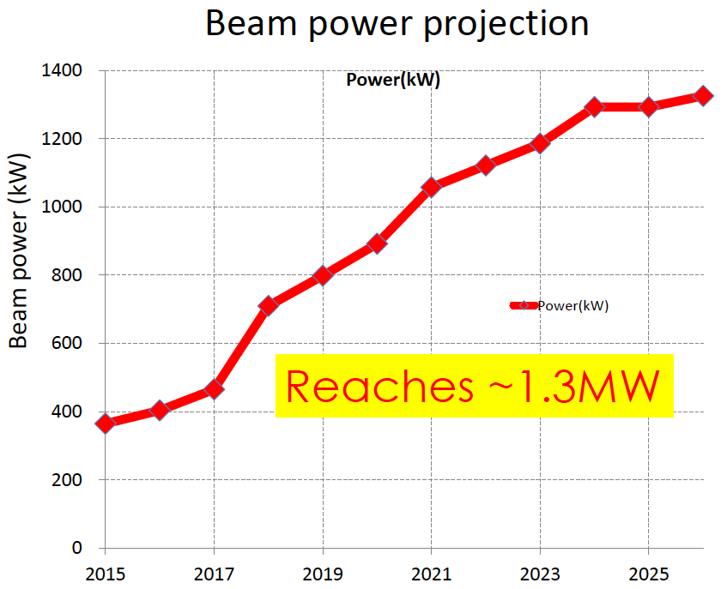
J-PARC MR Upgrade – Mid-Term Plan
Mid-term plan of MR upgrade for FX
RF upgrade
Magnet PS upgrade
2.48 → 1.3 s cycle
Add two 2nd H_RFs
1.3 → 1.16 s cycle
Target Power ~1.3 MW
2019
2015
2017
2020
2022
2024
2026
See T. Sekiguchi, “Upgrade of J-PARC Accelerator and Neutrino Beamline toward 1.3 MW”, Monday 25 Sep, WG3

Slide 17
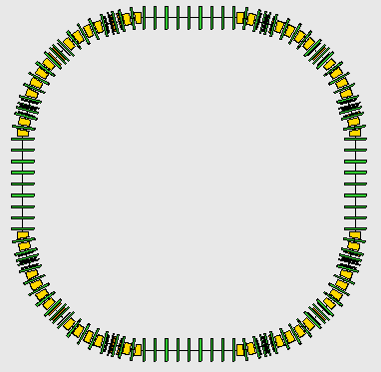
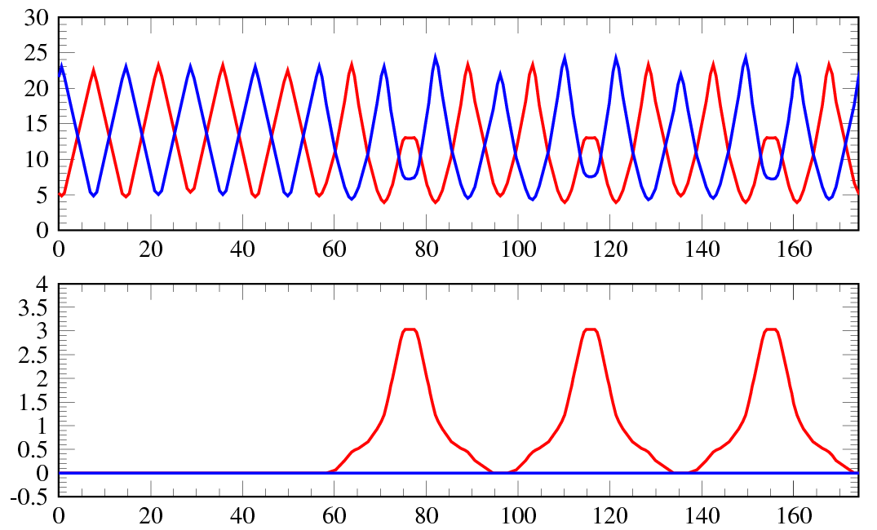
J-PARC – Long Term Plans: 8 GeV Booster Ring
RF CAVs
8-GeV BR
Injection energy 3 GeV
Extraction energy 8 GeV
Circumference 696.666 m
Superperiodicity 4
Transition gamma ~15 GeV
Collimator Aperture 126 π.mm.mrad
Physical Aperture 189 π.mm.mrad
Beta & Dispersion for 1-superperiod
INJ+COLL
RF CAVs
H & V
β_{x,y} (m)
EXT
η_{x,y} (m)
H. Hotchi et al, “Introducing an 8-GeV Booster Synchrotron between RCS and MR at J-PARC — One Possible Option toward a Multi-MW Output Beam Power from MR”, JPS Conf. Proc. 8, 012008 (2015)
s (m)

Slide 18
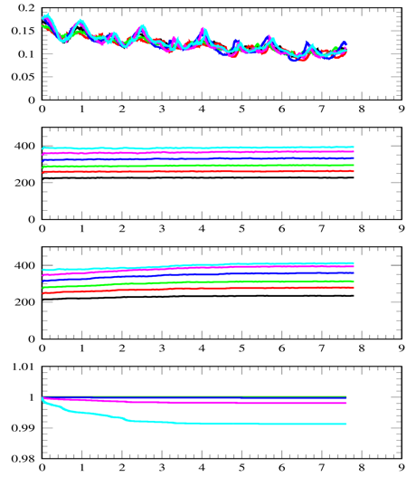
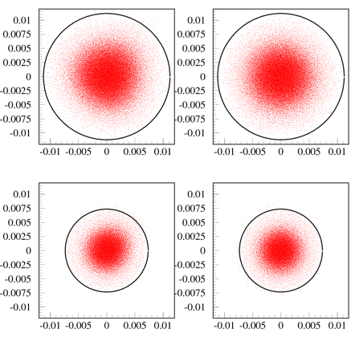
J-PARC – Long Term Plans: 8 GeV Booster Ring
Phase plot @ inj.(3GeV) & extr.(8GeV)
(12.45, 11.43)
Bf
RCS Beam:
ー 1.0 MW
ー 1.2 MW
ー 1.4 MW
ー 1.6 MW
ー 1.8 MW
ー 2.0 MW
@ 3GeV
ε>125.5π ~0.04%
ε_{x}
(π mm mrad)
99%, normalized
(x,x’)
(y,y’)
@ 8GeV
ε_{y}
(π mm mrad)
ε>54π ~0.06%
99%, normalized
Survaival
Tune footprint in 3 GeV calculated for the 1-MW-eq beam from the RCS
Time (ms)
RCS intensity | Survival | Loss power
1.0 MW | 99.998% | 3.2 W
1.2 MW | 99.998% | 3.8W
1.4 MW | 99.997% | 6.7W
1.6 MW | 99.977% | 59W
1.8 MW | 99.815% | 533 W
2.0 MW | 99.123% | 2806W
RCS : 1.4 MW
MR > 2.2 MW
RCS : 2 MW
MR > 3.2 MW
Courtesy of Y. Sato

Slide 19
KEK Long Term Plans: Proton Driver in the KEKB Tunnel
The 9-GeV proton linac using ILC cavity and cryomodule
Outline of acceleration :
  1.2 GeV in 1st straight.
  3.3 GeV in 2nd straight.
  2.9 GeV in 3rd and 4th straight.
  3.3 + 2.9 x 2 = 9.0 GeV
Peak current : 100 mA (pulse)
Beam duty : 1 %
Beam power:
9000 MeV x 0.1 A x 1 % = 9 MW
6.2 GeV
Three 1.3 GHz
rebunchers
9 GeV
Three 1.3 GHz
rebunchers
To Kamioka
3.3 GeV
1.2 GeV
Three 650 MHz
rebunchers
T. Maruta et al, “Design Study on the 9 GeV Proton Linac at KEKB Tunnel for the Next Generation Neutrino Experiment”, JPS Conf. Proc. 8, 011013 (2015)

Slide 20
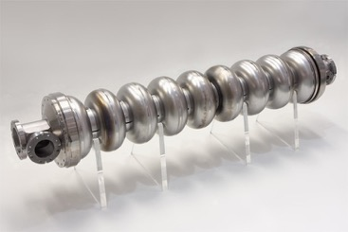
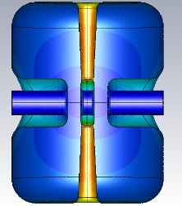
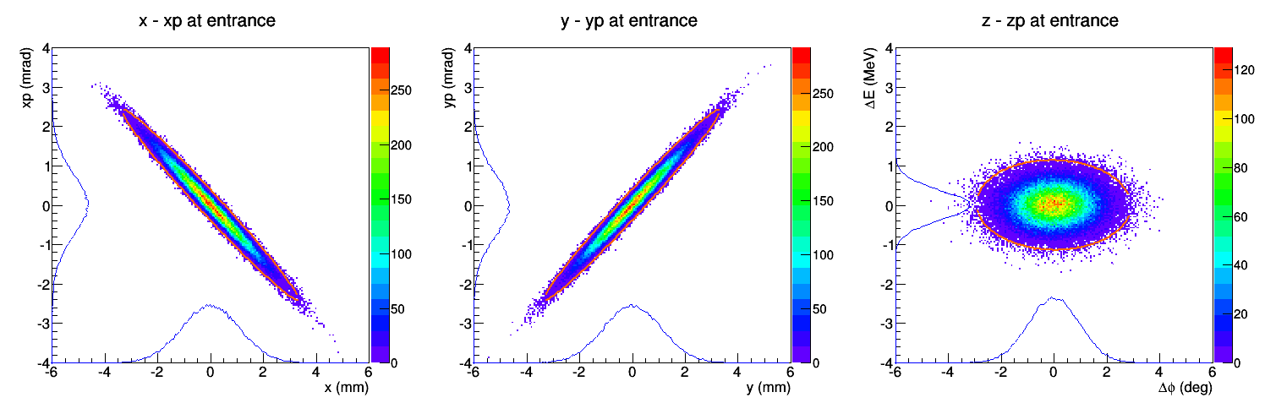
KEK Long Term Plans: Proton Driver in the KEKB Tunnel
Baseline layout
β=0.1
5.0 MeV
β=0.14
10 MeV
β=0.3
46 MeV
β=0.51
153 MeV
β=0.69
360 MeV
β=0.90
1200 MeV
β=0.98
3600 MeV
β=0.99
6200 MeV
β=1.00
9000 MeV
IS
RFQ
HWR-I
HWR-II
SSR
LBE
MBE
HBE-I
HBE-II
HBE-II
f = 325 MHz
f = 650 MHz
f = 1300 MHz
Accelerating cavity parameters
 | RFQ | HWR-I | HWR-II | SSR | LBE | MBE | HBE-I | HBE-II
βopt | 0.01 – 0.10 | 0.13 | 0.21 | 0.38 | 0.62 | 0.73 | 0.93 | 1.0
Vacc | − | 0.89 MV | 3.7 MV | 4.5 MV | 11.9 MV | 16.2 MV | 30 MV | 30 MV
E_{out} | − | 10 MeV | 46 MeV | 153 MeV | 360 MeV | 1200 MeV | 3600 MeV | 9000 MeV
cavity no. | 1 | 6 | 16 | 29 | 13 | 74 | 108 | 256
cm no. | − | 1 | 2 | 6 | 5 | 25 | 27 | 32
cavity/cm | − | 6 | 8 | 5 | 3 | 3 | 4 | 8
Courtesy of Y. Sato

Slide 21
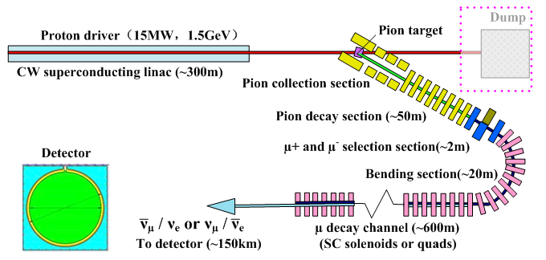
China – MOMENT Study
Science goal: leptonic CP violation phase measurement, future neutrino experiments
Features: ADS or ADS-like linac, High-field SC solenoids + fluidized target, DC muon beam for neutrinos, medium energy neutrinos
Courtesy of J. Tang

Slide 22
China – MOMENT Study
MOMENT will share or adopt similar CW superconducting linac as for ADS. In China, there is strong ADS development program
Y. Tang et al., “MOMENT: a muon-decay medium-baseline neutrino beam facility”, arXiv: 1401.8125v2

Slide 23
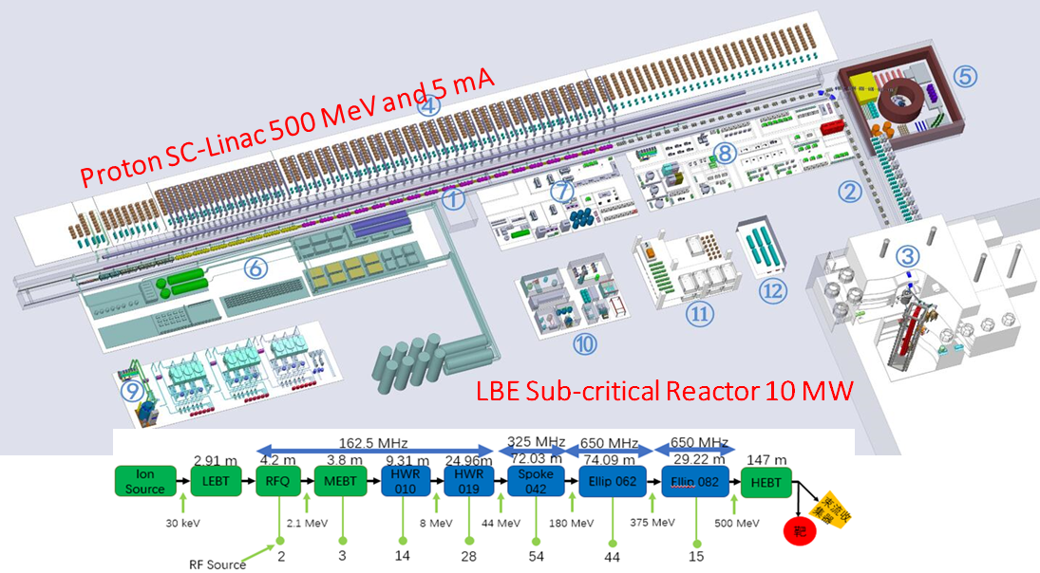
China – Recent ADS Linac Development
Very good progress in the Phase-I project (supported by IMP and IHEP): 25 MeV design goal achieved, CW mode achieved at 2 mA, world record!
CiADS project (ADS Phase-II) was approved and the construction is to start in Huizhou (not far from DYB): 500 MeV, 2.5 MW
CiADS schematic
Courtesy of J. Tang

Slide 24
China - CSNS
China Spallation Neutron Source (CSNS) is in commissioning, the accelerator reached its design energy of 1.6 GeV in July 2017. The project is on schedule to complete in March 2018
CSNS is mainly for multidisciplinary research based on neutron scattering techniques, but future neutrino experiments and muon physics are also under consideration
 | CSNS-I | CSNS-II
Beam Power (kW) | 100 | 500
Repetition rate (Hz) | 25 | 25
Target stations | 1 | 1 or 2
Average beam current (μA) | 63 | 313
Linac output energy (MeV) | 80 | 250
RCS output energy (GeV) | 1.6 | 1.6
Courtesy of J. Tang

Slide 25
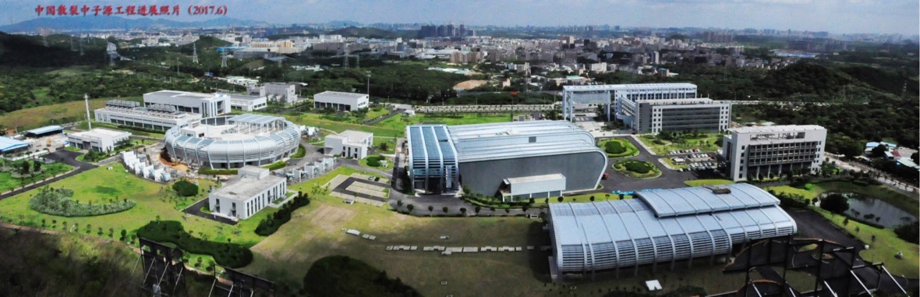
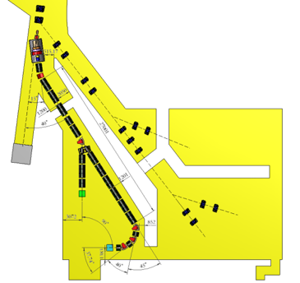
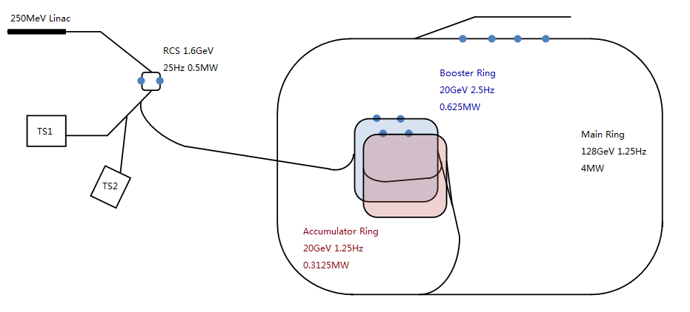
China - CSNS
EMuS muon source: neutrino cross section measurements
CSNS Post- Acceleration: 128 GeV – 4 MW for neutrino experiments
See G. Zhao, “EMuS in CSNS”, Tuesday 26 Sep, WG3.

Slide 26
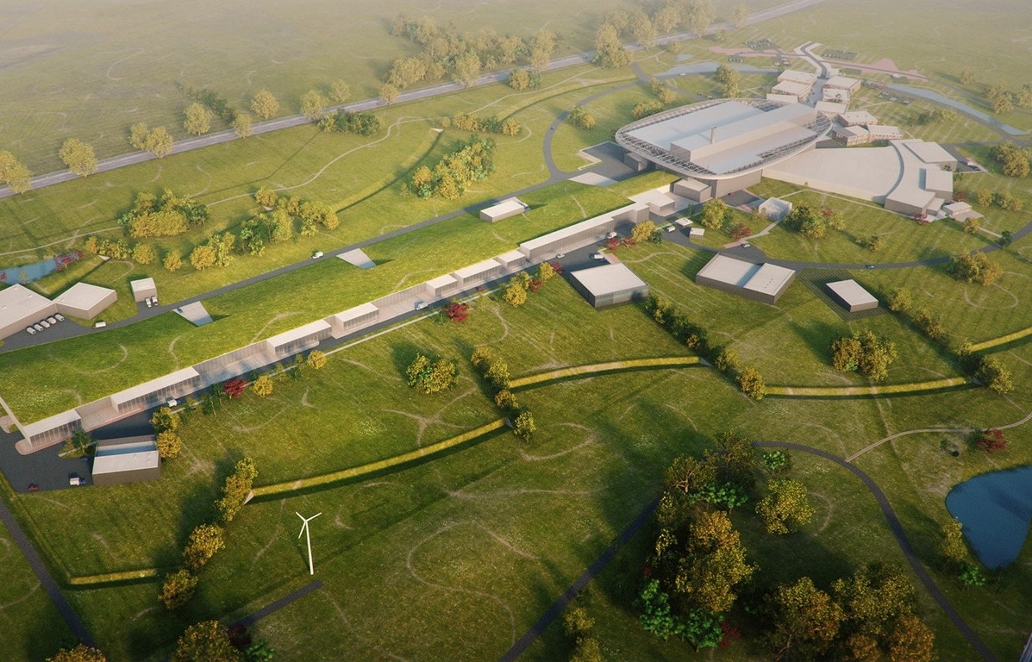
Europe – The European Spallation Source
High Power Linear Accelerator:
Energy: 2 GeV
Rep. Rate: 14 Hz
Current: 62.5 mA
Target Station:
He-gas cooled rotating W-target ( 5 MW average power)
42 beam ports
16 Instruments in Construction budget
Committed to deliver 22 instruments by 2028
Peak flux ~30-100 brighter than the ILL
Ion Source
Total cost: 1843 MEuros ₂₀₁₃

Slide 27
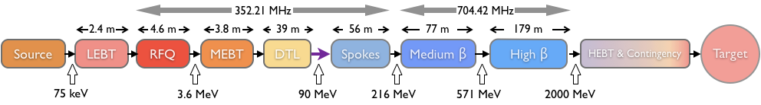
The ESS Linac
Ion Species | Protons
Output Energy | 2 | GeV
Frequency | 352.21/704.42 | MHz
Pulse Length | 2.86 | Ms
Peak Current | 62.5 | mA
Protons per Pulse | 1.1 x 10¹⁵
Repetition Rate | 14 | Hz
Duty Cycle | 4 | %
Average Beam Power | 5 | MW
Accelerating Structures | RFQ, DTL, SC Spokes/Elliptical
Accelerator Length | ~365 | m
See M. Lindroos, “Status of the ESS Project” – Thursday 28 September, WG3.

Slide 28
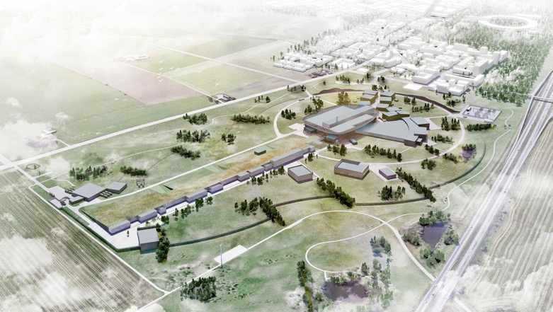
The European Spallation Source

Slide 29
The European Spallation Source

Slide 30
ESSnuSB
ESS has high potential
Neutrino SuperBeam
  Feasibility Study → CDR
nuSTORM
Short Pulse Neutron Source
See M. Dracos, “Status of ESSnuSB” – Thursday, 28 September, Plenary.
E. Wildner et al., “The Opportunity Offered by the ESSnuSB Project to Exploit the Larger Leptonic CP Violation Signal at the Second Oscillation Maximum and the Requirements of This Project on the ESS Accelerator Complex”, Advances in High Energy Physics, Volume 2016 (2016), Article ID 8640493

Slide 31
ESSnuSB
Simultaneous acceleration of H+ and H− ions at an average power of 5+5 MW
Significant Linac baseline upgrades
H- charge exchange injection
Accumulator design:
  1.1e15 protons – challenging
  Intensity Limits
  One ring vs four rings
  Etc.
See E. Wildner, “The ESSnuSB Accumulator” – Thursday, 28 September, WG3.

Slide 32
ESSnuSB – Linac Developments
RF Power Sources
  Modulators, Klystrons, etc.
Magnets
Cryomodules
Cooling
Cryogenics
Couplers
Beam Dynamics
Conventional Facilities
Etc.
See M. Eshraqi, “The ESS Linac and Upgrades for the Neutrino Facility” – Thursday, 28 September, WG3.

Slide 33
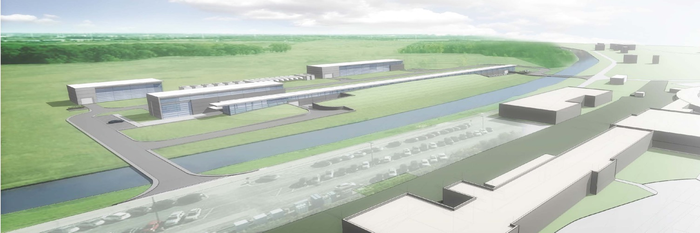
Fermilab – PIP-II
“The goal of PIP-II is to support long-term physics research goals as outlined in the P5 plan, by delivering world-leading beam power to the U.S. neutrino program and providing a platform for the future.”

Slide 34
PIP-II – Performance Goals
Increase MI power from 700 kW (NOvA) to >1 MW (LBNF) in the energy range 60 – 120 GeV
  To reduce the time for LBNF/DUNE to achieve world-first results
Increase Booster power from 80 to 160 kW
  8 GeV program: SBNE, …
To sustain high reliability operation of accelerator complex.
Future upgrades
  Mu2e at 0.8 GeV and ~100 kW CW beam
  Beam power to LBNF to >2 MW
  Provide a platform supporting a high duty factor/CW operation for future intensity frontier experiments getting beam simultaneously
V. Lebedev (Ed.) et al., “The PIP-II Conceptual Design Report ”, PIP-II-doc-113

Slide 35
PIP-II – Accelerator Physics Design
A new 800-MeV superconducting linac, constructed of CW-capable accelerating structures and cryomodules, operating with a peak current of 2 mA and a beam duty factor of 1.1%;
Beam transport line from the end of the SC Linac to the new Booster injection point, and to a new 800-MeV beam dump;
Upgrades to the Booster to accommodate 800-MeV injection, and acceleration of 6.5×10¹² protons per pulse;
  Repetition rate increase.
Upgrades to the Recycler to accommodate slip-stacking of 7.7×10¹³ protons delivered in twelve Booster batches;
  Repetition rate increase
Upgrades to the Main Injector to accommodate acceleration of 7.5×10¹³ protons per pulse to 120 GeV with a 1.2 second cycle time, and to 60 GeV with a 0.7 second cycle time.
All associated conventional facilities and infrastructure
Courtesy of V. Lebedev

Slide 36
PIP-II – Performance Goals
Performance Parameter | PIP | PIP-II
Linac Beam Energy | 400 | 800 | MeV
Linac Beam Current | 25 | 2 | mA
Linac Beam Pulse Length | 0.03 | 0.54 | msec
Linac Pulse Repetition Rate | 15 | 20 | Hz
Linac Beam Power to Booster | 4 | 17 | kW
Linac Beam Power Capability (@>10% Duty Factor) | 4 | ~200 | kW
Mu2e Upgrade Potential (800 MeV) | NA | >100* | kW
Booster Protons per Pulse | 4.3×10¹² | 6.5×10¹²
Booster Pulse Repetition Rate | 15 | 20 | Hz
Booster Beam Power @ 8 GeV | 80 | 166 | kW
Beam Power to 8 GeV Program (max) | 32 | 83 | kW
Main Injector Protons per Pulse | 4.9×10¹³ | 7.5×10¹³
Main Injector Cycle Time @ 60-120 GeV | 1.33** | 0.7-1.2 | sec
LBNF Beam Power @ 60-120 GeV | 0.7** | 1.0-1.2 | MW
LBNF Upgrade Potential @ 60-120 GeV | NA | >2 | MW
Courtesy of V. Lebedev

Slide 37
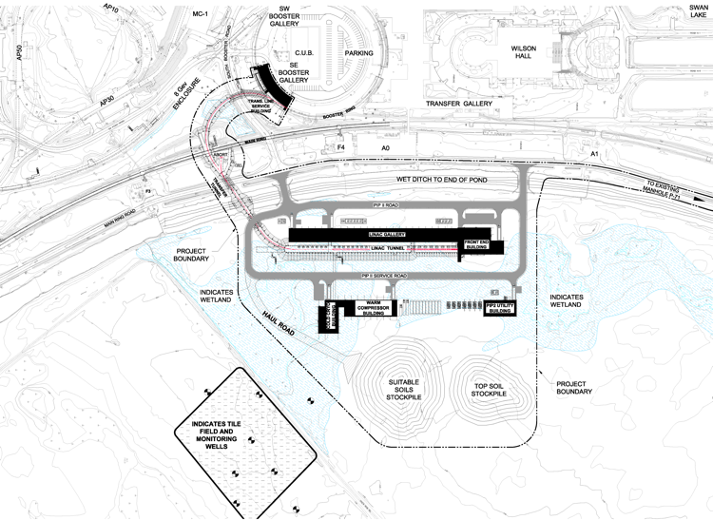
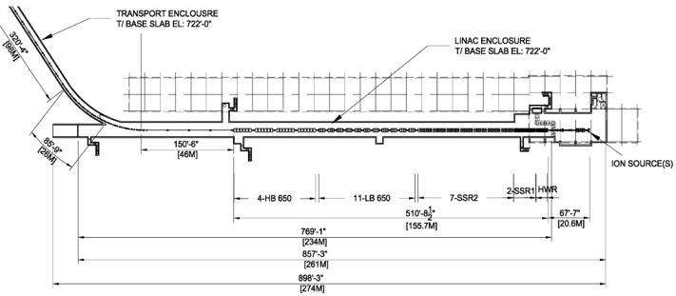
PIP-II – Site Layout

Slide 38

PIP-II – The SC Linac
Section | Freq | Energy (MeV) | Cav/mag/CM | Type
RFQ | 162.5 | 0.03-2.1
HWR (β_{opt}=0.11) | 162.5 | 2.1-10.3 | 8/8/1 | HWR, solenoid
SSR1 (β_{opt}=0.22) | 325 | 10.3-35 | 16/8/ 2 | SSR, solenoid
SSR2 (β_{opt}=0.47) | 325 | 35-185 | 35/21/7 | SSR, solenoid
LB 650 (β_{g}=0.61) | 650 | 185-500 | 33/22/11 | 5-cell elliptical, doublet*
HB 650 (β_{g}=0.92) | 650 | 500-800 | 24/8/4 | 5-cell elliptical, doublet*
*Warm doublets external to cryomodules All components CW-capable
Courtesy of V. Lebedev

Slide 39
Also at Fermilab: PIP-I+
PIP-I+ is proposed as a follow-on to PIP, before PIP-II
Program of Accelerator Improvement Projects
Aim at increasing NuMI intensity to 900 kW prior to PIP-II
  Increase intensity per pulse from Booster
Benefit of many improvements will carry over to PIP-II. Significant cross-over.
Address aging accelerator infrastructure
M. Convery, ”Accelerator prospects for FY18 and beyond” – PAC17

Slide 40
Conclusions and Topics for Discussion
Increase global demand for high power proton machines
Technology choice is better understood
Multi-MW beams will soon become a reality
Significant developments proposed
Multiple options for neutrino beams
Synergies
Existing machines can offer solutions for ready to be built neutrino facilities.
  nuSTORM?
Convergence?

Slide 41
Acknowledgments
M. Eshraqi, C. Prior, V. Lebedev, Y. Sato, J. Tang, E. Wildner, and many, others

Slide 42
Here’s to the ones who dream…

Slide 43
Here’s to ones who dream…
Courtesy of J. Pasternak
Courtesy of J-P Delahaye

