Slide 1
RaDIATE Collaboration and Proton Irradiation Campaign at BLIP
Yongjoong Lee (ESS)
On behalf of RaDIATE Collaboration
The 19th International Workshop on Neutrinos from Accelerators (NUFACT2017)
www.europeanspallationsource.se
26 September, 2017

Slide 2
Outline
High power targets: scope and challenges
Research focus of the RaDIATE collaboration
Irradiation Campaign at BLIP BNL
Summary

Slide 3
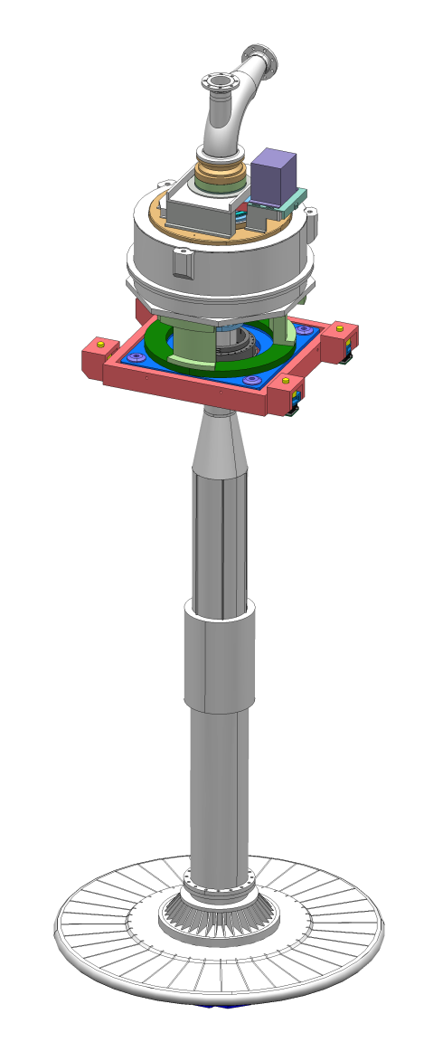
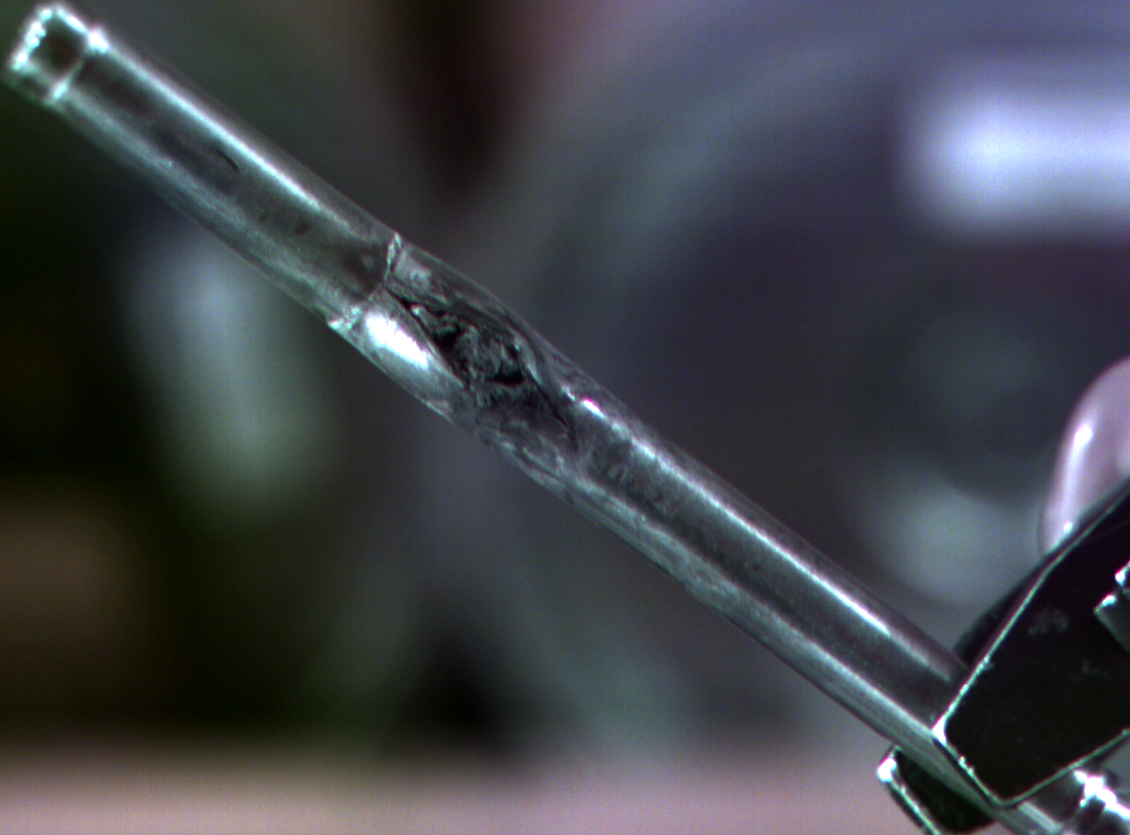
High Power Targetry Challenges
Major accelerator facilities have recently been limited in beam power not by their accelerators, but by their target facilities (SNS, NuMI/MINOS)
Even greater challenges are present for future high power and high intensity target facilities (ESS, …)
To maximize the benefit of high power accelerators (physics/€), challenges must be addressed in time to provide critical input to multi-MW target facility designs
Almost every high power target is an experiment!

Slide 4
High Power Targetry Scope
M. Wendel (SNS), Transformative Hadron Beamlines Workshop, Jul 2014 BNL
R&D Needs to support:
  Targets and Absorbers
    Solid, Liquid, Rotating, Rastered
  Other production devices
    Collection optics (horns, solenoids)
    Monitors & Instrumentation
    Beam windows
  Collimators
  Facility requirements
    Remote handling
    Shielding and Radiation Transport
    Air Handling
    Cooling System
J. Hylen (FNAL), NBI, Sep 2017 J-PARC

Slide 5
High Power/Intensity Targetry Challenges

Slide 6
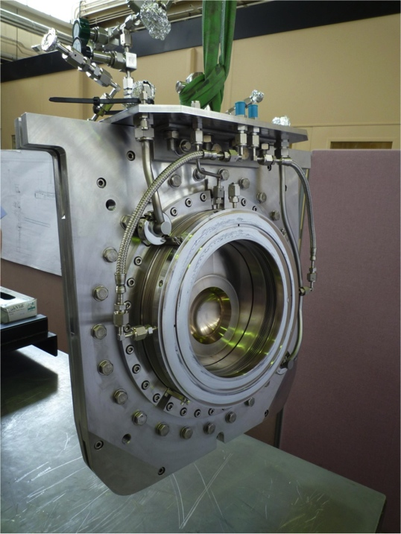
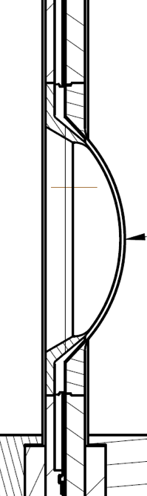
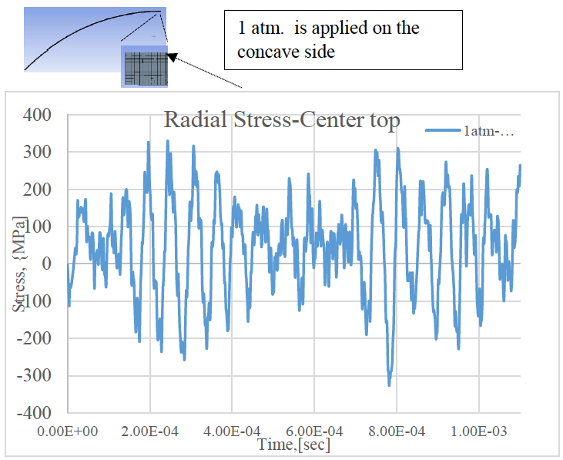
Thermal Shock (Stress Waves): T2K Beam Window
Material response dependent on:
  Specific heat (temperature jump)
  Coefficient of thermal expansion (induced strain)
  Modulus of elasticity (associated stress)
  Flow stress behavior (plastic deformation)
  Strength limits (yield, fatigue, fracture toughness)
Dynamic stress waves may result in plastic deformation, cracking, and fatigue
Heavy dependence on material properties, but material properties dependent upon Radiation Damage

Slide 7
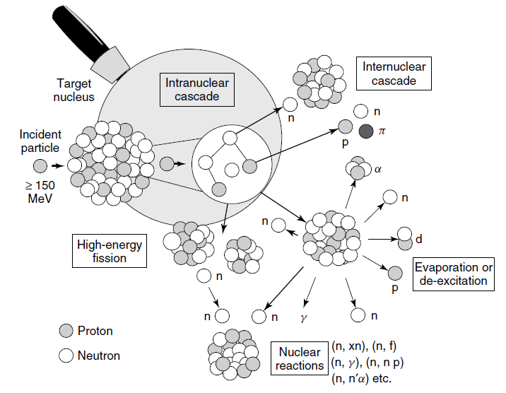
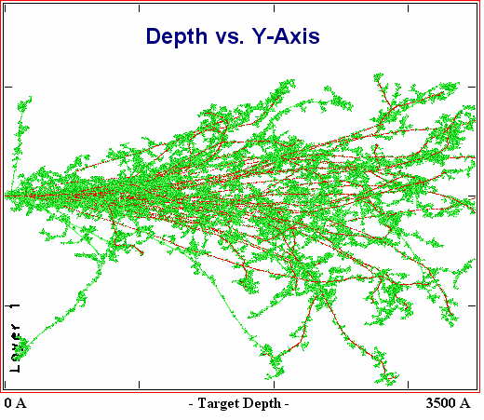
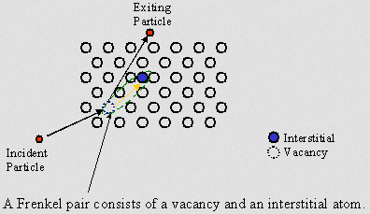
Radiation Damage Disorders Microstructure
Microstructural response:
  Creation of transmutation products
  Atomic displacements (cascades):
    Displacements Per Atom (DPA): Average number of stable interstitial/vacancy pairs created
From D. Filges, F. Goldenbaum, in:, Handb. Spallation Res., Wiley-VCH Verlag GmbH & Co. KGaA, 2010, pp. 1–61.

Slide 8
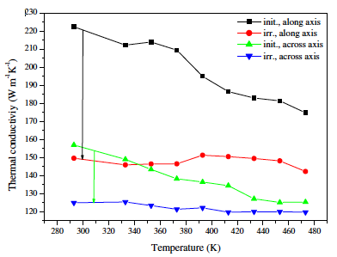
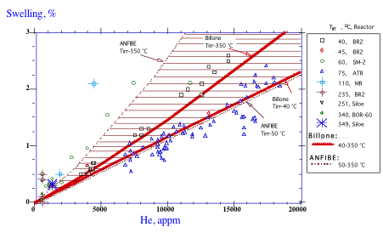
Radiation Damage Effects
Y. Dai, et al., JNM 377 (2008) 109
Loss of ductility, Increase of stiffness
Reduction of fracture toughness
Change of dimension, CTE
Decrease of thermal and electrical conductivity
Accelerated corrosion
Gas and solid transmutations
No universal correlation!
between radiation dose and properties of material degradation
V. Chakin, et al., Progr. in Nucl. Energy, 57 (2012)
Fusion Materials Handbook

Slide 9
High Power Target R&D Materials Exploratory Map

Slide 10
RaDIATE (Radiation Damage in Target and Accelerator Environments) Collaboration
Initiated by and chaired by Fermilab
  www.radiate.fnal.gov
  For contact: Patrick G Hurh, RaDIATE Chair, hurh@fnal.gov
Broad aims are threefold:
  to generate new and useful materials data for application within the accelerator and fission/fusion communities
  to recruit and develop new scientific and engineering experts who can cross the boundaries between these communities
  to initiate and coordinate a continuing synergy between research in these communities, benefitting both proton accelerator applications in science and industry and carbon-free energy technologies

Slide 11
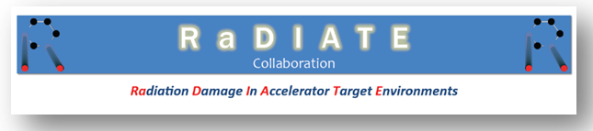






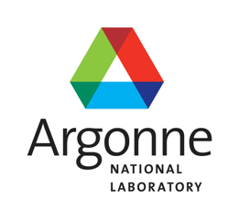





RaDIATE (Radiation Damage in Target and Accelerator Environments) Collaboration

Slide 12
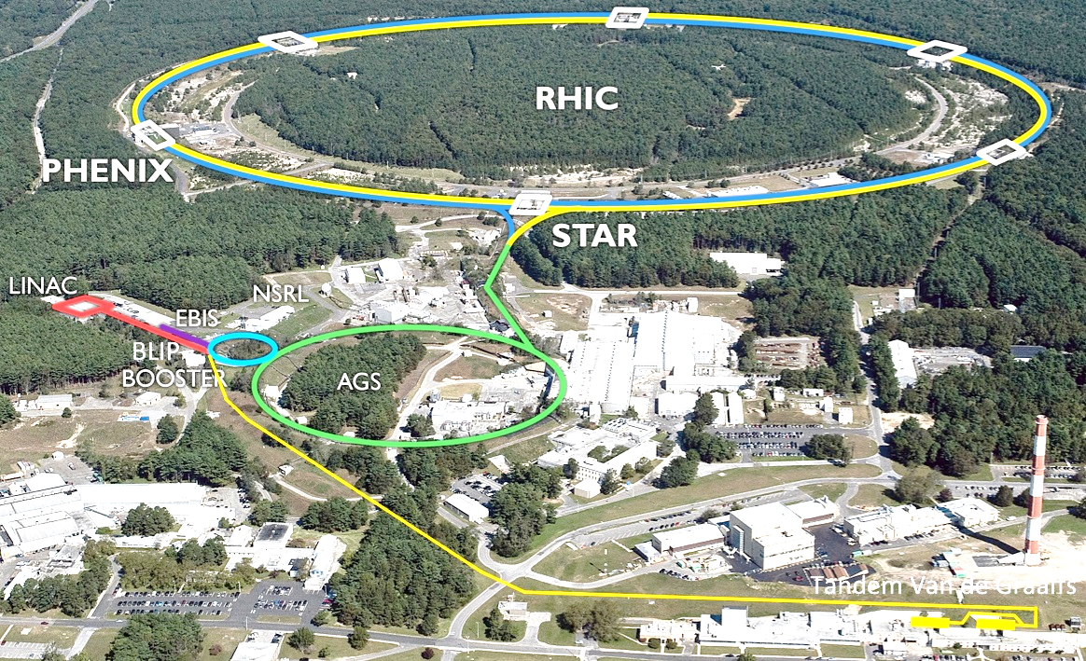
Proton Irradiation Campaign at BLIP BNL
BLIP’s primary mission is medical isotope production
High energy protons from the Linac
  Energy: 66 < E < 200 MeV
  Peak current: 165 µA
Material irradiation runs in tandem and upstream of isotope targets
  Optimized target array needed to deliver precise beam energy and flux for isotope production

Slide 13
Objectives
Evaluate radiation damage effects from high energy protons in beam intercepting and beam stopping materials
  Expose several material specimens to high energy protons at the BNL BLIP facility
Characterize property changes due to proton irradiation damage
  Perform PIE (Post Irradiation Examination)
Selection of radiation resistant candidate materials for intercepting and stopping of high power proton beam

Slide 14
Irradiation Capsule Layout
Total Irradiation Period:
8 Weeks during Apr 2017 – Feb 2018 (Max. 165 uA)

Slide 15
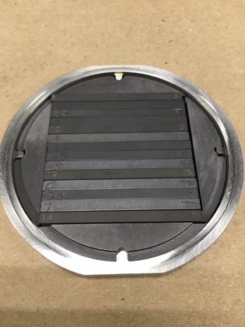
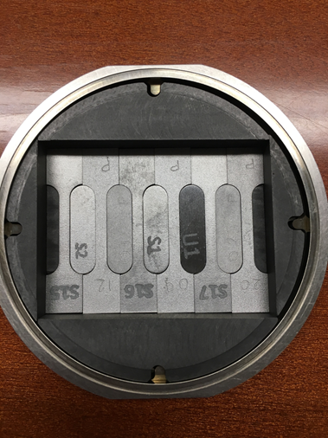
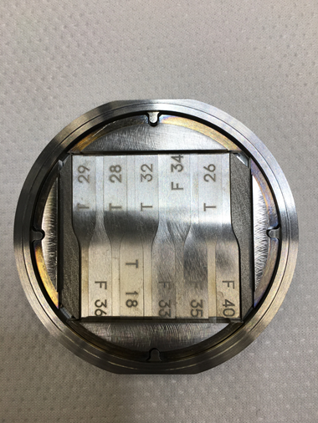
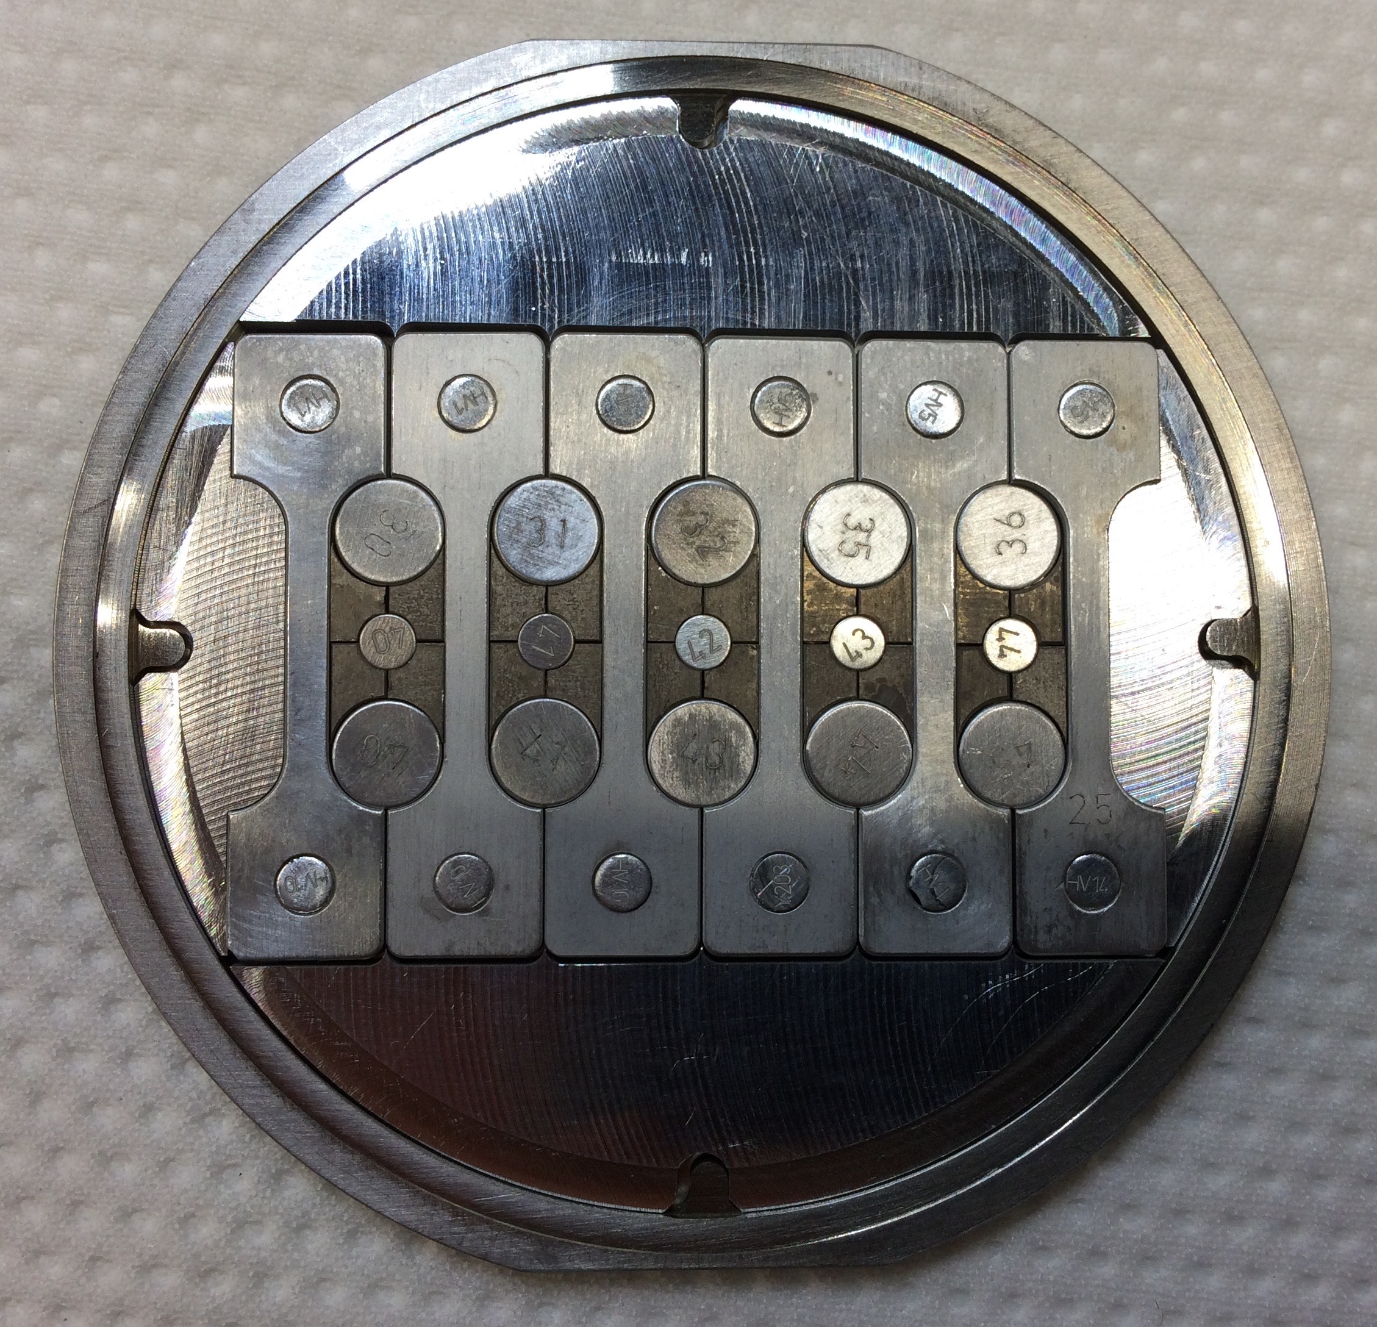
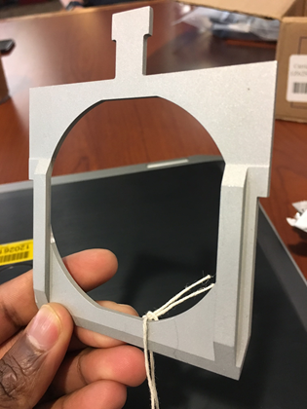
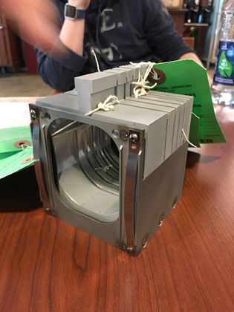
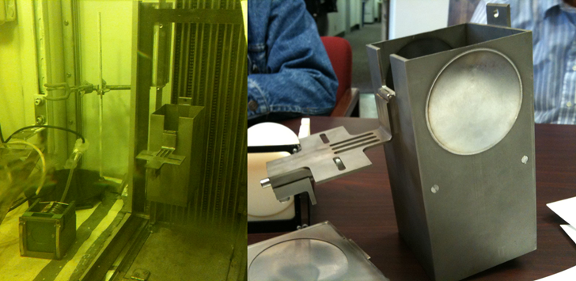
Specimens and Capsule Assembly/Installation
Graphite capsule
Beryllium capsule
Titanium capsule
Aluminum capsule
Welded capsule in gas/vacuum
Capsule holder and basket
Target box and BLIP hot cell

Slide 16
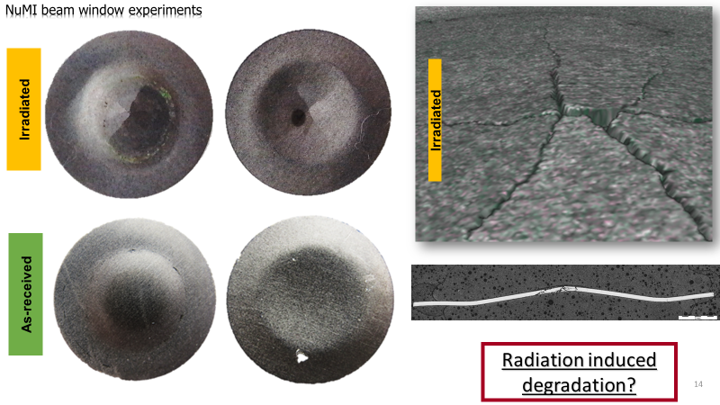
Beryllium Capsule
Characterization of NuMI Be window material under high fluence proton dose

Slide 17
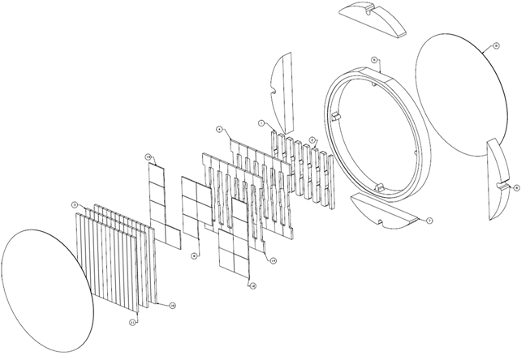
Graphite Capsule
Characterization of proton radiation induced material degradation of different grades of graphite for neutrino target application

Slide 18
Silicon, SiC coated Graphite, Expanded Graphite Capsule
Proton radiation induced degradation of beam dump core material (Si)
Proton radiation induced degradation of neutrino target material with oxidation resistant SiC coating (SiC coated graphite)
M. Calviani, A. Perillo-Marcone, RaDIATE Collaboration Meeting, Nov 24, 2015

Slide 19
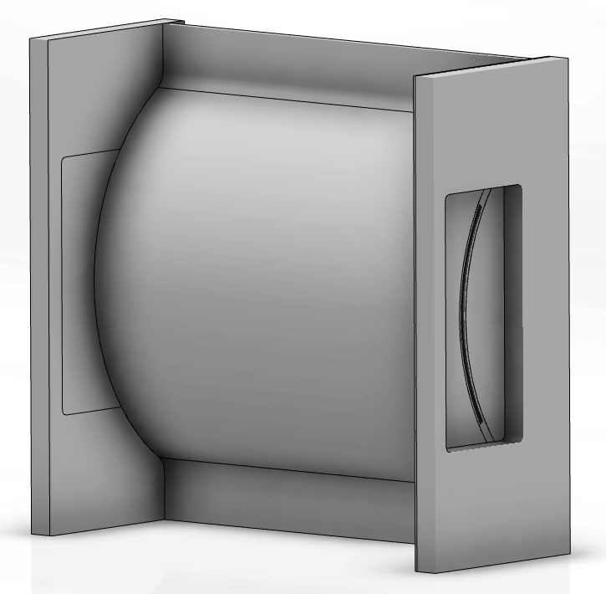
Aluminum Alloy Capsule
Purposes:
  Extension of PBW Materials:
    Characterization of helium bubble size and distribution in Al6061-T6 and Al5754-O
  Selection of luminescent coating materials for beam imaging:
    Characterization of radiation damage induced luminescence degradation of beam imaging coating materials
    Different grades of Cr-doped alumina

Slide 20
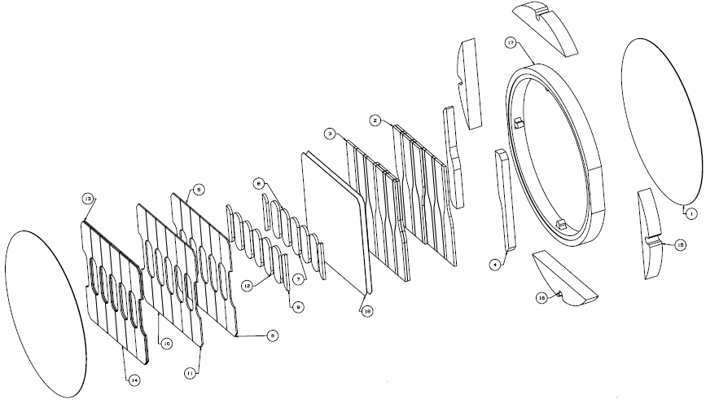
Titanium Alloy Capsule
Characterization of structural confinement materials for neutrino target under proton beam and dump under radioisotope beam
Characterization of beam induced luminescence loss in Optical Transition Radiation (OTR)

Slide 21
TZM, Iridium, CuCrZr, Flexible Graphite Capsule
M. Calviani, A. Perillo-Marcone, RaDIATE Collaboration Meeting, Nov 24, 2015

Slide 22
Summary
Beam intercepting devices in high power accelerators require stable/safe operation under challenging conditions
  Current accelerator facilities limited in beam power due to target survivability issues
  Future multi-MW accelerator upgrades/facilities pose even greater challenges
Beam intercepting devices will experience extreme operating conditions
  Increased rate of lattice displacements and transmutation gas production
  Larger dynamic thermal stresses due to pulsed beam nature
R&D activities by the global accelerator targets community under the aegis of RaDIATE is on-going to help meet future challenges
  Material radiation damage studies with high-energy protons at BLIP BNL
  Material radiation damage studies with low-energy ions
  In-beam thermal shock tests to evaluate response of both non-irradiated and irradiated materials – HiRadMat (Next Talk)

Slide 23
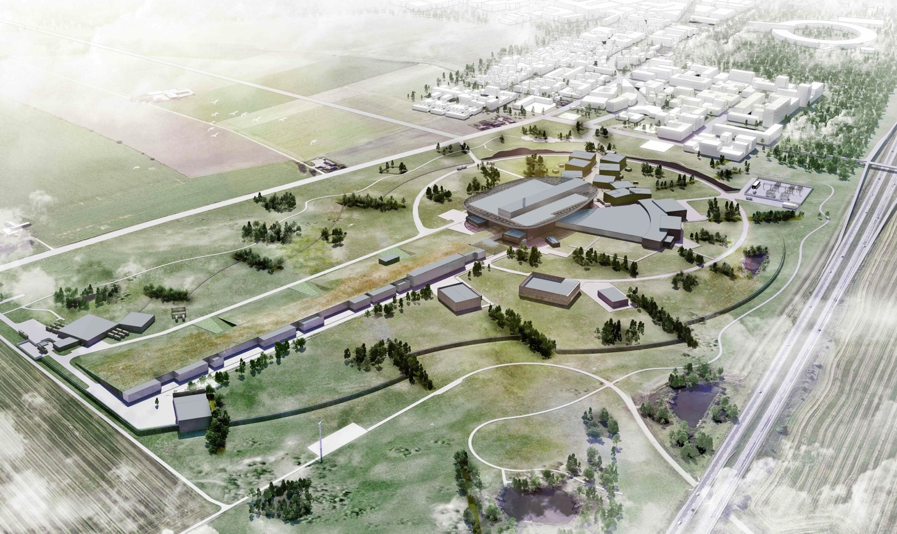
Thank you for your attention!

