Slide 1
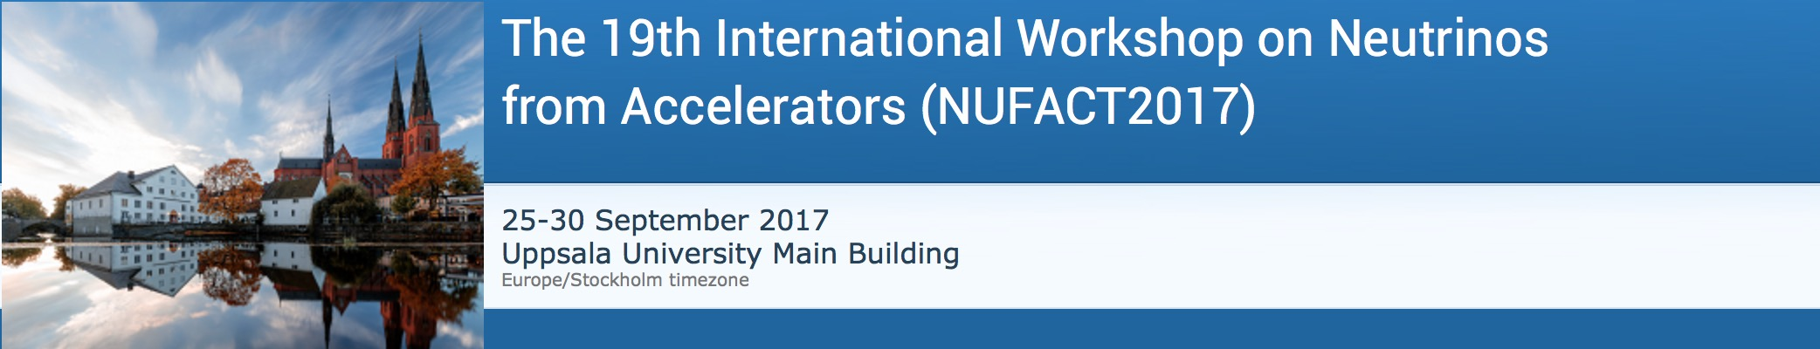
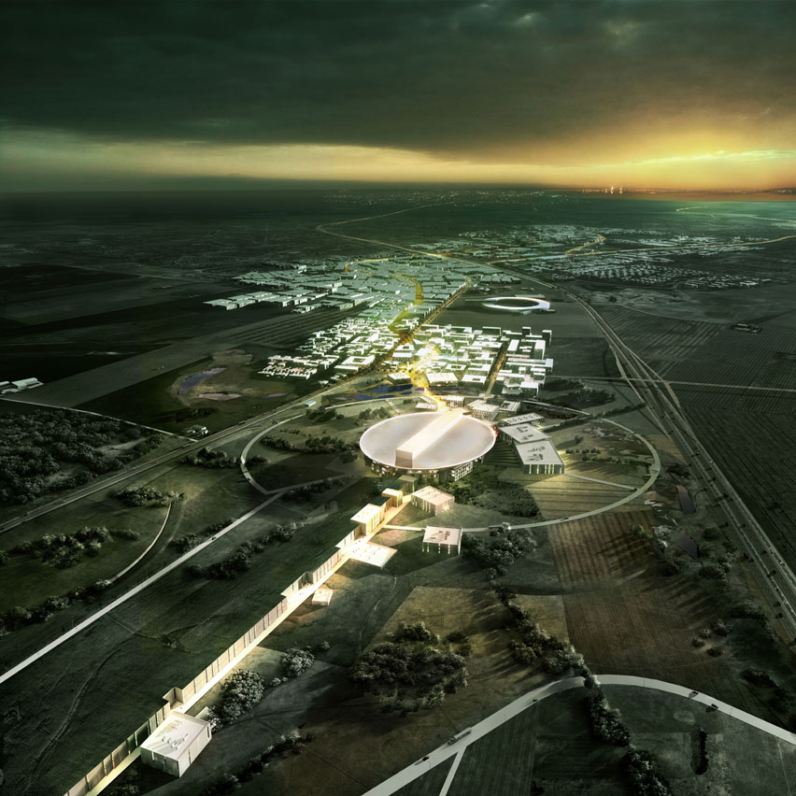
Status of ESS neutrino
Super Beam
(ESSνSB)
Marcos Dracos
on behalf of the ESSνSB/EuroNuNet project

Slide 2
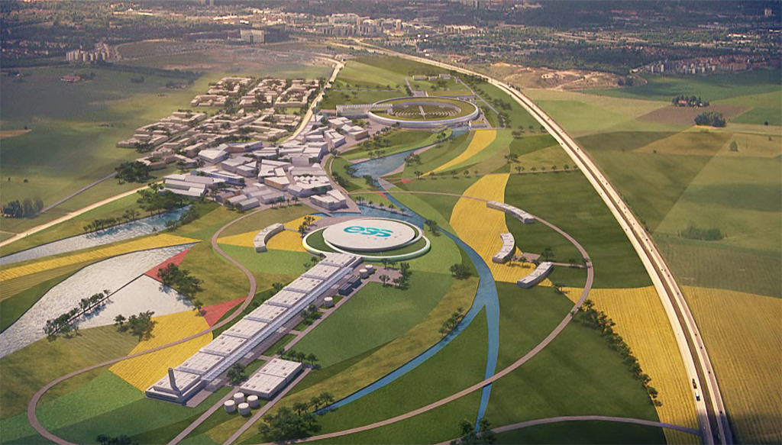
Overview
The European Spallation Source
The neutrino beam using the ESS facility
The needed ESS linac modifications
Ongoing activities
Physics performance
EU support

Slide 3


European Spallation Source

Slide 4
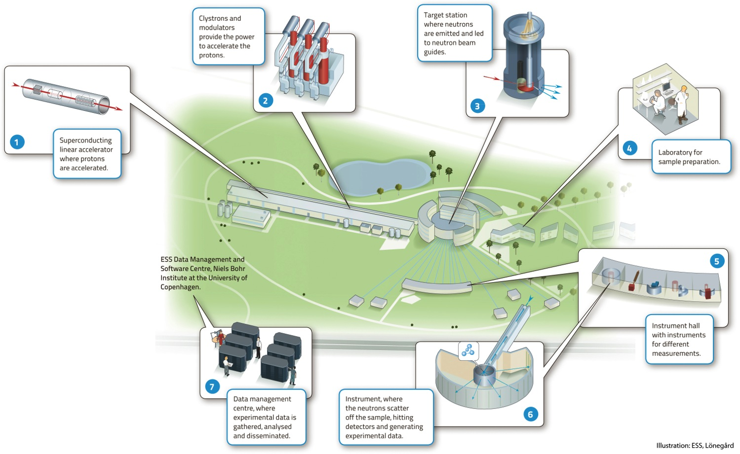


European Spallation Source
under construction since 2014
(~1.85 B€ facility)

Slide 5
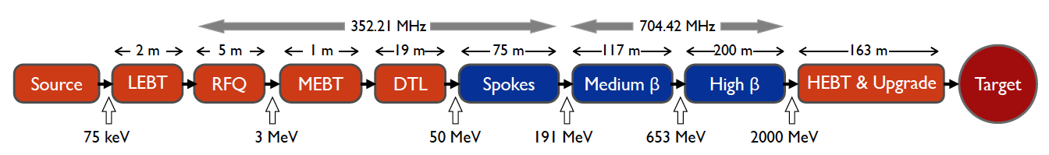
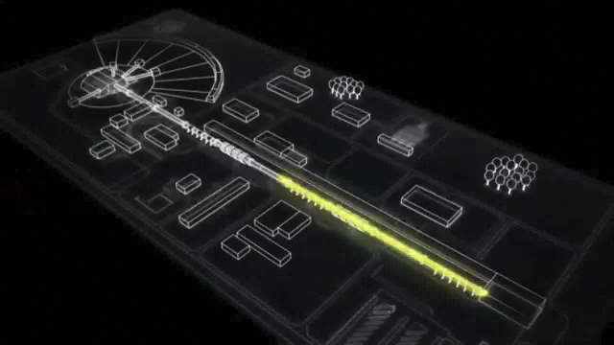
ESS proton linac
The ESS will be a copious source of spallation neutrons.
5 MW average beam power.
125 MW peak power.
14 Hz repetition rate (2.86 ms pulse duration, 10¹⁵ protons).
Duty cycle 4%.
2.0 GeV protons
  up to 3.5 GeV with linac upgrades
>2.7x10²³ p.o.t/year.
Linac ready by 2023 (full power)

Slide 6
What kind of neutrino beam can we extract using this linac?
by doubling the linac pulsing rate…
conventional neutrino (super) beam
decay tunnel
proton beam
hadrons
physics
p
π
ν
⨂B
target
hadronic collector
(focusing)
Detector
production of a powerful neutrino beam

Slide 7
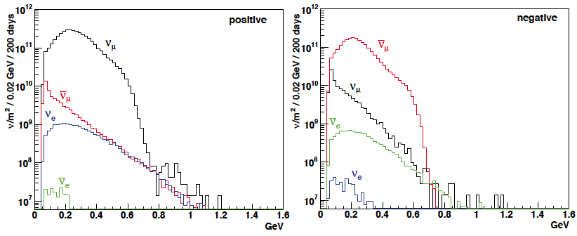
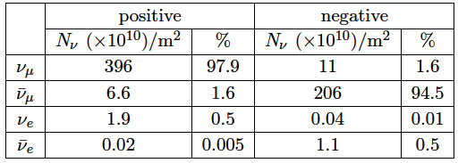
ESSνSB ν energy distribution
(without optimisation)
neutrinos
anti-neutrinos
almost pure ν_{μ} beam
small ν_{e} contamination which could be used to measure ν_{e} cross-sections in a near detector
at 100 km from the target and per year (in absence of oscillations)

Slide 8
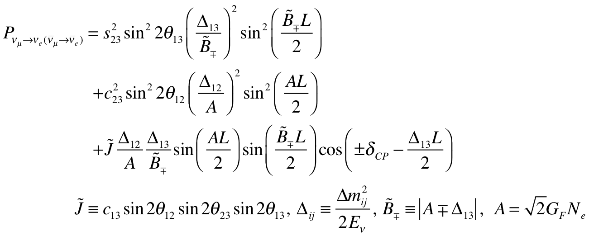
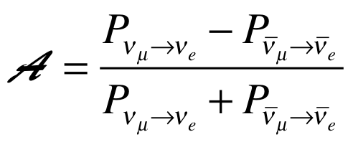
CP Violating Observables
(ν_{μ}→ν_{e})
atmospheric
Non-CP terms
solar
interference
CP violating
matter effect
⇒ accessibility to mass hierarchy
⇒ very long baseline
(small in our case)
≠0 ⇒ CP Violation
be careful, matter effects also create asymmetry

Slide 9
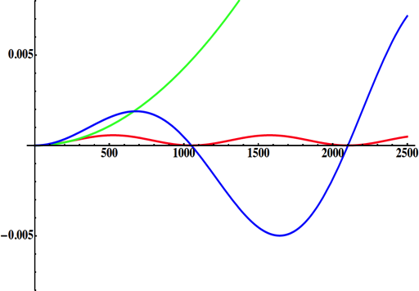
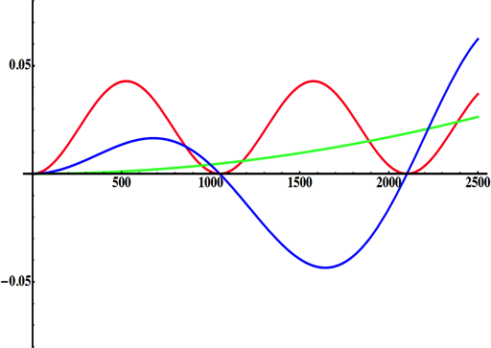
Neutrino Oscillations with "large" θ₁₃
solar
atmospheric
for "large" θ₁₃ 1st oscillation maximum is dominated by atmospheric term
for small θ₁₃ 1st oscillation maximum is better
atmospheric
solar
L/E
L/E
CP interference
(arXiv:1110.4583)
θ₁₃=1º
CP interference
θ₁₃=8.8º
2nd oscillation maximum
δ_{CP}=-90
δ_{CP}=0
δ_{CP}=+90
P(ν_{μ}→ν_{e})
1st oscillation max.: A=0.3sinδ_{CP}
2nd oscillation max.: A=0.75sinδ_{CP}
θ₁₃=8.8º
("large" θ₁₃)
(see arXiv:1310.5992 and arXiv:0710.0554)
L/E
more sensitivity at 2nd oscillation max.

Slide 10
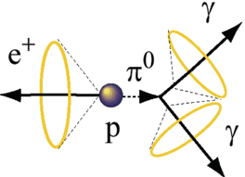
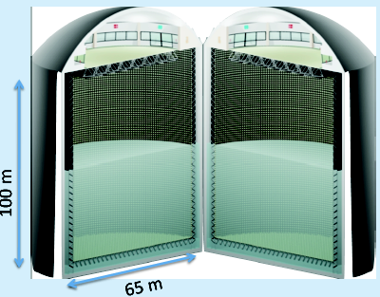
Can we go to the 2nd oscillation maximum using our proton beam?
Yes, if we place our far detector at around 500 km from the neutrino source.
MEMPHYS like Cherenkov detector
(MEgaton Mass PHYSics studied by LAGUNA)
(arXiv: hep-ex/0607026)
Neutrino Oscillations (Super Beam, Beta Beam)
Proton decay
Astroparticles
Understand the gravitational collapsing: galactic SN ν
  Supernovae "relics"
Solar Neutrinos
Atmospheric Neutrinos
500 kt fiducial volume (~20xSuperK)
Readout: ~240k 8” PMTs
30% optical coverage

Slide 11
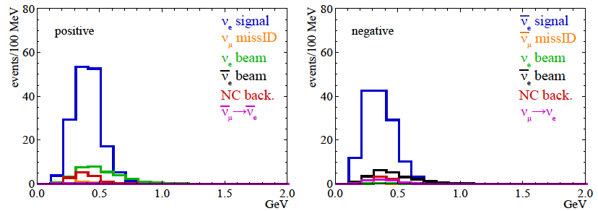
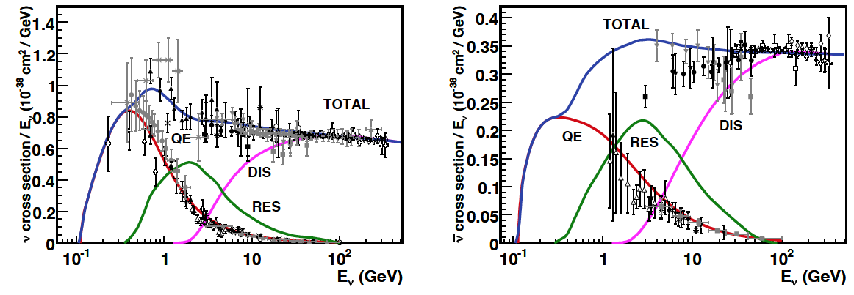
Neutrino spectra
540 km (2 GeV), 10 years
below ν_{τ} production, almost only QE events
neutrinos
anti-neutrinos
δ_{CP}=0
2 years
8 years

Slide 12
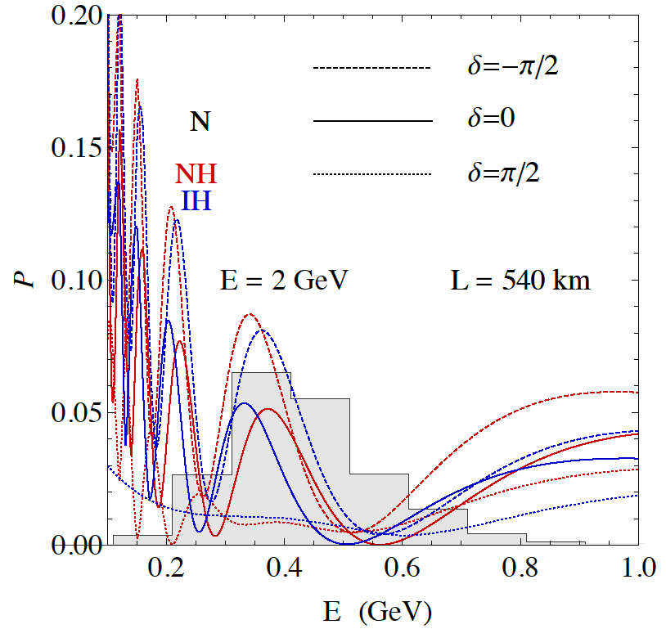
2nd Oscillation max. coverage
2nd oscillation max.
well covered by the ESS neutrino spectrum
1st oscillation max.

Slide 13
ESS Linac modifications to produce a neutrino Super Beam
European Spallation Source Linac

Slide 14
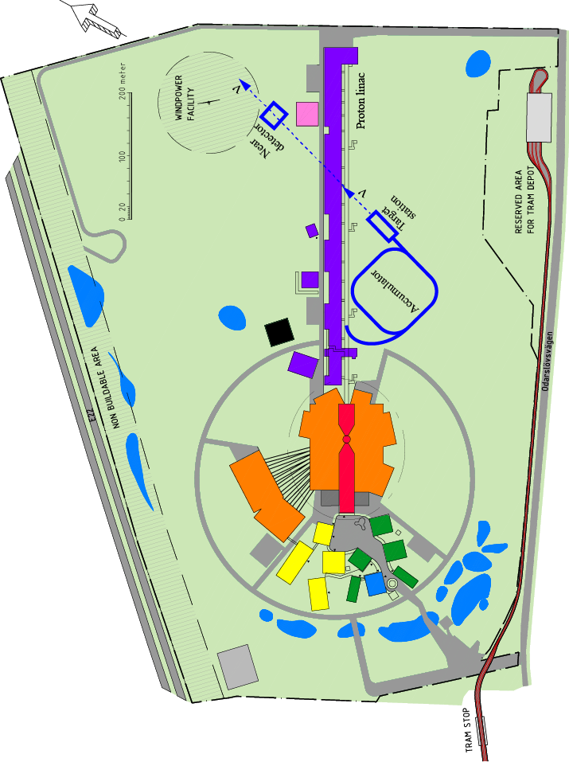
How to add a neutrino facility?
The neutron program must not be affected and if possible synergetic modifications.
Linac modifications: double the rate (14 Hz → 28 Hz), from 4% duty cycle to 8%.
Accumulator (C~400 m) needed to compress to few μs the 2.86 ms proton pulses, affordable by the magnetic horn (350 kA, power consumption, Joule effect)
  H⁻ source (instead of protons),
  space charge problems to be solved.
~300 MeV neutrinos.
Target station (studied in EUROν).
Underground detector (studied in LAGUNA).
Short pulses (~μs) will also allow DAR experiments (as those proposed for SNS) using the neutron target.

Slide 15
Required modifications of the ESS accelerator architecture for ESSνSB

Slide 16
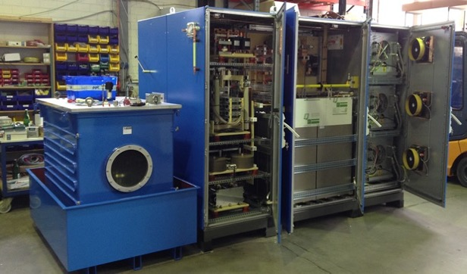
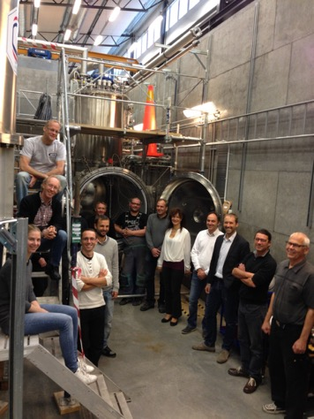
Preparing the ESS linac for operation at 10 MW with a 8% duty cycle and 28 Hz pulsing
For the medium-beta elliptical-cavity part ESS is planning to use tetrodes. Thales has developed a new screen grid with graded wire thickness making operation at 10 % duty cycle possible.
The picture shows the cryostat and test bunker at the FREIA Lab in Uppsala where a first prototype of the ESS 352 MHz spoke accelerating cavity is currently under test at 14 Hz and later on will be tested at 28 Hz.
FREIA Lab, Uppsala

Slide 17
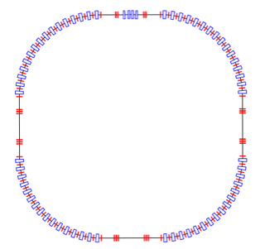
Accumulation Ring
The accumulator is needed to compress to less than few μs the 2.86 ms proton pulses, affordable by the magnetic horn (350 kA, power consumption, Joule effect), but also keeping a reasonable size of the ring.
Baseline: single-ring accumulator
  Current studies give a 376 m circumference accumulator ring 1.32μs.
  1 ring leads to a very large space–charge tune–shift of about 0.75.
Option: 4 superposed rings located in the same tunnel,
  Each ring receives 1/4 of the bunches during the multi–turn injection,
  This will lead to a reduction of the tune shift to the level of around 0.2 (acceptable for the 2.86 ms storage time),
  There has to be enough space between the bunches in the bunch train from the linac to permit the beam distribution system to inject from one ring to the next one,
  Experience already exists from the CERN PS Booster of using 4 superimposed rings with the aim to avoid high space charge effects.
Injection
Extraction
Collimation
RF
Lattice

Slide 18
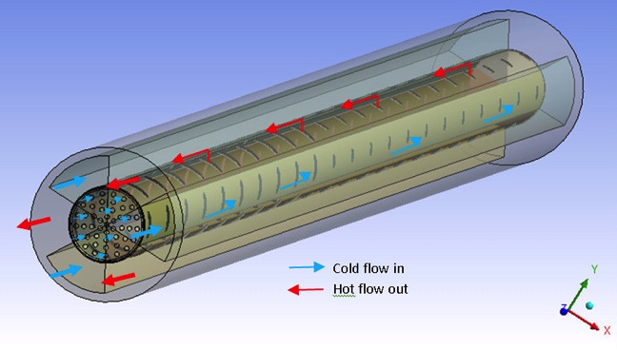
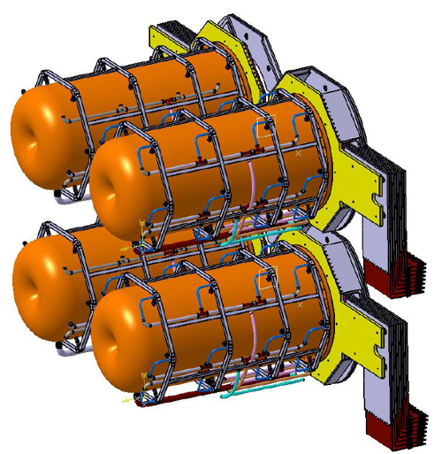
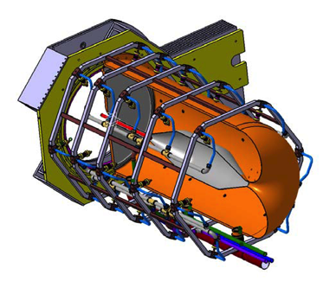
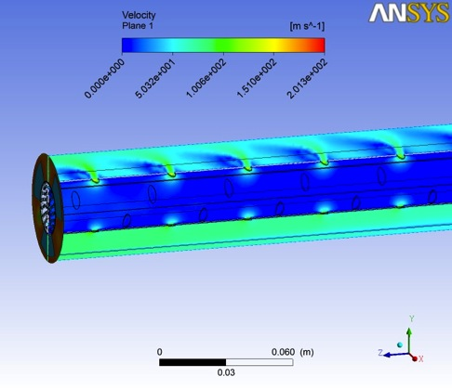
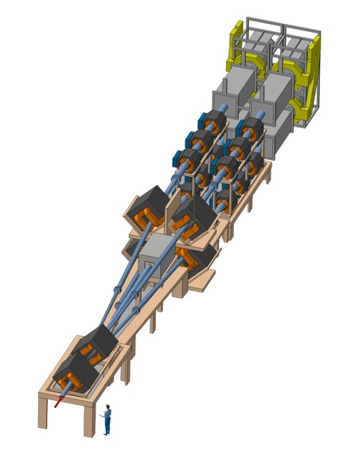
Mitigation of high power effects
(4-Target/Horn system for EUROν Super Beam)
Packed bed canister in symmetrical transverse flow configuration (titanium alloy spheres)
4-target/horn system to mitigate the high proton beam power (4 MW) and rate (50 Hz)
target inside the horn
Helium Flow
proton beam switchyard

Slide 19
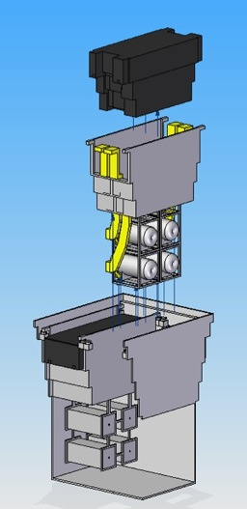
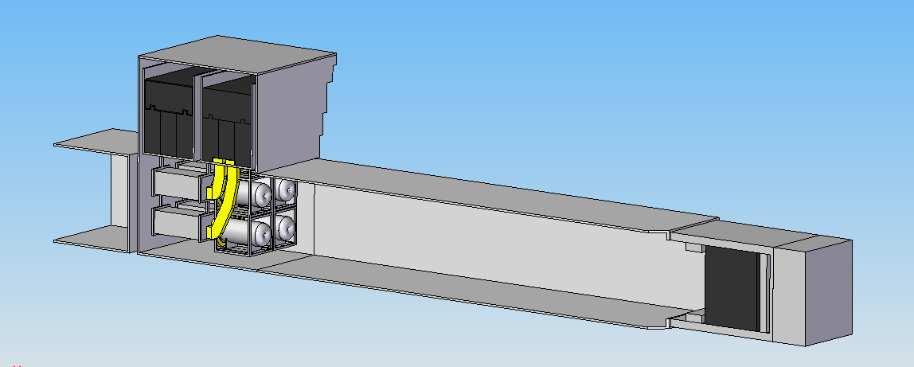
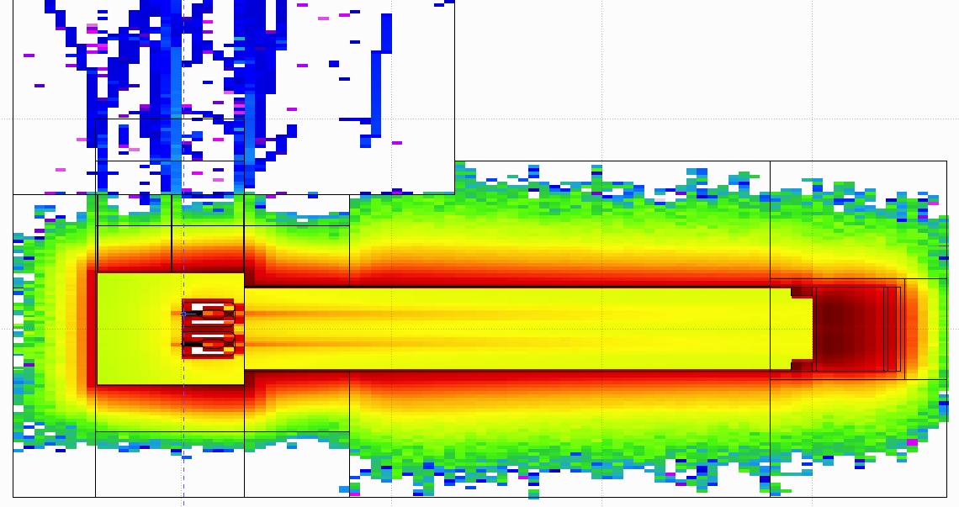
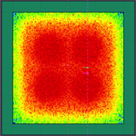
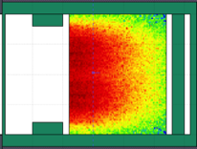
General Layout of the target station
(copied from EUROν DS)
Shield Blocks
Horn Support Module
8 m concrete
Split Proton Beam
Horns and Targets
Collimators
Decay Volume
(He, 4x4x25 m³)
Neutrino Beam Direction
Beam Dump

Slide 20
Physics Performance
little dependence on mass hierarchy (not so long baseline),
δ_{CP} coverage at 5 σ C.L. up to 60%,
δ_{CP} accuracy down to 6° at 0° and 180° (absence of CPV for these two values),
not yet optimized facility.

Slide 21
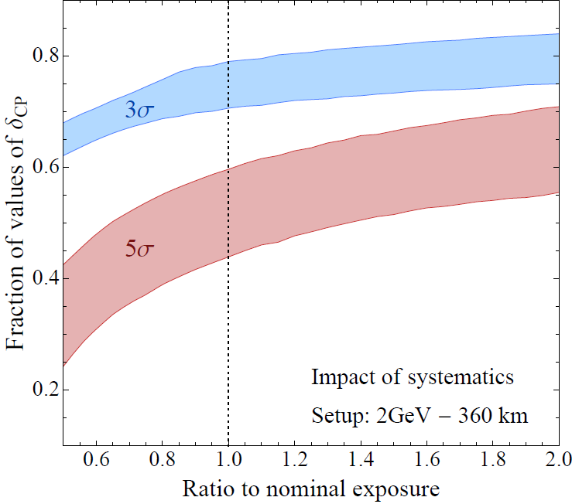
Systematic errors and exposure
for ESSnuSB systematic errors see 1209.5973 [hep-ph] (lower limit "default" case, upper limit "optimistic" case)
P5 requirement: 75% at 3 σ
High potentiality
5% syst.
7.5% syst.
10 years
20 years
(courtesy P. Coloma)

Slide 22
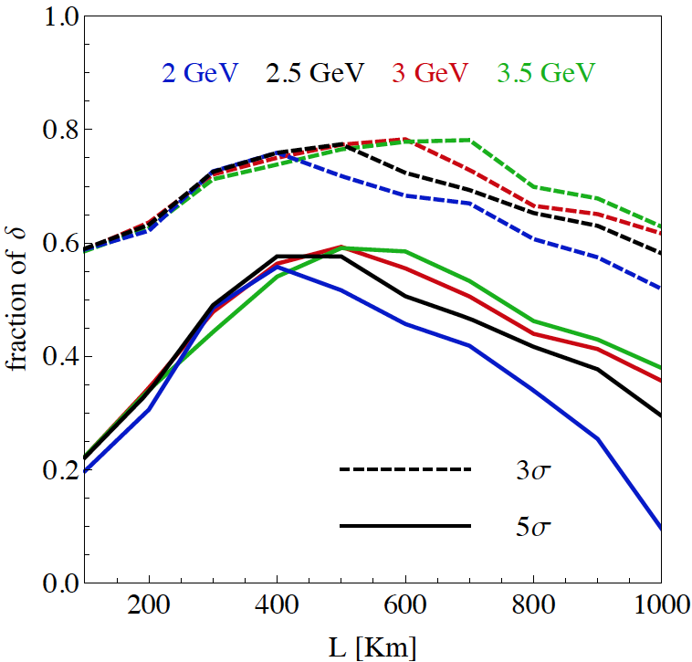
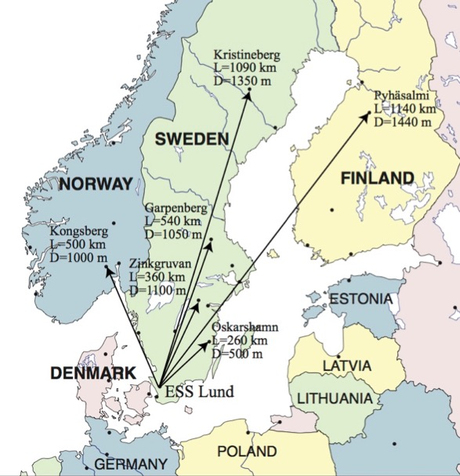
Which baseline?
CPV (Nucl. Phys. B 885 (2014) 127)
Garpenberg
Zinkgruvan
~60% δ_{CP} coverage at 5 σ C.L.
>75% δ_{CP} coverage at 3 σ C.L.
systematic errors: 5%/10% (signal/backg.)

Slide 23
The Garpenberg mine
(115 km from Uppsala)

Slide 24
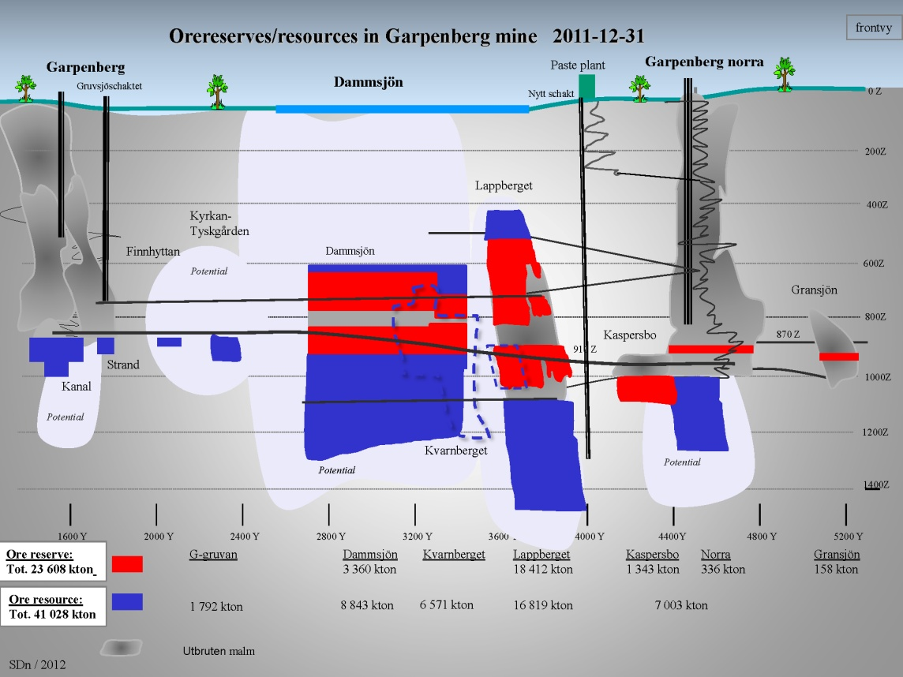
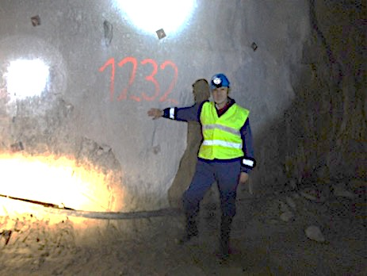
The Garpenberg mine
Distance from ESS Lund 540 km
Depth 1232 m
Truck access tunnel
Hoist shaft free to use by ESSnuSB
Rock-engineering prospection and studies in the Garpenberg-mine granite-zones
The owner of the Garpenberg mine, Boliden AB, has signed an MoU with Uppsala University, permitting agents of the University to access and make investigation in the Garpenberg mine.

Slide 25
Garpenberg Research Infrastructure Project for Neutrinos
(GRIPnu)

Slide 26
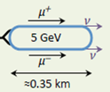
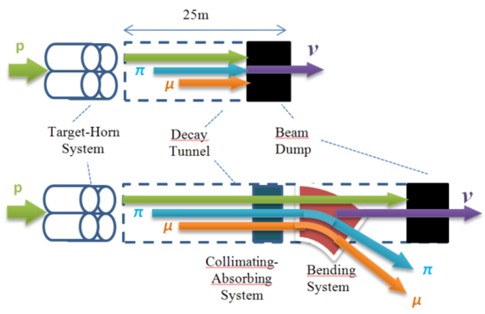
ESS neutrino and muon facility
2.7x10²³ p.o.t/year
Neutrons to ESS
ESS proton driver
Protons dump
ν_{μ} or ‾ν_{μ}
Long
Baseline
Detector
π decay
ESSnuSB
Test Facility
μ⁺ or μ⁻
ν_{μ} + ‾ν_{e}
Short
Baseline
Detector
Short
Baseline
Detector
Accumulator
Decay
channel or ring
nuSTORM
Front end
ν_{e} + ‾ν_{μ}
Muons of average energy ~0.5 GeV at the level of the beam dump (per proton)
RLA
acceleration
Storage
ring
Cooling
Long
Baseline
Detector
Neutrino
Factory
RCS
acceleration
Collider
ring
Muon Collider
→ ←
μ⁺ μ⁻
more than 4x10²⁰ μ/year from ESSS compared to 10¹⁴ μ used by all experiments up to now (10¹⁸ μ for COMET in the future).

Slide 27
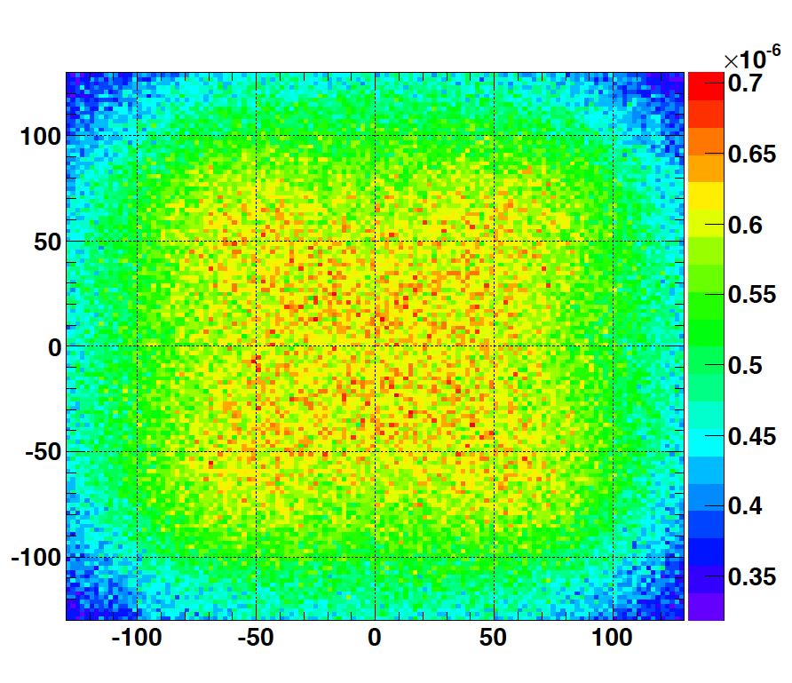
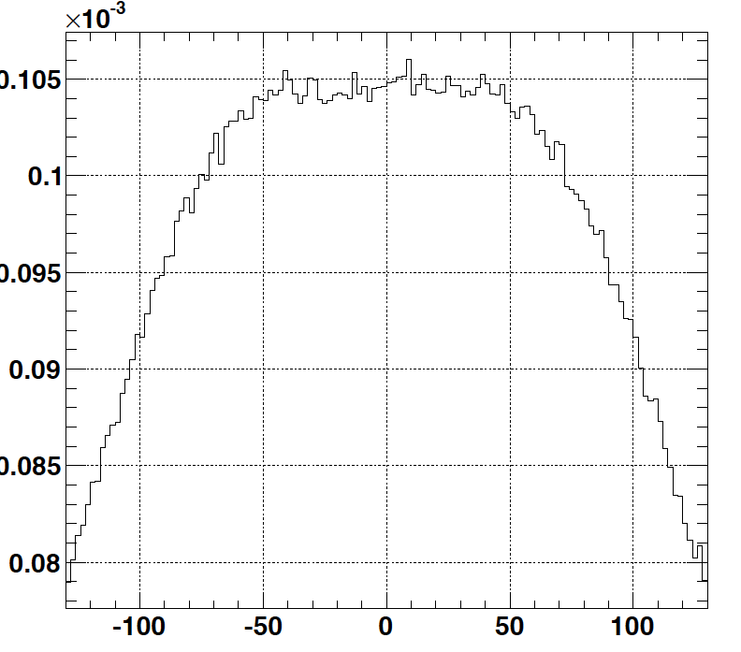
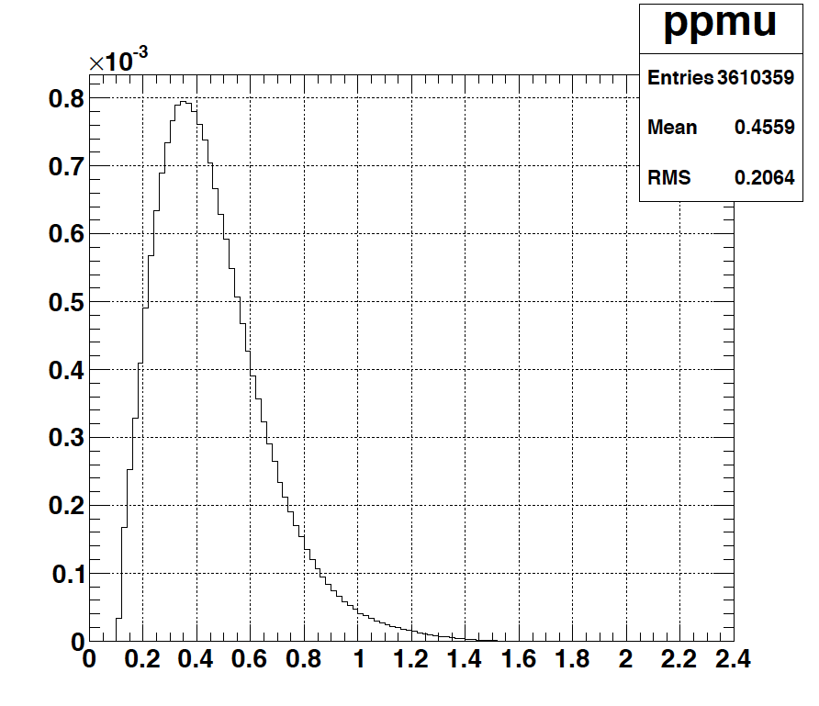
Muons at the level of the beam dump
2.7x10²³ p.o.t/year
y (cm)
muons at the level of the beam dump
(per proton)
4.2x10²⁰ μ/year
(16.3x10²⁰ for 4 m²)
x (cm)
10⁻³
4.1x10²⁰ μ/year
x (cm)
input beam for future 6D μ cooling experiments (for muon collider),
good to measure neutrino x-sections (ν_{μ}, ν_{e}) around 200-300 MeV using a near detector,
low energy nuSTORM,
Neutrino Factory,
Muon Collider.
muons/proton
<E_{μ}>~0.46 GeV
<L_{μ}>~2.9 km

Slide 28
Muons at ESS
Carlo Rubbia
Seminar at Uppsala
(PIC: Parametric Resonance Cooling of muons)

Slide 29
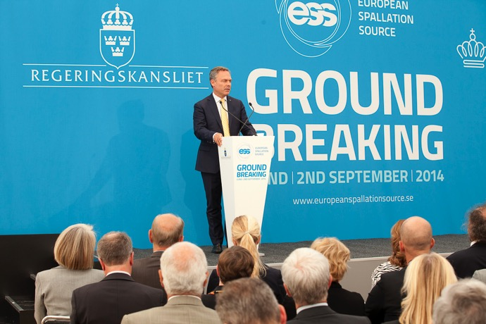
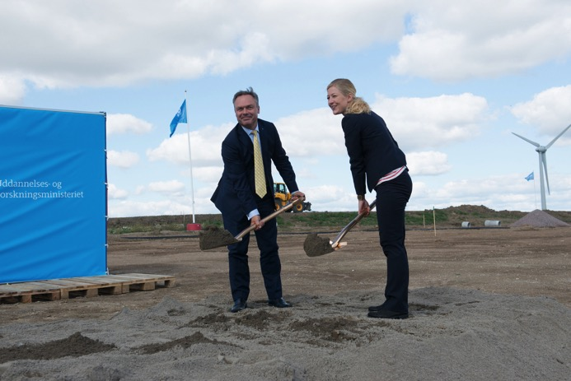
ESS under construction
September 2014
Linac
Beam Line Gallery
target monolith

Slide 30
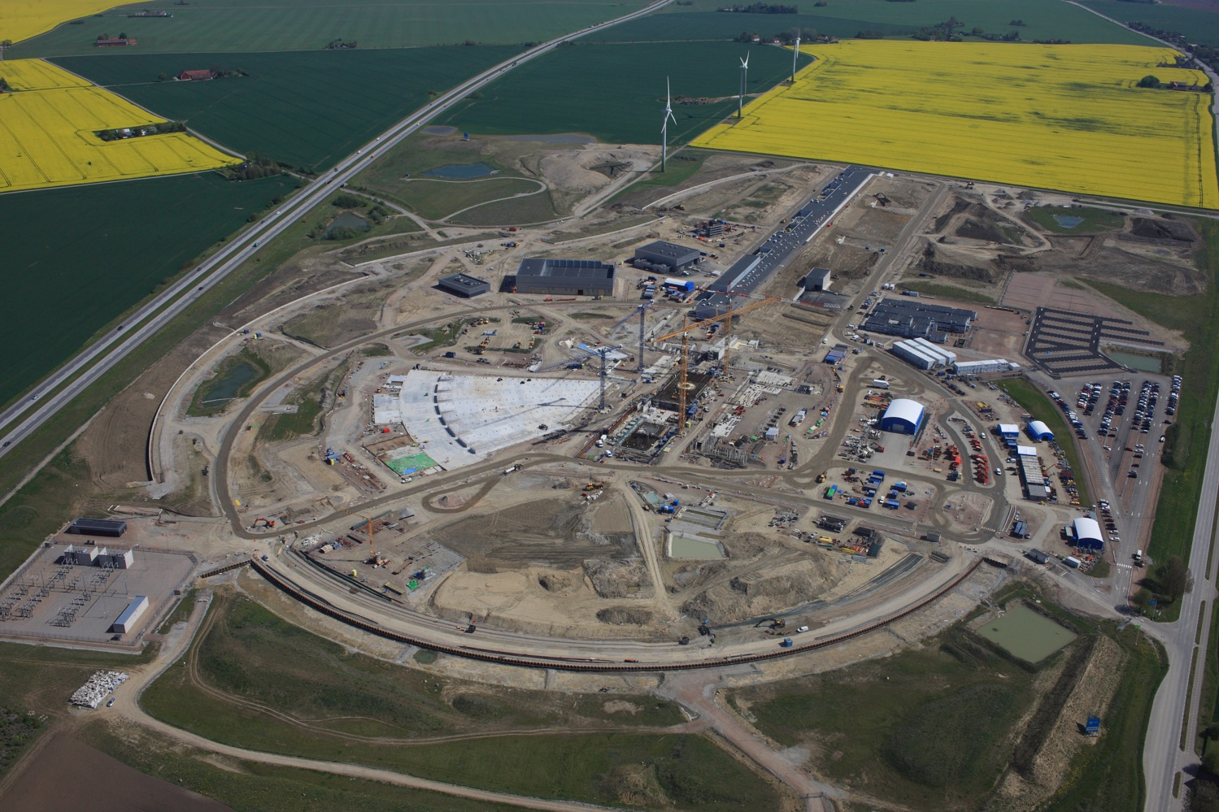
ESS construction site
ν
p
n
H⁻
May 2017

Slide 31

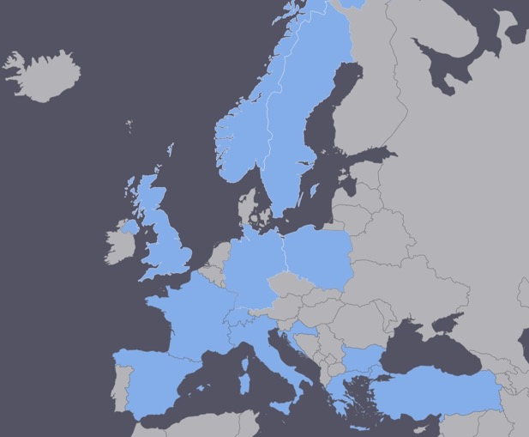
ESSνSB at the European level
COST application for networking has been succeeded: CA15139 (2016-2019)
  EuroNuNet : Combining forces for a novel European facility for neutrino-antineutrino symmetry violation discovery (http://www.cost.eu/COST_Actions/ca/CA15139)
specific session this afternoon
(room IV)
  Major goals of EuroNuNet:
    to aggregate the community of neutrino physics in Europe to study the ESSνSB concept in a spirit of inclusiveness,
    to impact the priority list of High Energy Physics policy makers and of funding agencies to this new approach to the experimental discovery of leptonic CP violation.
  13 participating countries (network still growing).

Slide 32

ESSνSB at the European level
A H2020 EU Design Study has been submitted end of March (Call INFRADEV-01-2017)
Title of Proposal: Discovery and measurement of leptonic CP violation using an intensive neutrino Super Beam generated with the exceptionally powerful ESS linear accelerator
Duration: 4 years
Total cost: 4.7 M€
Requested budget: 3 M€
15 participating institutes from
11 European countries including CERN and ESS
6 Work Packages
Decision: end of August
ESSνSB
BENE (2004-2008)
ISS (2005-2007)
EUROν (2008-2012)
LAGUNA (2008-2010)
LAGUNA-LBNO (2010-2014)
COST Action CA15139 (2015-2019)

Slide 33
Design Study ESSνSB
approved!

Slide 34
Design Study ESSνSB
(2018-2021)
very supportive letter from ESS director
The Grant Agreement has to be signed before the 23rd of November 2017.
ESSνSB will start engaging postdocs soon.
partners: IHEP, BNL, SCK•CEN, SNS, PSI, RAL

Slide 35
Conclusion
Significantly better CPV sensitivity at the 2nd oscillation maximum.
The European Spallation Source Linac will be ready in less than 8 years (5 MW, 2 GeV proton beam by 2023).
ESS will have enough protons to go to the 2nd oscillation maximum and increase its CPV sensitivity.
CPV: 5 σ could be reached over 60% of δ_{CP} range (ESSνSB) with large potentiality.
Large associated detectors have a rich astroparticle physics program.
Rich muon program.
COST network project CA15139 supports this project.
The Design Study ESSνSB is approved and will start soon.

Slide 36
Backup

Slide 37
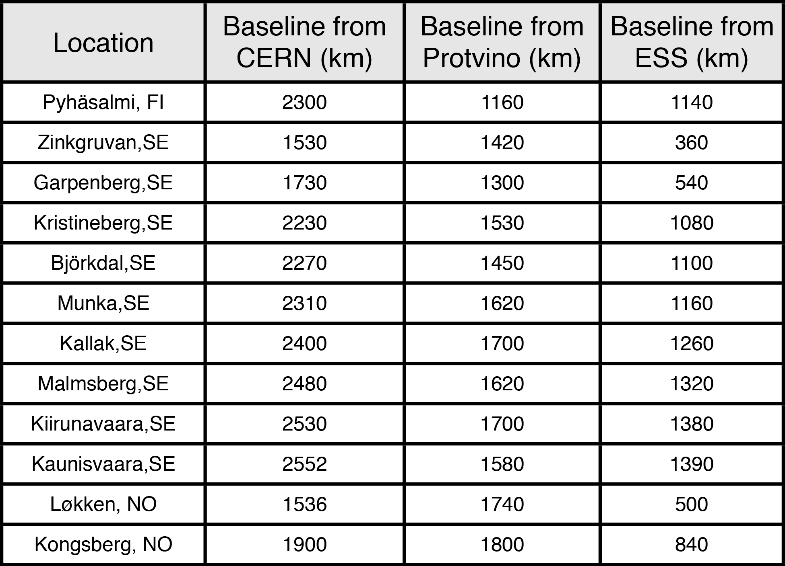
Possible locations for far detector
ESS
Kongsberg
Løkken
CERN
LAGUNA sites

Slide 38
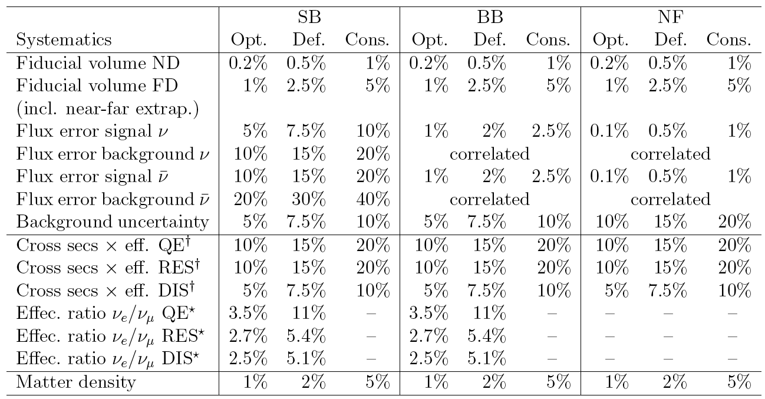
Systematic errors
Phys. Rev. D 87 (2013) 3, 033004 [arXiv:1209.5973 [hep-ph]]

Slide 39
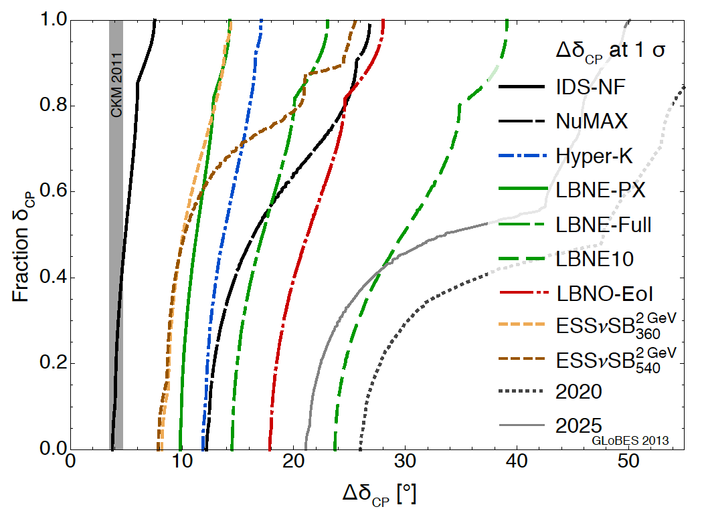
δ_{CP} accuracy performance
(USA snowmass process, P. Coloma)
"default" column
for systematic errors see (7.5%/15% for ESSnuSB):
Phys. Rev. D 87 (2013) 3, 033004 [arXiv:1209.5973 [hep-ph]]
arXiv:1310.4340 [hep-ex] Neutrino "snowmass" group conclusions

Slide 40
Comparisons

Slide 41
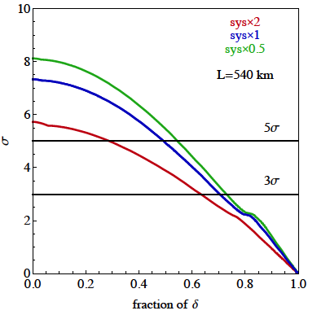
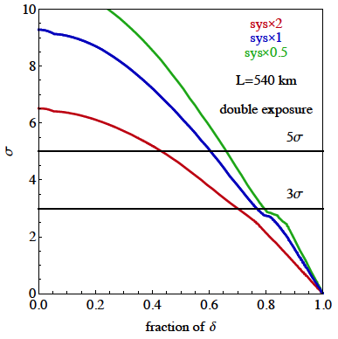
δ_{CP} coverage
CPV (2 GeV protons)
"nominal"
x2
after 10 years
with 2 times more statistics
systematic errors (nominal values): 5%/10% for signal/background
more than 50% δ_{CP} coverage using reasonable assumptions on systematic errors

