Slide 1
Muon beams for neutrino physics

Slide 2
Plan
Particle-physics potential of stored muon beams
Status of accelerator R&D
Muon Ionization Cooling Experiment (MICE)
Opportunities and conclusions

Slide 3
Particle-physics potential of stored muon beams
Muon beams for neutrino physics

Slide 4
Basis of potential
Muon mass:
  200 m_{e} ~ m_{μ} ~ 0.1 m_{p}
Muon decay:
  ν_{e}, ν_{μ}
  Precisely known energy spectrum
Energy frontier:
  No brem-/beam-strahlung
    Rate ∝ m⁻⁴
    [5 × 10⁻¹⁰ cf e]
  Enhanced coupling to Higgs
    Production rate ∝ m²
    [5 × 10⁴ cf e⁺e⁻]
  Efficient acceleration
    Favourable rigidity
Physics of flavour:
  Precision neutrino physics
  Sensitive cLFV searches

Slide 5
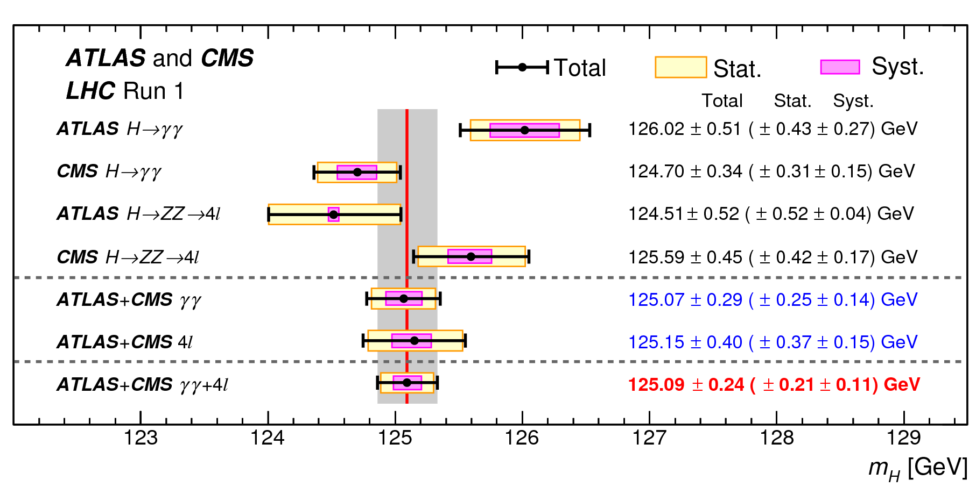
The Standard Model and beyond
S. GASCON-SHOTKIN, La Thuile 2016
Future study of the Higgs:
  Line width; establish single resonance (?) in s-channel with μ⁺μ⁻
  Couplings; requires > 1 TeV for complete, precise study

Slide 6
Line shape
Standard Model Higgs:
  M = 125 GeV;
  Γ=4.5 MeV
    Exquisite resolution
      R < 0.003%
“Two-state” Higgs:
  Deviation from SM line shape
  Resolve states
    Exquisite resolution!
M.Greco,T.Han,Z.Liu
B.Autin, A.Blondel, J.Ellis;
CERN 99-02, 1999

Slide 7
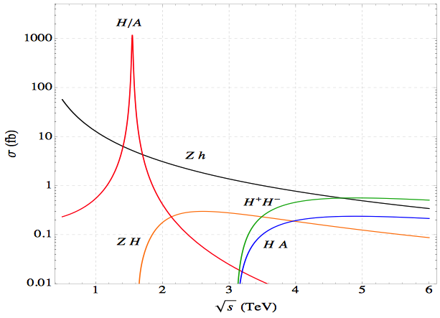
Couplings/branching ratios
Standard Model Higgs
  Accurate threshold measurement
  Exploiting accurate knowledge of (narrow) energy spectrum
Beyond SM Higgs
  Exploit narrow energy spectrum to search for :
    Narrow resonances
    Unexpected thresholds
M.Greco,T.Han,Z.Liu
m_{bb} > 100 GeV
arXiv:1306.2609

Slide 8
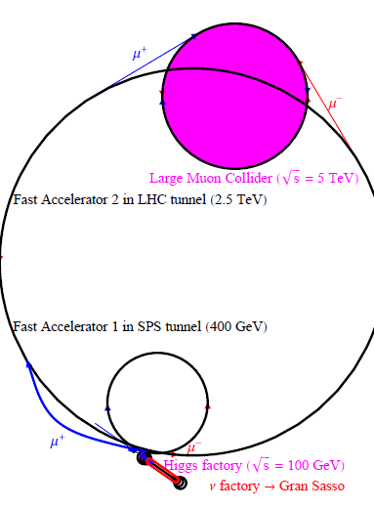
MAP
Principal (accelerator) issue of principle:
  Small beam spot in 6D (transverse + longitudinal) to deliver requisite luminosity; cooling

Slide 9
Efficient acceleration to very high energy
MAP/MASS
MAP/MASS

Slide 10
“Standard Neutrino Model (SνM)”

Slide 11
SνM: Accelerator-based contributions
CERN
Horn and bubble chamber
First neutrino beam
IHEP
SKAT, JINR
CERN
Gargamelle, Aachen/Padova, CDHS,
CHARM, BEBC, CCFR, NOMAD, CHORUS
FNAL
MINOS, MINOS+, NOvA
Global neutrino
progamme
Hyper-K
LBNF/DUNE
CERN Neutrino Platform
CERN
OPERA, ICARUS
BNL
first neutrino
“beam”
BNL/FNAL
CITF, HPWF, 7’ BC, 15’ BC, E605,
E613, E734, E776, NuTEV
KEK/J-PARC
K2K, T2K
CERN
Horn #2 & Gargamelle
1950
1960
1970
1980
1990
2000
2010
2020
2030
ν_{μ}
discovery
Development of
E/w SM, QPM, QCD
Development of
Standard Neutrino
Model
ν_{e}/ν_{μ}
universality
Neutral
Current
discovery
Innovation in detectors to provide:
— High-precision
— Large data sets
— Control of systematics
Innovation in accelerators to go beyond
Discovery of
CP-invariance violation?

Slide 12
Muon Collider and Neutrino Factory
MAP

Slide 13
Neutrino Factory
Optimise sensitivity
and precision:
  Requirements:
    Large ν_{e} (ν_{e}) flux
    Detailed study of
    sub-leading effects
Unique:
  Large, high-energy
  ν_{e} (ν_{e}) flux
    Muon-beam cooling
  Favourable rigidity:
    Optimise E for given L

Slide 14
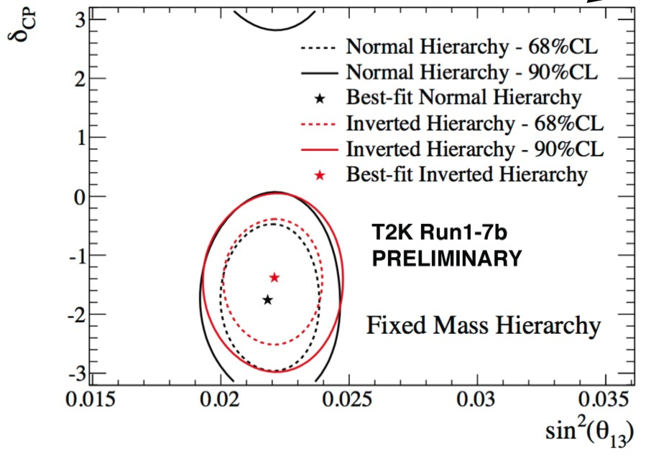
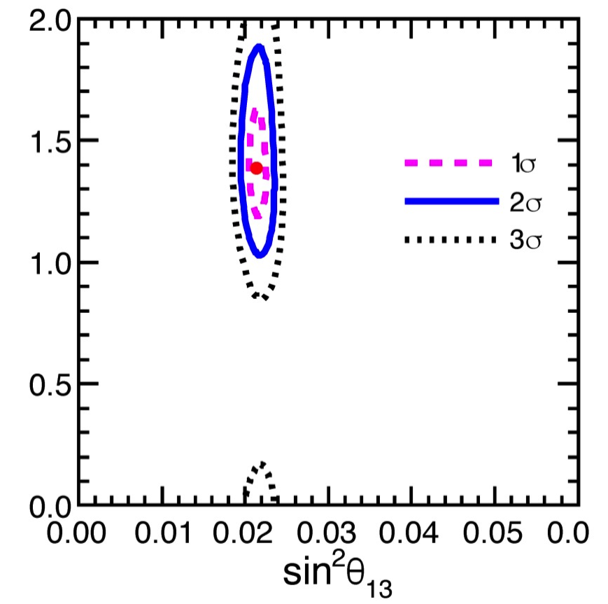
Where do we stand?
T2K
Neutrino 2016
Marone
Neutrino 2016
T2K:
  Preference for CP-invariance violation at 90% CL
Marone: preliminary global fit for Neutrino 2016:
  Indication that CP-invariance disfavoured at >2σ

Slide 15
Completing the SνM
Mass hierarchy:
CP-invariance violation:

Slide 16
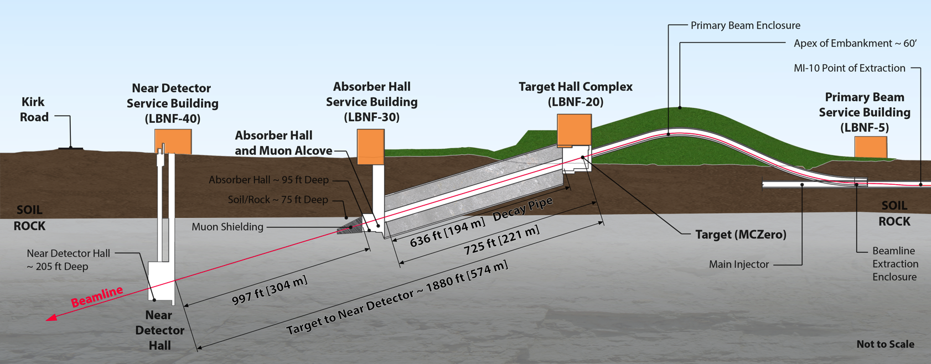
Long Baseline Neutrino Facility
https://web.fnal.gov/project/LBNF/SitePages/DUNE%20and%20LBNF%20Reports%20and%20Papers.aspx
New neutrino beam on Main Injector:
  Horn-focused, wide-band beam
  Peak in E_{ν} ~ 3 GeV; matched to 1300 km baseline
  Main Injector, with PIP II, delivers 1.07 MW @ 80 GeV
PIP II: 800 MeV s/c linac:
  1.2 MW @ 120 GeV;
  1.07 MW @ 80 GeV – baseline for LBNF/DUNE
PIP III: u/g 3 GeV s/c linac [2.4 MW @ 120 GeV]

Slide 17
DUNE: far detector strategy
https://web.fnal.gov/project/LBNF/SitePages/DUNE%20and%20LBNF%20Reports%20and%20Papers.aspx
Sanford Underground Research facility (SURF)
40 kT LAr TPC:
  Modular approach: 4 caverns, 4 independent 10 kT modules
  Approach allows:
    Staged build
    Flexibility to exploit advancements in LAr TPC technique

Slide 18
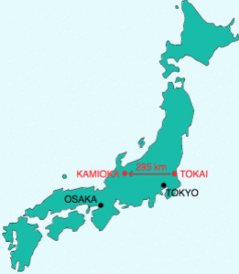
J-PARC to Hyper-K; accelerator upgrade
Upgrade programme to increase power on target
  1.3 MW by ~2025, “start of Hyper-K era”

Slide 19
Hyper-K
Prog. Theor. Exp. Phys. 2015, 00000; DOI: 10.1093=ptep/0000000000
https://lib-extopc.kek.jp/preprints/PDF/2016/1627/1627021.pdf
KEK Preprint 2016-21,ICRR-Report-701-2016-1
374 kT fiducial mass ring-imaging H₂O Cherenkov
  Two independent modules; each with a total mass of 260 kT
  Inner detector:
    80k 20-inch PMTs; 40% photo-cathode coverage
  Outer detector:
    25k 8-inch PMTs

Slide 20
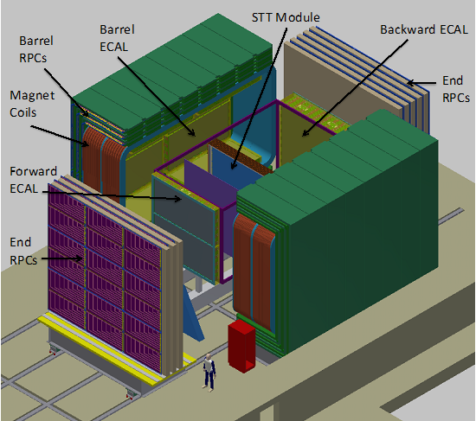
DUNE: near detector
https://web.fnal.gov/project/LBNF/SitePages/DUNE%20and%20LBNF%20Reports%20and%20Papers.aspx
Required to measure unoscillated beam
  Near/far extrapolation
Detector concept under development:
  Example (from proposal):
  Fine-grained detector:
    Central straw-tube tracker
    Pb/scintilator ECAL
    Dipole magnet
    RPC-based muon detectors
Alternatives:
  LAr TPC; and/or
  High-pressure Ar TPC
under discussion

Slide 21
Hyper-K near detectors
* https://indico.fnal.gov/getFile.py/access?contribId=308&sessionId=29&resId=0&materialId=poster&confId=8022
Essential to constrain flux and cross sections
  ν_{μ}N and ν_{e}N
Upgrades to present ND280 detector considered:
  3D grid water detector (WAGASCI, J-PARC T59)
  High-pressure Ar TPC [*]
  Water-based liquid scintilaltor [NIM A660 51 (2011)]
  Emulsion detector (J-PARC T60)
Intermediate detectors being developed:
  TITUS [arXiv:1504.08272]:
    2 kT, Gd doped, H2O Cherenkov
    Placed at ~2 km so that flux shape is similar to that at Hyper-K
  nuPRISM [arXiv:1412.3086]:
    Measure νN as a function of o.a. angle …

Slide 22
Sensitivity of DUNE and Hyper-K
DUNE and Hyper-K alone:
  5σ sensitivity over >50% of all values of δ_{CP} after 10 yrs
Combined—sensitivity enhanced

Slide 23
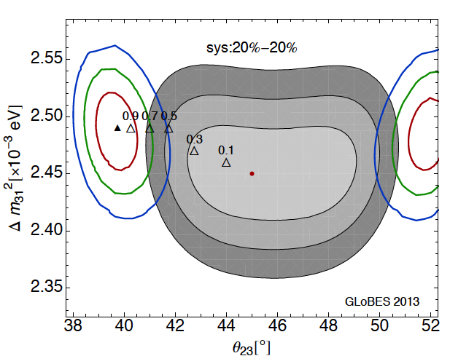
Effect of systematics:
1307.1243; Coloma, Huber
Cross section error makes a critical contribution:
  To systematic error
  Potential source of (pernicious) bias

Slide 24
This is a big deal!
Opportunities to contribute:
Directly, to beam or detector
Indirectly, by providing essential measurements

Slide 25
Benefit of second oscillation maximum
Increased sensitivity to CP-invariance violation
  Decreased impact of systematic errors
Increased emphasis on event rate
  Beam power & fiducial mass

Slide 26
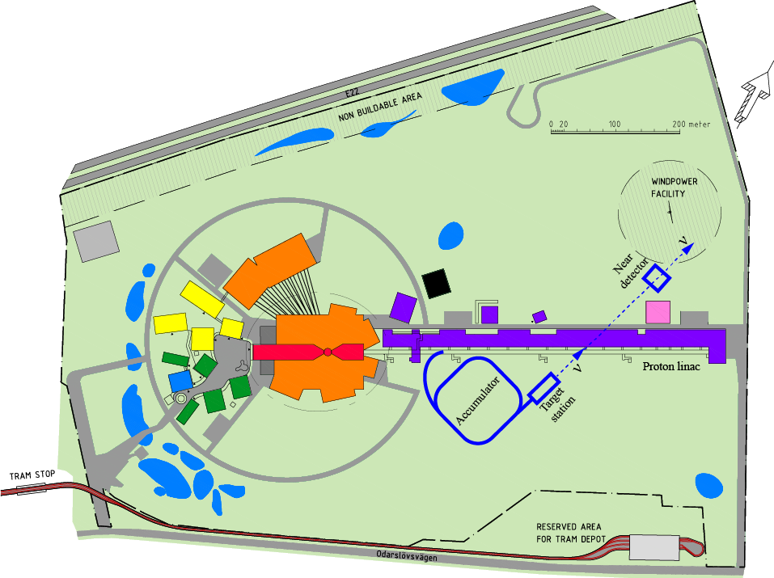
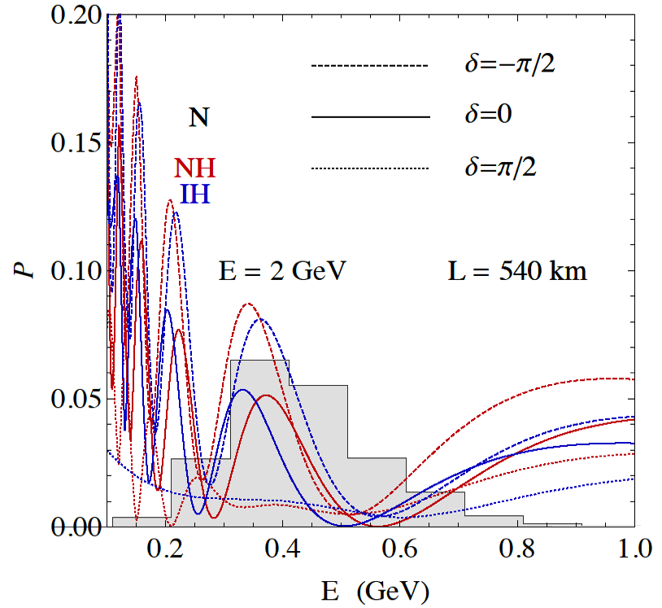
ESSnuSB: accelerator facility
Wildner, IPAC’15, THPF100
Bouquerel, IPAC’15, MOPWA017
Neutrino beam requires:
  Upgrade to 10 MW @ 2.5 GeV
    Extra H⁻ source
  Switchyard to serve:
    4 targets; 4 horns; one decay pipe
  Accumulator ring ➔ 1.5 μs pulses

Slide 27
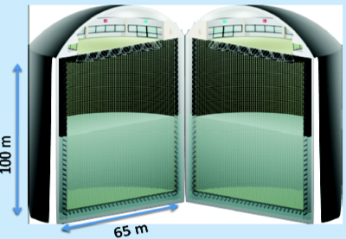
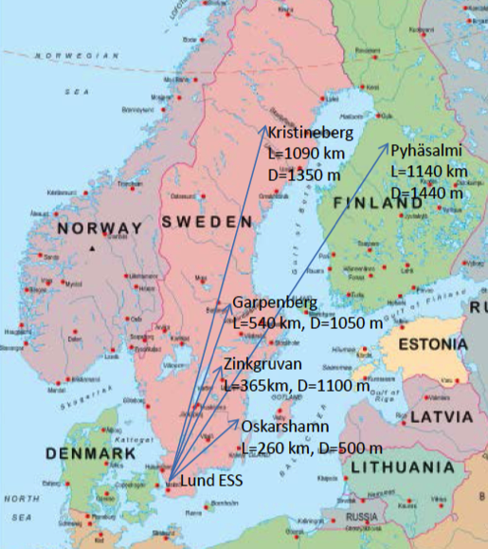
ESSnuSB: H₂O Cherenkov; MEMPHYS
Fiducial mass 500 kT
Readout:
  120,000 PMTs (8” or 10”)
  “30% photocathode coverage”
Building on:
  EUROnu, LAGUNA, LAGUNA-LBNO
Nucl.Instrum.Meth. A639 (2011) 287-289,
JCAP 1301 (2013) 024,
EUROnu WP5

Slide 28
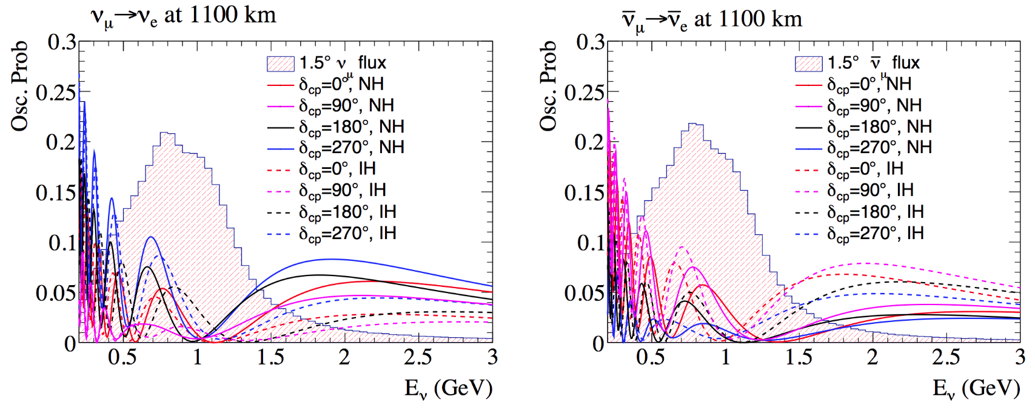
”T2HKK”: Hyper-K with second tank in Korea
The First Workshop on the Second Hyper-Kamiokande Detector in Korea (21-22 Nov 2016 Seoul)
https://indico.snu.ac.kr/indico/event/6/other-view?view=standard

Slide 29
nuSTORM
10.1103/PhysRevD.89.071301
Precise neutrino flux:
  Normalisation: < 1%
  Energy (and flavour) precise
π ➔ μ injection pass:
  “Flash” of pion decay neutrinos
Objectives:
  %-level (ν_{e}N)cross sections
    Double differential
  Sterile neutrino search
    Beyond SBN
  Muon accelerator test bed
    6D cooling experiment

Slide 30
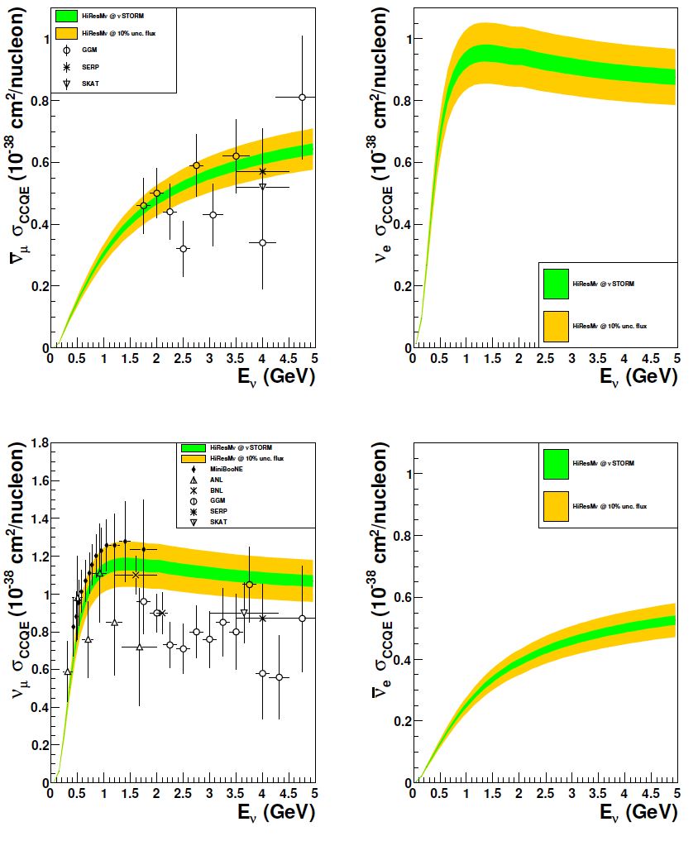
Example: CCQE cross section
CCQE at nuSTORM:
  Six-fold improvement in systematic uncertainty compared with “state of the art”
  Electron-neutrino cross section measurement unique
10.1103/PhysRevD.89.071301; arXiv:1305.1419

Slide 31
nuSTORM and light sterile neutrinos
Explore all eight channels with:
  Small systematic and statistical uncertainties
And:
  Determine neutral current rate
    Oscillation to steriles changes neutral-current rate
  Study ν_{e}N and ν_{μ}N scattering
    Including final states to eliminate hadronisation uncertainties
Notes:
Add “parenbar”

Slide 32
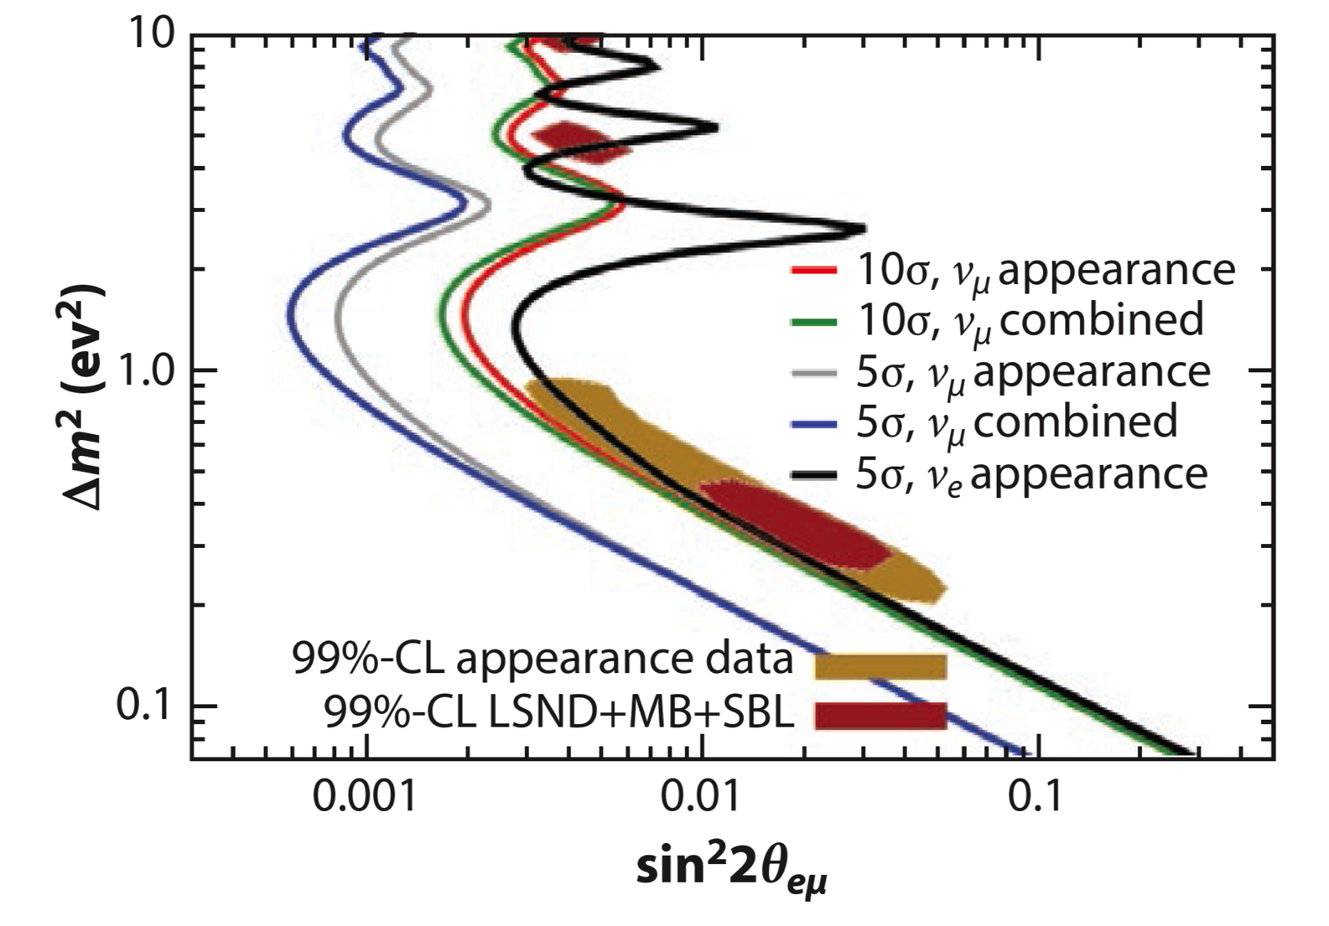
Light sterile neutrino sensitivity
Adey, Bayes, Bross, Snopok,
Ann. Rev. Nucl. Part. Sci. 2015 65:145-75.
Capability:
  Continue the search; or
  Study new phenomena

Slide 33
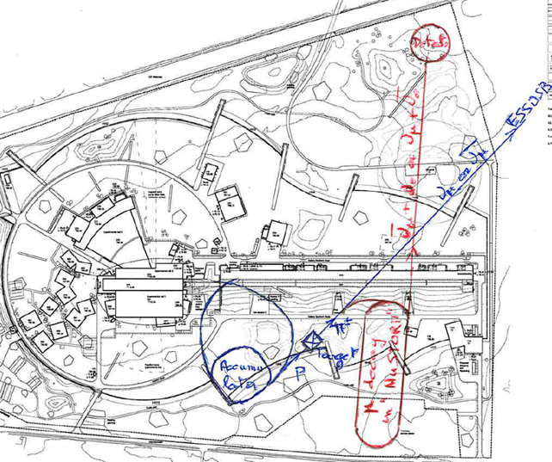
ESSnuSB: accelerator facility
Wildner, IPAC’15, THPF100
Bouquerel, IPAC’15, MOPWA017
Bouquerel, MOPL010 (2016), ISBN 978-3-95450-178-6
nuSTORM @ ESS
  Accumulate beam and boost its energy
  Site capable of accommodating nuSTORM facility

Slide 34
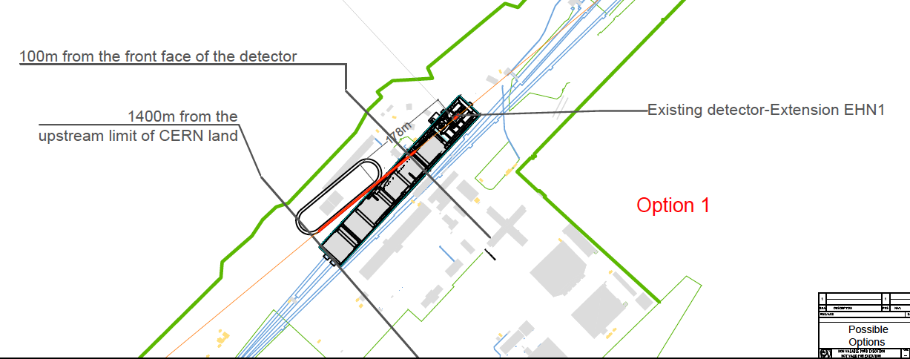
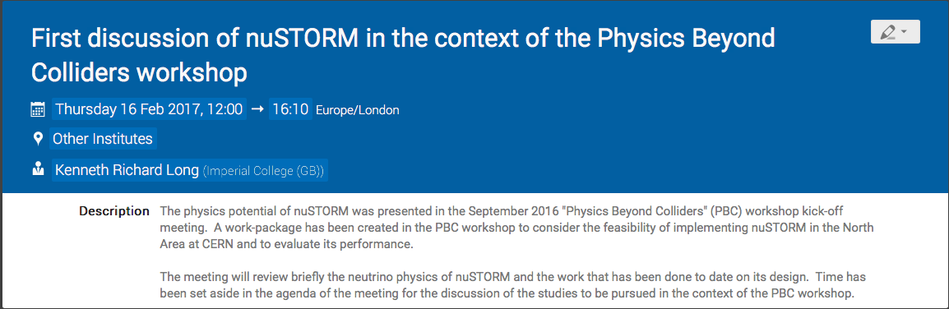

nuSTORM @ CERN
10.1103/PhysRevD.89.071301
Work package in “Physics Beyond Colliders” workshop
https://indico.cern.ch/event/606246/

Slide 35
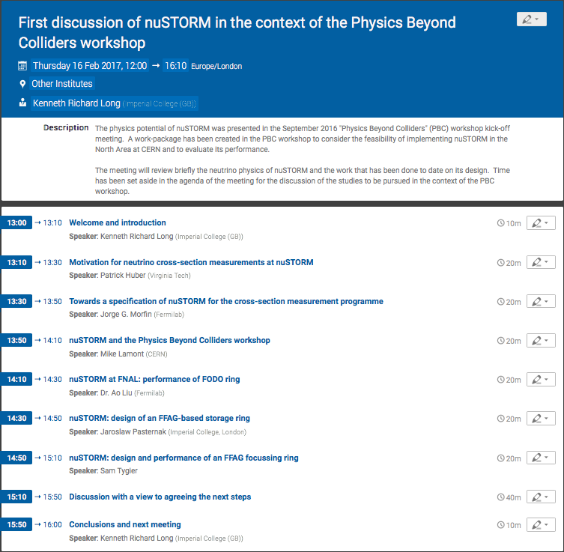
https://indico.cern.ch/event/606246/

Slide 36
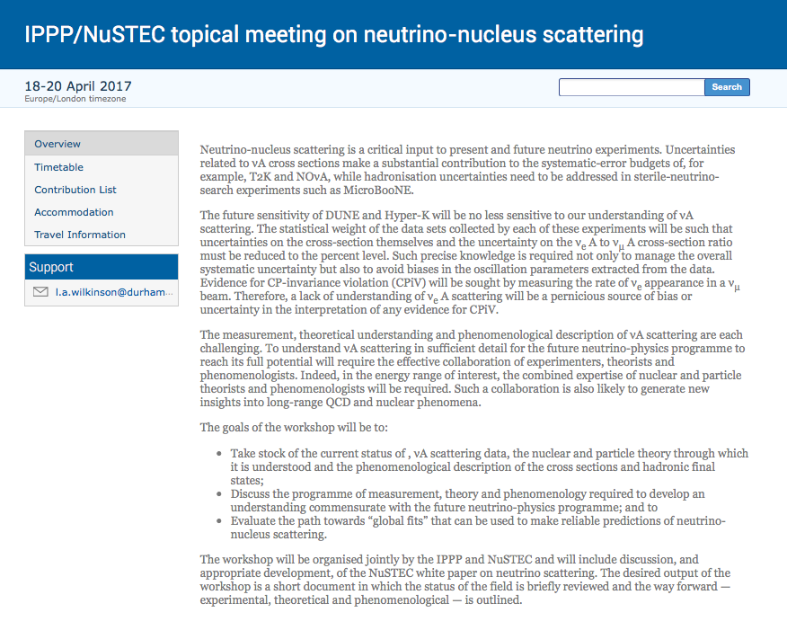
http://conference.ippp.dur.ac.uk/event/583/
IPPP Durham

Slide 37
Status of accelerator R&D
Muon beams for neutrino physics

Slide 38
Accelerator challenges
High-power, pulsed proton driver:
  “MW class”; e.g.:
    FNAL Proton Improvement Plan
    J-PARC Main Ring upgrade
Pion-production target:
  MERIT experiment [CERN]
Muon front end:
  MICE experiment [STFC Rutherford Appleton Laboratory]
    Proof of principle of ionization-cooling technique
  MuCool programme at FNAL
Rapid acceleration:
  EMMA experiment [STFC Daresbury Laboratory]

Slide 39
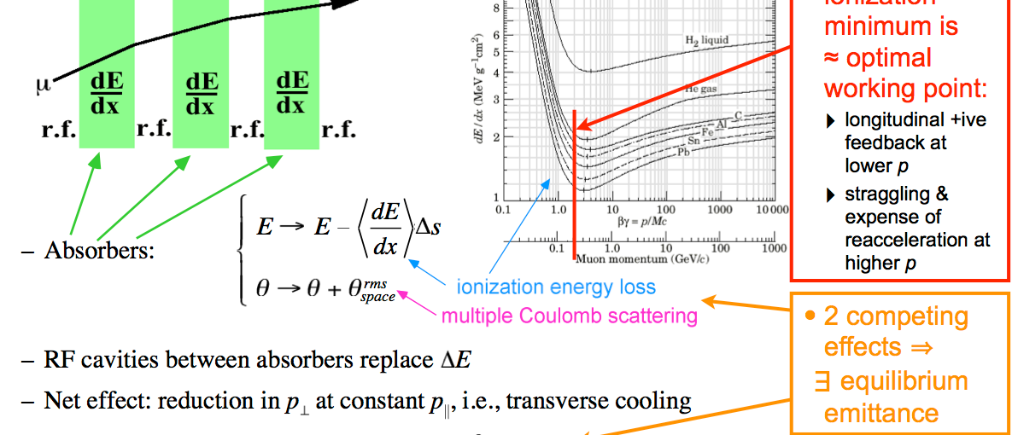
Ionization cooling
Muon lifetime is short:
  Require technique in which cooling-effect is rapid
    Ionization cooling
Kaplan

Slide 40
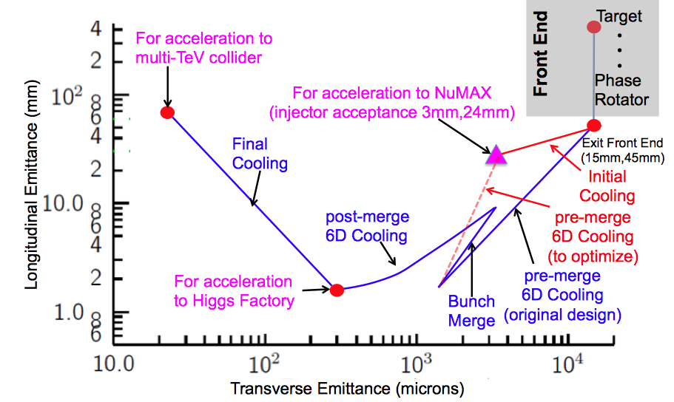
Advanced techniques a
Improved HF Luminosity
Simplified Final Cooling requirements
PIC assumed in Carlo
Rubbia’s Proposal
MAP Higgs
Factory Target
MAP

Slide 41
Cooling ring
Cooling ring proposed by Balbekov and Palmer
  Efficient use of accelerator components
    Issue: injection/extraction
Parametric (resonance) ionization cooling:
  Drive resonant growth of beam emittance through half-integer resonance (Derbenev)
  Damp emittance growth through ionization cooling
Rubbia:
  Use of PIC in a ring configuration leads to efficient, rapid cooling

Slide 42
MICE
Muon beams for neutrino physics

Slide 43

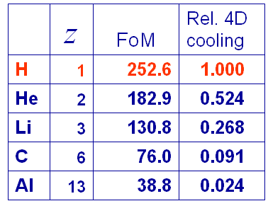
The principle of ionization cooling
Competition between:
  dE/dx [cooling] and MCS [heating]
Optimum:
  Low Z, large X₀
  Tight focus
  H₂ gives best performance

Slide 44
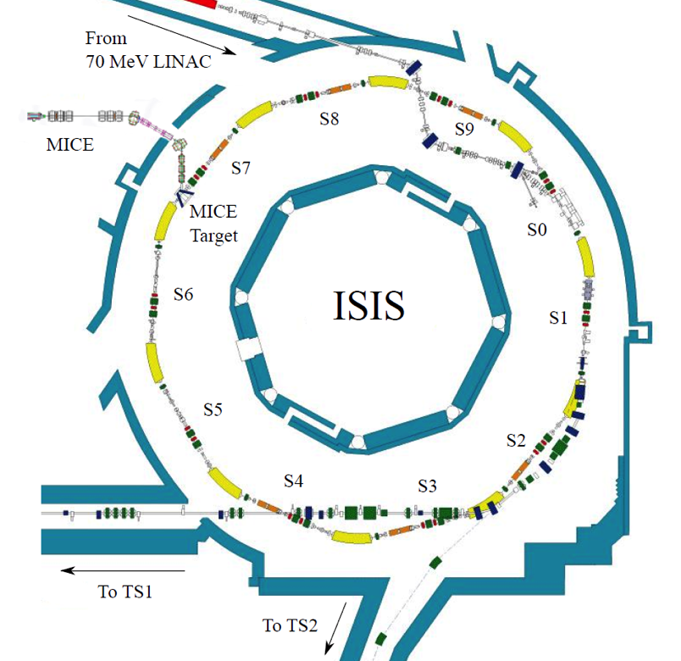
Muon Ionization Cooling Experiment
Proof of principle:
  Design, build commission and operate a realistic cooling cell;
  Measure its performance in a variety of modes of operation and beam conditions
ISIS
RAL
MICE

Slide 45
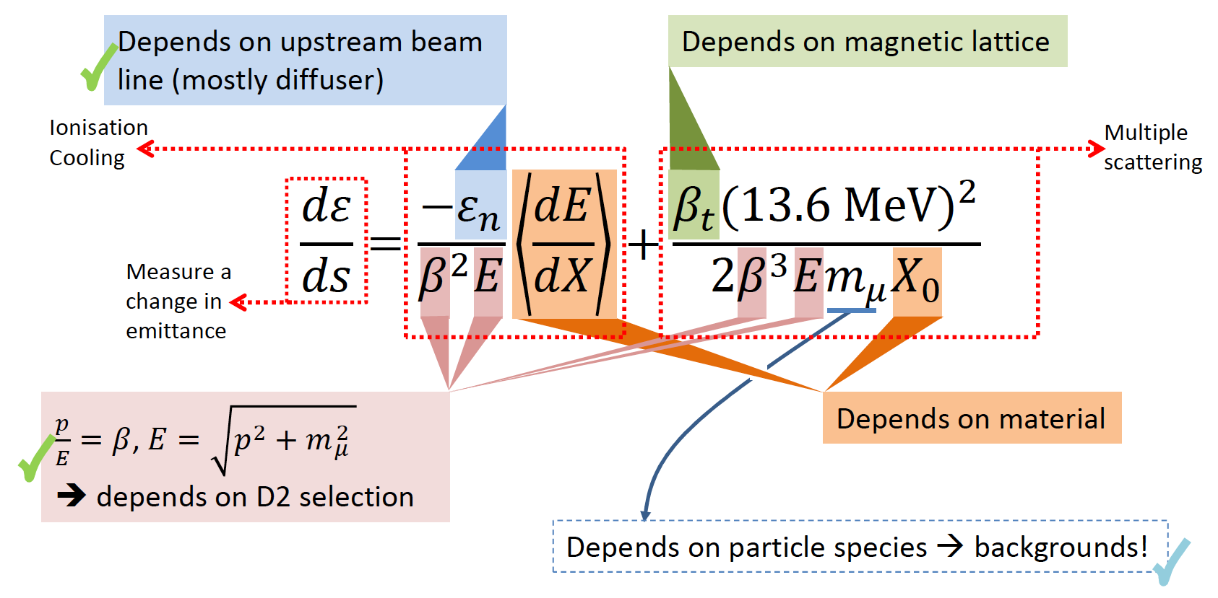
Characterisation of the cooling equation
Acceleration not required (Step IV):
Emittance:
  Vary beam optics/diffuser;
Material:
  Absorber change (LH2; LiH);
p, E and β:
  Vary beam momentum, optics

Slide 46
Scientific programme

Slide 47
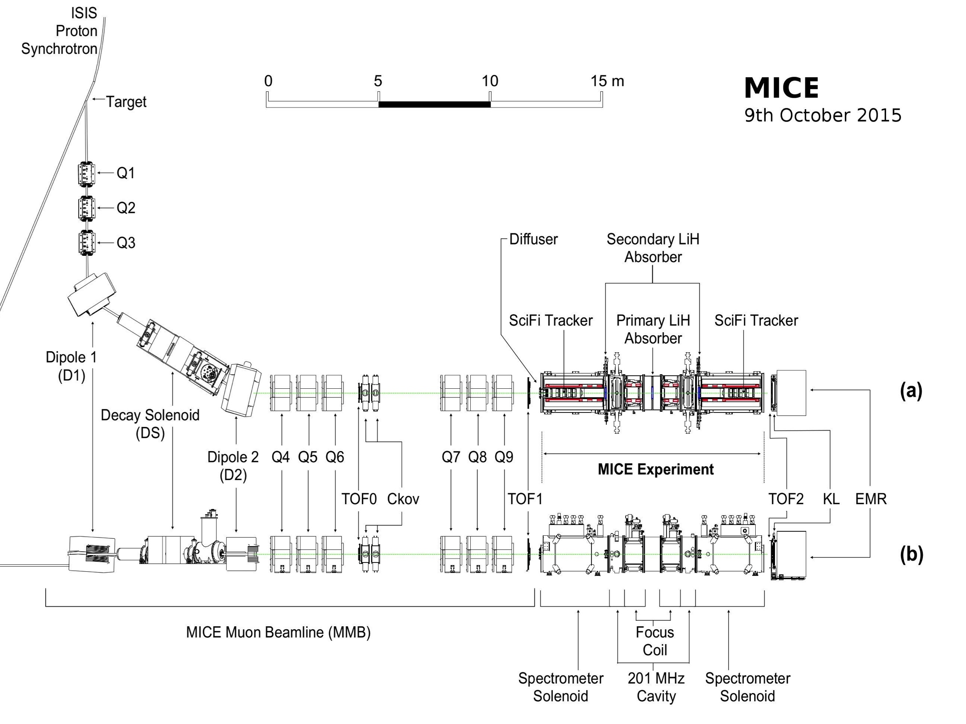

Slide 48
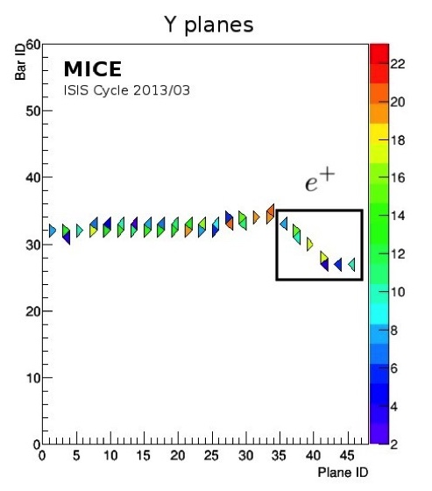
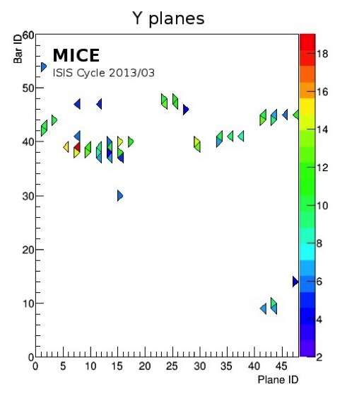

Slide 49
Emittance reconstruction

Slide 50
Emittance reconstruction
Construct phase-space covariance matrix:
  One track at a time
Compute normalised transverse emittance

Slide 51
Emittance reconstruction
First reconstruction of emittance “particle-by-particle”
Validates MICE measurement approach:
  Space charge not an issue for Neutrino Factory

Slide 52
Measurement of muon-LiH MCS
Field off measurment of MCS of muons on LiH
  Data taken with LiH absorber and “empty channel”
  Example: 200 MeV/c

Slide 53
Step IV status

Slide 54
Step IV plans
Extended Step IV run approved to August 2017
Full programme with LiH and LH₂ absorbers
  Measurement of Multiple Coulomb scattering
  Study of energy loss
  Study of optics and normalised emittance reduction
Status:
  LiH:
    Scattering programme complete
    Solenoid-more emittance evolution programme complete
    Flip-mode emittance evolution programme will start 14Feb17
  LH2:
    Will start April 2017

Slide 55
Cooling demonstration
arXiv:1701.06403
arXiv:1701.06403
Cooling demonstration can be brought forward now Step IV data taking is in full swing

Slide 56
Upgrade to demonstrate cooling
Use only one spectrometer solenoid
http://micewww.pp.rl.ac.uk/documents/177

Slide 57
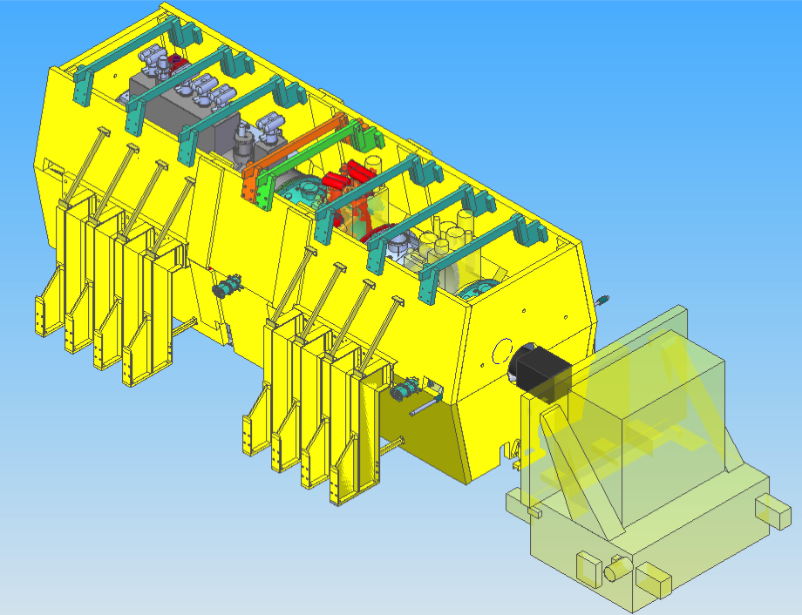
J. Tarrant
http://micewww.pp.rl.ac.uk/documents/177

Slide 58
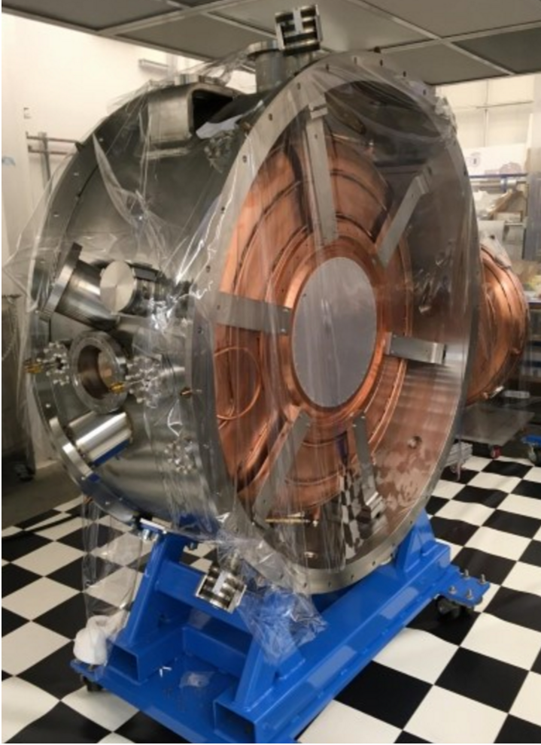
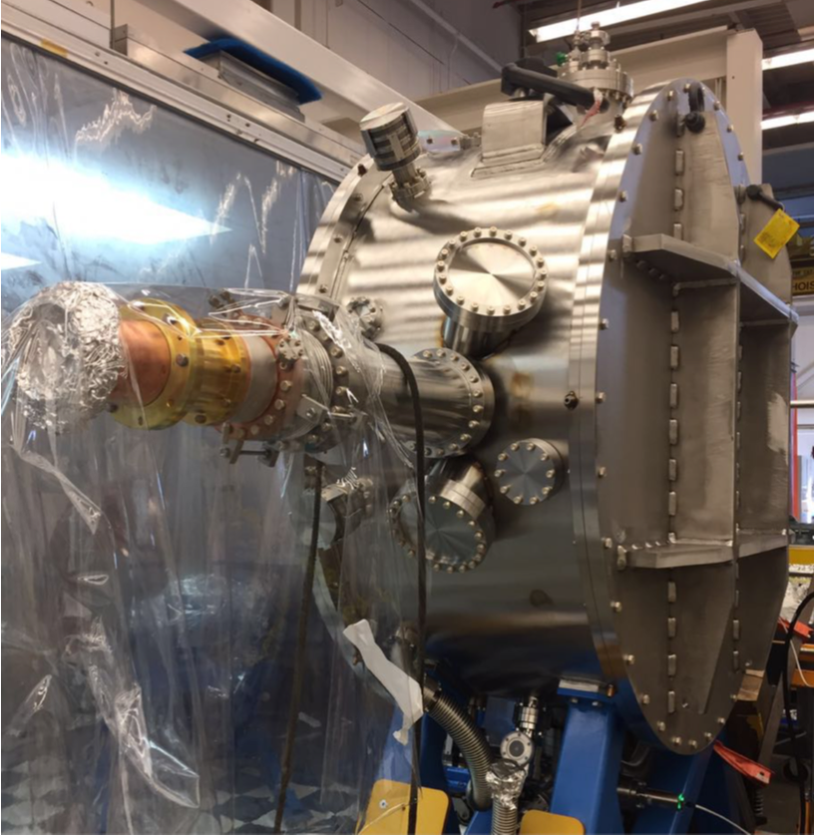
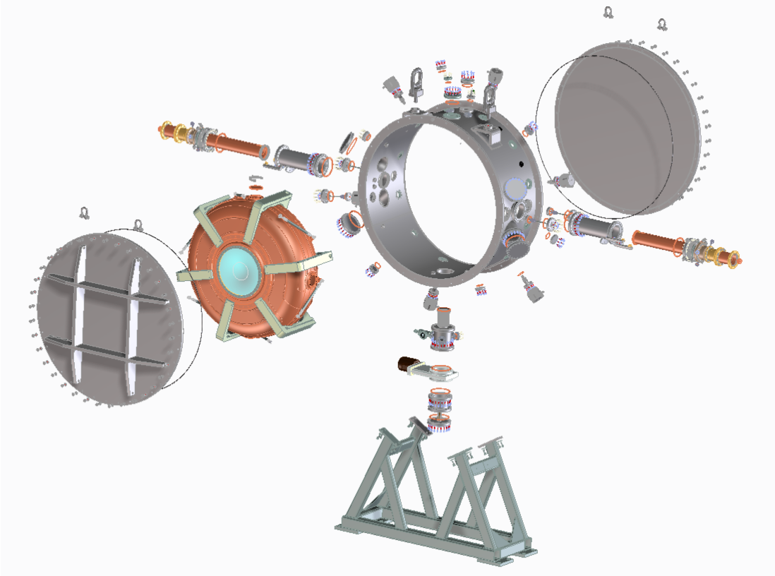

Slide 59
Performance
Rogers
Upgrade
Initial estimate of performance:
  Cooling effect: 8% at emittance of 7.9 mm;
    Comparable to baseline
  Transmission 85% vs 91% of baseline:
    Issue is systematic error:
      Believe that effect of modest decrease in transmission can be understood and systematic error can be kept under control
http://micewww.pp.rl.ac.uk/documents/177

Slide 60
Opportunities and conclusions
Muon beams for neutrino physics

Slide 61
Muon beams for particle physics
Have the potential to:
  Serve neutrino physics by providing intense beams with:
    Precisely known flavour content;
    Precisely known energy spectrum
  Provide multi-TeV lepton-anti-lepton collisions:
    With extremely small energy spread;
    Most cost-effective means to achieve E_{CM} > 1. TeV
Incremental path:
  MICE; nuSTORM/6D cooling demonstration;
  Neutrino Factory; Muon Collider
    Articulated by:
      US Muon Accelerator Program—“Muon Accelerator Staging Study”
      International Design Study for the Neutrino Factory collaboration

Slide 62
Opportunity
To define innovative programme:
  Based around demonstrator that:
    Delivers critical measurement: ν_{e}/ν_{μ} N scattering;
    Has discovery potential: sterile neutrinos;
    Serves “cLFV” and energy frontier-programmes through:
      6D ionization-cooling/phase rotation demonstrator
  Seek to develop “distributed” R&D model:
    European national labs and universities
    Seek broader involvement from Asia and the Americas
Programme for next decade:
  Complete MICE
  Execute nuSTORM as a precision neutrino-user facility
  Execute a 6D cooling demonstration

