Slide 1


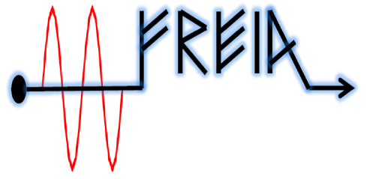
A high-repetition rate low-emittance thermionic RF gun
A. Opanasenko, V. Mytrochenko, V. Zhaunerchyk
Vitaliy Goryashko
2017

Slide 2
Why do we do this?
High-brightness electron beams are required to generate high-brightness photon beams
The better the electron beam quality, the brighter the photon beam
Upon acceleration the electron beam quality only degrades because of nonlinearities and non-ideal nature of real physics elements of an accelerator
We must start with as good electron beam as possible.
Need the best beam quality, go for a SC photogun
But it is expensive, complicated and requires a team for its operation
Can we design a simple, robust, inexpensive electron gun with the beam quality comparable to the best photoguns?
Our idea is to combine an RF gun cavity and a pulsed DC thermionic gun. Not a new idea but we went quite far in the design and physics.

Slide 3
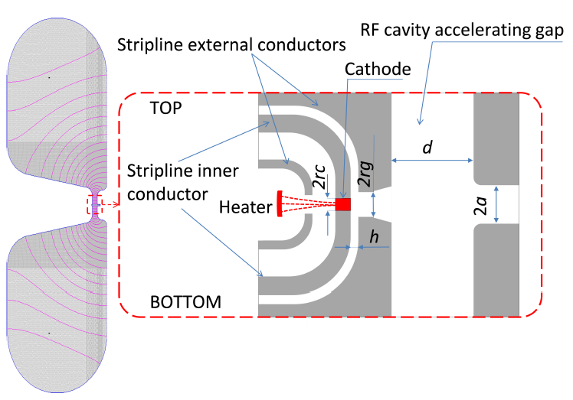
Gun Layout

Slide 4
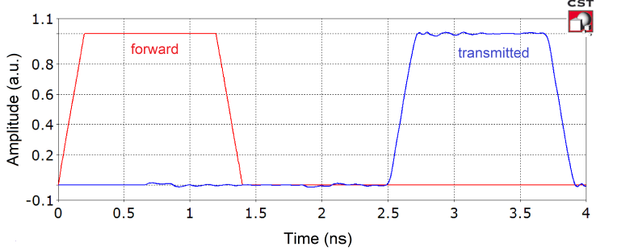
Gating of electron emission with a stripline-loop

Slide 5
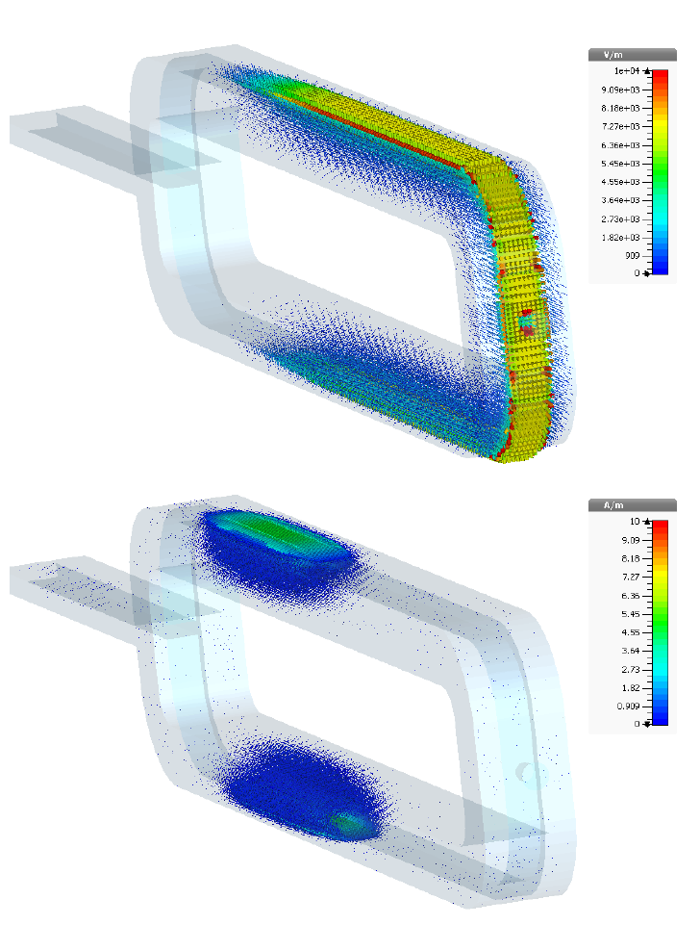
Fields in the stripline-loop and cathode region
HV pulse
Electric field
HV pulse
Magnetic field

Slide 6
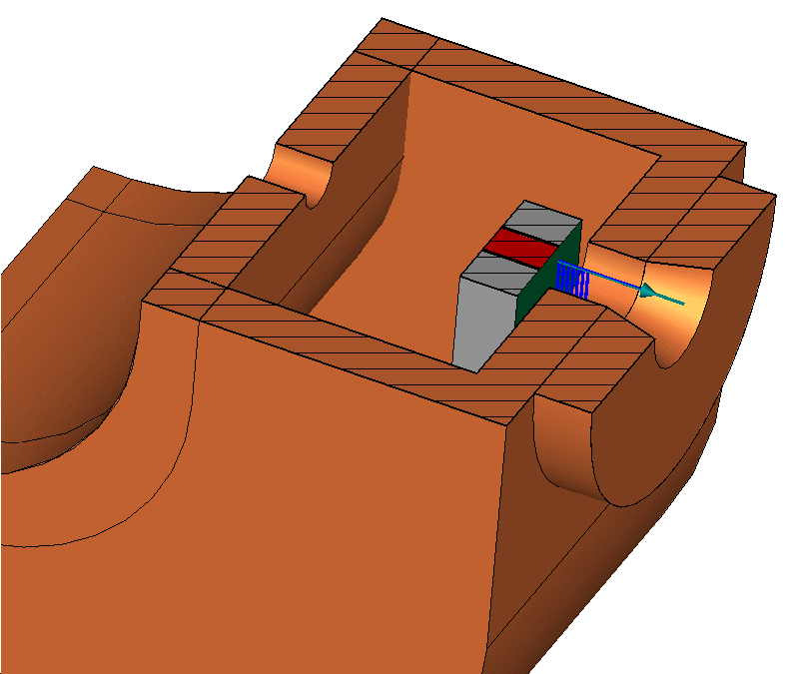
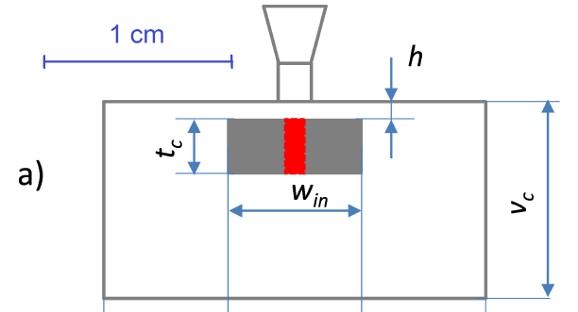
Fields in the cathode region

Slide 7
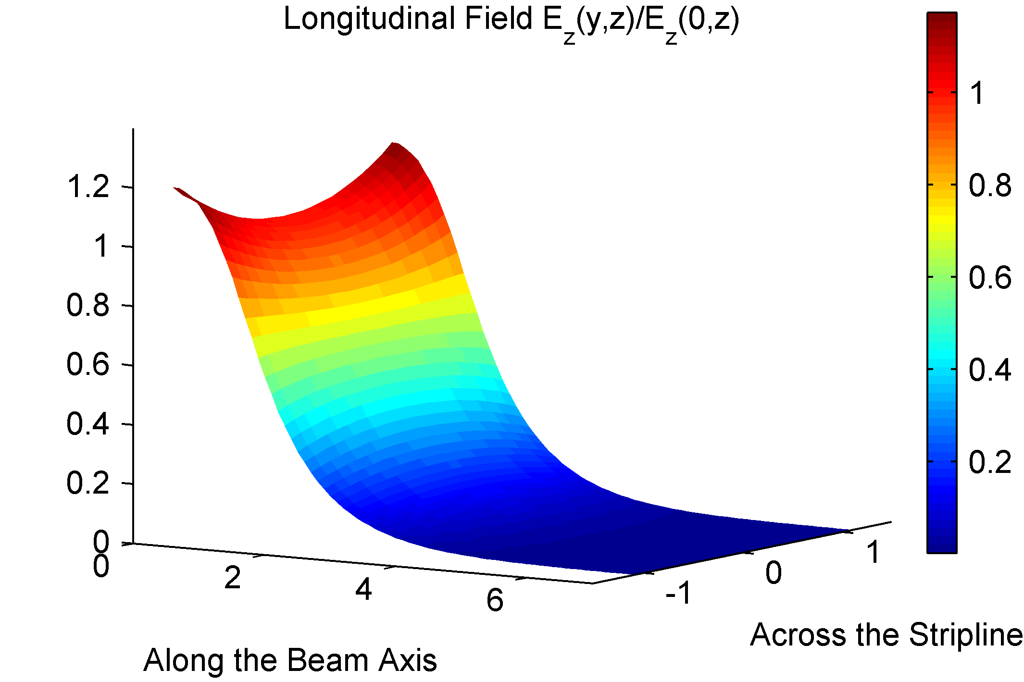
Field in the cathode-aperture region

Slide 8
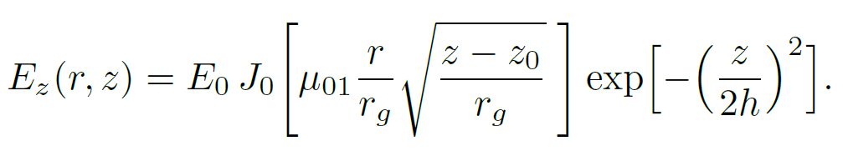
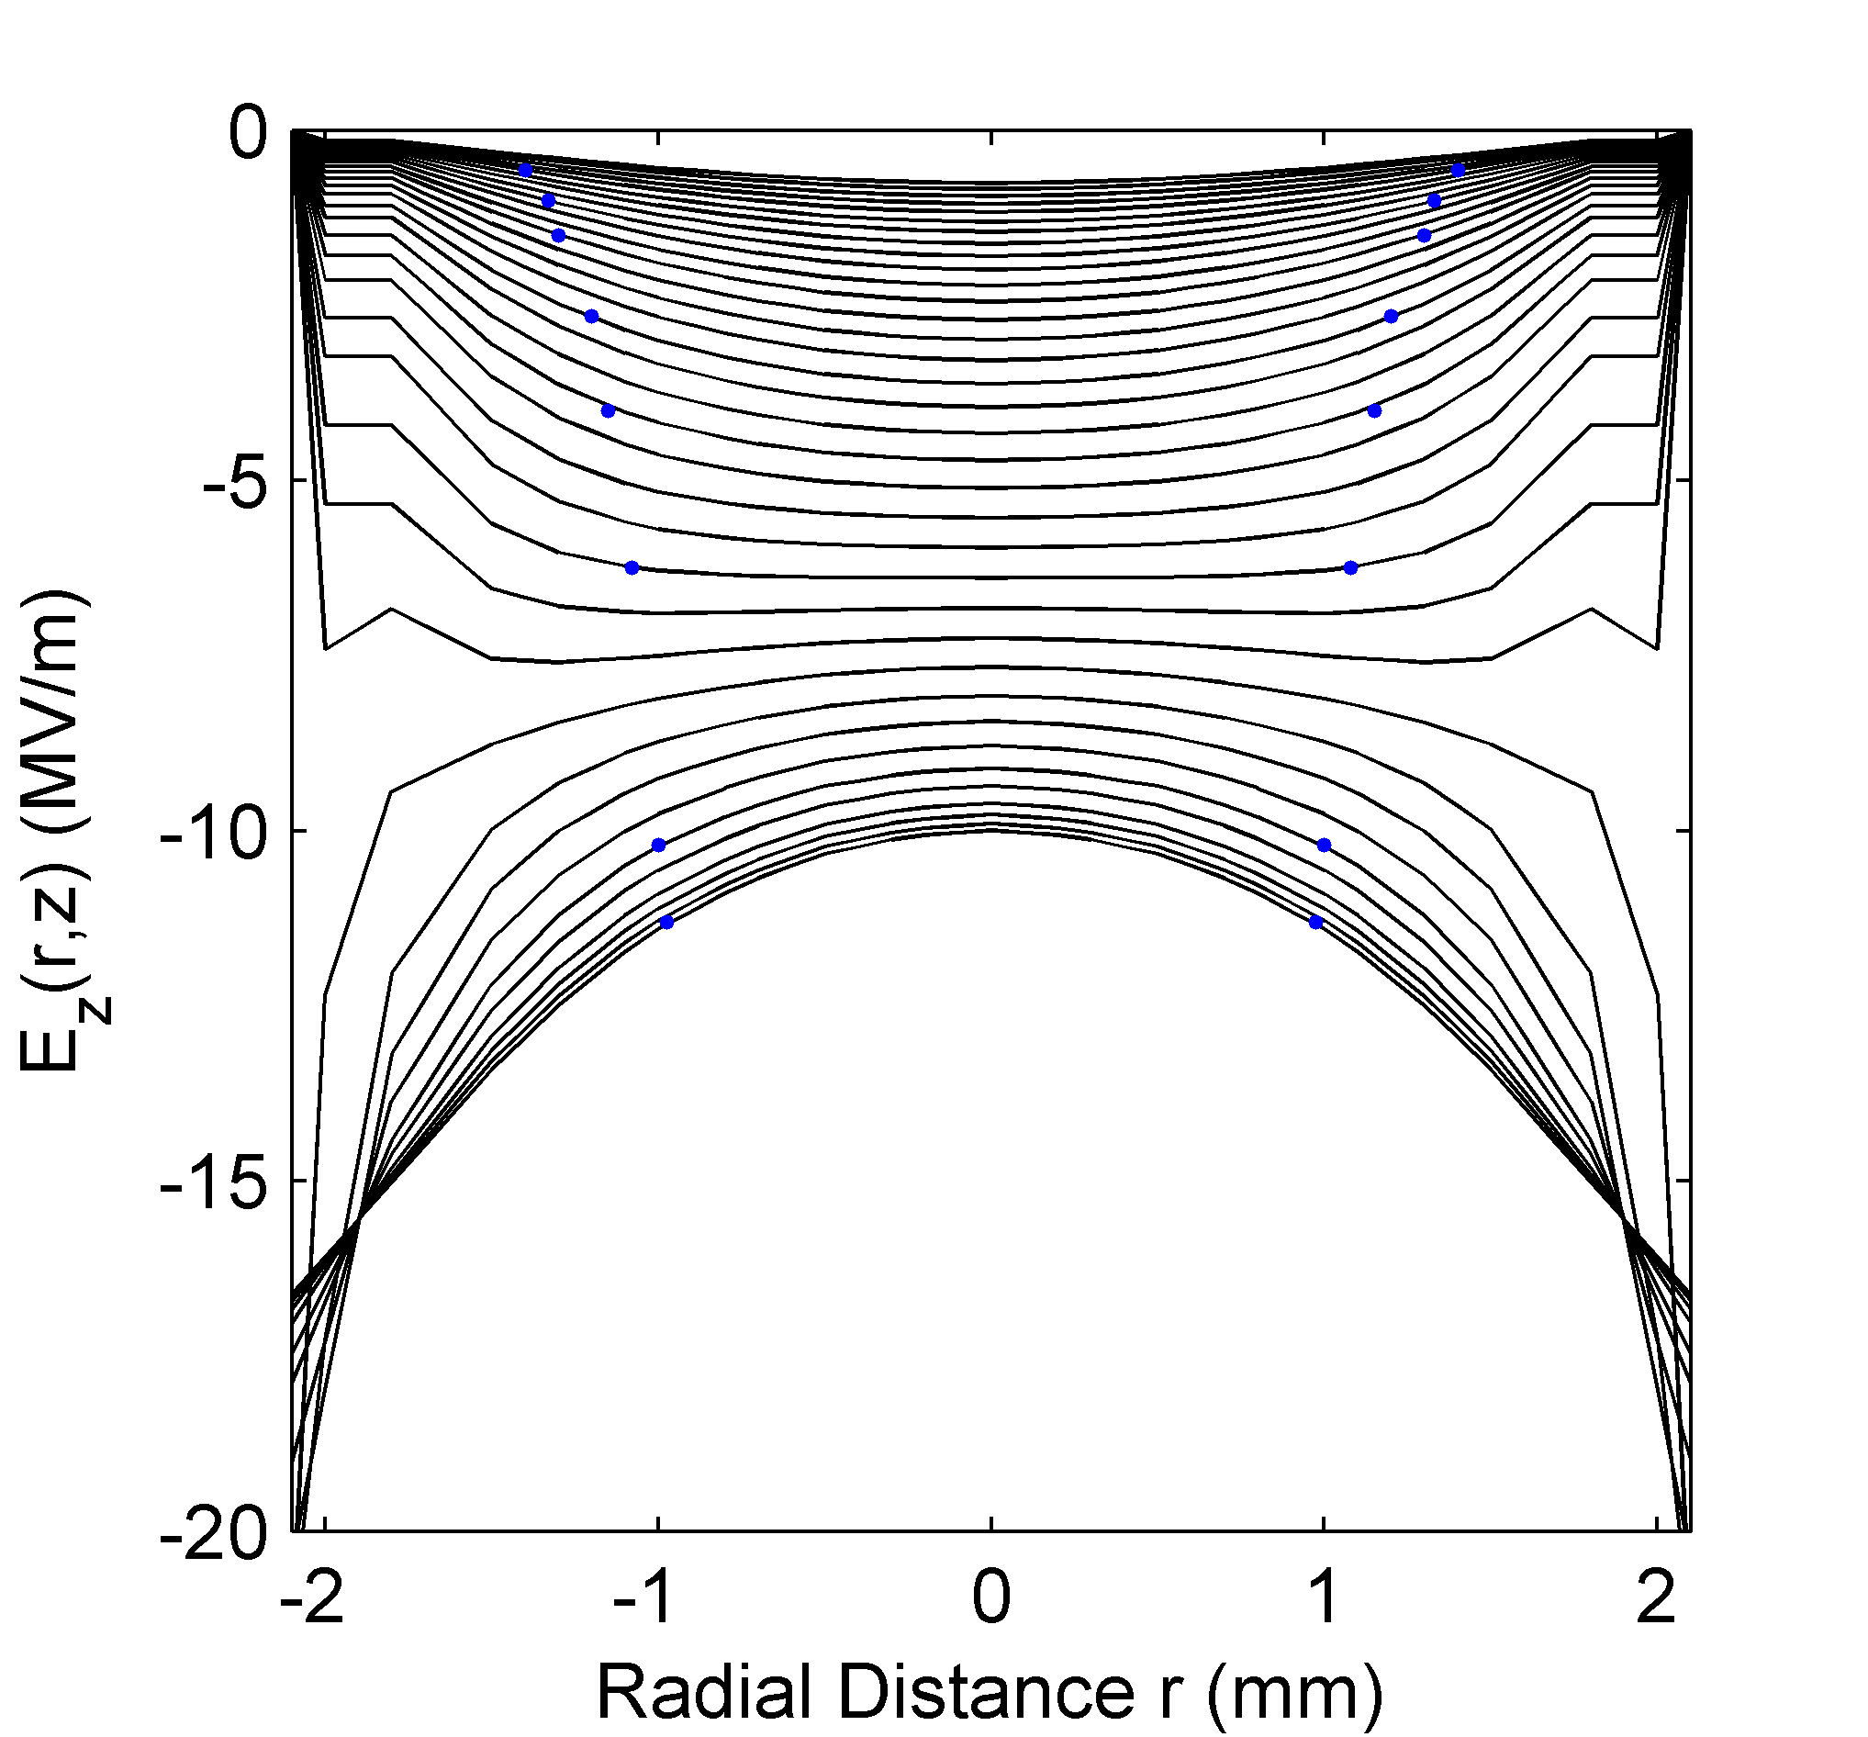




Cathode-aperture region
$$−V_{0}$$
$$h$$
zero potential
cathode
$${2r}_{g}$$
zero potential
$$z$$

Slide 9
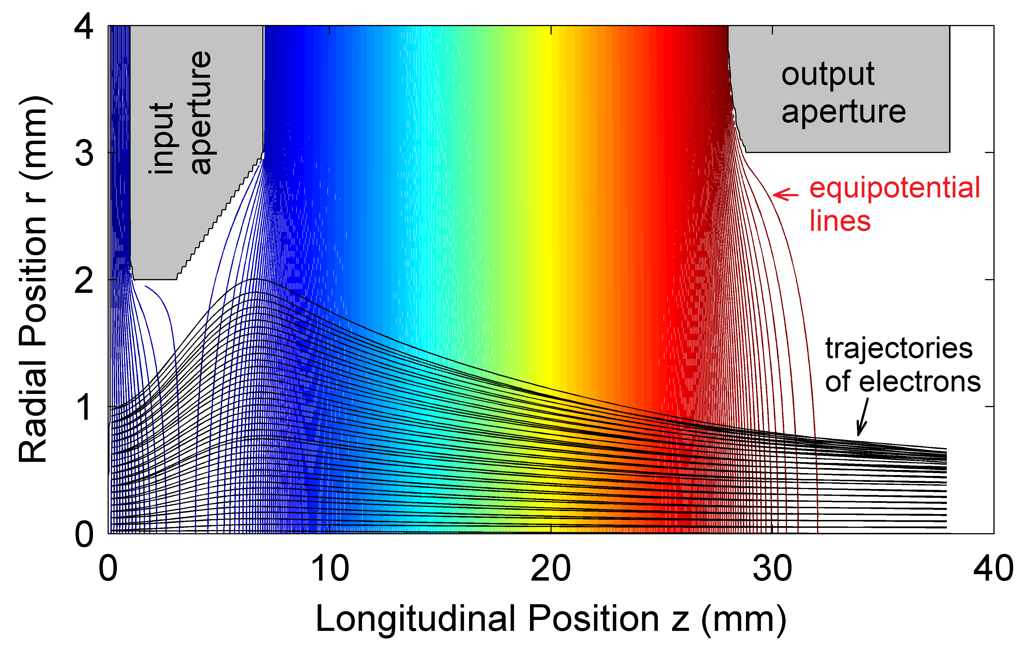
Gun geometry

Slide 10
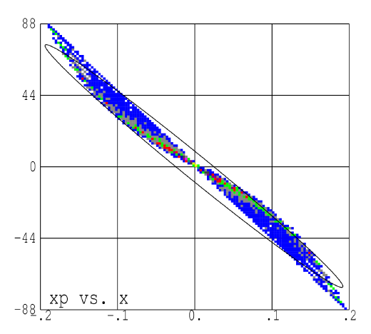
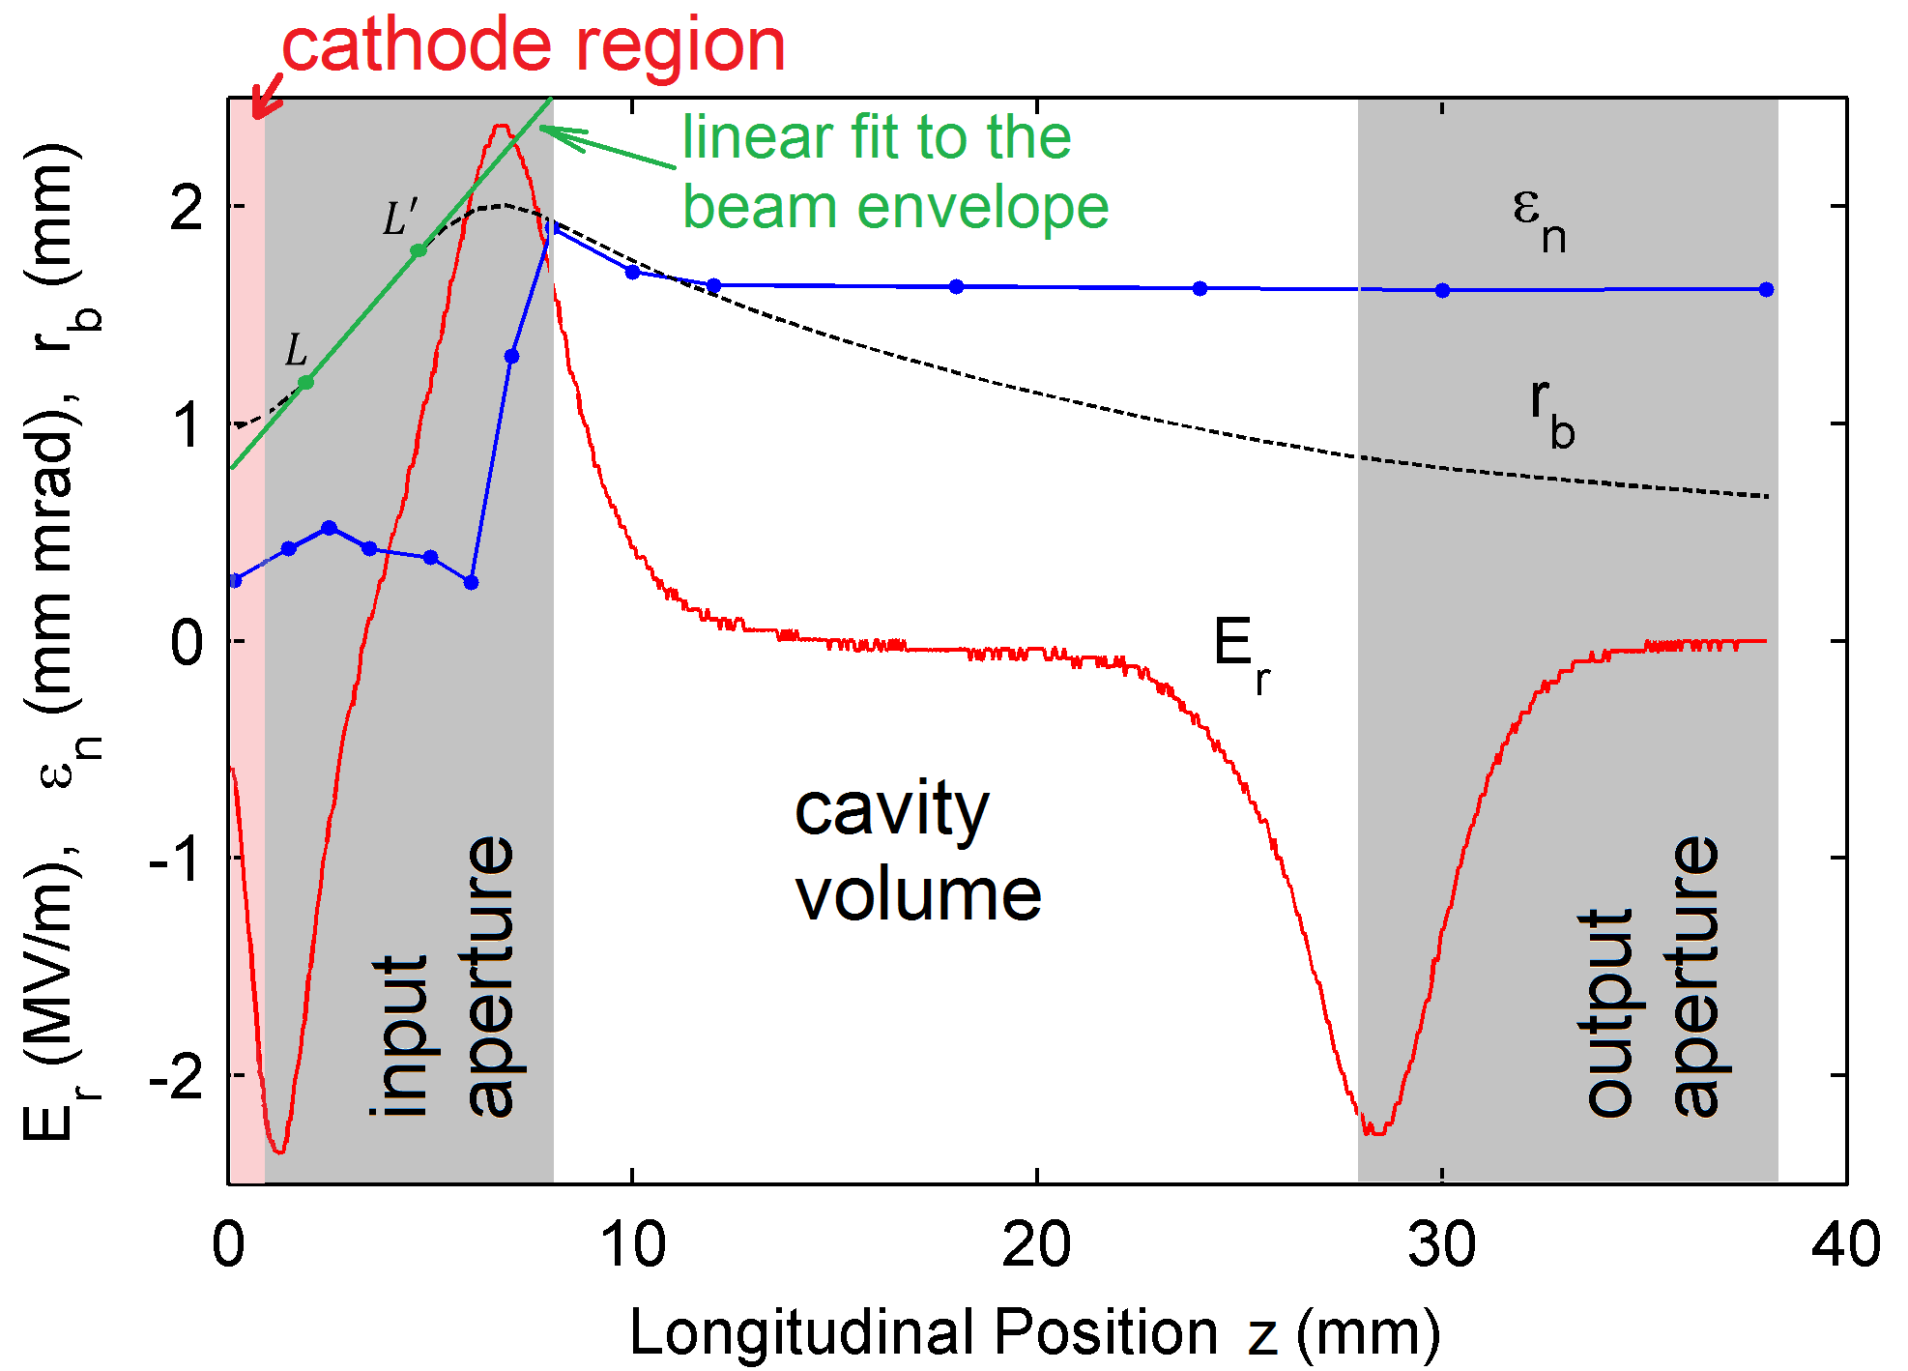
Beam optics of the gun
x/
x
Phase-space is S-shaped
There is a strong spherical aberration at the end of the injection aperture, which increases the beam emittance by a factor of 6!

Slide 11
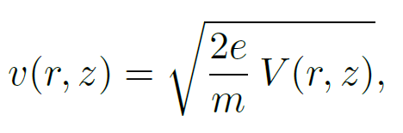
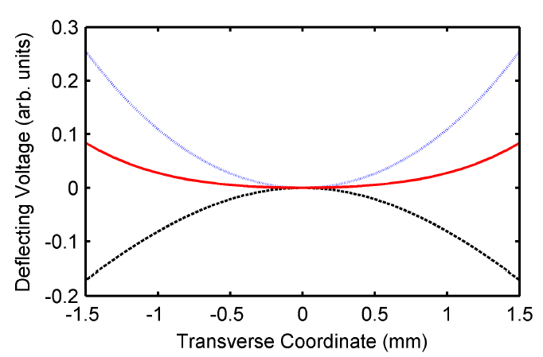
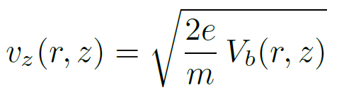
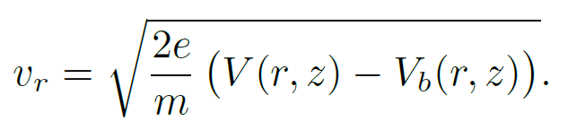
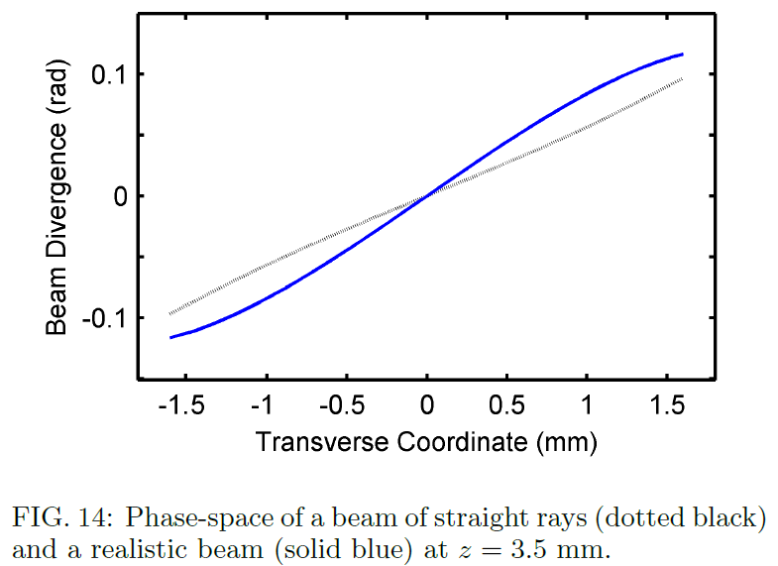
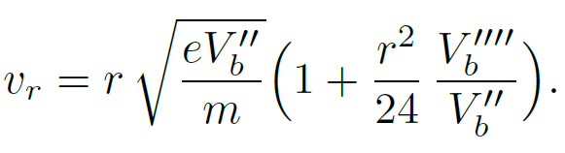
Spherical aberration in the cathode-aperture region

Slide 12
Recap on the field in the cathode-aperture region

Slide 13
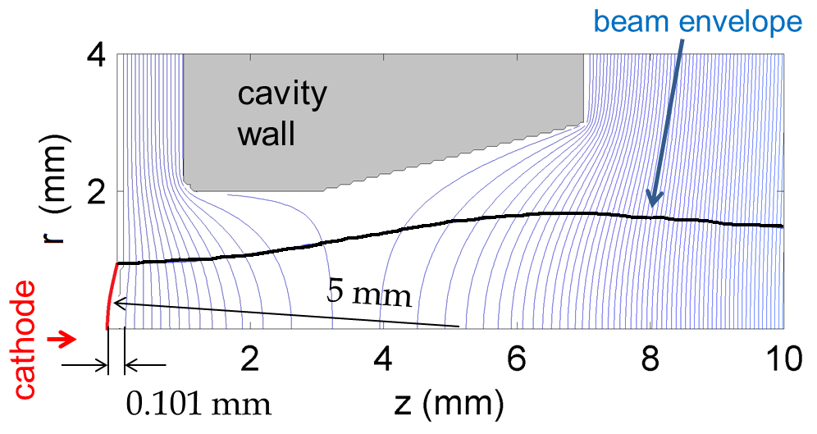
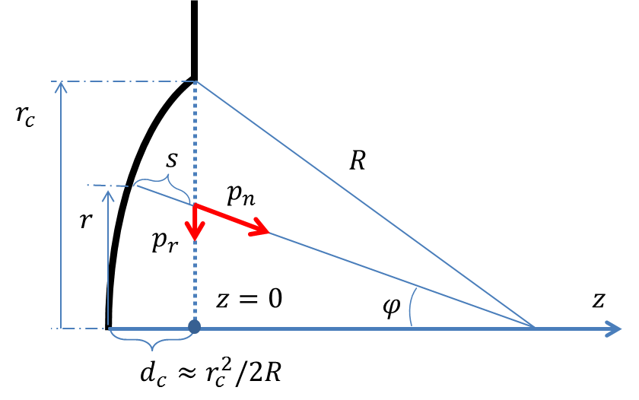

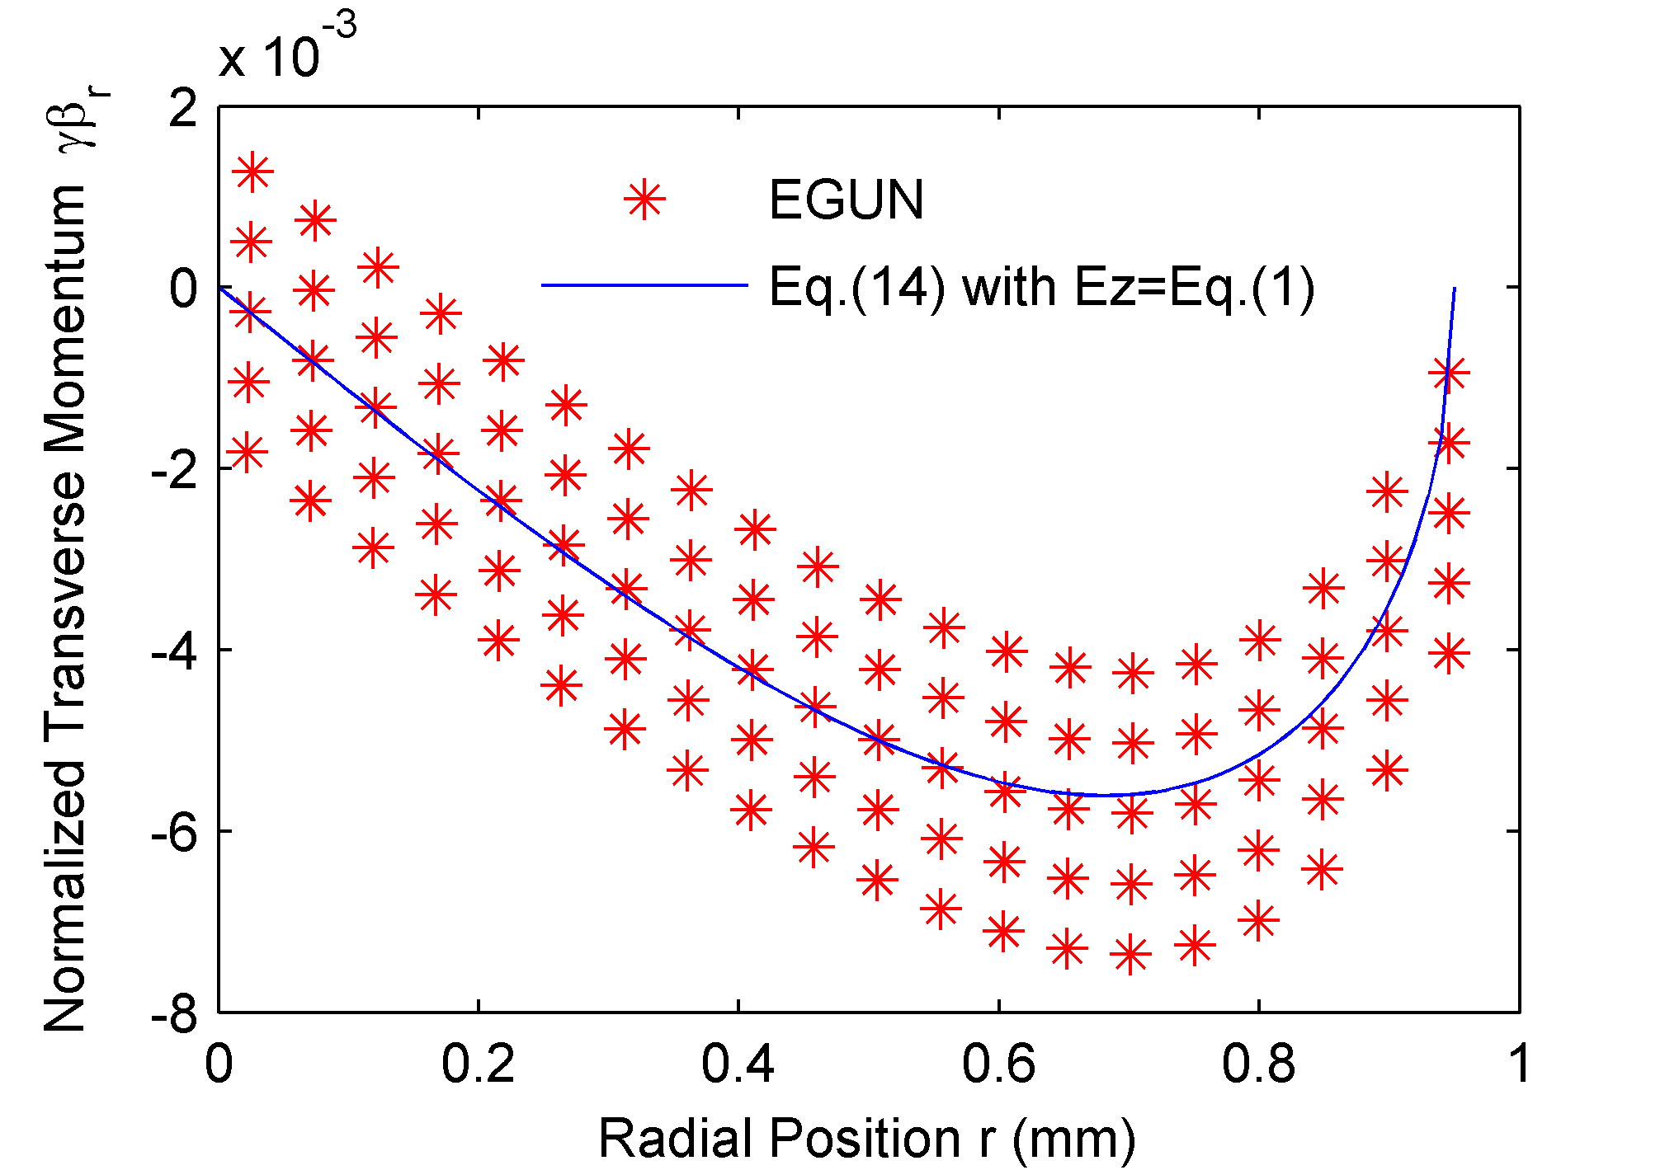


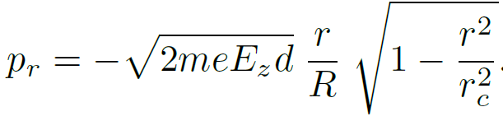
To counteract the spherical aberration we use concave cathode
Phase-space is Ζ-shaped

Slide 14
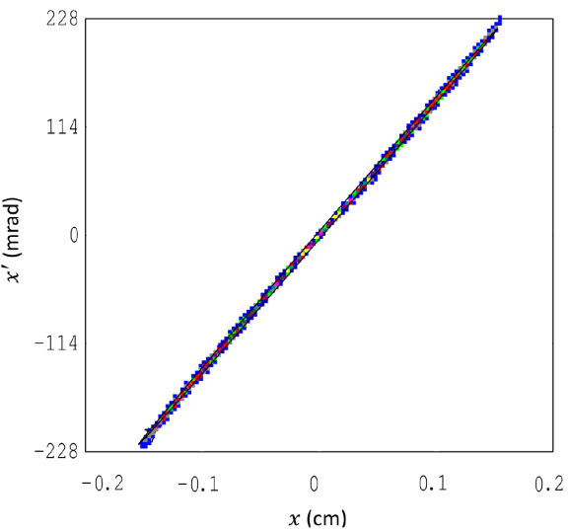
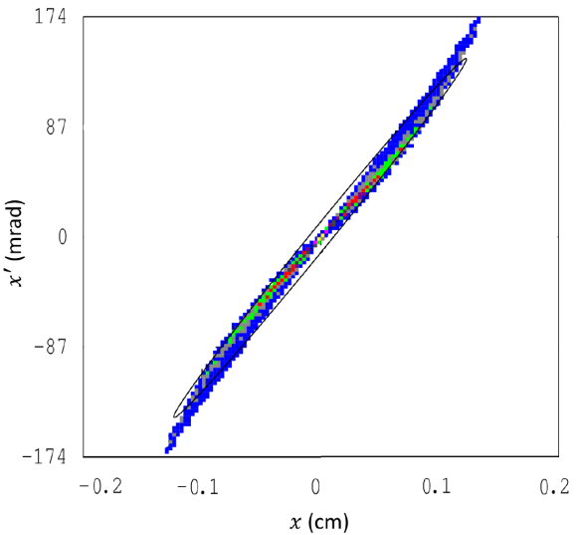
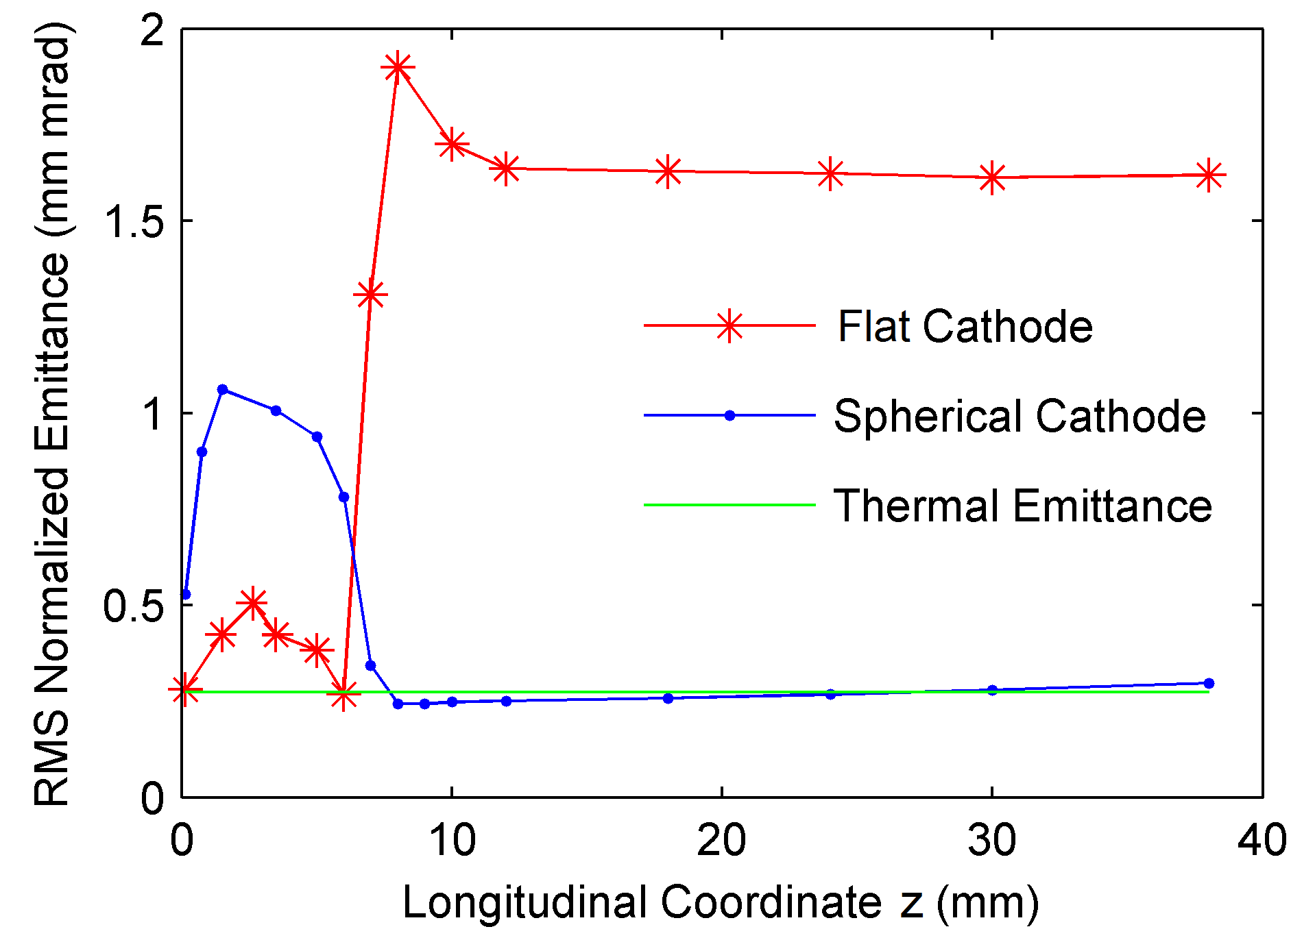
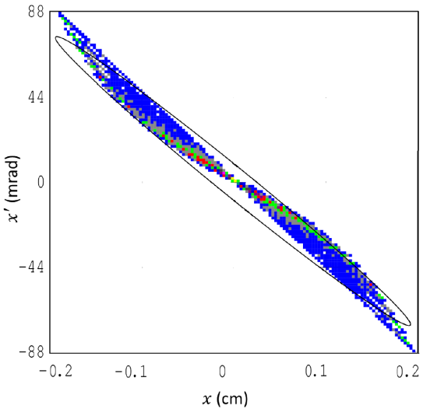
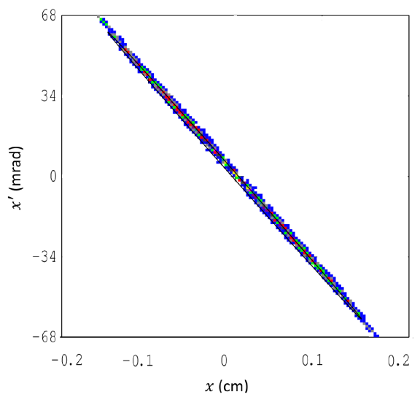
Emittance compensation
Flat cathode
S-shaped
Before the aperture
After the aperture
Ζ-shaped
Concave cathode

Slide 15
Tunability of the gun with beam current

Slide 16
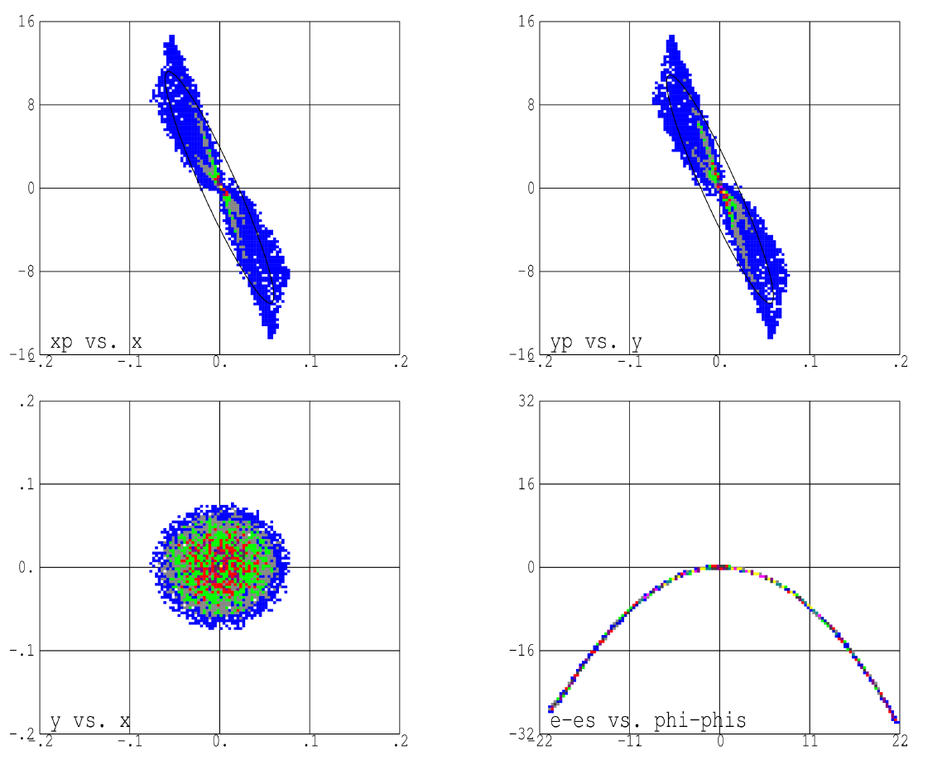
Impact of RF field on beam phase-space: FLAT cathode

Slide 17
FLAT cathode vs. CONCAVE cathode in RF fields
FLAT
CONCAVE

Slide 18
CONCAVE cathode + 3rd harmonic cavity

Slide 19
Final beam parameters

Slide 20
Summary
We propose a novel continuous wave RF gun with a
thermionic cathode that provides the bunch emittance at the same level as photocathode RF guns.
The peculiarities of our gun are:
i) nonlinear emittance compensation
that holds the slice emittance at the thermal level,
ii) variable repetition rate,
iii) long lifetime of the cathode,
iv) moderate requirements on vacuum.
Thank you for your attention!

