Slide 1

  The European Spallation Source
  John Womersley, Director General
  February 2017

Slide 2


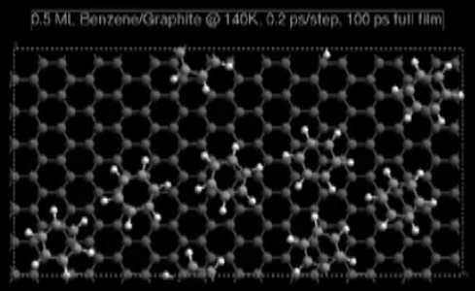
Neutrons are special
Electrically neutral - deeply penetrating ... except for some isotopes
Nuclear interaction: cross section depending on isotope (not Z), sensitive to light elements and water
Spin ½ probing magnetism and quantum properties
Mass n ~ p; thermal energies,
non-relativistic velocities
E = 293K = 25 meV, λ = 1.8 Å
v = 2 km/s
Neutrons tell us where are the atoms
and what do they do

Slide 3
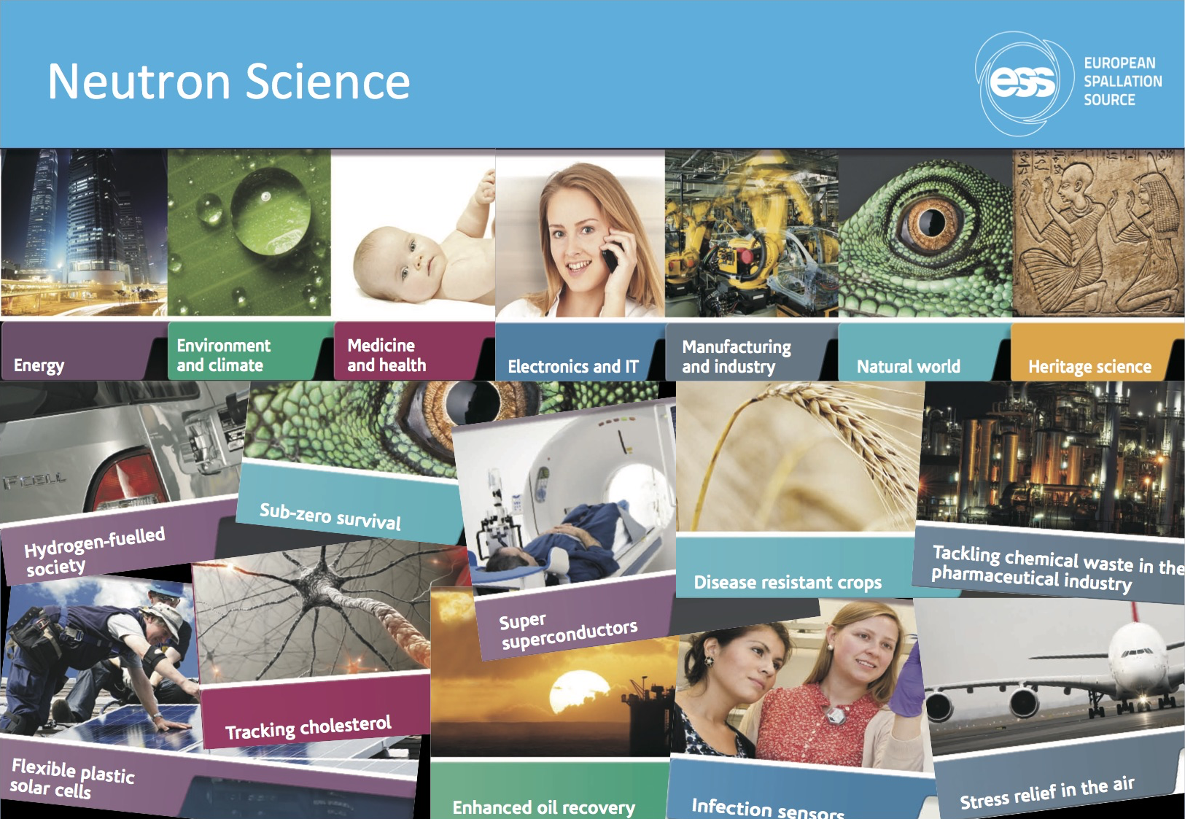

Slide 4








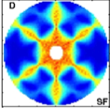
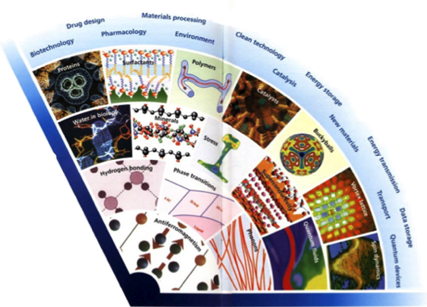

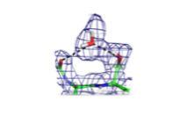

Neutron Science Needs to Push the Boundaries
Wider range of application areas
In Operandi Advanced
Energy Devices
Multi-scale structure
and dynamics
Kinetics of Complex
micro-fluids
Complex Interfaces
Charge and spin
Transport
in Novel Materials
New States of Matter
Quantum Enzymology
Protein Dynamics
Greater complexity
Need for more precision
2020+
2000’s
1990
1980
Time
1970
1960
2013-10-11
STC16 Agenda Item 9

Slide 5
Neutron facilities – reactors and particle driven
10²⁰
Reactor Sources
Spallation Sources
J-PARC
ESS
HFIR
ILL
LANSCE
ISIS
CSNS
10¹⁵
MTR
HIFAR
MARIA
ORPHEE
IPNS
SALAM
HANARO
SNS
NRX
HFBR
NIST
ZING-P’
Dhruva
CARR
PIK
NRU
SAFARI-1
JRR-3
ETERR-2
FRM-II
OPAL
LVR
RSG
SINQ
IBR-II
HOR
JEEP II
KENS
X-10
WNR
Effective thermal neutron flux n/cm²-s
ZING-P
10¹⁰
CP-2
CP-1
10⁵
Berkeley 37-inch cyclotron
Particle driven pulsed
350 mCi Ra-Be source
Particle driven steady state
Pulsed reactor
Fission reactors
1
Chadwick
1930
1940
1950
1960
1970
1980
1990
2000
2010
2020
2030
Year
(Updated from Neutron Scattering, K. Skold and D. L. Price, eds., Academic Press, 1986)
Notes:
CP-1 Chicago USA
CP-2 Chicago USA
X-10: Oak Ridge, USA
NRX: Chalk River, USA
MTR: Idaho, USA
LVR: Rez, Czech Republic
HIFAR: Sydney Australia
NRU: Chalk River, USA
HOR Delft Netherlands
SAFARI-1 Pretoria South Africa
HFBR: Brookhaven, USA
HFIR: ORNL, Oak Ridge, USA
NIST: National Inst. for Stds and Tech. Gaithersburg, USA
ILL: Grenoble, France
JEEP II Kjeller Norway
MARIA Swierk Poland
ORPHEE LLB Saclay France
Dhruva: Mumbai, India
RSG: serpong, Indonesia
SINQ: PSI, Switzerland
JRR-3: Tokai, Japan
ES-Salam Algiers Algeria
HANARO: Daejon KAERI, South Chorea
ETERR-2 Cairo Egypt
FRM-II: Munich, Germany
OPAL: Sydney, Australia
CARR: Beijing China
PIK: Gatchina, Russia
ZING-P Argonne USA
WNR Los Alamos USA
KENS Tsukuba Japan
IPNS Argonne USA
IBR-II Dubna Russia
LANSCE Los Alamos USA
ISIS Oxfordshire UK
SNS Oak Ridge USA
JPARC Tokai Japan
CSNS Beijing China
ESS Lund Sweden
More reactor sources exist across the world….

Slide 6
Neutron facilities
Reactor sources
Accelerator-driven sources
ESS
Effective thermal neutron flux n/cm²-s
J-PARC
NIST
ILL
LANSCE
ISIS
FRM-II
SNS
CSNS
Year
Notes:
CP-1 Chicago USA
CP-2 Chicago USA
X-10: Oak Ridge, USA
NRX: Chalk River, USA
MTR: Idaho, USA
LVR: Rez, Czech Republic
HIFAR: Sydney Australia
NRU: Chalk River, USA
HOR Delft Netherlands
SAFARI-1 Pretoria South Africa
HFBR: Brookhaven, USA
HFIR: ORNL, Oak Ridge, USA
NIST: National Inst. for Stds and Tech. Gaithersburg, USA
ILL: Grenoble, France
JEEP II Kjeller Norway
MARIA Swierk Poland
ORPHEE LLB Saclay France
Dhruva: Mumbai, India
RSG: serpong, Indonesia
SINQ: PSI, Switzerland
JRR-3: Tokai, Japan
ES-Salam Algiers Algeria
HANARO: Daejon KAERI, South Chorea
ETERR-2 Cairo Egypt
FRM-II: Munich, Germany
OPAL: Sydney, Australia
CARR: Beijing China
PIK: Gatchina, Russia
ZING-P Argonne USA
WNR Los Alamos USA
KENS Tsukuba Japan
IPNS Argonne USA
IBR-II Dubna Russia
LANSCE Los Alamos USA
ISIS Oxfordshire UK
SNS Oak Ridge USA
JPARC Tokai Japan
CSNS Beijing China
ESS Lund Sweden
More reactor sources exist across the world….

Slide 7
ESS long pulse potential
8
x10¹⁴
ESS 5 MW
2015 design
thermal moderator
λ=1.5 Å
7
Possibilities of pulse shaping
6
5
Brightness (n/cm²/s/ster/Å)
4
ESS 5 MW
2012 design (TDR)
3
2
US
1.4 MW
Japan
300 kW
UK TS1
128 kW
UK TS2
32 kW
1
ILL 57 MW
0
time (ms)
1
2
3
4

Slide 8















Financing includes cash and deliverables
Host Countries Sweden and Denmark
Construction 47.5% Cash Investment ~ 97%
Operations 15%
Non Host Member Countries
Construction 52.5% In-kind Deliverables ~ 70%
Operations 85%

Slide 9
Construction investment
CURRENT
Sweden (member) | 35.0 %
Denmark (member) * | 12.5 %
Germany (member) * | 11.0 %
United Kingdom (member) | 10.0 %
France (member) | 8.0 %
Italy (member) | 6.0 %
Spain (founding observer) * | 5.0 %
Switzerland (member) | 3.5 %
Norway (member) | 2.5 %
Poland (member) | 2.0 %
Czech Republic (member) | 2.0 %
Hungary (member) | 0.95 %
Estonia (member) | 0.25 %
Total * | ~98.7 %
FUTURE
Belgium (founding observer) | tbd
Netherlands (founding observer) | tbd
* Includes Pre-construction Costs, Current Construction Commitment
Notes:
Founding Members
Czech Republic
Denmark
Germany
Estonia
France
Italy
Hungary
Norway
Poland
Sweden
Switzerland
Founding observers
Belgium
Spain
Netherlands
United Kingdom
Ireland

Slide 10
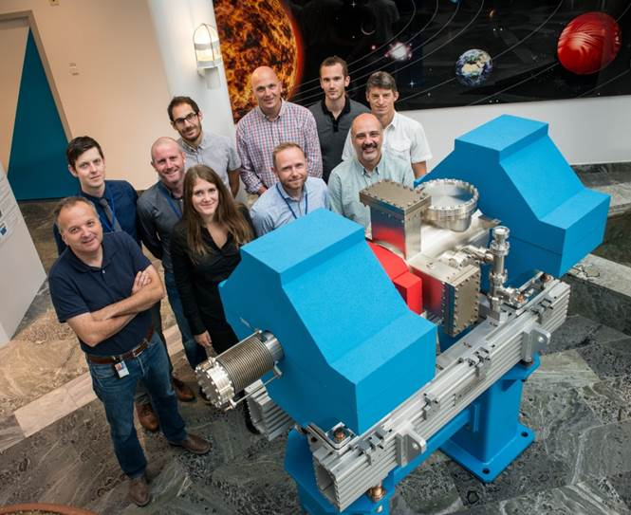
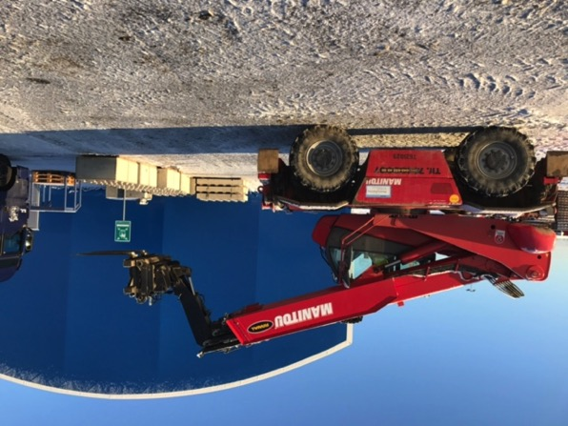
ESS In-kind Partners
Aarhus University
Atomki - Institute for Nuclear Research
Bergen University
CEA Saclay, Paris
Centre for Energy Research, Budapest
Centre for Nuclear Research, Poland, (NCBJ)
CNR, Rome
CNRS Orsay, Paris
Cockcroft Institute, Daresbury
Elettra – Sincrotrone Trieste
ESS Bilbao
Forschungszentrum Jülich
Helmholtz-Zentrum Geesthacht
Huddersfield University
IFJ PAN, Krakow
INFN, Catania
INFN, Legnaro
INFN, Milan
Institute for Energy
Research (IFE)
Rutherford-Appleton Laboratory, Oxford(ISIS)
Copenhagen University
Laboratoire Léon Brilouin (LLB)
Lund University
Nuclear Physics Institute of the ASCR
Oslo University
Paul Scherrer Institute (PSI)
Polish Electronic Group (NCBJ, TU Warsaw, TU Lodz)
Roskilde University
Tallinn Technical University
Technical University of Denmark
Technical University Munich
Science and Technology Facilities Council
University of Tartu
Uppsala University
WIGNER Research Centre for Physics
Wroclaw University of technology
Warsaw University of Technology
Zurich University of Applied Sciences (ZHAW)

Slide 11


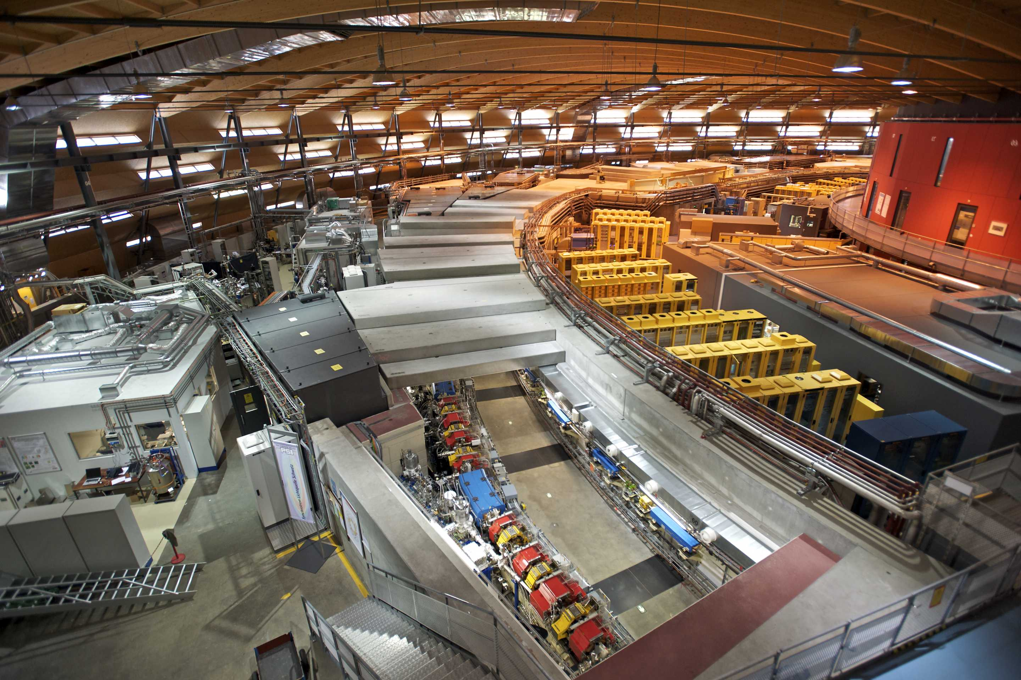
Organisation and People
388
Employees
48
Nationalities
~ 100
Collaborating Institutions

Slide 12
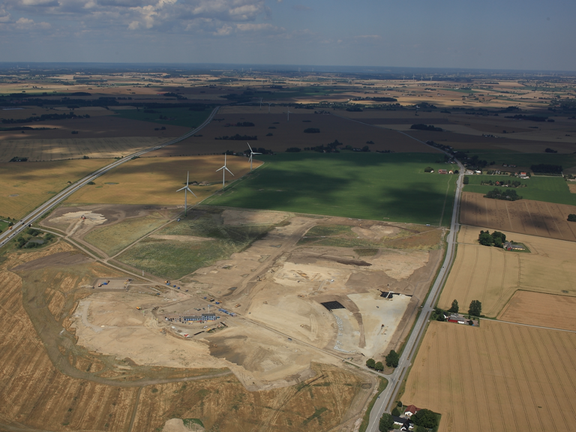
Civil construction groundbreaking
September 2014

Slide 13
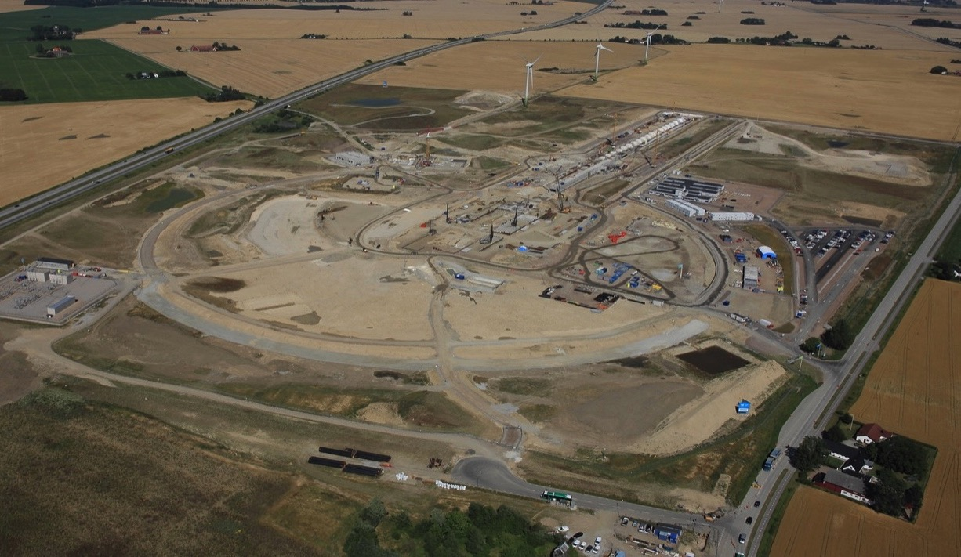
August 2015

Slide 14
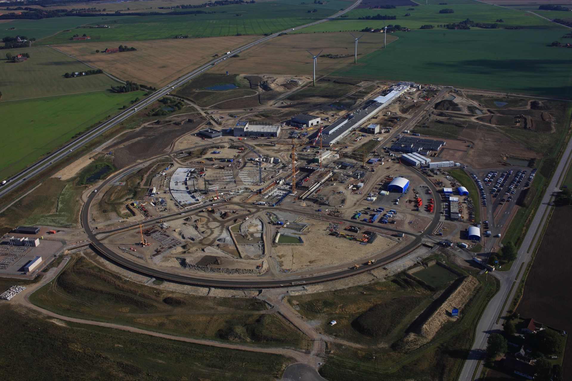
September 2016
August

Slide 15
December 2016

Slide 16
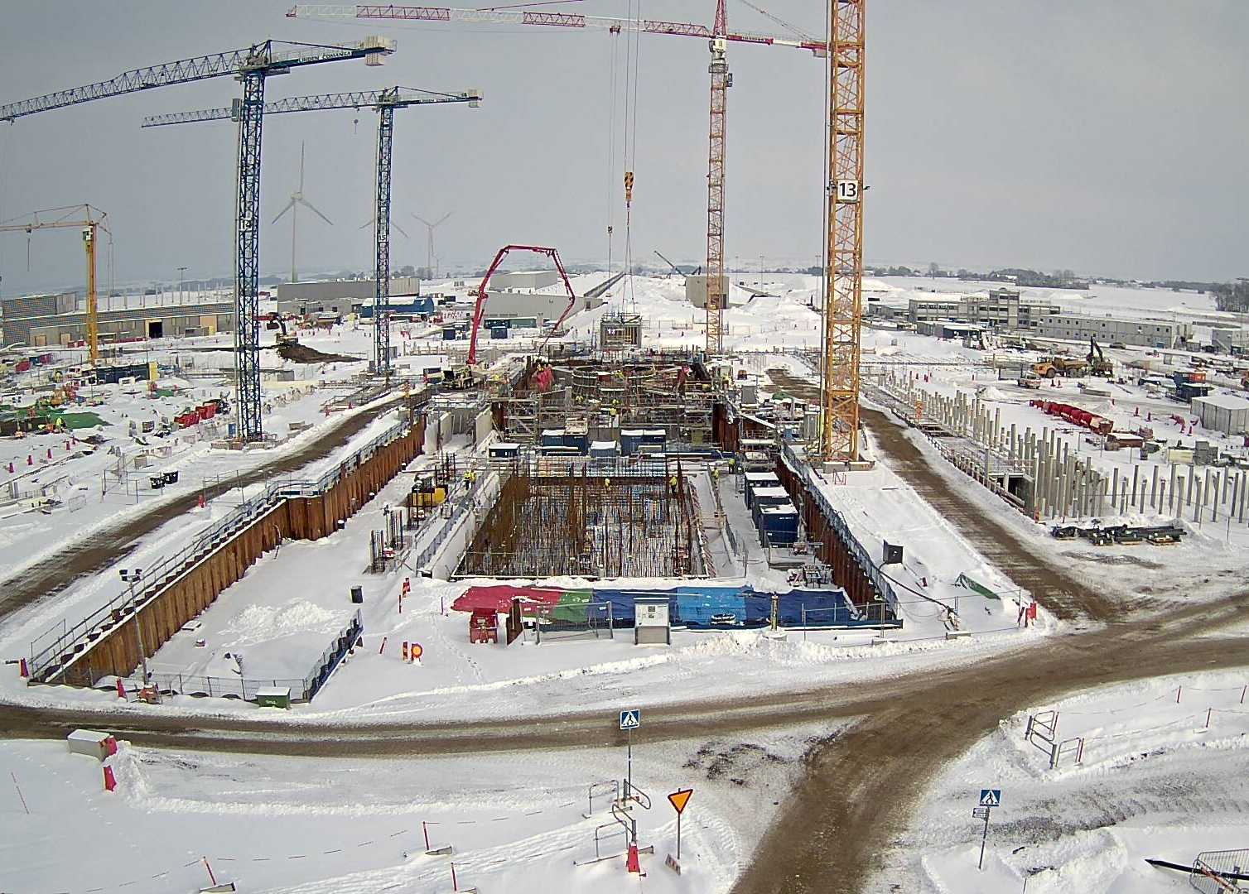
Central Utilities Building (CUB)
LINAC
Site
Offices
Instruments
Target
February 2017

Slide 17
Project progress– December 2016

Slide 18



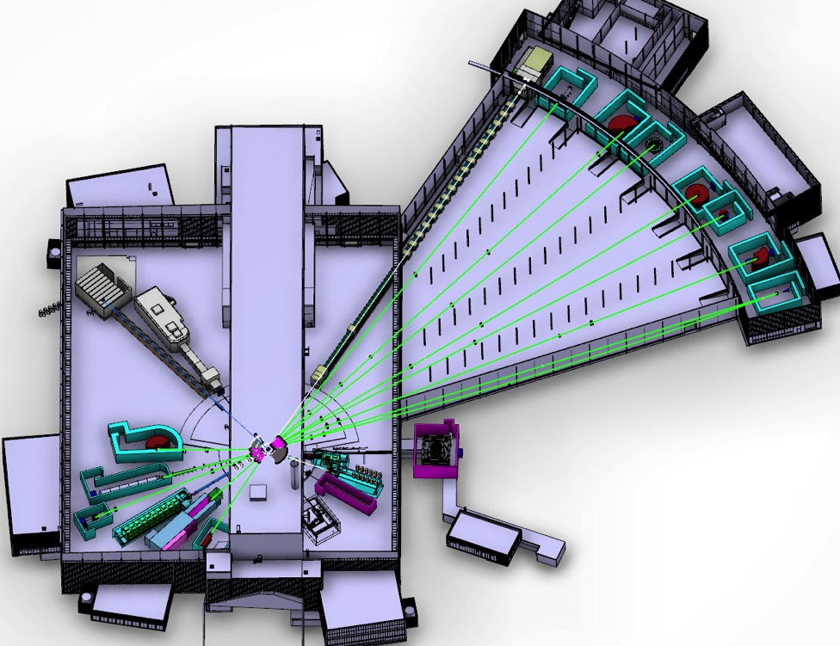









ESS Neutron Instruments 1-15
ESS Lead Partners for instrument construction
+
Nuclear Physics Institute
NMX
BEER
C-SPEC
BIFROST
MIRACLES
MAGIC
DREAM
ODIN
T-REX
HEIMDAL
VOR
LoKI
VESPA
FREIA
SKADI
ESTIA
50 m
100 m
150 m
ESS Instrument Layout (June 2016)

Slide 19
Instruments
Scope, budget, and timelines set for 15 instruments
Defined which 8 to build first
All 15 instruments will be world leading at 2 MW +
Important to move on fast into construction to maintain schedule (preliminary design => detailed design)
Instruments 15-22 to be funded from initial operations
User operation in 2023: challenging but realistic goal

Slide 20
Science Drivers for the
Reference Instrument Suite
Multi-Purpose Imaging ODIN
General-Purpose SANS SKADI
Broadband SANS LOKI
Surface Scattering
Horizontal Reflectometer FREIA
Vertical Reflectometer ESTIA
Thermal Powder Diffractometer HEIMDAL
Bispectral Powder Diffractometer DREAM
Monochromatic Powder Diffractometer
Materials Science Diffractometer BEER
Extreme Conditions Diffractometer
Single-Crystal Magnetism Diffractometer MAGIC
Macromolecular Diffractometer NMX
Cold Direct Geometry Spectrometer C-SPEC
Wide Bandwidth Direct Geom. Spectrometer VOR
Bispectral Direct Geometry Spectrometer TREX
Cold Crystal-Analyser Spectrometer CAMEA
Vibrational Spectrometer VESPA
Backscattering Spectrometer MIRACLES
High-Resolution Spin-Echo
Wide-Angle Spin-Echo
Fundamental & Particle Physics
Large-Scale Structures
Spectroscopy
Diffraction
life sciences | magnetism & superconductivity
soft condensed matter | engineering & geo-sciences
chemistry of materials | archeology & heritage conservation
energy research | fundamental & particle physics

Slide 21
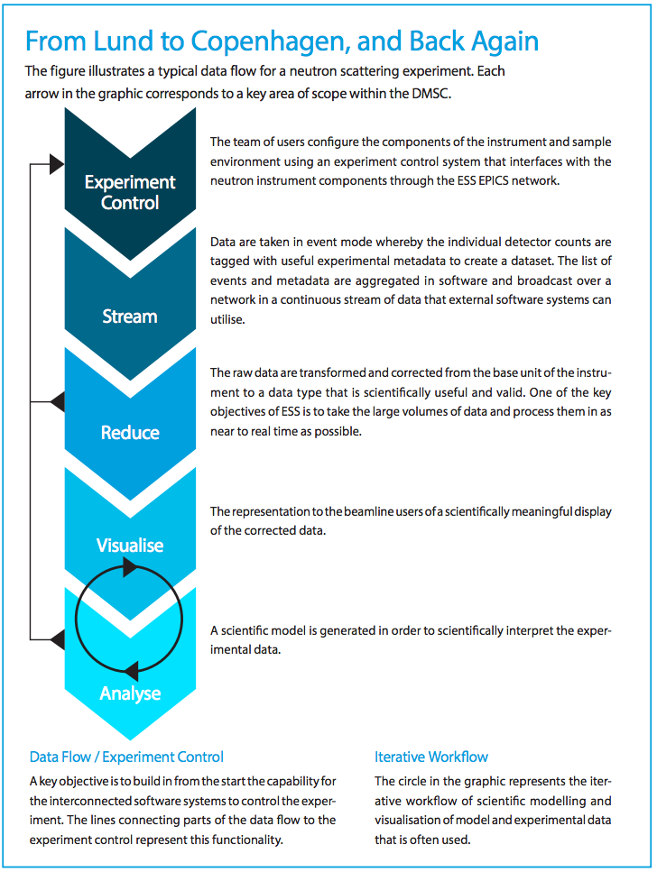
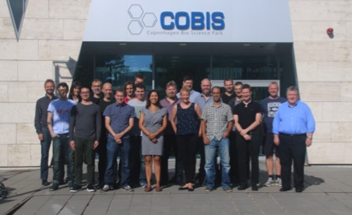
Data Management and Software Centre
COBIS, Copenhagen University North Campus
Provide world leading scientific software and scientific computing support for neutron scattering at ESS
Scientific Software
ESS experiment control system, Data acquisition, Data correction software, visualization, and software to model and analyze experimental data sets.
Data center operations
Store and catalogue ESS datasets, provide ESS users remote access to their data, computing for live data correction, and analysis software during and after experiments.
User support
Support ESS users with
data treatment and
analysis.
22* DMSC Staff now → 60
(*20 FTEs and 2 part time)
21

Slide 22
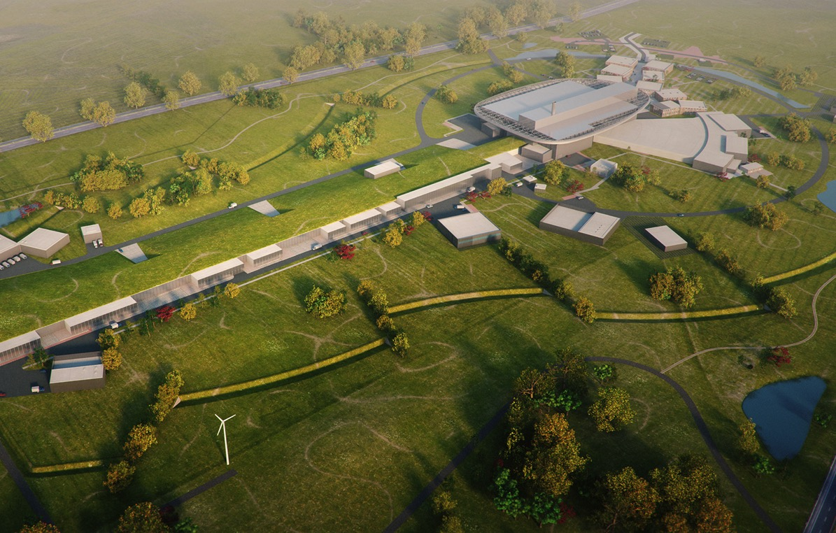
Journey to deliver the world’s leading facility for research using neutrons
2025
ESS Construction Phase Complete
2014
Construction Starts on Green Field Site
2023
ESS Starts
User Program
2009
Decision to Site ESS in Lund
2019-20
Machine Ready for
1st Beam on Target
2012
ESS Design Update Phase Complete
2003
European Design of ESS Completed

Slide 23
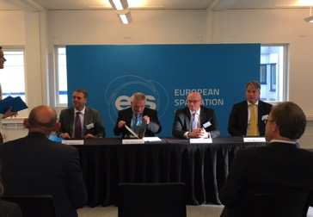
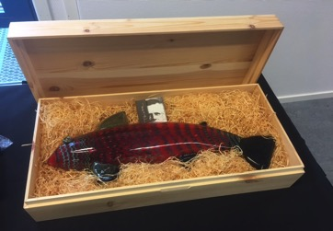
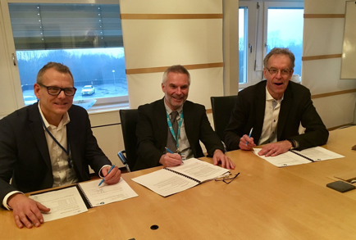
ESS is making rapid progress
Conventional construction moving fast
First in-kind deliveries on site
Agreement on Financing with EIB, NIB, SEK ✅
Selection of Initial Instruments ✅
Target price agreed for remaining civil construction ✅
Starting installation of first cryo and electrical systems
Will begin to move ESS staff out to the site in 2017

Slide 24

Our current focus
Maintaining the schedule and the cost ceiling
In-kind agreements, member commitments
Integrated Project Schedule
Value Engineering exercise
Understanding the transition to initial operations

Slide 25
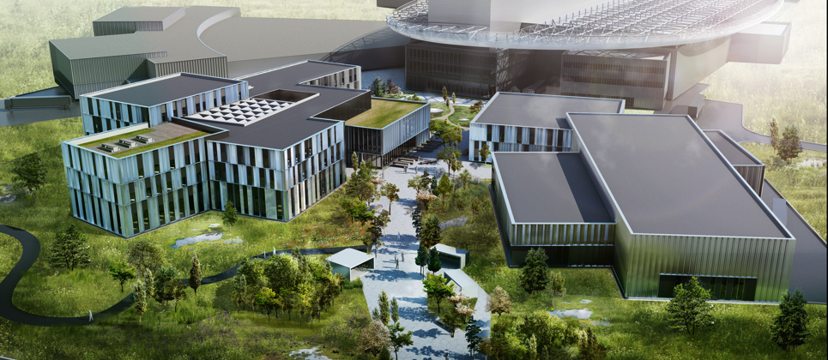
ESS Office Campus
        Financing tenders received and process complete
        Building requirements review and approval ongoing
        Design/Construct tender published Q3 2017
        Contract signing Dec 2017
        Design and Construction Q1 2018 – Q2 2020
Notes:
Schedule:
Tender Design & Technical Tender documentation completed and reviewed: 15 March 2017
Requirements B01 & B02 reviewed and approved: 15 March
Financing and Land agreement settled: 31 March
Procurement documentation completed: 30 April
Design/Build Contract to be included in the tender package 30 April
Pre qualification period (4 weeks): 1 May – 26 May
Pre qualification evaluation and announcement (4 weeks): 29 May- 23 June
Design/Construct tender period (10 workweeks+4 weeks summer vacation period): 26 June – 30 Sep
Design/Construct tender evaluation (4 weeks): 1 Oct – 27 Oct
Design/construct negotiations (4 weeks): 30 Oct – 24 Nov
Design/Construct contract signing: 1 Dec 2017
Design/Construct period (30 months): 1 Dec 2017 – 29 May 2020

Slide 26
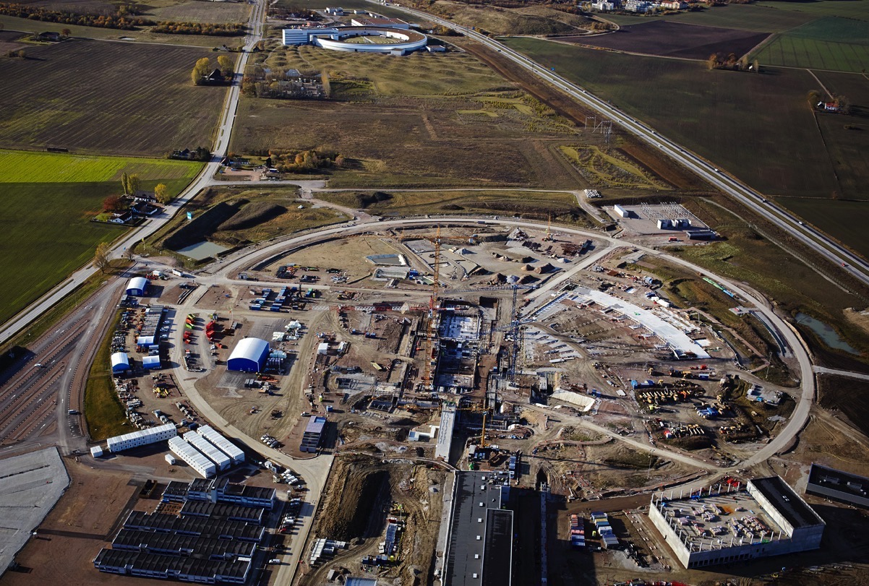
ESS is part of an ecosystem

Slide 27

ESS

Slide 28
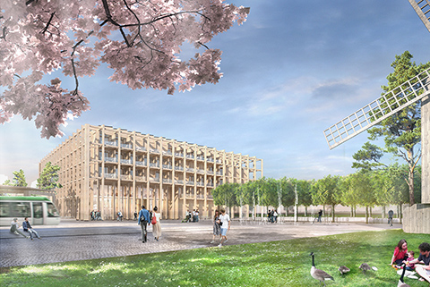
SPACE Building: Reception, exhibition space,
guest house for MAX IV and ESS (~100 rooms),
office and meeting space, restaurant
Tramway to Lund C station

Slide 29
Construction and Operations cost
Construction Budget: Instruments 1-15
Initial Operation Budget (2019-2025):
instruments 16-22, scope upgrades for
instruments 1-15
Steady State
Operation

Slide 30
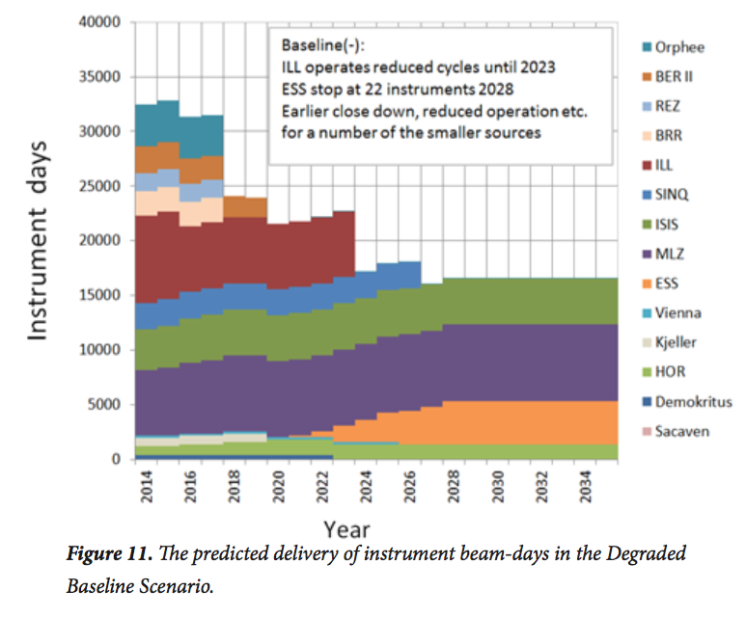
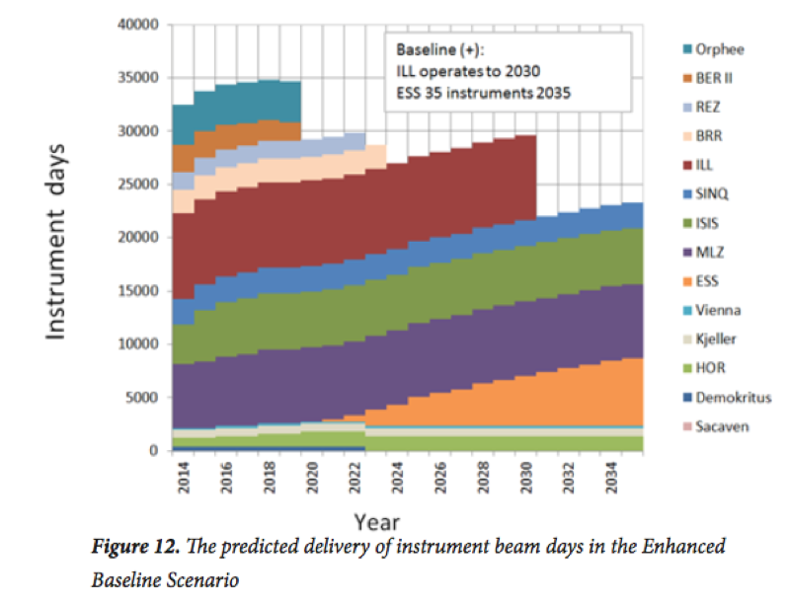
European Neutron facilities landscape
2016 ESFRI report
Pessimistic scenario: ILL operates at reduced output until 2023, ESS with 22 instruments beyond 2028. Earlier closer and/reduced operations for a number of medium power sources
Optimistic scenario: ILL operates until 2030, ESS with 35 instruments beyond 2035.

Slide 31
European Neutron facilities landscape
2016 ESFRI report
ESS needs to build up its research capacity
as soon as at all possible
Pessimistic scenario: ILL operates at reduced output until 2023, ESS with 22 instruments beyond 2028. Earlier closer and/reduced operations for a number of medium power sources
Optimistic scenario: ILL operates until 2030, ESS with 35 instruments beyond 2035.

Slide 32
Our vision is to build and operate the world’s most powerful neutron source, enabling scientific breakthroughs in research related to materials and molecules, and addressing some of the most important societal challenges of our time
To do this, we commit to deliver ESS as a facility that:
Is built safely, on time and on budget
Produces research outputs that are best-in-class both in terms of scientific quality and in terms of socioeconomic impact
Supports and develops its user community, fosters a scientific culture of excellence and acts as an international scientific hub
Operates safely, efficiently and economically and responds to the needs of its stakeholders, its host states and member states
Develops innovative ways of working, new technologies, and upgrades to capabilities needed to remain at the cutting edge

Slide 33
Thank you!

