Slide 1
UPPSALA UNIVERSITY GERSEMI
Project follow-up
Quality monitoring
Lery, 14-15/02/2017

Slide 2
Quality monitoring
Objective: to increase the quality of delivered product to the customer
Why?
Limit post-delivery operations
How?
Advise the manufacturer to improve the production quality
Perform pre-shipment checks
When?
Milestones + workshop visits during production
What?
Compendium of control reports (cf. table)
Existing documents
Dimensional control report
Cleaning control report
Thermal shock and leak test control report
Pressure test control report
PID check control report
Electrical insulation test control report
2-wire electrical resistance test control report
4-wire electrical resistance test control report
Between-wire insulation test control report

Slide 3
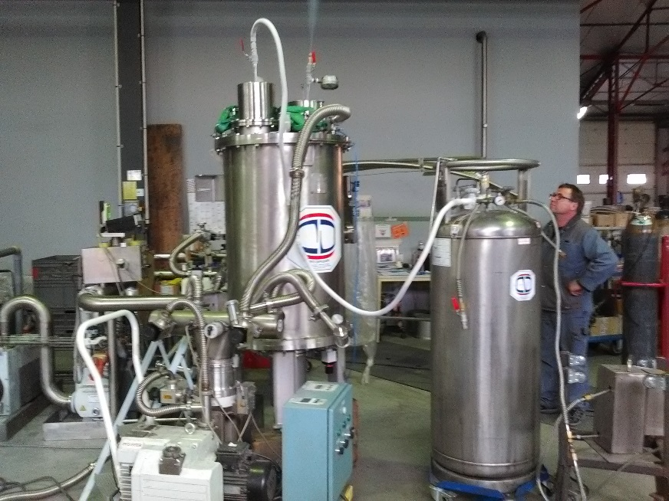
Quality monitoring: applications
The control methodologies and the documents were used on the following projects (cf. table).
Improvement of the documents in collaboration with CD
Gain of experience
Following tasks:
Prepare compendium of control reports, dedicated to Vertical Cryostat and auxiliaries
Projects
Transfer Line L001(13/12/2016)
Inter Connection Box (13&15/12/2016)
Double Reheater (23/12/2016, 04/01/2017)
Thermal shock and leak test

Slide 4
Quality monitoring: sample of document (Thermal shock and leak test control report)
Référence (PCQ ou Spec.) : / Ref. (ITP or Tech. spec.) |  | PCQ 1721-1 §2.f |  | Ref. Outil de Contrôle : / Control tool reference
 |  |  |  | Ref. fuite étallon externe : / Calibrated leak Id.
Stade de fabrication / Fabrication stage |  |  | Cours d'assemblage / While building | 1 | Assemblage final / Final assembly | Autre : / Other
Méthode de test : / Control Methodology |  | Cocher / Select | Méthode / Methodology |  | Valeur de fuite max autorisée / Max. leak value allowed |  | Pression ou Vide / Press. or Vaccum | Manomètre / Mano Id.
Cas de test par jet / Case of test by spraying : Débit He / He flow rate > 10 l.min-1 /!\ Effectuer un choc thermique à l'azote sur les soudures avant leur He LT / Carry-out a nitrogen thermal choc on welds before the He LT /!\ |  |  | Par renniflage / Snifing |  |  |  | Phe = ……..barG
 |  |  | Au jet / Spraying |  | 5.10^(-9) mbar.l.s-1 |  | Pv < 5.10^(-2) mbarG
 |  |  | Par accumulation / Accumlating |  | 5.10^(-9) mbar.l.s-1 |  | Phe = ……..barG
 |  |  | Pression Helium / He pressure test |  | 5.10^(-9) mbar.l.s-1 |  | Phe = ……..barG, pendant …… min.
Repère de pièce ou soudure / Part or weld Ref. |  |  | Valeur mesurée / Measured Value |  | Conformité / Conformity | Commentaires / Comments
Plan / Drawing | Pièce ou Cahier de Soud. / Part or WB | Repère / Ref.
Personnel Qualifié / Qualified Operator |  |  |  |  | Client ou organisme Notifié / Client or NB
Date du PV / Date of the repport |  |  |  |  | Date de Validation / Validation Date
Signature / Visa |  |  |  |  | Signature / Visa

