Slide 1

Uppsala University
Contract UH2015/09 - UA2016/05
Job nr. 5973/7200
Vertical Cryostat GERSEMI
3rd follow-up meeting
14/02/2017

Slide 2
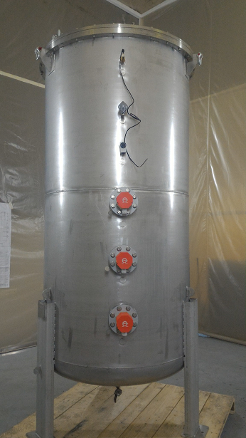
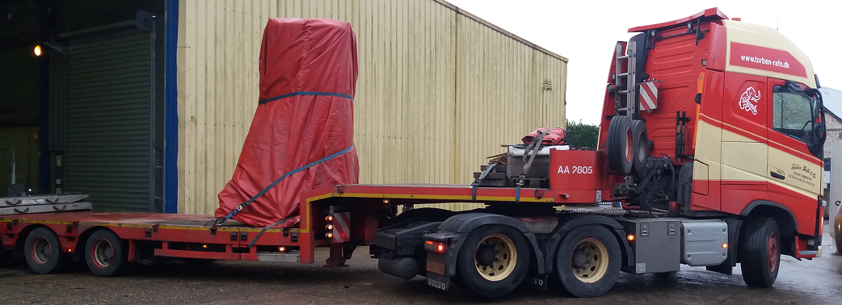
JOB STATUS
WP1: double re-heater
  Delivered to Uppsala
  Manufacturing and testing procedure reviewed with ACS
  Use of the clean area
  Manufacturing file to be integrated in GERSEMI or to be done separately

Slide 3
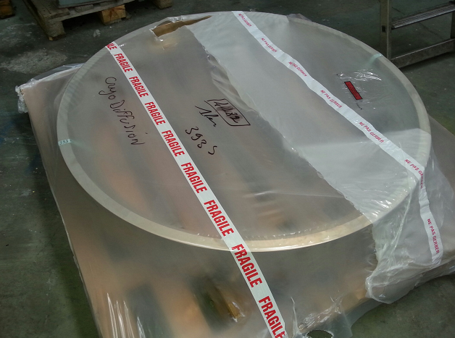
JOB STATUS
WP2: cryostat status
  Overall: 68%
  Procurement: 77%
  Manufacturing: 21%
  Actual tasks:
    Vacuum vessel procurement
    Lambda flange pre-assy
  On critical path: Vacuum vessel procurement
  Manufacturing start date: W1/2017
  Manufacturing end date: W22/2017

Slide 4
JOB STATUS
WP2: cryostat
  Actual issues: Helicoflex gasket
  The cryostat is still the critical path

Slide 5
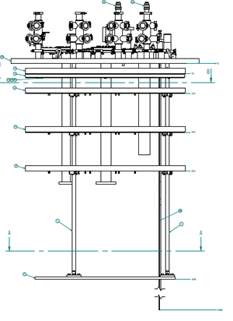
JOB STATUS
WP3: magnet insert
  Design updated W3 by ACS
  Manufacturing drawings not started
WP4: bath insert
  Procurement finished
  Assembly just started
  Will be stored in clean area

Slide 6
JOB STATUS
WP3: magnet insert
  Actual issue: planning. Not in critical path if not linked to the VC+VB+bath insert

Slide 7
JOB STATUS
WP5: valves box status
  Large parts (valves, HX) already procured
  Vacuum vessel and vacuum equipment in procurement
  Sensors and in procurement
  Assembly start date: W11/2017
  Manufacturing end date: W18/2017

Slide 8
JOB STATUS
WP6: transfer lines
  Multiline general design completed
    An auxiliary support is needed
  Transfer line design to implement
    Close to critical path

Slide 9
JOB STATUS
Procurement:
  Other material:
    Butterfly control valves: VAT → 1rst valve to be delivered W9
    Vacuum valves: VAT → other valves delivered W12
    Pressure sensors: BROOKS → delivery W13
    Vacuum sensors: Pfeiffer
    Temperature sensors: Cernox → issue on delivery postponed to W10
    Flowmeters: BROOKS → delivery W13
    Film heaters: Winkler: tests validated by ACS → delivery W9
    Gas heaters: Vulcanic
    Level sensors: AMI → delivery W20
    Cryogenic valves delivered
    DATE HX delivered

