Slide 1
Gersemi Cryostat
Mechanical and cryogenic configurations
3rd Follow-up meeting – 14th February 2017
ACS – P. Bujard, J.P. Thermeau, F. Dieudegard, T. Junquera

Slide 2
Outline
Cryogenic and mechanical Studies
Cryostat, valve box, liquid insert designs
Lambda Insert
Cryogenic schemes modifications
Simulator design

Slide 3
Cryostat, valve box, liquid insert design
Mechanical design:
The mechanical designs of the cryostat, valve box, liquid insert are finalized,
The main CD mechanical drawings are checked.
Follow-up:
- Double re-heater : end of manufacturing and shipping in January 2017
- Liquid insert : manufacturing is started.

Slide 4
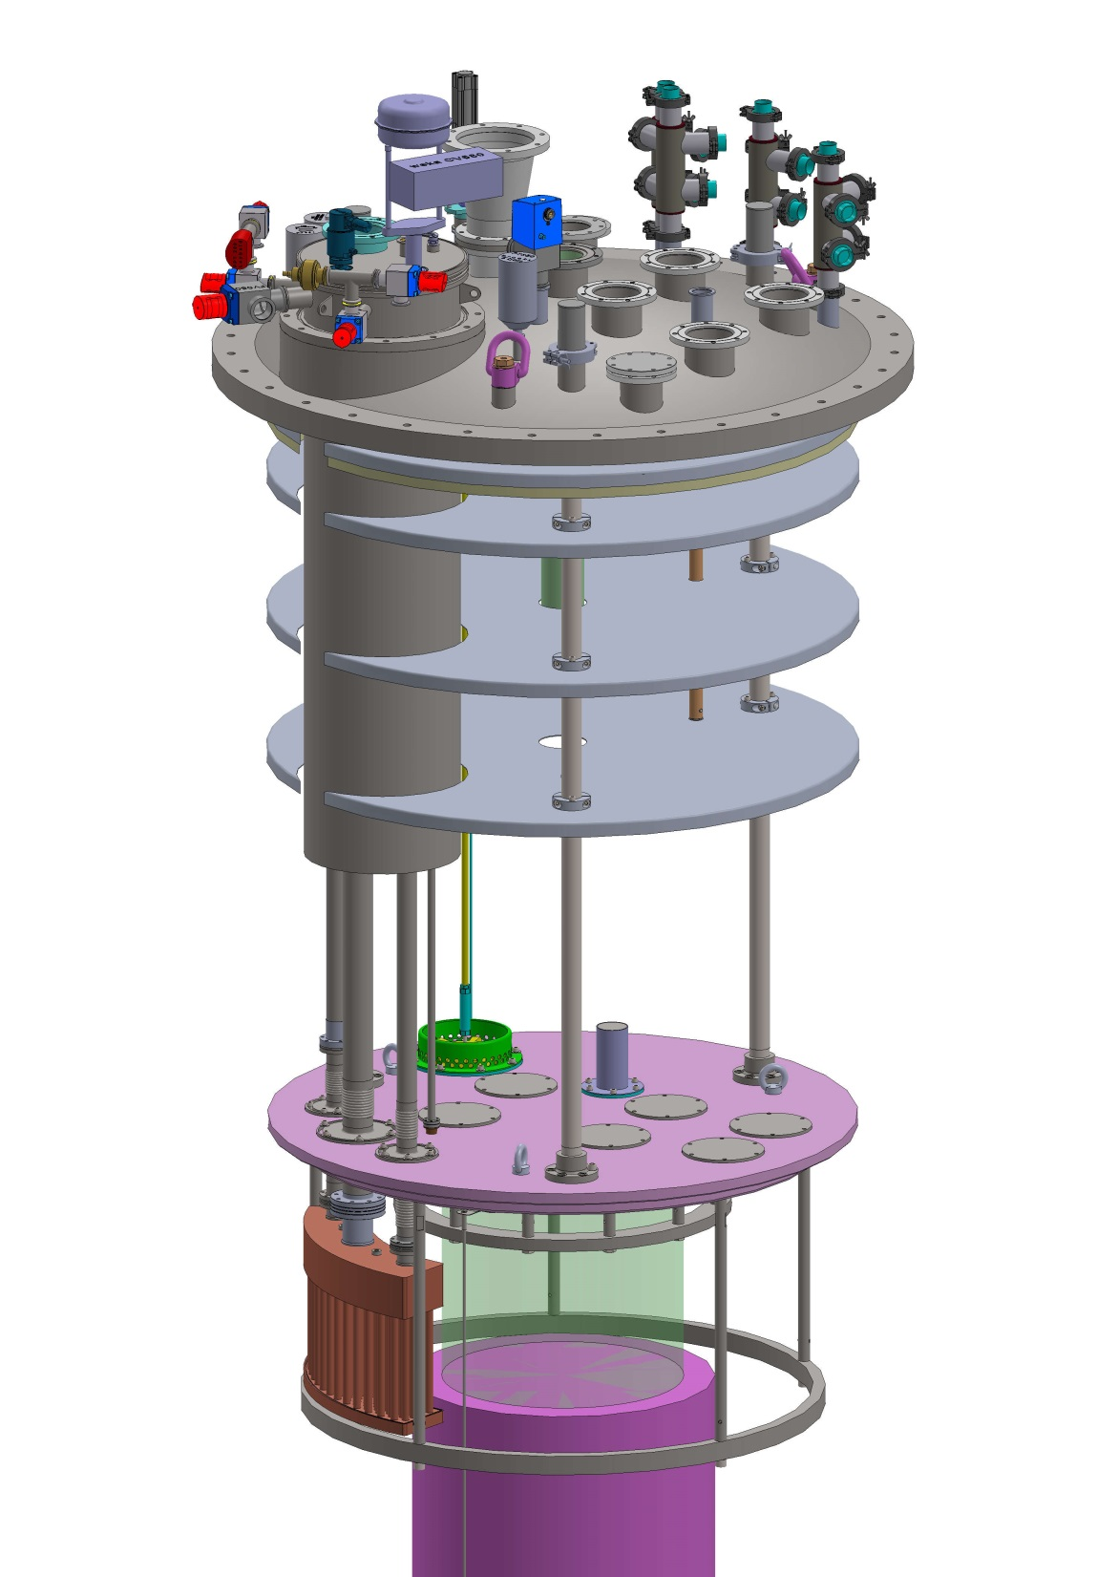
Lambda Insert : several modifications
Changes designed
flanges re-organised to clear central access
(racetrack clearance)
TopLid “bulked” (crane 7T)
Shield design in one disc + external rib (as CD liquid insert)
More spares acces ?
Simplified Lambda-plate profile
Still possible/nesseseary to add some acces holes ?
Heat exchanger design ( SS304+copper)
2 shorter Level Sensors
Magnet is around 5100kG

Slide 5
Cryogenic schemes
The new cryogenic scheme and the nomenclature included the equipment modifications are available.
The modifications concerned :
Cryostat thermal shield, new control valve to allow the end of the cooling without the end of the cooling of the valve box thermal shield : CV740 (valve installed on the body on the body of FT740)
The vacuum gauge of the vacuum insert : PT080 and PT081 instead of PT070 and PT071
Magnet insert, new electrical heaters : EH689AC associated with TT689AC
Magnet insert, heat exchanger : HX683 instead of HX681.
Simulator : a first version of the cryogenic scheme is available

Slide 6
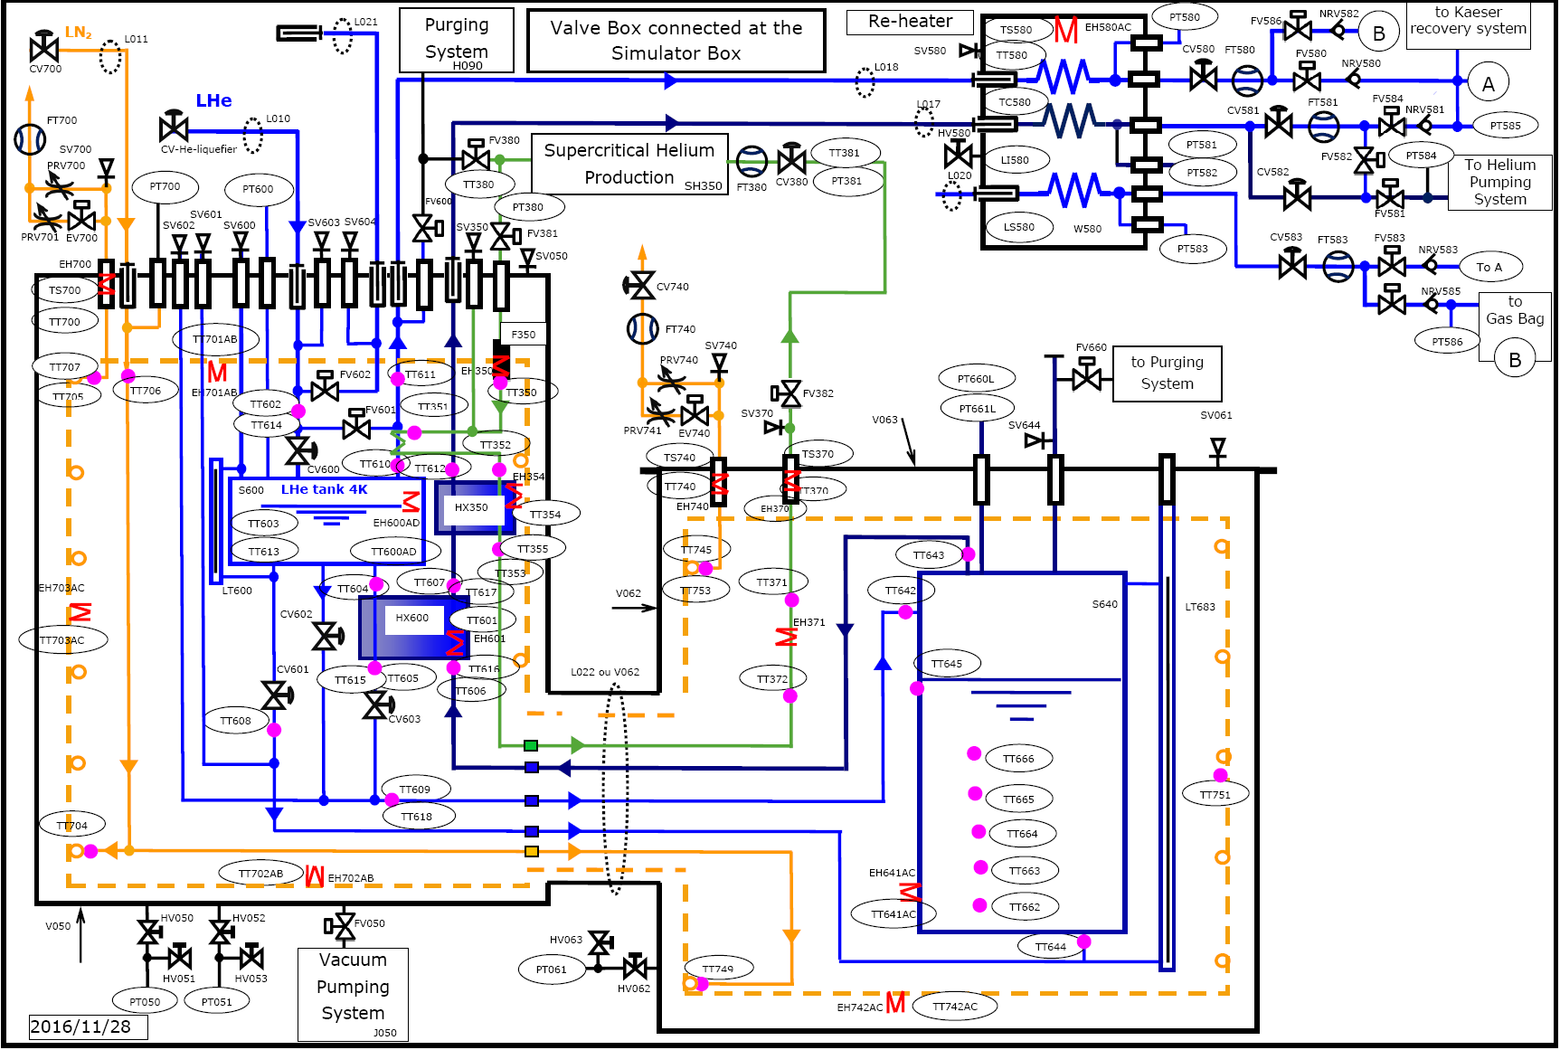
Simulator to test the valve box

Slide 7
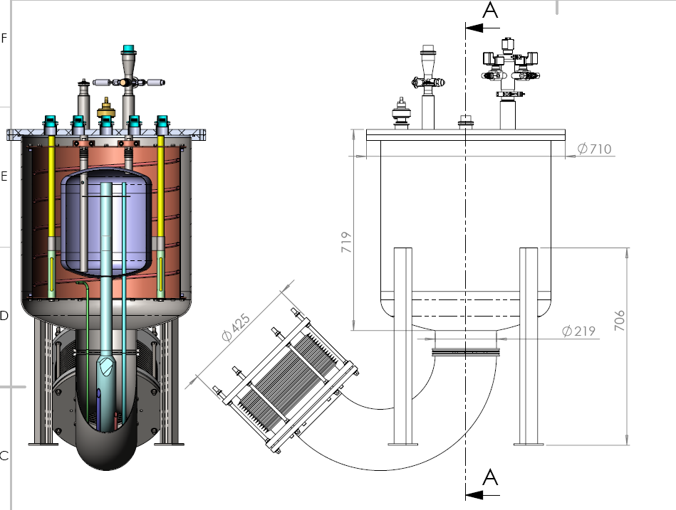
Simulator mechanical design
Small dimensions in comparison with the cryostat size
The main functions of the cryostat can be tested
Connections to Valve box

Slide 8
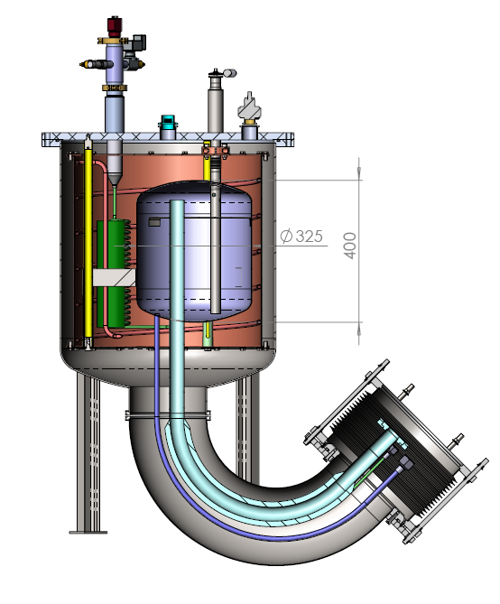
Simulator mechanical design
SHe electrical heater
Vacuum gauge
Small LHe tank ≈ 40 l
which can operate at 4K or 2K
Vacuum vessel
Thermal shield
Cryogenic lines connected to the valve box cryogenic lines
A loop to simulate the SHe circuit

