Slide 1
Teleconf ACS – FREIA 13th March 2017
Agenda:
- Magnet insert mechanical studies, - Liquid insert manufacturing, - Control and command (electrical equipments, cabling, sequences, ...), - Simulator for testing the valve box, - Tests for the commissioning at Lery and Uppsala - Planning

Slide 2
Magnet insert
Last meeting et Lery, 27th February 2017
The magnetic insert has been modified to add an oval hole in the center of the top plate and the lambda plate. The components on the lambda-plate have been reviewed.
→ CD started the study of the manufacturing drawings
The design of the heat exchanger Lambda HX683 (Copper heat exchanger) has been validated.
→ CD makes quotation request for the manufacturing
A lifting tool is required to move and installed insert in the vertical cryostat.
→ Responsibility for design and manufacture of this tool must be clarified by UU.

Slide 3
Liquid insert
Last meeting et Lery, 27th February 2017
The manufacturing started
This week all components will be welded on the top flange.
The planning manufacturing of the thermal shields and the date of the end of the manufacturing are not clear.
→ ACS will ask more explanations at CD

Slide 4
Control and Command
ISII-Tech and TechNergie sent us a new version of the of the electrical components implantation in the electrical cabinet.
5 Cernox CABTF (instead of 4)
7 AMI level controller (instead of 4)
ISII-Tech and TechNergie must send us a proposition about the cryostat cabling (valve Box, Cryostat and the inserts) including:
The description of the equipement (connection box for the inserts),
Kinds of cables and connectors
Electrical schemes
List of the I/O components
ACS sent a new version of the control sequences.

Slide 5
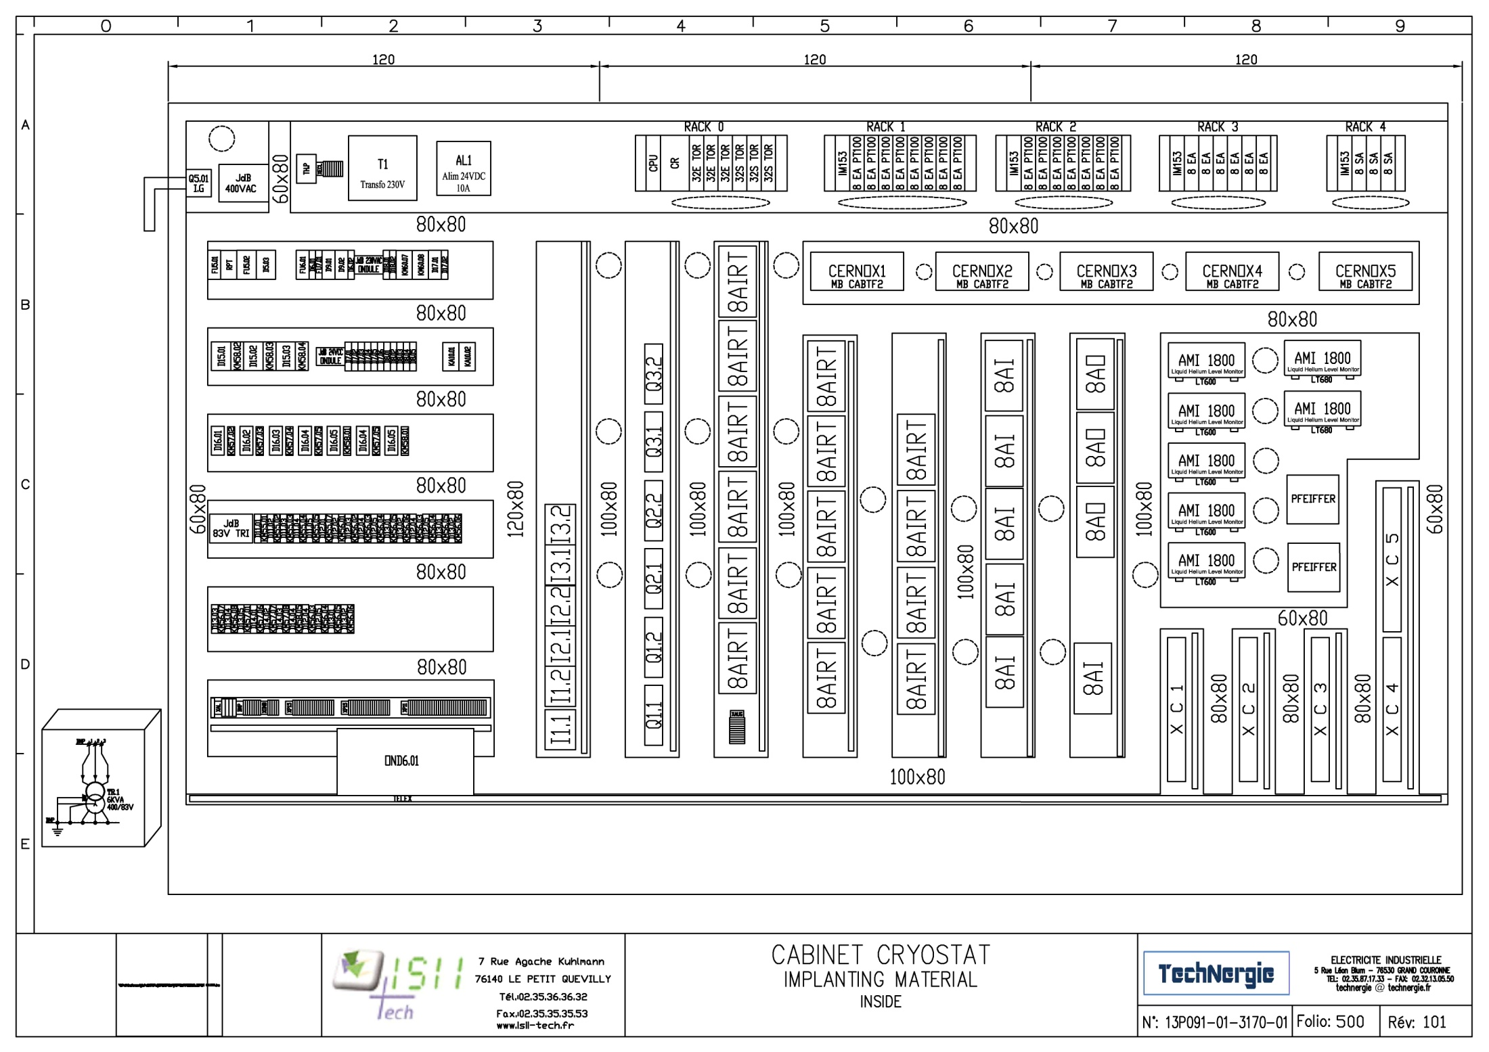

Slide 6
Simulator box
Cryogenic scheme and mechanical design made by ACS
ACS will make the mechanical drawings to save time,
CD must send us a quotation for the manufacturing

