Slide 1
Teleconf ACS – FREIA 28th March 2017
Agenda:
- Magnet insert mechanical studies - Liquid insert and cryostat manufacturing - Control and command (electrical equipments, cabling, sequences, ...) - Simulator - Tests for the commissioning at Lery and Uppsala - Planning

Slide 2
Magnet insert
Last meetings et Lery, 21th and 27th March 2017
Heat exchanger Lambda HX683.
→ a future meeting with the Pro-Beam compagny (Thursday 30th mars 2017 at Lery)
Agenda:
- Presentation of Electron Beam Welding Technology
- Technical design review of the copper HX in order to prepare it for EBW and pricing by ProBeam

Slide 3
Cryostat and Liquid insert
Last meetings at Lery, 21th and 27th March 2017
All components are welded on the top flange of the liquid insert.
The thermal shields of the liquid insert are manufactured, the assembly of all components is started.
CD prepare the welding of tubes (length 300 mm) on each side of the lambda seat.

Slide 4
Control and Command
Electrical components implantation in the electrical cabinet.
7 AMI level controllers will be used for the liquid and magnet inserts, 2 additional AMI are required for the vacuum configuration. Technergie will try to add them inside the cabinet
Electrical cabinet.
The volume that will be occupied by the electrical cabinet is more important that 3.5m length . The minimum dimension for the electrical cabinet plus the cable trays is about 3.5 + 0.3m. UU must check the implantation of the cabinet with the cable trays.
Connections box.
One box for each equipment (valve box, cryostat, liquid insert, magnet insert)
The current dimensions of these boxes are 400x400x150.
ISII Tech and Technergie propose to extend the new trench (0.3x0.3m) until the cabinet.
With this configuration, it will be possible to install directly under the ground the cables between the cryostat and the electrical cabinet..
The starting of the software programming is expected early April and the starting of each sequence tests in the end of May.

Slide 5
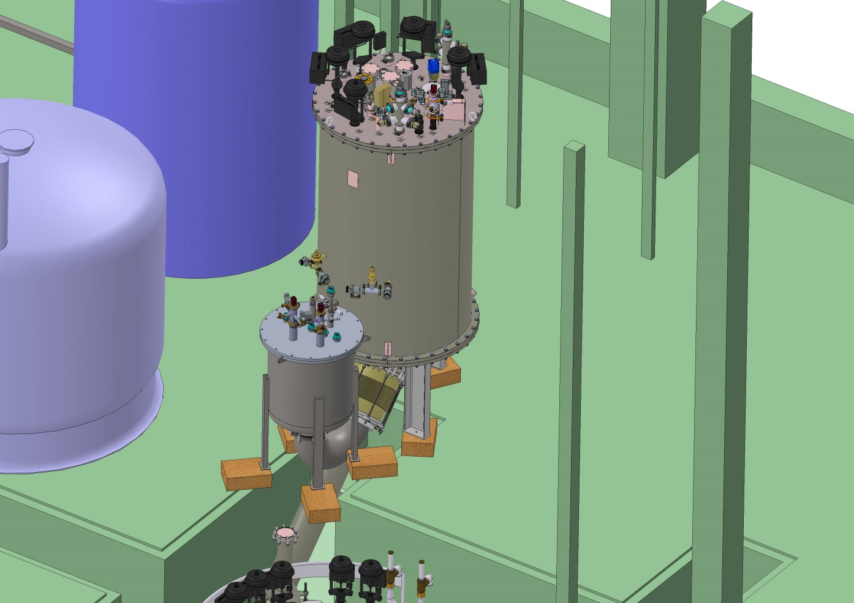
Simulator box
CD sent a quotation for the manufacturing: 29 615 €
Planning: 1 (manufacturing drawings) + 8 (manufacturing) weeks after the order receipt
Input Bellows & instrumentation “for free”
Same connection to VB as TL012

Slide 6
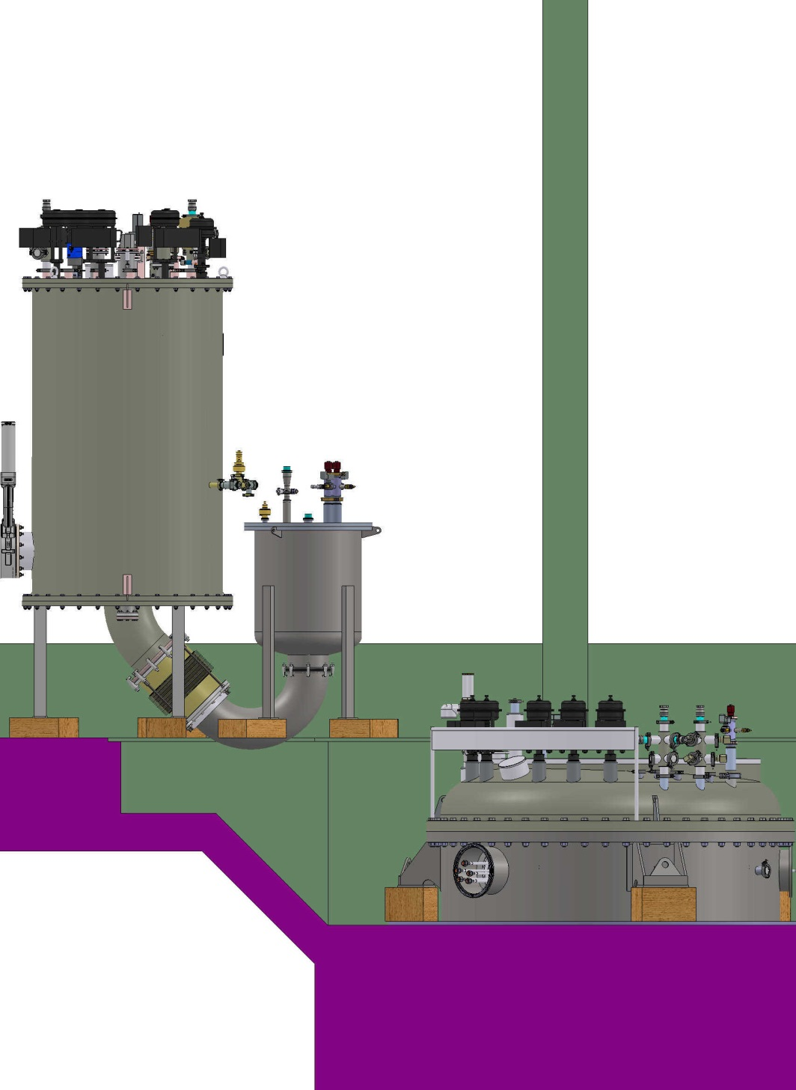

Slide 14
Tests at Lery 1/2
Valve Box:
Global leak detection (the leak tests of each component will be made during the manufacturing) -> 1 week
Checking of the cabling, electrical tests of the valves, thermometers, electrical heaters, pressure sensors, level sensors, flowmeters, … -> 2 weeks
Installation / connection of the simulator -> 1 week
Cryogenic tests with LN2 and simulator -> 3 weeks to test about 10 sequences
Cryostat:
Global leak detection of the cold vessel (the leak tests of each component will be made during the manufacturing) -> 2 weeks
Checking of the cabling, electrical tests of the valves, thermometers, electrical heaters, pressure sensors, level sensors, flowmeters, … -> 2 weeks
No cryogenic test

Slide 15
Tests at Lery 2/2
Liquid insert:
Checking of the cabling, electrical tests -> 1 week
No cryogenic test
Magnet insert:
Checking of the cabling, electrical tests of the valves, thermometers, electrical heaters, pressure sensors, level sensors, flowmeters, … -> 2 weeks
No cryogenic test

Slide 16
Commissioning tests at Uppsala 1/2
Valve Box:
Global leak detection to check the valve box after its transport -> 1 week
Cables installation -> 2 weeks
Cabling checking and electrical tests -> 1 week
Installation of the simulator -> 1 week
Cryogenic tests with LN2 and LHe and the simulator -> 3 weeks to test about 15 sequences
Cryostat:
Global leak detection to check the cold vessel and the thermal shield after their transport -> 2 weeks
Cables installation -> 3 weeks
Installation of the liquid insert -> 1 week
Cabling checking and electrical tests -> 1 week
Removing of the simulator and installation of the cryogenic line between the cryostat and the valve box, vacuum pumping system in operation
-> 1 week

Slide 17
Commissioning tests at Uppsala 2/2
Liquid insert:
Cryogenic tests with the valve box and the liquid insert -> 2 weeks to test 12 sequences:
Test of the sequences without cavity (Conditionning, LN2 cooling, LHe cooling, operation at 4.2K, Operation at 2K, warm up, ….)
Magnet insert:
Removing the liquid insert / installation of the magnet insert -> 1 week
Cabling checking and electrical tests -> 1 week,
Cryogenic tests with the valve box and the magnet insert -> 5 weeks to test 18 sequences:
Test of the sequences without magnet (Conditionning, LN2 cooling, LHe cooling, operation at 4.2K, Operation at 2K, warm up, ….)

Slide 18
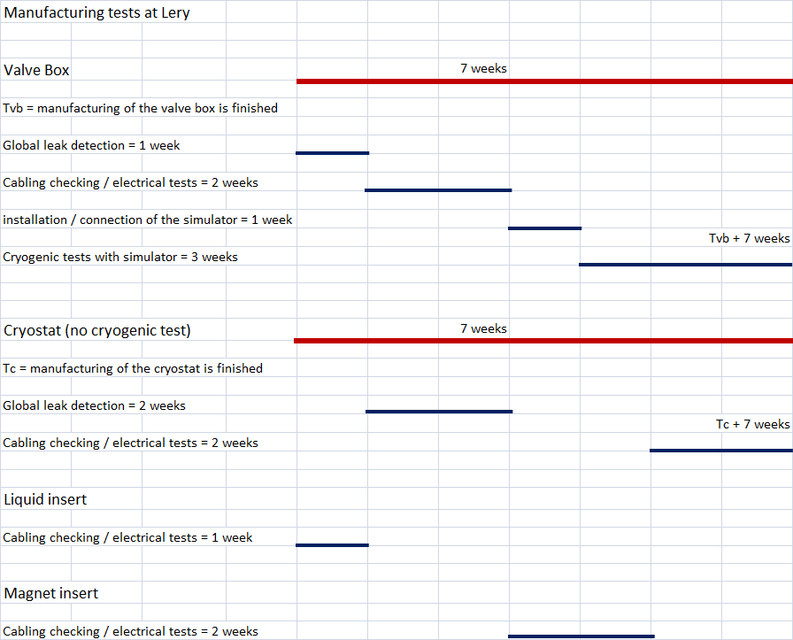
Planning of the tests at Lery

Slide 19
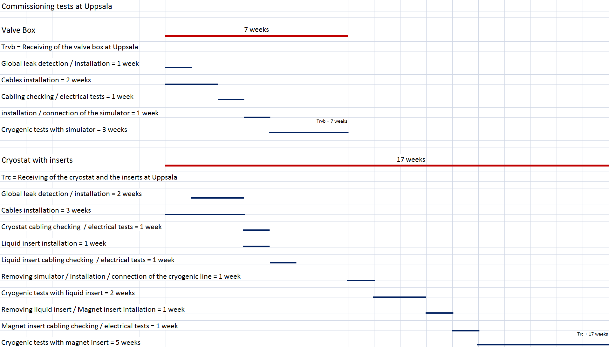
Planning of the tests at Uppsala

