Slide 1
Teleconference ACS – FREIA 18th April 2017
Agenda:
Magnet insert mechanical studies
Manufacturing follow-up
Control and command (electrical equipments, cabling, sequences, ...)
Simulator – MicroGersemi

Slide 2
Magnet insert mechanical studies
Lery, 30th March 2017
meeting with Karl-Heinz Röhlich (sales manager), Pro-Beam
Presentation of electron beam welding technology
Design review of the heat exchanger Lambda HX683 with Pro-Beam
CD modified the design of HX683 (initially designed for brazing) for electron beam welding optimization
12th April, CD sent the new drawings to Pro-beam for a quotation
Review of the manufacturing drawings
ACS provided details about the cryostat (GN2 heaters) and magnetic insert (positions of electrical heaters)

Slide 3
Manufacturing follow-up
Valve box
Preparation of the manufacturing zone and upper flange hanging up
Reception control
Cryostat
Welding of the ferrules (L=300mm) on the lambda seat
Sominex sent the vacuum vessel for cleaning
He leak test of vacuum vessel delayed to end of Week 16
Liquid insert
Assembly of the main components on the liquid insert

Slide 4
Control and Command
ISII-Tech send the technical details for 4 Stainless steel connections boxes.
Associated systems | Dimensions [mm] (height x width x depth) | Connectors
Cryostat | 400x400x200 | 1 x 12-pin connector for analog signals (7-wires) 2 x 48-pin connectors for digital signals (60-wires)
Valve Box | 600x400x200 | 1 x 12-pin connector for analog signals (6-wires) 1 x 48-pin connector for analog signals (48-wires) 2 x 48-pin connectors for digital signals (72-wires)
Magnet Insert | 400x400x200 | 2 x 48-pin connectors for analog signals (74-wires) 1 x 48-pin connector for digital signals (40-wires)
Liquid Insert | 400x400x200 | 1 x 48-pin connector for analog signals (14-wires) 1 x 12-pin connector for digital signals (6-wires)

Slide 5
Control and Command
Connection boxes cost:
Boxes
Connectors and plugs
Cabling
The price of the 4 boxes (including the cabling operations), but without provision of connectors is about 10k€.
Sequences:
The comments of UU are taken in account in the new version of the sequences of 14th April 2017.
The remarks of ACS are included in the FREIA document “Feedback on Gersemi Sequences”
ACS will send the sequences to ISII-Tech this week

Slide 6
µGersemi connected to VB
Cryostat connected ‘’as” L012
Using trench for elbow
Wood-blocks on both equipments (for levelling)

Slide 7
µGersemi elements
Cryostat access through bottom
Used lines: pumping - LN2 – LHe (cooling) – LHe (filling) – GHe (supercritical)
Hanged copper shield
Vacuum common with VB
Teleconf ACS - FREIA 18th April 2017

Slide 8
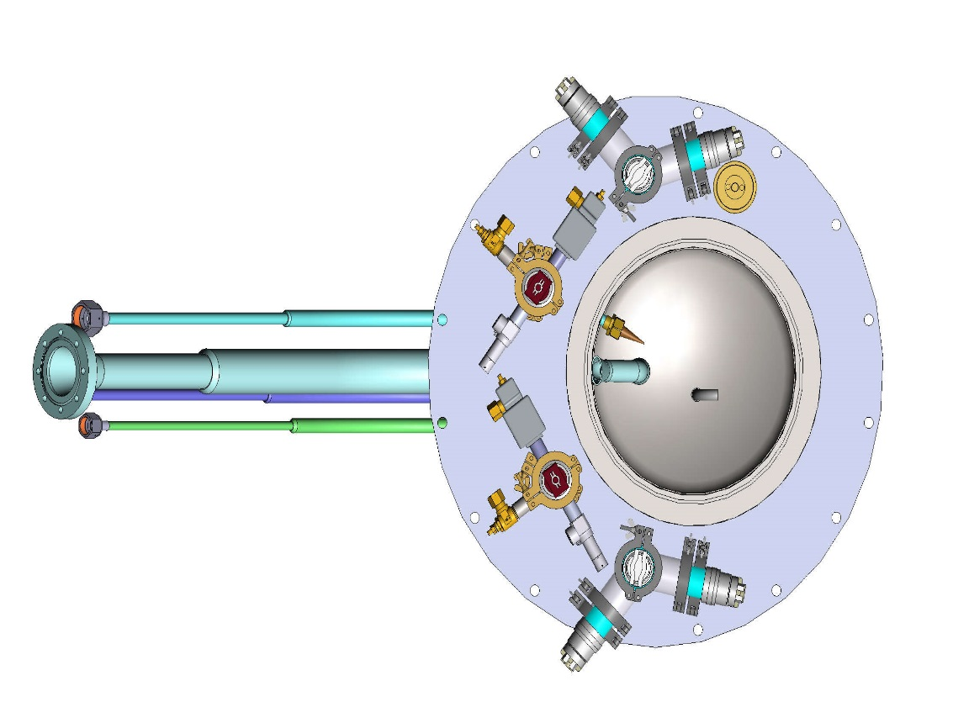
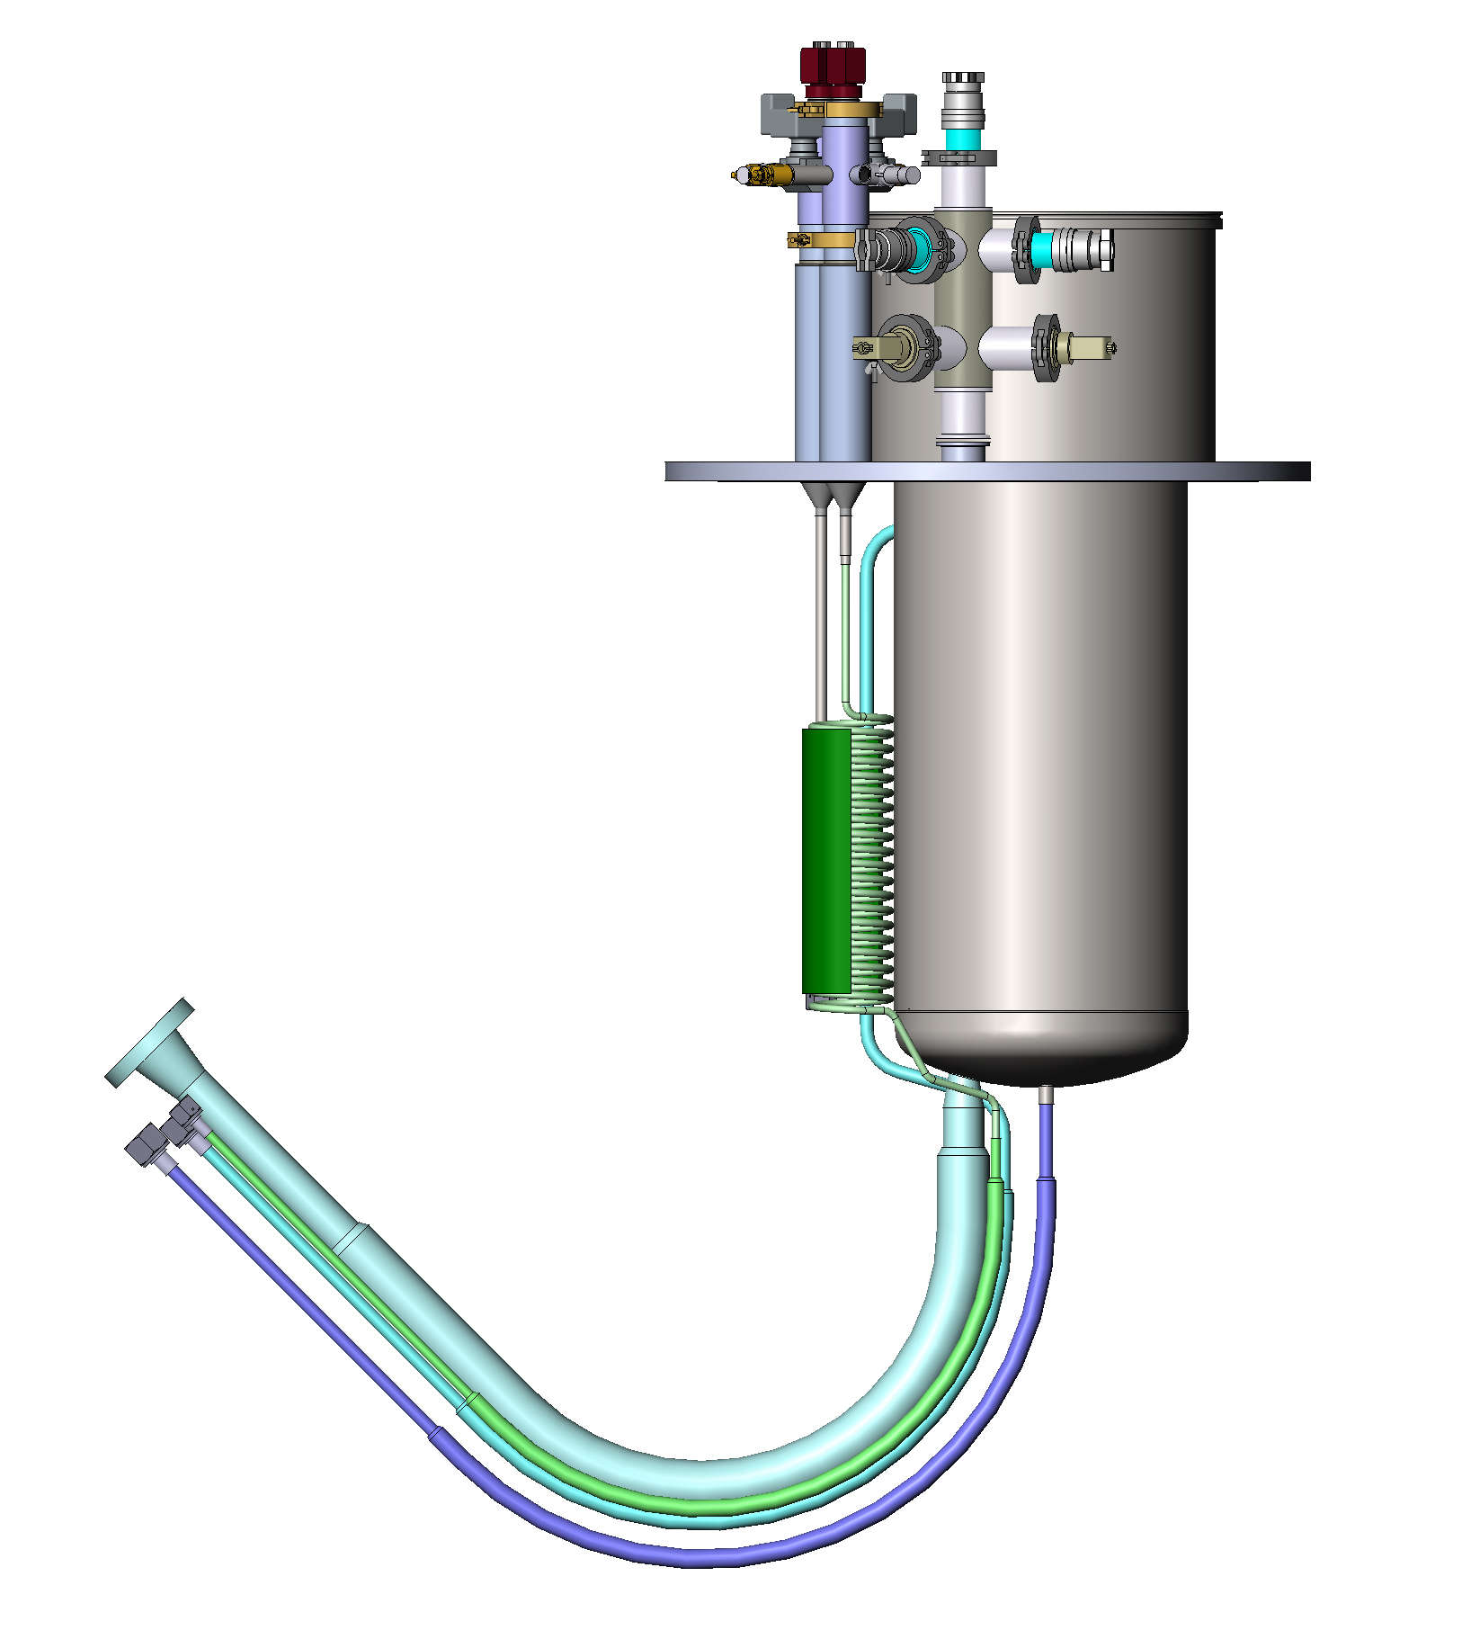
Top Lid equiped
10 measurement ports (+ insert … )
Standard GN2 and SHe Heaters
8

Slide 9
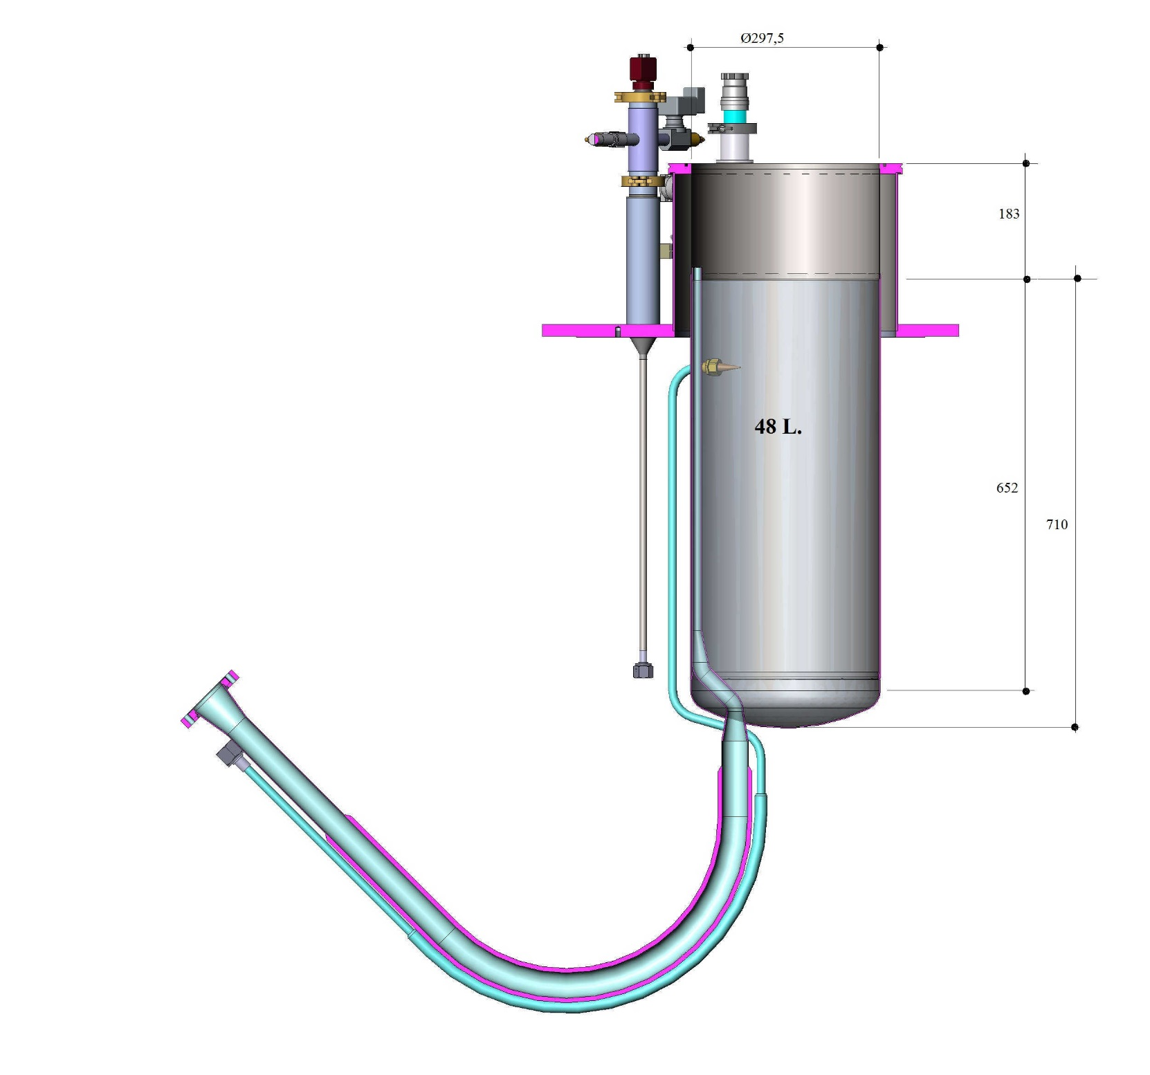
Top Lid equiped cut
Inner Ø~300
Pressure regulation under article 4.3
Maximun pressure < 1b
Teleconf ACS - FREIA 18th April 2017

Slide 10
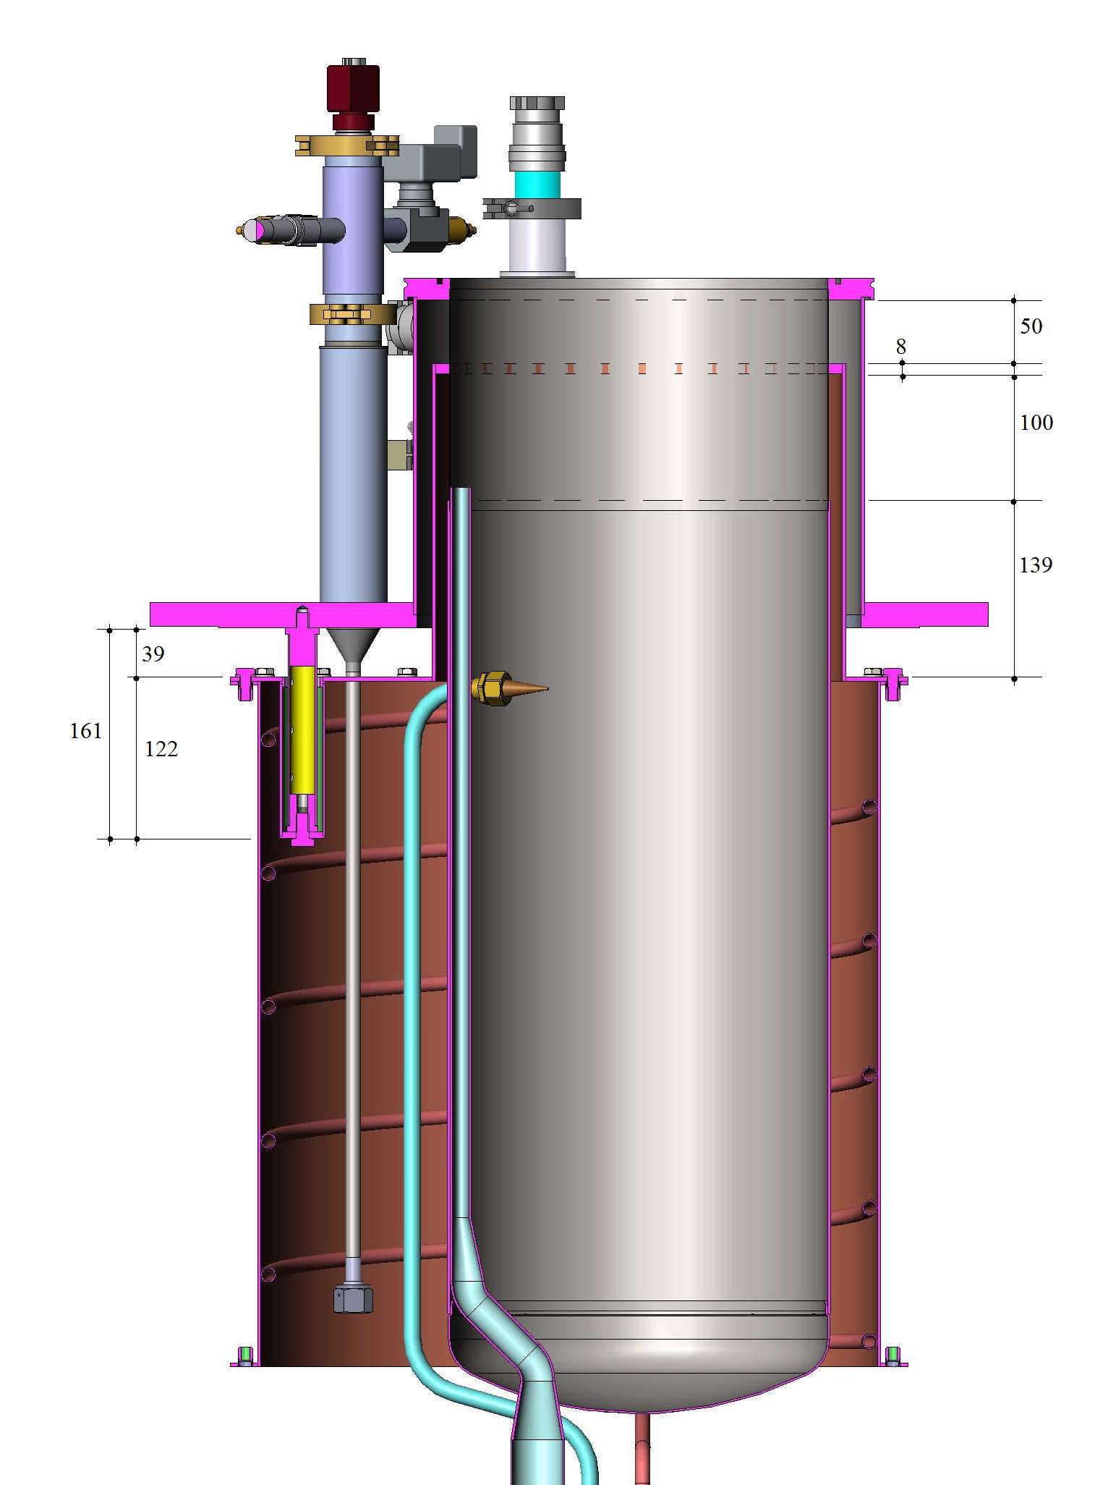
Top Lid equiped cut
Top shield welded
Short Tie Beams
Main shield removable

Slide 11
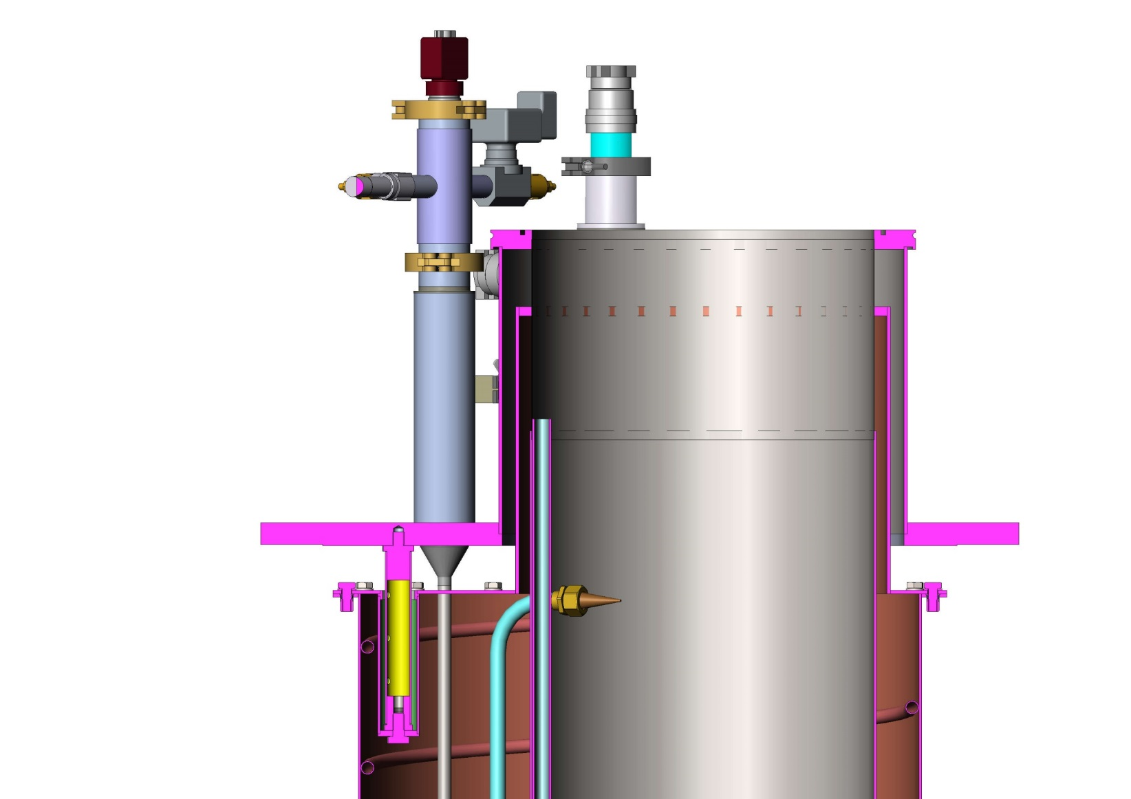
conclusion
Design analysis with CD this Friday (21st)
Price should be ≈ equivalent to simulator

