Slide 1
Teleconference ACS – FREIA 10th May 2017
Agenda:
Manufacturing follow-up
Control and command
Simulator – MicroGersemi
Planning

Slide 2
Manufacturing follow-up
Cryostat
SOMINEX finished the vacuum vessel. Delivery expected middle of week 19.
ACS has been invited by CD for the receiving tests at SOMINEX:
Dimensional control, OK
Cleaning control, OK
helium leak control, OK
Test installation for the vacuum vessel at SOMINEX

Slide 3
Manufacturing follow-up
Dimensional validation using the 3D model
Cryostat
ACS measure the dimensions of the vacuum vessel to check with the pit

Slide 4
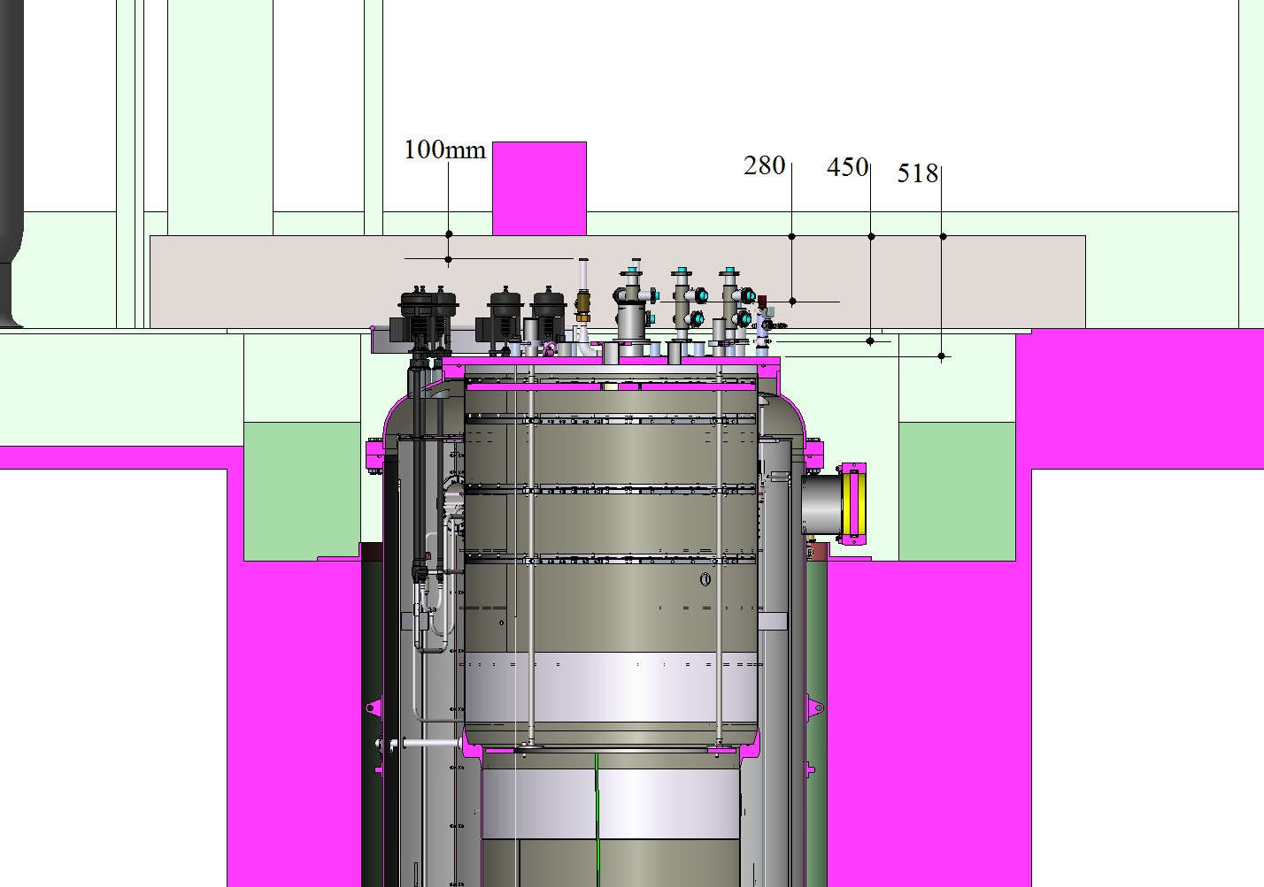
Manufacturing follow-up
Dimensional validation using the 3D model
Cryostat
Distances between beams(roof) and components of the liquid insert

Slide 5
Manufacturing follow-up
Cryostat
The lambda seat has been re-machined to obtain the flatness
Lambda seat installation on the machine tool

Slide 6
Manufacturing follow-up
Cryostat
CD performed the welding of the pressure vessel tubes
X-ray test will be performed in week 19
CD expects the delivery of all parts soon to finish the welding of the pressure vessel, in week 20
Welding of the pressure vessel tubes

Slide 7
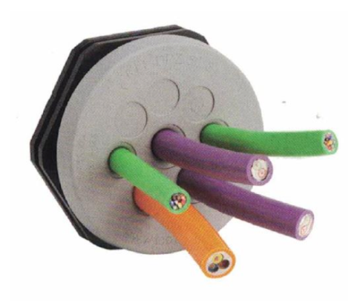
Control and Command
Connection boxes
There will be 4 connection boxes placed on the systems:
1 for cryostat
1 for valve box
1 for magnet insert
1 for liquid insert
Those boxes collect only the equipment operating at room temperature
Schematic diagram of a connection box inside
Sample of feedthrough for incoming wire

Slide 8
Control and Command
Connection boxes
A 5th connection box will be placed in the pit and dedicated for the instrumentation of the inserts,
Instrumentation of insert will be connected to the 5th box in which all insert instrumentation cables will be connected at the electrical cabinet
The quotation is ongoing by ISII-Tech.

Slide 9
Control and Command
CB_INSERT
CB_VB
CB_VB
CB_CRYOSTAT
CB_INSERT
Electrical cabinet
IB
CB_CRYOSTAT
IB
Electrical cabinet
CB: connection box
IB: instrumentation box (dimensions under estimated)
Attempt to install the junction boxes and instrumentation box
Due to a lack of space, welded supports seems require to maintain boxes as part of the cryostat and the insert while keeping access to the top lid and plate

Slide 10
Control and Command
Programming
Sequences send to ISII-tech expected in week 21,
Delay of programming: around 1 month

Slide 11
Simulator – MicroGersemi
ACS and CD reviewed the design according to CD standards and workshop capacities
Philippe Bujard is completing the manufacturing drawings
Manufacturing drawings for externally proceed parts, (7 flanges over Ø150) expected week 19
Next weeks, the cryogenic scheme will be updated
Teleconf ACS - FREIA 18th April 2017

Slide 12
Planning
An updated planning is under review at CD, expected week 19
Teleconf ACS - FREIA 18th April 2017

