Slide 1
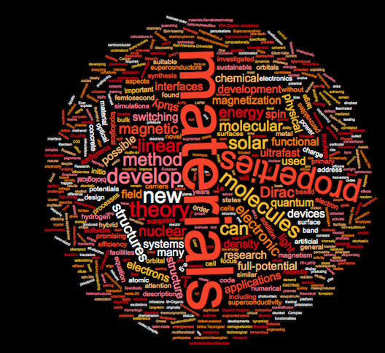
Materials Theory

Slide 2
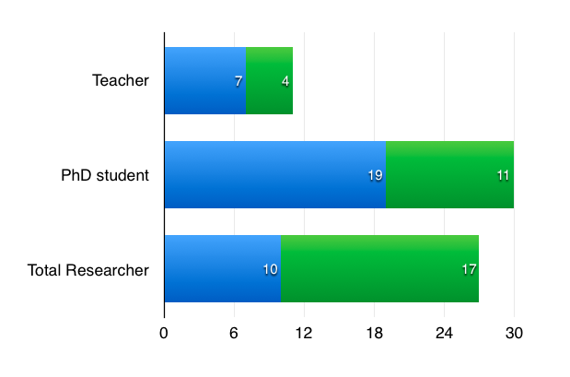
Personnel
Prof.
Lektor
Own funding
2-year
permanent

Slide 3
Research I
- Basic science (curiosity driven)
- Multidisciplinary science
- Interdisciplinary science
- Applied science
average h-index (Teachers) 32
10/11 hold grant (Teachers)
6/17 hold grant (Researchers)

Slide 4
Research II
Magnetism
Magnetism
Magnetism
Functional magnetic materials
Magnetism
mathematical
physics
Topological systems, quantum information, strongly correlated systems, magnetism
© Ralph Scheicher 2014
Magnetism

Slide 5
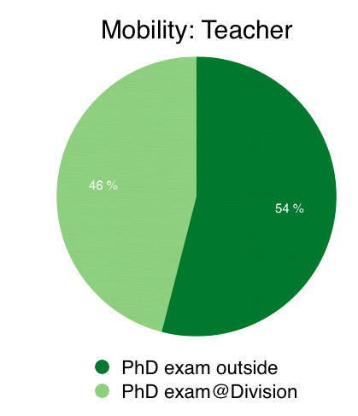
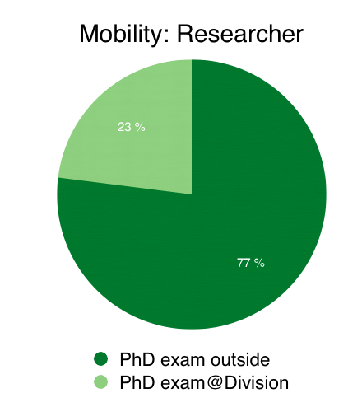
Mobility

Slide 6
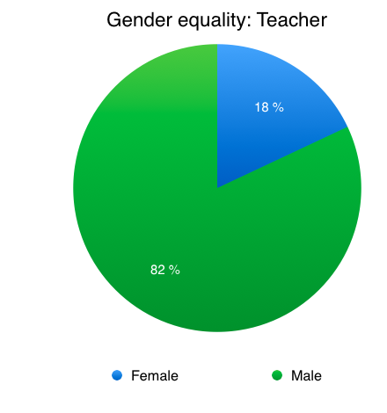
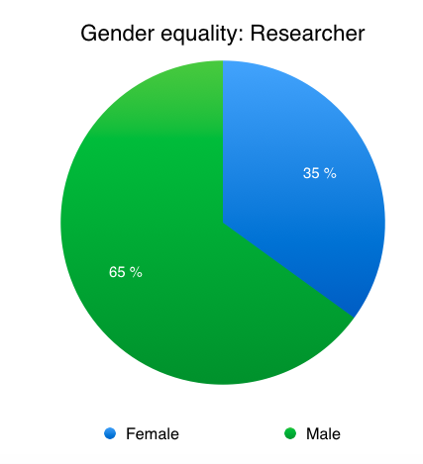
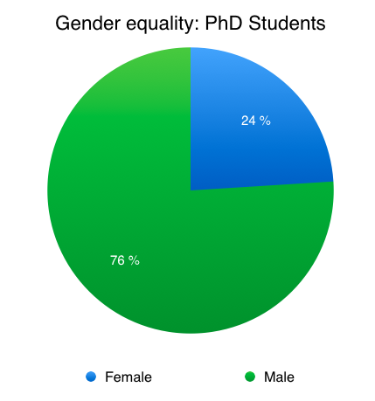
Gender equality

Slide 7
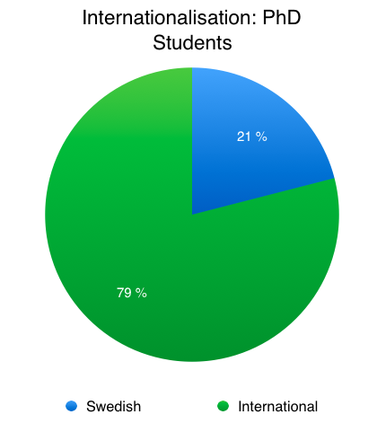
Internationalization

Slide 8
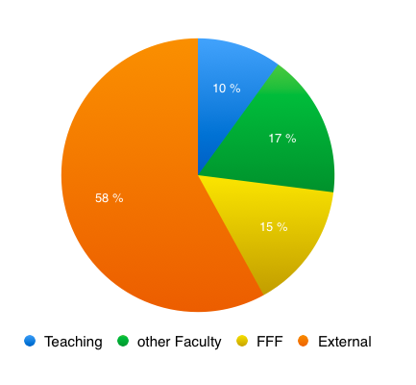
Economy
Total 58,8 MSEK (2016)

Slide 9
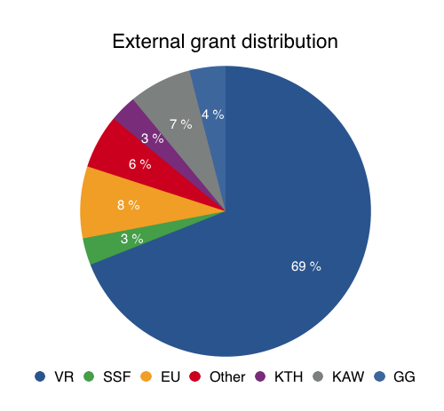
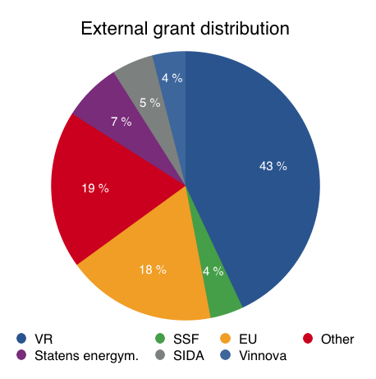
External grants
(2016) 34 MSEK
(2010) 20,4 MSEK

Slide 10
Infrastructure
Division uses national (within SNIC) 10.000 cores
simultaneously all the time
Division uses 12% of national supercomputer-resources
In house usage for code-development:
170.000 core hours/month

Slide 11
Processes: Administration
Weekly Division seminar with good attendance
Monthly Division council
Delegated duties within Division:
computer (PhD-student), kitchen (2 PhD-students),
office space (2 researchers),
undergraduate teaching (researcher),
PhD-education (professor),
master program (lektor), webpage (researcher),
coffee and cake responsible twice a week (rotating),
information (external) (lektor)

Slide 12
Processes: Future at Division
Collegial discussions
Discussions at Division council
Discussions between program responsible professor
and head of Division
Future strategy: We actively recruit ERC and
Wallenberg recipients.

Slide 13
Processes: Part of Faculty
- Strategy documents, plans of action;
Weekly meeting between Division Heads,
Head of Department and Section Dean;

Slide 14
Challenges
Career paths for younger scientists
Seminar-culture on Department level
Division identity (culture, two locations)
Infrastructure finances
Unbalanced external finances
Few students in Master program (materials theory)
Teaching possibilities have to increase

