Slide 1
Department’s introduction to KOF 17
Department of Physics and Astronomy

Slide 2
Welcome to the Department of Physics and Astronomy at Uppsala University
First lecture on physics in 1486
(Aristotelian physics, but still … )
First astronomy professor: Laurentius Paulinus Gothus1593
First physics professor: Samuel Klingenstierna 1728

Slide 3
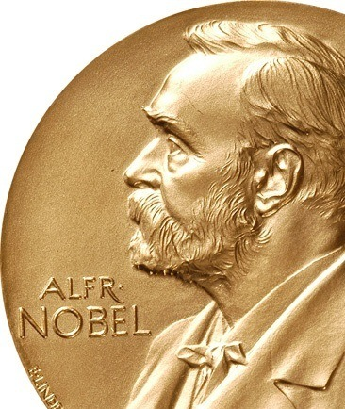
Nobel Laureates from Uppsala
Allvar Gullstrand – Nobel Prize in Physiology and Medicine 1911
Robert Bárány – Medicine 1914
Manne Siegbahn – Physics 1924
The Svedberg – Chemistry 1926
Nathan Söderblom – Nobel Peace Prize 1930
Arne Tiselius – Chemistry 1948
Dag Hammarskjöld – Nobel Peace Prize 1961
Kai Siegbahn – Physics 1981
Carl von Linné
Anders Celsius
Anders Ångström
etc.

Slide 4
Materials theory
Materials physics
Global energy systems
Molecular & condensed matter physics
Applied nuclear & ion physics
Nuclear physics
Physics education research
Astronomy & space physics
High energy physics
Theoretical physics
T Johansson: Welcome Students
2

Slide 5
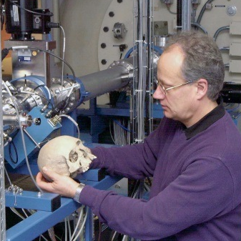
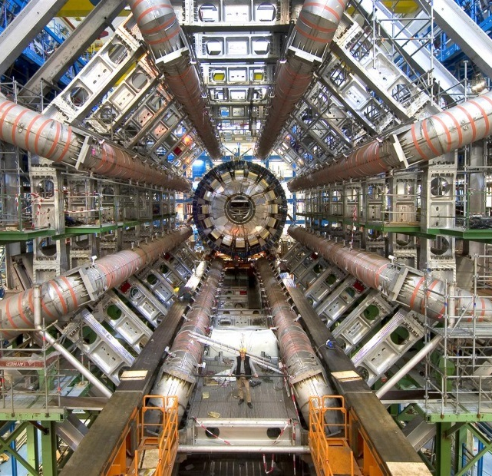
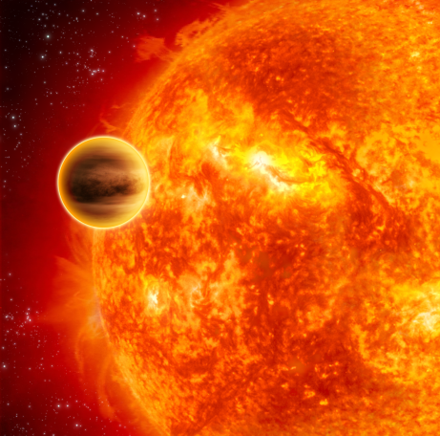
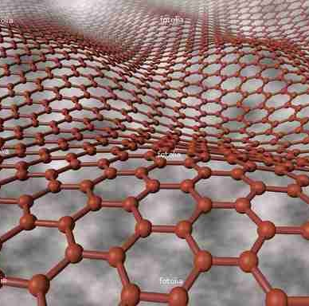
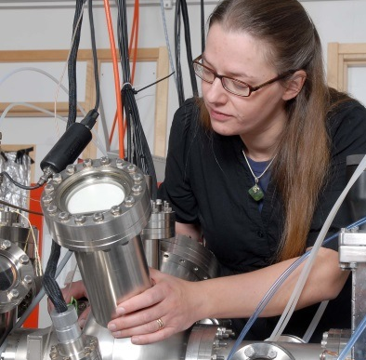
Physics and astronomy - from micro- to macrocosmos
Basic and applied science
International cooperation

Slide 6
Our department in numbers
Total about 360 employees at the department
Total turnaround about 370 million sek (about 44 million USD)

Slide 7
Gender (im)balance
Percentage women

Slide 8
Our programs in numbers
Programs | Profs | Lecturers | Researchers | Grad. students
Didactics | 1 | 1 |  | 5
High energy physics | 4 | 4 | 4 | 11
Nuclear physics | 3 | 1 | 2 | 7
Materials physics | 3 | 2 | 1 | 12
Materials theory | 5 | 4 | 17 | 24
Molecular and condensed matter physics | 6 | 1 | 6 | 14
Observational astrophysics | 1 | 3 | 3 | 4
Space and plasma physics |  |  |  | 4
Theoretical astrophysics | 1 | 2 | 1 | 4
Theoretical physics | 4 | 3 |  | 6
Applied nuclear physics | 3 | 6 | 9 | 13
FREIA |  |  | 3
Total | 31 | 27 | 46 | 104

Slide 9
Our programs in numbers: Personnel

Slide 10
Our programs in numbers: Personell

Slide 11
Comparison 2010 - 2016

Slide 12
Comparison 2010 - 2016

Slide 13
External grants (%)

Slide 14
External grant bodies (%)

Slide 15
Sizes of external grants

Slide 16
Money for infrastructure

Slide 17
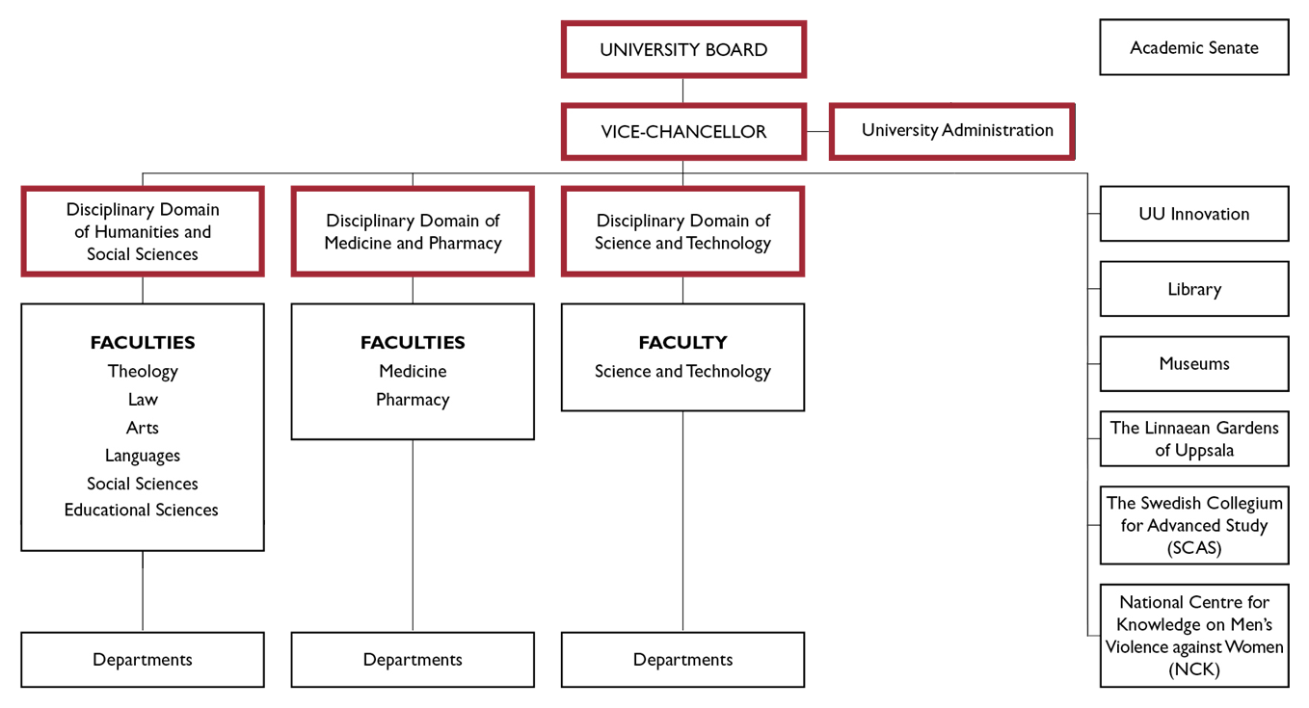
5

Slide 18
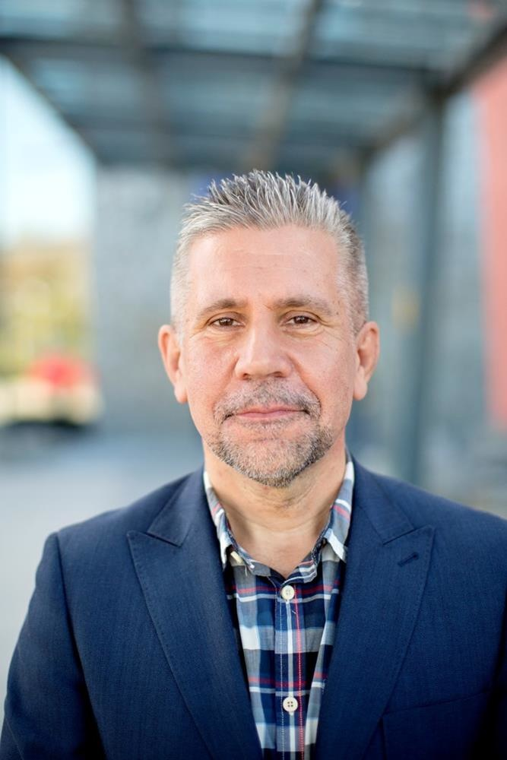
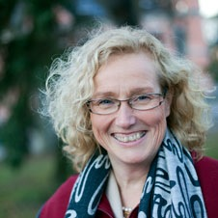
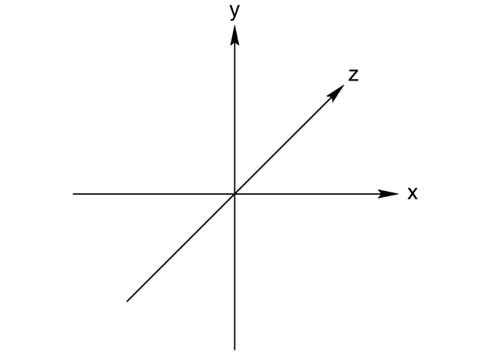
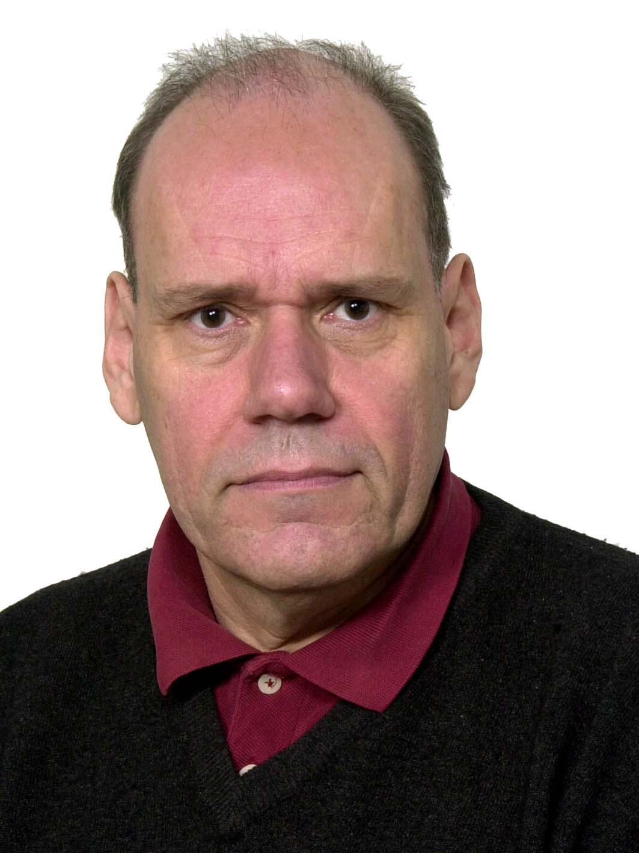
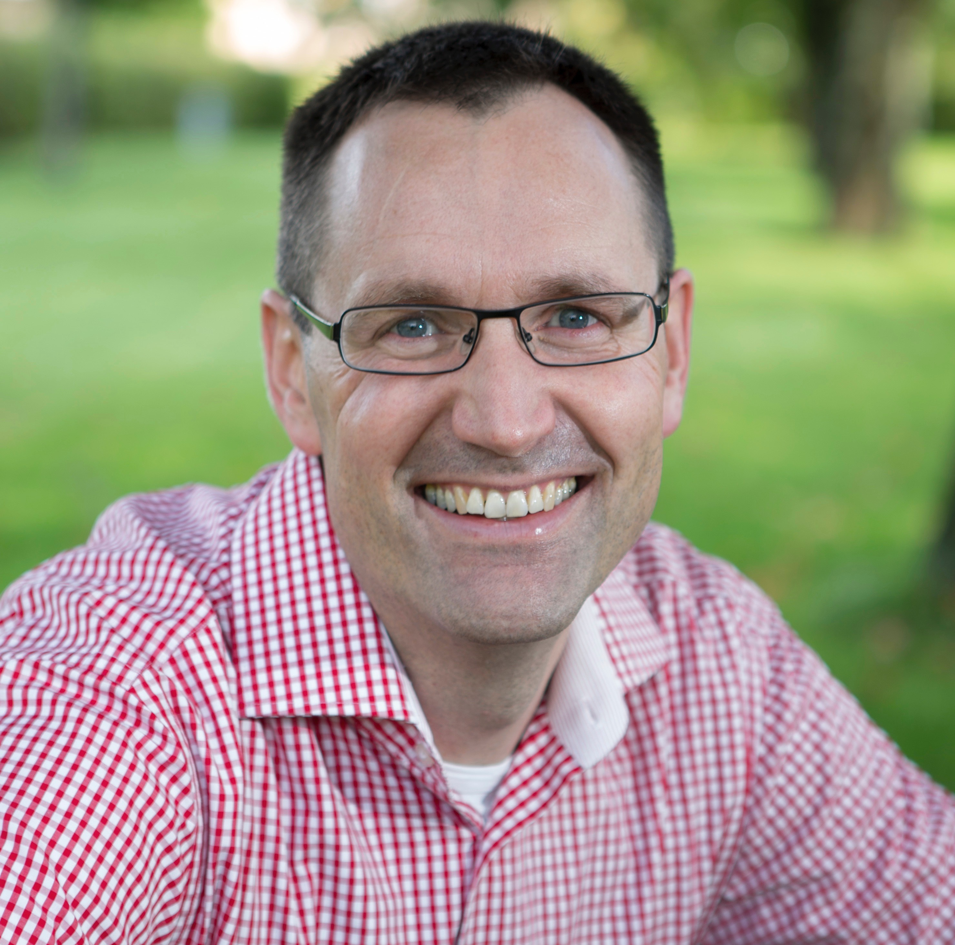
Faculty of Science and Technology
Dean
Johan Tysk
Vice-Chancellor
Eva Åkesson
Departement of
Physics and Astronomy
Student
Student
Physic Dean
Tord Johansson
Physics Section
Department Head
Olof Karis

Slide 19
G. Ingelman: Welcome Students
3

Slide 20
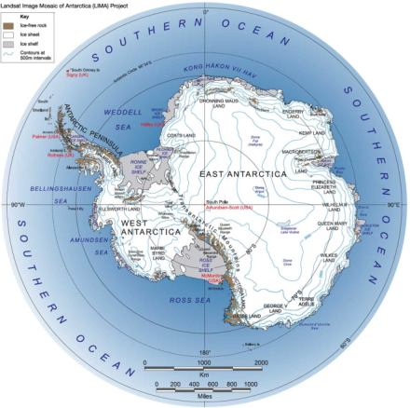
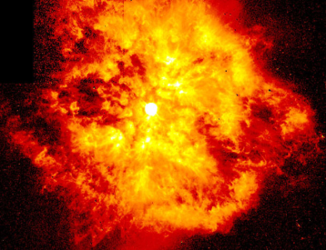
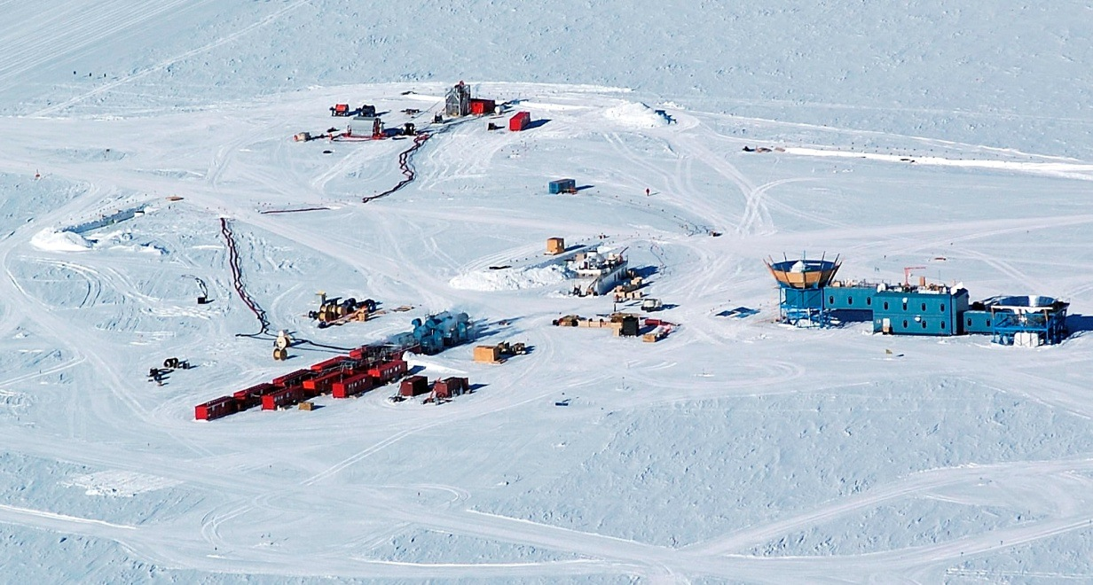
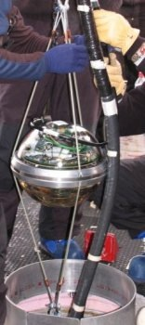
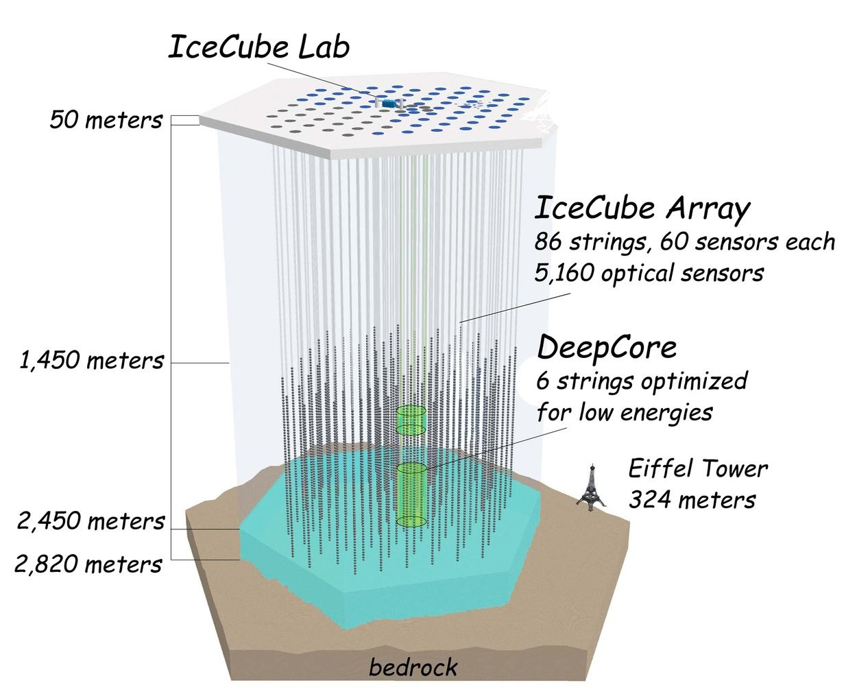
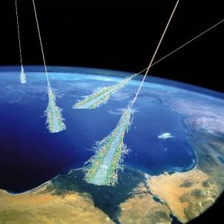
Example: Cosmic neutrinos @ IceCube
GRBs
GZK-neutrinos
EeV
PeV
10¹⁵ eV
AGN
TeV
Atmospheric
GeV
10⁹ eV
MeV
G. Ingelman: Welcome Students
4

Slide 21
Organisation (as viewed from the outside)
UNIVERSITY BOARD
Internal Audit
Academic Senate
Vice-Chancellor’s Management Council
VICE-CHANCELLOR
University Administration
Innovation
Library
Disciplinary Domain of Humanities and Social Sciences
Disciplinary Domain of Medicine and Pharmacy
Disciplinary Domain of Science and Technology
FACULTIES
Theology Law Arts Languages Social sciences Educational sciences
FACULTIES
Medicine Pharmacy
FACULTIES
Science and technology
Departments
Departments
Departments
Notes:
21

Slide 22
Organization: Faculty-Department relations
FACULTY BOARD
SECTION DEANS
Sections
Research Programs
Notes:
22

Slide 23
Organization: Department
Head of department
DEPARTMENT BOARD
Strategy committee
Administrative head
Directors of studies
Assistant head of dept
Preparatory body
DIVISIONS
Astro-nomy & Space Physics
Physics Education Research
High Energy Physics
Molecular & Cond. Matter Physics
Applied Nuclear Physics
Nuclear Physics
Materials Physics
Materials Theory
Theoretical Physics
3 res programs
1 res program
1 res program
1 res program
1 res program
1 res program
1 res program
1 res program
1 res program
Spring and fall strategy meetings
Notes:
23

Slide 24
Organization: Department
Head of department
DEPARTMENT BOARD
Strategy committee
Administrative head
Directors of studies
Assistant head of dept
Preparatory body
DIVISIONS
Astronomy & Space Physics containing 3 research programs
3 division without research programs
8 Divisions containing one program
8 Divisions containing one program
8 Divisions containing one program
8 Divisions containing one program
8 Divisions containing one program
8 Divisions containing one program
8 Divisions containing one program
8 Divisions containing one program
Notes:
24

Slide 25
Organization analysis
Workgroup proposes
Organization in units with similar research focus
e.g. Programs Materials theory, Materials physics and Molecular and condensed matter physics forms a body for coordination
Merge division head with program responsible leaving one person responsible
Notes:
Complete after the review round about department’s organization
25

Slide 26
Communications strategy
Aim: provide a regular flow of information within the organization, both internal and external, about research, education and outreach activities
Internal (researchers, teachers and admin staff)
Channels
Weekly meetings with head of divisions
Web and information contacts at divisions
Medarbetarportalen – internal web
Newsletter
Objectives/goals
Demonstrate activities and achievements within the department
Transparency
Create a common atmosphere
Activities
Notes from weekly meetings with heads of divisions
Internal newsletter about research, education and outreach activities
Seminars
External (general public, students, funding agencies, other universities)
Channels
Website
Press releases
Direct contact with media
Objectives/goals
Communicate the department’s achievements outwards
Recruit new students
Attract new funding
Activities
Articles
Press releases
Videos
Outreach activities including popular science

Slide 27
Information flow (as intended)
Notes:
Networks for our future
27

Slide 28
Organisation
UNIVERSITY BOARD
Internal Audit
Academic Senate
Vice-Chancellor’s Management Council
VICE-CHANCELLOR
University Administration
Innovation
Library
Disciplinary Domain of Humanities and Social Sciences
Disciplinary Domain of Medicine and Pharmacy
Disciplinary Domain of Science and Technology
FACULTIES
Theology Law Arts Languages Social sciences Educational sciences
FACULTIES
Medicine Pharmacy
FACULTIES
Science and technology
Swedish Collegium for Advanced Study (SCAS)
National Centre for Knowledge on Men’s Violence Against Women
Departments
Departments
Departments
Notes:
28

Slide 29
We think we are good at …
Strong international brand
Several areas considered world-leading
Strong collaborative environment (theory – experiment, within Ångström, nationally and internationally)
Strong links between research and education
Strong competence related to MAX IV, ESS, LHC, ESO, SNIC, FAIR, JET, ILL, ICECUBE …
Successful young researchers (ERC, KAW, VR)

Slide 30
We want to improve on …
Quality enhancing processes
Prioritizing
Decision making
Organizational structure
Transparency of management
Gender imbalance
Communication and information flows
Department culture

Slide 31
We would like your advice on how to …
Improve our quality processes
Support ‘tenure track’ and clear career paths
Fund research infrastructure
Provide adequate admin support to the core activity
Improve equal opportunities

Slide 32
Dark clouds …
Lack of coordinated strategies for infrastructure (at all levels) might destroy some of our hallmark activities
Increasing admin load
Swedish funding is largely moving toward very specified calls
Inability to renew sufficiently fast given changing environments (in the widest sense)

