Slide 1
FREIA Division for Accelerator and Instrumentation Development
Introduction to the Inteview by the Quality and Renewal Review Group Meeting Tuesday 9 May 2017 at 13.30-14.20

Slide 2
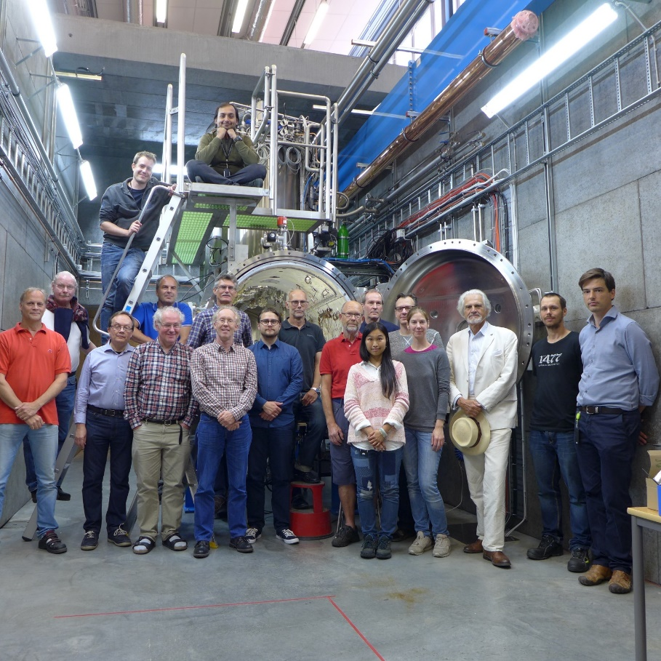
Personnel
Eight senior staff have been recruited from the former National Uppsala Accelerator Laboratory TSL.
New recruitments of mostly younger members of the personnel have been made through wide international announcements.

Slide 3
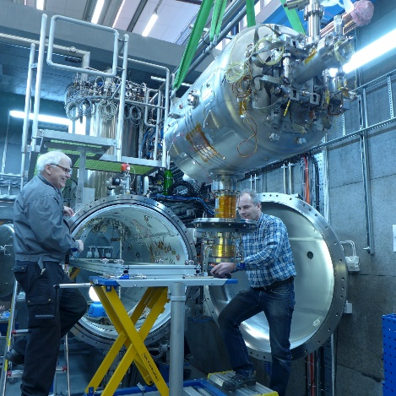
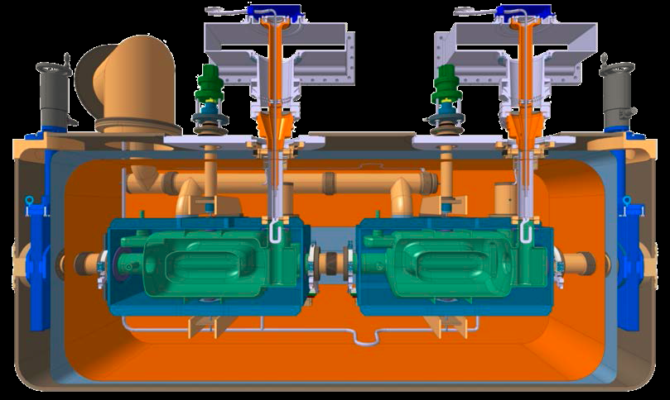
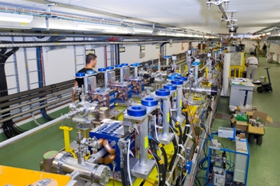
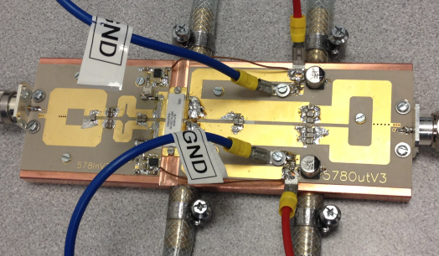
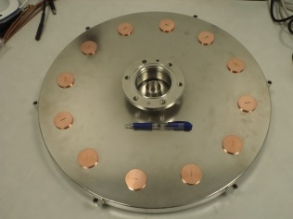
Research profiles
Ongoing or starting projects
Test and development of Superconducting Accelerating Cavities and Radio Frequency High Power sources for ESS
Test and development of
superconducting Crab cavities
and magnets for the CERN
LHC Luminosity Upgrade
Study of accelerating gradient
limiting discharges in CLIC
accelerating cavities at CERN
Commission the Laser Heater for X-FEL
Solid State Radio Frequency High Power Generation for accelerators
2017-05-09
KoF FREIA Interview Meeting 9 May 2017-05-09 Tord Ekelöf
3

Slide 4
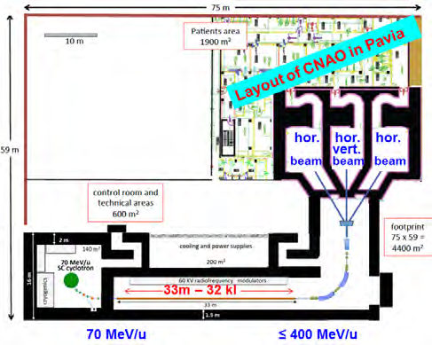
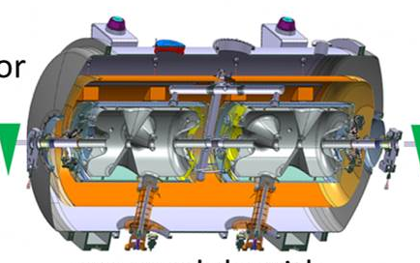
Research profiles
Some planned activities
Development of
Control system for
ESS modulators
with Swedish
industry
Doubling of the linac power
and compression of the proton
pulse for the ESS Neutrino
Super-Beam (ESSnuSB) project
Generation of
single-cycle THz
light-beams
Superconducting Light Ion
Hadron Therapy Cyclinac

Slide 5
Academic culture
Publishing papers and giving seminars and international conferences
Teaching
Inviting external scientists to give seminars
Weekly meetings

Slide 6
Teaching
8 FREIA lecturers
giving
lecture hours
and
158 laboratory instruction
hours

Slide 7
Finances
From EU-projets:
EUCARD2 40 kEURO,
ARIES 337 kEURO,
EuroNuNet 16 kEURO and
AMICI 100 kEURO.
The contribution from the Faculty (FFF) to FREIA budget is 0.1 MEUR/year = 4%

Slide 8
Finances
Operational costs presently covered up till spring 2020
More collaborative contracts are currently being negotiated for beyond 2020
For this a regular operation budget 1.2 MEURO/year will be needed as from 2021.
FREIA operates as a national laboratory in collaboration with Swedish industry
The activity thus requires funding on the national level
Is currently developing and testing high-tech components with ESS, LHC, CLIC and X-FEL
Other potential collaborative partners: MAX-IV, E-ELT, FAIR, ITER, MYRRHA, ILC, FCC….

Slide 9
Head of Division
Relations with university, with collaborating laboratories and industries and with funding sources
Organization
Divisional Board
Project Manager
Leads the major infrastructure projects
Laboratory Manager
Leads the daily work in the FREIA laboratory
Senior Member
of the Technology Department
21 Researchers, Engineers, Technicians and PhD Students
Specialized in different research areas
Planning and reporting made in weekly meetings Monday 2-4 pm

Slide 10


“Valley of Death”
FREIA
Basic
Research
&
Invention
VR
New
Business
&
Innovation
VINNOVA
Consequence: there is a nearly total absence of high-tech orders from European Accelerator Infrastructures (CERN, ESS, X-FEL…) to Swedish industry

Slide 11
FREIA Vision
Pursue physics research and development on the national and international level of accelerators and instrumentation in collaboration with large research infrastructures and industry for the development of new research instruments for Basic Science and for Society.

Slide 12
What works well and what we need help with
What works very well
1. Relation with Department, Faculty, University, ESS, CERN and others
2. Acquisition and operation of advanced high-tech infrastructure
3. Establishment of cutting edge infrastructure high-tech projects
4. Recruitment of qualified personnel
To continue on this successful route we need help to establish:
1. A bridge in Sweden between basic research and industry/ innovation
2. A regular operations budget to make possible a longer term planning of activities beyond 2021 and provide matching funds in collaborative projects
3. A FREIA Faculty Program to provide tenure track employments (lectureships) for the FREIA personnel

