Slide 1
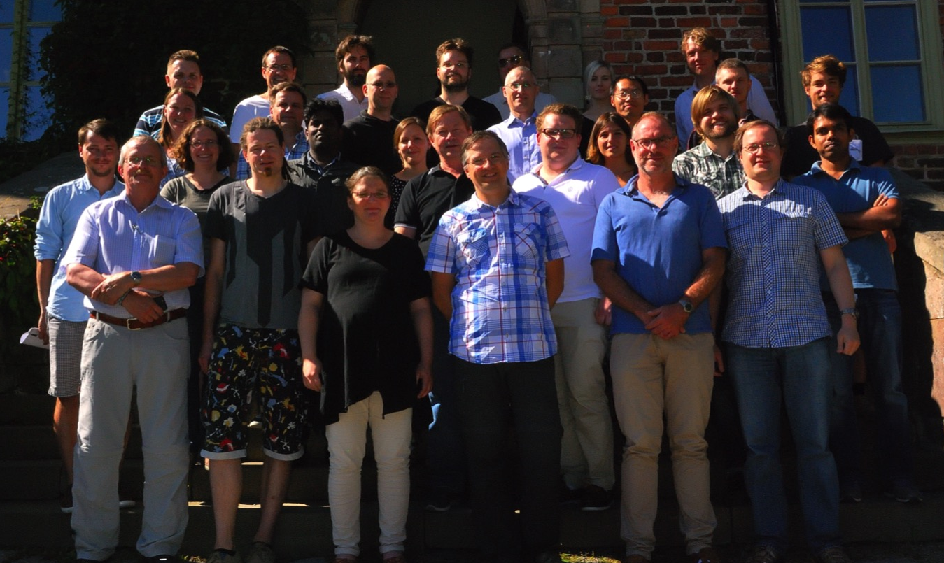
Division of Molecular and Condensed Matter Physics
physics.uu.se/research/molcond/

Slide 2
Challenges and Opportunities
New professor
Scientific development
Infrastructure development
Gender and diversity aspects
Researcher positions

Slide 3
Human resources
≈50 people: ≈20% women, ≈50% Swedes, 13 nationalities
2 postdoctoral research fellows
(external + faculty funding)
6 professors (≈35% faculty funding)
4 senior professors (external grants)
13 PhD students
(faculty + external grants)
5 lecturers / assistant lecturers
(≈35% faculty funding)
2 postdocs
(1 faculty +1 external)
1 research engineer (faculty + external grants)
19 researchers
(mainly external grants)
One ongoing professor recruitment
Notes:
statsanslag GU/FO 3 810 218 12 687 229
studiestöd 1 925 244
studiestöd Teng Zhang 470 719
StandUp 300 000
postdoc IFA 760 000
lokaltilldelning 676 710
medfinansiering Teng -112 973
medfinansiering KAW, STINT, CTS -566 435
medfinansiering ERC teknat 500 000
medfinansiering ERC rektor 250 000
SUMMA medel 2017 3 659 097 19 361 265

Slide 4
  Total annual budget 58 MSEK. (≈6 M$/M€)
PhD funding, co-financing etc from faculty
Teaching (faculty)
External funding
e.g. VR, SSF, ERC, Wallenberg and Carl Trygger Foundation, Energy agency
10 %
10 %
FFF (Faculty funded research)
20 %
60 %
    Include 5-10 MSEK annually for to instrument development and support
    External funding has increased by 30% (since 2010)
    Teaching has increased by 80% (since 2010)
Several long-term high-risk projects + Substantial short-term external funding
➔ Pressure for more funding
Notes:
Mkr Personal exlusive lokaler
Avskrivningar extern 6 Mkr.
1 Mkr av FFF till avskrivningar etc. 480 kkr.
1 Mkr. Drift.

Slide 5
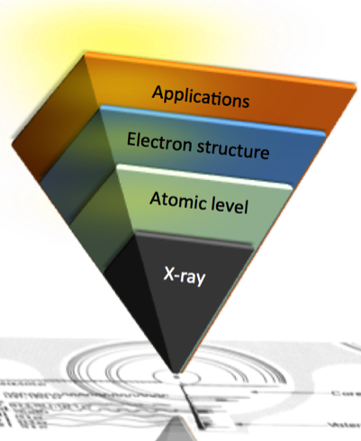
From three programmes to one
Molecular Physics +
Surface and Interface Science +
Soft X-ray Physics
Molecular and Condensed Matter Physics
…to do…
Research on light-matter interactions at the atomic level for understanding and control of electronic properties of molecules and liquids and new functional materials.
Notes:
1. Who are you visiting Vission very strongly linked to this theme.
Who we are use and develop X-ray based methodologies These goals
Molecules liquids functional materials. Bridging Basic and applied science.
1. Our Fondation Ny instrument by X-ray based methodology development.
2. As we now this is the key to attomic level understanding of the Electronic structure important for material properties and applications.
3. Core is X-rays interacting with matter – detecting outgoing light or photo emmited electrons.
Key words representing what to expect from these thre exciting days.
How we are looking forward to an exciting week were we hoe that dig in to th ebeuty of scince exploring the relaton between atomic structure and dnamics of electrons and how this relate to properties of matter and material applicationss.
Many of the most powefull tools to understand this experimentally is X-ray based spectroscopipie, Since its nature alow information on atomic length and time. Naturally it has a stron ling to the visionof our reseach porogram.

Slide 6
From “technique-based” to
“application-motivated” research
in three new themes
X-rays: Synchrotrons, XFEL, home-labs (XPS, HHG), …
  Close to 100 weeks of beamtime/year outside Uppsala University.
70-80 papers/year (10 % high profile)
  External co-authors on the vast majority of our papers.
  Extensive collaborations outside division.

Slide 7
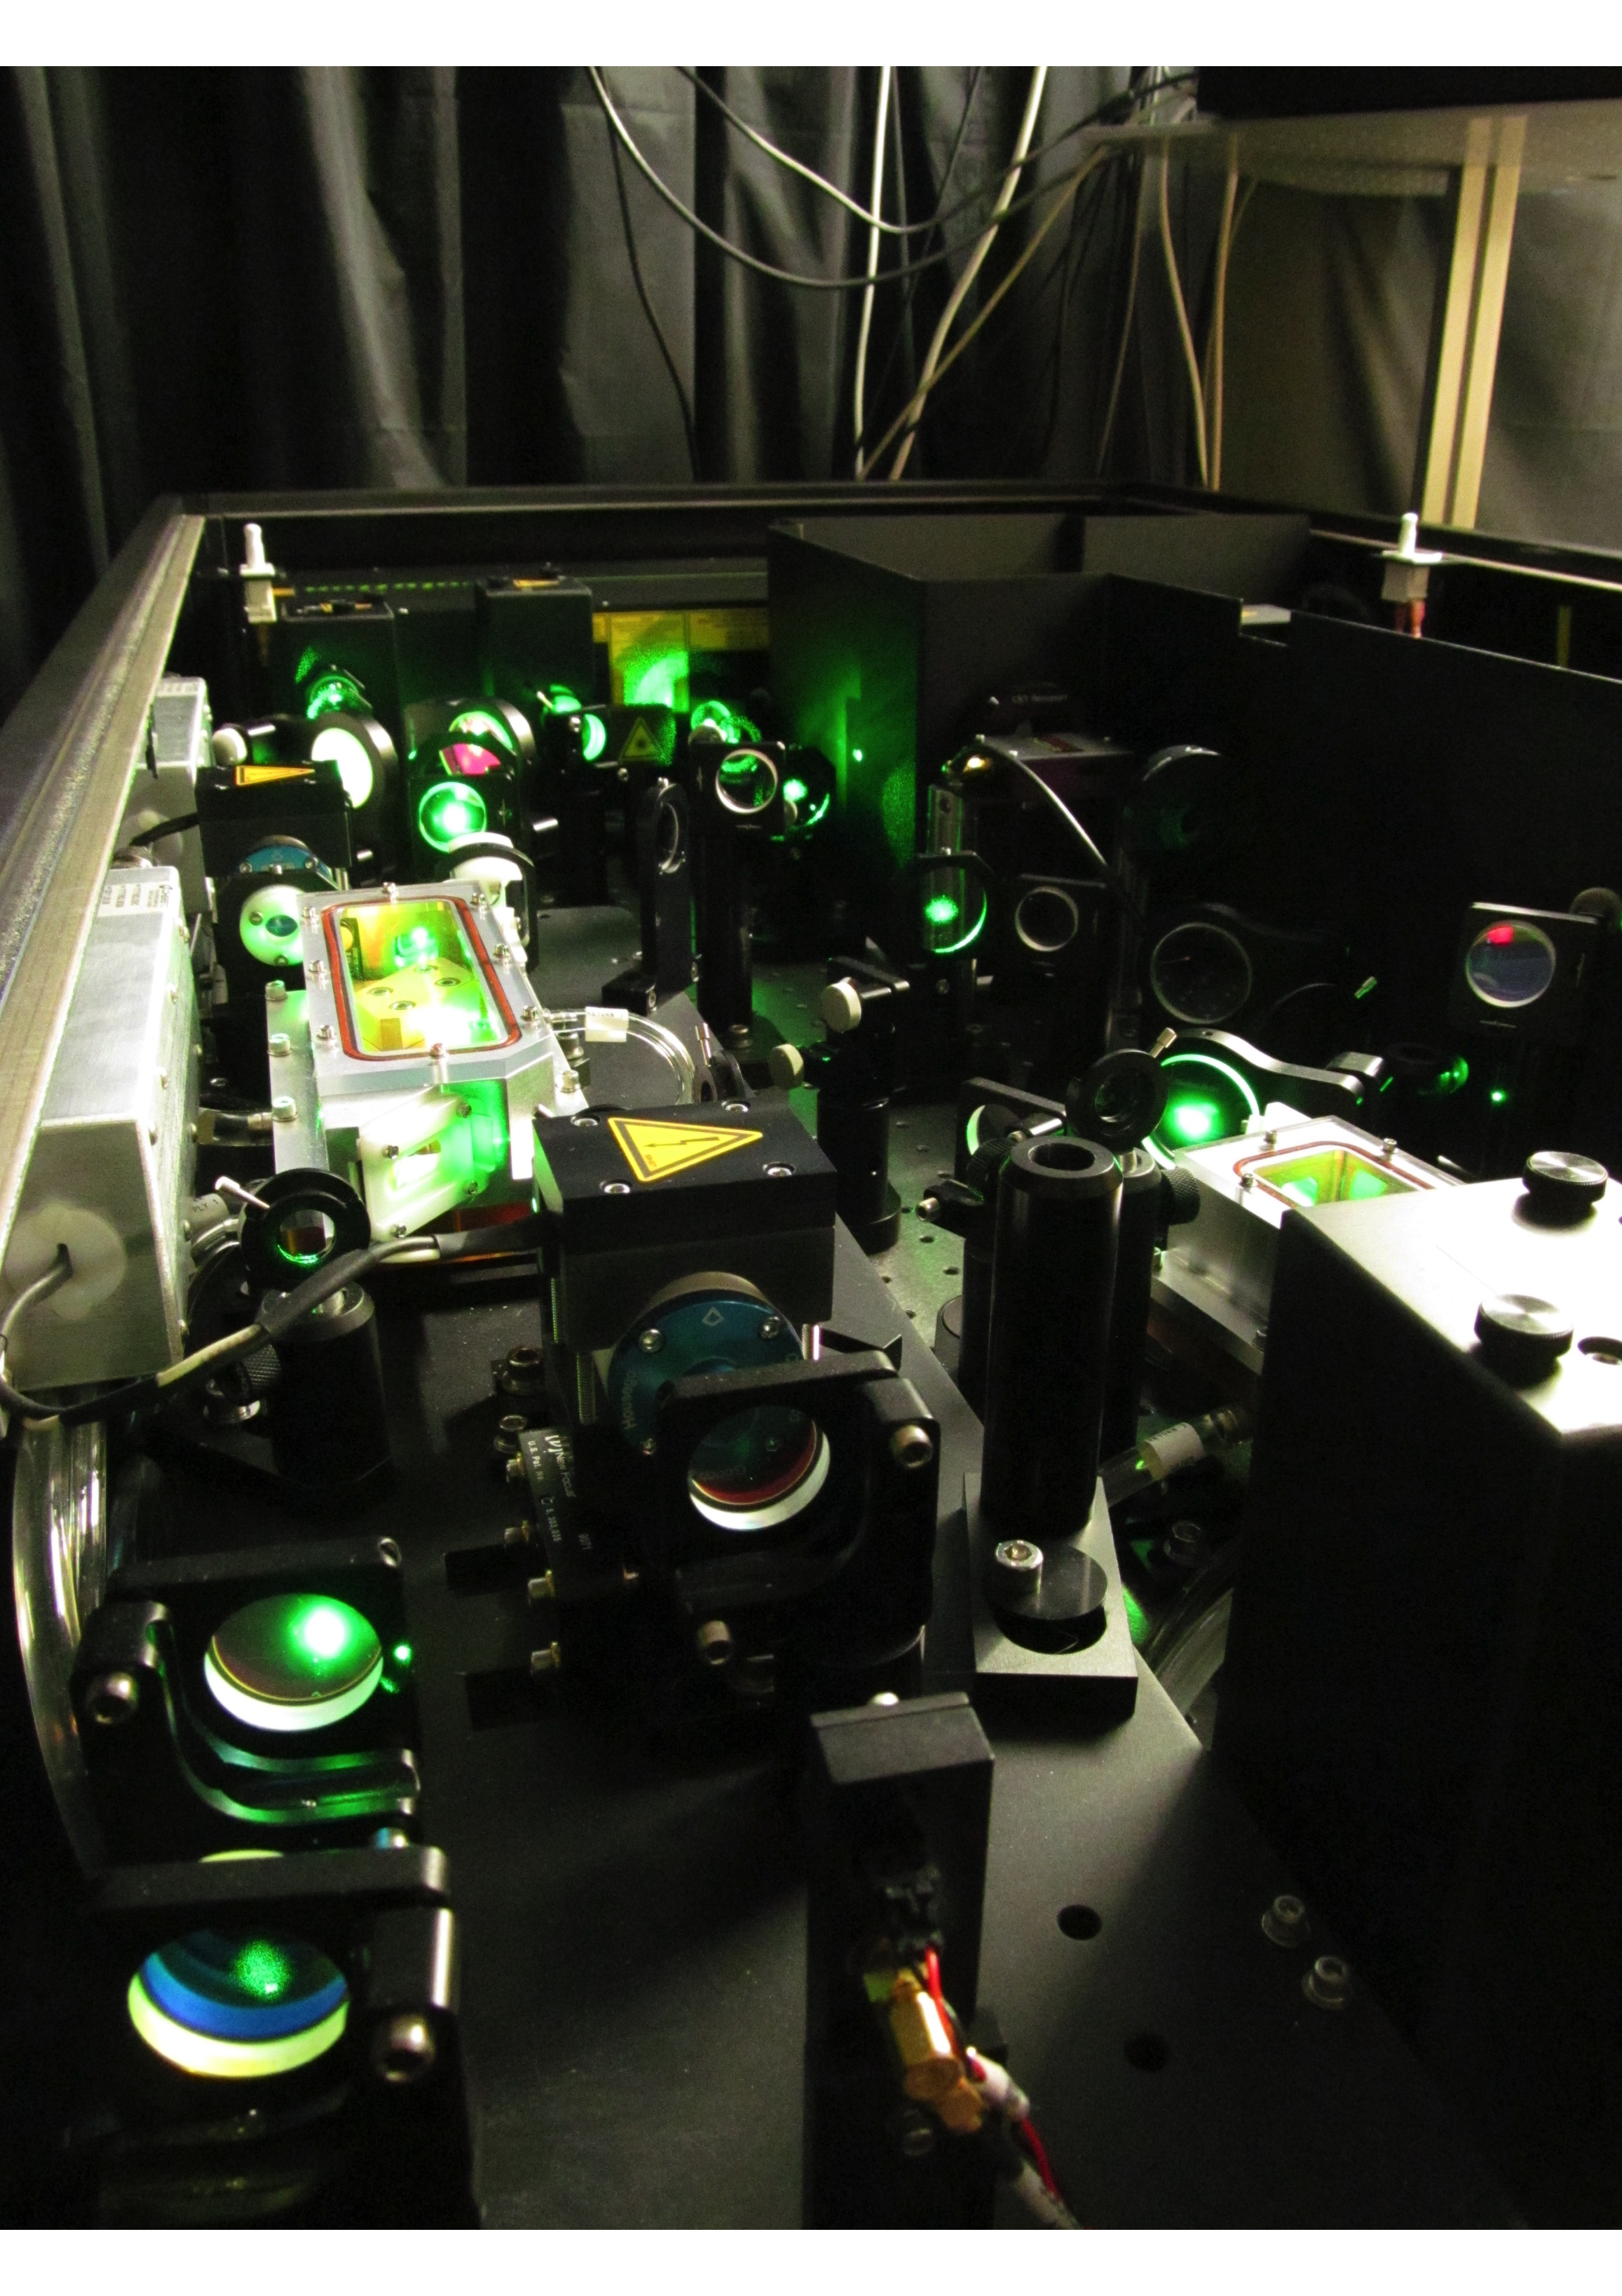
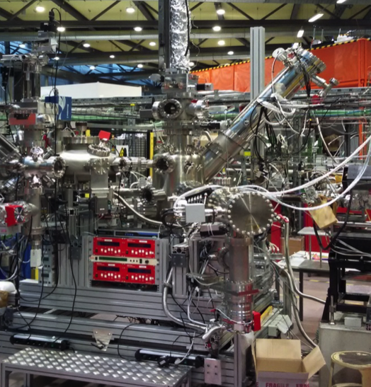
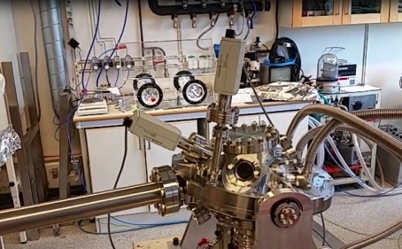
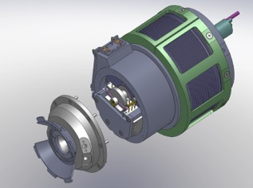
X-ray based methodology
Main current development projects
Property | Facility | Technique
TIME RESOLVED | HELIOS (HHG @ UU) | fs PES and T-MOKE
HIGH RESOLUTION | VERITAS @ MAX IV | RIXS >30 K resolving power
EFFICIENT DETECTION | UBjL @ Bessy 2 | PES using ArTOF - 1000 times faster acquisition
ENVIRONMENTS | SPECIES, HIPPIE @ MAX IV | High pressure PES
HIGH INTENSITY | SQS @ XFEL | RIXS for SQS
Notes:
Sample environment
X-FEL (Non linear physics)
and MAXIV
1-10-100 K Wueo developments
Source, detection AND sample environment
KeysTIME AND RESLOUTION FROMSOURCES, EFFICIENT DETECTION AND RESOLUTION FROM THE DETECCTORS.
CLEVER ENVIRONMENT TO MEASURE ON RELEVENT SAMPELS . EVERY THING HAS TO BE DEVELOP.
The building of thes machins is to perform SCIENCE.

Slide 8
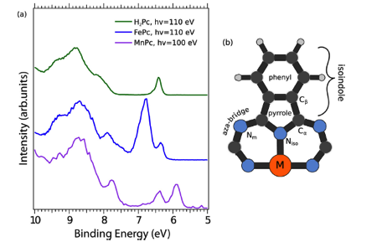
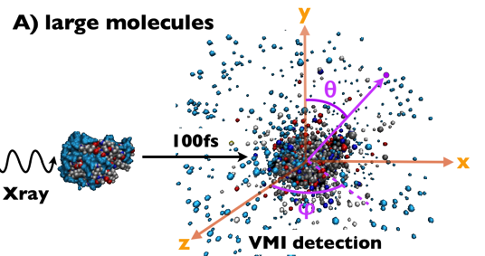
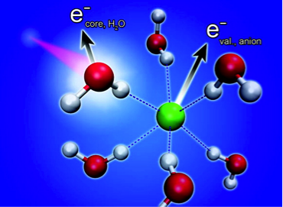
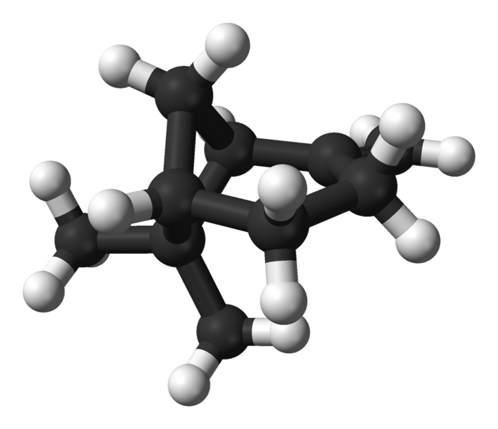


Molecules and Liquids
  Molecules: From atoms and molecules to clusters and biomolecules
FEL:
“Diffraction before destruction”
Plasma dynamics
Design of dye molecules
  Liquids:
  Basic solvation
  X-ray induced dynamics
  Atmospheric molecular science
Microscopic structure and composition
Macroscopic
properties
Parametrizations
for modeling
Notes:
This also applys to Functional materials.
Using the basic understandin of matter.
Magnetsim:
1 Modern magnetic applications depend on structure. Thin layers in magnetic divices.
2 Spince are distributed in space and what ar the character of the spin.
3 Understanding spindynamics open up for new pintronic devices.
Our investigations on modern magnetism and spintronics focuses on understanding and controlling atomic spins in space and time. We study how the behavior of atomic spins depend on the sample structure/composition and how they are affected by various types of excitations

Slide 9
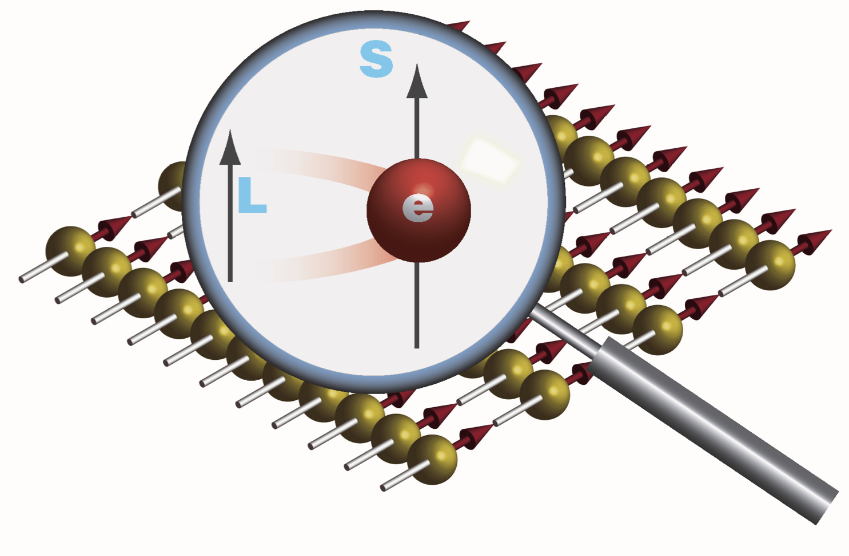
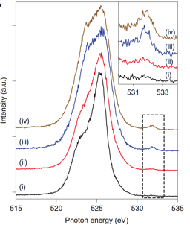
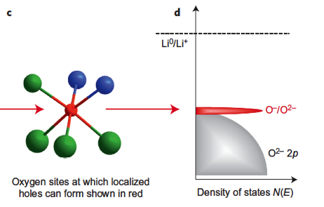
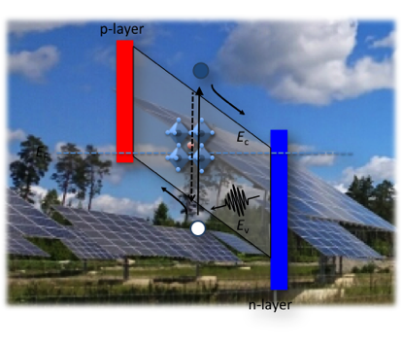
Functional Materials basic to applied
  Surfaces and interfaces:
  Fundamentals
  Magnetism:
  Controlling atomic spins in space and time.
Energy Materials:
Solar cells, batteries, photocatalysis
Following fs spin orientation (submitted)
Were is the electron in energy and space?
Plogmaker et al. Rev. Sci. Instrum. 86, 123107 (2015)
Where is the energy stored?
Luo et al. Nature Chemistry (2016)
Notes:
This also applys to Functional materials.
Using the basic understandin of matter.
Magnetsim:
1 Modern magnetic applications depend on structure. Thin layers in magnetic divices.
2 Spince are distributed in space and what ar the character of the spin.
3 Understanding spindynamics open up for new pintronic devices.
Our investigations on modern magnetism and spintronics focuses on understanding and controlling atomic spins in space and time. We study how the behavior of atomic spins depend on the sample structure/composition and how they are affected by various types of excitations

Slide 10
Division Leadership
One Division Head 20% + One Program Professor 20% (economy, personnel) (research)
One Teaching Coordinator 5%
Division council
  Weekly meetings with head of department, division heads, etc.
  Member of preparatory group
  Scientific leadership
  Should link to the new strategy committee – regular link not yet established
  Interacting with Department Director of Studies on staffing of courses
  Elected for 3-year periods,
  Proposes division head
  Meets 4-8 times yearly for input on specific strategy, personnel, budget, recruitments, etc

Slide 11
Use of funding
Opportunities with one larger program
Allows for major infrastructure investments
Can accommodate some fluctuations
Has given the possibility for recruitment at the highest level: One professor recruitment in progress
PIs decide on their external money (together with the division head/program professor)
Faculty funding used to increase internal renewal by shared PhDs

Slide 12


Internal Processes
Daily:
Division Head and Program Professor meet
Lunch and fika
Weekly:
Information meetings. (one-hour ALL)
External seminar and internal course
Seniors lunch
Monthly:
PhD meetings
Twice a year:
Kick-off meeting: strategy and processes (one day, ALL)
PhD supervisor follow-up meeting (half day, ALL)
Thematic meetings:
New opportunities, increased coherence, scientific renewal
Informal bottom up process
  Supervisors/PIs leadership at the PhD/Postdoc/researcher level:
  Support in the research
  General career support
  Good working conditions
Notes:
Twice a year kick-off meeting discussing current research/education, strategies/organisation and social environment.

Slide 13


External funding strategy
Continue with traditional funding agencies
Further broaden the use of our tools to other areas:
Applied areas (e.g. Energy materials, Magnetic materials, Biophysics, Environment)
Larger constellations (Chemistry and Technology)
Opportunities at MAX IV and at other X-ray sources
Industrial collaborations
Develop strategies to increase European funding (currently one ERC grant)
Improving quality of applications:
Internal feedback on applications (this has been rather successful)

Slide 14
Feedback from our self-evaluation
- + Shared elected leadership
+ Individuals appreciate large freedom
  - + Flat organisation
- - + Career structure
  - + Instrumentation and infrastructure

Slide 15
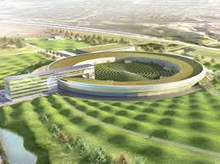
Challenges and Opportunities
New professor
Renewal and strengthening
Continuous coaching for scientific development
More thematic research units?
Bottom up - Kick-off at the division. Include other divisions?
Top down - Strategic committee at the Department and Faculty
Infrastructure development
Opens new research opportunities
Unclear national funding, local infrastructure fund?
Long scientific pay-off times
Risky for individuals
Local/non-local?
Problem with visibility
Gender and diversity aspects
More women and higher diversity in research leadership roles
Career coaching, interacting with role models
Researcher positions
Unsecure positions linked to external money
Career coaching

