Slide 1
Division of Astronomy and Space Physics
In cooperation with the Swedish Institute of Space Physics (IRF)

Slide 2
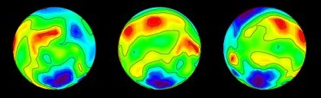

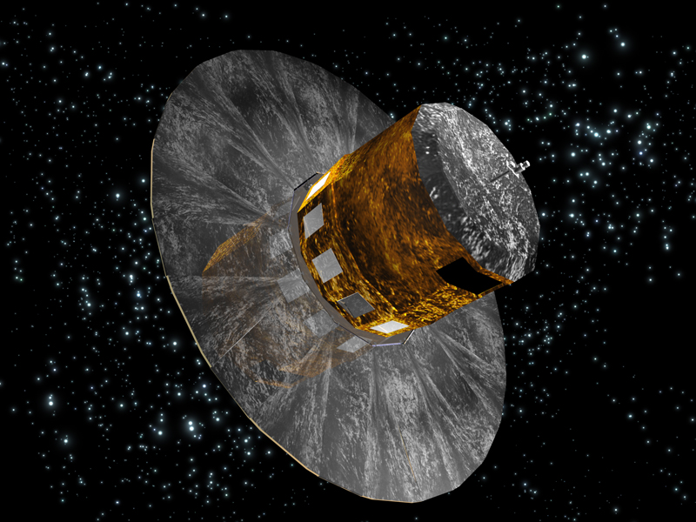
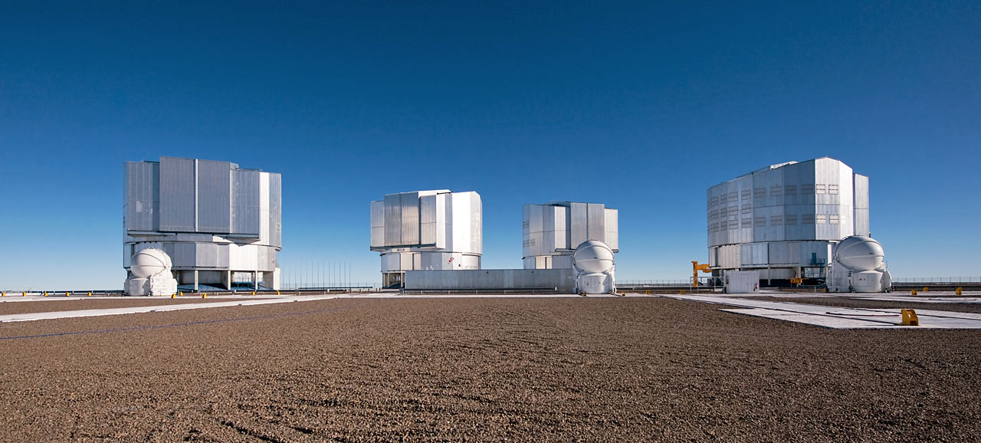
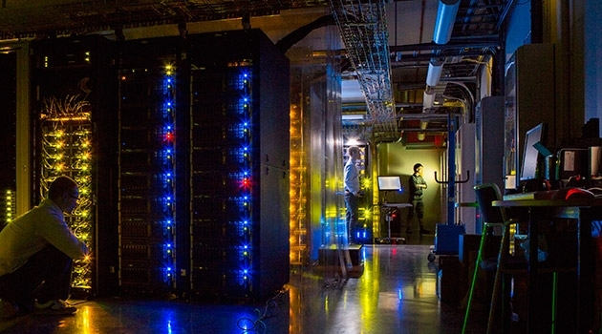
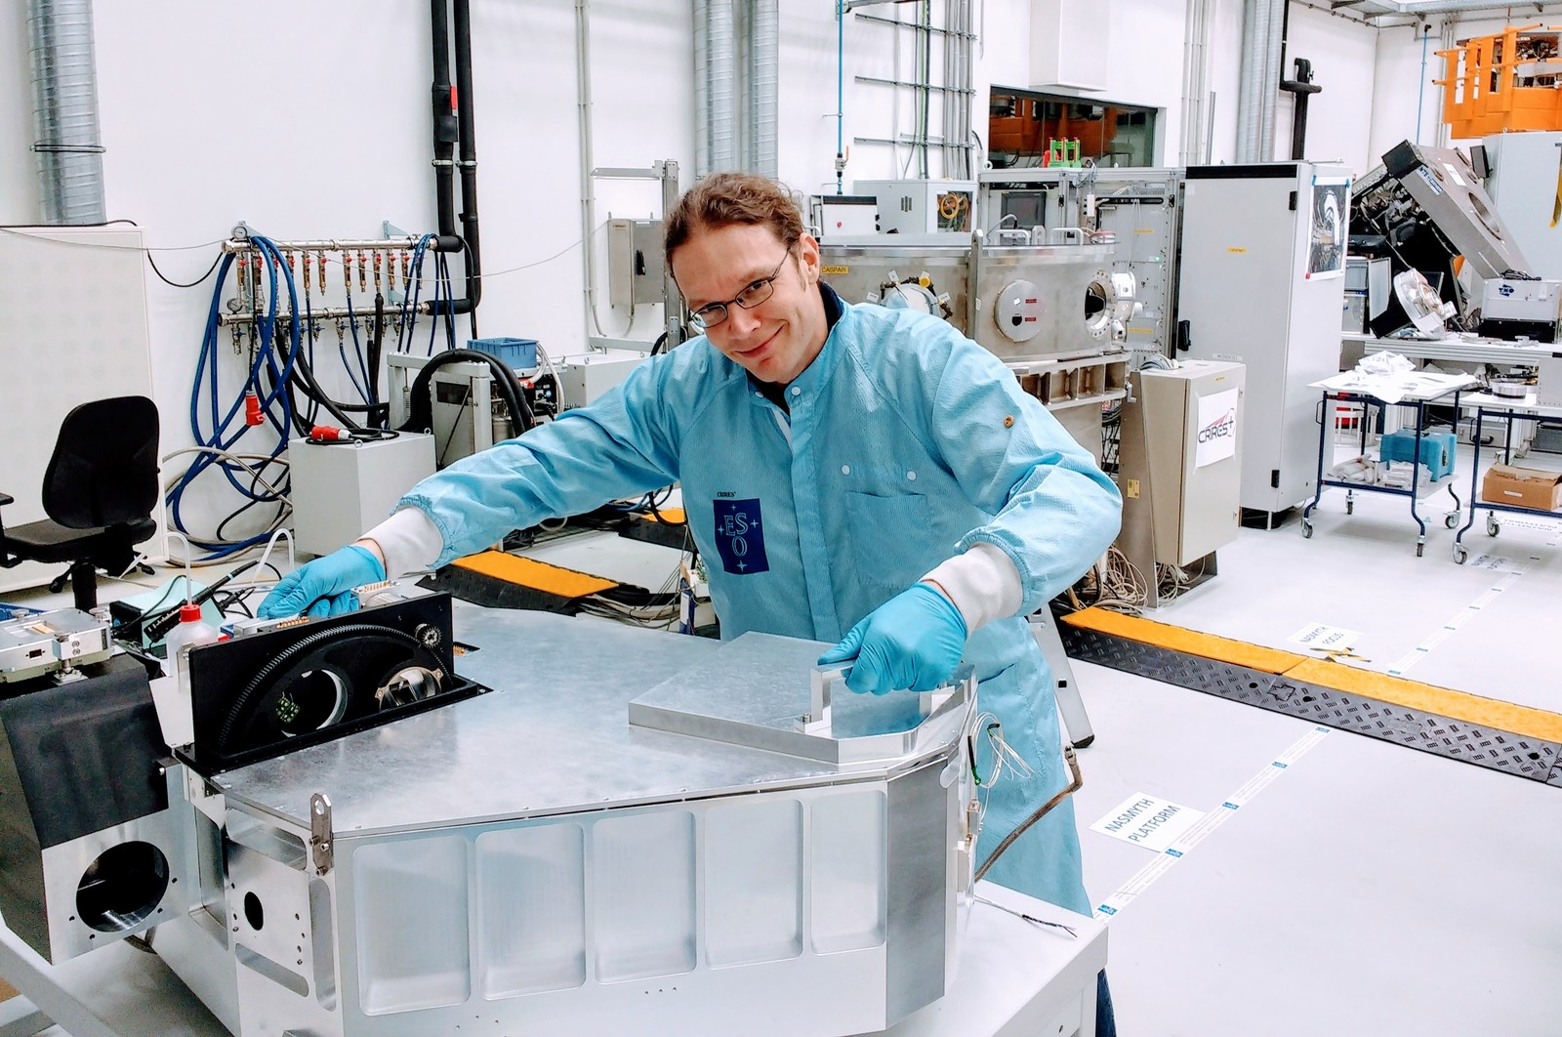
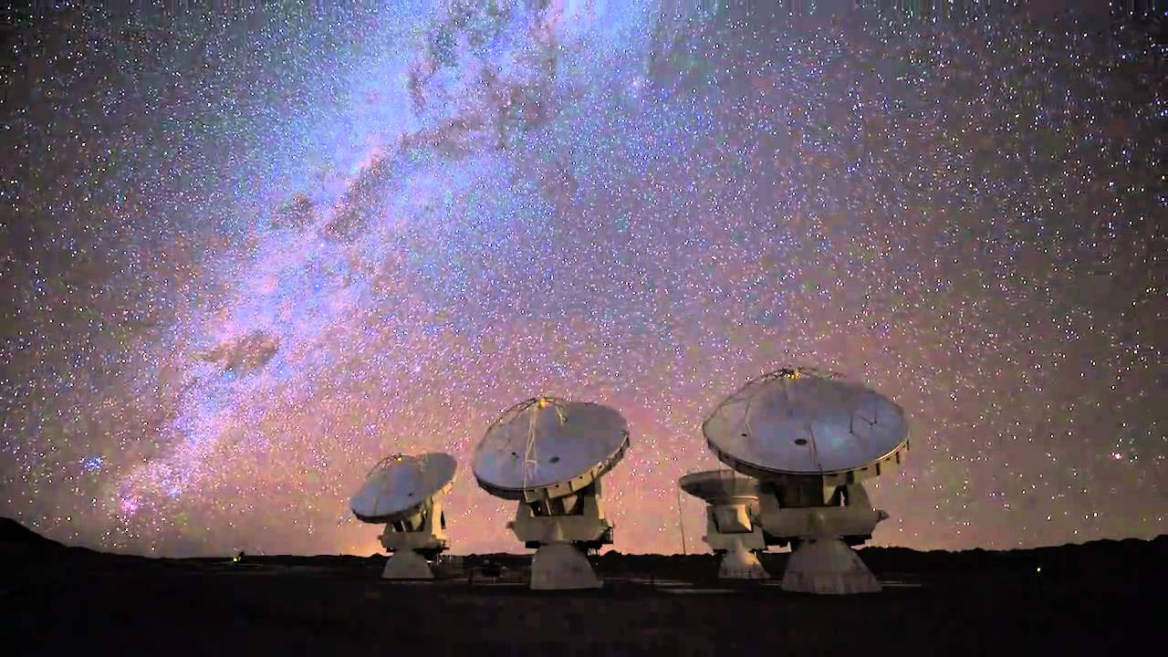
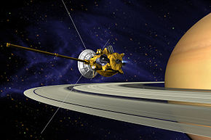
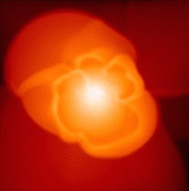
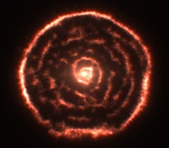
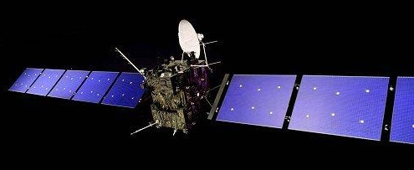
Astronomy & Space Physics: Research Profiles
  The first stars & galaxies, re-ionization of the Universe
  Gaia: star survey of our galaxy
  ESO VLT and E-ELT instrumentation for studying stars and exoplanets
  Stars and exoplanets
  Stellar magnetic
  fields
  Milky Way
  Computations of micro-physical data
  Hydrodynamic models of stars & stellar winds
  Comparison with observations of evolved stars (ALMA & infrared)
  Rosetta
  Cassini
  PI Jupiter Icy Moons
  (ESA Cosmic Vision)

Slide 3

Astronomy & Space Physics: Overview
Three Programs
  Distinct but complementary areas of expertise
  Several common science goals
  Shared resources
2(1) professors, 7(1) lecturers, 6(2) researchers, 14(5) PhD students, 3 long-term visitors

Slide 4
Division Economy (2016)
+ access to infrastructures: ESO, ESA, SNIC, …
External funding pays some salaries, project costs and overhead.
IRF has its own budget for research.
Problem: we have to rely too much on external funds for salaries.
Problem: local infrastructure does not match the ambitions of international projects.

Slide 5
Division has a substantial teaching load
Division specific courses
5 of the courses are taught by IRF staff.
IRF staff also supervises PhD students
and undergraduate student projects
Bachelor level: 3 courses
10- 40 students
Master level: 10
5 – 50 students
PhD students also take part in undergraduate
teaching, mostly as course assistants
Popular/introductory: 5
Some of these attract many students
and significant income, 40 – 90 students.
They also bring students to Astronomy
PhD education
PhD studies include an equivalent of one
full year of course work. Each PhD student
has an individual plan of studies
5 general Physics courses
E.g., Mechanics. These have many students,
often from the Engineering programs,
and bring in most of our teaching income.
With up to 130 students
Weakness: No real Astronomy bachelor
program.

Slide 6
Scientific Strategy and Recruitment
Dynamic research groups with theoretical and observational expertise not restricted by Program or Division boundaries.
Broad international announcement of positions (60-90 applicants for a PhD, 30-60 for postdoc, and 20-50 for lecturer).
Long-term funding and generation shift analysis in connection with recruitments.
Previous KoF evaluations were instrumental in selecting directions and avoiding subcritical projects.
Problem: complex University procedures, often involving non-specialists, make recruitment slow and inefficient.
Problem: lack of control/selection steps in the existing tenure track system.

Slide 7
Our Perception of Administration
Excellent science
and teaching
Scientists with
research goals
and teaching
Division head, council, program professors, PhD program chair
Economic
oversight, division
of duties, weekly info
Initiatives, arguments
against excessive
centralisation
(Excessive)
unification,
homogenisation
and centralisation
Department: board, head, administration, common resources, coordination of education and PhD training
Reports, requests,
proposals
Regulations,
money, strategy,
joint initiatives, inquiries
Faculty: teaching, recruiting,
administration, strategy

Slide 8
Administrative Processes
Program professors and Division Head define the research strategy, and defend it at various levels at the Department.
Program resources consist of faculty block grant and Division teaching income.
External (personal) grants give freedom to pursue research, and occasionally hire PhD students and postdocs.
Head of Division has a mainly administrative role.
Division council is an advisory body (meets monthly, minutes distributed).
Informal staff meetings weekly.
PhD studies include several quality control mechanisms. Department guidelines have been modelled after astro-space.
Strength: We receive good administrative support in the Department.
Weakness: Few are willing to take on administrative duties for the
Department; such are seen as a one-way street.
Weakness: Central administration is becoming harder to reach.
Notes:
The three programme professors are responsible for research and budgets within their different programmes.
The three programmes collaborate very well and a fourth person take on much of the administrative work as head of division, leads the division council, and acts as the link to the department directorate.
This choice is currently accepted by the board and director for one year at a time.
The Head of division was recently reelected by the personnel to be proposed for another year.
The three programme professors collaborate very well and the economic boundaries between the programmes are adjusted when needed.
There is some opposition to that the faculty budget is governed by the programme professors through the division head.
The division council holds representatives for PhD students, Young researchers, Senior researchers and the administrator helping us with our accounting.
The council meets once a month during semesters before each preparatory board meeting to discuss those items and other issues that arise. There may be extra meetings when needed.
A protocol of the meeting is written by the chair person and circulated to the council before distribution.

Slide 9
Visibility in society
Strength: Division has a very active relationship with the press/radio/TV and general public/schools. Most questions sent to the Department end up at our Division.
Strength: Introductory Astronomy courses attract potential astronomers and also connect to the general public.
Weakness: This is not quite the kind of “connection” that the Government likes to fund and the University favours.

Slide 10
Astronomy & Space Wish List
University research grants are needed to smooth the variations in external funding.
Clear tenure-track system with several control points is urgently needed.
University support of experimental research is crucial to secure UU participation in large international projects.
A fully-fledged Bachelor program, with a sufficient curriculum and a project in Astronomy, is needed to attract Astronomy students.

