Slide 1
Teleconference ACS – FREIA 31th May 2017
Agenda:
Presentation Spoke Cavity Testing in HNOSS
Manufacturing follow-up
Control and command
Planning

Slide 2
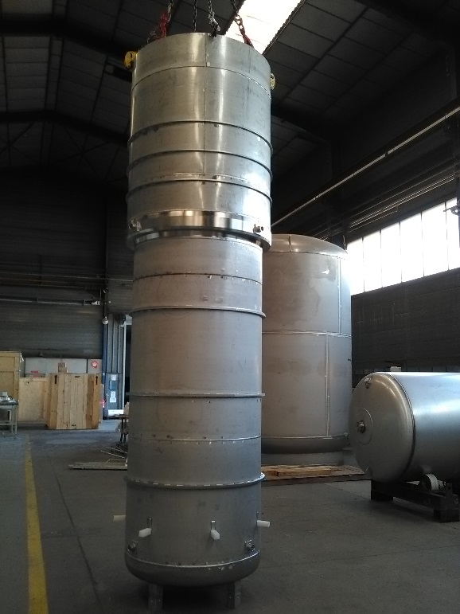
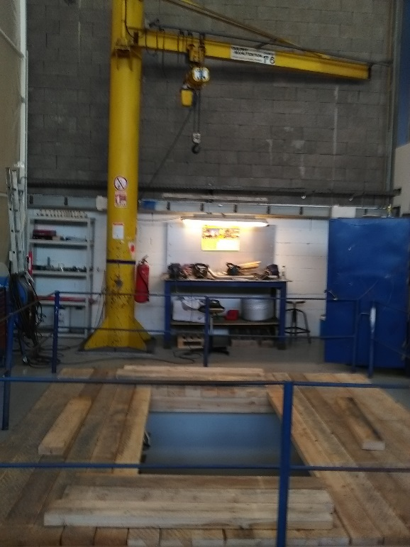
Manufacturing follow-up
Valve box
All components are available, excepted several pipes which are bending by a subcontractor.
Cryostat
CD received the vacuum vessel
The pressure vessel is in welding stage
The pit is prepared to install the vessel for assembly
Magnet insert
The manufacturing drawings will be finished soon and will be send for production after validation by ACS and UU.
Pressure vessel waiting for X-ray control
Preparation of the pit

Slide 3
Control and Command
Connection boxes (inserts)
Cables between connection box on insert and instrumentation box in the pit will be joined to the connection box
When changing an insert the cables will be disconnect from the instrumentation box then pose on storage racks on the insert

Slide 4
Control and Command
Instrumentation box in the pit
It gathers cables from the insert connection box and instrumentation towers
> important number of connectors, important size
> under study by Technergie to select the optimal box (may be custom-made)
Implementation?

Slide 5
Control and Command
Connection boxes
Cryostat, inserts, pit: stainless steel
Valve box: PVC
New quotation made according to last comments
Special cables
Directly connected to the electrical cabinet (cg: coaxial), except if can be connected to the connection box (cg: AMI)

Slide 6
Control and Command
Programming
ISII-Tech presented a draft software to CD and ACS
ISII-Tech will send the scheme to ACS for validation
2 tests are foreseen at the end of June and at the end of July to check every sequences

Slide 7
Planning
Valve box
W25: reception of components
W26: heat exchanger 4K
W27: thermal shielding
Cryostat
W22: cleaning, assembly, welding and control (X-ray) of the pressure vessel
W23: welding of cooling system and top lid on pressure vessel
W24: assembly of equipment
Simulator
W22: sending the nomenclature
W23: purchase of components
W27: start of manufacturing
Magnet insert
Heat exchanger Lambda HX683: 18 weeks of manufacturing

Slide 8
Planning
C&C and cabling:
W36: start of workshop pre cabling
Duration: 1 months
Tests in October
Electrical design
2 weeks of delay + summer holidays

