Slide 1
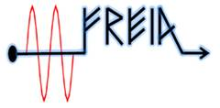
Design of a Solid State Power Amplifier for a H+ ECR Ion Source at 2.7 GHz
Pedro J. González, RF Group, ESS-Bilbao
TIARA Workshop on RF Power Generation for Accelerators
17-19 June 2013
Ångström Laboratory, Uppsala (Sweden)

Slide 2
Contents
ISHP: ESS Bilbao H+ ECR Ion Source
Description
ISHP Microwave System
Block Diagram
Klystron Amplifier, RFGEN, ATU, Control
Why an SSPA?
SSPA Design
Redundancy Configurations
1:2 Phase Combined Redundancy System
1-kW Module
WG Switches and Components
Power Supplies / Control
Phase Matching
Bibliography
Acknowledgements

Slide 3
ISHP Source: Description
ISHP: Ion Source - Hidrogen Positive
ECR H+ Ion Source, installed at the University of the Basque Country UPV/EHU in Leioa-Bizkaia (Spain)
EXPECTED MAIN PARAMETERS
75 keV proton beam
up to 60 mA peak current
Emittance < 0.2 π mm mrad
Pulse length up to 1.5 msec
Pulse repetition rate up to 50 Hz
CW possible
Plasma Chamber
Water cooled cylindrical cavity (Ф80 mm x 97 mm long) → fr = 2.7 GHz
Microwave System
Pulsed RF generator + Klystron amplifier up to 2kW @ 2.7 GHz
WR340 Automatic Tuning Unit (ATU) for measurement and matching of the “load impedance” (plasma chamber)
Vacuum window + Tee/E-plane bend + Ridge coupler
Magnetic System
2 movable coil pairs to set magnetic field for ECR conditions (≈100mT)
Extraction Column
Movable Extraction Electrode System (adjustable acceleration gap)
Plasma electrode (HV) + 2 Ground electrodes + Repeller electrode
3

Slide 4
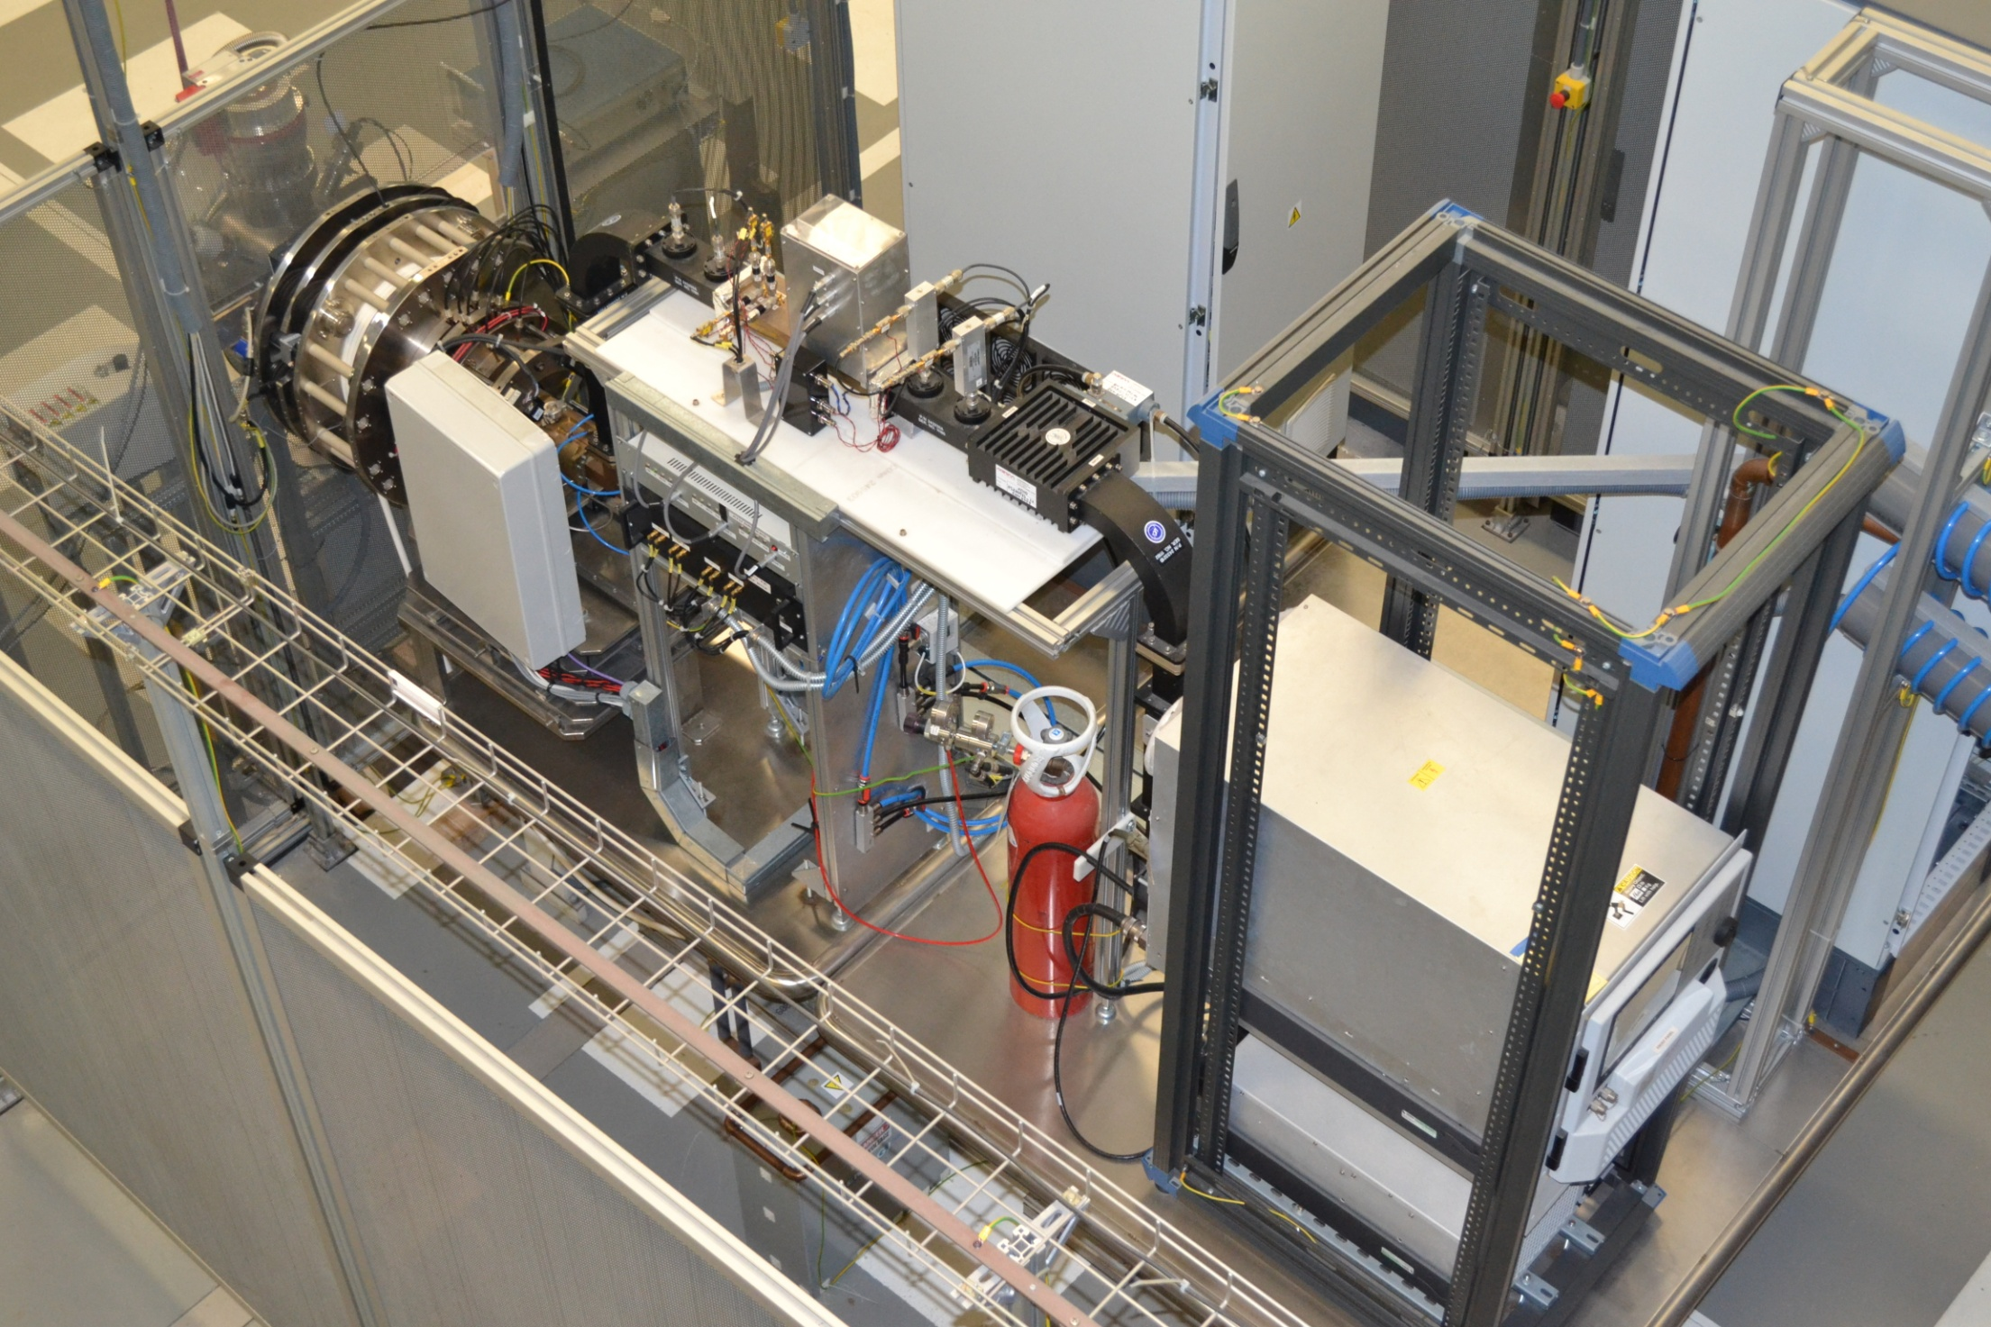
ISHP Source: Description

Slide 5
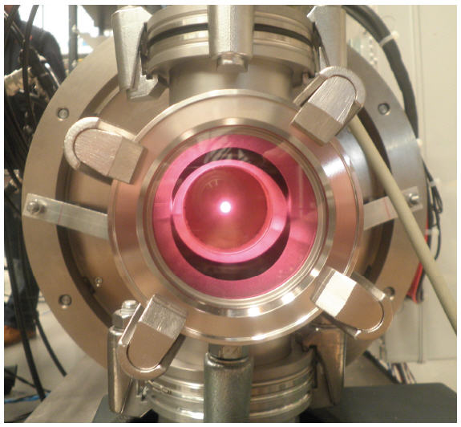
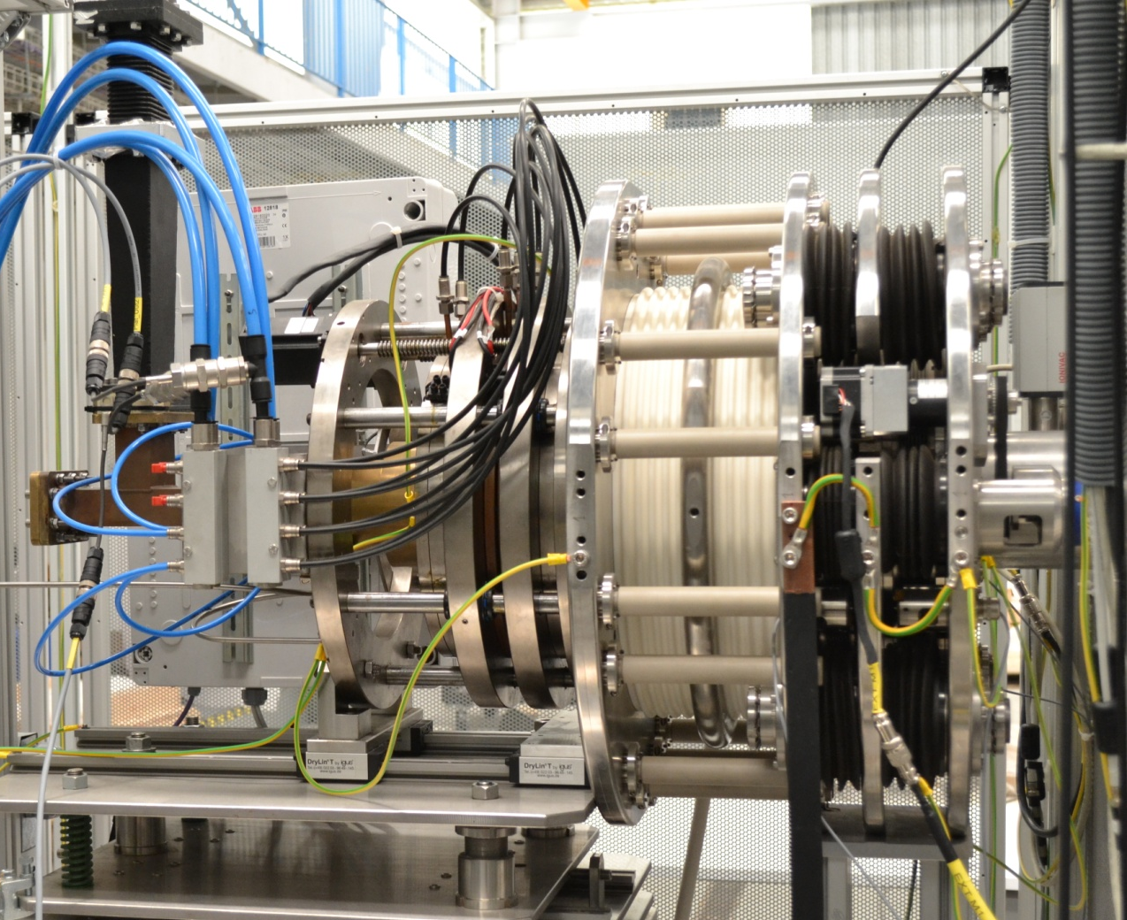
ISHP Source: Description
-1st CW proton beam: July 2012 at 15 keV
-Highest extraction voltage in pulse mode so far 35kV

Slide 6
Microwave System: Block Diagram
ATU FRONT/END
+
CONTROLLER
+
TUNER DRIVER UNIT
PFWD / PREV
PFWD / PREV
CIRCULATOR
E-PLANE SWEEP BEND
F
R
F
R
E-PLANE SWEEP BEND
AUTOMATIC TUNER UNIT
DUAL
DIRECTIONAL
COUPLER
THREE-STUB TUNER
POWER DETECTORS
DUAL
DIRECTIONAL
COUPLER
RFGEN
KLYSTRON
LOAD
WR340 TO WR284
RF VACUUM WINDOW
PLASMA
CHAMBER
Coax
WR340
MODIFIED TEE
(E-PLANE MITER BEND)
POWER COUPLER
6
POWER SUPPLY
-SSPAs (x3) (50V, 7Amp)
-Control box (12V, 3.3V)
-WG Switches (x2) (24V, 3Amp)
Notes:
SILHI/IPHI CEA Saclay 1.2 kW (magnetron 2.45 GHz/ klystron 3 GHz) CW and pulsed, H+ >100mA, 95 KeV TRIPS-TRASCO: 2.45 GHz, 2 kW magnetron CPHS Tsinghua 2.45 GHz, 1.5 kW magnetron Pantechnik 1.2 kW, 2.45 Ghz magnetron Tekvac 1.2 kW, 2.45 Ghz magnetron

Slide 7
Microwave System: Klystron Amplifier
Many similar ECR ion sources use a Magnetron @ 2.45 GHz exceeding 1-1.5 kW
Known drawbacks arising from magnetrons in free-running operation:
Load-pulling
Frequency drift v.s. power
Poor spectral purity
Low stability in pulse mode
These problems can be reduced by Injection-Locking of magnetron RF output to a stable RF source
Just a few ion sources use Klystrons:
Better performance (stability, spectral purity,...)
Well suited for CW and pulse mode
Require a stable RF input
(Much) More expensive
Notes:
SILHI/IPHI CEA Saclay 1.2 kW (magnetron 2.45 GHz/ klystron 3 GHz) CW and pulsed, H+ >100mA, 95 KeV TRIPS-TRASCO: 2.45 GHz, 2 kW magnetron CPHS Tsinghua 2.45 GHz, 1.5 kW magnetron Pantechnik 1.2 kW, 2.45 Ghz magnetron Tekvac 1.2 kW, 2.45 Ghz magnetron

Slide 8
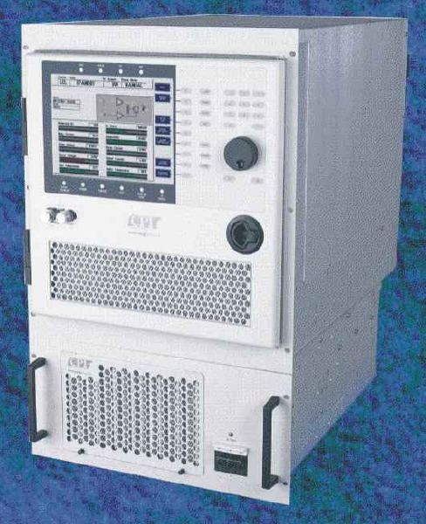
Microwave System: Klystron Amplifier
COMPACT KLYSTRON AMPLIFIER
K3S64 from CPI, Inc.
Originally designed for Satellite Communications
High Output Power: 2 kW
FDMA and TDMA→ “CW and pulsed operation”
Separate RF and Power Supply 19in drawers
High Reliability: “field proven performance”
-No failures after 2 years of tests and operation
8

Slide 9
Microwave System: Klystron Amplifier
Parameter | Value
fo | 2.7 GHz (BW: 8 MHz)
Po | 2 kW @ Psat
Gain | 77 dB min (small signal)
Output power adjustment | 0 to -20dB (0.1dB resolution)
RF Drawer | 19in x 12HU x 838mm depth (72kg)
PS Drawer | 19in x 5HU x 610mm depth (45kg)
Cooling | Forced air (integral system)
Primary Power | 400 Vac, 3P, 47-63 Hz
Power consumption | 10 kW
Class A Amplifier: Low efficiency
(same power consumption for CW
or pulsed operation)
-CW and pulse mode are possible
-Problems for pulses with repetition rate <10 Hz
(as required at commissioning stage):
-internal peak power meters do not respond properly → amplitude stability is affected
Eff = Po(avg)/Pac is 20% @ CW
only 2% @ 10% DC!!

Slide 10
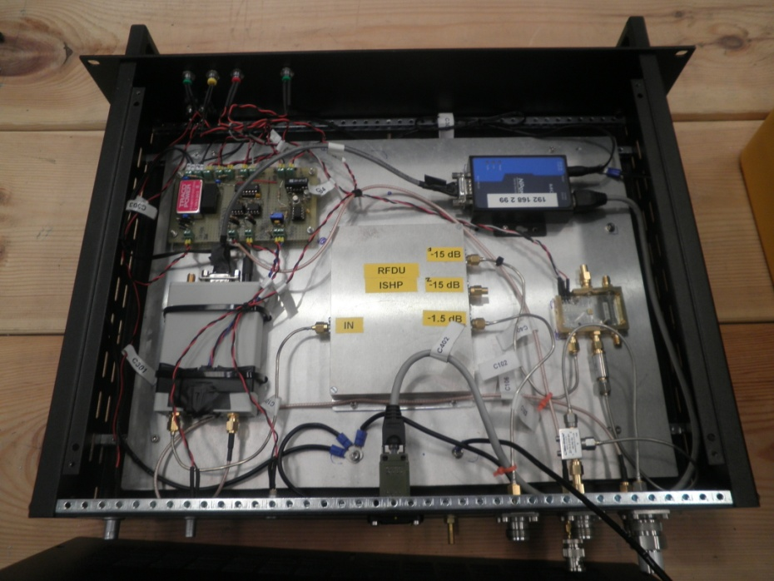
Microwave System: Pulsed RF Generator
RFGEN (Pulsed RF Generator)
2.7 GHz CW Phase-Locked Loop (PLL) Synthesizer (Adjustable frequency)
RFDU: RF Distribution Unit (Custom Power Splitter)
RF Switch: generation of RF pulses, according to external trigger
CW and Pulsed operation (any pulse length and repetition rate are possible)
Pulsed RF
Trigger In
+24Vdc
Input
DC BOARD
LOAD
Interlock In
RF SWITCH
POWER SPLITTER
RF1 (Klystron)
Interlock Out
RFDU
RF2 (Sample)
10MHz Ref
In/Out
RF3
(ATU-FE-LO)
PLL
SYNTHESIZER
LOAD
Control
RS-232 TO LAN

Slide 11
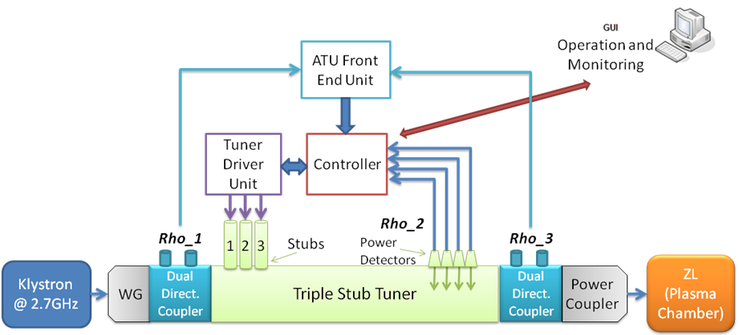
Microwave System: Automatic Tuner Unit
ATU (Automatic Tuner Unit) in WR-340 waveguide:
- Measures plasma chamber’s load impedance (ZL)
- Determines a proper impedance matching solution using a three-stub tuner
- Commands stepped motors to the right positions
- Checks achieved impedance matching
Reflection Coefficient Measurement Methods:
- Set of 3 E-field probes + power detectors→VSWR pattern
- Dual Directional Coupler + I/Q demodulators
- Dual Directional Coupler + Gain and Phase detectors
+ One-port Calibration
(3-term error correction)
<5% Reflected Power
@ Pklystron = 1kW
11

Slide 12
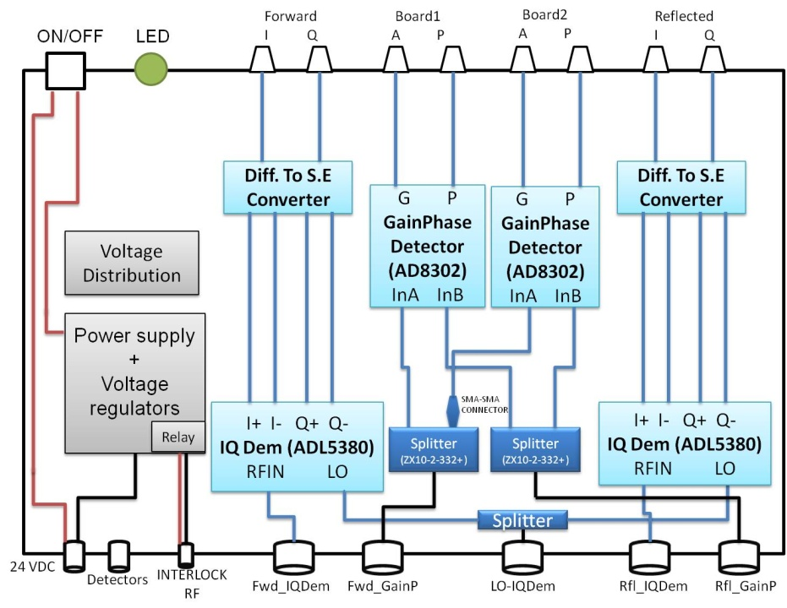
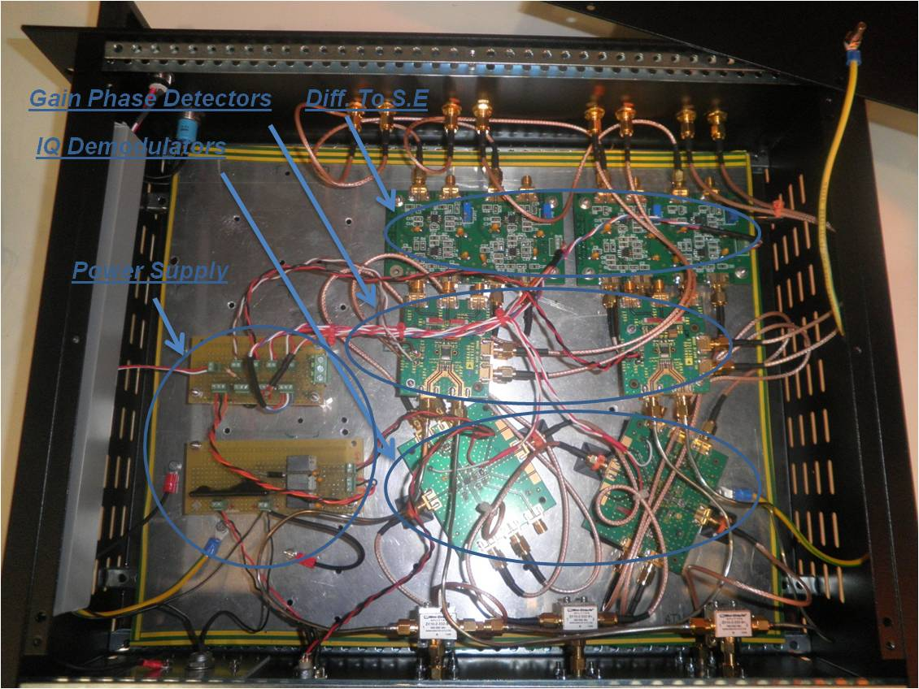
Microwave System: Automatic Tuner Unit
ATU-FE (ATU Front-End)
RF inputs: Fwd/Refl samples from Dual Directional Couplers
Internal cards: I-Q demodulators and Gain-Phase detectors
Baseband outputs: towards Control System to calculate reflection coefficients

Slide 13
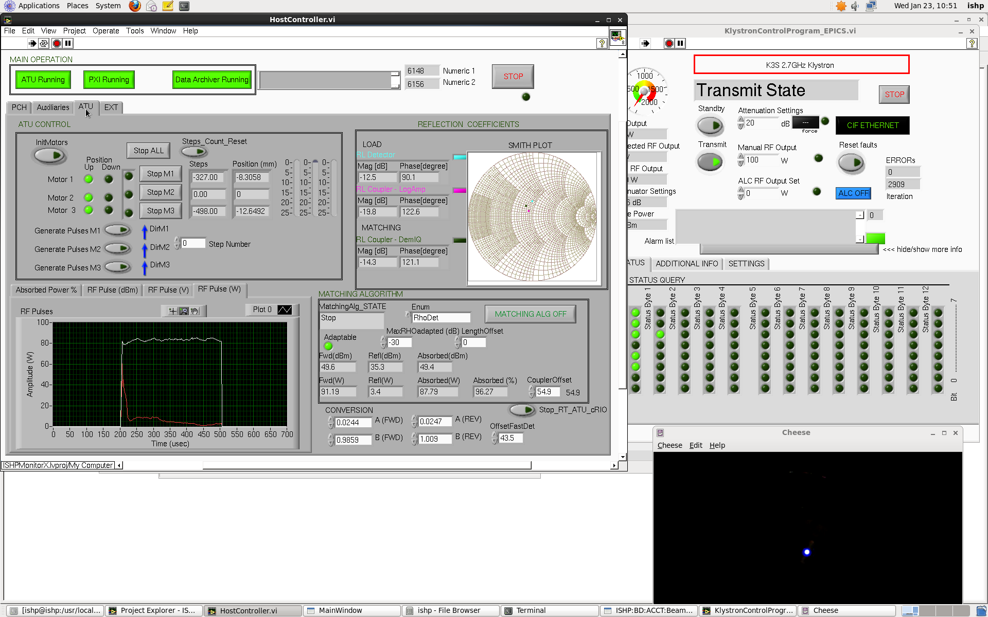
Microwave System: Control
RFGEN, Klystron and ATU Control GUI

Slide 14
Microwave System: Why an SSPA?
Why a solid state replacement for tube amplifiers?
SSPA: Solid State Power Amplifier
Cost-Effective Solution
Lower Cost of Spares
Smaller Size and Weight
Higher Efficiency in Pulse Mode→ Energy and cost saving
More Reliable (??) → Predicted MTBF SSPA >> Tubes (20,000 - 50,000 hours)
No HV Power Supplies Required
Increasing number of manufacturers of power transistors and amplifiers (LDMOS, GaN HEMT), providing higher power levels (even hundreds of Watts up to 3 GHz), for ISM (2.45 GHz) and S-Band RADAR (2.7-3.5 GHz) applications (markets traditionally served by tubes such as magnetrons, klystrons or TWTs)
e.g.: NXP, Freescale, RFHIC, Cree, Sumitomo, Toshiba, Nitronex, Triquint, RFMD,...
The Tube Guy: “Most SSPA systems are redundant, include redundant hot-swappable power supplies and justify high reliability figures. That suggests there is a major problem!”
14

Slide 15
SSPA: Specifications
Parameter | Value
fo | 2.7 GHz (BW: 10 MHz)
Output Pulse Power | Up to 1.8 kW / 62.5 dBm (peak)
Pulse Width | up to 1.5 msec
Pulse Repetition Rate | up to 66 Hz for 1.5ms (up to 10% Duty Cycle)
Pulse Droop | <0.5 dB
Gain | 77 dB min (small signal) (0 to -20dB output power adjustment)
Cooling | Forced air (SSPAs and PS)
Size | 19in x 12HU x 610 mm (30 kg) (excluded WG network assembly)
Primary Power | 220 Vac, 47-63Hz
Power Consumption | <900 W @ 10% Duty Cycle
-CW not possible
-Suitable for low repetition rates
<500W @ 5% DC
Eff = Po(avg)/Pac > 20% @ 10% DC
18% @ 5% DC

Slide 16
SSPA: Redundancy Configurations
1-KW SSPA CONFIGURATIONS
A) Single Amplifier
Amp 1
Unit Cell:
Po ≈ 1 kW
Cost ≈ 10,000 €
RF in
RF out
1oo1
B) 1:1 Redundant System
Amp 1
Redundancy:
Same Po
Cost: x2.3
Higher Reliability
RF
in
RF
out
Amp 2
1oo2
Standby
16

Slide 17
SSPA: Redundancy Configurations
2-KW SSPA CONFIGURATIONS
C) 2 Phase Combined Amplifiers
Amp 1
No Redundancy:
Po: x2
Cost: x2.3
Lower Reliability
RF
in
Amp 2
RF
out
2oo2
(series)
D) 2 Phase Combined Amplifiers
plus Redundancy
E) 1:2 Phase Combined Redundancy System
Amp 1
Amp 1
Standby/Failed
Sw 1
1oo2-2oo2
2oo3
Amp 2
Amp 3
RF
in
RF in
RF
out
RF out
Amp 3
Standby
Amp 1 + Amp 2
Sw 2
Amp 1 + Amp 3
Amp 2
Amp 2 + Amp 3
Amp 4
Po: x2
Cost: x5
Higher Reliability
Po: x2
Cost: x4
Higher Reliability
Standby/Failed
Standby

Slide 18
SSPA: Redundancy Configurations
RELIABILITY PREDICTION: Definitions
Reliability, R(t): Probability that a system will perform under specs for a stated mission time, t
Failure Rate, FR: Expected number of failures per unit time of operation
Mean Time Between Failure, MTBF: Average time that a (repairable) system operates between failures
For a system with a constant Failure Rate (FR = λ) → Exponential Law
18

Slide 19
SSPA: Redundancy Configurations
RELIABILITY PREDICTION: Definitions
ACTIVE v.s. STANDBY REDUNDANCIES
Active Redundancy:
Redundant components are continuously energized and sharing a portion of the load
(e.g.: three power supply modules operate in parallel with current share, featuring an automatic balance)
Standby (Inactive) Redundancy:
Different strategies can be followed for standby redundancy:
HOT: standby failure rate = operating failure rate
(e.g.: standby amplifier delivers rated RF power to a dummy load)
WARM: standby failure rate < operating failure rate
(e.g.: standby amplifier is energized, but delivers no RF)
COLD: standby failure rate = 0
(e.g.: standby amplifier is switched off)

Slide 20
SSPA: Redundancy Configurations
RELIABILITY PREDICTION: Analysis of SSPA configurations
Series configuration:
Parallel configuration:
k-out-of-n configuration:
2oo2
(series)
1oo2
1oo2-2oo2
2oo3

Slide 21
SSPA: Redundancy Configurations
RELIABILITY PREDICTION: Summary of SSPA Configurations
MTBF (switch): >1,000,000 hours
21

Slide 22
SSPA: Block Diagram
LEVEL DIAGRAM
-16dBm +12dBm +5dBm 0dBm +60dBm +62.7dBm +62.5dBm
REDUNDANCY CONTROL BOX
PHASE TRIMMER
ATT
SSPA 1
COAX-WR340
PFWD PREV
WG
SWITCH 1
VOLTAGE VARIABLE ATT
4-WAY POWER SPLITTER
PHASE TRIMMER
POWER
DETECTORS
ATT
ATT
SSPA 3
MAGIC
TEE
RFGEN
AMP 1
AMP 2
CIRCULATOR
COAX-WG
F
R
RF
OUT
Standby
LOAD
LOAD
DUAL
DIRECTIONAL
COUPLER
CONTROL
-WG Switches
-Pdrive, Pfwd, Prev
-Psspa, Tsspa (x3)
-Power Supply
-VVAtt
POWER
DETECTOR
PHASE TRIMMER
LOAD
ATT
WG
SWITCH 2
SSPA 2
PDRIVE
COAX-WG
POWER SUPPLY
-SSPAs (x3) (50V, 7Amp)
-Control box (12V, 3.3V)
-WG Switches (x2) (24V, 3Amp)
1:2 Phase Combined Redundancy System
22

Slide 23
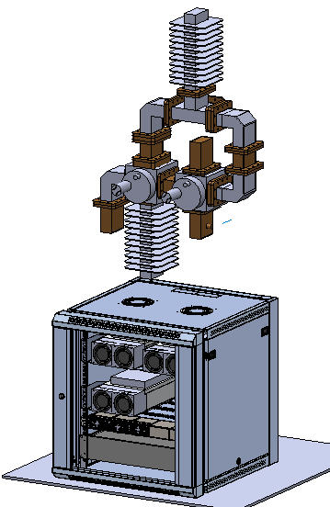
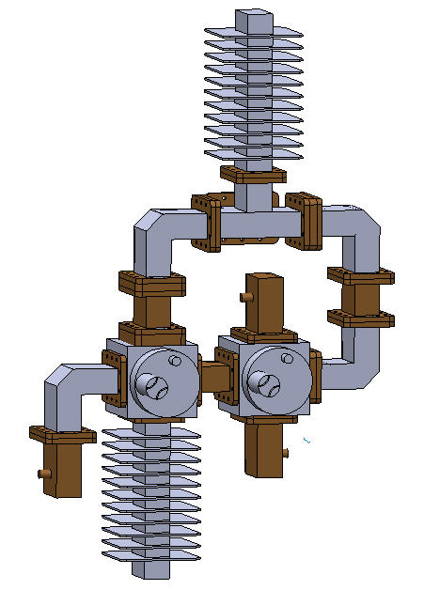
SSPA: 3D Model

Slide 24
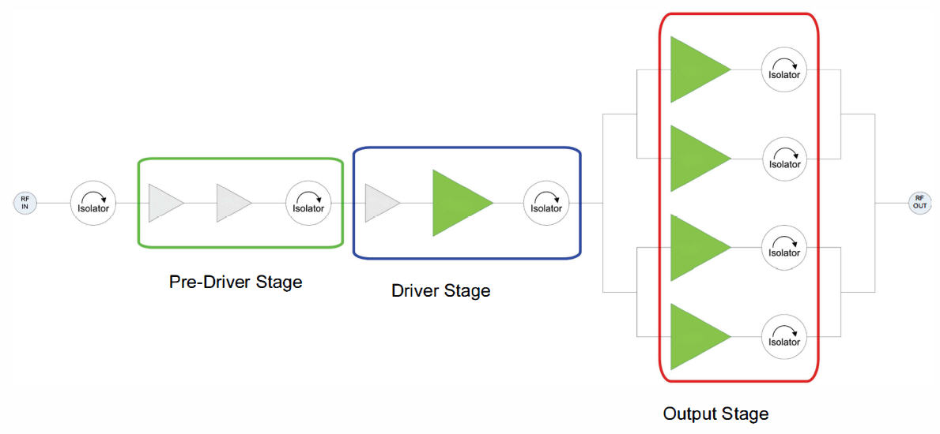
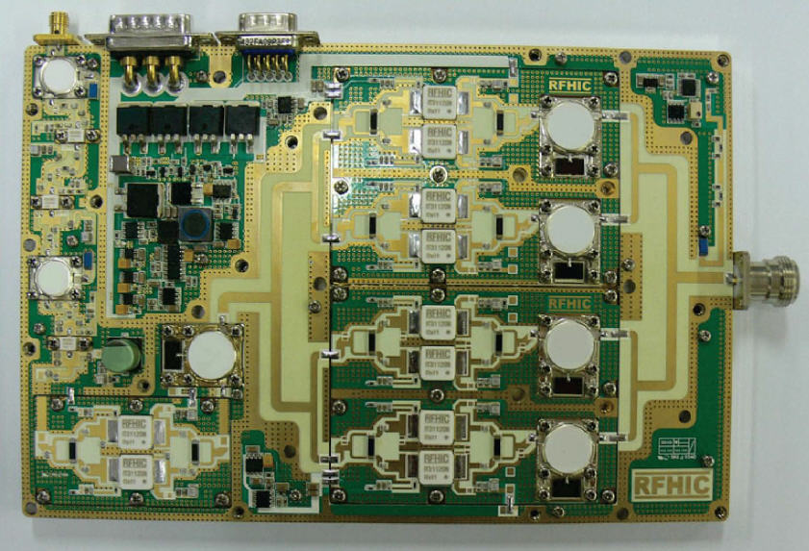
SSPA: 1 kW Module
SSPA MODULE
RRP27001K0-60 from RFHIC
1-kW pulsed amplifier derived from used for
S-Band RADAR applications
SSPA based on GaN HEMT technology:
High breakdown voltage and current density
High gain and efficiency
Wide bandwidth
Proper packaging of transistors:
Electrical and thermal performance
Block Diagram:
Driver stages
Power blocks
Wilkinson & T-Junction splitters/combiners
Isolators
Shielding between stages

Slide 25
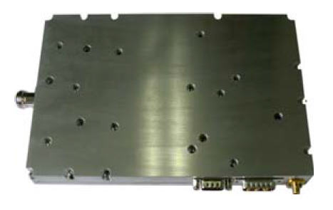
SSPA: 1 kW Module
Parameter | Value
fo | 2.7 GHz (BW: 10 MHz)
Output Power | >1100 W (peak)
Pulse Width | up to 1.5 msec
Duty Cycle | up to 10%
Pulse Droop | <0.5 dB
Gain | 60 dB
Size | 220 x 145 x 27 mm (1.3 kg) (excluded heatsink)
Monitors | Peak power, Temperature
Controls | Shutdown, RF Mute
Supply Voltage | 50 Vdc
Current Consumption | <7 A @ 10% DC
Output Stage: Class C
350W power consumption @ 1 kW(peak), 10% DC
200W power consumption @ 1 kW(peak), 5% DC
Eff = Po(avg)/Pdc is 30% @ 10% DC

Slide 26
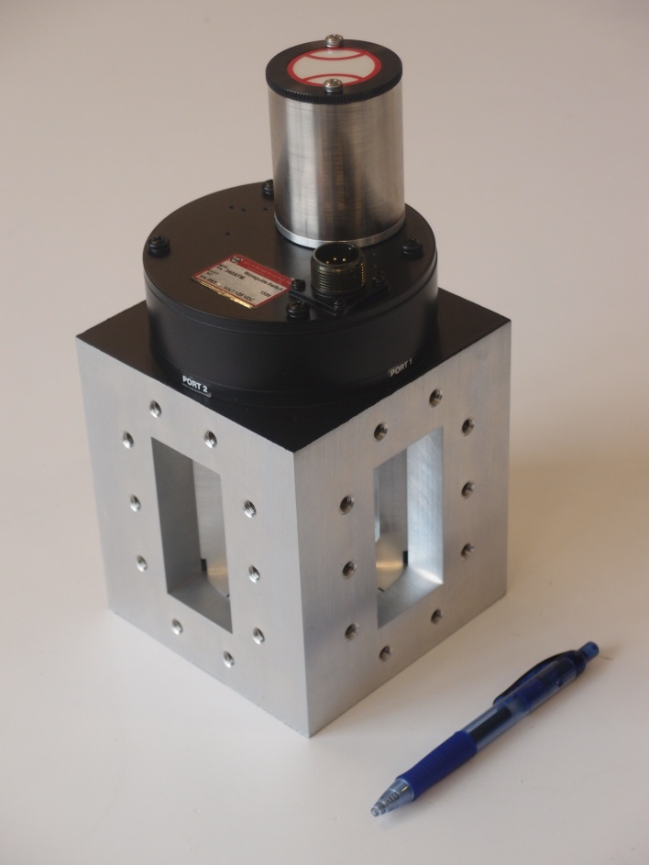
SSPA: Waveguide Switches and Sections
WR-340 Components from MCI Broadcast (μCI):
Semi-Flex Straight Sections, Miter Bends,...
Magic Tee: Low loss
Good collinear balance (amplitude and phase)
High E-H isolation
Sector Microwave 340AFM
Parameter | Value
Type | DPDT (1-2,3-4 or 1-4,2-3)
Frequency Range | 2.17 – 3.3 GHz
Insertion Loss | <0.02 dB
Isolation | >70 dB
Switching Time | <500 microsec
Lifetime | >100,000 cycles
26

Slide 27
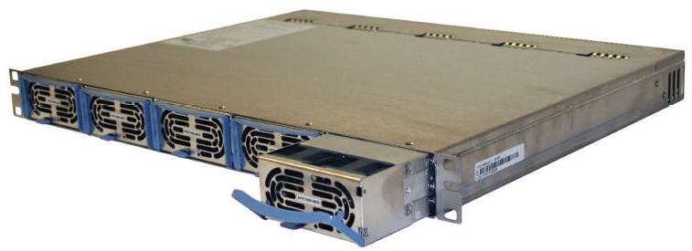
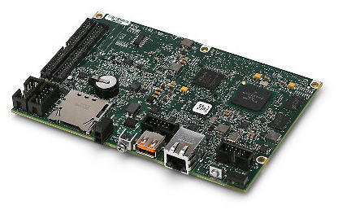
SSPA: Power Supplies and Control
TDK-LAMBDA HFE1600-48: 1600W 1U Front End Power Supplies
Parameter | Value
Input Voltage | 85 - 265 Vac, 47 - 63 Hz
Output Voltage | 48 Vdc nominal (38.4-58 Vdc) (Remote sensing)
Max. Current | Up to 33 Amp (1600W)
Parallel Operation | Up to 10 modules with current share, hot swappable
Remote Interface | PMBUS (I2C)
Alarms and Protections | ACFail, DC fail, Overtemp, Overcurrent, Overvoltage
Cooling | Two internal fans
Size (W x H x D) | PS: 85 x 41 x 300 mm, 1.5kg Rack: 19in x 1HU x 366 mm, 4.8kg
Weight | PS: 1.5 kg each, Rack: 4.8 kg
National Instruments sbRIO-9636 Single-Board Embedded Device
400 MHz processor, 256 MB DRAM, 512 MB storage
Xilinx Spartan-6 FPGA
16 analog inputs, 4 analog outputs (16-bit), 28 Digital I/O lines (3.3V)
Integrated Ethernet, RS232, RS485, USB, CAN, and SDHC ports
Size: 15.4 x 10.3 cm

Slide 28
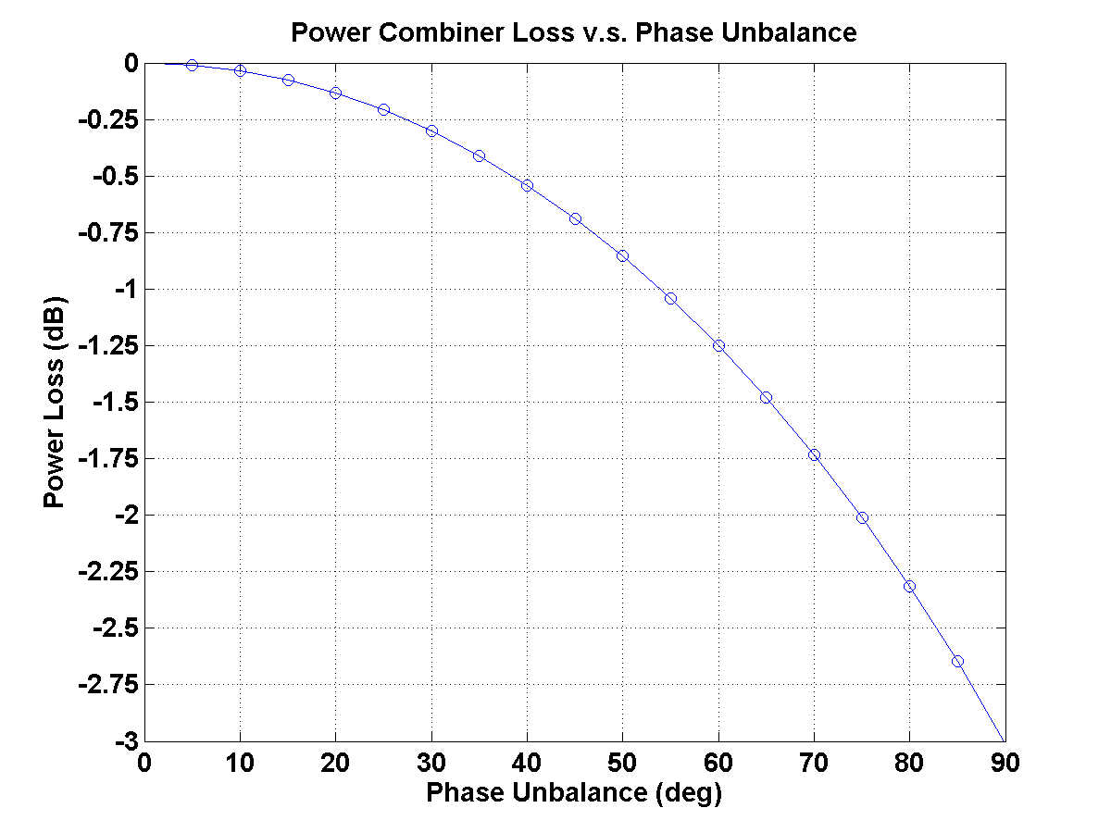
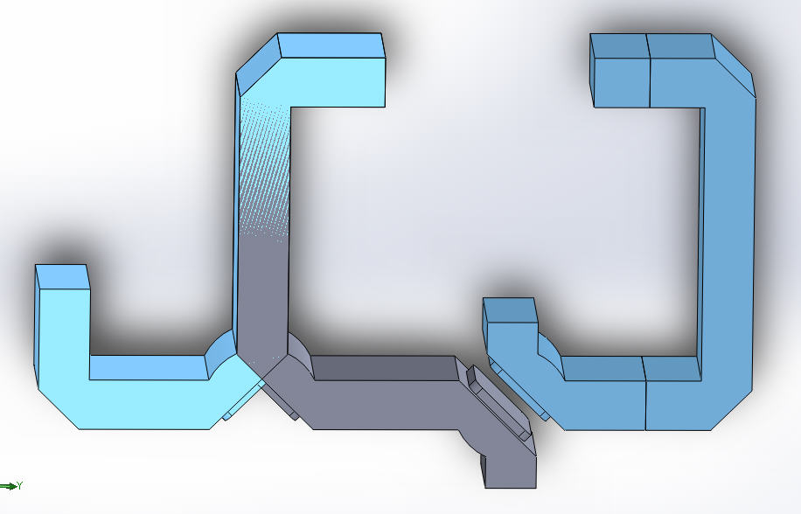
SSPA: Phase Matching
Any 2 out of 3 Amplifiers must be combined in phase
Phase unbalance affects combiner losses:
8º → loss increases by 0.02dB (≈ 10W @ 2kW)
17º → loss increase by 0.1dB (≈ 50W @ 2kW)
Careful design of:
Waveguide runs (straights, bends, switches,…)
Coaxial runs (combining and splitting networks)
WR-340 Waveguides @ 2.7 GHz
86.36 x 43.18 mm → λg = 145.1mm → 1mm ≈ 2.5º
WG bends (elbows, switches) → EM simulations
+ Measurements
Coaxial cables @ 2.7 GHz
PTFE (εr≈2.2) → 1mm ≈ 4.6º
PE foam (εr≈1.52) → 1mm ≈ 4.0º
Amplifiers exhibit different amplitude and phase responses
Proper compensation of amplitude and phase differences is required (e.g.: attenuators, phase trimmers/shifters)
28

Slide 29
Bibliography
Status of the Ion Sources at ESS-Bilbao, J. Feuchtwanger et al., IPAC’12, New Orleans (USA), 2012.
Automatic Tuner Unit Operation for the Microwave System of the ESS-Bilbao H+ Ion Source, L. Muguira et al., IPAC’12, New Orleans (USA), 2012.
Last results of the continuous-wave high-intensity light ion source at CEA Saclay, R. Gobin et al., Rev. Sci. Instrum. 69, 1998
Phase Combined Amplifiers as a Means of Achieving High Output Power and Redundancy (Whitepaper), Stephen D. Turner, Paradise Datacom.
Design for Reliability, D. Crow and A. Feinberg, CRC Press, 2000
Design for Accelerator Reliability, P. Pierini and D. Sertore, TESLA Meeting, 2003
1kW S-band Solid State Radar Amplifier, Ju-Young Kwack, Ki-Won Kim, Samuel Cho, IEEE 12th WAMICON, 2011.

Slide 30
Acknowledgements
Thank you very much for your attention!
Thanks also to ESS Bilbao ISHP Team:
* No longer at ESS-Bilbao
** University of the Basque Country
Ion Sources
Jorge Feuchtwanger*
Rosalba Miracoli
Slobodan Djekic
F. Javier Corres
Control
Iñigo Arredondo
Mikel Eguiraun
Daniel Piso*
María del Campo*
Diagnostics
Daniel Belver
Pablo Echevarria
Seadat Varnasseri
RF
Nagore Garmendia
Leire Muguira
Arash Kaftoosian
Tomaso Poggi
F. Javier Fernández
Jordi Verdú*
Electrical
Giles Harper
Xabier González
Jon Bilbao
Gorka Mugika
Accelerating Structures
Adolfo Vélez
Oscar González
EHU/UPV**
Víctor Echevarría
Joaquín Portilla
Josu Jugo

