Slide 1

The future of solid-state transistors
Jörgen Olsson
Uppsala University
Sweden

Slide 2
Outline
Development of RF-LDMOS
High-power transistor options
  VMOS
  LDMOS
  GaN
Development trend
Summary

Slide 3
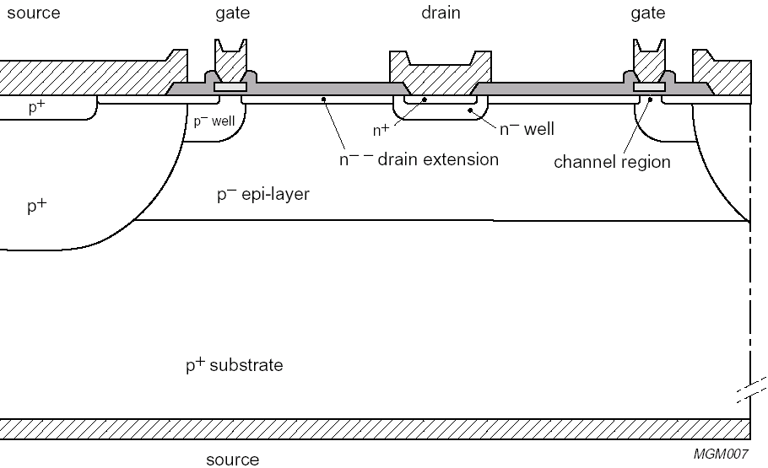
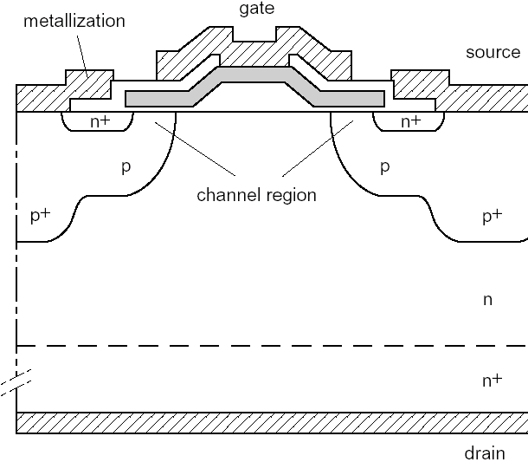
What is a DMOS?
Double-diffused MOS
LDMOS
  Lateral double-diffused MOS
  Short channels
VDMOS
  Vertical double-diffused MOS
  Mostly for high power

Slide 4
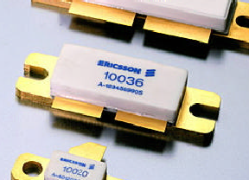
History of LDMOS
1969 – the first LDMOS was presented
1972 – the LDMOS as a microwave device was presented
Switching devices
  Power supplies
  Motor controls
  etc.....
From mid-90‘s – Base station applications
  NMT, GSM, 3G, LTE, 4G (900 MHz-3 GHz)
  NXP (Philips), Freescale (Motorola), Infineon (Ericsson)
Other applications, such as S-band radar etc.

Slide 5
RF-LDMOS 28V
Major development has been with focus on parameters important for mobile communications, such as gain, efficiency, linearity, increased operation frequency.
Other advantages: high reliability, low-cost package with ground on chip back-side (low inductance and resistance)

Slide 6
Infineon, 7th generation LDMOS
Faraday shield
drain
contact
gate
p⁺ sinker
LDD region
channel
source contact
Channel doping by lateral diffusion.
p⁺ sinker contacts source to backside for low inductance and
good rf grounding.
Lightly doped drain (LDD) region for high breakdown voltage
Faraday shield for low Cdg feedback capacitance, reduced hot-carrier
injection and optimized breakdown voltage

Slide 7
Infineon, 8th generation LDMOS
Silicided gate
Thin field plate
Source runner
Au metallization
Low stress ILD
60 um die thickness

Slide 8
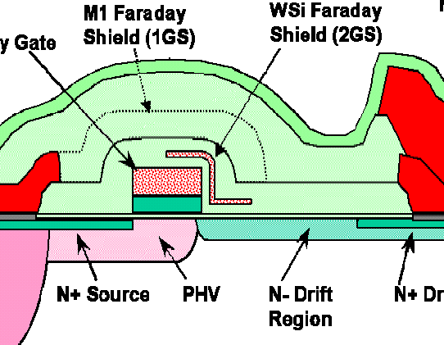
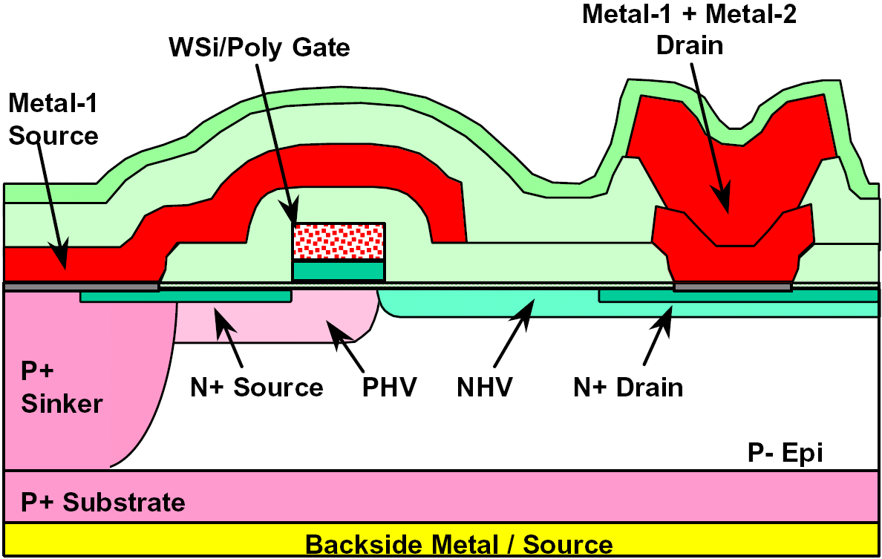
Cross-section of Freescale LDMOS
source: Motorola/Freescale

Slide 9
NXP LDMOS technology
0.4 um gate length
25 nm gate oxide
shield
Source
Gate
Drain
V_{supply}= 28-32 V
V_{bd} = 70 V
f_{t} = 12 GHz
N+
n- drain extension
N+
SN
P-sinker
P-well
P-type
P- substrate
P - substrate
Source Contact

Slide 10
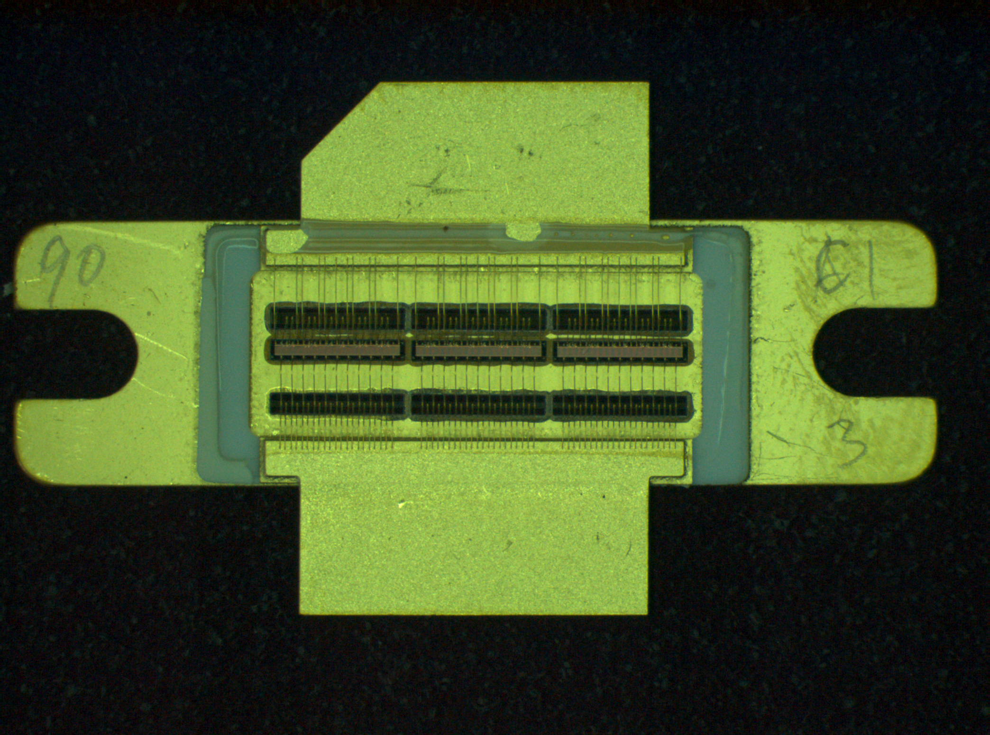
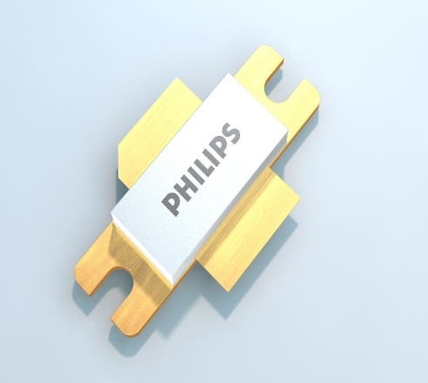
Example: 100 W transistor
Drain
Inshing MOS-
Capacitor
LDMOS-die
Prematch MOS-
capacitor
Gate
NXP
BLF6G38-50
Advantage: on-chip matching

Slide 11
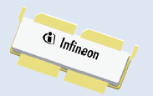
LDMOS for high power
LDMOS for 28-32 V are the most developed due to their use in cellular infrastructure.
Available up to around 400 W and <3GHz
Some limitations are the efficiency and the thermal management

Slide 12
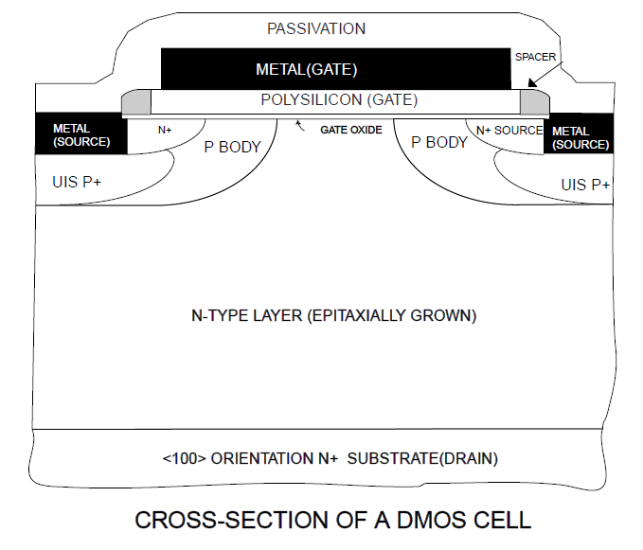
VDMOS – for high power
Available at high voltages but generally have lower performance than similar LDMOS.
Around 500 W
Disadvantage is that drain is on backside meaning more expansive package solution and worse thermal management.
Also higher feed-back capacitance.

Slide 13
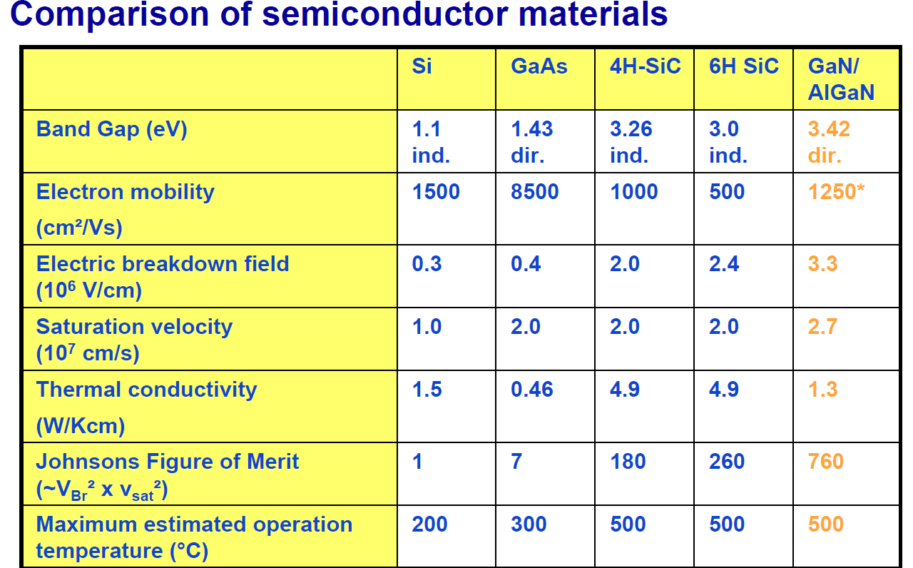
Alternative semiconductors

Slide 14
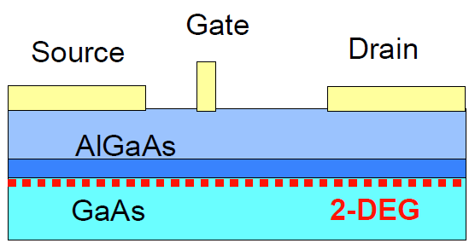
GaN RF power
Due to its better semiconductor properties GaN has the potential to drastically increase RF performance.
Higher supply voltages possible giving higher output power, which is perhaps the most important advantage
The HEMT (high electron mobility transistor) is most common and using a heterojunction structure with 2D electron gas as the current conducting channel

Slide 15
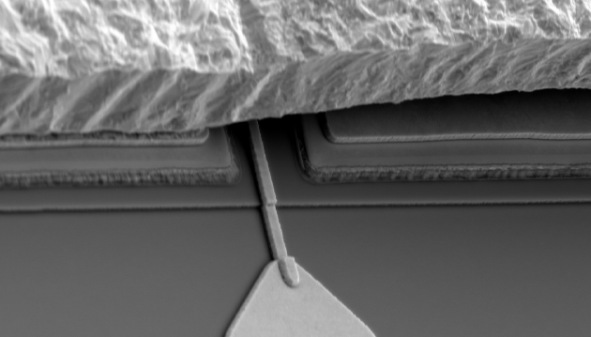
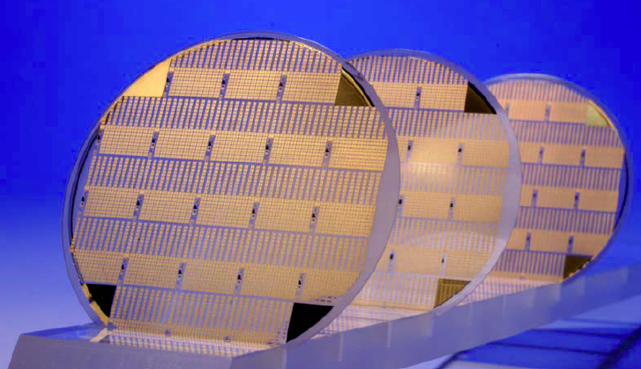
GaN technology
Hetero structure grown on different substrates:
  Si: lower cost, bigger wafers, but greater mismatch and thermal limitations
  SiC: higher cost, but otherwise better performance (SiC good thermal conductor)
GaN technology may require non-planar technology, such as air-bridges

Slide 16
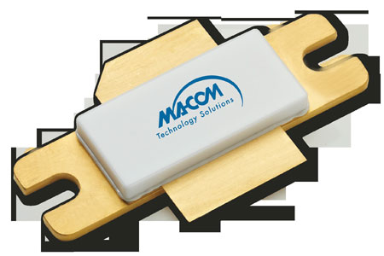
GaN performance
Impressive performance has been demonstrated
However, technology still not mature and fully reliable for cellular applications
Drift, charge effects and other phenomenon make the transistor not stable
GaN transistors for pulsed power up to around 500 W @ 50 V are available for frequencies up to 1.5 GHz, but efficiency not that great yet.

Slide 17
Development trends
The use of e.g. SMPA in cellular, motivated by higher efficiencies, has driven technology towards higher supply voltages
Present 28 V not easily scaled to higher voltages – new concepts may be needed
Major players, such as NXP, Freescale and Infineon now have 50 V LDMOS technology, mainly targeting applications outside the cellular infrastructure

Slide 18
50 V LDMOS performance
Typically, increased power density and lower output capacitance is obtained with 50 V compared to 28 V LDMOS technology.
Maximum operation frequency around 3 GHz
Maximum output power above 1kW at rather high efficiency, but at lower frequency < 1 GHz
Excellent ruggedness for large mismatch conditions and > 10⁵ years MTTF at T>200 C

Slide 19
Going for even higher voltages
Critical regions for high electrical field
channel
Switch LDMOS used for RF-LDMOS with small modifications
Lateral diffusion of p-base -> short channel 0.3 μm
Long poly-gate -> low gate resistance
Long drift region -> high breakdown voltage

Slide 20
Double RESURF LDMOS
channel
Buried p-top (formed with high energy implant) =>
  more effective drift region depletion (RESURF) =>
  higher drift region (n-well) doping =>
  lower resistance for almost preserved BV =>
  higher drive current

Slide 21
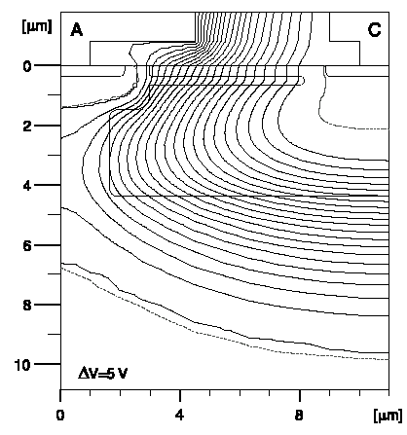
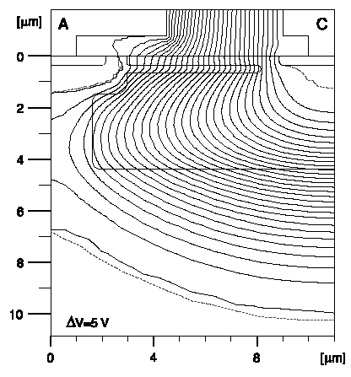
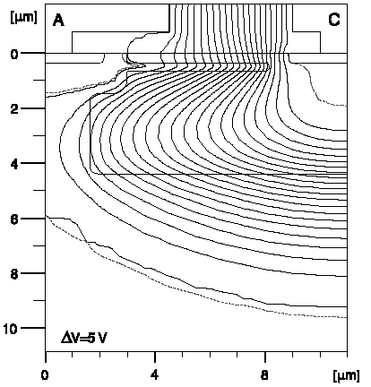
Double RESURF
Buried p-top assists in depleting the n-well. Very sensitive to the p-top dose. However, about 30 % lower on-resistance is possible for the same BV
Low dose
Optimum dose
High dose

Slide 22
Enhanced dual conduction layer LDMOS
channel
N-top at surface =>
  Even higher current for preserved BV
  Also changes the field profile at the gate
  (which affects reliability, f_{T} roll-off etc.)

Slide 23
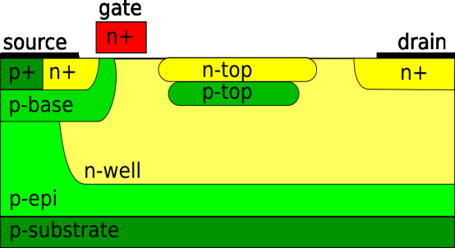
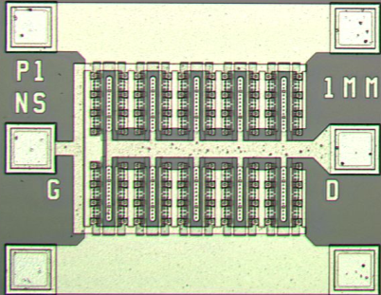
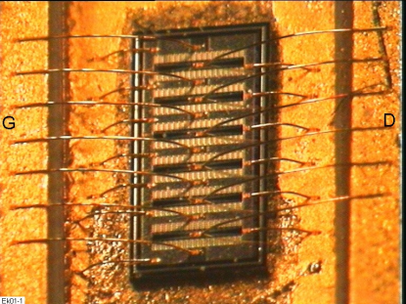

Excellent results
Device design:
Expertise in device physics
and TCAD
Device fabrication:
Test structures at MSL
RF-power devices at foundry
Evaluation:
Full electrical characterization
Industrial evaluation
Developed, UU in collaboration with Comheat Microwave AB, a novel LDMOS transistor with high on-current (170 mA/mm) and high breakdown voltage (>150 V).
World-record RF performance:
2W/mm at 1 GHz, 70 V
>1W/mm at 3.2 GHz, 50 V

Slide 24
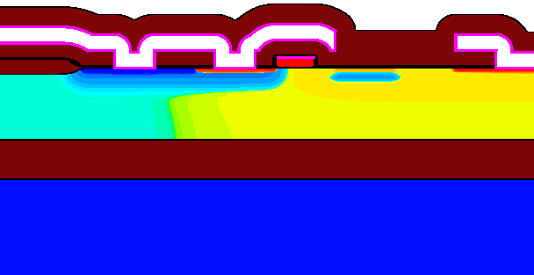
High performance RF-LDMOS
- next generation
Next generation LDMOS targeted for high efficiency SMPA and pulsed radar
For SMPA:
  f ∝ 1/(C_{out} x R_{ON})
  P ∝ V_{DD}²
SOI results in lower C_{out} and lower R_{ON} - 16x improvement possible!
Current development is targeted at implementation on SOI and hybrid substrates, with extremely high performance predicted; I_{ON}>600 mA/mm (>500 mA/mm already demonstrated) and low output capacitance, making SMPA applications above 3 GHz possible. Also suitable for applications in harsh environments (high-T, rad hard etc.)
S
G
D
SOI
Silicon-on-Insultator
substrate
BOX

Slide 25
LDMOS on SiC hybrid substrate
S
G
D
BOX
SiC
LDMOS on Si/SiC hybrid substrate results in further improvements
S.I. substrate eliminates Csub
Bond pad/wire cap eliminated
Better thermal handling
SMPA at even higher frequency possible or
Higher output power level

Slide 26
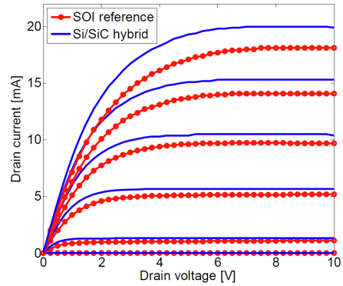
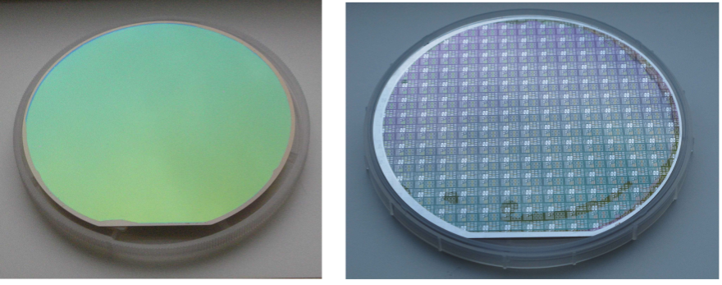
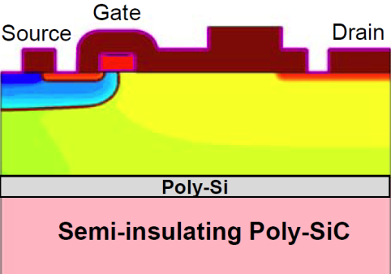
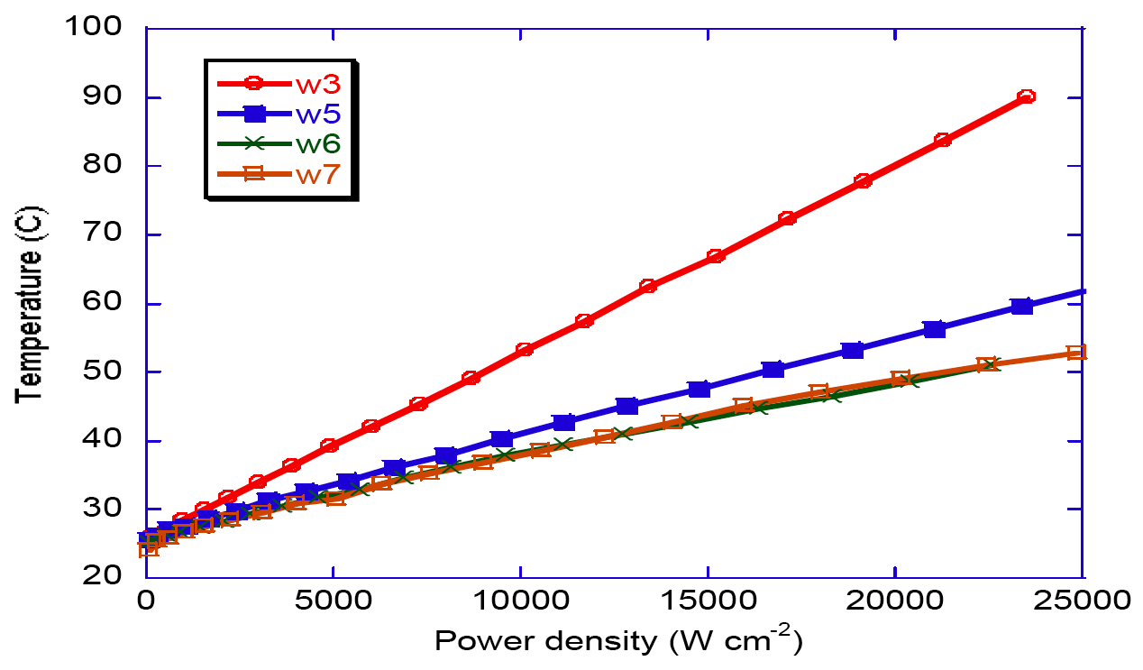
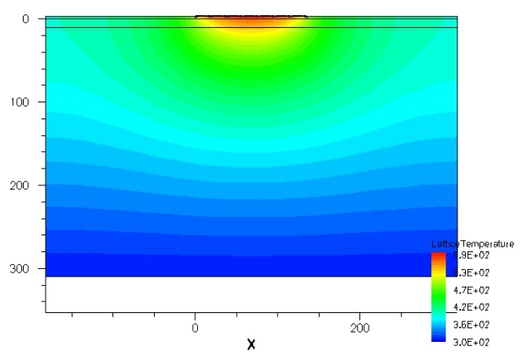

Si/SiC hybrid substrates
- proof of concept
Defect free 150 mm hybrid substrates manufactured as well as electrical and thermal devices and compared to SOI reference
First ever LDMOS demonstrated on Si/SiC. Ideal transistor behavior with better than or equivalent performance as SOI. No difference in GOI or bulk and inversion mobility. Superior RF performance. Currently in foundry manufacturing (Comheat, VTT)
Si–poly-Si–poly-SiC
SOI
SiC
SiC/10um diamond
Si–(poly-Si)–SiC
Hybrid substrate has 2-3x higher heat conductivity than SOI. c-SiC slightly better than poly-SiC
Simulation show further improvent possible by integrating heat-spreading diamond layer

Slide 27
Summary
Present commercial 50 V LDMOS technologies provide output power > 1 kW
GaN is in fast development and already > 500 W is available. Maturity and thermal management are issues to address
Silicon (and GaN) can be developed to higher voltage, i.e. power levels
Substrate engineering (SOI and Si/SiC) may be necessary for thermal management and high efficiencies (reduced parasitics)

Slide 28





Acknowledgments
Some material shown with courtesy of:

