Slide 1
Knowledge
Transfer
@CERN
Giovanni Anelli
Knowledge Transfer Group

Slide 2
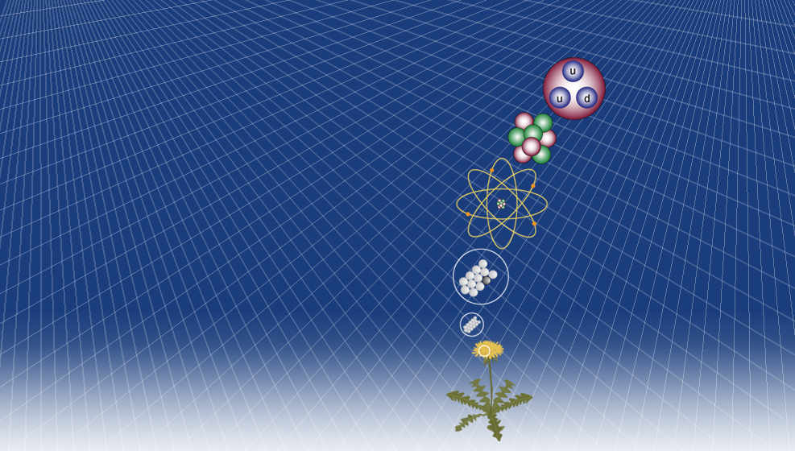
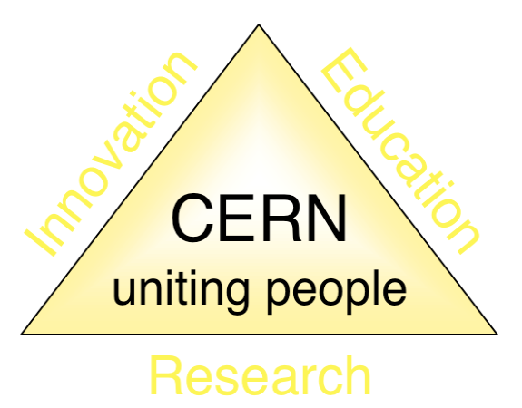
KT: one of CERN’s missions
CERN Mission
Quarks
Proton
Push back the frontiers of knowledge in nuclear research
Develop new technologies for accelerators and detectors
Train scientists and engineers of tomorrow
Unite people from different countries and cultures
Electron
Nucleus
Atom
Knowledge Transfer
Molecule
Matter

Slide 3
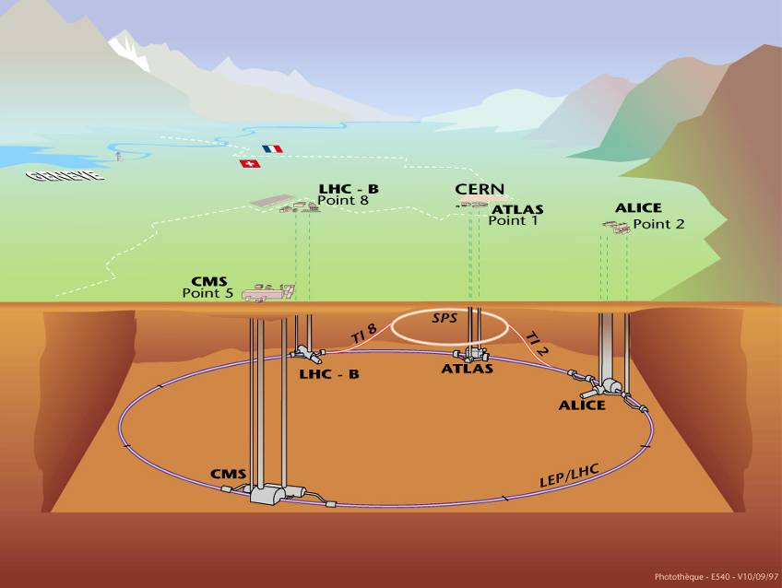
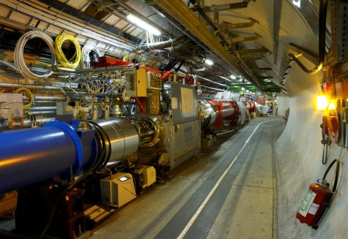
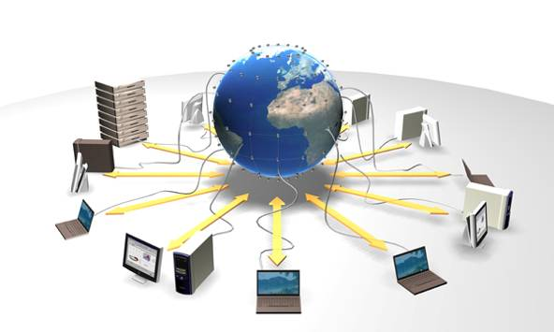


CERN’s areas of excellence
Accelerating
particle beams
Detecting
particles
IT technologies

Slide 4
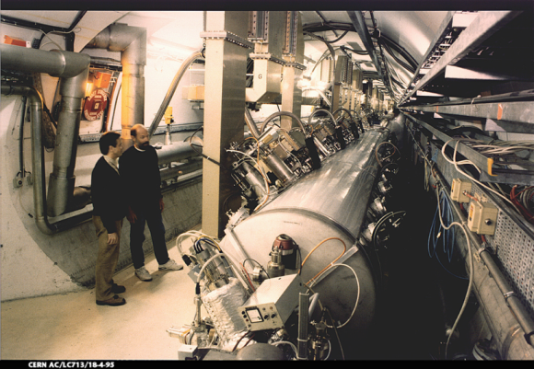
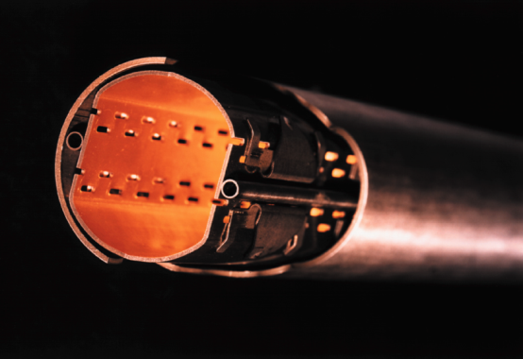

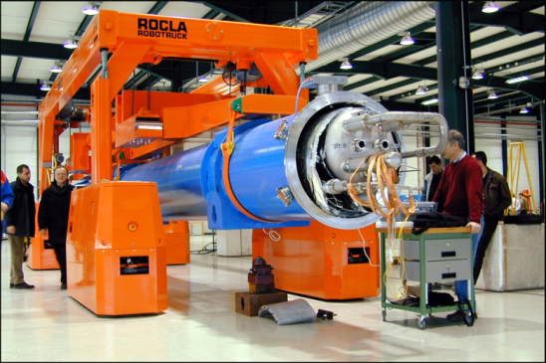
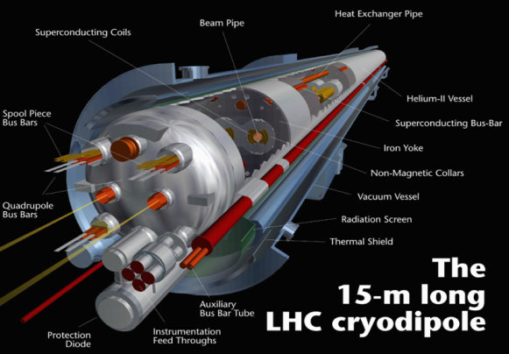
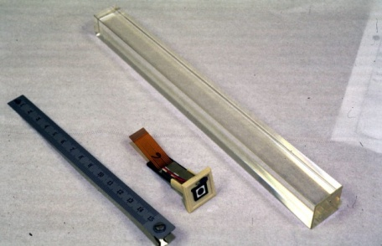
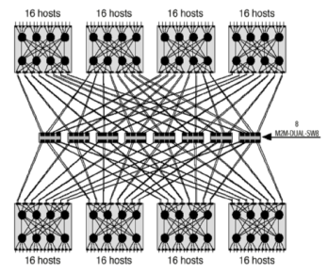
CERN Core Competences
Super-conductivity
(13kA, 7MJoules)
Vacuum
(10⁻¹² Torr)
Cryogenics (1.9 K)
Very high performance
detectors and electronics
Magnets
(10 T)
Data processing

Slide 5
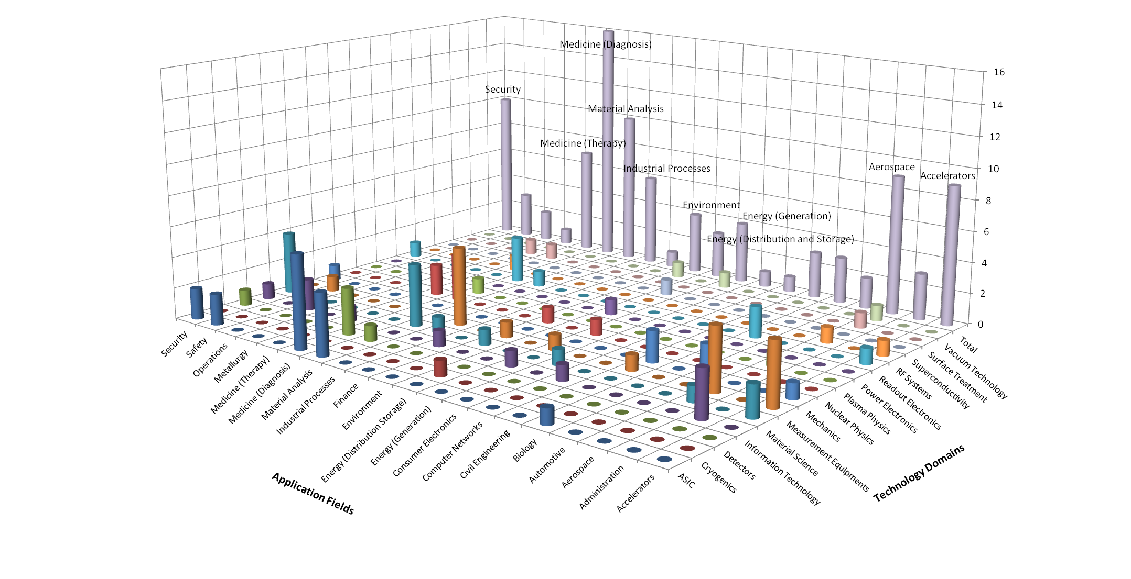
CERN’s Technology Portfolio

Slide 6
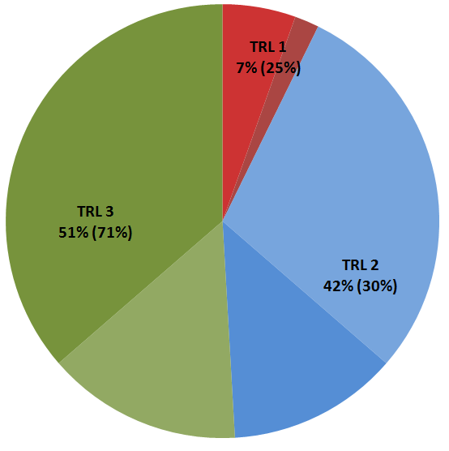
Technology Portfolio - statistics
Technology Portfolio - General Statistics
~200 TT cases (40% open, 20% protected by patent)
  ~40 new disclosures per year
  Exploitation level: ~50%
TRL | Simplified Definition
1 | Technology application formulated and basic concept demonstrated
2 | Functional validation in laboratory environment
3 | Representative prototype fully qualified (technology ready to transfer)

Slide 7
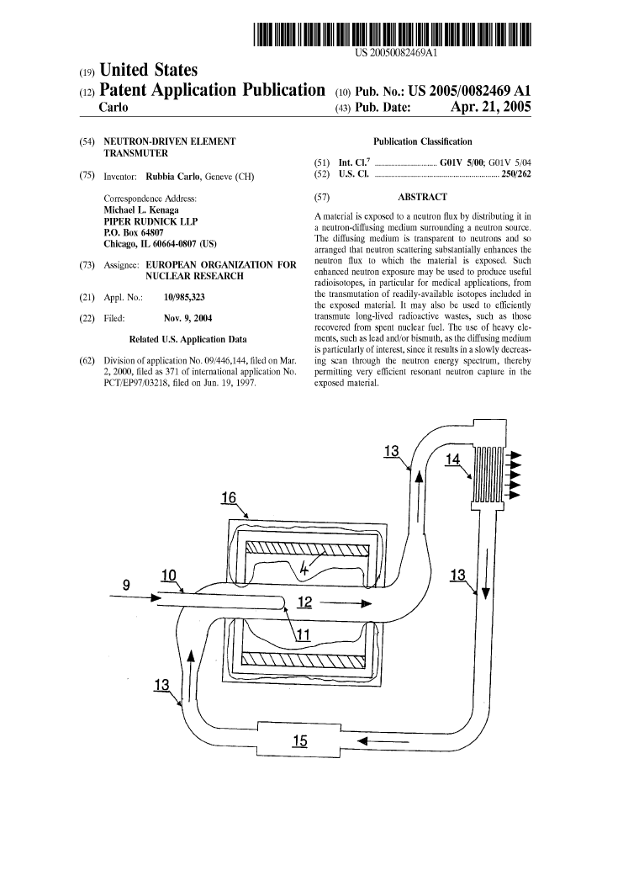
CERN and Patents
Strategic motivation:
  “Promote and enhance the image of the Organization as a source of innovation and economic activities”

Slide 8
CERN and Patents
Patents are taken in order to:
Increase the probability of having the technology transferred (justify development investments from industry)
Significantly enhance the commercial value of the technology
Ensure CERN’s recognition as the originator of an exceptional invention

Slide 9
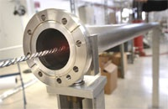
From high vacuum…
NEG (Non-Evaporable Getter thin film coatings)
Technology used to create and maintain ultra-high vacuum in the accelerator vacuum chambers.

Slide 10
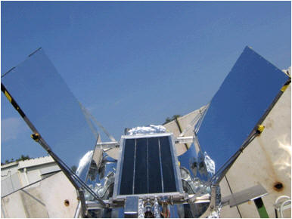
… to solar energy!
License and partnership with a start-up company
Development of a commercial product able to use diffused or indirect light and reach very high temperatures of up to 300 degrees
Development of a prototype production chain

Slide 11
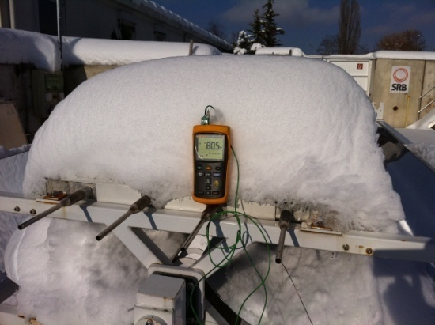
Vacuum is an excellent insulator!

Slide 12
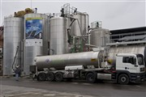
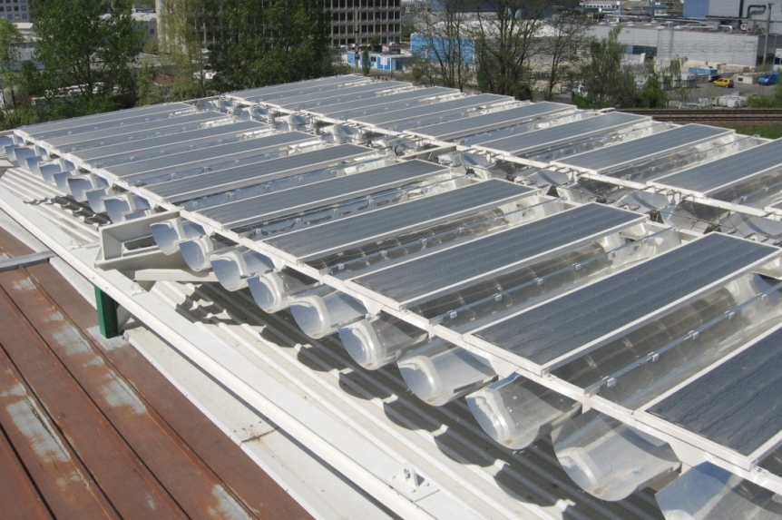
Solar panels plant
Civil-engineering company opened a new solar power plant
Environmentally friendly "solar field" heats close to 80,000 cubic metres of bitumen to 180 degrees.

Slide 13
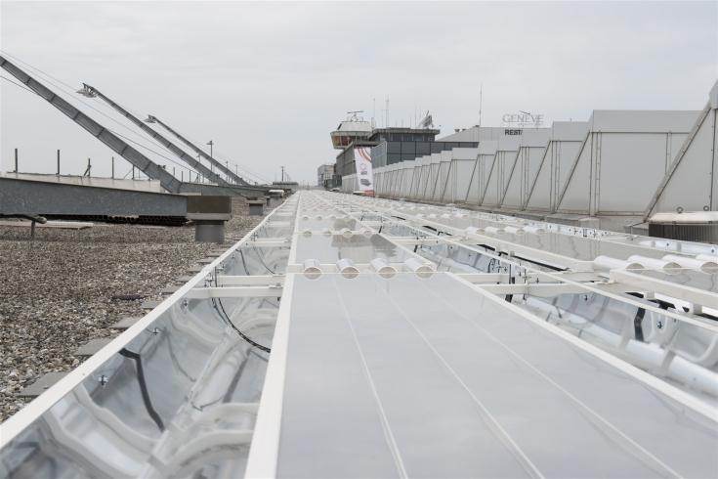
Installation at GVA airport

Slide 14
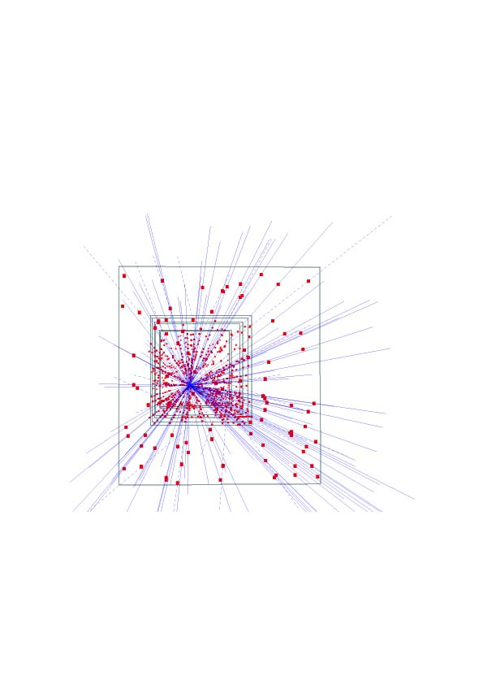
Silicon pixel detectors (SPDs)
Hybrid silicon pixel detectors for tracking applications in High Energy Physics
153 high energy particle tracks flying through a telescope of half a million pixels in the WA97 experiment back in 1995

Slide 15
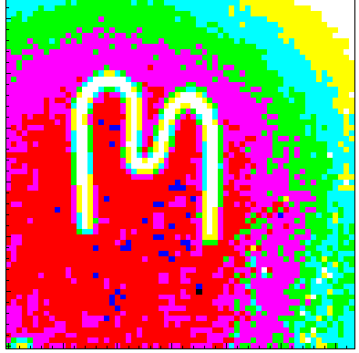
Medipix
A family of single photon counting integrated circuits used in Hybrid Silicon Pixel Detectors
The Medipix collaborations (close to 20 institutes) contributed to the development and dissemination of the technology
A good example of how (fundamental) science fosters innovation which can be transferred to society… and back!

Slide 16
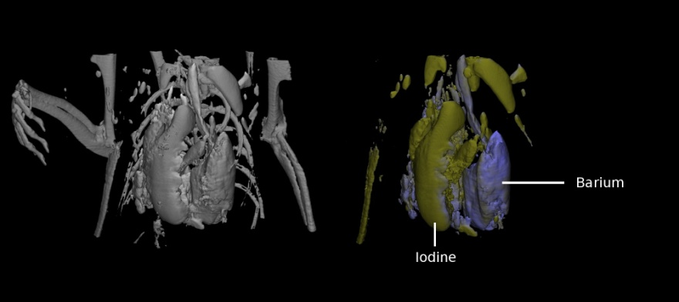
Application: Medical imaging
MARS project
  Colour CT X-ray scanner based on the Medipix technology
(courtesy of MARS Bioimaging Ltd)

Slide 17
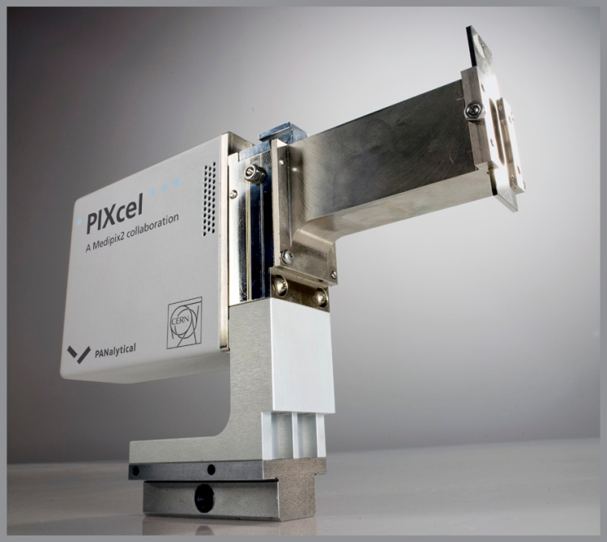
Application: Material analysis
Partnership and license agreements with a company to build a X-ray diffractometer

Slide 18
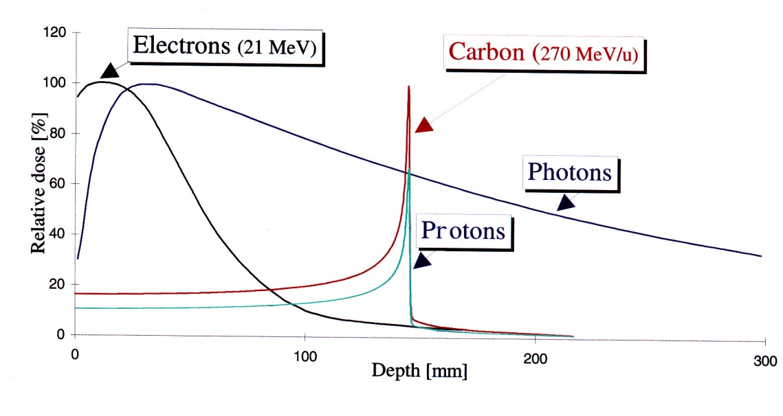
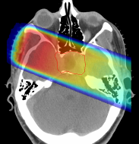
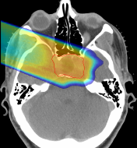

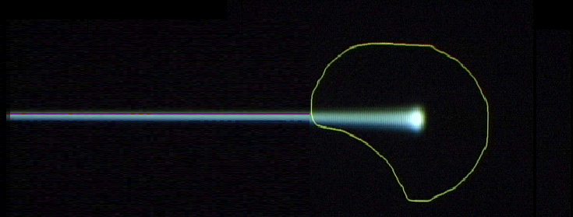
Hadrontherapy
Hadron beams:
new treatment opportunities for deep-seated tumours
tumour
target
charged hadron beam
that loses energy in matter
X rays
protons or
carbon ions
Photons
Protons
C ions: 24 times more energy than protons
GSI

Slide 19
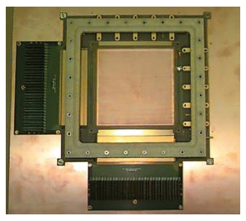
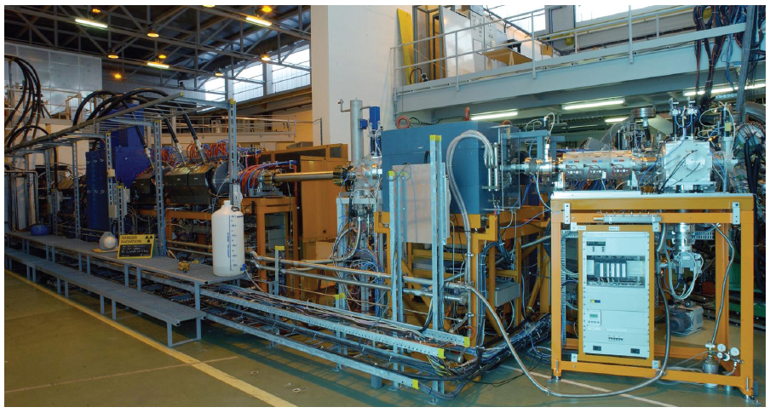
KT Fund: To develop technologies to market matureness
The KT Fund is a financial instrument which helps bridging the gap between CERN and society
The requests are evaluated by a Committee composed by all the Department Heads and members of the KT Group
The 12 projects submitted in 2011 and 2012 were all judged excellent by the committee and financed

Slide 20
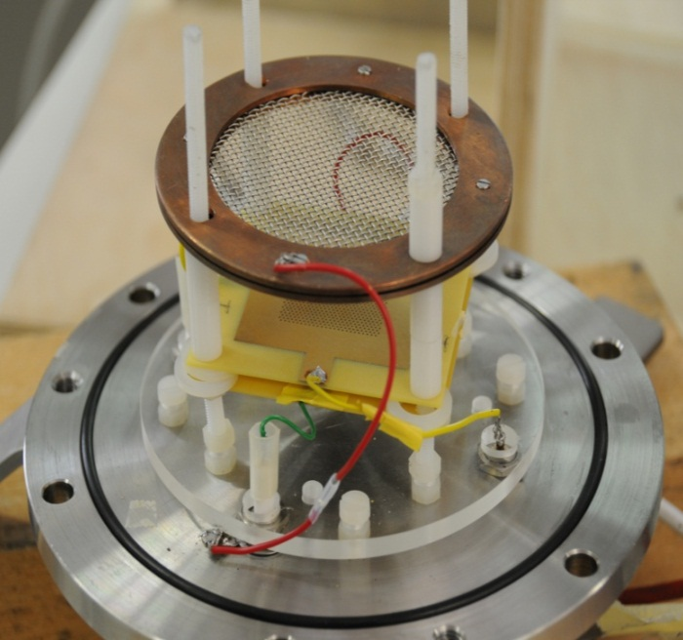
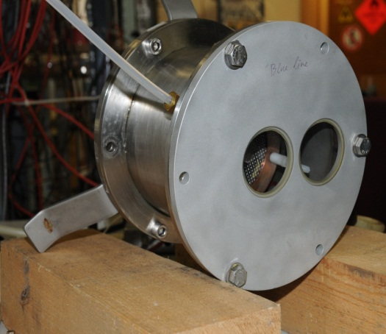
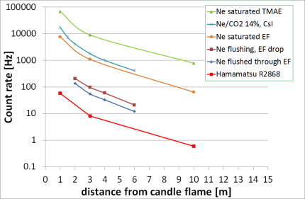
KT Fund 2011 project:
Flame/smoke detector and Rn detector
Two demonstrators have been built and tested
Comparison with best commercial devices shows at least a factor 10 improvement
A number of companies interested in the technologies, two patents are filed

Slide 21
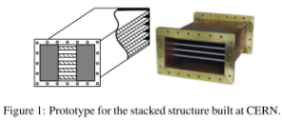
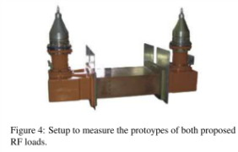
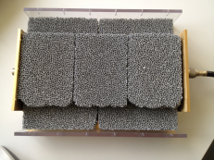
High power & temperature RF load
A two year KT fund project led by S. Federmann, F. Caspers and M. Betz
Goal: Convert otherwise wasted RF power from particle accelerators to a technically useful form of heat; water at 150 °C and 70 Bar or air at > 600 °C
  For water, a stacked waveguide geometry, inside coated with a thin layer of ferrite
  For air, porous silicon carbide blocks in a waveguide act as a heat exchanger
Low power prototype of the 2 loads constructed, narrowband material measurements of ferrite on a rubber carrier and SiC foam in a waveguide at 400 MHz carried out
  Presented at “CW and High Average Power RF Workshop” in Lund, Sweden and at “IPAC 2012” in New Orleans, search for potential customers
Broadband material measurements in a coaxial structure done recently (0.1–2 GHz)
Collaboration with RWTH Aachen (ferrite powder plasma coating process), Institute of modern physics, China, (adapt commercial Crisp plates to waveguides), CEA Saclay (use their high power RF test stand)
Project originally on dielectric-free load alleviating outlet temperature/pressure limits
  During project, described alternatives emerged, consecutive patent application filed
For integration of concepts in one application, and to gain more time to assess which ideas offer best valorization opportunities, a PCT (worldwide) was filed (C31781PCT)
Seeing the potential to recover energy, the concept has been added to the WIPO green list, aiding dissemination.
Broadband microwave measurement of SiC foam

Slide 22
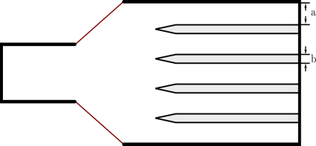
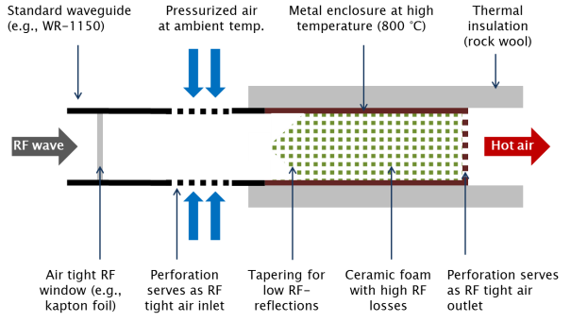
Cross section of a water cooled structure
Taper to gain height
And to compensate thermal expansion
WR1150 waveguide
Iris for resonant
operation
Metal sheets with water cooling pipes
Cross section of an air cooled structure

Slide 23
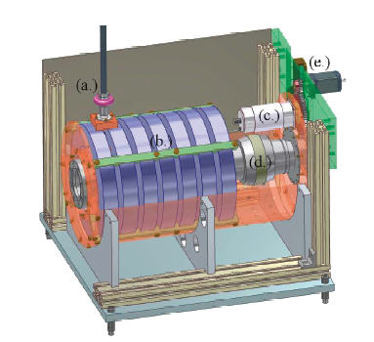
Other ideas from the CERN RF group:
Tuning of Cavitys with Ferrites
(via Magnetic Biasing)
Drawing of a ferrite-loaded coaxial line cavity

Slide 24
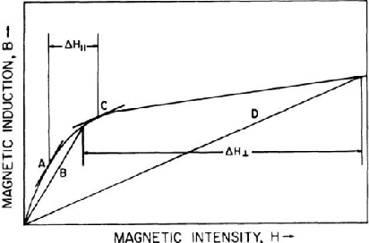
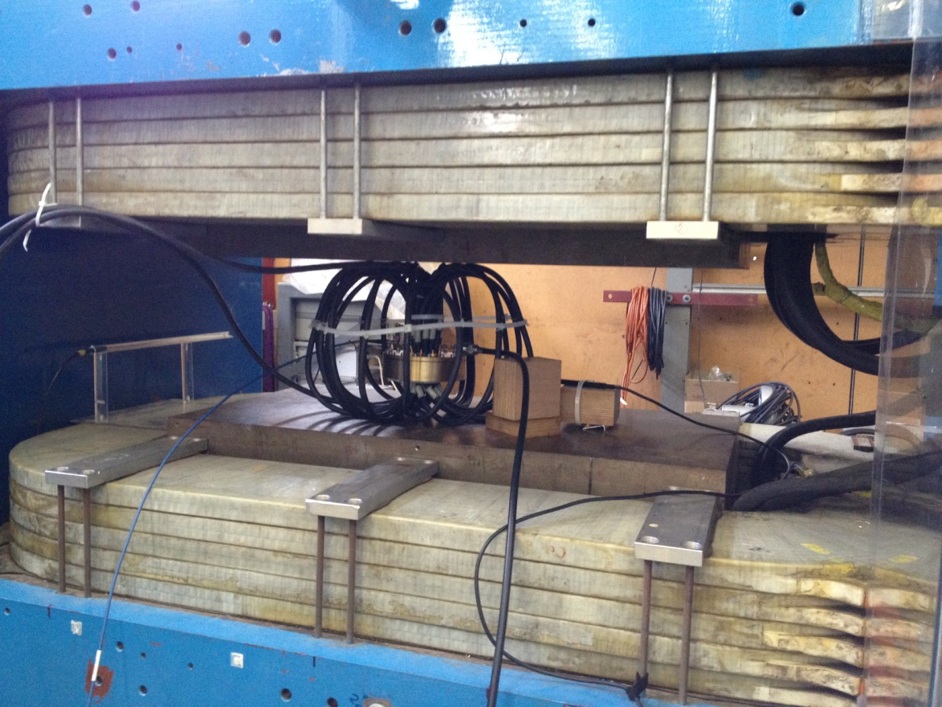
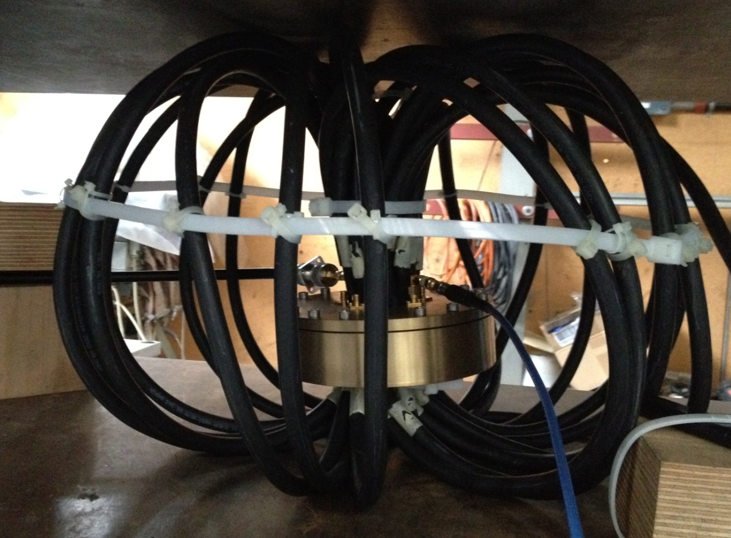
Idea of Smythe (1983)
Perp. bias
Par. bias

Slide 25
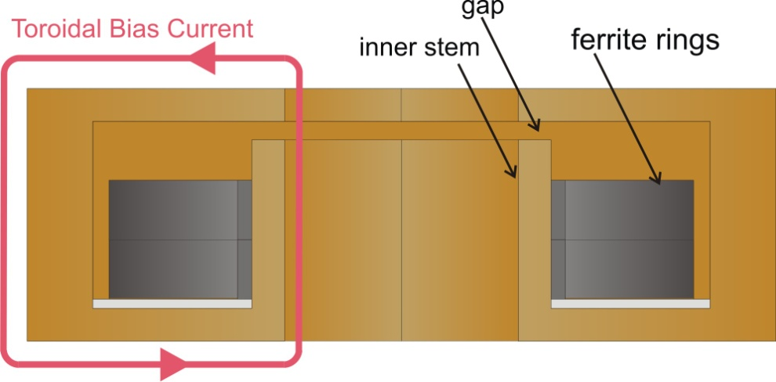
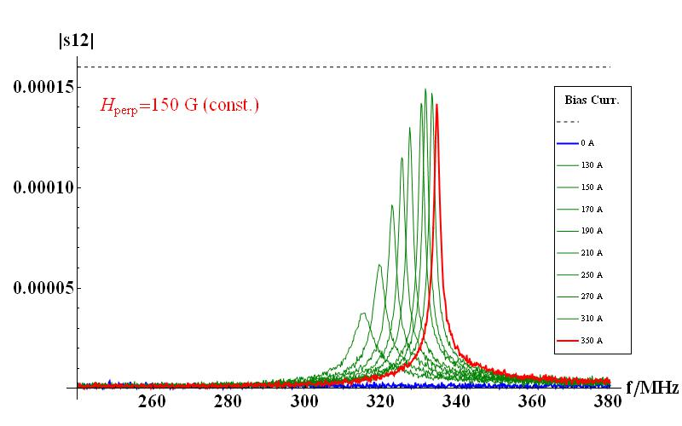
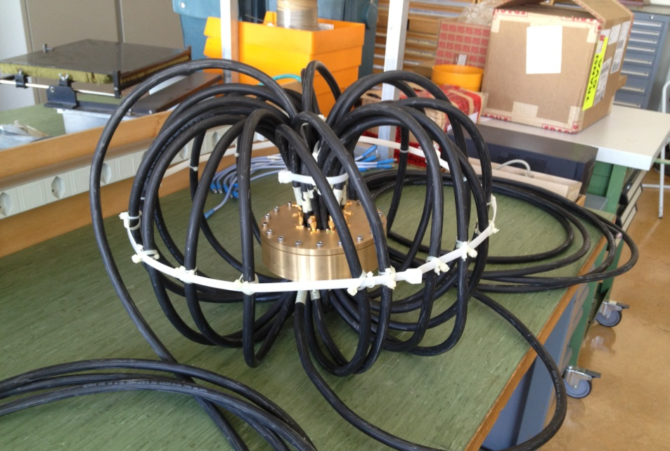
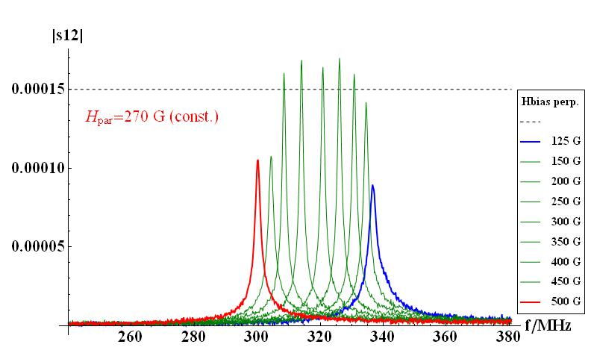
Cavity Tuning with 2-directional Magnetic Bias – Successfully Tested.
tuning range
tuning range
Cavity with ferrite rings and external toroidal coil
Next step: Build a prototype cavity
Depending on the bias orientation, the tuning range enlarges significantly.

Slide 26
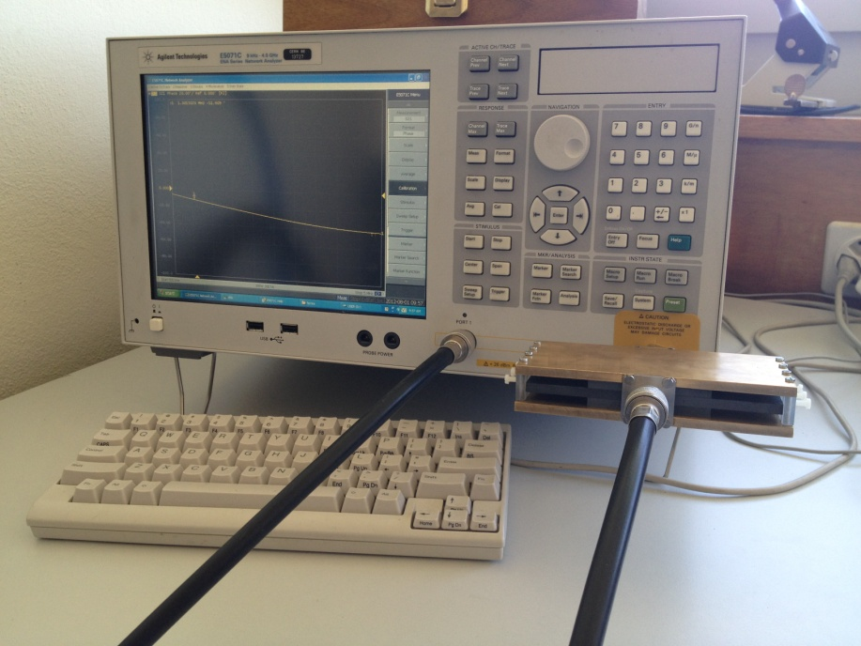
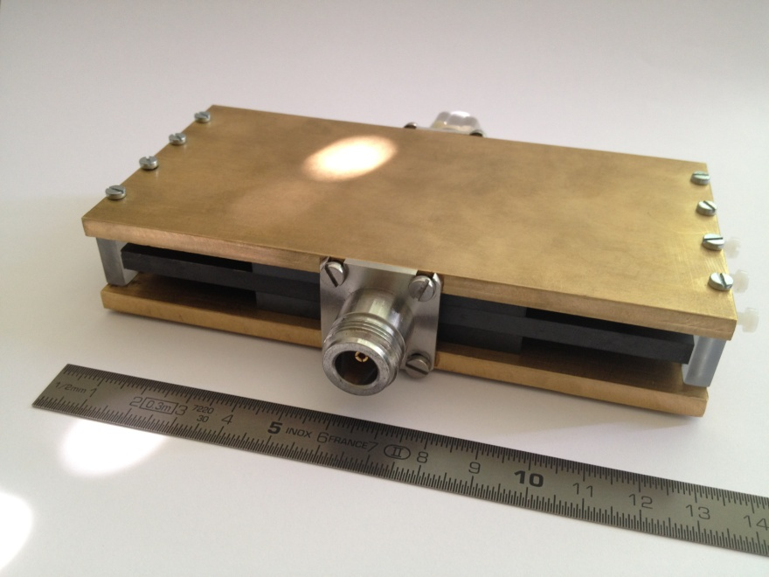
Material Measurement – New Method
This ferrite is readily available in tiles of 6 cm x 6 cm and 5 mm
thickness;
Material samples are “wrapped” around an inner conductor;
this allows a non-destructive measurement,
without any machining of the ferrite.

Slide 27
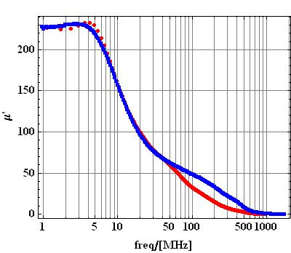
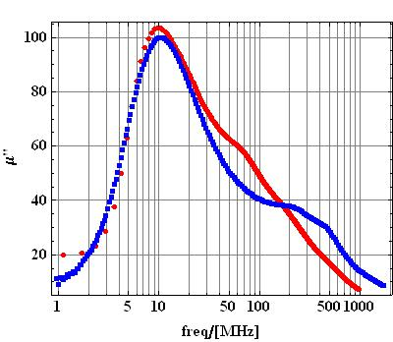
Material Measurement of TT2-111R /Permeability
Red= Measurement in SH-sample holder;
Blue= Measurement provided by TT.

Slide 28
Other ways of dissemination
The Technology Transfer process:
invention disclosure → IP protection → license to a company
is difficult, especially for the world of particle physics. Collaborative R&D (with industry and other research institutes) is key for a successful transfer.
Other ways of dissemination are also very important for the Organization

Slide 29






Langton Ultimate Cosmic ray Intensity Detector uses 5 Timepix chips to monitor the radiation environment in Space
CERN@school allows students to use a Timepix chip in the lab to visualise radiation
Data from LUCID and CERN@school detectors will be uploaded to the Grid and made available for students to analyse

Slide 30


CERN Easy Access IP
Notes:
This is a screenshot of our website.
We have implemented the scheme pioneered by the University of Glasgow. We are ready to give a free license (for some of our technologies) to companies who will demonstrate that they can turn it into a product.

Slide 31

KT implementation ways
Market Pull
Transfer to Existing Companies
Technology Push
Creation of New Companies
Spin-Off Support

Slide 32



CERN Business Ideas Accelerator
CERN
Pre-Incubator
CERN STFC BIC (UK)
NATIONAL BIC
NATIONAL BIC
NATIONAL BIC
NATIONAL BIC

Slide 33

Turning CERN technologies into new business opportunities

Slide 34
Incubators in the MS
The STFC CERN BIC is a pilot scheme which we plan to replicate in other Member States
Integration into existing structures is crucial
To “fill” these incubators, we are working on a “pre-incubator” concept: CERN technologies + (external) fundings + (external) entrepreneurs → new companies generation

Slide 35
Knowledge Transfer through Procurement
Results from a survey of companies involved in technology-intensive
procurement contracts with CERN.
178 questionnaires analyzed, related to 503 MCHF procurement
budget.
Results:
44% indicated technological learning
42% increased their international exposure
38% developed new products
36% indicated market learning
13% started new R&D teams
52% would have had poorer sales performance without CERN
41% would have had poorer technological performance

Slide 36


Knowledge Transfer through People
Every year, hundreds of students come to CERN to contribute to our research programs
An opportunity for young people to learn in a multicultural environment
Not only for physicists! Also engineers, computer scientists, administrative students…

Slide 37
More info / Contacts
www.cern.ch/knowledgetransfer
giovanni.anelli@cern.ch
mail-KT@cern.ch

