Slide 1
High Temperature High Power RF Loads
TIARA workshop
17. – 19. 06. 2013
M. Betz, F. Caspers,
S. Federmann

Slide 2
Overview
Introduction
Two conceptional models of high temperature high power loads
Material studies: Coating materials
Conclusions

Slide 3
Motivation
High power RF loads (but at low/moderate temperature) are commonly used in particle accelerators:
Travelling wave accelerating cavity
Standing wave accelerating cavity

Slide 4
The problem Power dissipation in termination loads
Example: the CERN SPS
Water-cooled termination loads in the tunnel
Average power dissipation in R_{L}: 4 x 190.5 kW
Heat is not utilized and dissipated to the environment by heat exchangers on the surface
Annual:
6.7 million kWh
~ 450 000 €
Distribution of the average (24 h)
Power dissipation per
Cavity (there are 4):
325 kW
Peak
Σ = 254 kW
TL … transmission line
Rcu … copper losses
Beam … beam losses
RL … power in the termination loads
We assume: 0.067 € / kWh.
Which is the average energy cost for France in Nov. 2009
Source: http://www.energy.eu/#industrial

Slide 5
First Idea
Recover energy directly before it is dissipated in the load
Problem: Extraction out of the transmission line has to be done somehow
The extracted RF energy has to be fed back into the grid
This problems were subject of the Master thesis of M. Betz

Slide 6
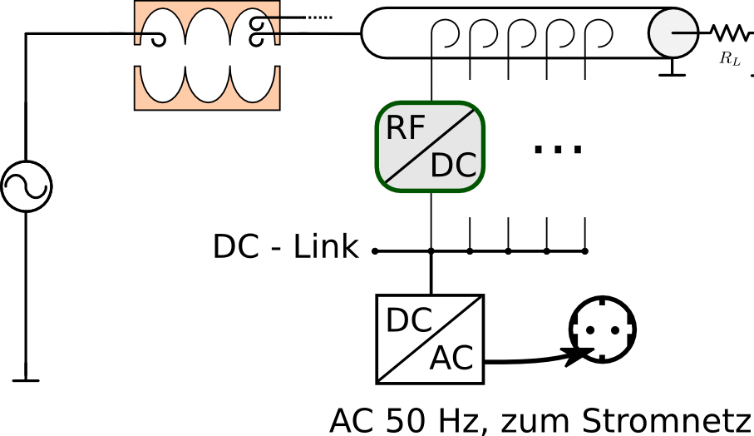
Direct Energy Recovery concept Possible layout for the SPS
RF - Power splitter: 325 kW (peak) → 300 x 1 kW
300 x RF/DC modules
DC – Link: DC power of individual module outputs is combined
DC to AC (50 Hz): e.g., with commercial photopholtaik power converters
DC – power combination
(similar to solar cell arrays)
AC 50 Hz, fed to electric supply network

Slide 7
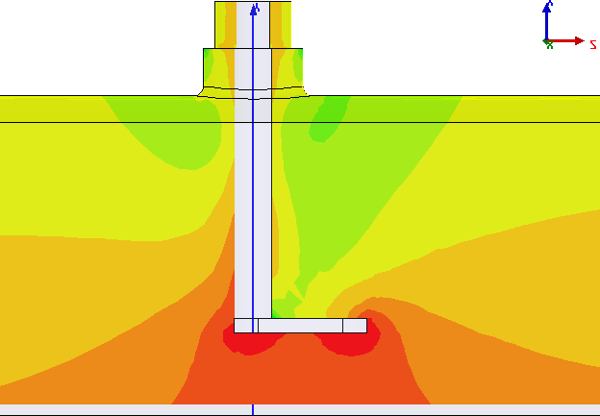
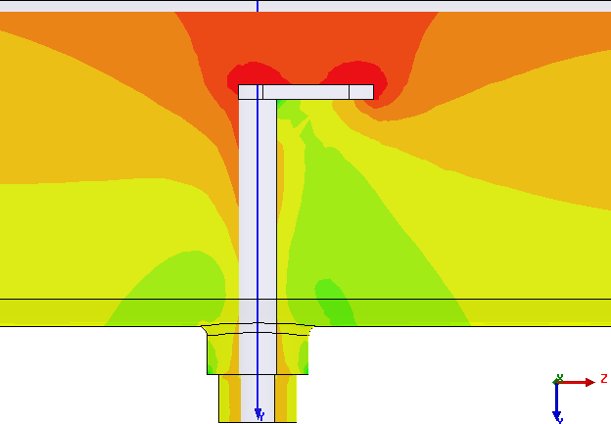
Direct Energy Recovery concept Possible layout for the SPS
Coaxial power splitter
DC – power combination
(similar to solar cell arrays)
Inner conductor
AC 50 Hz, fed to electric supply network
RF - Power splitter: 325 kW (peak) → 300 x 1 kW
300 x RF/DC Modules
DC – Link: DC power of individual module outputs is combined
DC to AC (50 Hz): e.g., with commercial photopholtaik power converters
Capacitive coupling pin
Outer
conductor

Slide 8
Requirements for a single RF/DC Module
Requirement
Possible Solution
f_{in} = 200 MHz (+-2%), P_{in} = 1 kW
Good 50Ω input match (S₁₁ <= -20 dB)
Failsafe operation: Failure of individual components shall not lead to disturbance of the SPS
No significant harmonic signals towards the input
4 resonant Rectifiers, 250 W each Narrowband matching network Circulator redirects input power if the rectifier fails

Slide 9
Summary for this concept Solid State Energy Recovery
Rectifier with 2 x GS150TC25110 diodes
Working frequency: 200 MHz
Nominal power: 250 W
Efficiency: > 85 %
Harmonic radiation: - 30 dB
4 x RF/DC units = 1 kW module
300 x modules = Replacement for one SPS existing RF power load

Slide 10
Next Idea
Looking at conventional loads and identifying limitations and potential for optimizations
Conventional RF power loads often produce cooling water at low pressure and moderate temperature (often below 50 °C)
At this level, the energy is barely usable
It would be desirable to have cooling water with at least 80 °C - already foreseen for ESS. This can be done with selected conventional loads.
But > 150 °C and high pressure or maybe hot air at 600 - 800°C would even be better. Both media are technically usable (Domestic heating, Industrial process heat, Stirling engines, etc.)

Slide 11
High Power High Temperature Loads
To adress the afore mentioned issues, two types of loads have been investigated:
A waveguide loaded with silicon carbide (SiC) foam
A ferrite coated stacked waveguide structure
Conceptional models for each version have already been built and preliminary measurements of their absorption properties look promising

Slide 12
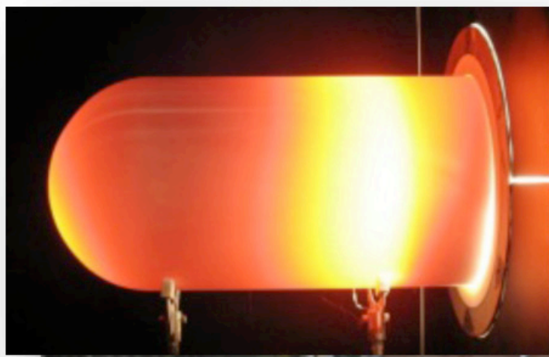
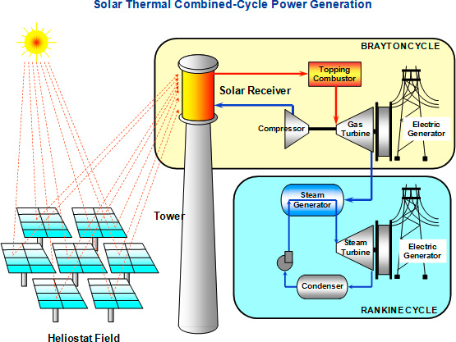
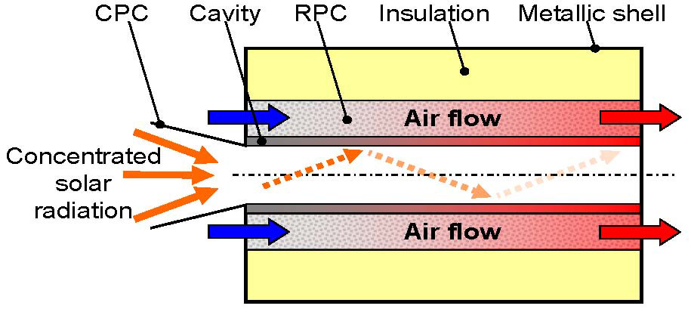
Air cooled RF load with ceramic foam
The solar energy absorber concept by I. Hischier [1] inspired us to this new kind of very high temperature air cooled RF load
[1] I. Hischier, Development of a pressurized receiver for solar-driven gas turbines, 2011 Diss. ETH 19723

Slide 13
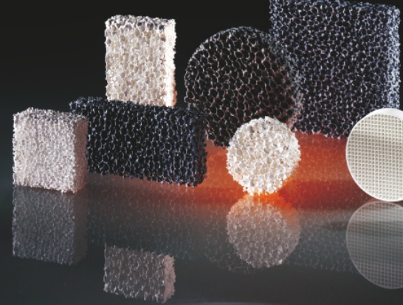
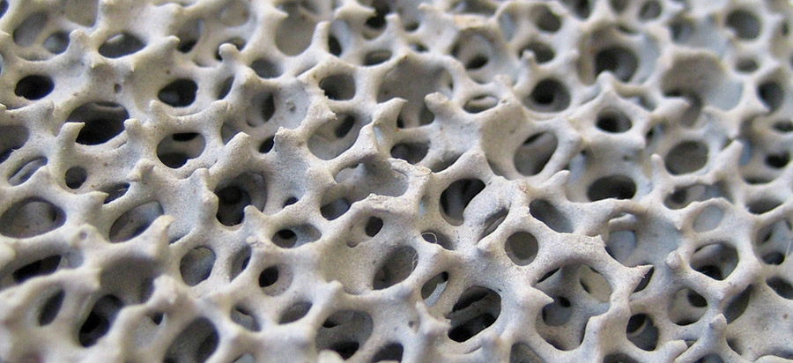
Air cooled RF load with ceramic foam
SiC foam is widely used in metal casting applications as a filter
Molten metal is guided through the foam to filter out impurities and to control fluid flow
Different shapes, sizes and porosities are commercially available
Maximum temperature for SiC: 1550 °C
http://www.hofmann-ceramic.de http://www.frank-landmesser.de

Slide 14
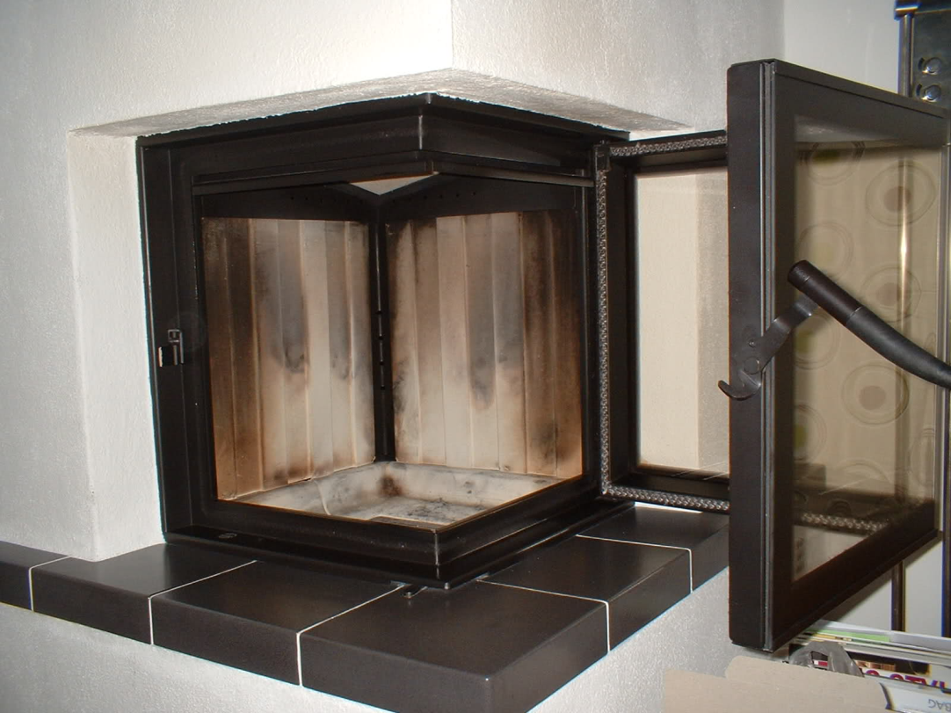
Air cooled RF load with ceramic foam
This special ceramic foam is indeed a good microwave absorber and can be used in the design of an RF load in a similar way as the energy absorber in the design introduced in the solar high temperature structure by I. Hischier
Applying this concept to an RF load, would result in SiC foam embedded in a metal enclosure (ceramic NOT brazed to the enclosure)
This is the principle of using fire clay in the average oven

Slide 15
Air cooled RF load with ceramic foam
Cross section of a Travelling wave structure
Standard waveguide
(e.g., WR-1150)
Slightly pressurized air (<0.2 bar) at ambient temp.
Thin metal sheet to compensate thermal expansion
Metal enclosure at high temperature (800 °C)
Thermal insulation
(rock wool)
RF wave
Hot air
Air tight RF window (e.g., kapton foil)
Perforation serves as RF tight air inlet
Tapering for
low RF-reflections
Ceramic foam with high RF losses
An array of stainless steel pipes with ≈ 1 cm diameter serves as RF tight air outlet (honey-comb style RF-filter)
Length = 0.5 … 2 λ₀
Height = 0.5 …1 λ₀

Slide 16
Conceptional model A
Silicon carbide filled load

Slide 17
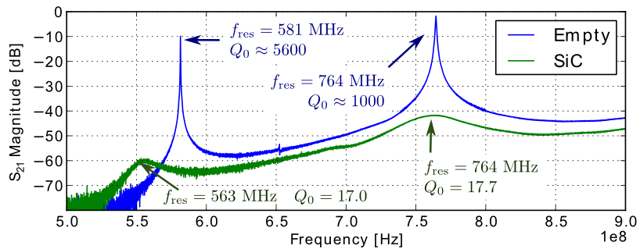
Conceptional model A
First Results: Waveguide filled with SiC

Slide 18
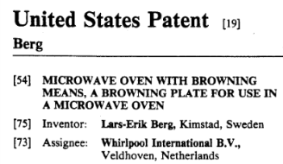
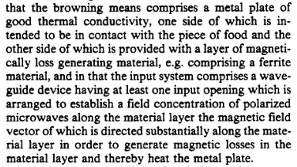
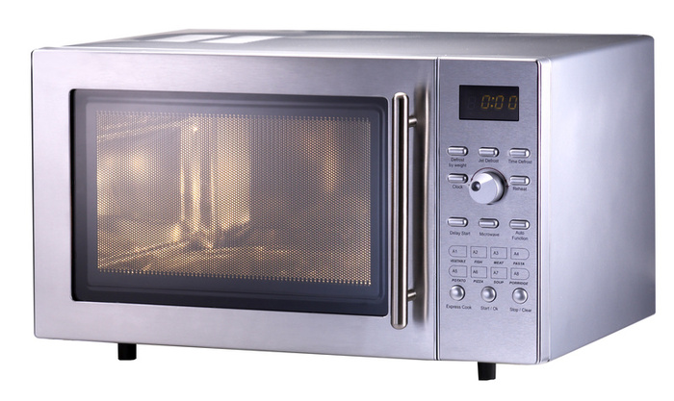
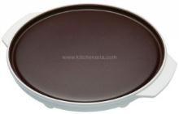
Another high temperature microwave load:
Some modern microwave ovens are equipped with a so called browning- or crisp-plate
Essentially a metal plate coated with a microwave absorbing material (ferrite) which can heat up to ≈ 200 °C
A proof of principle! High temperature loads based on ferrite do exist

Slide 19
Plasma sprayed ferrite
We do not use tiles of solid ferrite brazed onto metal:
The thermal expansion coefficient differs from its metal carrier
The ferrite will get brittle and crack
ECCOSORB® MCS is based on ferrite powder in a rubber matrix. It is fairly elastic, thus brittleness is not an issue.
The ECCOSORB material is rated up to 177 °C

Slide 20
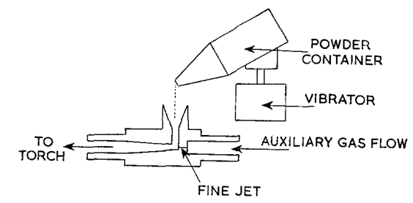
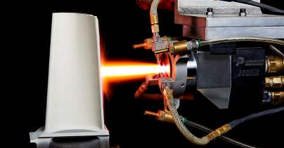
Plasma sprayed ferrite
For higher temp., a better solution would be a very thin ferrite coating (150 - 300 μm)
The coating can be applied by plasma spraying [1]
Then the load could heat up to the curie temperature of the ferrite (can be > 300 °C)
[2]
[1] I. PREECE, C. W. D. ANDREWS, Plasma spraying of ferrites, JOURNAL OF MATERIALS SCIENCE 8 (1973) 964-967
[2] http://www.progressivesurface.com/newsArticle.php?id=25

Slide 21
Conceptional model B
Ferrite load

Slide 22
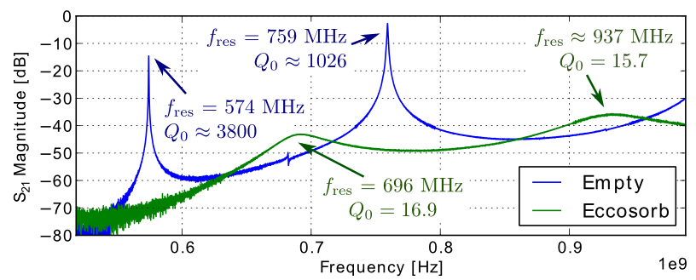
Conceptional model B
First Results: Stacked waveguide with Eccosorb material

Slide 23
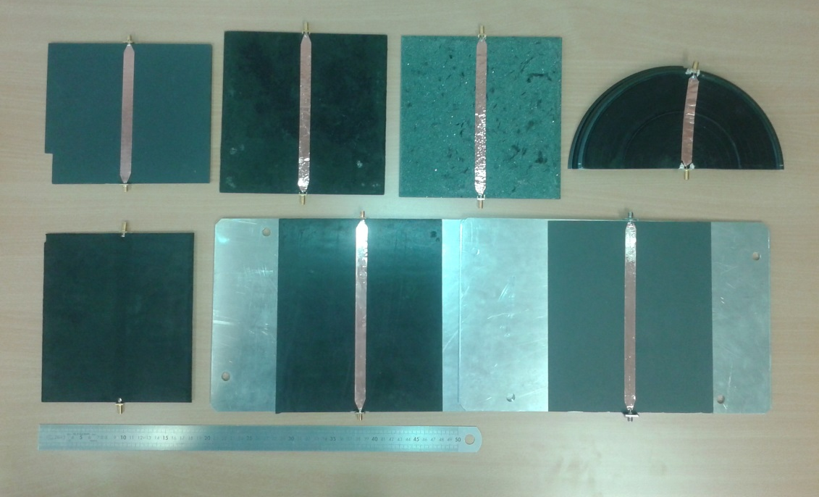
Material choices
In order to find proper materials for coating the stacked waveguide structures, several material samples were measured according to their absorption properties:
Plasma Sprayed Ferrite sample (provided by IOT Aachen)
Painted Ferrite sample (provided by Shenzhen Cui Baolong Industry Co. Ltd.)
Painted SiC sample (provided by Shenzhen Cui Baolong Industry Co. Ltd.)no. Ltd.)
Commercial crisp plate (producer: Whirlpool)
Ferrite loaded silicon rubber sample #1 (provided by Shenzhen Cui Baolong Industry Co. Ltd.) Ltd.)
Ferrite loaded silicon rubber sample #2(provided by Shenzhen Cui Baolong Industry Co. Ltd.)aolong Industry Co. Ltd.)
Eccosorb MCS (provided by Emerson & Cuming)
1.
2.
3.
4.
5.
6.
7.
Tested samples - here equipped with the stripline for measurement

Slide 24
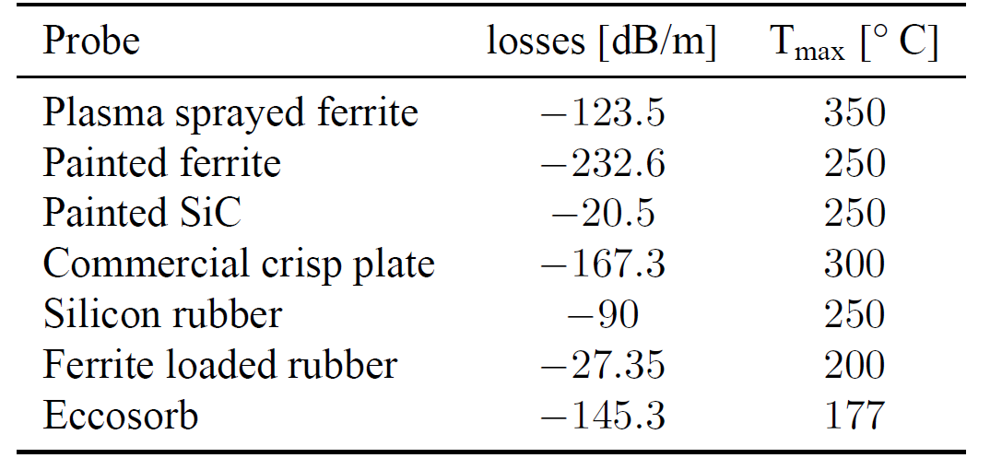
Material choices
With ferrite (#1)
(#2)

Slide 25
Conclusions
Direct energy recovery is a very promising concept providing a recovery efficiency of over 85%. However, due to the required volume and $$$ involved not feasible at the moment - this might change in the future!
An alternative load consisting of a silicon carbide foam in a waveguide would be able to provide pressurized hot air (up to 800°C) . First measurements of a dedicated conceptional model delivered encouraging results.
A conceptional model consisting of a waveguide incorporating coated absorber plates has also successfully been tested.
Different materials were investigated to find a suitable coating for a stacked structure. The most promising lead here is “crisp plate” technology which is readily available and rather cheap in production.

Slide 26
Thanks for your attention!

Slide 27
Additional slides

Slide 28
Prototypes
Measurement setup
Iris to ensure weak coupling
waveguide

Slide 29
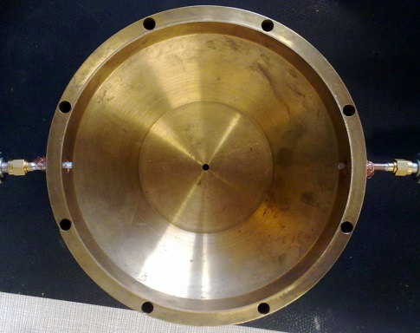
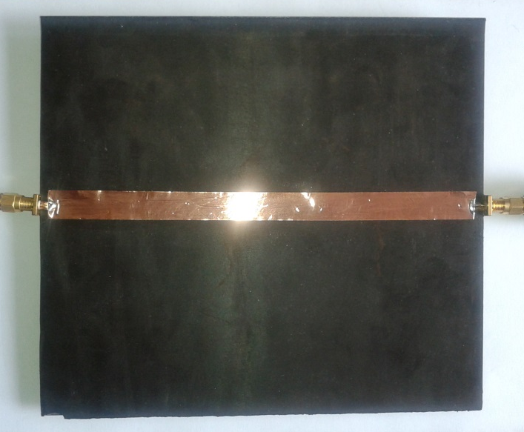
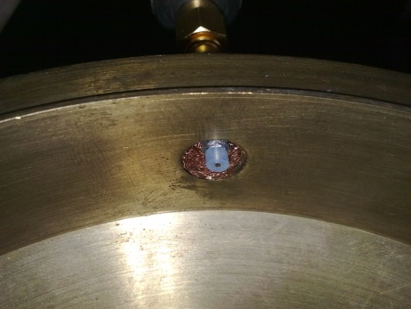
Material choices
Measurement setup:

