Slide 1
FREIA
Facility for Research Instrumentation and Accelerator Development
Roger Ruber
for the FREIA team
17 June 2013, Uppsala
TIARA Workshop on RF Power Generation for Accelerators

Slide 2
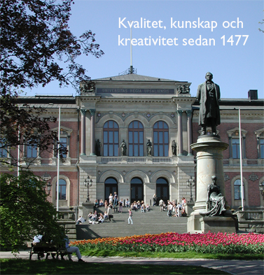
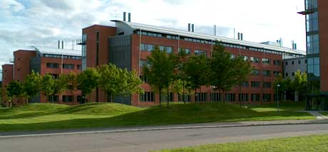
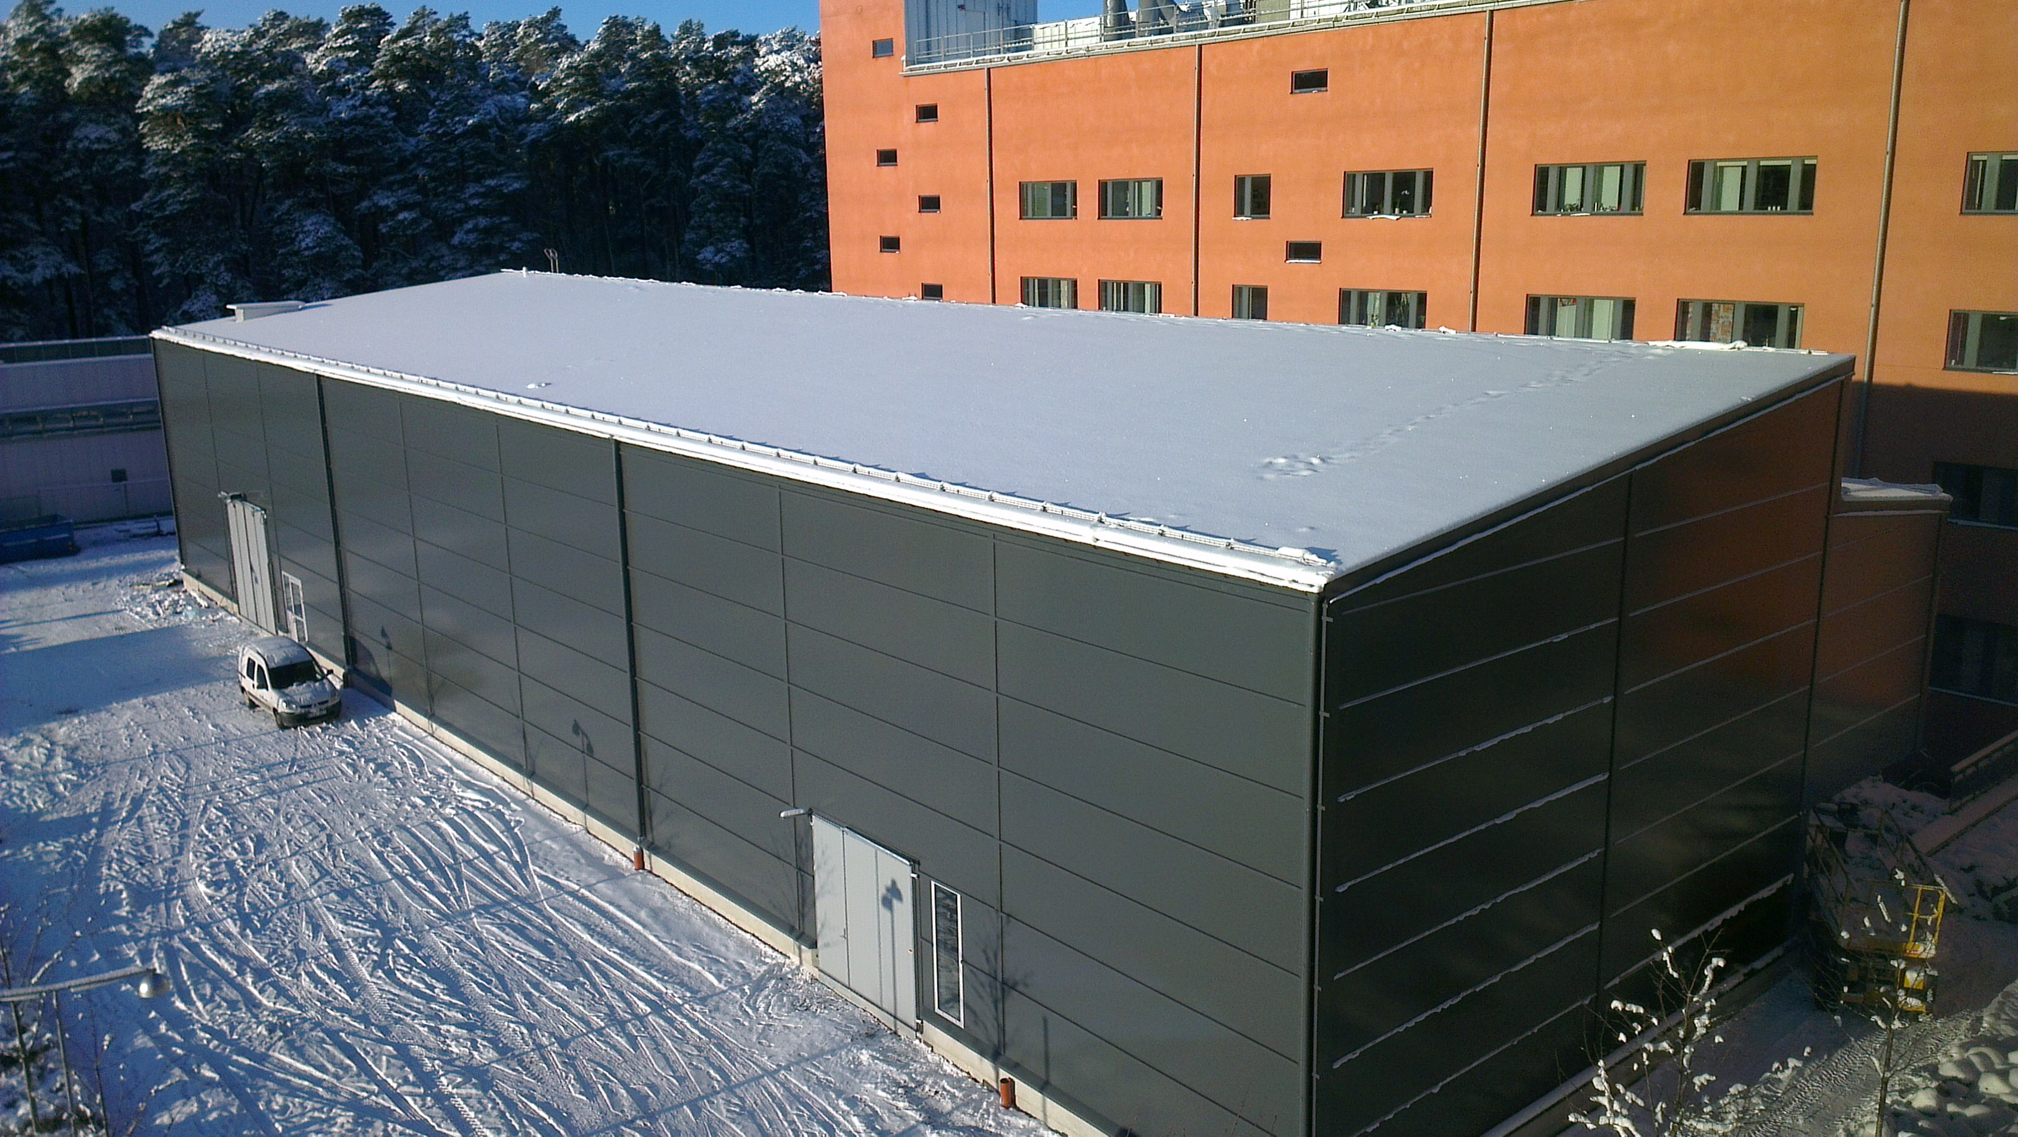
Accelerator Physics at Uppsala University
Concentrating on microwave power (RF)
and instrumentation …
Cyclotron (since 1948)
CELSIUS storage & accelerator ring (1984 – 2006)
Electron-positron linear collider development
  CERN projects CTF3/CLIC & NorduCLIC
  Two-beam Test Stand & RF breakdown issues
  EU FP6-EuroTeV, FP7-EuCARD, FP7-TIARA
Free electron laser development
  FLASH Optical Replica Synthesizer,
  XFEL Laser Heater
  Stockholm-Uppsala FEL Centrum
European Spallation Source development
  microwave power systems
  accelerating cavity & cryostat prototyping
  cryomodule series acceptance testing
Notes:
concentrating on microwave power: the so-called RF systems that do the real acceleration work
and instrumentation: diagnostics to understands what happens in the accelerator

Slide 3
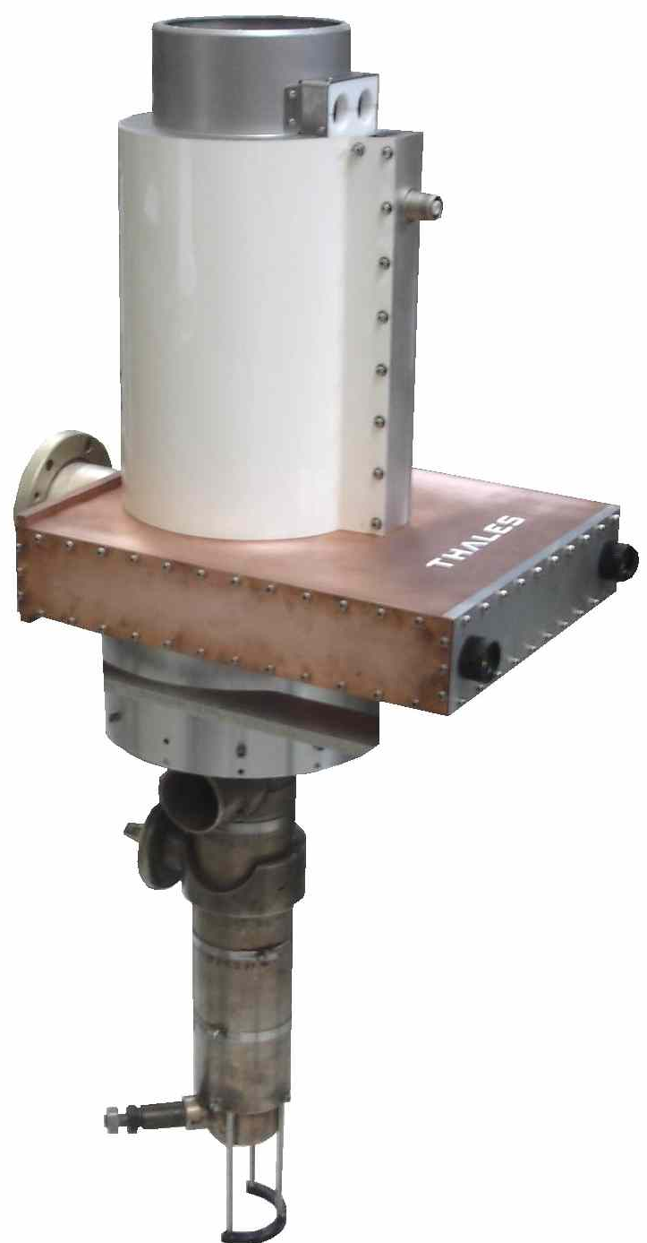
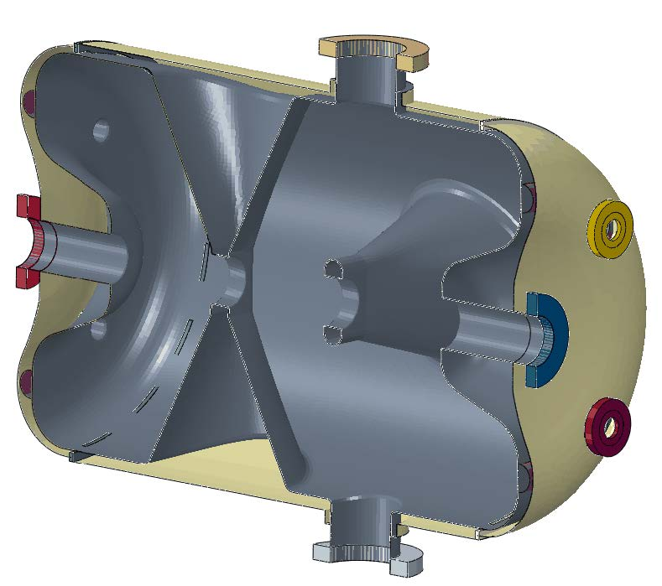
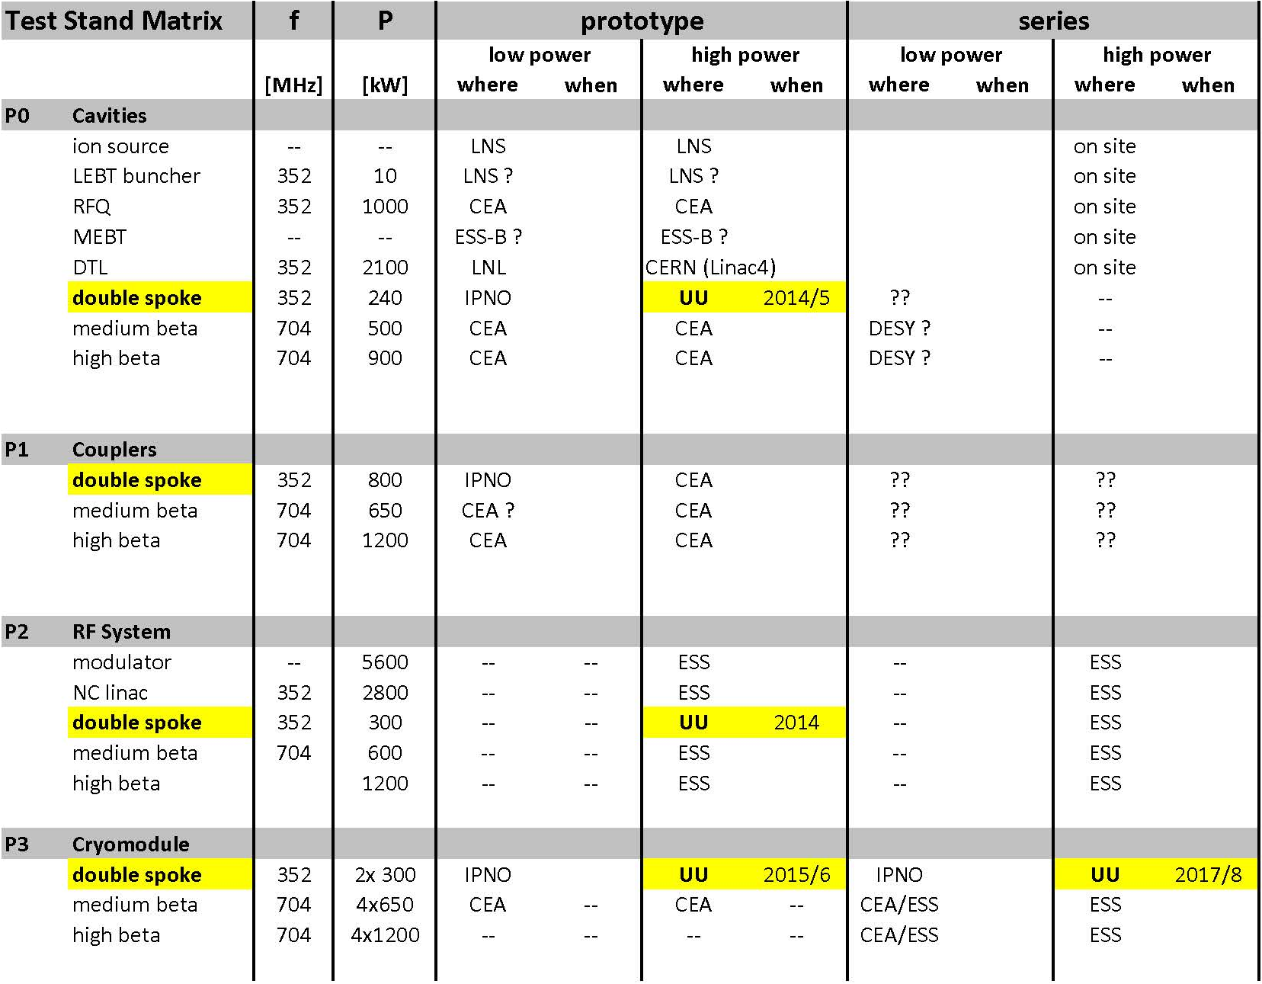
Responsibility for ESS Accelerator
Contribution to the technical design & construction effort
  design concept spoke accelerating cavity power source
  design concept radio-frequency (RF) power distribution
  survey test stand infrastructure and requirements
  study of upgrade scenarios RF systems for ESS power upgrade
Development power station for spoke cavities
  soak test with water cooled load, then accelerating cavity, incl. controls
  collaboration with industry to develop vacuum tube and solid-state based prototypes
System test, power station with
spoke cavity and cryostat-module
  fully dressed prototype cavity (in test cryostat)
  complete prototype module (2 spoke cavities)
Acceptance test cryostat-modules
(proposal submitted)
  for all final modules before installation

Slide 4
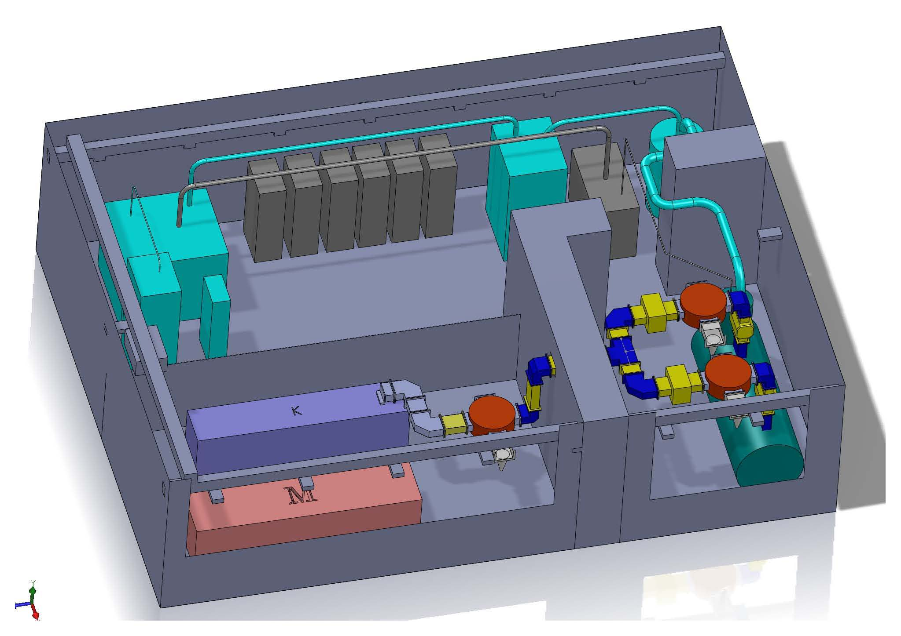
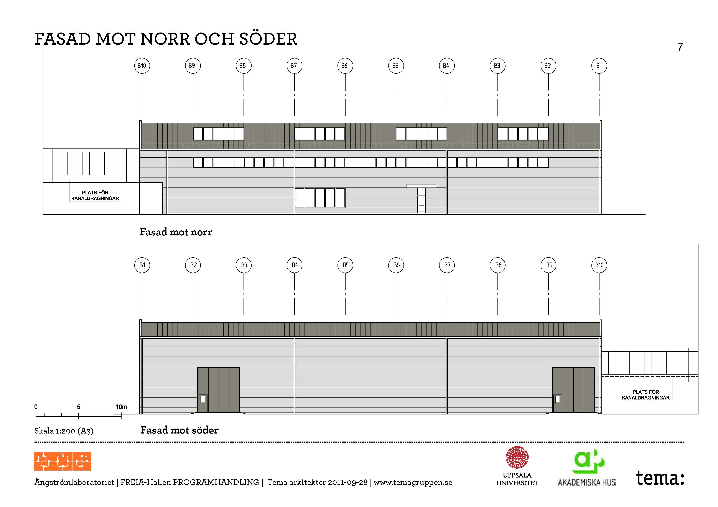
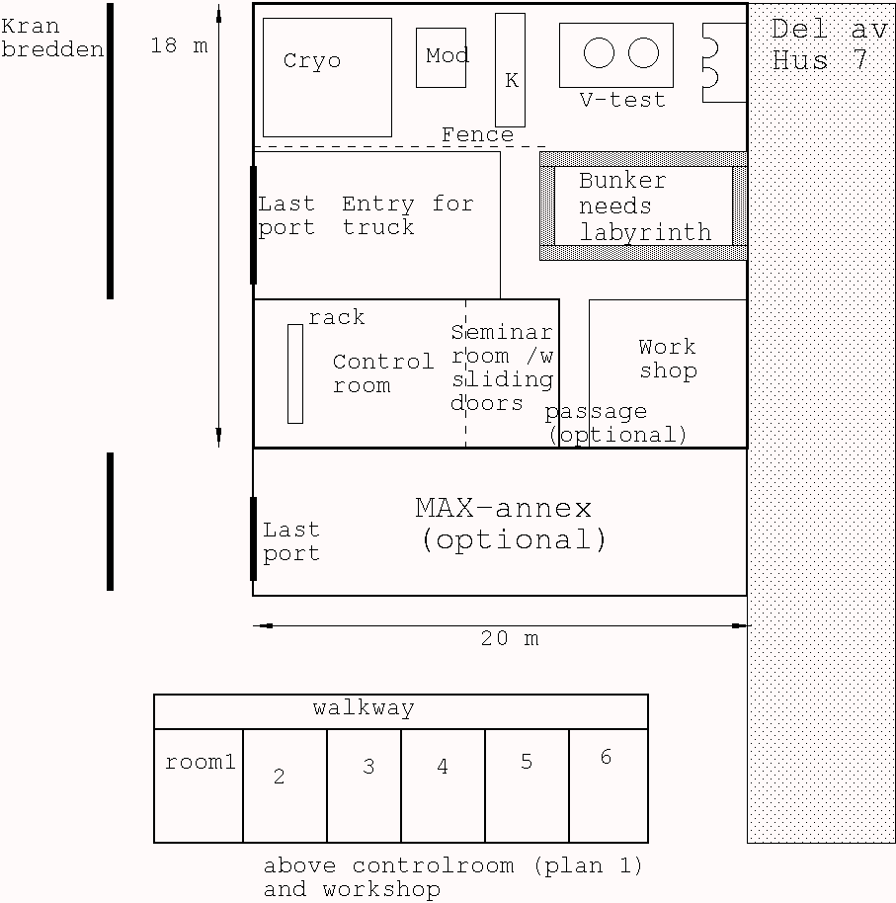
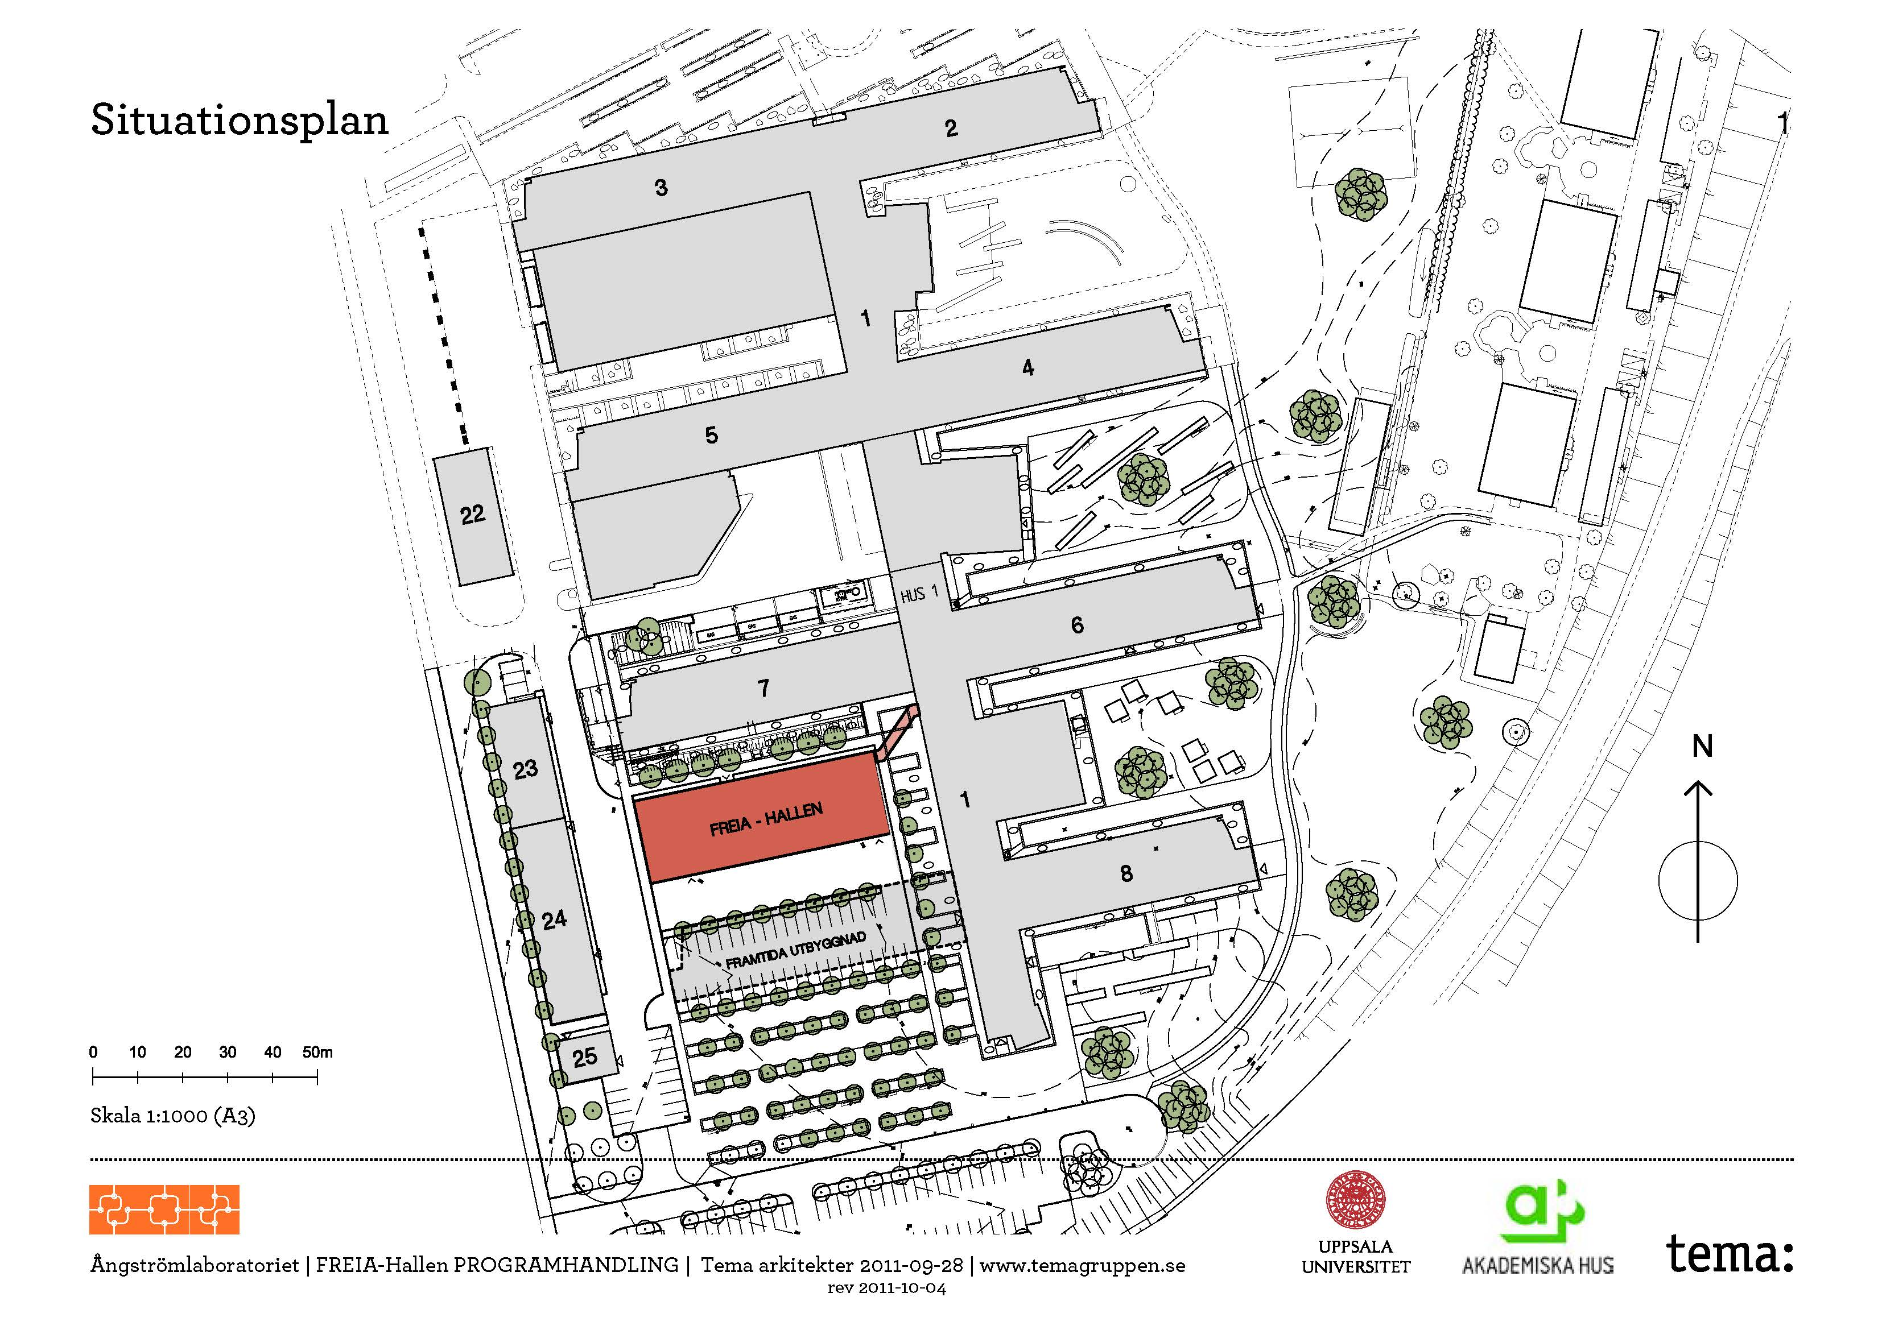
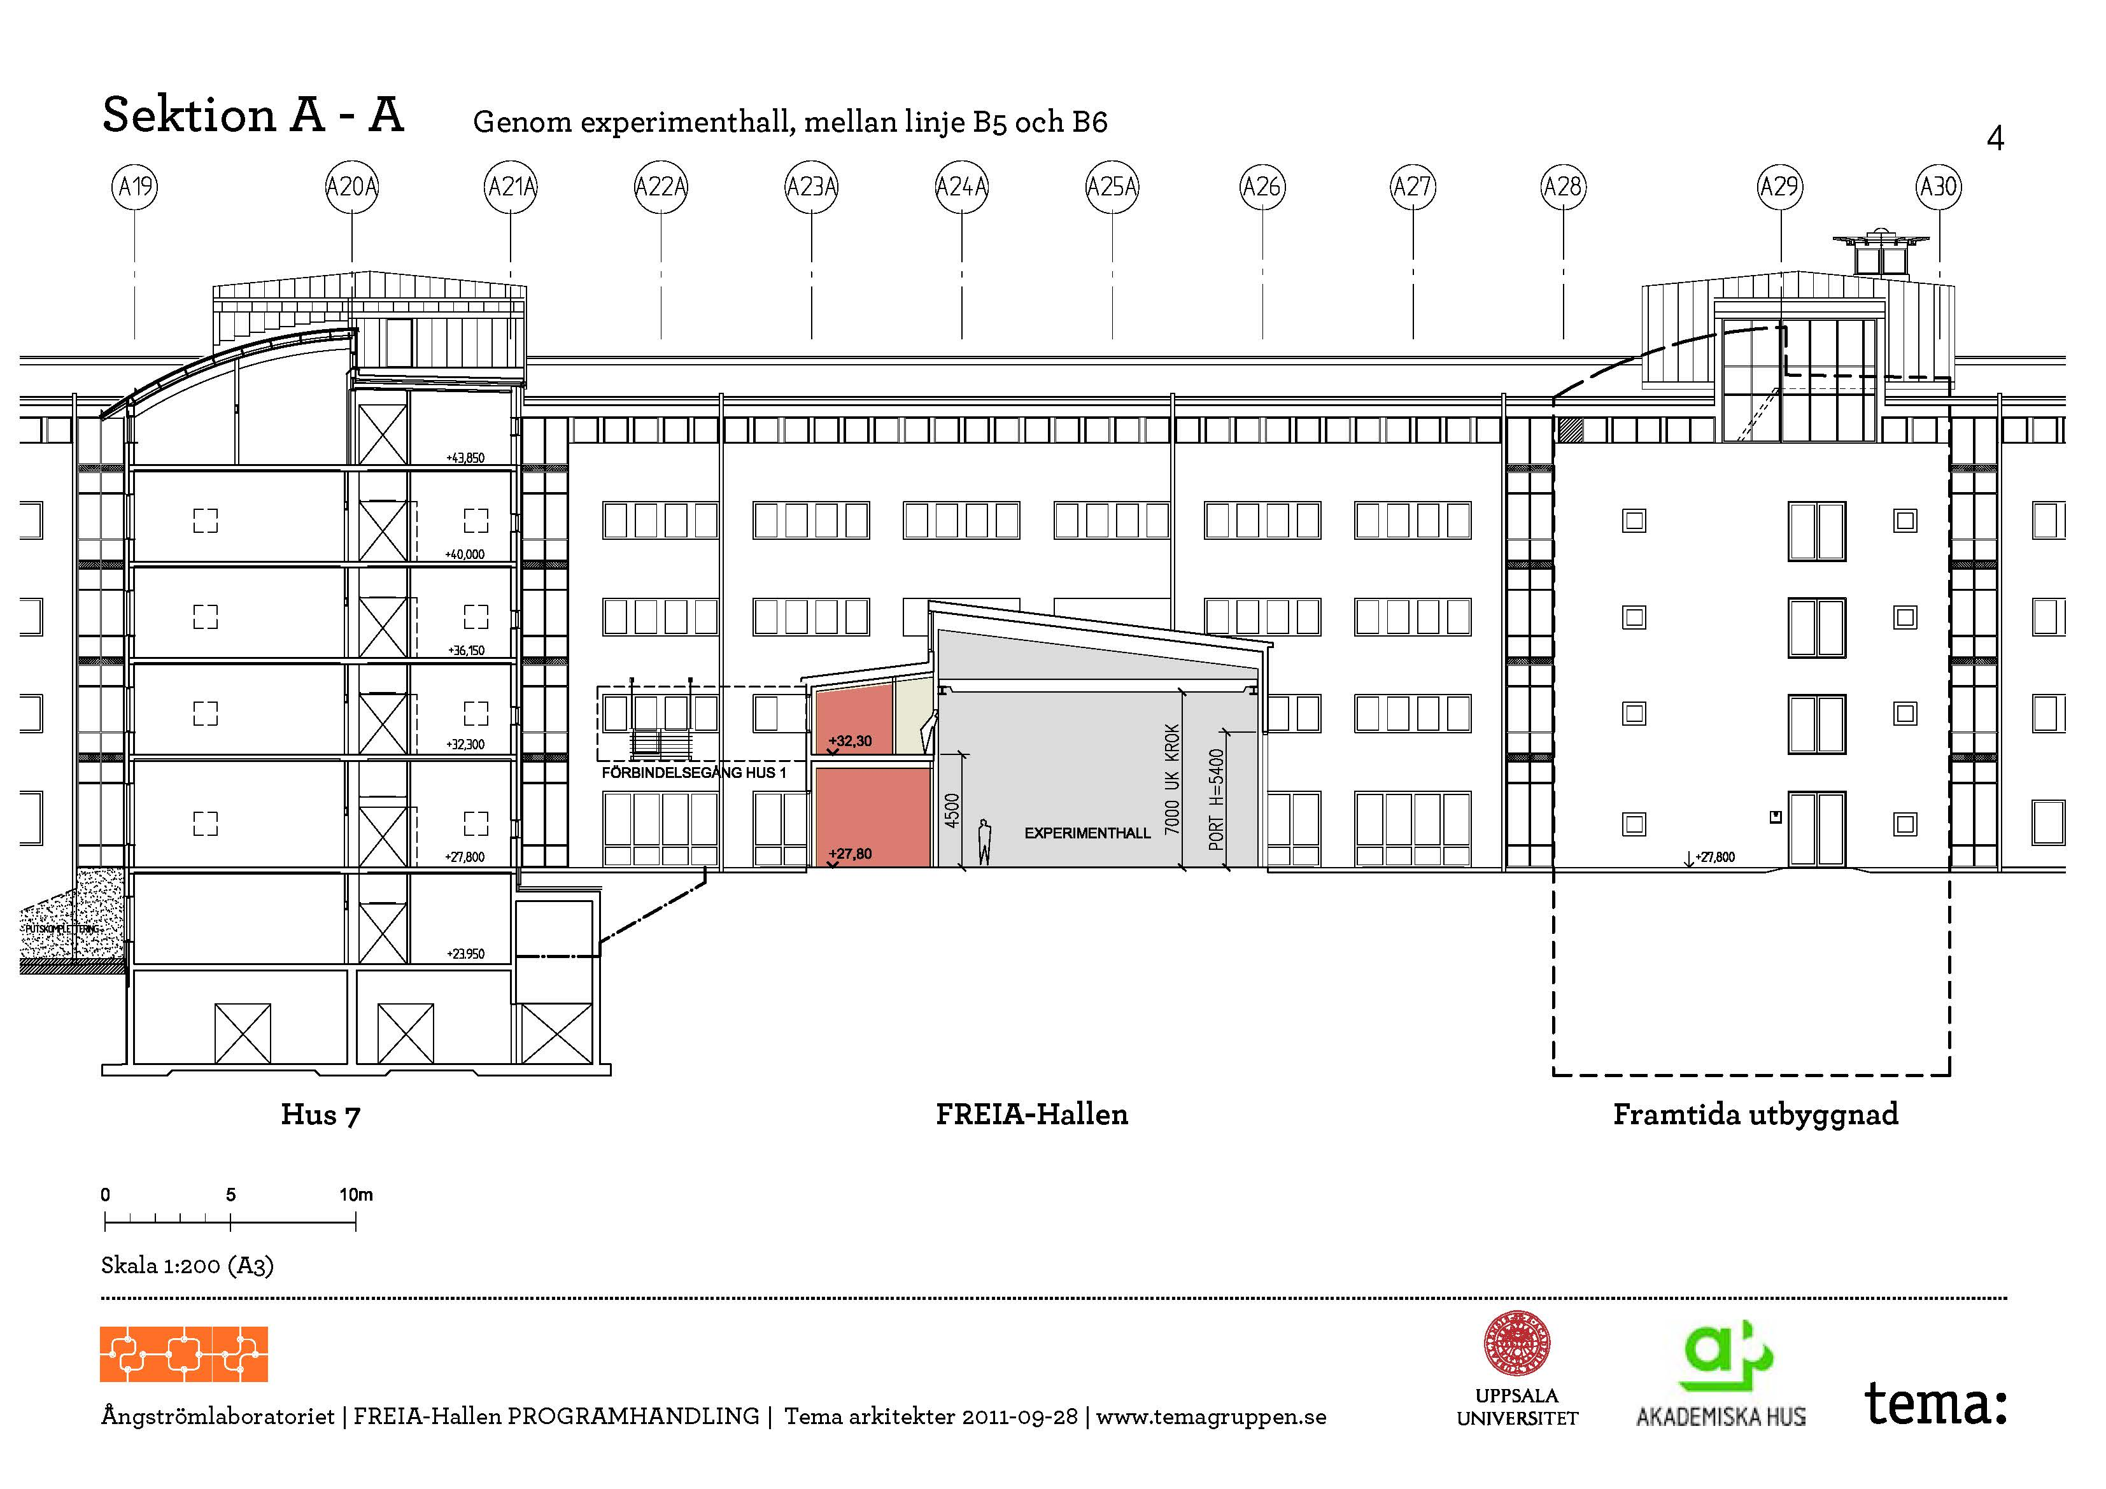
Why FREIA?
Several circumstances
test stand needs large experiment space and bunker
university’s helium liquefier in need of replacement
Decision on new construction at Ångström (2010)
funding support from KAWS, government and university
2009
2011
2010

Slide 5
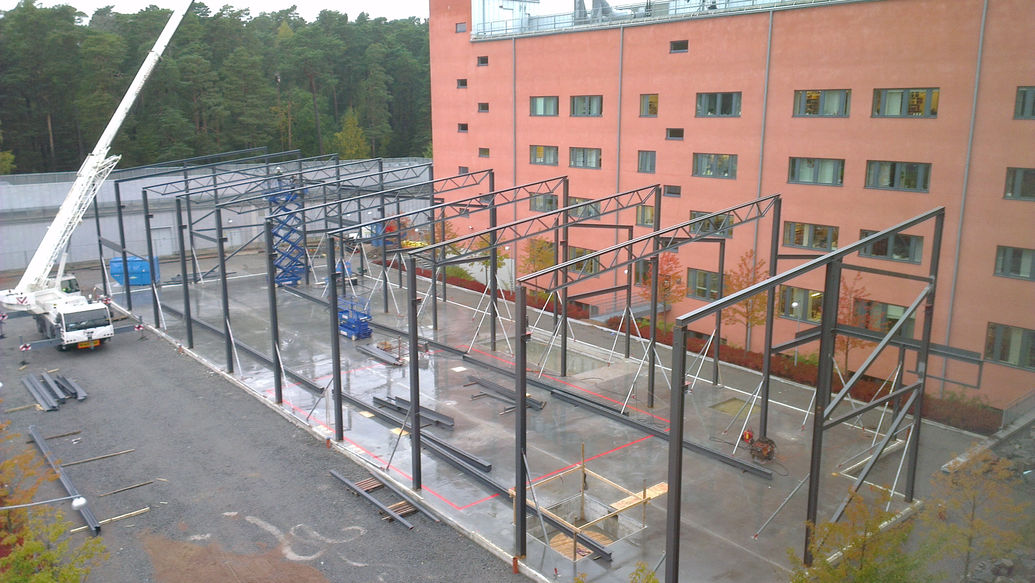
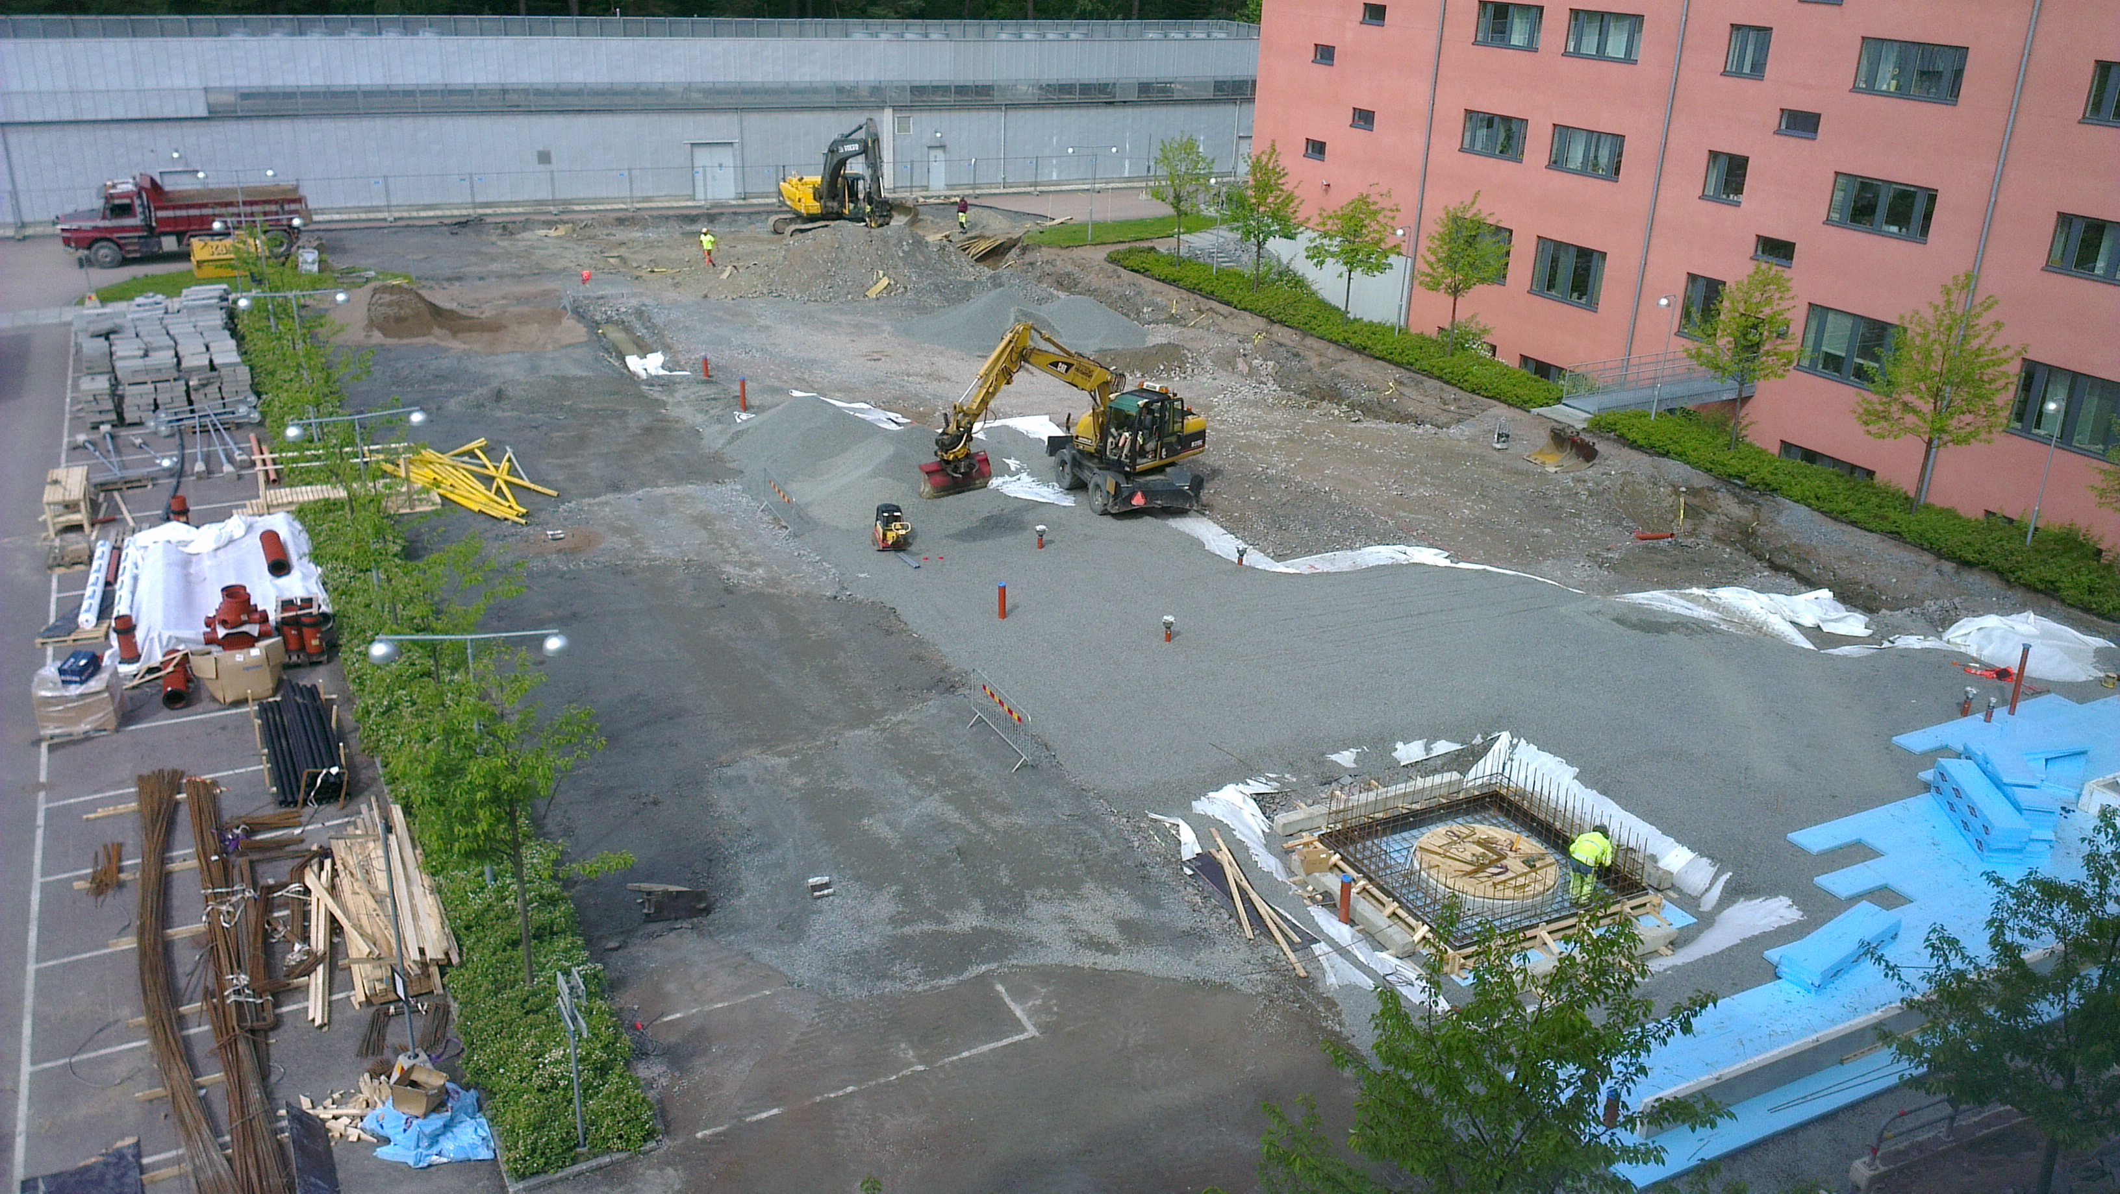
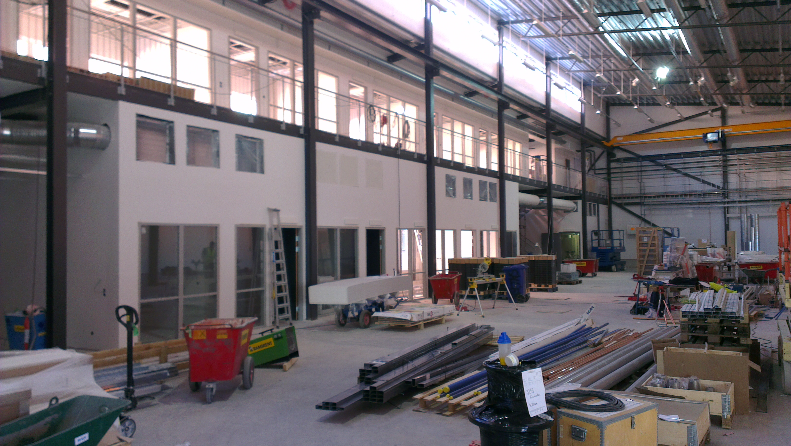
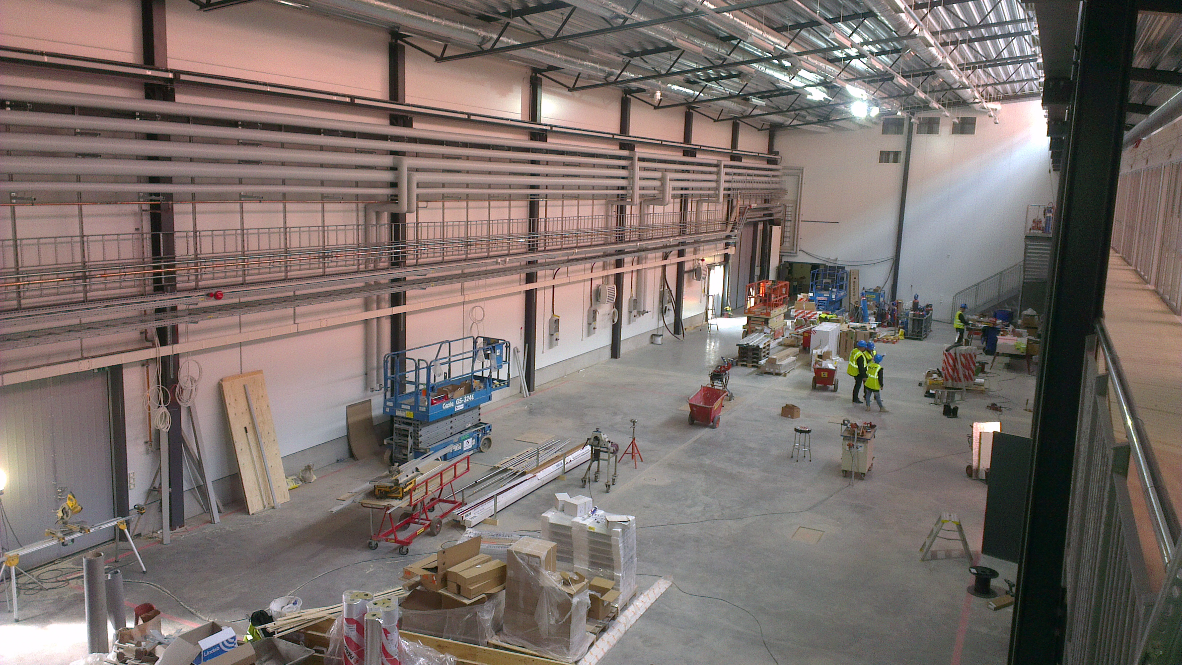
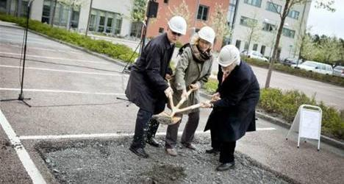
Construction Progress
3 December 2012
28 September 2012
5 June 2012
27 March 2013
Inauguration
Tomorrow
2 May 2013
14 May 2012

Slide 6
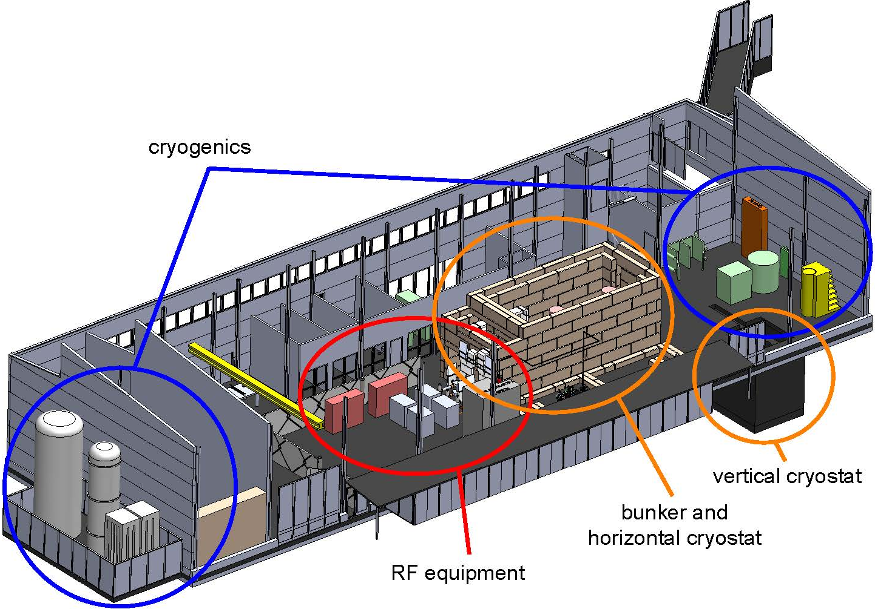
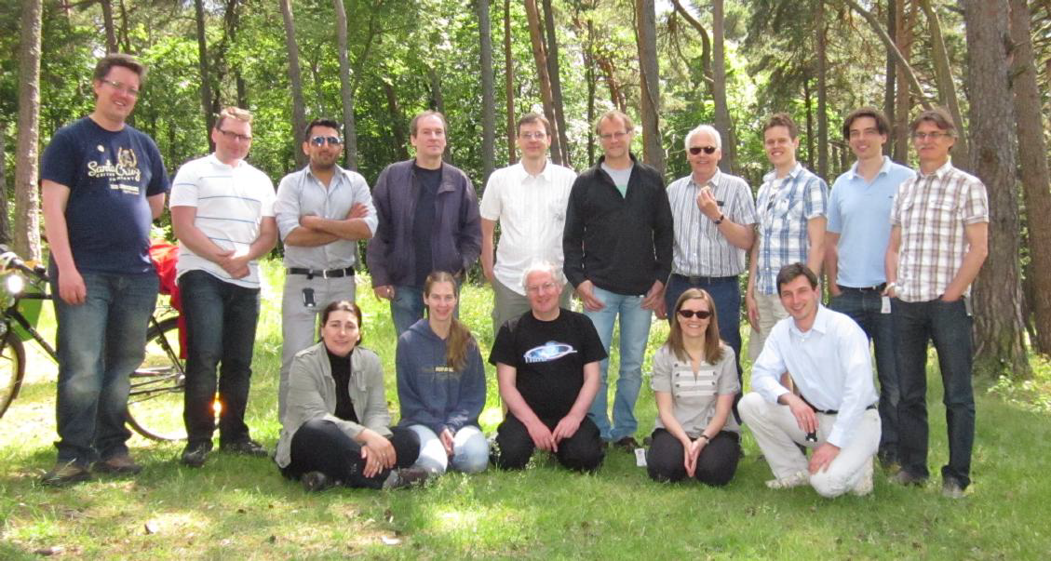
What FREIA?
Facility for Research Instrumentation and Accelerator Development
General Infrastructure
  liquid helium, nitrogen production & distribution
  specialized workshop, control room
  concrete bunkers
Accelerator & General Test Stands
  horizontal test cryostat (vertical in future)
  power sources: 352 MHz (704 MHz, 12 GHz in future)
Neutron Generator
  neutron tomography, detector tests
  student exercises and projects

Slide 7
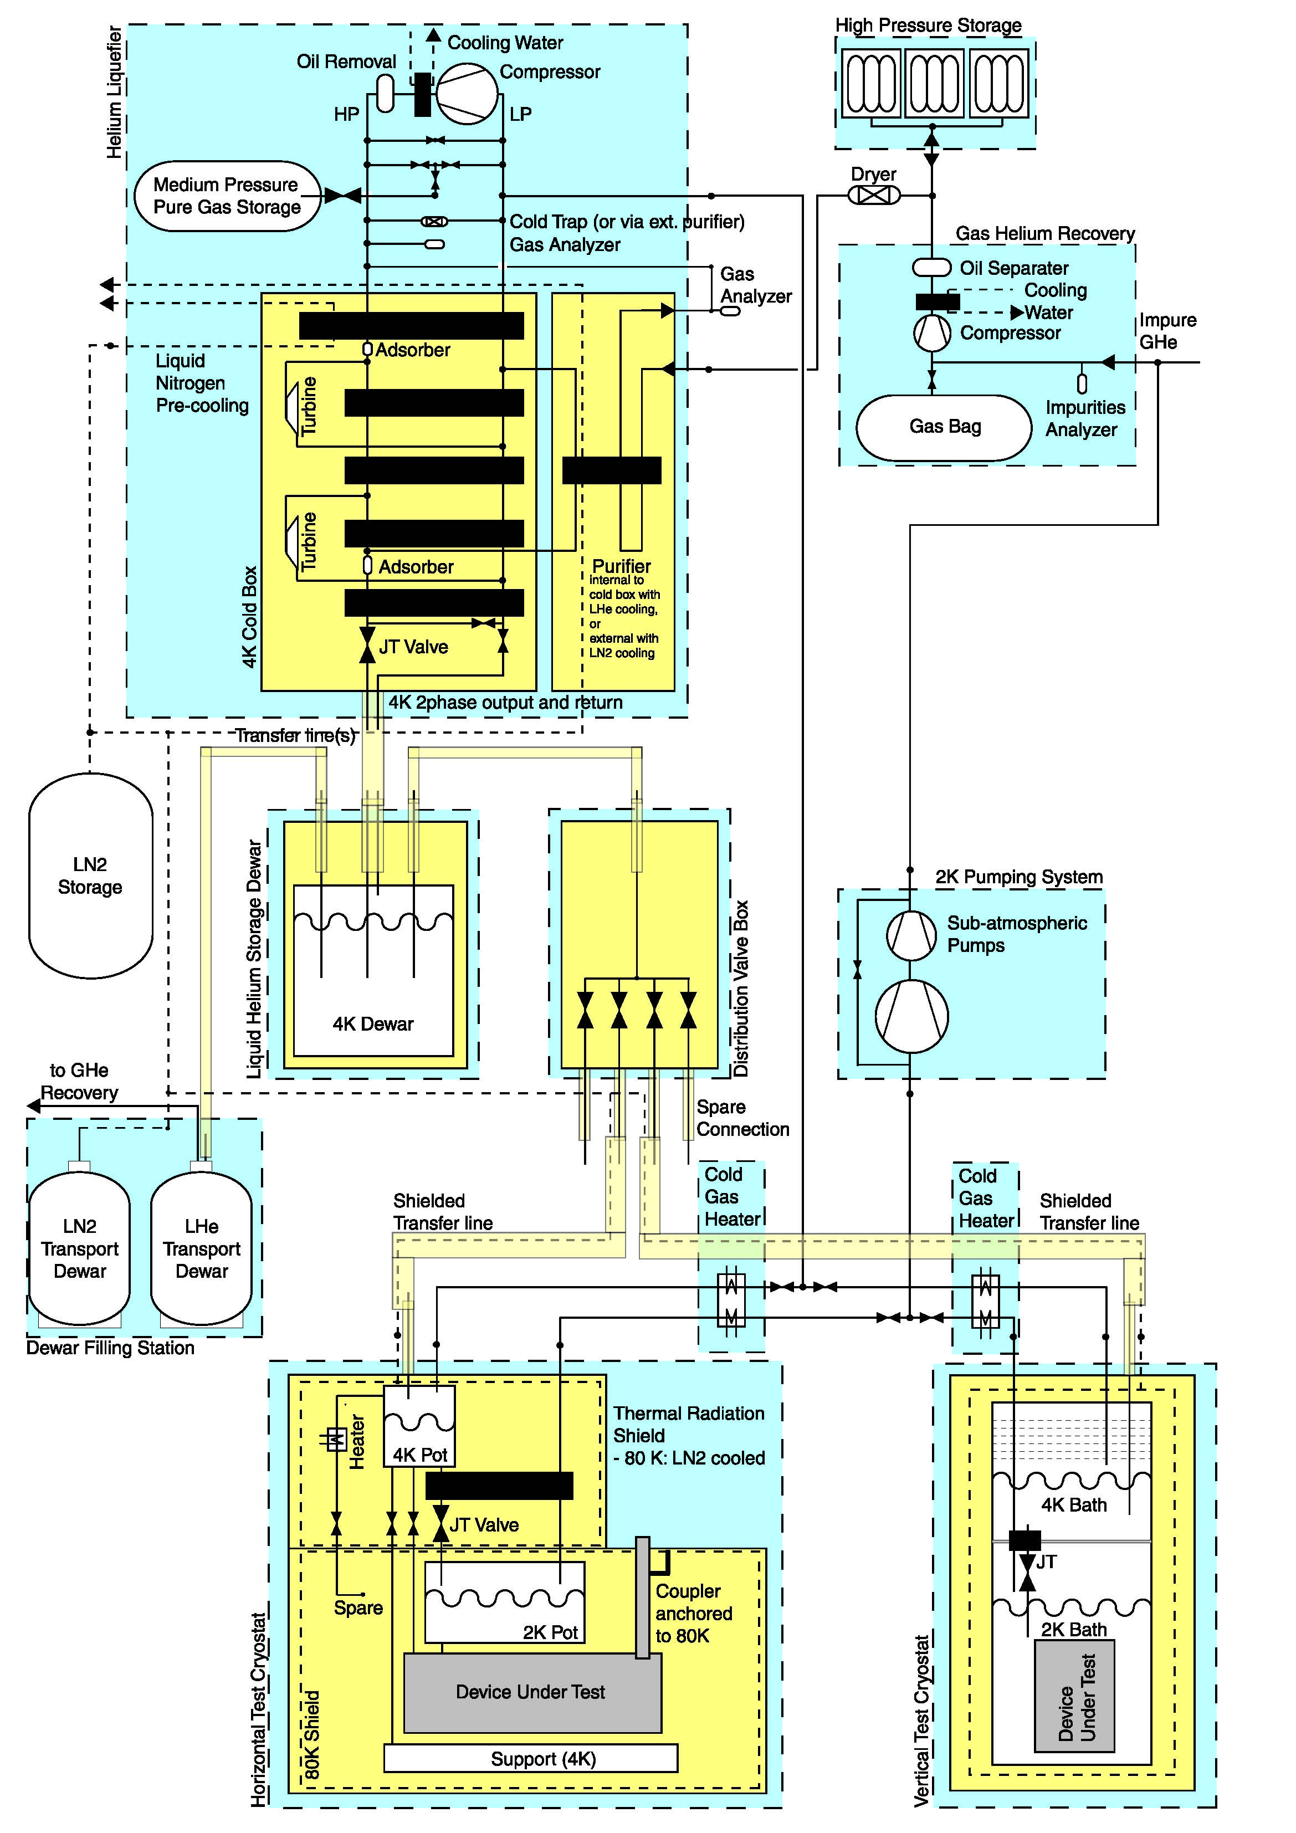
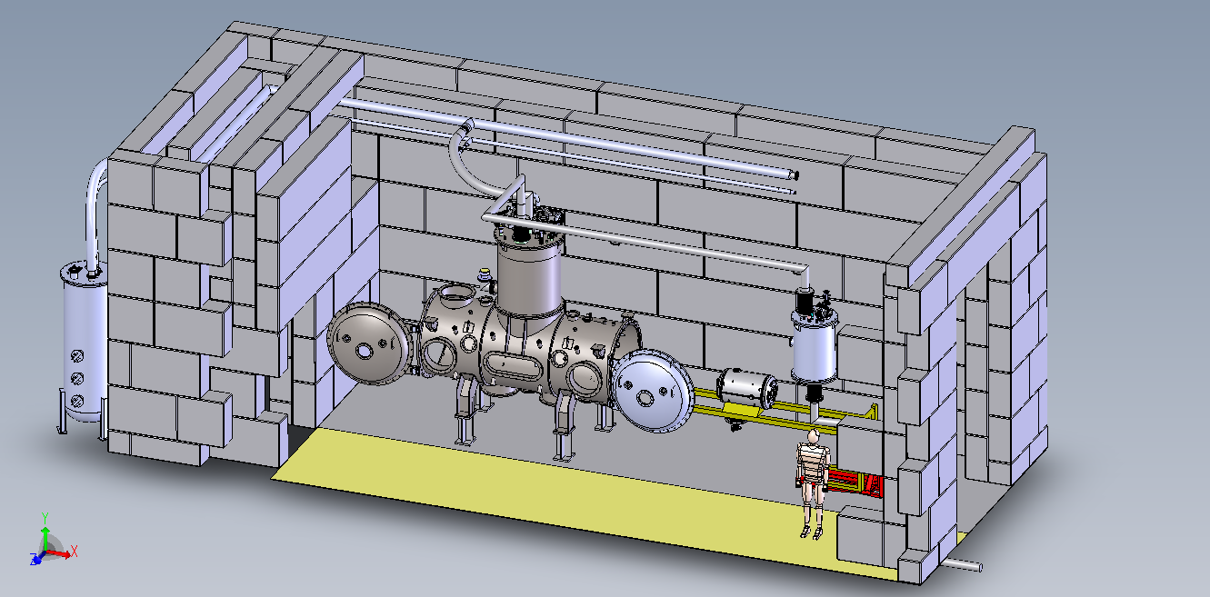

FREIA Cryogenic Centre
supported by Wallenberg foundation
Multiple users
  external users (dewars)
  horizontal test cryostat
  vertical test cryostat (future extension)
Liquid nitrogen
  20 m3 tank
Helium liquefier & recovery system
  140 l/h peak at 4 K, 2000 l storage
  80 m3/h recovery, 100 m3 gas balloon
  ~8 g/s, 80 W peak load at 2 K

Slide 8
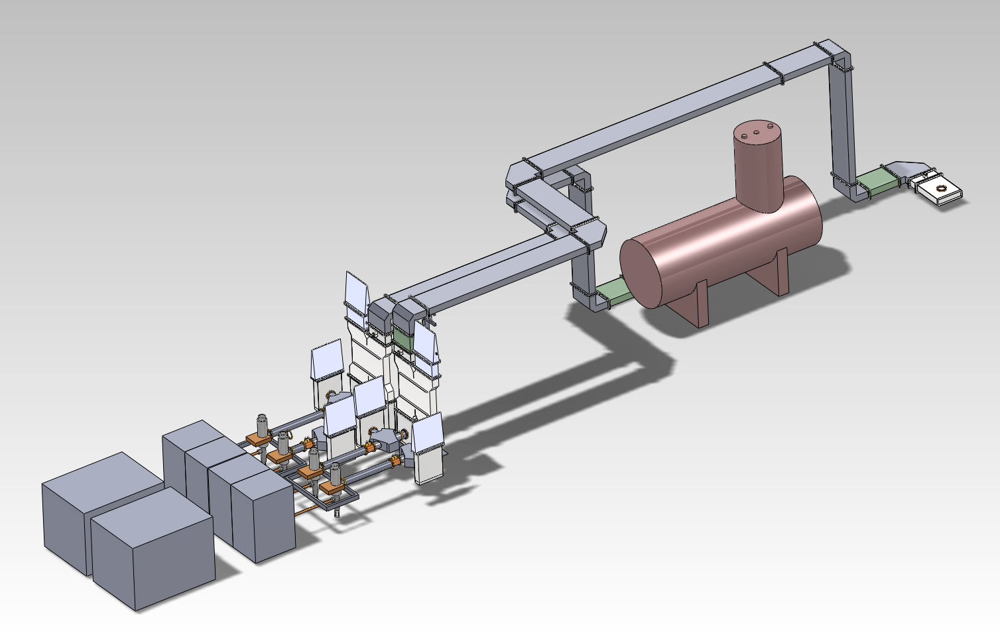
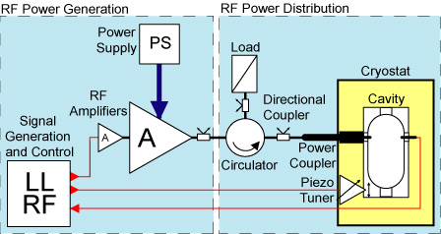
FREIA RF Power Station
ESS pre-series #1
352 MHz, 400 kW pulsed
  FREIA 2pc
  ESS linac 28pc
FREIA design based on TH595
  tender >350 kW (2012 design)
  allowed alternative solutions
  12 offers: tetrode, IOT, solid-state
  TH595 solution most competitive
Solid-state R&D station
352 MHz, 400 kW pulsed
  FREIA 1pc
Commercial design
  1 kW transistors
  8 kW modules
  coaxial combiner
SOAK TESTING

Slide 9
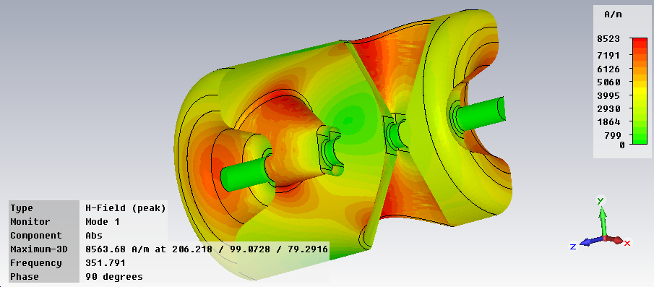
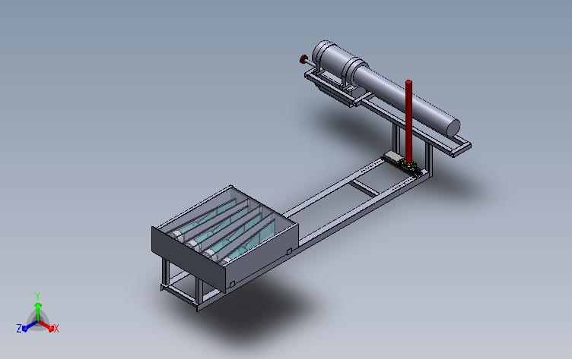
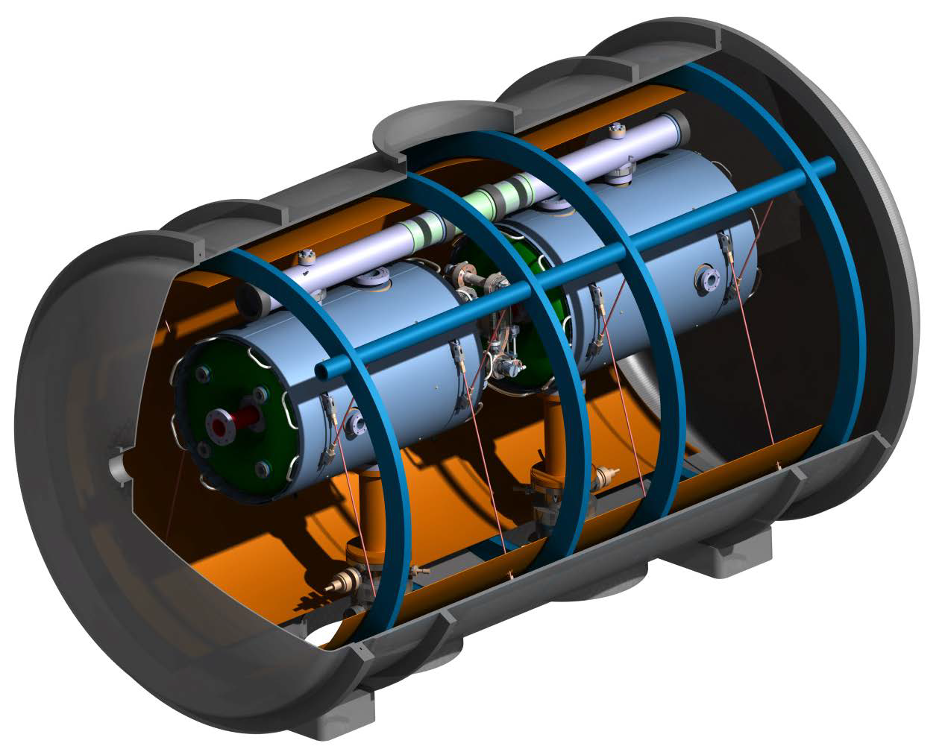
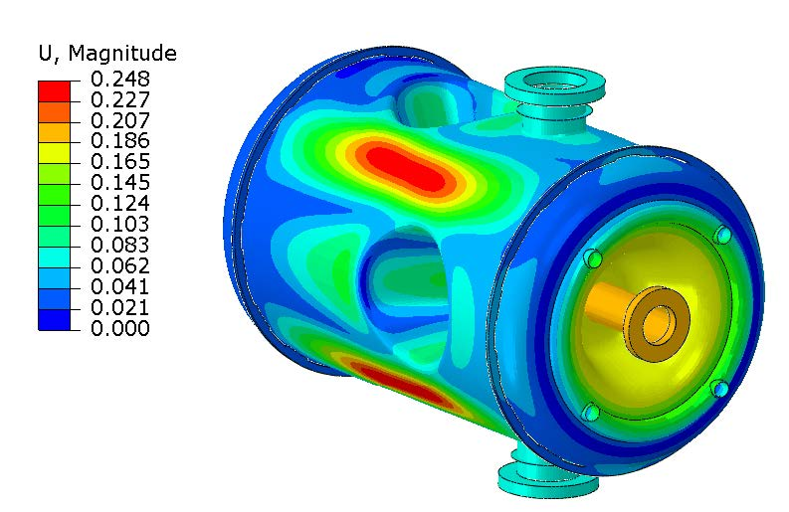

Approved Projects
ESS Accelerator
High power system test of source,
spoke cavity and cryostat-module
high power soak testing of
power source, controls, amplitude and phase stability with accelerating cavity
test cavity tuning system, dynamic load, electron emission and multipactoring
Neutron Generator
Access to neutrons
neutron tomography and detector tests
student exercises and projects
physics experiments in combination with
solid-state based gamma-detector
  nuclear fission
  activation analysis
B_{surf}
DT source
n-generator
scintillation detectors
deformation
Peak fields @ 8 MV/m
E_{surf} = 35 MV/m
B_{surf} = 56 mT
Deformation 0.25 mm
Cryo loss = 15 W
space for object

Slide 10
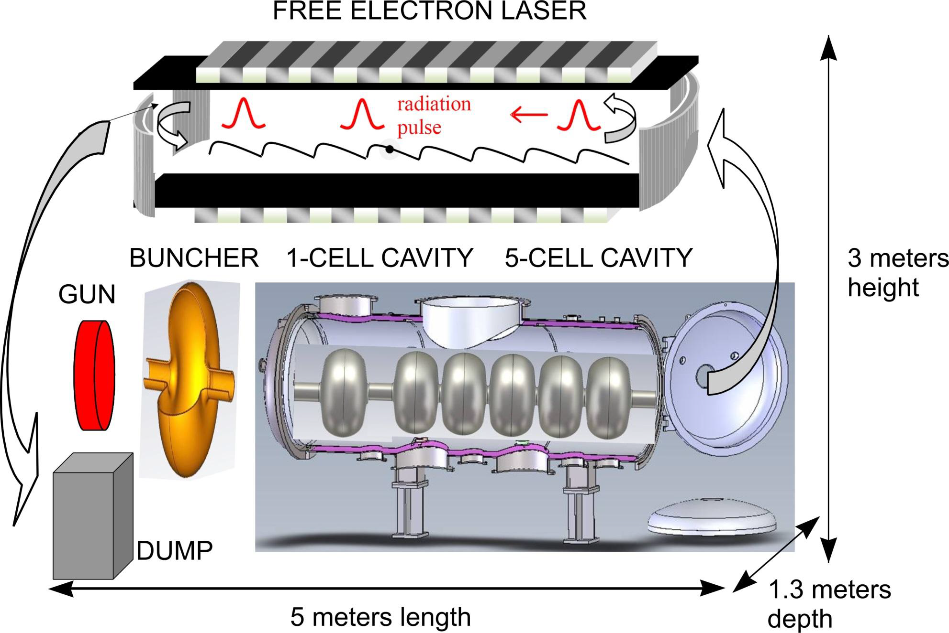
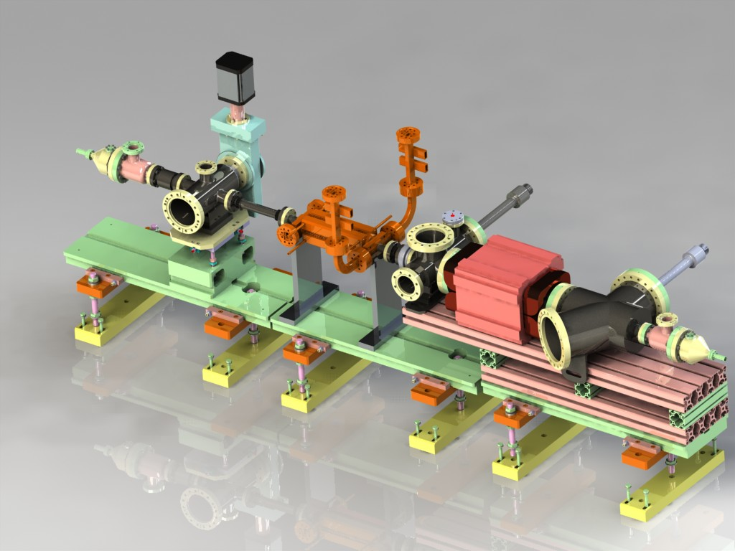
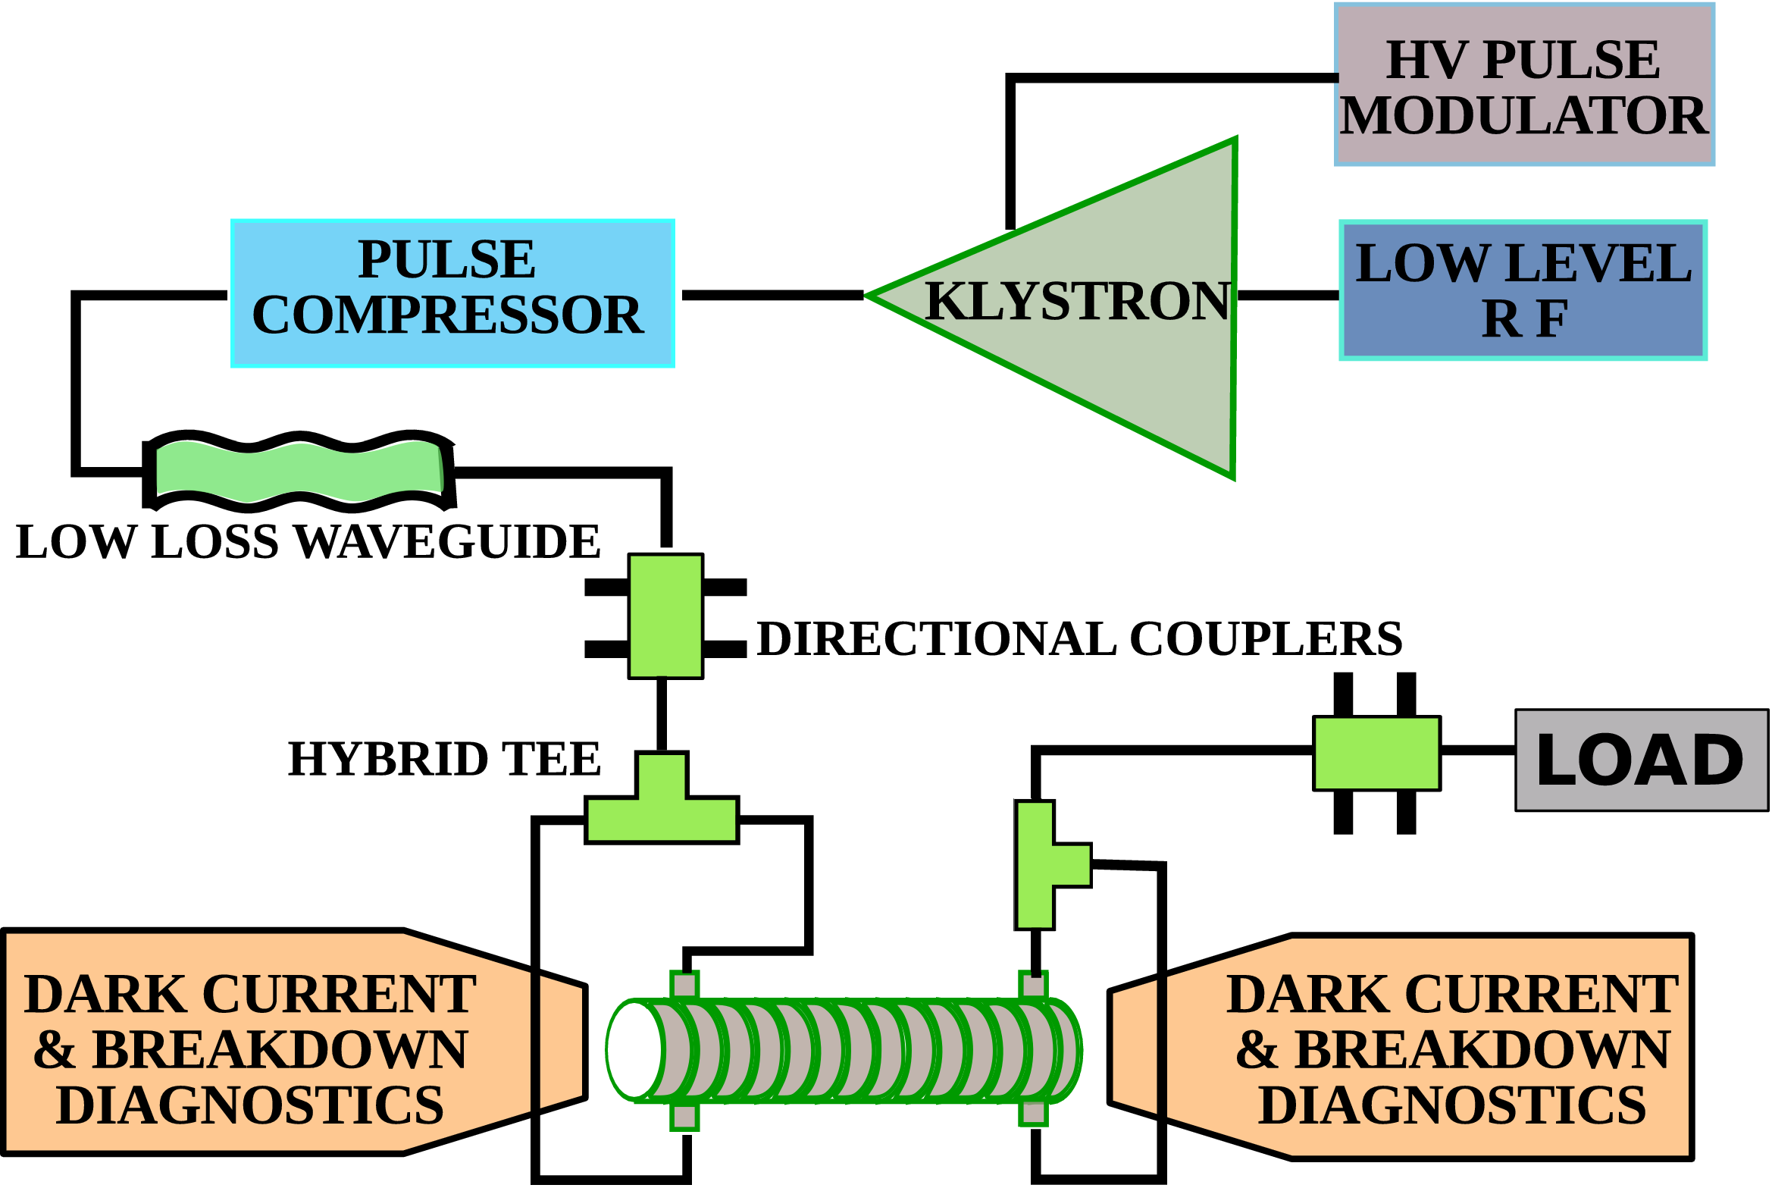
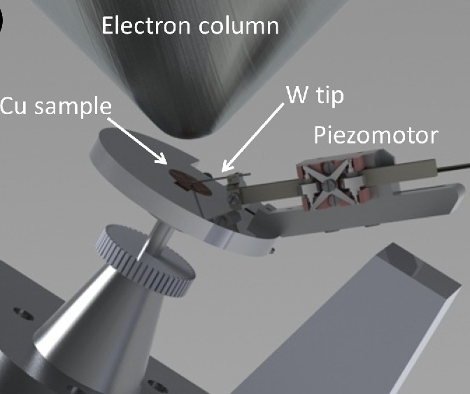
Projects under Discussion
SIGURD
Set-up and Instrumentation for GHz Research and Development
High Gradient RF research
compact high gradient accelerators (medical, FEL, particle collider)
vacuum breakdown pattern, rate, relation to gradient, memory effects
pulse heating, plasma formation, dark currents, breakdown currents
post-mortem analysis of structures in SEM at Microstructure Lab
link to theory developments
(Helsinki University)
THz FEL
THz radiation non-ionizing, strongly absorbed by water
Biology and Material Science
imaging & spectroscopy for biological tissues, proteins, molecular and material science
extends existing efforts by the Microwave group

Slide 11

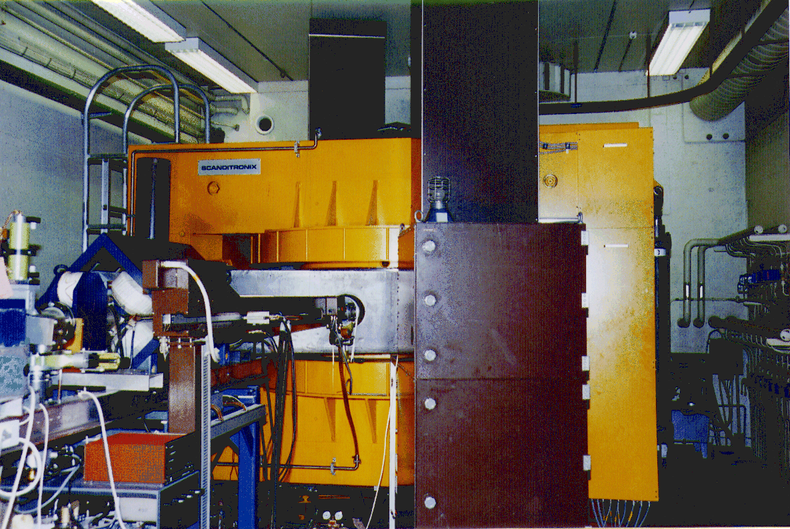
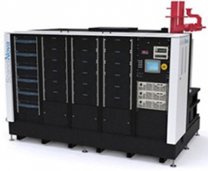
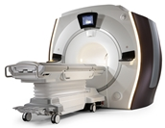

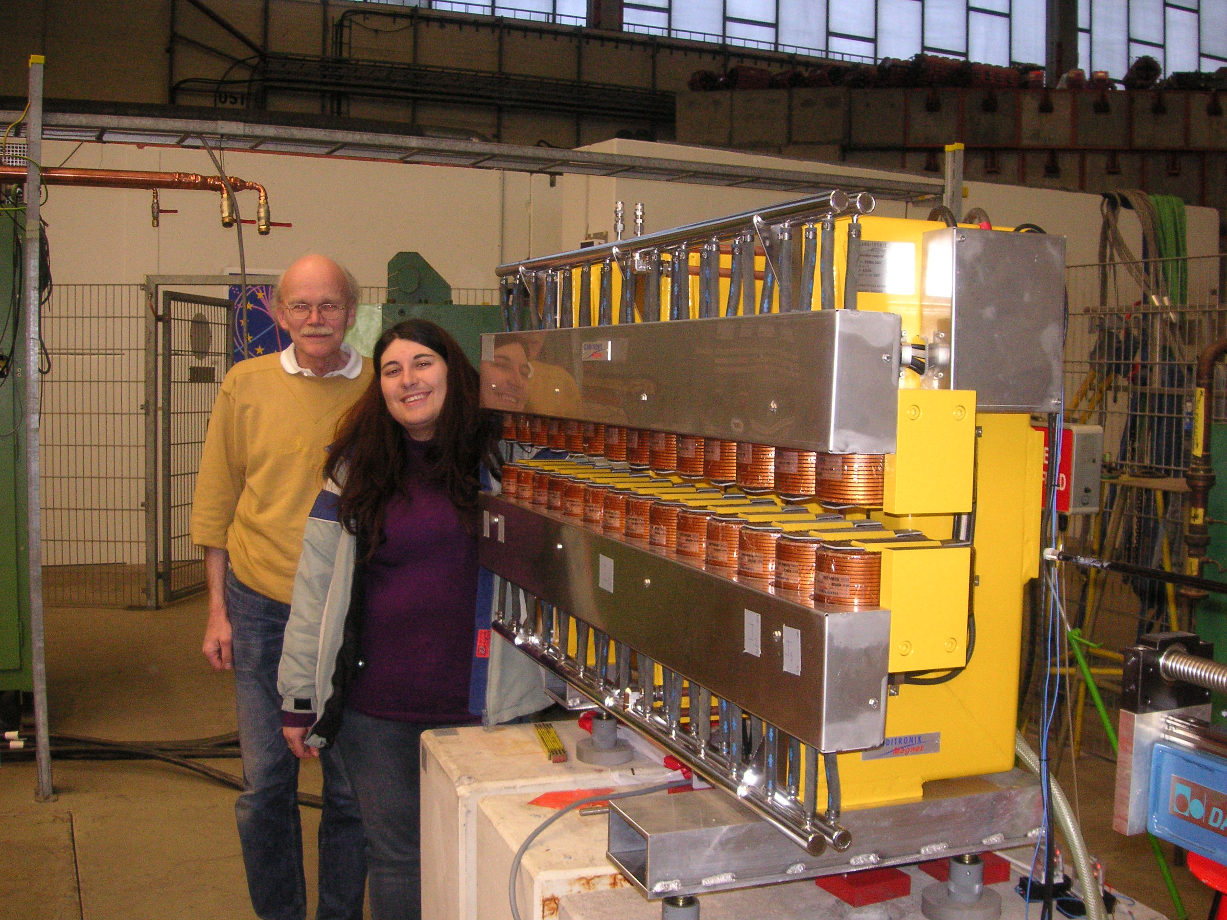

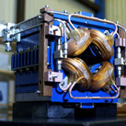

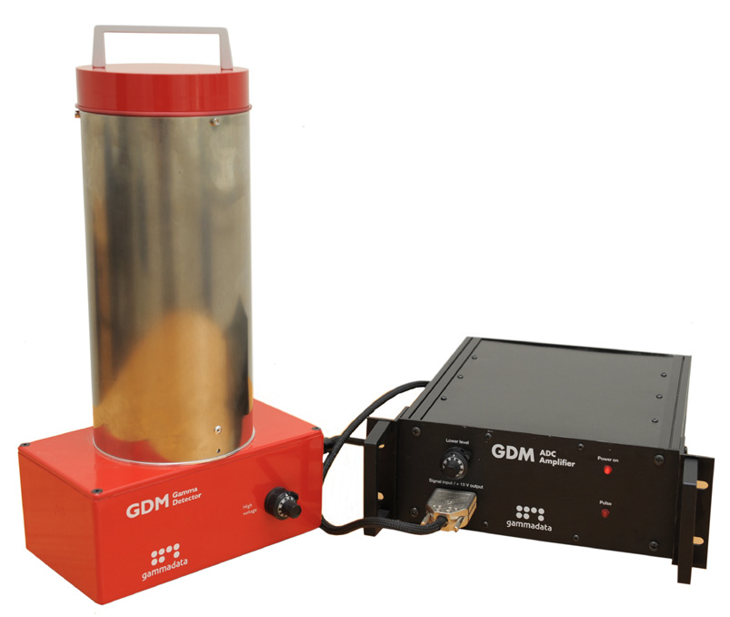

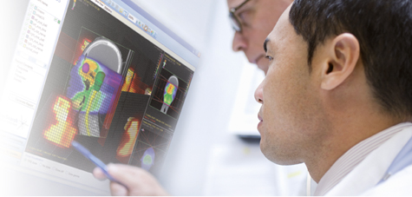

Spin-off from Uppsala Accelerator R&D
Scanditronix
  major supplier
    cyclotrons 1970-80’s
    PETs 1980’s
GE Medical Systems
PET and cyclotrons
  former Scanditronix
IBA Dosimetry
  former Scanditronix Wellhöfer
ScandiNova
  high voltage
  pulse modulators
Scanditronix Magnets
  magnets
Gammadata
  physics tools
  education,
  research,
  industry

Slide 12
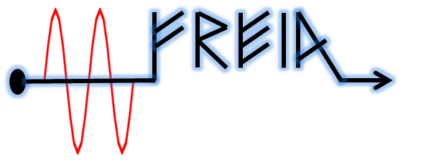



Summary
FREIA is building a bridge
between fundamental scientific research, applied physics and industry
FREIA laboratory enables
  accelerator R&D for medical and research purposes,
  construction of ESS for biology and material science,
  enlarged Cryo Centre
  enlarged R&D space
FREIA opens new opportunities for unique scientific projects in Uppsala
Thanks to
university, faculty,
physics & astronomy department and the FREIA team.

