Slide 1

ESS
A superconducting proton linac
Mats Lindroos on behalf of the ESS
Uppsala 17 June 2013

Slide 2
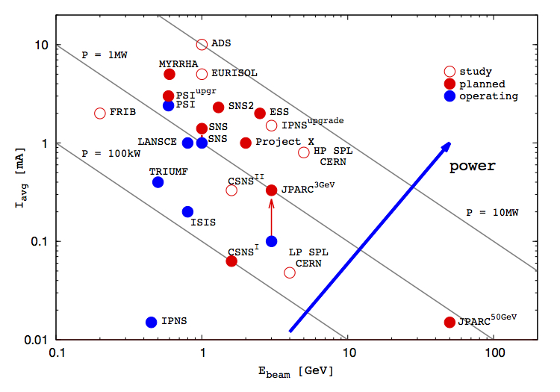
The hadron intensity frontier
2019
1984
Courtesy of Mike Seidel (PSI) and Emmanuel Laface (ESS)

Slide 3
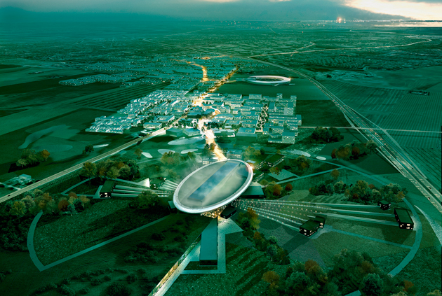
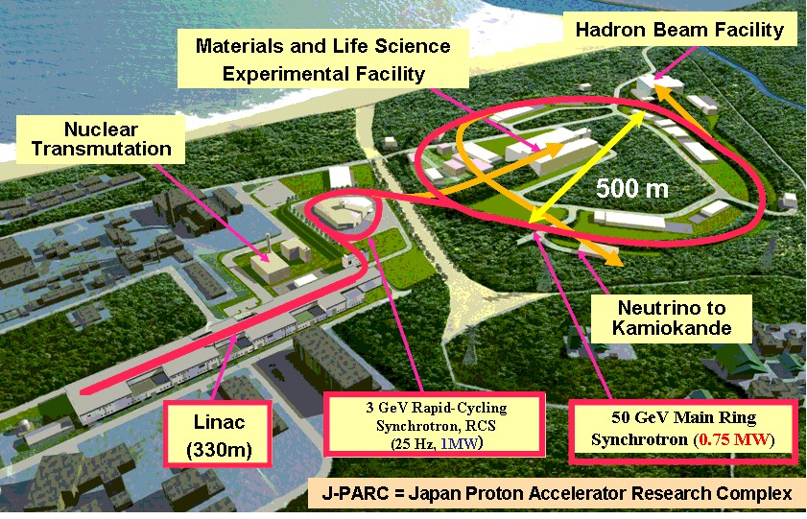
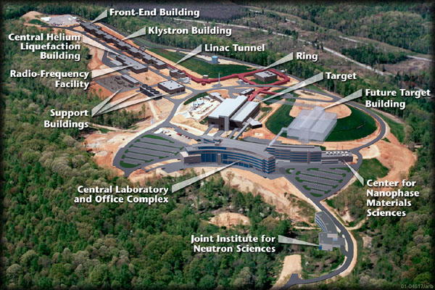
Why ESS ?
Europe 2019: The European Spallation Source
(<5 MW)
One of Europe's largest planned research infrastructure
Will bring new insights to the grand challenges of science and innovation
Collaborative project: Includes more than 17 countries
2014: Start of construction phase of the world's most powerful linear proton accelerator
2019: Provide the world's most advanced tools for studying materials with neutrons co-located with a very bright light source (MAX-IV) (ESS ~ 450 employees > 2500 users / year)
Lund, Sweden
Japan 2008:
JPARC (<1MW)
USA 2006:
SNS (<1.4 MW)
Notes:
Promouvoir la Science de la vie tout comme cela a ete developpe aux USA et au Japon.
Construire une competition tout en assurant un partnenariat entre les differents pays europens autour de la science et de l’innovation.
Outils scientific reliant les sources de lumiere et les sources de neutrons.
Example de projets qui sont construits sur leur predecesseurs.
Each builds on the previous and prepares for the next
regional and European impact
Intensity frontiers
BC: Max 4 , LS

Slide 4
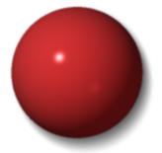



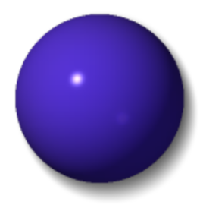






Light and neutrons
H
Li
C
O
S
Mn
Zr
Cs
X-rays
neutrons

Slide 5

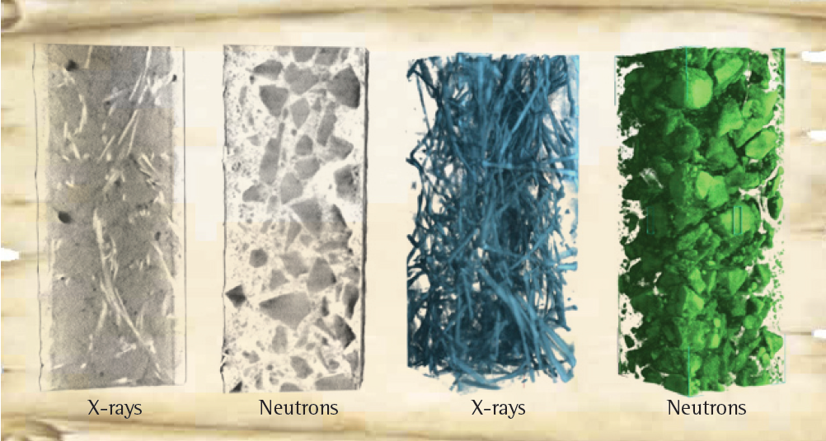
Engineering materials
Non-destructive analysis of a steel armed concrete block with neutron imaging and X-ray tomography.
Source: PSI, CEMNET workshop 2007

Slide 6
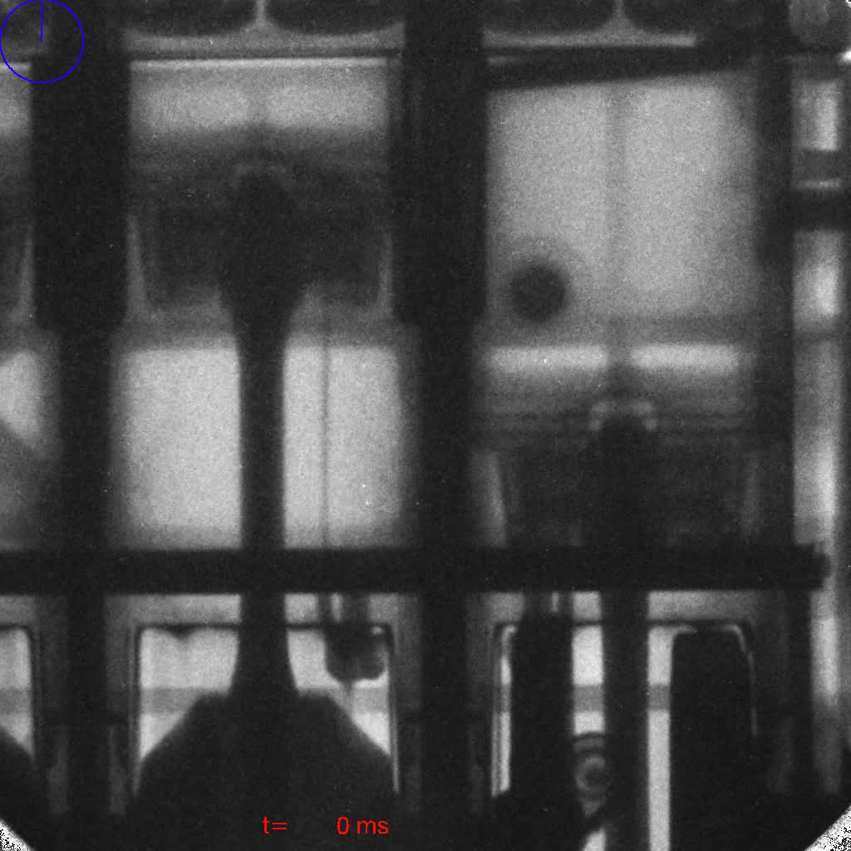
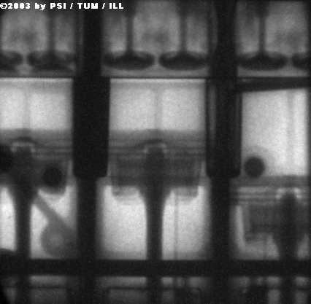
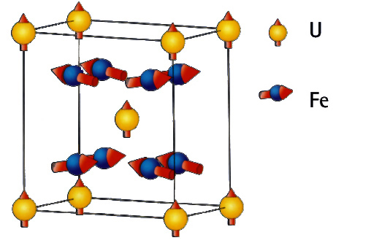
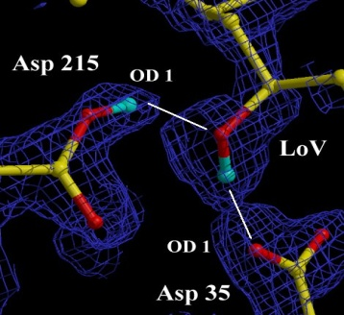
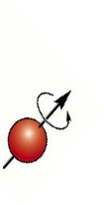
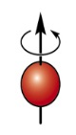
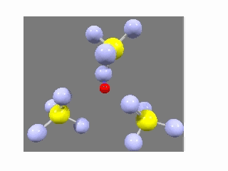
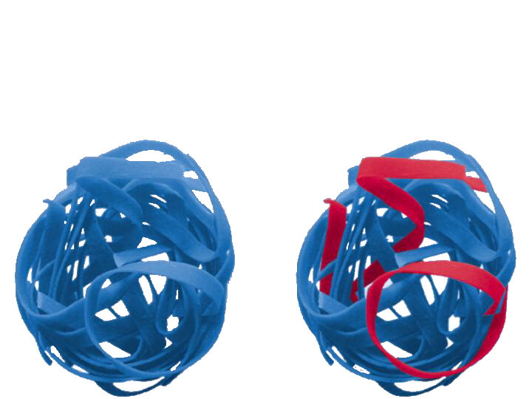
Neutrons and x-rays are complementary
- neutrons…
..see magnetic atoms
..see inside materials
..see light atoms
..see atoms move
..see isotopes
Coutsey of Ian S. Anderson
Notes:
Brief description:
Neutron scatter from the nucleus and not the electrons -> penetrating, see light atoms, and magnetic structures.
Top clockwise:
Neutron Radiograph (from Munich) of an operating BMW engine
X-rays reveal the protein crystal structure – neutrons reveal the positions of the H atoms which are key to the catalytic activity
Isotope contrast (H/D in this case) allows specific strands to be picked out in this complex polymer
Neutrons have mass similar to atoms – and can measure dynamics easily. This is a CH4 electrolyte – the H is transferred via a rotation and cross over mechanism – revealed by neutrons
Neutrons have a magnetic moment. Most magnetic structures have been determined with neutrons. Can also be applied to magnetic dynamics e.g. Spin waves – important in studies of high Tc materials.

Slide 7
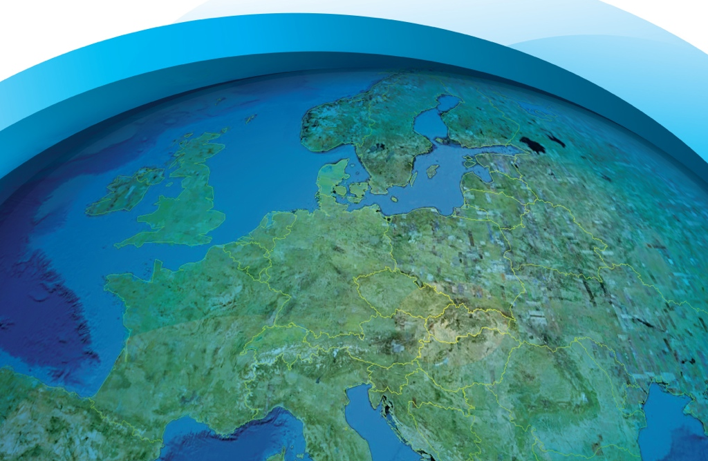

ESS - Bridging the neutron gap
10²⁰
SNS
ESS
MTR
NRU
HFIR
ILL
ISIS
10¹⁵
NRX
HFBR
ZINP-P/
IPNS
WNR
KENS
FRM-II
X-10
SINQ
Effective thermal neutron flux n/cm²-s
10¹⁰
CP-2
ZINP-P
CP-1
10⁵
Berkeley 37-inch cyclotron
350 mCi Ra-Be source
Steady State Sources
Pulsed Sources
1
Chadwick
1930
1940
1950
1960
1970
1980
1990
2000
2010
2020
(Updated from Neutron Scattering, K. Skold and D. L. Price, eds., Academic Press, 1986)
Notes:
Many of the reactor based neutron sources are being phased out = decline in the availability of neutrons = decline in competence and competitiveness
The vast majority of users will profit from a pulsed structure
A large fraction of users are fully satisfied by a long pulse source
Existing short pulse sources (ISIS, JPARC and SNS) can supply the present and imminent future need of short pulse users
Long pulse for physics flexibility (cold and thermal neutrons available)
++. Keep competency in communities – countries balance in science knowledge

Slide 8


















17 nations committed to build ESS
Cash contributions
from Sweden, Denmark and Norway
50% of construction and
20% of operations costs
In-kind contributions
from the other
14 nations
Construction cost: 1843 M€
Operation cost: 140 M€
Decommissioning cost:

Slide 9
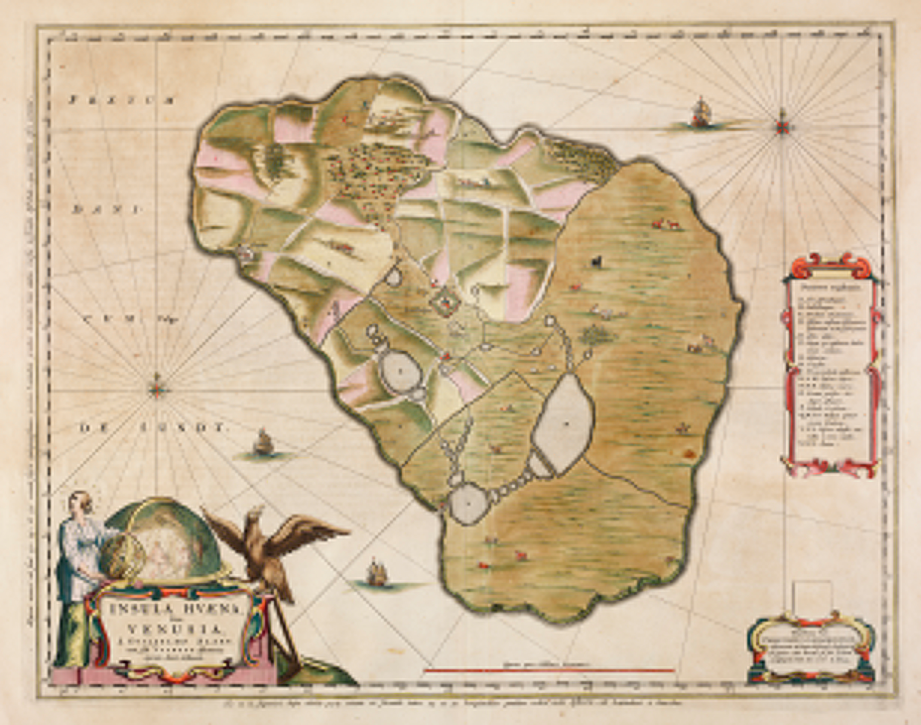
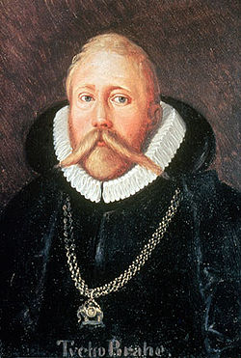
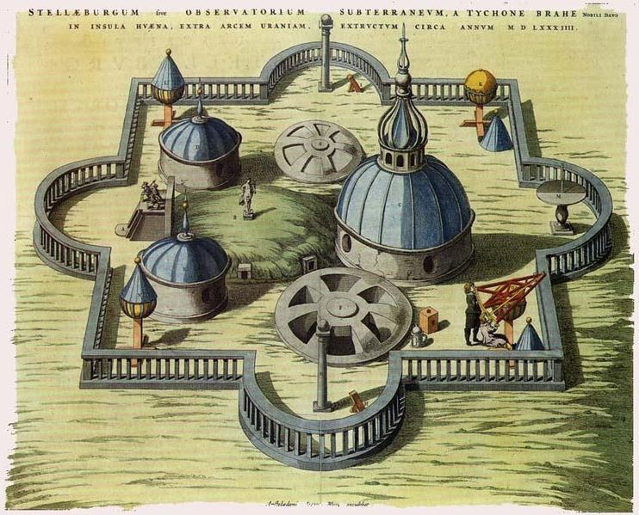
1.8 Billion Euros:
Biggest investment in Science ever in Scandinavia?
In modern time, definitely YES!
However, Tycho Brahe’s Stjärneborg costed the Danish king 1% of the state budget in 1580.
Or you could for 1.5 Billion Euros pay the US bankers bonuses for 24 days!
Notes:
1% would be 1.7 Billion Dollars in 2011

Slide 10

Collaborative projects
ESS is an emerging research laboratory with (still) very limited capacity in-house
Two possibilities:
  Limit the scope of the project so that it can be done with in-house resources
  Work in a collaboration where the scope of the project can be set by the total capacity (distributed) of the partners
The accelerator part of the project well suited for this as this community has a strong tradition of open collaboration (XFEL, FAIR, European commission framework programs such as EUCARD and TIARA, EC design studies such as EURISOL, XFEL, FAIR, LINAC4,...)
To keep cost down and to optimize schedule this requires that investments in required infrastructure is done at the partner with best capacity to deliver
10
Notes:
User driven innovation – external actor to be collective ownership

Slide 11
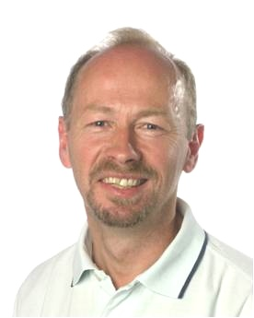
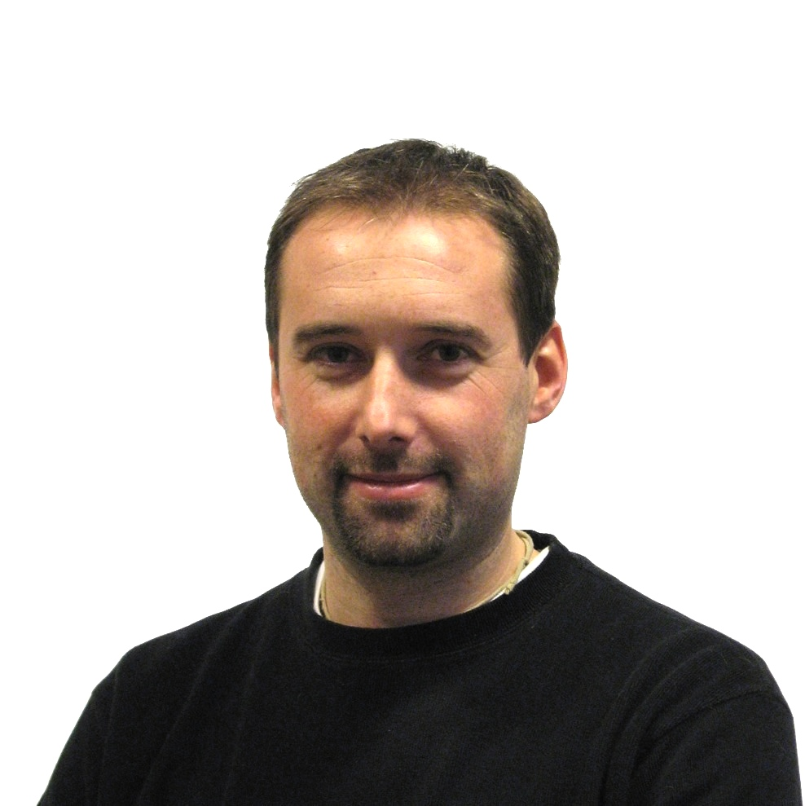


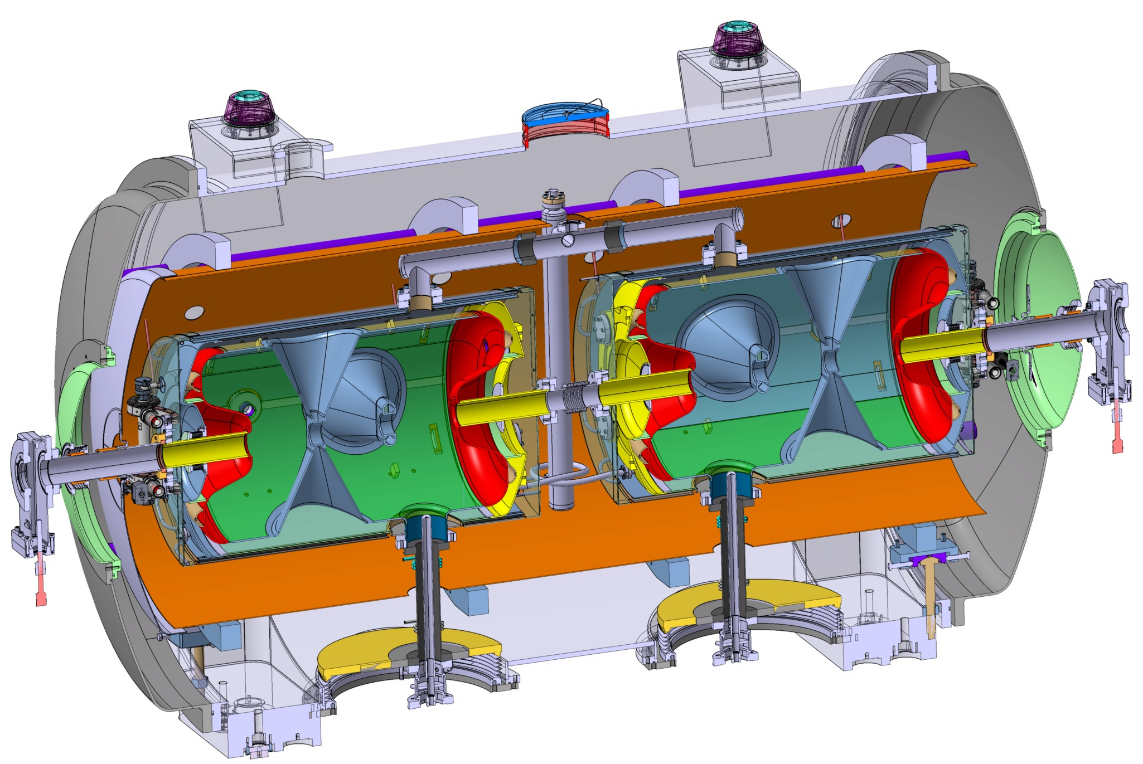
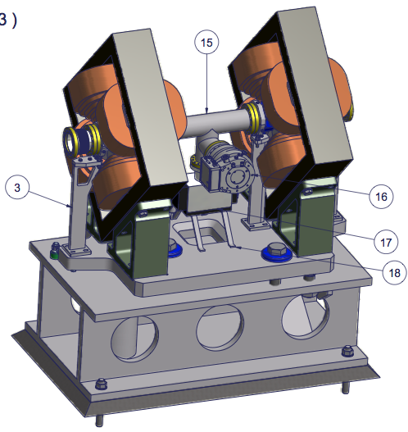
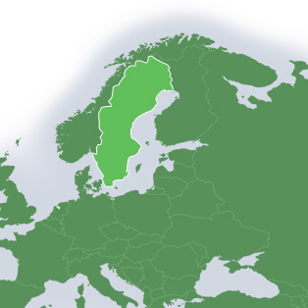
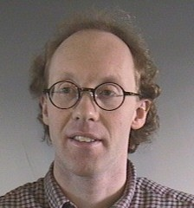


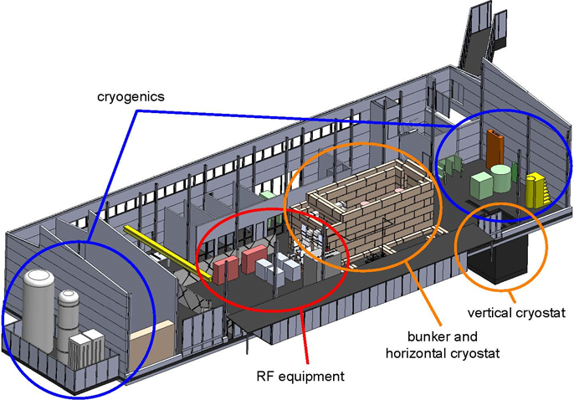
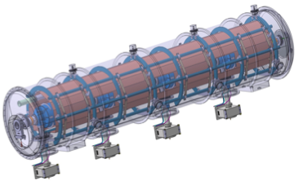

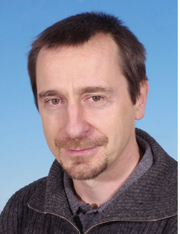
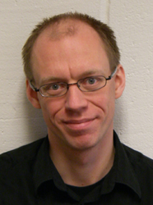
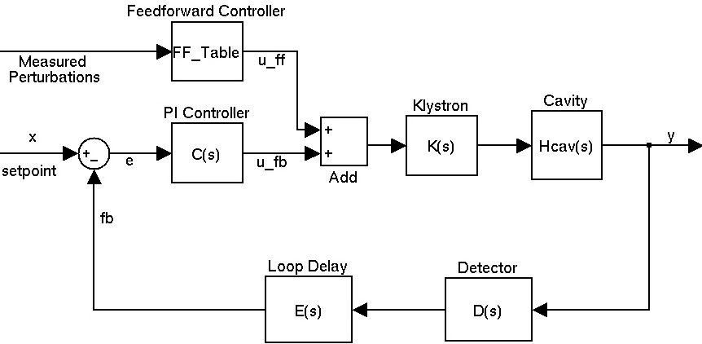

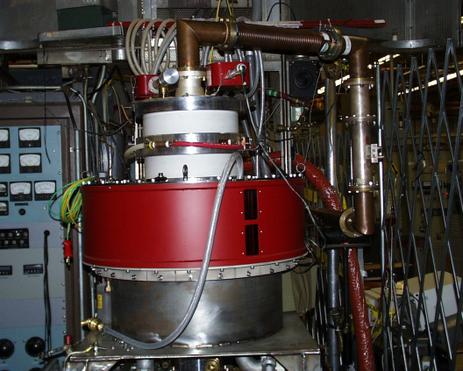

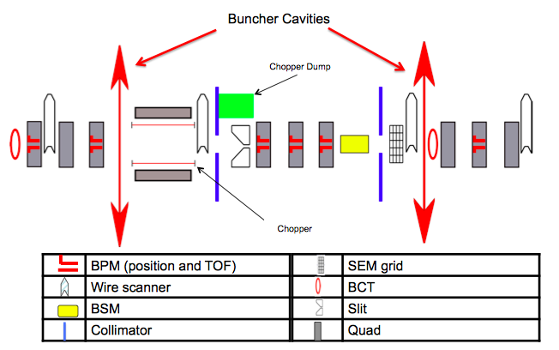
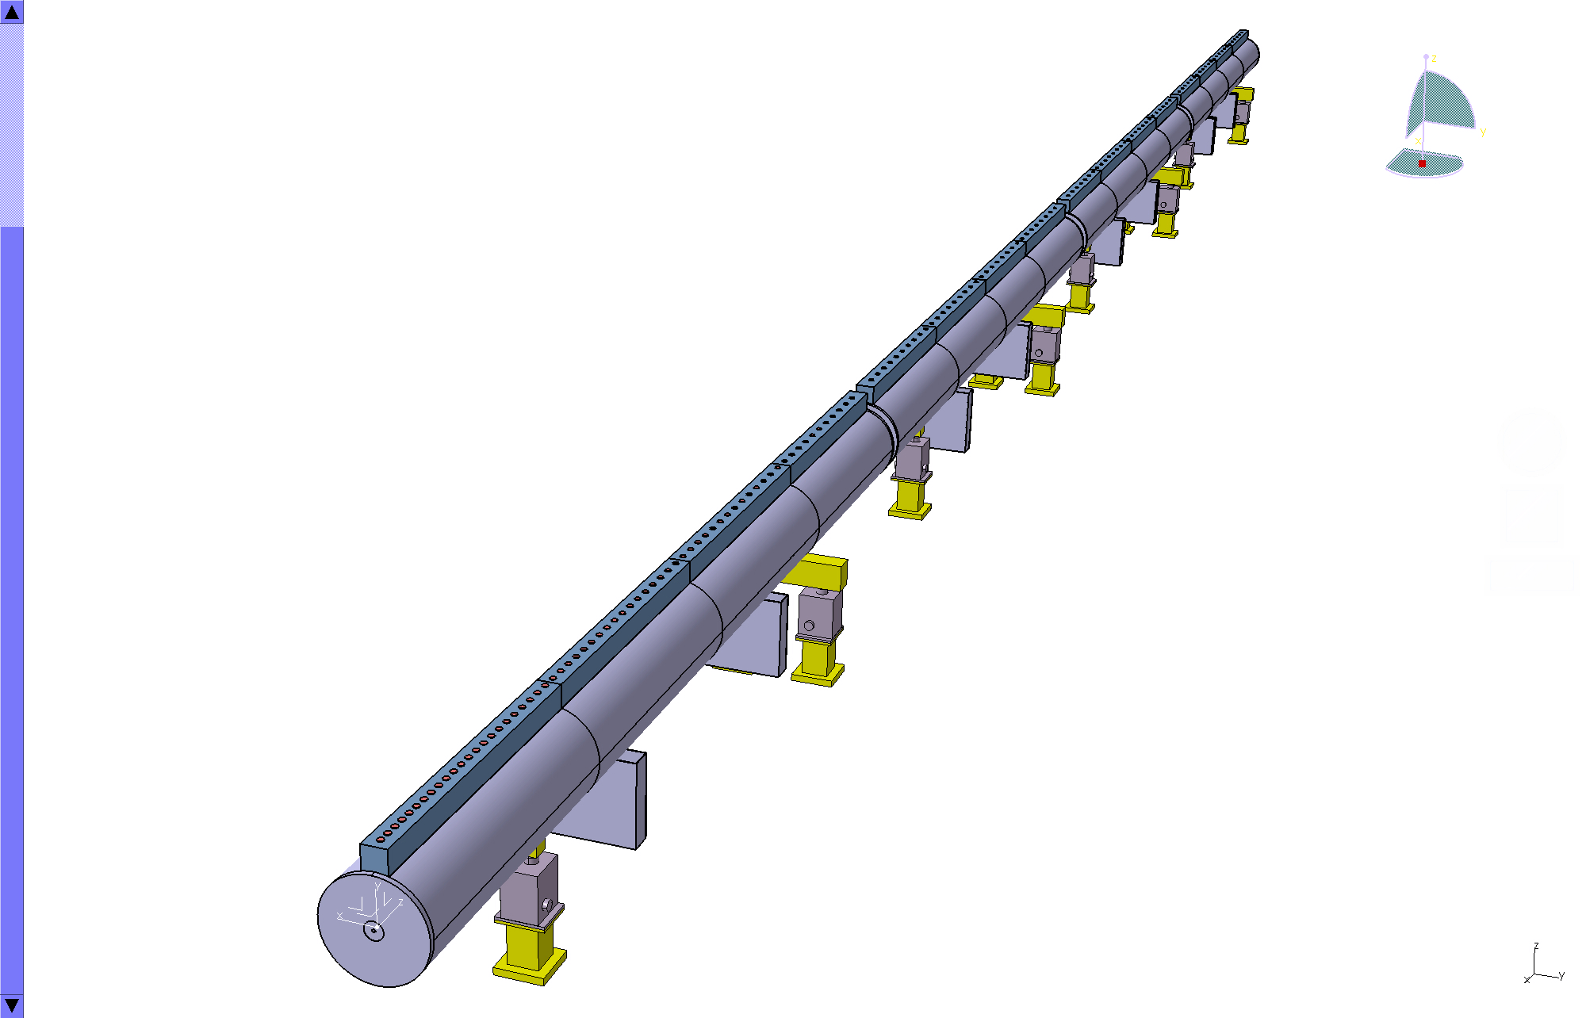
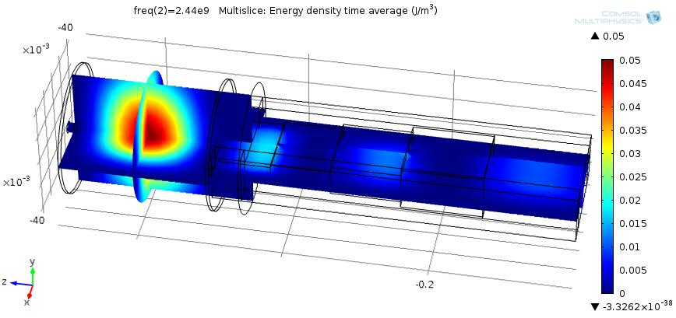
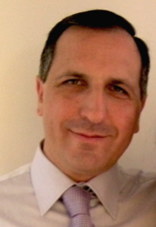


Prototyping the ESS accelerator
Søren Pape Møller
Sebastien Bousson
Roger Ruber
Pierre Bosland
Anders J
Johansson
CERN
The National Center for Nuclear Research, Swierk
Ibon Bustinduy
Santo Gammino

Slide 12
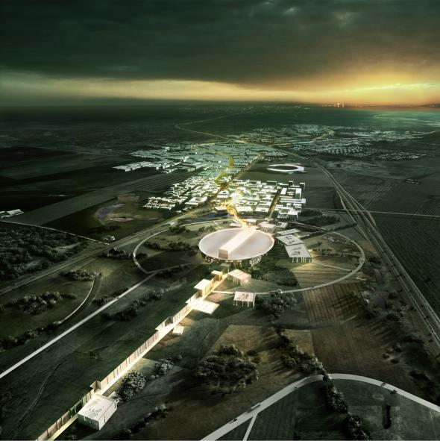




ESS accelerator
Design Drivers:
High Average Beam Power
5 MW
High Peak Beam Power
125 MW
High Availability
> 95%
Key parameters:
    -2.86 ms pulses
    -2 GeV
    -63 mA
    -14 Hz
    -Protons (H+)
    -Low losses
    -Low heat loss cryostats
    for minimum energy
    consumption
    -Flexible design for
    future upgrades

Slide 13
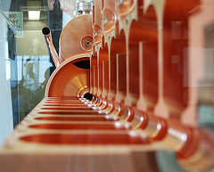
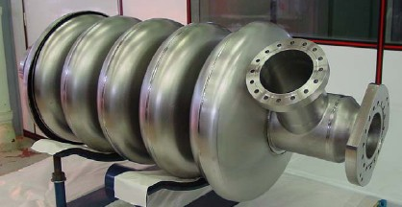
Linac Design Choices
The energy of the linac is a tradeoff of
  Linac length
  Beam current:
    Space charge forces
    Halo losses
Copper Linac
  Low construction costs but high operational costs
  Small bore radius < 3 cm
  Long linac > 750 meters for 2 GeV
Superconducting Linac
  High construction costs but low operational costs
  Large bore radius > 7 cm
  Short Linac < 360 meters for 2 GeV

Slide 14
ESS Linac
352.21 MHz
704.42 MHz
2.4 m
4.0 m
3.6 m
32.4 m
62 m
66 m
182 m
Target
Source
LEBT
RFQ
MEBT
DTL
Spokes
Medium β
High β
HEBT & Contingency
75 keV
3 MeV
78 MeV
223 MeV
532 MeV
2000 MeV
 | Energy (MeV) | No. of Modules | No. of Cavities | βg | Temp (K) | Cryo Length (m)
Source | 0.075 | 1 | 0 | – | ~300 | –
LEBT | 0.075 | – | 0 | – | ~300 | –
RFQ | 3.6 | 1 | 1 | – | ~300 | –
MEBT | 3.6 | – | 3 | – | ~300 | –
DTL | 79 | 5 | 5 | – | ~300 | –
Spoke | 220 | 15 | 2 (2S) × 15 | 0.5 βopt | ~2 | 4.14
Low β | 520 | 8 | 4 (6C) × 8 | 0.67 | ~2 | 8.28
High β | 2000 | 22 | 4 (5C) × 22 | 0.86 | ~2 | 8.28
HEBT | 2000 | – | 0 | – | ~300 | –

Slide 15
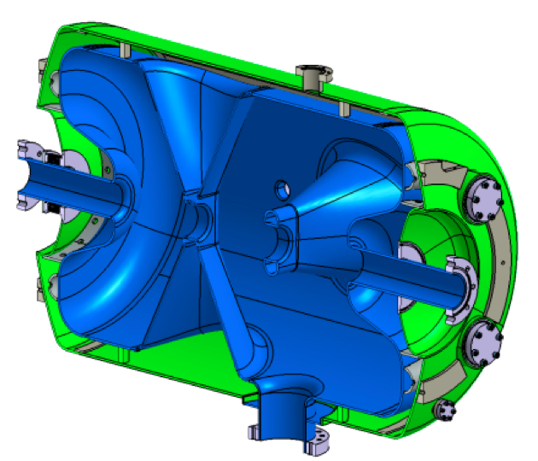
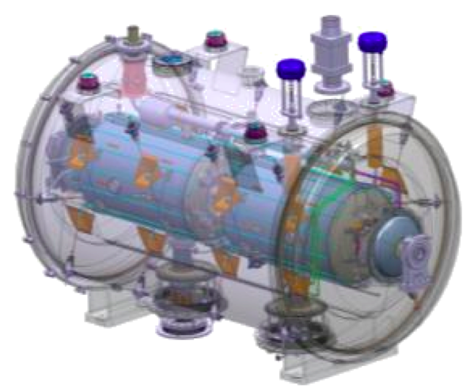
Spoke Cavities
IPNO
  A double spoke cavity, the coupler, helium vessel, ancillaries and cryomodule.
    Cavity made of 4 mm thick bulk niobium
    4 HPR ports on one end
    Helium vessel made of 4 mm thick titanium
    Coupler is the EURISOL design
  The production of 3 prototypes had started in March 2013
Courtesy of Guillaume Olry

Slide 16
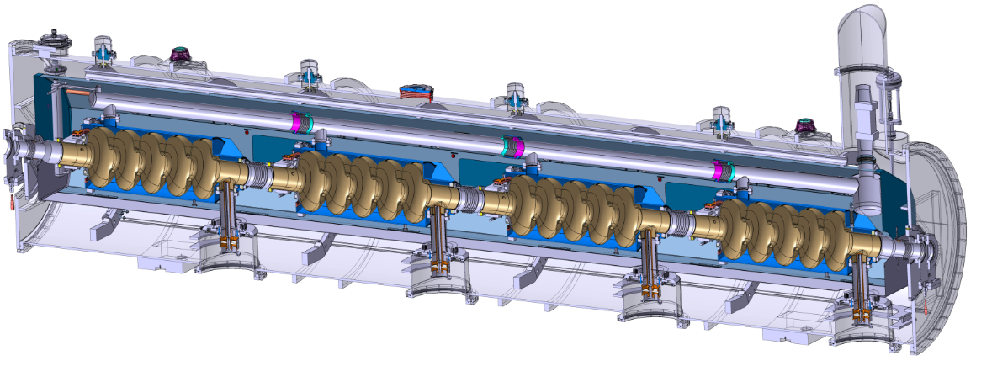
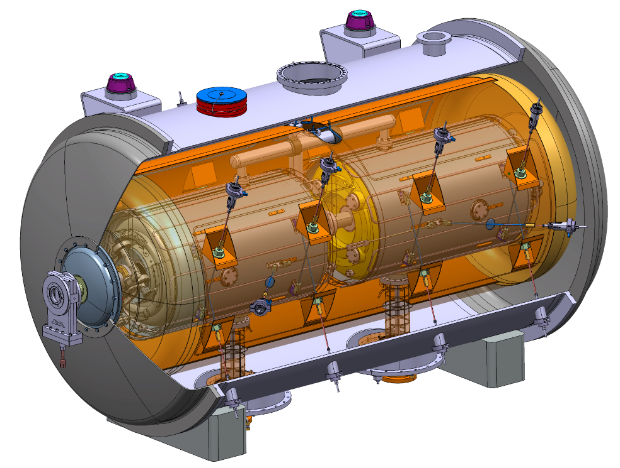
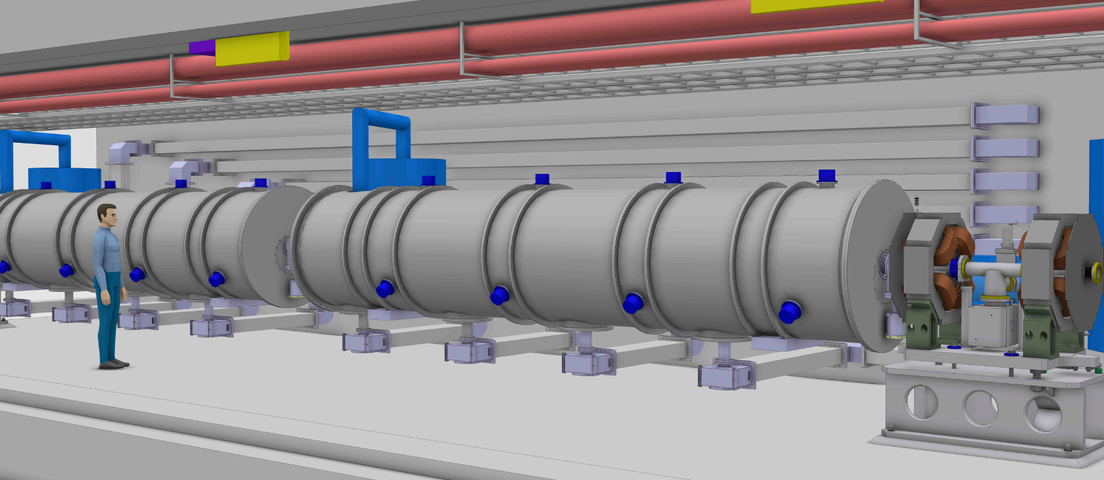
Cryomodules Technology demonstrators
Helium tank
Cold tuning System
5-cell elliptical cavity
Power coupler
Space frame
→ Cavities Cryomodule Technology Demonstrator results by the end of 2015

Slide 17
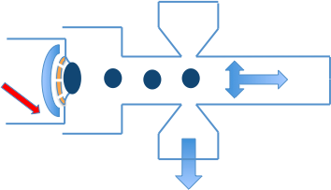
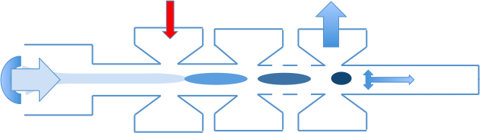
Inductive Output Tubes or klystrons?
RF in
ESS
  Induction Output Tubes, IOTs
    Higher electrical efficiency
      They don’t conduct in the absence of input drive
    Compact
    Short MTTR
    Cheaper modulator (No high voltage switching)
  Why suddenly IOTs?
    Development of Pyrolytic graphite grids
    Solid state drivers
RF in
IOT
Density Modulation
Klystron
Velocity Modulation
Courtesy of Morten Jensen

Slide 18
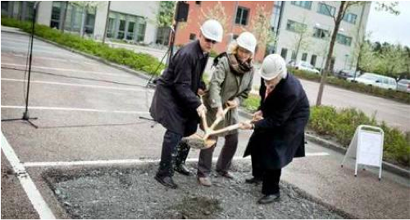
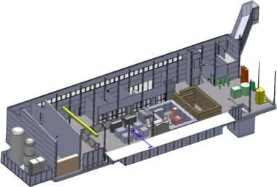
Uppsala Test stand
ESS
Uppsala
  FREIA hall
    Ground breaking, 2012 May 14
    Hall ready by 2013 July
  352 MHz RF test stand
    Spoke cryomodule test stand
      Including the cryogenics

Slide 19
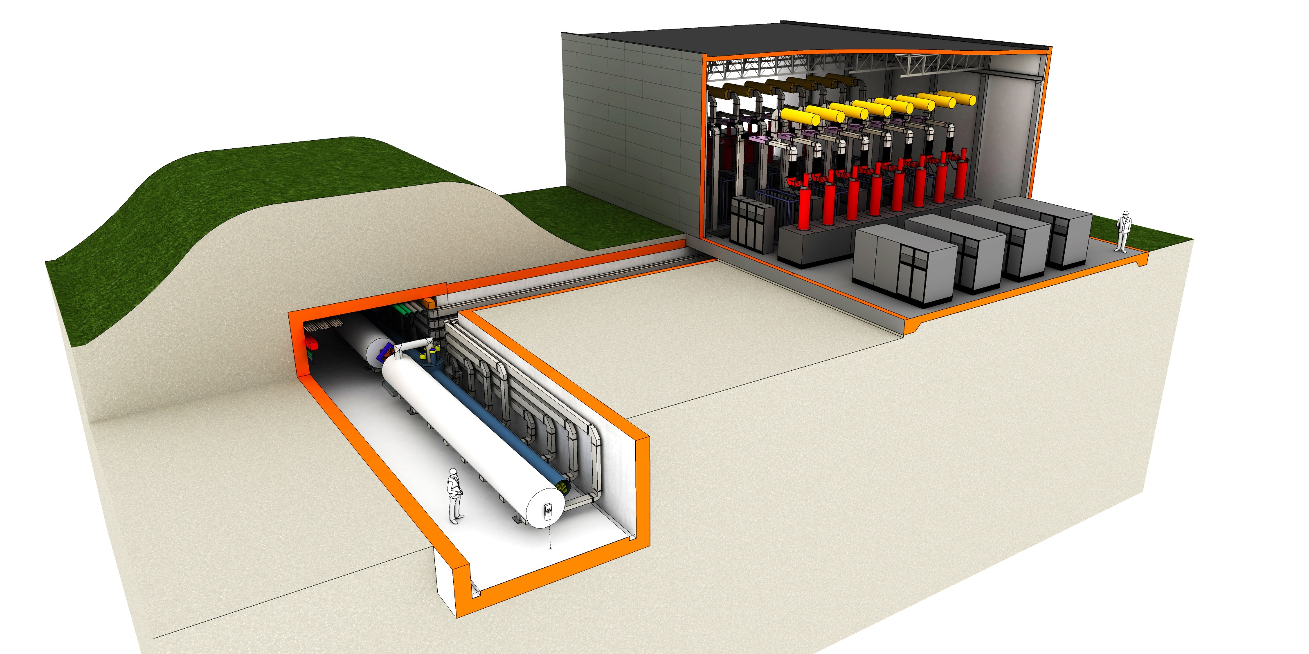
LINAC and klystron buildings, principal structure

Slide 20
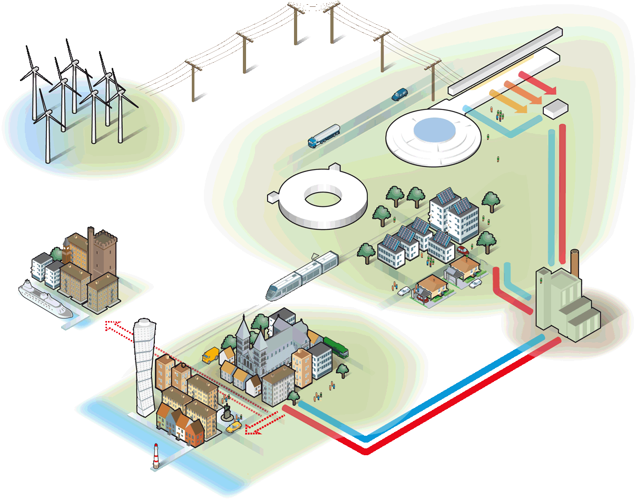
A sustainable research facility
Responsible
Carbondioxide:
- 30 000 ton/year
Renewable
Carbondioxide:
- 120 000 ton/year
Recyclable
Carbondioxide:
- 15 000 ton/year
Notes:
Högsta temp: 118 GWH
All värme: 215 GWh = 10 000 villor

Slide 21
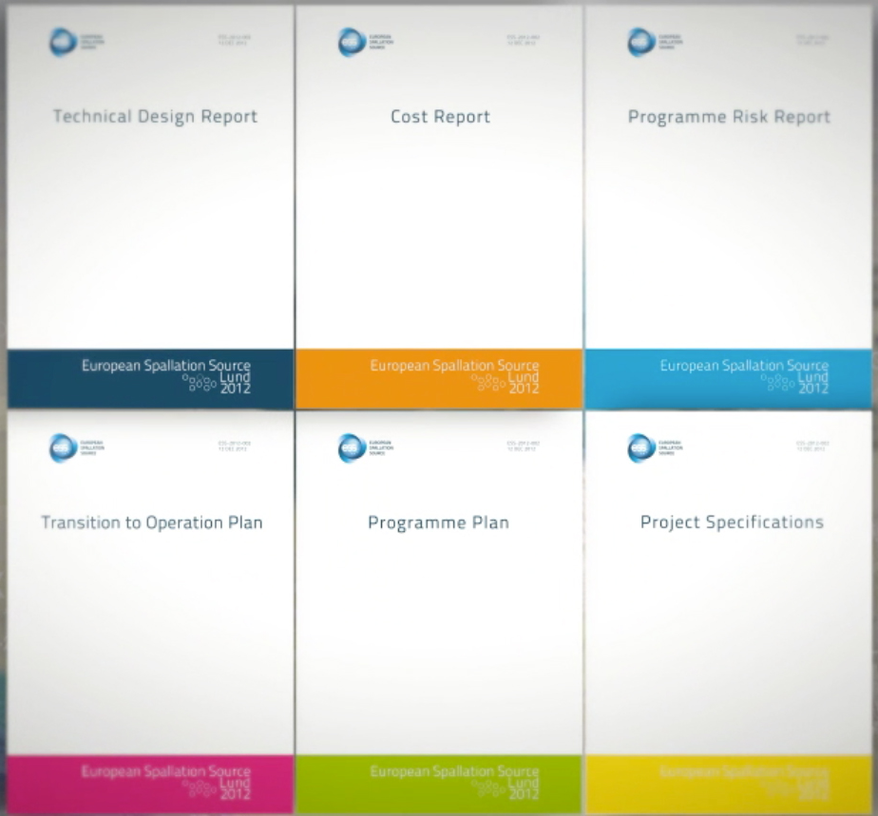

In-kind Process for Construction Begins
Call for Expressions of Interest (Uppsala-FREIA has already submitted an EOI for ESS construction!)
Based on TDR, Project Plan & Cost Book
May contribute “component” or “work”
Several calls; WPs will be released as they mature
Slightly different for Accelerator, Target & Instruments
Competence of the team(s) responding, references
We expect there will be partnering on Work Packages
An Institution or Laboratory, Company, or a Combination
After EoI response, a detailed discussions for IKC begin
- Allen Weeks
Head of Communications @ ESS
ESS | Expression of Interest| 2013-04

Slide 22
Headlines
The ESS Accelerator Design answers ESS need, is hold a lot of potential for a long life with many upgrades – maybe even a neutrino beam…
The ESS partners (collaborations) are essential for the project
A large part of the contributions will come as in-kind from the member states
We are building ESS together!
Many thanks to Uppsala University for important support and contributions – looking forward to continue and further evolve our collaboration!
Many thanks to TIARA for helping to make the ESS accelerator collaborative construction project possible!

Slide 23

Welcome

Slide 24

Elliptical cavities
CEA
IPNO
  The prototyping activities at Orsay/Saclay is planned
    Two cavities to be prototyped
    Niobium is provided
    Clean room 50% complete
  An ESS PhD student at Lund Uni. is designing a medium β cavity
βg | Eacc (MV/m) Ver. Test | Eacc* (MV/m) linac | Q0 @ Eacc | N Cells
0.67 | 17 | 16.7 | 5 × 10⁹ | 6
0.86 | 20 | 19.9 | 6 × 10⁹ | 5
* New design with higher peak surface field!

Slide 25









Properties of neutrons for measurements
Charge neutral
deeply penetrating
S=1/2 spin
probe directly magnetism
Nuclear scattering
sensitive to light elements
and isotopes
Test AdS/CFT correspondence
Li motion in fuel cells
Solve the puzzle of High-Tc
superconductivity
Actives sites in proteins
Help build electric cars
Efficient high speed trains
Better drugs
Notes:
See ILL:
The development of neutron scattering over the past 40 years has been from the initial studies of basic solid state physics in model systems, to detailed studies of complex systems with applications. Similar development can be expected in the next 40 years.
None descriptive tool for the sample → make in-vivo / in real time measurements
Wavelengths comparable to interatomic spacings (1-5 Å)
Energies comparable to structural and magnetic excitations (1-100 meV)
Neutrons interact only weakly with matter
Neutrons are deeply penetrating (bulk samples can be studied)
Neutrons are scattered with a strength that varies randomly from element to element (and isotope to isotope) – tuning ?
Neutrons have a magnetic moment : μ_{n}= -1.913 μ_{N}
➔ Neutron scattering is therefore an ideal probe of magnetic and atomic structures and excitations

Slide 26

The target station design is detailed in the Technical Design Report
Helium-cooled rotating tungsten target
Nearly 5 MW of heat carried away by cooling systems
Entombed in 5 m of steel
Critical components become highly activated, requiring remote handling for servicing
Source: KIT
ESS Technical Design Report, ESS-2013-001, April 22, 2013, available at
http://eval.esss.lu.se/cgi-bin/public/DocDB/ShowDocument?docid=274 .

Slide 27

High beam power leads to an innovative design
Rotating tungsten target
  2.5 m diameter
  33 sectors
  Suspended on a 6 m shaft
  Total mass: 17 tonnes
  Rotational speed = 0.42 Hz
  Estimated lifetime = 5 years
Helium coolant
  3 kg/s flow rate
  4 bar inlet, 1 bar ∆P
  20°C inlet, 200°C ∆T
Source: KIT

Slide 28

Liquid hydrogen moderators deliver cold neutrons to instruments
Moderator-
Reflector
Plug
Liquid para-hydrogen at 20 K carries away 20 kW
of deposited heat
Moderators surrounded by beryllium reflector provides peak neutronic performance
Moderator-reflector plug weighs 24 tonnes
Estimated lifetime = 1 year
moderators
inner Be
reflector
outer SS
reflector

Slide 29

Activated components are handled remotely in hot cells

