Slide 1
PPT-mall 2
Synchrotron Light Sources
Lars Malmgren
On Behalf of the MAX IV RF Group
Med linje

Slide 2
Outline
MAX IV overview
RF sources for synchrotron facilities
MAX IV RF sources

Slide 3
Inauguration June 21, 2016

Slide 4
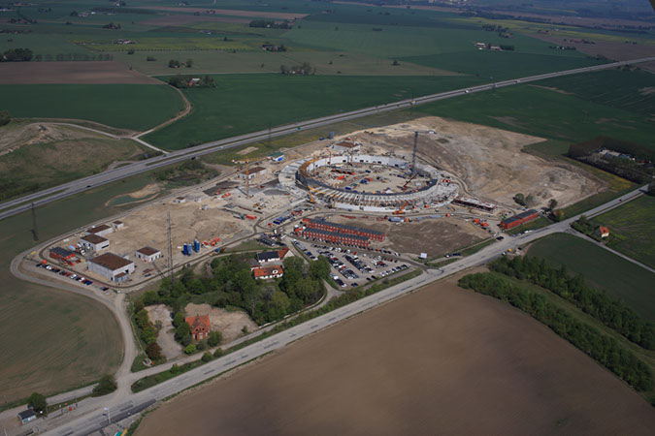
Aerial view of the MAX IV site
Photo Perry Nordeng 130516

Slide 5
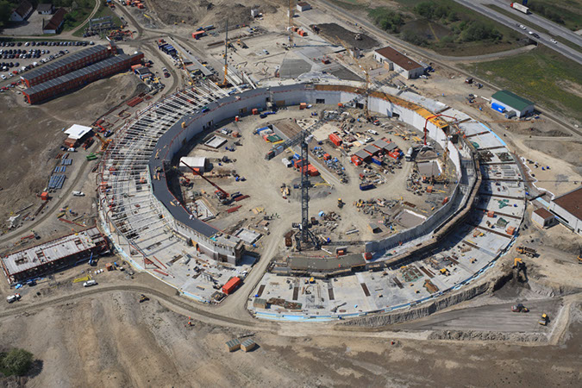
Aerial view of the MAXIV 3 GeV ring construction
Photo Perry Nordeng 130516

Slide 6
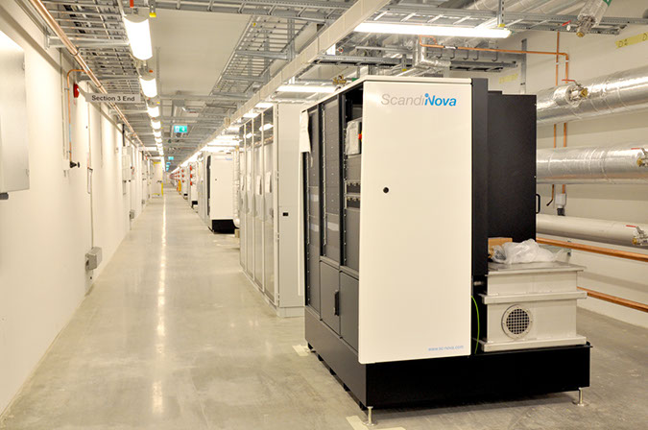
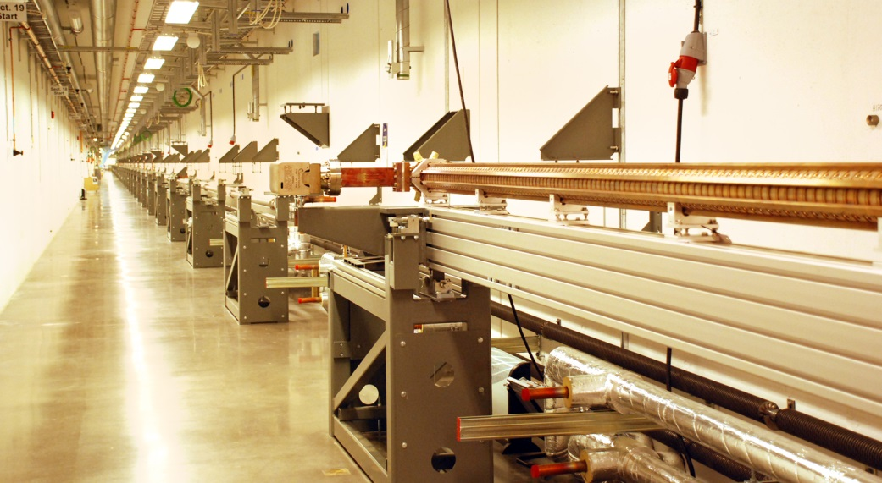
MAX IV Linear Accelerator
Linear accelerator
Klystron gallery
Photo Annika Nyberg 20130614

Slide 7


RF transmitters for accelerating structures in synchrotron facilities
Cavity tuning loop
Amplitude loop
Phase loop
RF Distribution
Control System
Pre-amp.
Power
Amplifier
Master Oscillator
LLRF
Power Supply
Modulator
Dummy Load
RF Power Sources
Accelerating Cavity

Slide 8
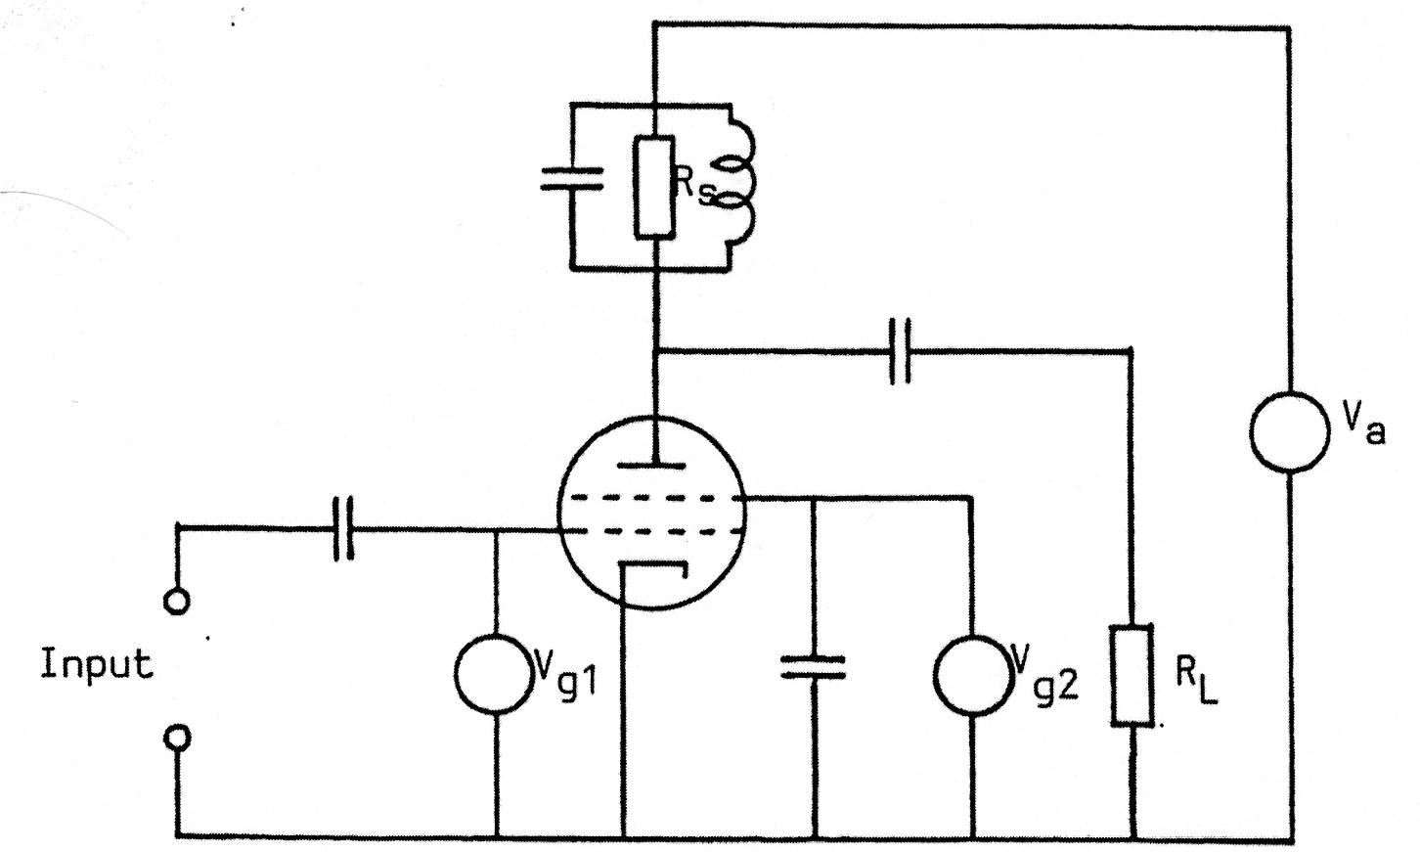
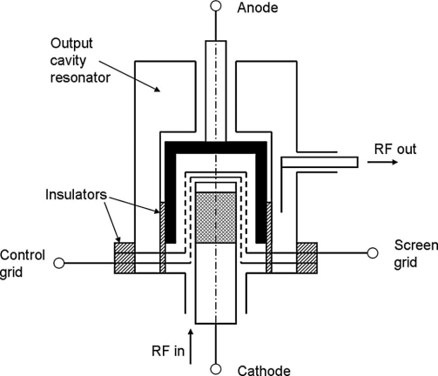
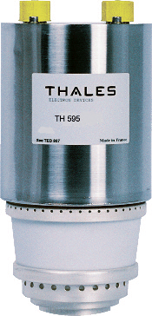
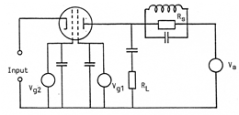

Tetrode
Vacuum tube based on intensity modulation of a electronbeam
Typical parameters:
  Frequency: accelerator applications up 300 to 400MHz
    Finite electron drift time limits the achievable gain at higher frequencies
Grounded cathode

Slide 9
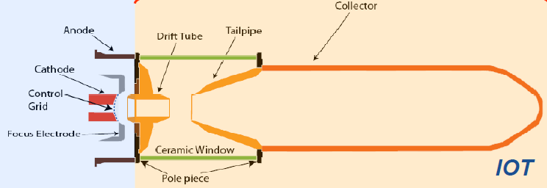
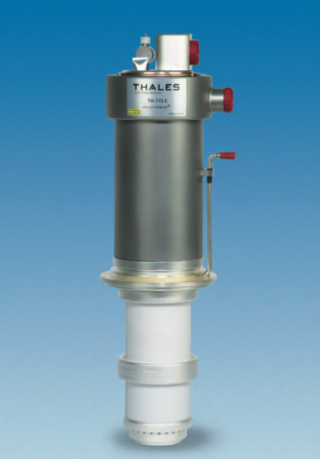
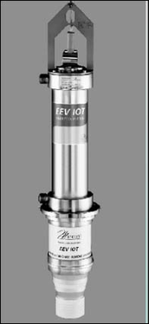
Inductive output tube (IOT) - Klystrode
As a tetrode
As a klystron
IOT developed for accelerators [Thales, CPI]:80 kW CW at 470 –760 MHz
  High efficiency (70%) operation in class B
  Intrinsic low gain ( 20 -25 dB) ⇒Pin= 1 Kw
  Less Amplitude/Phase sensitivity to HV ripples
  Compact, external cavity ⇒easy to handle
  Low unit power ⇒power combiners
1.3 GHz for cw XFEL linacs and ERLs
  16 to 20 kW CW, efficiency 55 to 65% ( CPI, E2V, Thales)

Slide 10
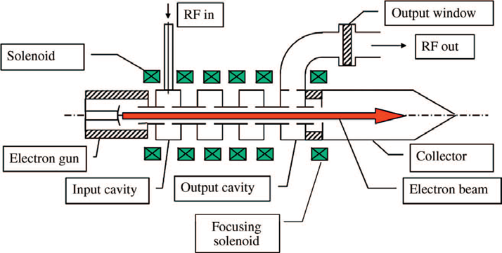
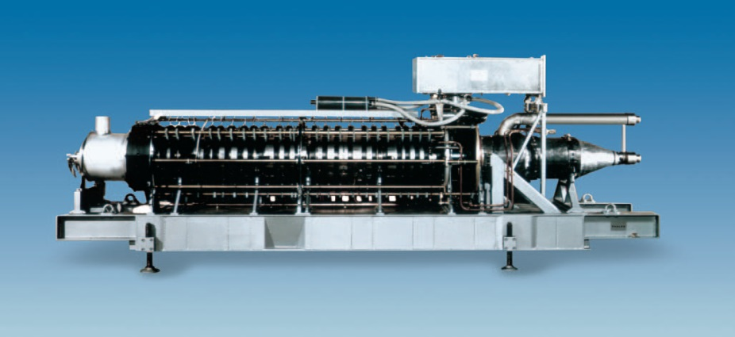
CW klystron
Typical CW klystrons:
  Smaller accelerators: TV klystrons
  60 kW / 500 MHz
  Larger Machines: Super klystrons
  1…1.3 MW
  352, 500, 700 MHz
  ηtyp= 62 %
  Gtyp= 42 dB ⇒Pin≤100 W
1.1 MW @ 352 MHz
Requires:
100 kV, 20 A dc High Voltage Power Supply
With Crowbar protection (ignitron, thyratron)
Modern alternative: IGBT switched PS
High voltage ⇒X-ray shielding
Thales TH 2089

Slide 11

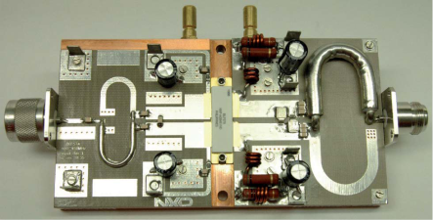
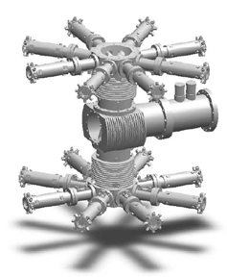
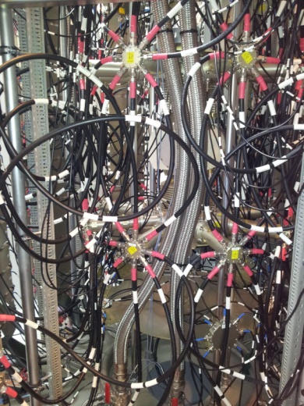
Solid state CW power source
Various technologies avaliable
Silicon bipolar transistors
Silicon LDMOS
One of eight 352 MHz 75 kW solid state amplifier towers for the ESRF, Grenoble, booster RF system
BLF578XR (NXP) ”Unbreakable” )
LDMOS power transistor ~1kW@100MHz
The power required is obtained by combining transistor modules
Max Power | Class of operation/Efficiency | Features | Drawbacks
200 kW/plant | B, AB η≤ 50% | Simplicity Modularity No HV | Large currents High initial costs

Slide 12
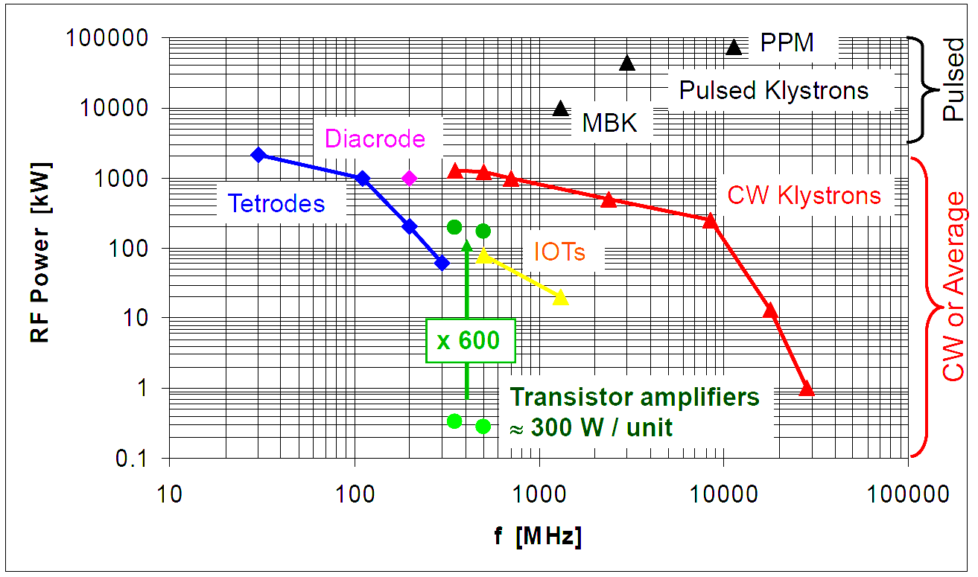
RF power sources
LDMOS Transistor
̴1000W/unit
MAXIV
J. Jacob (ESRF)

Slide 13
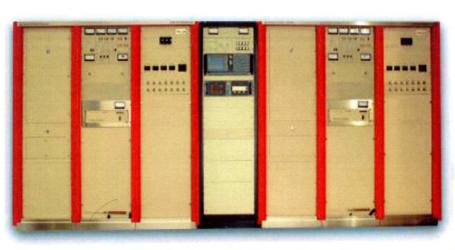
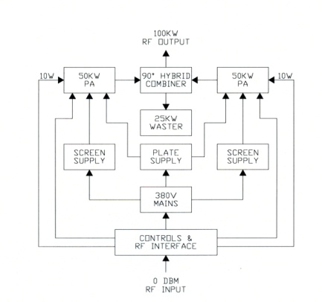
Tetrode 100 MHz CW power sources for the Max IV storage rings
Storage Rings Parameters
Max IV Water coold
2 combined 60 kW transmitters
1 single 60 kW transmitters
The operation frequency makes it possible to use standard FM transmitters
Max Power | Class of operation/Efficiency | Features | Drawbacks
- | C /η ≥60% | Low cost/kW | Tube liftime limited ≈30000 hours

Slide 14
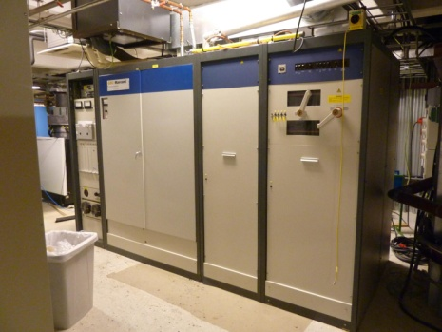
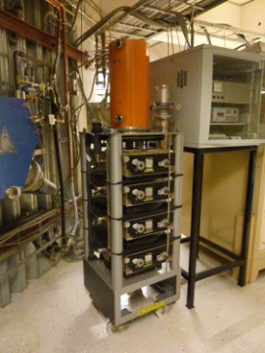
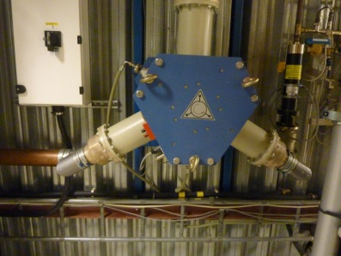
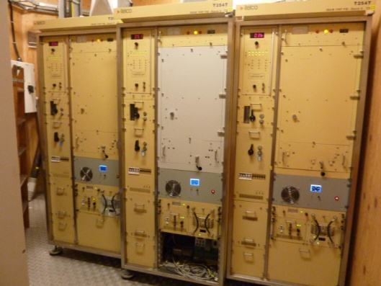
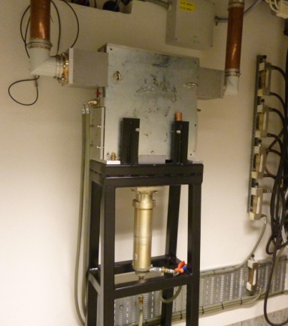
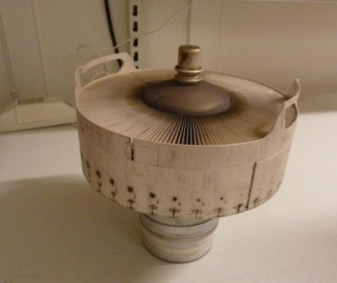
CW power sources at Maxlab storage rings (Max I, II and III)
Max I is operated at 500 MHz but both Max II and III uses 100 MHz
500 MHz circulator
Rigid coaxial transmission lines are used
Max I uses a 40 kW klystron TV broadcast transmitter from Teracom
CW klystron unit
4CX20000 Max II and III
Air coold tetrode
Max II and III uses 30 kW air coold FM transmitters
Max II needs three transmitters feeding one cavity each. Max I needs only one.
100 MHz circulator
Rigid coaxial transmission line are used

Slide 15
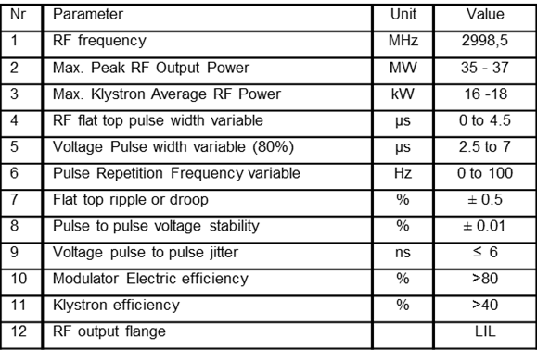
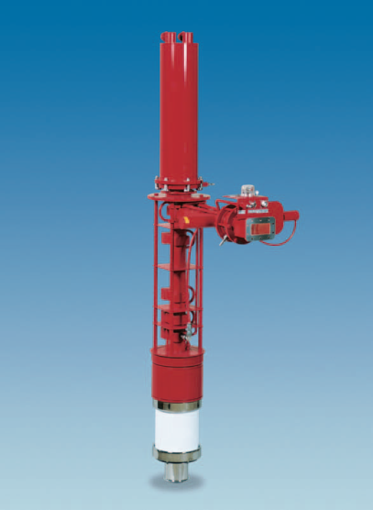
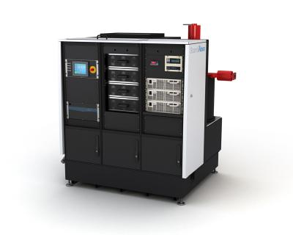
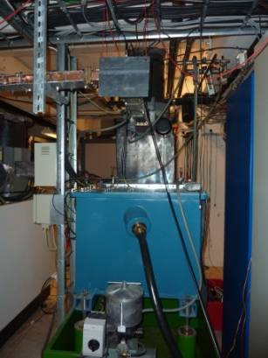
Pulsed klystron power sources at Maxlab and MAX IV
MaxIV Linac
Maxlab Linac
Toshiba
E37310
S-band
Klystron
Thales
TH 2100
S-band
Klystron
f = 2998.5 MHz
P= 35 MW pk/
16 kW rms
Max RF pulse time 4.5µs
η=42 %
Gain= 50 dB typ.
Beam voltage
275 kV pk
Beam current
303 A pk
f = 2998.5 MHz
P= 35 MW pk/
17.5 kW rms
Max RF pulse time 4.5µs
η=45 %
Gain= 53 dB typ.
Beam voltage
285 kV pk
Beam current
295 A pk
Klystron pulsed power supply
(solidstate modulator Scandinova)
MaxIV

Slide 16
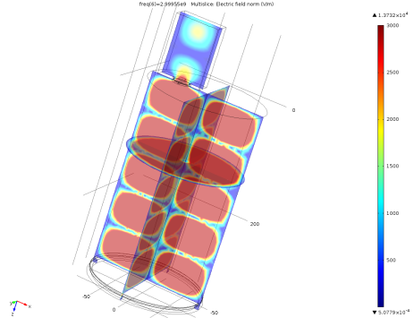
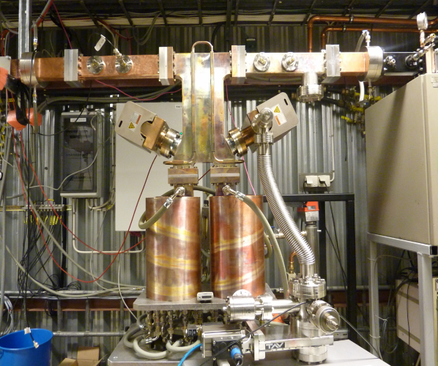
Pulse compression (SLED)
The Stanford Linac Energy Doubling (SLED) is used to increase the peak power for a given total pulse energy. This is obtained by charging an overcoupled (β≈6) high-Q cavity by the RF generator.
Waveguide input (iris)
coupler
The accelerating gradients integrated over a small portion of the klystron pulse durtion is almost doubled.
Δφ/ΔT =8°/°C
TE₀₁₅, Q≈10⁵
Coolingwater temperatur stability ± 0.02 °
RF phase stability < ± 0.2°
E_{K}
E_{L}
180º phase shift
Klystron
3 dB Coupler
Cavity 1
Cavity 2
Accel. sections

Slide 17
MAX IV linac RF system
The linac should be used as injector for both the 1.5 and 3 GeV storage rings and SPF
18 klystrons
18 SLEDs
39 linac structures
Operating frequency 2998.5 MHz
Maximum rep. rate 100Hz
Maximum RF power 35 MW
RF pulse length 4.5µs
Linac length 250 m
1 klystron feeding the thermionic gun(7.5MW)
Operating beam energy 3 GeV
Max. on-crest beam energy 3.6 GeV
  44% RF power redundancy

Slide 18
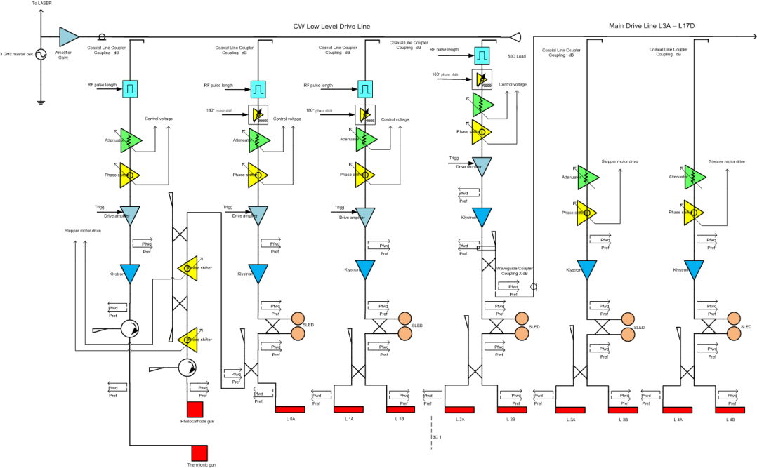
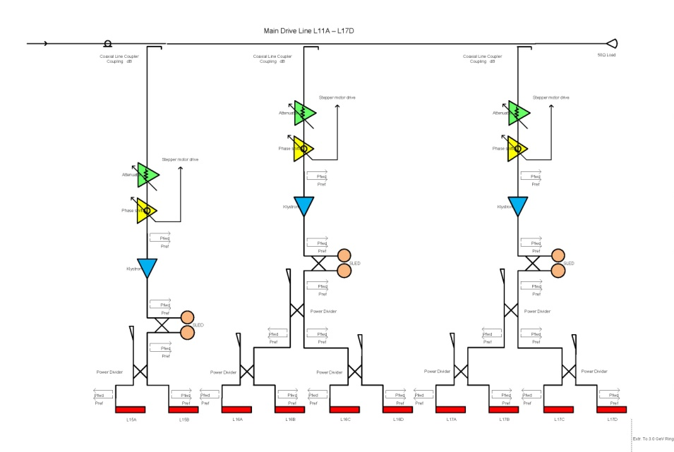
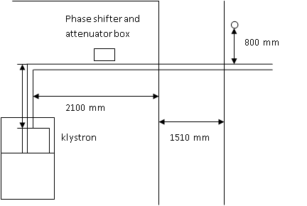
Max IV linac RF system
Random voltage and phase variationstions are reduced by one over the square root of the number of klystrons
Main Drive Line (MDL) feeding 15 klystrons
Klystron tunnel
Concret
Linac tunnel
The linac consists of two parallel tunnels with 1.5 m concret in between.
The wave velocity in an air-filled transmission lines is almost the same as the speed of the electrons in the linac.
Length variations of the linac tunnel due to e.g. seasonal outside temperature variations will automatically be compensated for since the MDL, consisting of a rigid 1 5/8” coaxial transmission line with sliding joints, also will follow this length variations.

Slide 19
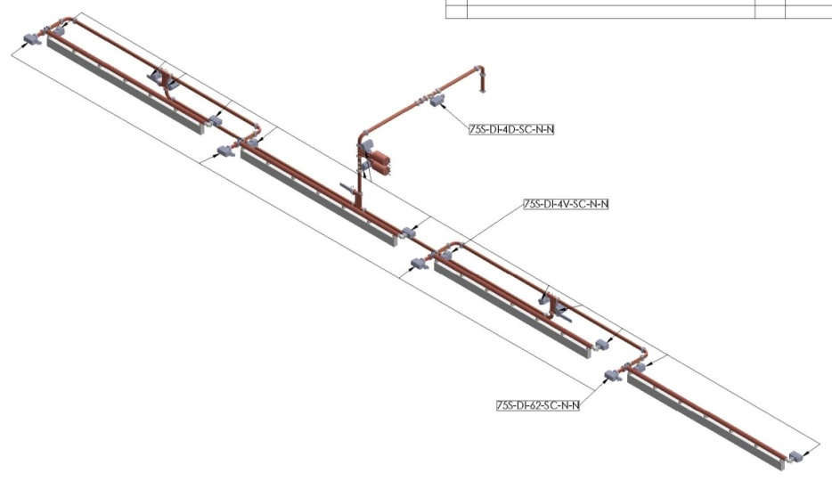
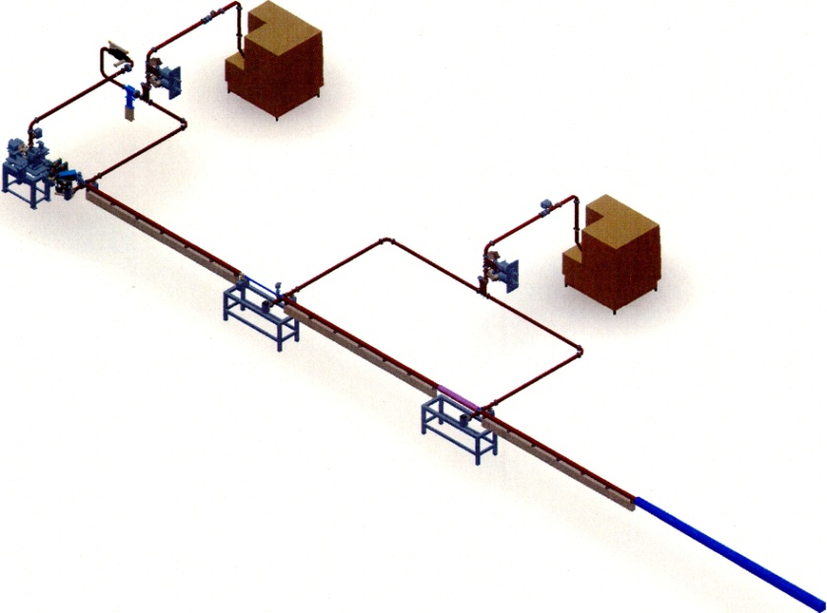
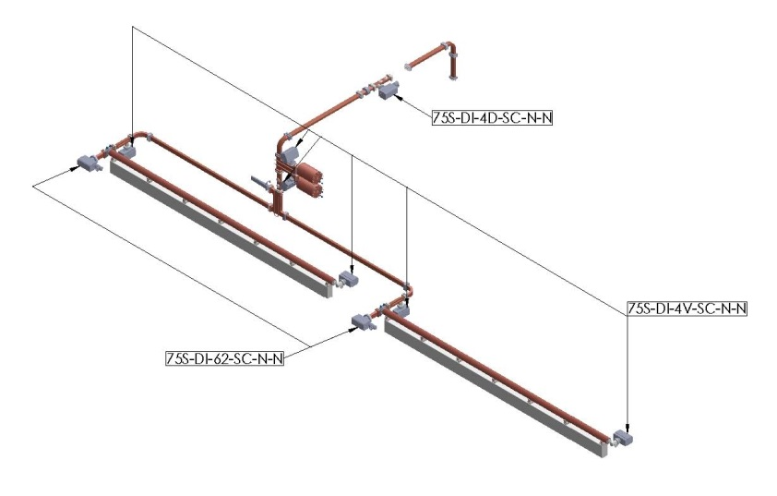
MAX IV linac configuration
RF unit including klystron and
modulator(power supply)
Waveguids are used for high power distribution
15 RF units feeding two accelerator
Structures each
2 RF units feeding four accelerator
Structures each
S-band (2998.5 MHz) constant gadient traveling wave linac sections (5.2m).

Slide 20
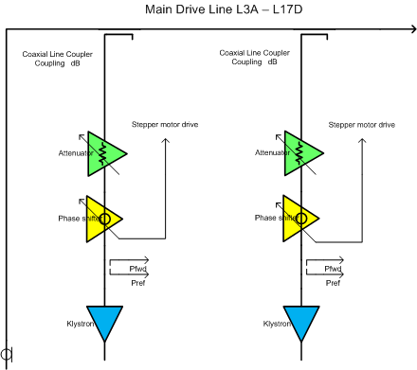
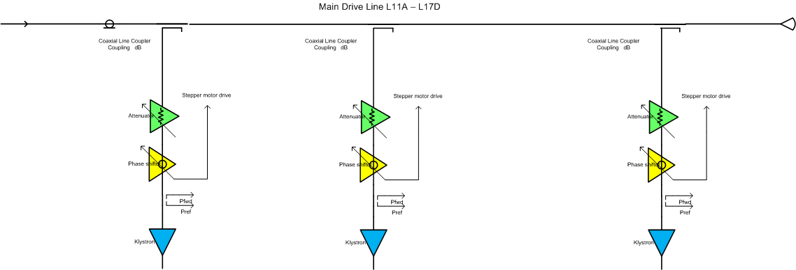
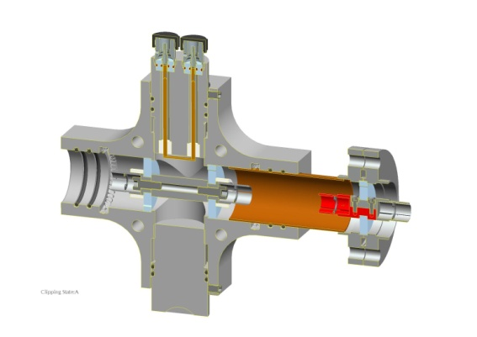
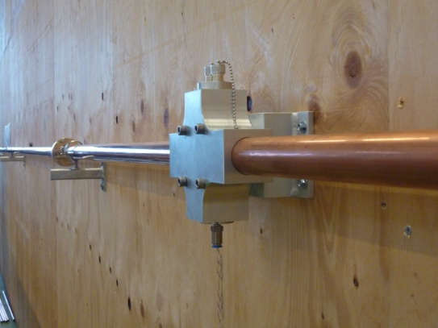
MDL
MDL feeding 15 klystrons
The MDL input RF power taken from the fourth klystron is 90 kW
The transmission line pressure(nitrogen) is regulated to compensate for propagation variations due to pressure change
Adjustable directional couplers
Fixed to the linac tunnel wall at each accelerating section
Sliding joints
Connected together with pressure regulated 1 5/8” EIA rigid line

Slide 21
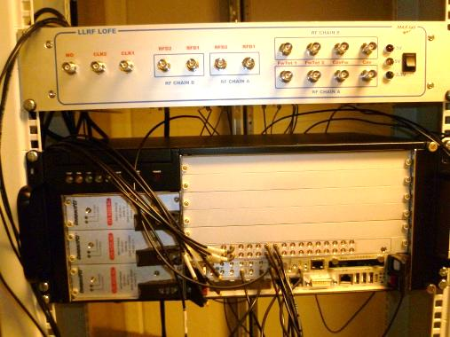
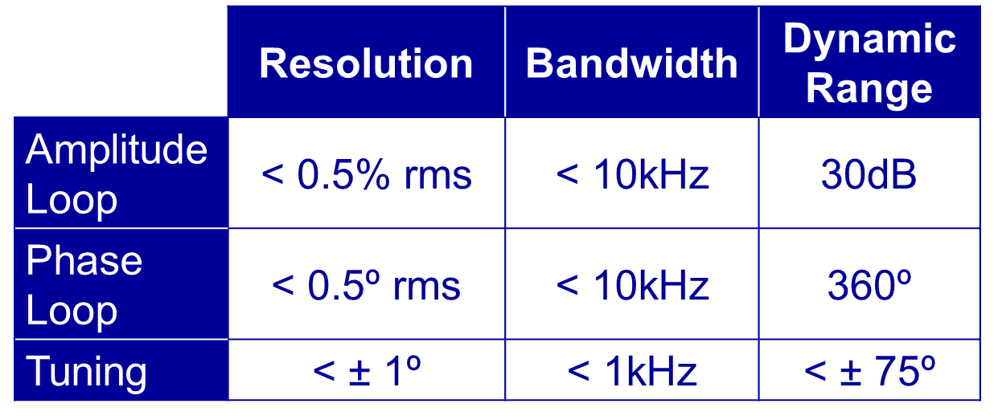
Digital Low Level RF
Design by A.Solom,ALBA
Prototype Assembled and Tested at MAX-lab
First Successful tests with Beam at MAX-III in September 2011.
200 mA ramped with voltage and frequency loops engaged.

Slide 22
Thanks for your attention

Slide 23
