Slide 1
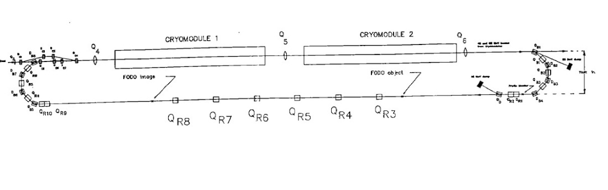
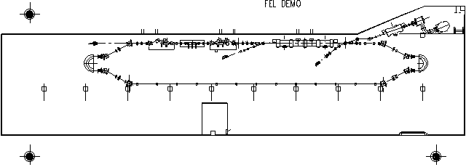
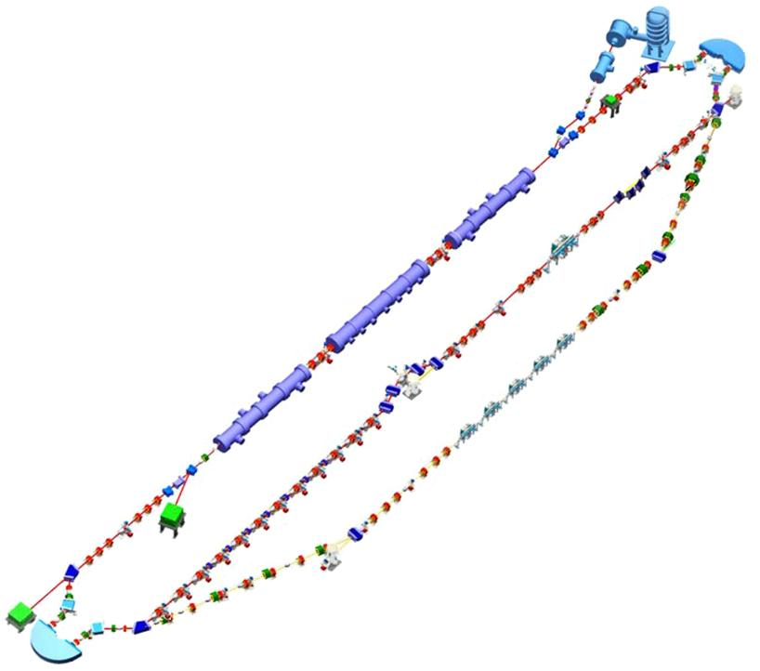
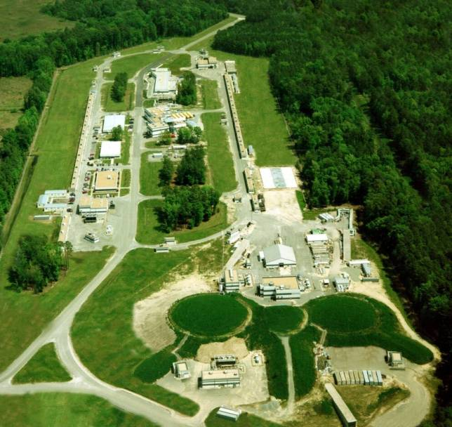
Energy Recovered Linacs:
The User Beam as RF Source
Notice: This manuscript has been authored by Jefferson Science Associates, LLC under Contract No. DE-AC05-06OR23177 with the U.S. Department of Energy. The United States Government retains and the publisher, by accepting the article for publication, acknowledges that the United States Government retains a non- exclusive, paid-up, irrevocable, world-wide license to publish or reproduce the published form of this manuscript, or allow others to do so, for United States Government purposes.

Slide 2
Outline
What/Why are ERLs?
The importance of longitudinal matching
  Example: FEL driver
RF constraints/RF Transients

Slide 3
What are ERLs?
Compare to conventional accelerators…
Rings
  Recycle each accelerated particle an infinite number of times – adding a bit of energy each time
  High beam powers for modest input power: efficient acceleration
    MW of RF + MW DC ⇒ GW beam power (e.g., 0.5 A @ 2 GeV)
  Circulation of beam ⇒ radiation excitation ⇒ inherently limited beam quality
Linacs
  Accelerate each particle rapidly in a multiple RF structures
  Beam power inherently less than power required for acceleration (wall losses): inefficient acceleration
    MW of RF + MW of DC ⇒ MW beam power (e.g., 50 μA @ 20 GeV)
  BUT… Beam is not in machine long enough for quality to degrade: performance is source limited

Slide 4
Linac Cost/Performance Optimization:
Recirculation and SRF
Linacs provide great beam quality, so its worthwhile to try to make them more cost effective
To control cost & improve performance, linac builders utilize certain “slight of hand” tricks
Recirculation : “reuse” accelerating structure, reducing linac size and hence cost
  Transport beam from end of linac & reinject in phase with the RF fields for further acceleration
Superconducting RF : avoids wall losses
  Allows high gradient CW operation
  Dramatically reduces required RF power (enough to offset cost of cryogenic plant and additional RF system complexity)
  Significantly improves beam quality
Notes:
Linacs give such good quality beam, it has been worthwhile to try to make them more cost effective…
You might argue that using SRF simply shifts cost of machine from installed RF power to cost of cryogenic plant and

Slide 5
Machine Topologies
RF Installation
Beam injector and dump
Beamline
Recirculating
Linac
Ring
Linac
Notes:
Multiple recirculations allows reuse of accelerating cavities – makes acceleration more efficient while requiring little additional bending, and imposing little additional constraint on beam quality…

Slide 6
Whence ERLs?
Use of recirculation reduces cost
  Beamline inexpensive relative to RF structure
Proper system design avoids instabilities, beam quality degradation
RF power still a problem:
  CEBAF: 200 μA x 4 GeV = 0.8 MW
    manageable (affordable)
  “Future light source” 100 mA x 5 GeV = ½ GW
    needs dedicated nuclear power plant...
    and… what do you do with a GW of waste electrons?

Slide 7
What to Do? Energy Recovery!
“Consider a circular linac”… or at least a recirculated linac
To accelerate turn-to-turn, beam bunches must be synchronous with RF. Pass-to-pass phase is important!
You might wonder what will happen if you reinject the beam out of phase with the accelerating field, rather than in phase…
Linac energy gain
time
Subsequent pass is decelerated – the beam power is deposited back into the RF system…
and can be used to accelerate later bunches!
(M. Tigner, 1965)

Slide 8
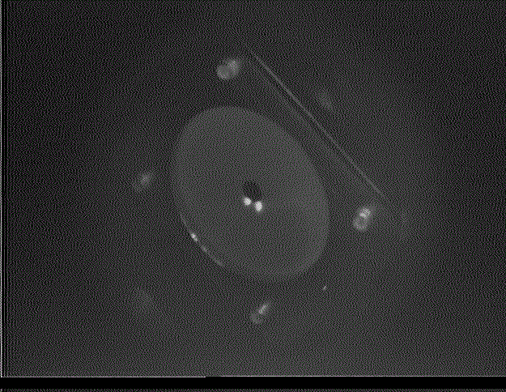
Example: CEBAF-ER

Slide 9
Why are ERLs?
IMPROVED EFFICIENCY OF ACCELERATION
  SRF ⇒ no wall losses
  Energy recovery ⇒ “no” beam loading - Only injected beam power is needed
    Inject 0.1 A @ 10 MeV (1 MW), accel. to 100 MeV (10 MW), & recover:1 MW
    Inject 0.1 A @ 10 MeV, (1 MW) accel. to 10 GeV (10 GW), & recover: 1 MW
  Recycle “waste” (post-use) beam to drive RF
    Save on RF costs, dumped radiation
    A natural “two beam accelerator”
Near-linac beam quality at near-storage ring efficiency
  Cost optimization
  “Recovered” beam is at low energy/low POWER; beam dump easier
Entertainment value
  Numerous phenomena (source limitations, space charge, BBU, CSR, halo) become of interest
Notes:
Need the MW for the injector

Slide 10
ERL Performance
ERLs provide very high power/high brightness beams
FEL drivers
  E: 10s – 100s of MeV
  Q: 100s pC – 1 nC
  I: mA – 100s mA
  ε^{normalized} ~ λ/4π
    1-10 mm-mrad
  P_{beam} ~ MW – 100 MW
Colliders
  E: 10-100(?) GeV
  Q: ~10s pC – 100 pC
  I: 1-10(s) mA
  ε^{normalized} < ~few mm-mrad
  P_{beam} ~ (many) GW
Light sources
  E: 5 – 10 GeV
  Q: ~10s pC – 100 pC
  I: 100(s) mA
  ε^{normalized} < ~1 mm-mrad
  P_{beam} ~ GW
very high power => halo major issue! Can’t lose 10⁻⁵ of beam!
implications: tiny spot size, COTR effects, 6-d systems…

Slide 11
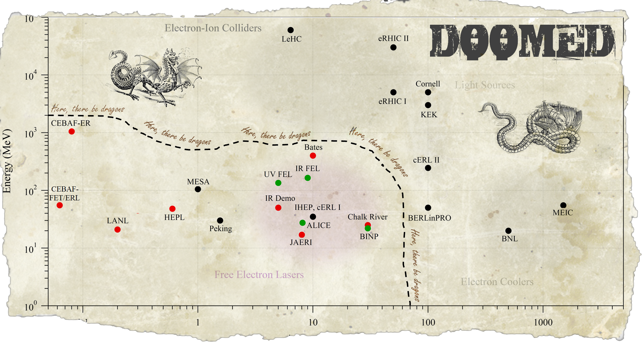
System Parameters/ERL Landscape
 | Time frame | E_{inj} (MeV) | E_{full} (MeV) | I (mA) | Q_{bunch} (pC) | Milestone
FET-ERL | 1991 | 5.5 | 45 | 0.03 | – | BBU validation for CEBAF
IR Demo | 1997-2001 | 5-9 | 20-48 | 5 | 60 | 2.1 kW IR FEL CW power
CEBAF-ER | 2003 | 20, 50 | 1000 | 0.007, 0.09 | – | High energy CW ERL validation
IR Upgrade | 2003 - present | 5-9 | 88-165 | 9 | 135 | 14.3 kW IR FEL CW power
UV Demo | 2009 - present | 9 | 135 | 5 | 60 | 100+ W FEL power in visible/near UV, 100 mW CW at 10 eV harmonic
Current (mA)

Slide 12
ERLs Provide Advantages over Traditional Machines
Provide linac quality beam, with near storage ring power (energy & current) with wall-plug efficiencies approaching that of storage rings…
They are the “hybrid automobiles” of the accelerator world… accelerate (beam), and recover energy (power) during deceleration…
Allow flexible time structure, from single bunch to CW bunch train, and everything in between (within the constraints of the source)
Allow independent manipulation of various portions of beam phase space essentially at will and independently of other sub-spaces – they are fully 6 dimensional systems!
And this is where the fun begins…

Slide 13
The Challenges of Energy Recovery
Naively, ERLs behave like conventional linacs until the user uses the beam
However, at some point – logically, full energy – the beam interacts with a target, makes light,… does something, … which typically
  takes energy out,
  degrades the beam, and
  otherwise causes sorrow for the system designers….
As a result, ERL operation is not just a matter of riding the RF crest up and RF trough back down…
Unique ERL properties can then lead to difficulties:
  Performance is source limited; beam only gets worse the farther it goes
  There is no closed orbit or equilbrium (no bucket, no phase stability, not betatron stable…)
  User-induced beam degradation antidamps during energy recovery…
  Beam is very high power, so almost no loss is tolerable

Slide 14
The Key: Longitudinal Matching
The single most critical aspect of ERL design and operation is typically how the beam is managed in energy and time
Dictated by user requirements (what beam is to be delivered and how its used/degraded)
Defines much of the system configuration (especially RF requirements)
Example: Longitudinal Matching in an FEL Driver ERL

Slide 15
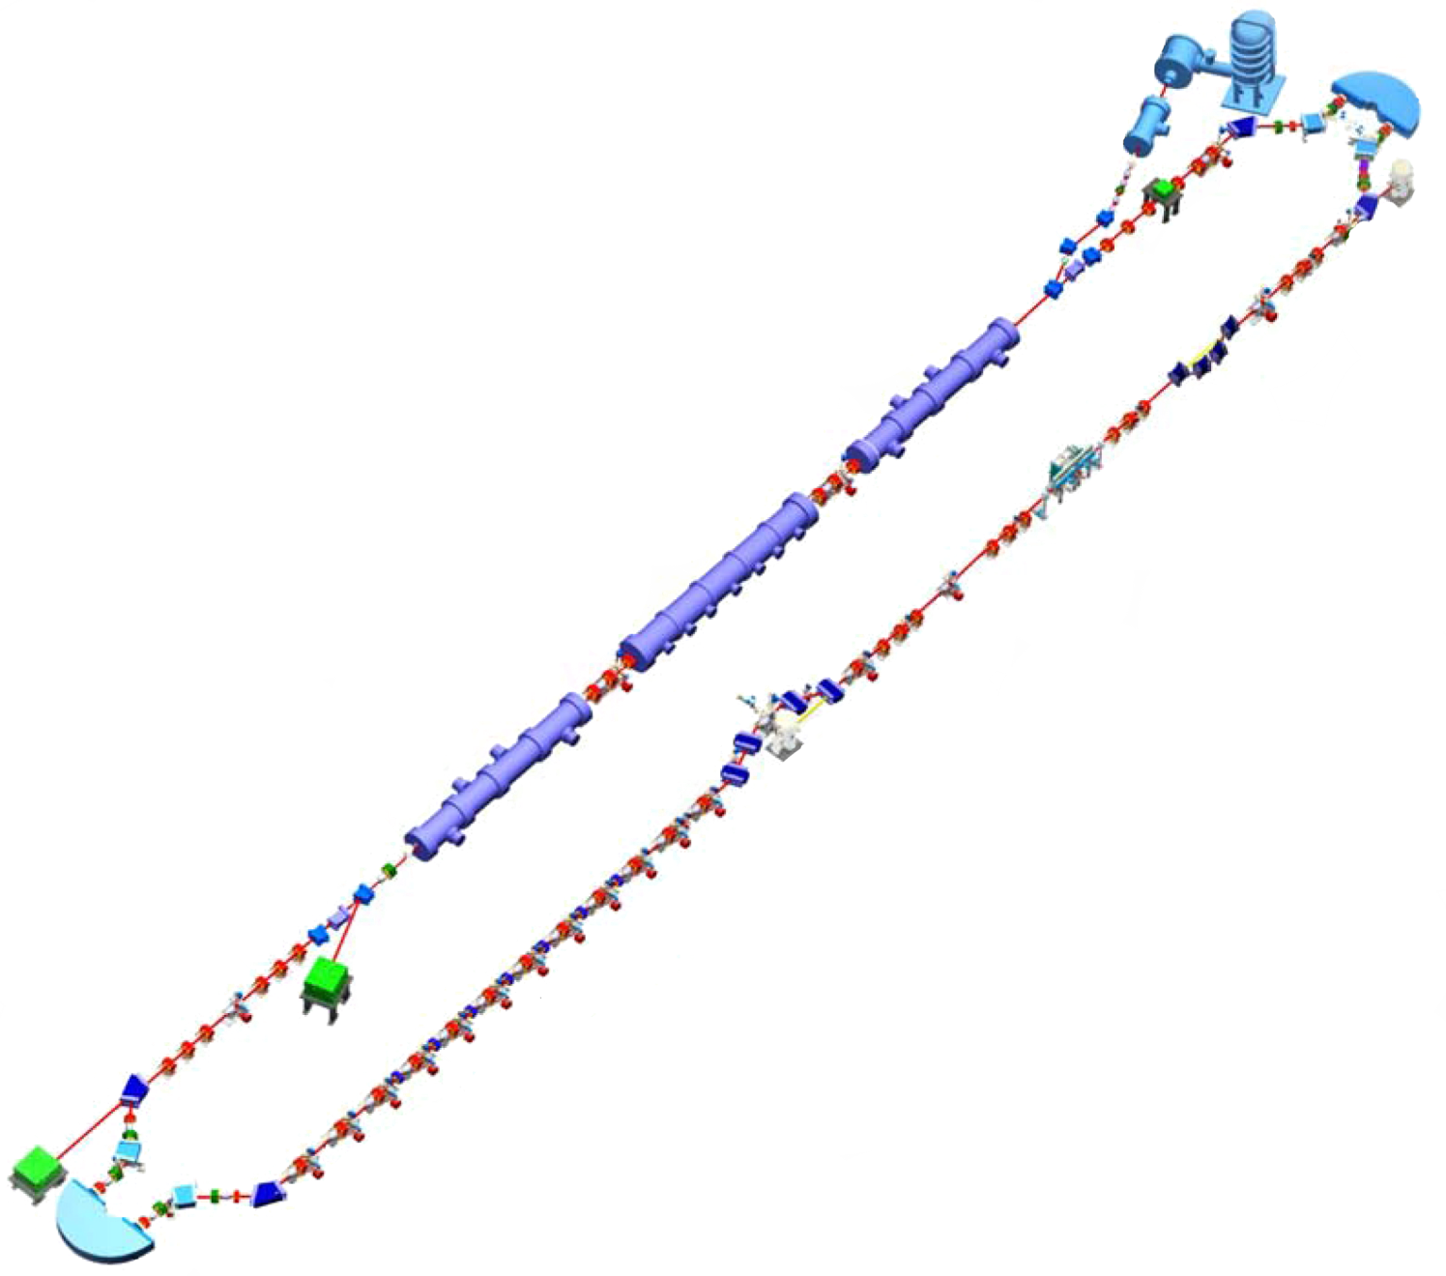
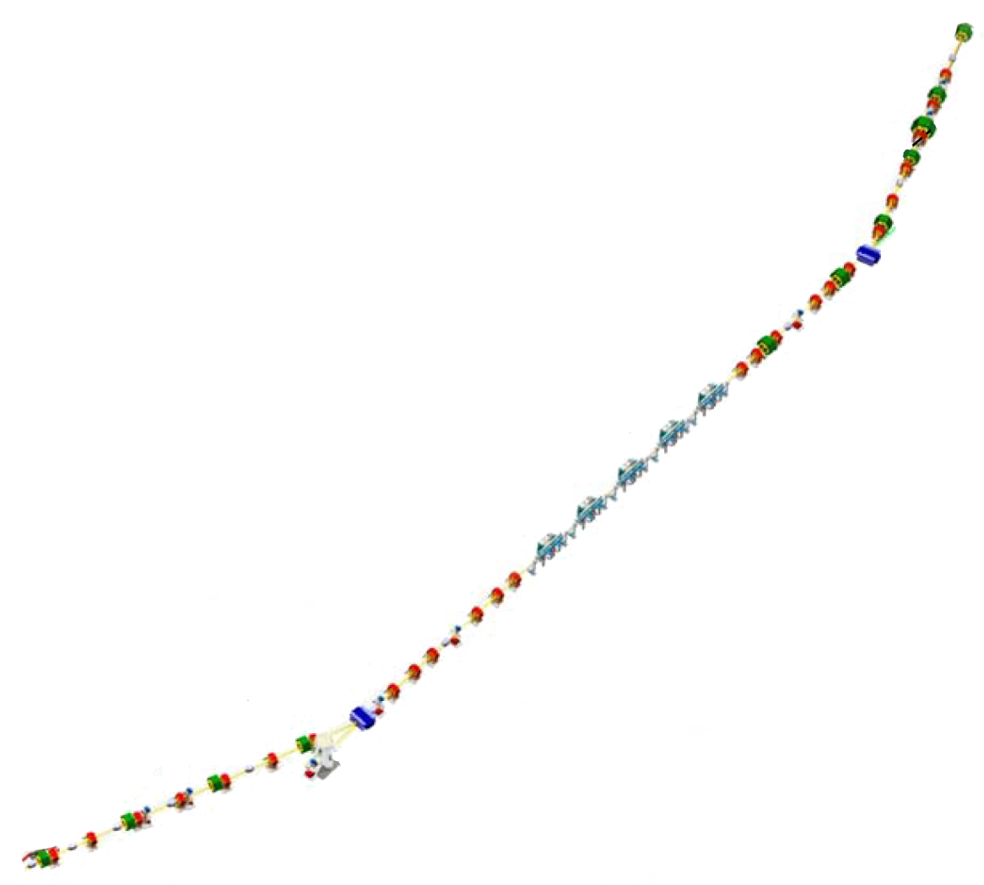
Longitudinal Matching Scenario
DC Gun
E
Requirements on phase space:
high peak current (short bunch) at FEL
  bunch length compression at wiggler
  using quads and sextupoles to adjust compactions
“small” energy spread at dump
  energy compress while energy recovering
  “short” RF wavelength/long bunch,
  large exhaust δp/p (~10%)
  get slope, curvature, and torsion right
  (quads, sextupoles, octupoles)
φ
E
IR Wiggler
φ
SRF Linac
E
Bunching Chicane
E
φ
E
φ
Dump
E
φ
φ

Slide 16
Energy Compression
E
E
E
All e⁻ after trough go into high-energy tail at dump
t
t
t
Beam central energy drops, energy spread grows, reinjection phase shifts
Linac RF undergoes transient from phase shift
Beam rotated, curved, … to match shape of RF waveform
Maximum energy can’t exceed peak deceleration available from linac
  Corollary: entire bunch must preceed trough of RF waveform
Energy spread small/central energy invariant at dump – even with transients
Acceleration/recovery less than 180º out of phase: “incomplete” energy recovery
E_{dump} > E_{injection}: need extra RF power!

Slide 17
Aside: Higher Order Corrections
E
Without nonlinear corrections, phase space becomes distorted during deceleration
Curvature, torsion,… can be compensated by nonlinear adjustments
  differentially move phase space regions to match gradiant required for energy compression
t
Required phase bite is cos⁻¹(1-ΔE_{FEL}/E); this is >25º at the RF fundamental for 10% exhaust energy spread, >30º for 15%
  typically need 3rd order corrections (octupoles)
  also need a few extra degrees for tails, phase errors & drifts, irreproducible & varying path lengths, etc, so that system operates reliably

Slide 18
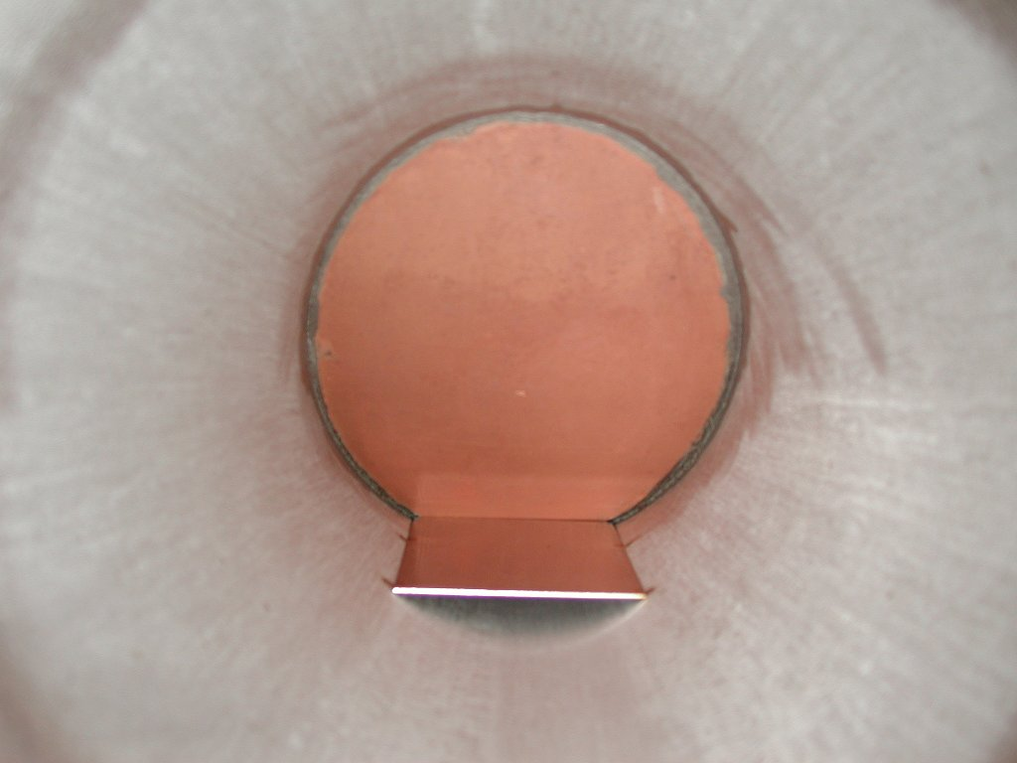
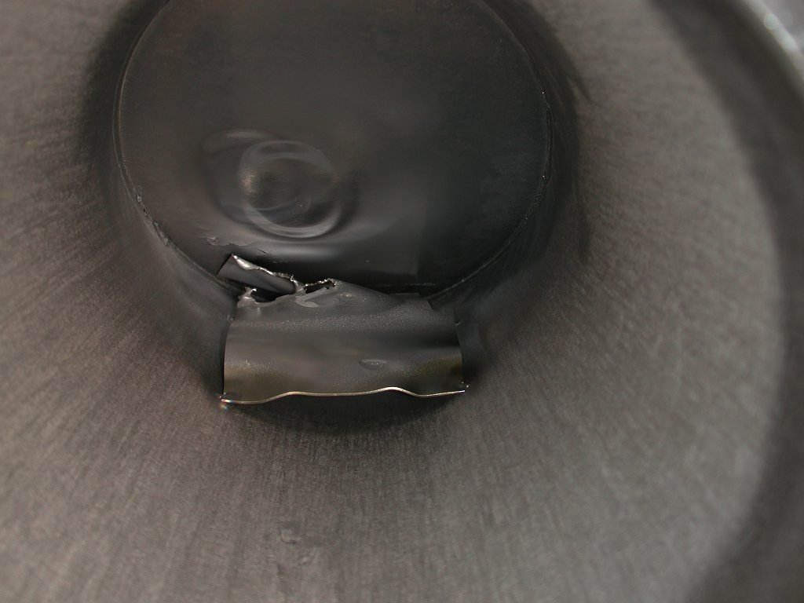
JLab IR Demo Dump
core of beam off center,
even though BLMs showed
edges were centered
(high energy tail)
Key points:
Recovery may not give you back all the power you used
Beam phase transients => transient detuning of SRF cavities

Slide 19
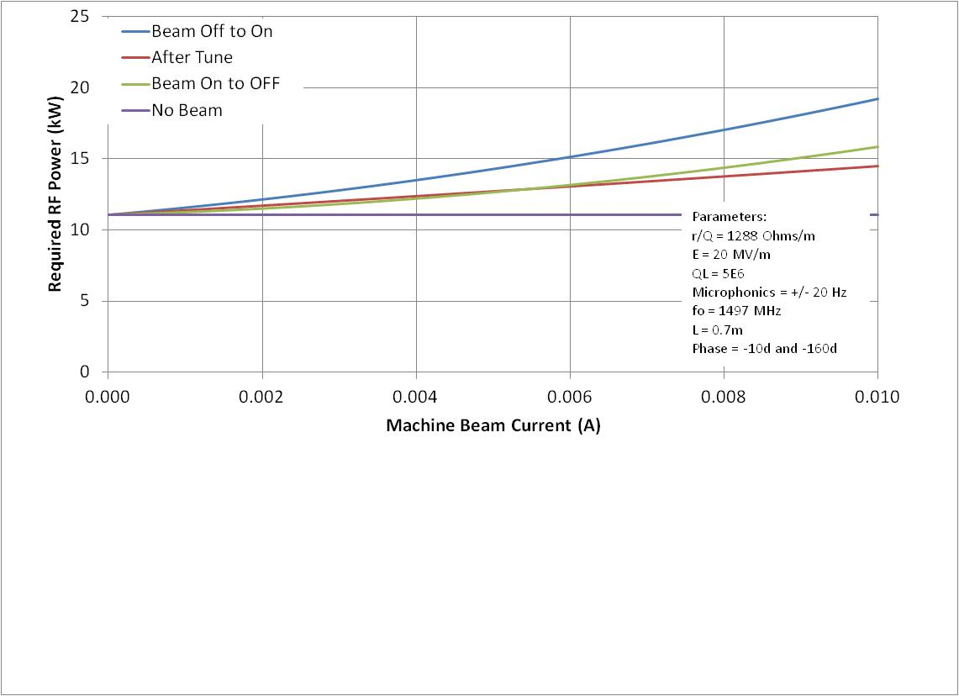
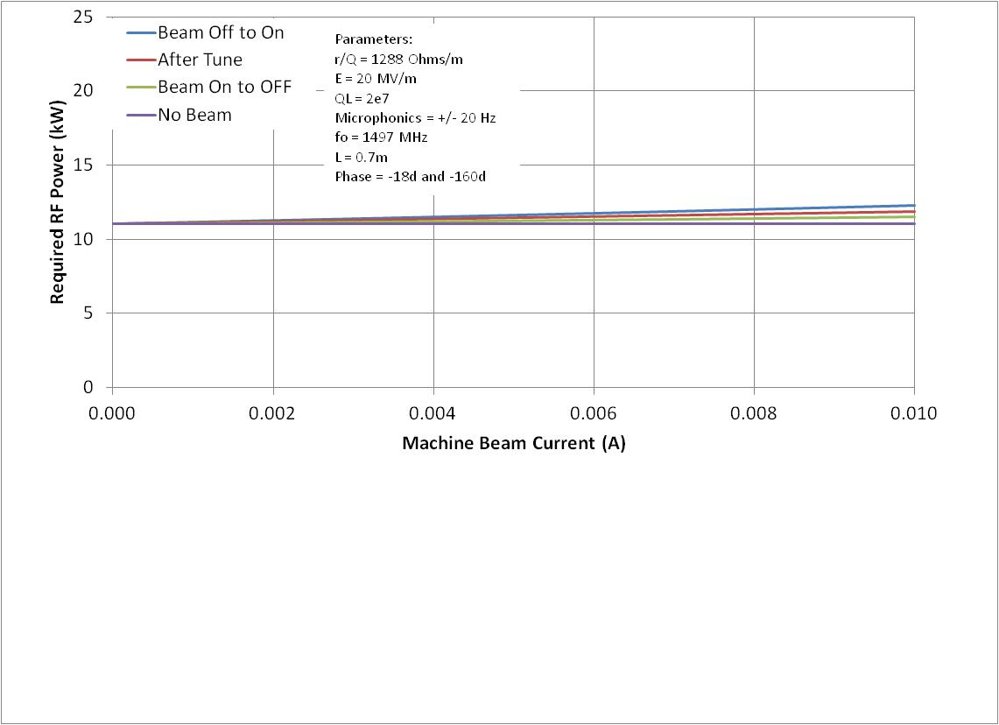
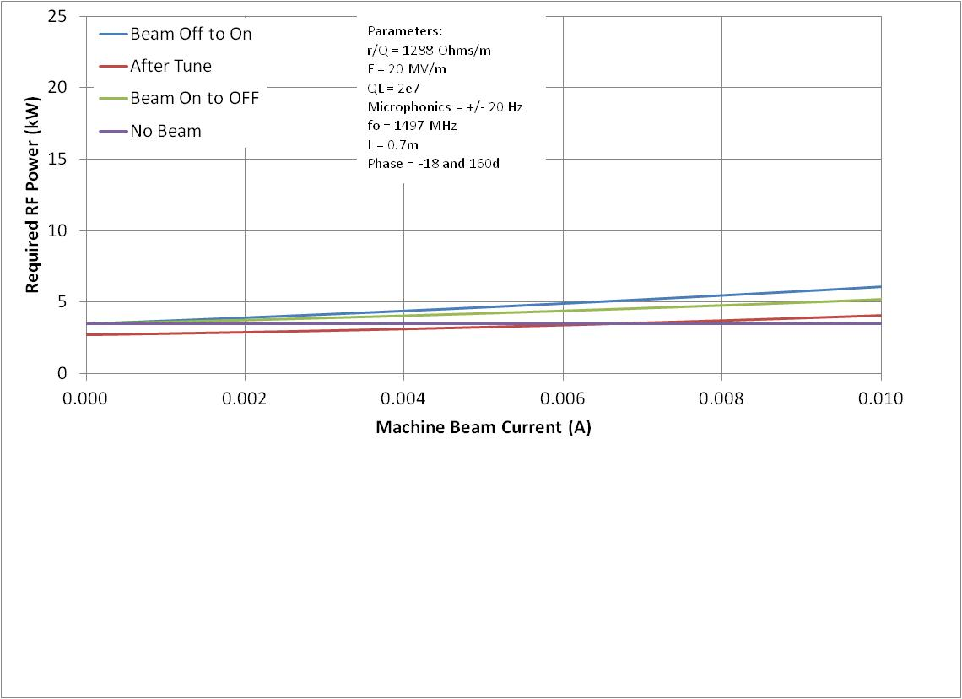
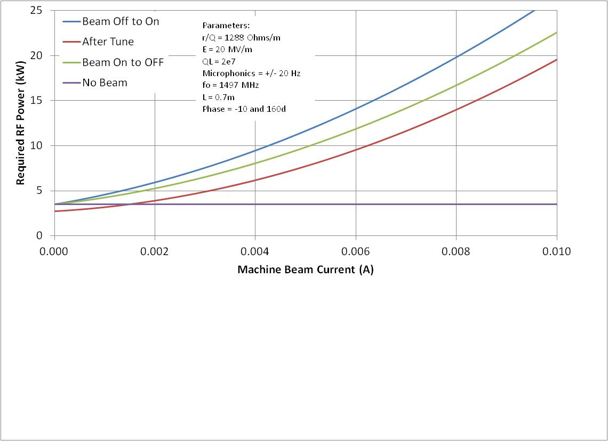
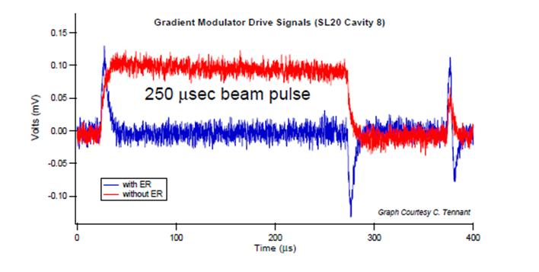
RF Transient Effects
5e6
Beam off/on
  transient beam loading
  cavities detune
FEL off/on
  energy transients
  reinjection phase transient
  transient beam loading
  cavities detune
Need adequate RF control & power to avoid tripping
  Specs/methods depend on details of cavity design and operational modes
  ( RF analysis courtesy T. Powers)

Slide 20
PREDICTED AND MEASURED FORWARD POWER IN AN ERL
The solid lines indicate the predicted values based on:
  Q_{L} = 2 x 10⁷
  E = 5.6 MV/m.
  Δf = 10 Hz
Test Process:
  Tune the cavity with no current.
  Disable the mechanical tuners.
  Ramp the current up and record the forward power and phase.
  Repeat with Tuners enabled.
  (courtesy T. Powers)

Slide 21
Predicted and Measured RF Drive Phase In an ERL
  (courtesy T. Powers)

Slide 22
Summary
ERLs provide novel and effective means for system cost optimization – particularly for very high powers at low energy/very high energies
Several system demonstrations complete, multiple ERLs in regular operation
“Free” RF power from user beam isn’t completely free –
  Must insure beam is well controlled – no losses – during recovery
  RF transient control

Slide 23
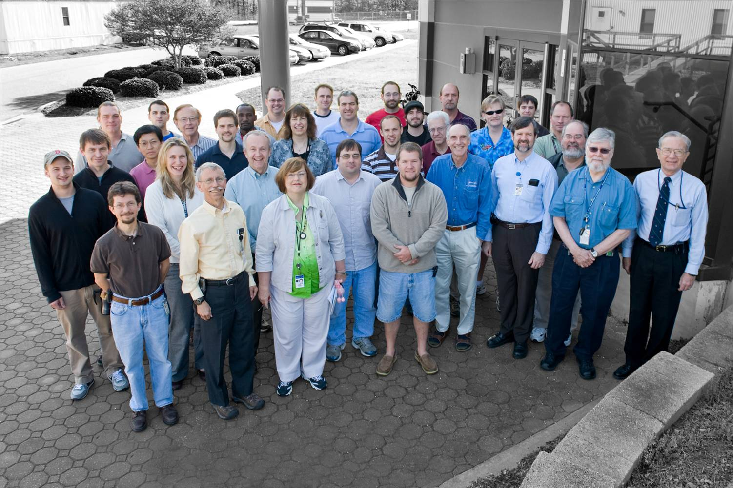
Acknowledgements
Many thanks to the organizers for the opportunity to participate – and for their special efforts to accommodate “sequestration-driven” changes in plans at the last minute!
This talk includes results provided by many Jefferson Lab colleagues and reflects work done at the JLab FEL over nearly 2 decades
Support provided by the US Dept. of Energy under Contract No. DE-AC05-06OR23177 and the Commonwealth of Virginia

