Slide 1
High Energy Proton Synchrotrons
… by the example LHC
Erk Jensen, CERN
TIARA Workshop on RF Power Generation for Accelerators
17-19 June 2013
Ångström Laboratory, Uppsala, Sweden
Many thanks to T. Mastoridis , O. Brunner whose slides I took, and all the others in BE-RF who helped make this work!

Slide 2
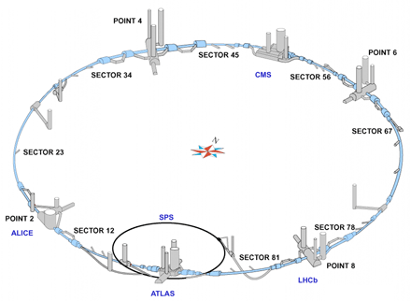
The LHC RF System
Two independent rings,
8 RF cavities per ring all installed at point4,
Klystrons and Cavity Controllers in a cavern ~150 m underground,
100kV, 40A (ex-LEP) power converter located at the surface,
Klystron modulators, fast protection systems in four HV bunkers,
Sixteen 330 kW klystrons + circulators + RF ferrite loads in UX45,
Power control system based on industrial PLCs, plus a fast Interlock protection system,
WR2300 HH WG distribution system to individual cavities,
LLRF for Cavity Controllers in two Faraday Cages,
Beam Control equipment in a surface building in SR4.
O. Brunner

Slide 3
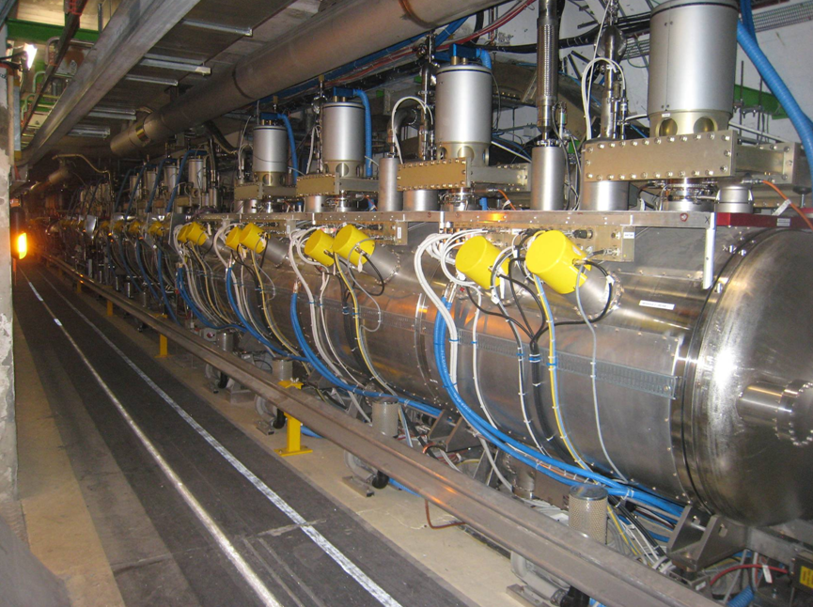
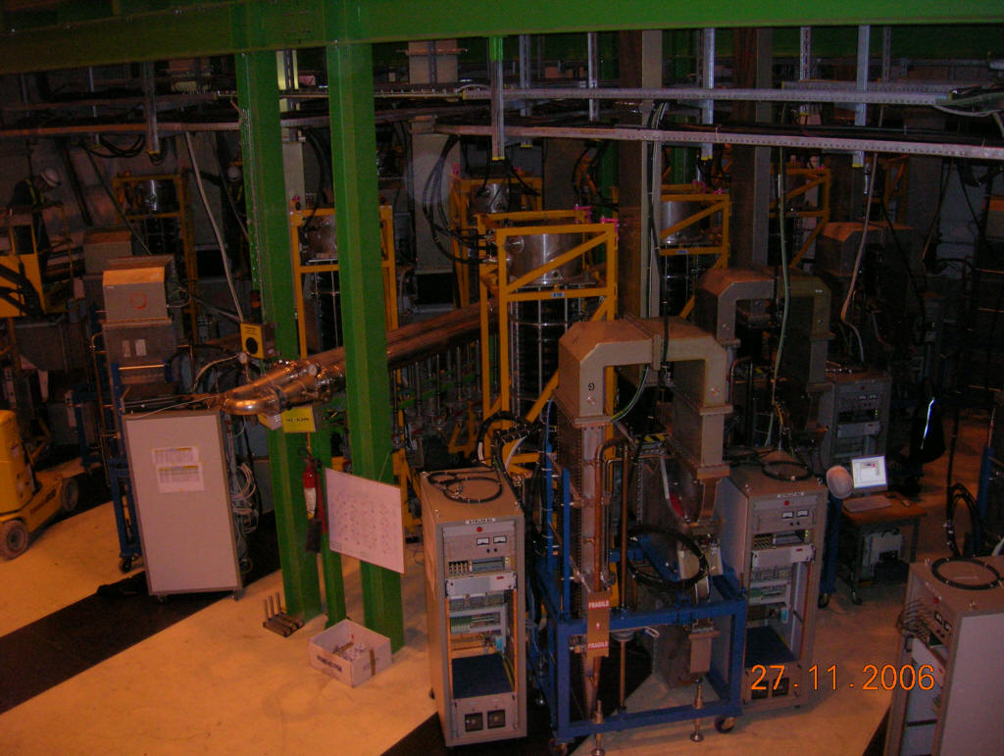
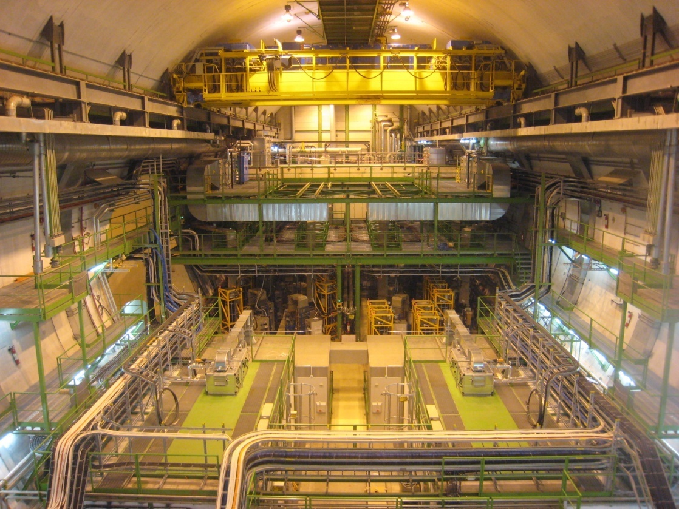
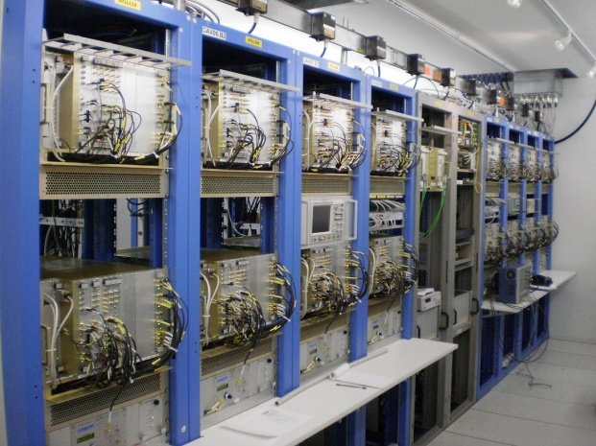
The LHC RF system
O. Brunner

Slide 4
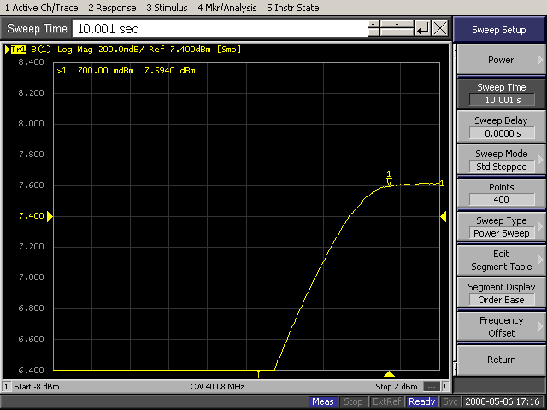
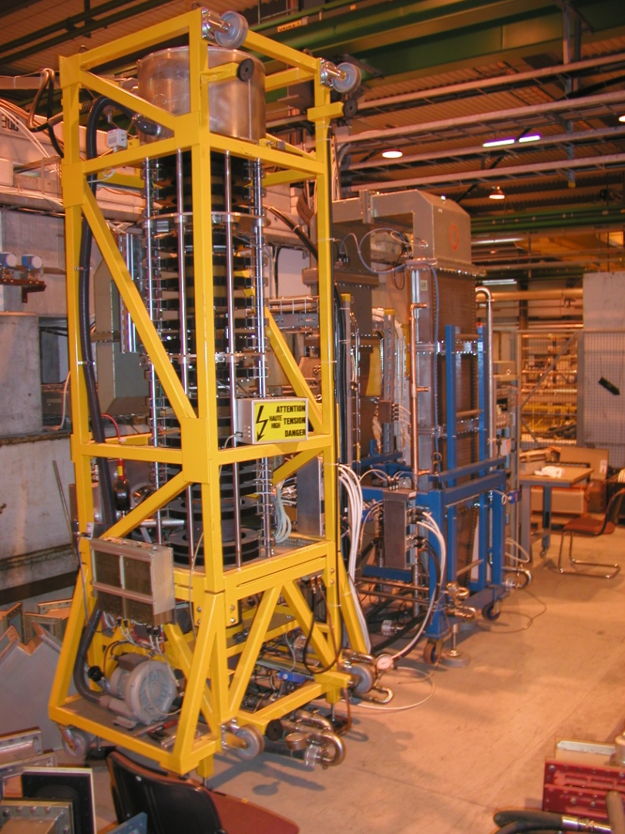
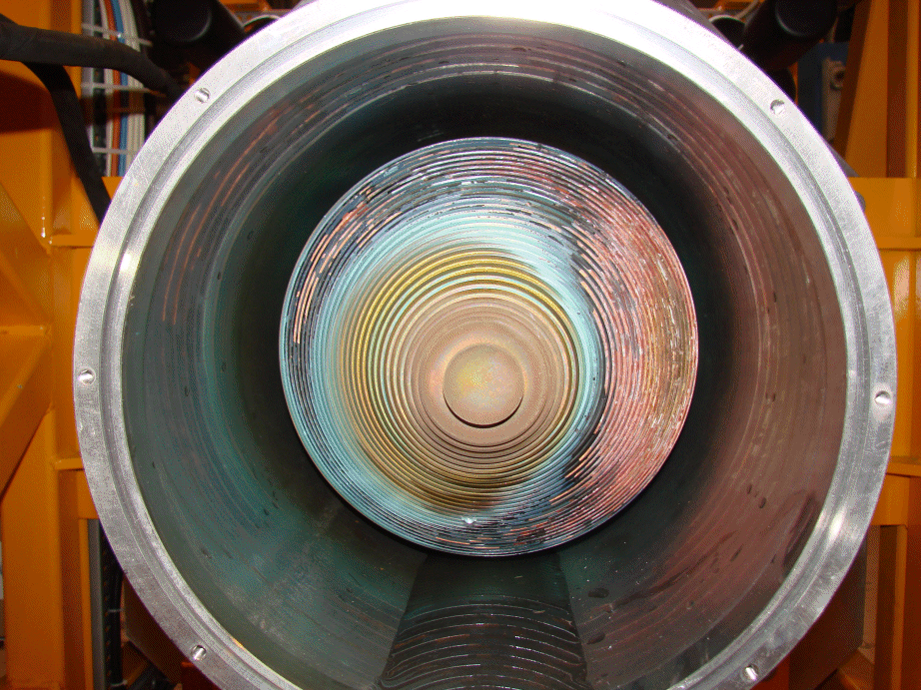
The Klystrons
P_{out}
Clamped (SWAP)
Operating point
≈ -1.5dB below saturation
Klystron power sweep CW @ 400.8 MHz
P_{in}
1 klystron per cavity
330 kW max (58 kV, 8.4 A)
130 ns group delay (~ 10 MHz BW)
CW gain 39 dB @ 200 kW, 36 dB @ 300 kW
In operation ≈ 200 kW CW
21 klystrons @ CERN, 16 in operation
Klystrons had problems with boilers – now replaced
O. Brunner

Slide 5
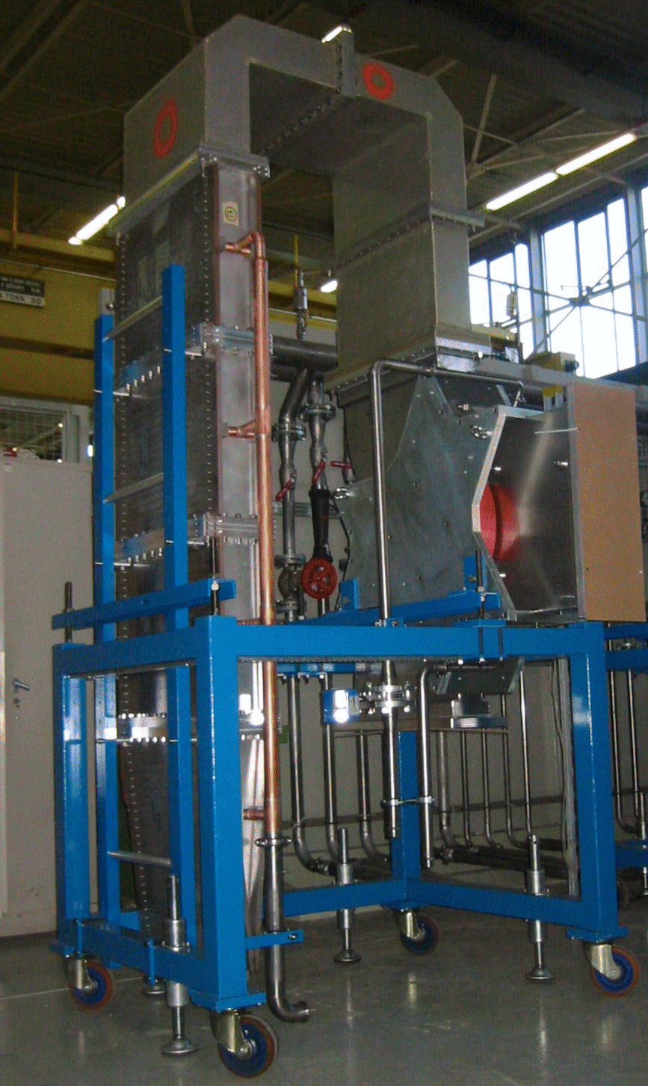
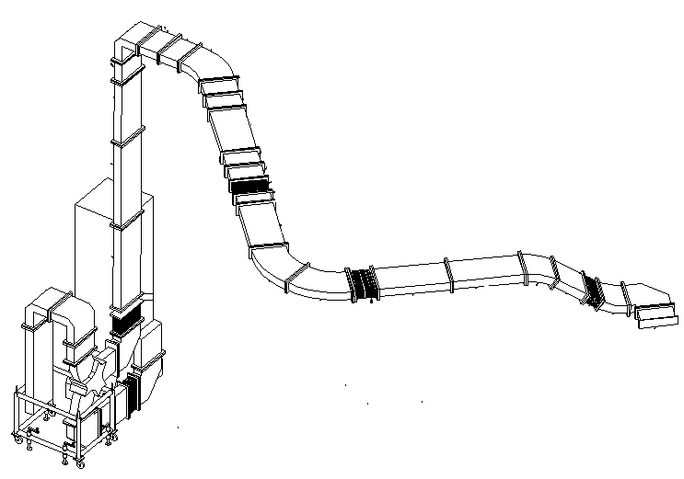
Circulators, Loads, WG’s
1 circulator per cavity
330 kW max
60 ns group delay
Circulator equipped with temperature control system
Affects the Q_{ext} of the cavity
1 RF ferrite load per circulator
330 kW CW
RF loads reflection < -28 dB
Wave guide system
WR2300 HH
Length: 15 to 30 meters
O. Brunner

Slide 6
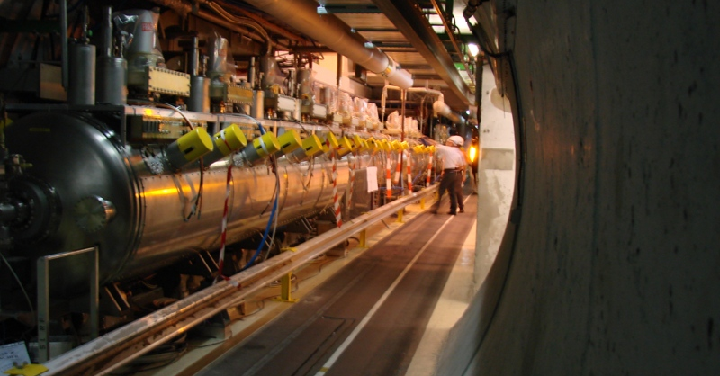
The Cavities
O. Brunner
8 RF cavities per ring at 400.790 MHz:
Super Conducting Standing Wave Cavities, single-cell, $R/{Q=45 Ω}$, 6 MV/m nominal
Equipped with movable Main Coupler ($20,000< Q_{L}<180,000$)
Mechanical Tuner range = 100 kHz
4 spare cavities assembled in a cryomodule + 1 spare cavity
more new spare cavities/cryomodule shall be built in the next years

Slide 7
Planned module swap
T. Mastoridis: Evian 2012

Slide 8
LLRF System

Slide 9
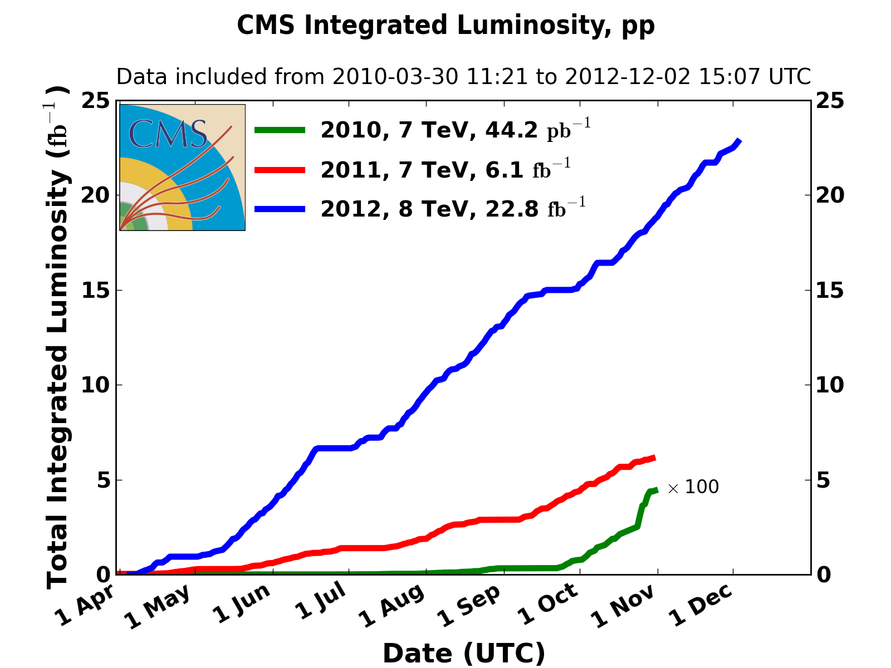
LHC performance 2012
S. Myers, EuCARD13

Slide 10
RF Performance 2012: no limits
T. Mastoridis: Evian 2012

Slide 11
Performance 2012: steps ahead
T. Mastoridis: Evian 2012

Slide 12
Improvements
T. Mastoridis: Evian 2012

Slide 13
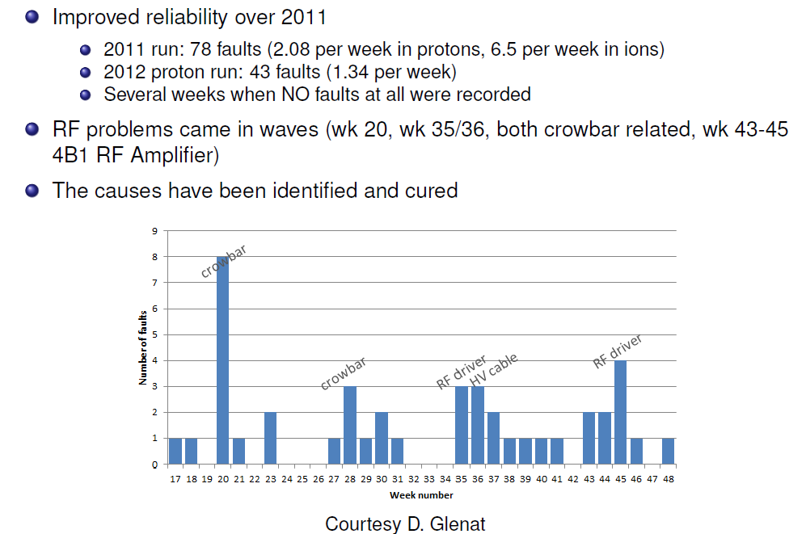
Performance 2012: fault summary
T. Mastoridis: Evian 2012

Slide 14
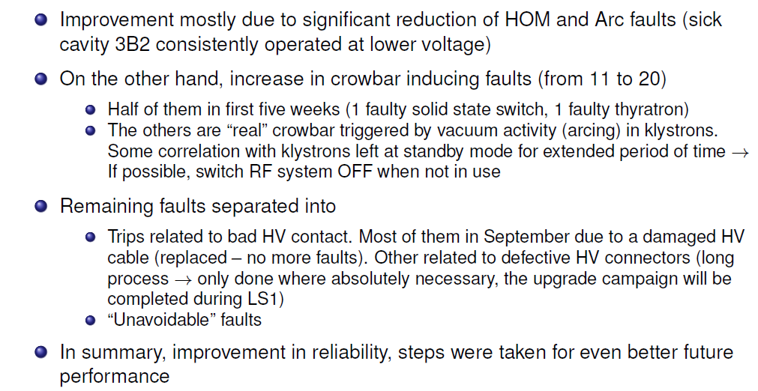
Performance 2012: fault summary
T. Mastoridis: Evian 2012

Slide 15
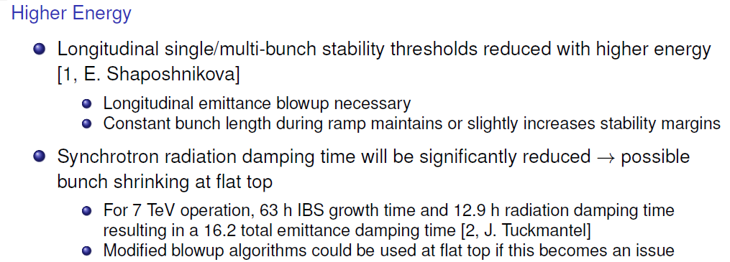
Preparing for after LS1 (2015):
Getting ready for 6.5 TeV per beam:
T. Mastoridis: Evian 2012

Slide 16
Preparing for after LS1 (2015):
Getting ready for 25 ns bunch spacing
T. Mastoridis: Evian 2012

Slide 17
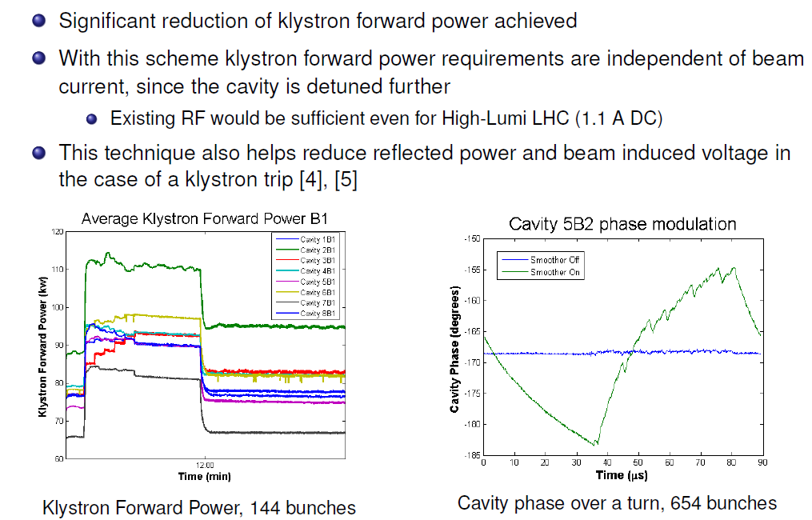
Cavity set-point modulation
T. Mastoridis: Evian 2012

Slide 18
Thank you very much!

