Slide 1
Tetrode Power Amplifiers
TIARA & Uppsala University
Workshop on RF Power Generation for Accelerators
Eric Montesinos, CERN, BE-RF-PM

Slide 2
Introduction
Workshop on novel concepts for RF power generation for accelerators
Experienced researchers and leading companies in the field of RF power generation will gather to explore the technical challenges emerging from the design of new accelerators and to match them with state-of-the-art industrial solutions for RF power generation
Through knowledge exchange between research institutes and commercial partners, the workshop will address technical challenges shared by European research infrastructures collaborating in TIARA
The workshop will focus on the main areas of
electron tube devices (Tetrodes-Diacrodes, IOTs, Klystrons,…)
solid-state amplifiers
phase-stability and timing

Slide 3
Content
UN-FAQ about tetrode (Unfortunately Not - Frequently Asked Questions)
Study case
new CERN SPS 2 x 1.7 MW @ 200 MHz
Conclusion

Slide 4
Power vs Frequency

Slide 5
Output Power vs Input Power
10 µs (x1.7)
100 µs (x1.5)
1 s (x1.4)
CW (x1.2)
35 kW nominal

Slide 6
Output Power vs Input Power

Slide 7
Special thanks to SSPA
An allegation against tetrodes is lack of gain
Gain for a tetrode is about 14 dB
For an output power of 100 kW, a 4 kW driver is required
In the past, this was achieved with a small tetrode, HVPS, Grids supplies, …
Nowadays, up to ~ 25 kW it will be SSPA
Perfect combination with tetrodes
Final
gain = 14 dB
Pout = 100 kW
Driver
gain = 14 dB
Pout = 4 kW
SSA
gain = 52 dB
Pout = 160 W
LLRF

Slide 8
Special thanks to SSPA
An allegation against tetrodes is lack of gain
Gain for a tetrode is about 14 dB
For an output power of 100 kW, a 4 kW driver is required
In the past, this was achieved with a small tetrode, HVPS, Grids supplies, …
Nowadays, up to ~ 25 kW it will be SSPA
Perfect combination with tetrodes
Tetrodes
SSPA

Slide 9
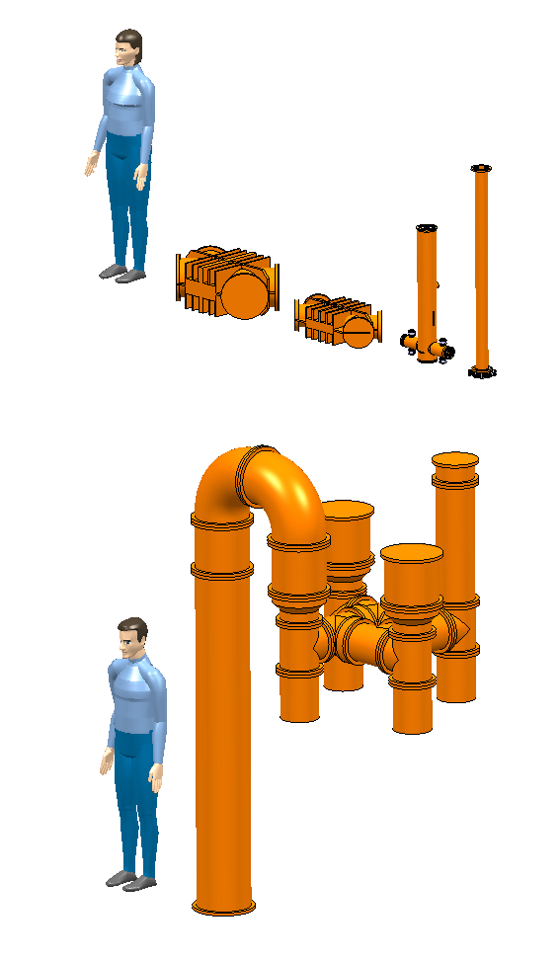
Combining
Minimum 0.1 dB losses per combiner
Up to few kW
λ/4 wavelength combiners
Up to 10 to 1 combiners
With higher power
3 dB combiners
Magic Tees
Has to be taken into account
For overhead specification
Regarding average power for building Cooling and Ventilation
200 MHz CW combiners
2 x 40 kW
to 80 kW
10 x 4 kW
to 40 kW
3 dB : 550 kW & 160 kW
3 dB : 1.1 MW

Slide 10
SPS 1.1 MW @ 200 MHz 5 s - 0.1 Hz

Slide 11
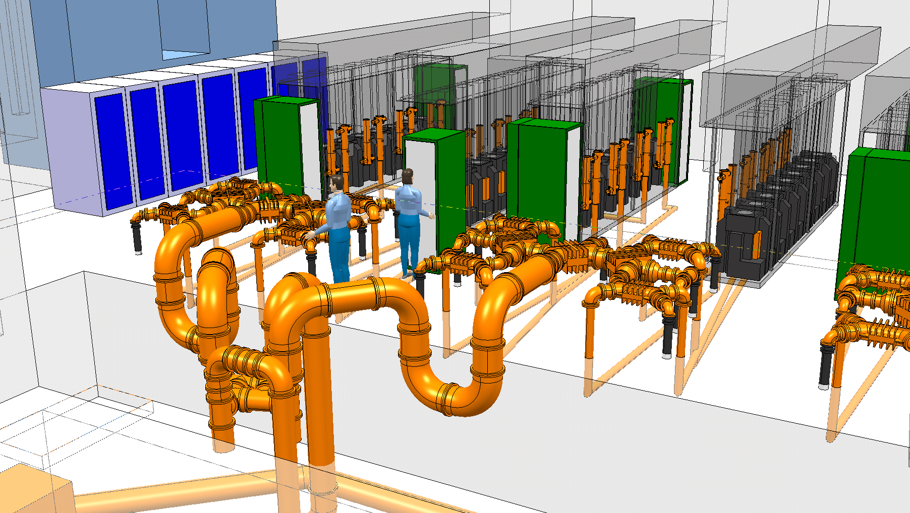
SPS 1.1 MW @ 200 MHz 5 s - 0.1 Hz

Slide 12
Efficiency
Nominal power 35 kW
η = 66.4 %
Pulsed 1 µs to cw, no variation

Slide 13
PS efficiency - pulsed system
Tetrodes will provide output power following any kind of driver amplitude modulation from pulsed to CW
Klystrons have additional losses as HV has to be stabilized prior to RF pulse
power
RF pulse
RF pulse
time
Tetrode direct RF
-> neglictible additional losses
power
HV modulator envelope
HV modulator envelope
Rise time losses
Rise time losses
RF pulse
RF pulse
time
HVPS Modulator for klystron
-> additional overall losses

Slide 14
Statistics
Total 1980-2013 : 254 tubes
Average lifetime : 32’000 hours
Tubes with > 28’000 hours : 78 %
(also true for tubes stored 20 years !)

Slide 15
Statistics
YL1530 SPS 200 MHz, 2 x 32 tubes in parallel
Reason of fault | # of faults | % of faults
Loss of emission | 99 | 39
Input reflections | 97 | 38
Unknown | 20 | 8
Over Temp | 20 | 8
Arcing | 18 | 7
Unpredictable : 23 %
Graceful degradation : 77 % (possible to monitor and predict)
Graceful operation : 99.5 % (2012)

Slide 16
Statistics
SPS 200 MHz : 100 tube sockets + transmitters (HVPS, controls, combiners, etc.)
Availability not only depends upon the technology
but also upon the exploitation strategy
spares, manpower, schedules, …

Slide 17
Supplier
Nowadays tetrodes are mainly Thales
Frame contract
Known prices with a known % price increase per year
25 years production guaranteed
If not, end of production: drawings, cooking recipes and Intellectual Property for free, we will be allowed to subcontract the construction of the tube
In the past, some tetrodes have already been discontinued
They have been replaced by a ‘pin to pin’ compatible tube from another supplier
An alternative tube has always been provided
Are there so many suppliers for the other technologies ?
Who can guaranty NO obsolescence ?

Slide 18
Supplier
Still more new powerful applications with tubes within the last 10 years (tetrodes + diacrodes)

Slide 19
Miscellaneous
Tetrode amplifiers are radiation capable
Single power source per cavity allows individual LLRF, clear advantage
High peak short excursion is mandatory with cyclotrons LLRF
SPS SWC 200 MHz with
its Tetrode amplifier

Slide 20
Study case
New SPS amplifiers plant @ 200 MHz
2 transmitters
Pulse mode from 1 µs to 5 s
1.7 MW peak with respect to 850 kW average

Slide 21
Possible transmitters
16 tetrodes (or 16 IOTs)
16 is a very good number to combine tetrodes
This allows to ensure a graceful operation even with 14/16 tetrodes
Each power source, 140 kW capable, operated 106 kW
Gain is 14 dB, 16 individual 6 kW SSPA drivers, perfect combination
2 diacrodes (2 MB-IOTs)
Less combiners
Each diacrode, 850 kW capable, operated 785 kW
Gain is 14 dB, 2 individual 32 kW SSPA drivers
2’000 SSPA
Graceful degradation, only 10 % oversized, 2’000 x 1 kW units
Additional combiners, more losses, building Cooling and Ventilation

Slide 22
Combining losses
Power level | Combiner | SSPA 1 kW transistor | Tetrode 140 kW | Diacrode 850 kW
# units operated x nominal power |  | 2’000 x 900 W | 16 x 106 kW | 2 x 785kW
8 kW | 8 to 1 λ/4 | 0.1 dB | - | -
50 kW | 6 to 1 λ/4 | 0.1 dB | - | -
100 kW | 3 dB | 0.1 dB | - | -
200 kW | 3 dB | 0.1 dB | 0.1 dB | -
400 kW | 3 dB | 0.1 dB | 0.1 dB | -
800 kW | 3 dB | 0.1 dB | 0.1 dB | -
1600 kW | 3 dB | 0.1 dB | 0.1 dB | 0.1 dB
To cavity |  | 1’500 kW | 1’500 kW | 1’500 kW

Slide 23
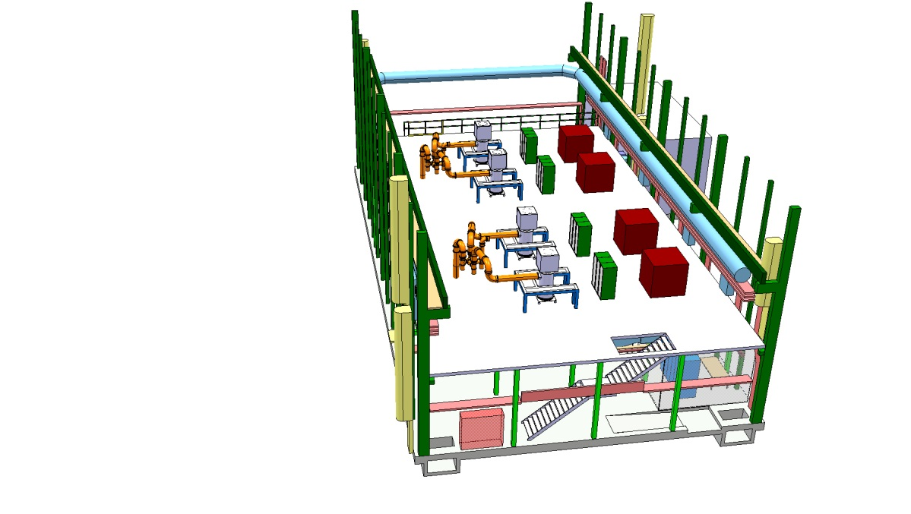
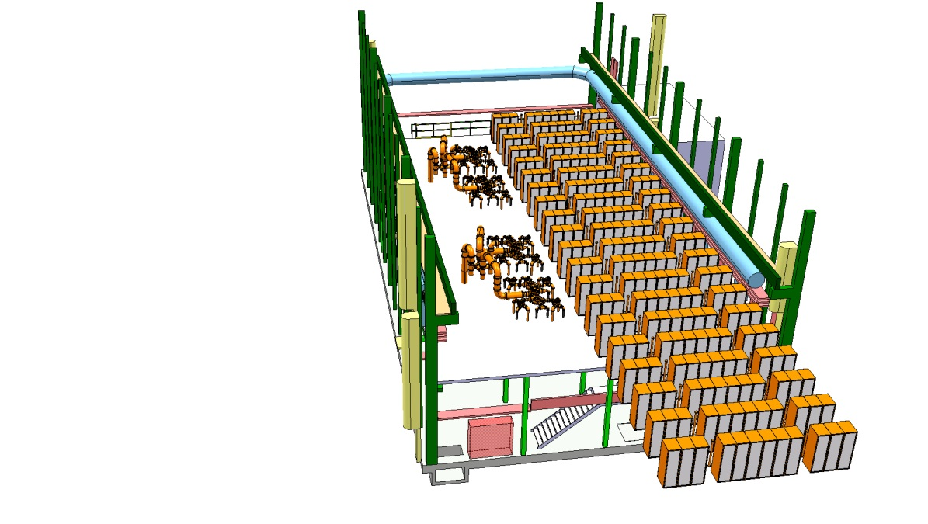
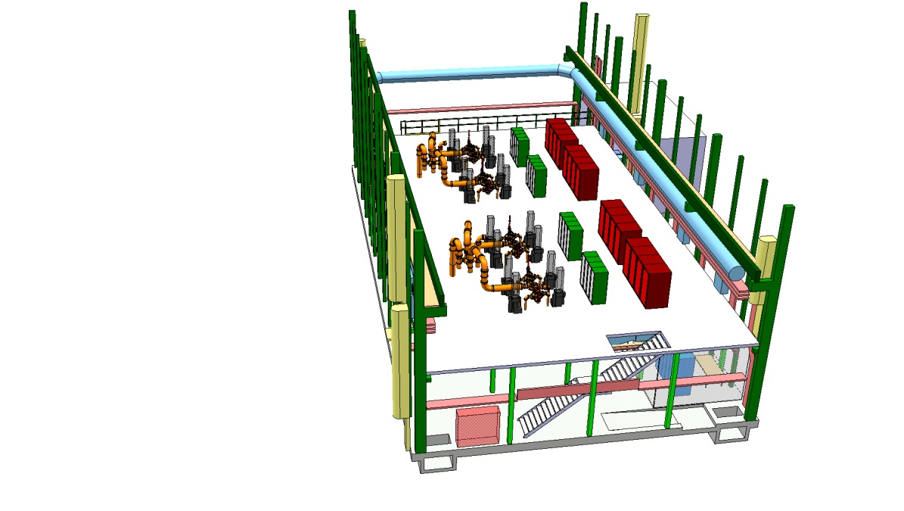
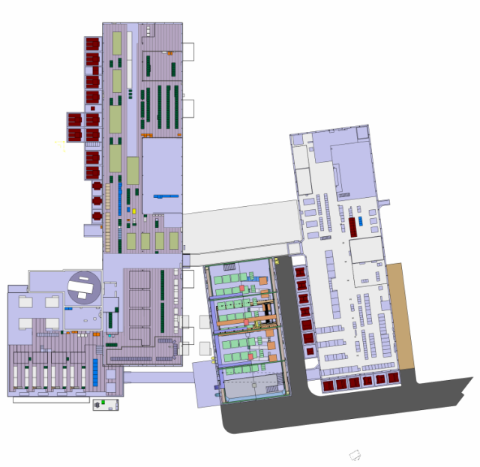
Foot print
2 x
2 Diacrodes
2 x
2000 SSPA
New building
2 x
16 Tetrodes

Slide 24
SPS Supercycle
FT
CNGS
CNGS
CNGS
LHC
CNGS
MD
Magnets
cycle
Particles

Slide 25
SPS Supercycle
FT
CNGS
CNGS
CNGS
LHC
CNGS
MD
Magnets
cycle
RF

Slide 26
SPS Supercycle
48 s
FT
CNGS
CNGS
CNGS
LHC
CNGS
MD
RF Power
kW
14.7 s
6.1 s
6.1 s
6.1 s
6.6 s
6.1 s
2.3 s
1700
3.2 s
12 µs 43 kHz
3.5 µs 172 kHz
4.0 s
2.0 s
1 µs – x Hz
to
CW
850
2.8 s
2.8 s
2.8 s
2.8 s
425
1.2 s
0
0
48
Time
sec
For such a machine the key parameter is AVAILABILITY

Slide 27
Efficiency
SSPA Pmax
1000 W
Tetrode Pmax
140 kW
FT + LHC + MD
4.6 s
CNGS flat top
11.2 s
Flat bottom
6.0 s
At maximum power
SSPA operated at 90 %
Tetrode operated at 76 % (106/140 kW)
(availability AND lifetime)

Slide 28
Overall efficiency
RF source
LLRF
Combiners
Power Supply
& infrastructure
Cavity
Technology | η_{RF source [%]} | η_{PS [%]} | η_{RF dist. [%]} | η_{RF tot [%]}
Tetrode | 47 | 90 | 89 | 38
Diacrode | 48 | 90 | 93 | 40
SSPA | 50 | 90 | 83 | 38
SSPA cavity combiner | 50 | 90 | 89 | 40

Slide 29
Why tetrodes are so beautiful
Within their frequency range, few MHz to 400 MHz, they are powerful
In association with SSPA drivers, they are the perfect RF Power Source
Their efficiency is good, over 65 % at nominal power
Almost same overall efficiency as SSPA
Graceful operation with redundant amplifiers
Graceful operation as predictable end of life

Slide 30
Why tetrodes are so beautiful
A single power source per cavity is a clear advantage having an individual LLRF
They allow short pulses peak excursion
They offer a reduced foot print, important regarding acquisition cost
Regarding combining, reduced losses, easier to be ‘Green’ and easier for building Cooling and Ventilation
Tetrode amplifiers are radiation capable

Slide 31
Why tetrodes are so beautiful
Under certain circumstances, full reflection can be sustained
Reduced HV compared to klystron, less than 25 kV, no oil HV transformers
Tetrodes and their amplifiers are a very well known technology
We have very good statistics
Tetrodes kept their characteristics even after 20 years of storage
Single supplier is not a problem as we have a frame contract

Slide 32
Conclusion
Workshop on novel concepts for RF power generation for accelerators
Experienced researchers and leading companies in the field of RF power generation will gather to explore the technical challenges emerging from the design of new accelerators and to match them with state-of-the-art industrial solutions for RF power generation
Tetrodes are not young, but their characteristics are constantly evolving to match new RF power generation requests
We should always consider tetrode power amplifiers for new accelerators !

Slide 33
Thank you very much
Anode
Screen grid
G2
Control grid
G1
Cathode
Filament (or heater)
Schematic of a tetrode amplifier

