Slide 1


IOT based High Power Amplifiers
Morten Jensen
TIARA Workshop on RF Power Generation for Accelerators – Uppsala June 2013

Slide 2
The Inductive Output Tube
Invented in 1938 by Andrew V. Haeff as a source for radar
To overcome limitation of output power by grid interception
Pass beam trough a resonant cavity
Achieved: 100 W at 450 MHz, 35% efficiency
Used first in 1939 to transmit television images from the Empire State Building to the New York World Fair
IOTs then lay dormant
Intense competition with velocity modulated tubes (klystron had just been invented by the Varian Brothers.
Difficult to manufacture
The IOT is often described as a cross between a klystron and a triode hence Eimac’s trade name ‘Klystrode’

Slide 3
Klystron
(Velocity Modulated)
Cathode
(DC Beam)
RF input
RF output
Collector
IOT
(Density modulated)
Reduced velocity spread
Higher efficiency
No pulsed high voltage
Cheaper modulator
RF input
Biased
Control Grid
RF output

Slide 4
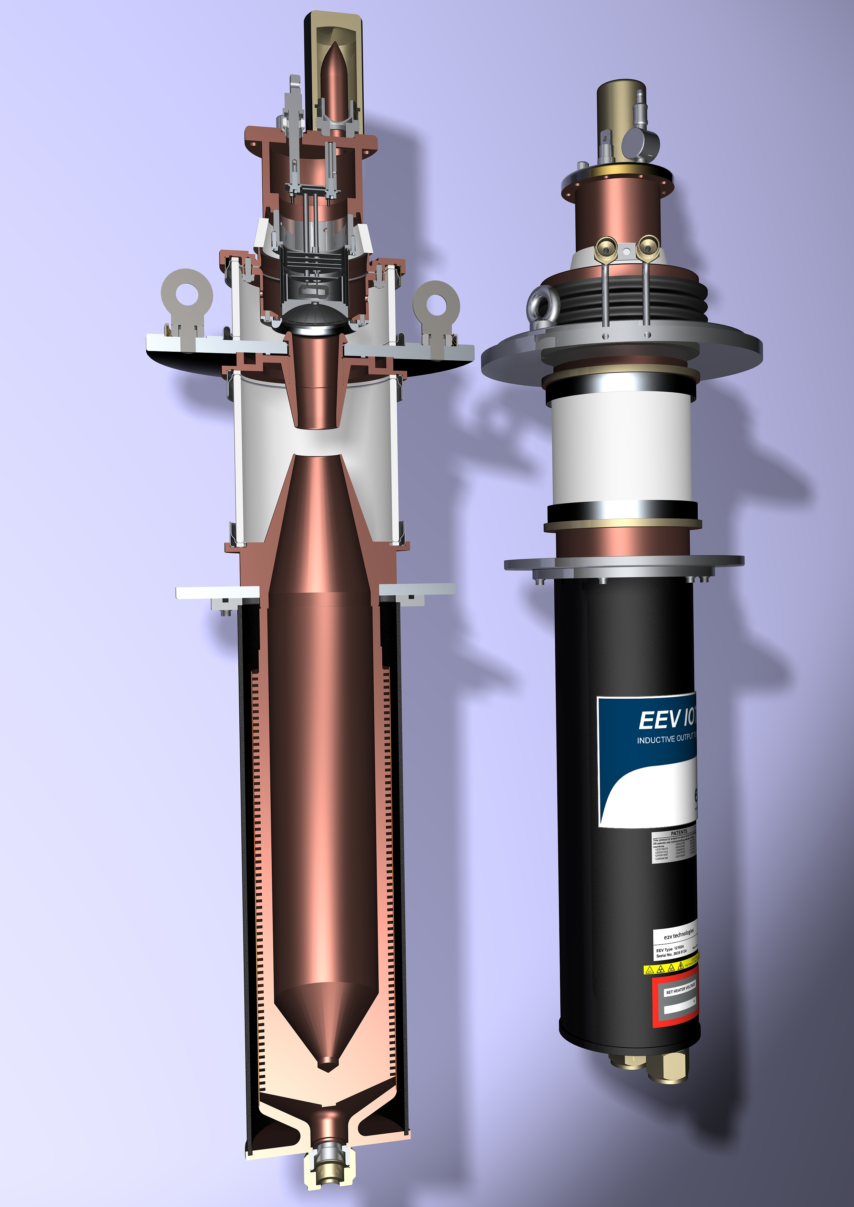
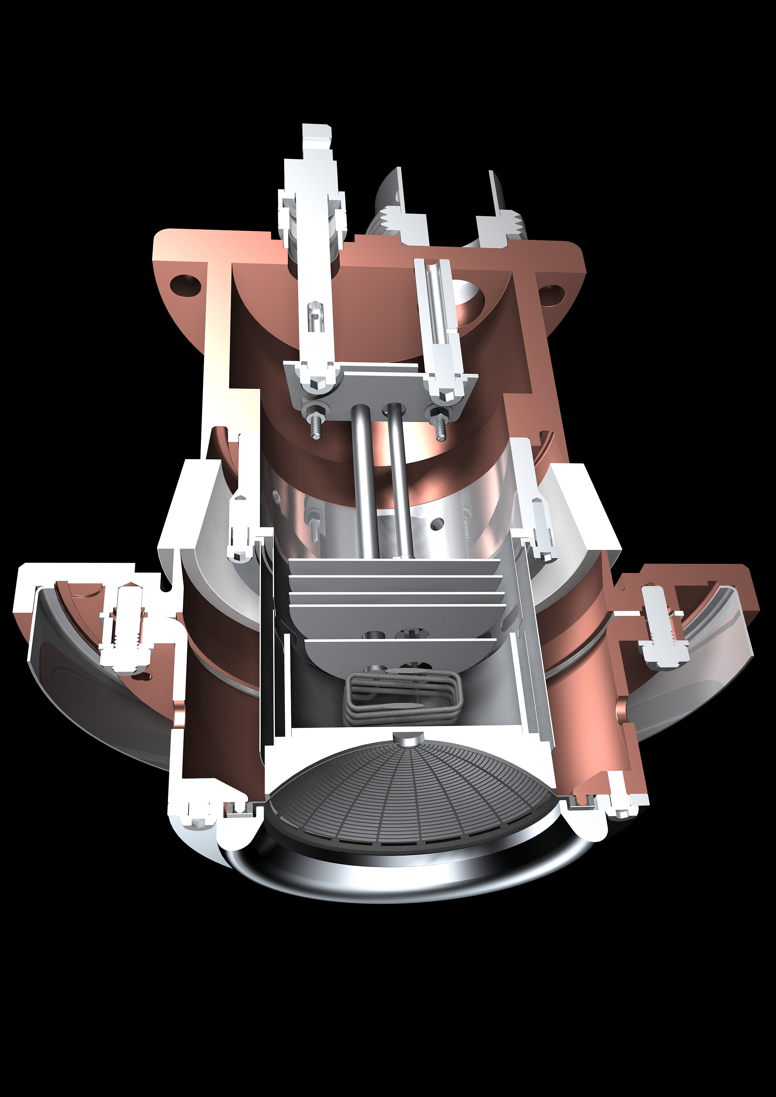
Typical Broadcast IOT
Courtesy of e2v

Slide 5
The Performance Comparison
IOT’s don’t saturate.
Built-in headroom for feedback.
IOT
MB-IOT
Klystron/MBK
Back-off for feedback
+6 dB
Short-pulse
excursions possible
Operating
Power Level
η_{sat} ~ 65-68%
Long-pulse
excursions possible
P_{out}
ESS ~ 45%
~ 70%
High gain
Typical Example of 80 kW IOT
Courtesy of CPI
Low Gain
P_{in}
Klystrons: Back-off for feedback cost 30%
IOTs: Operate close to max efficiency
Example: ESS > 3 MW saved from from high beta linac
Courtesy of e2v

Slide 6
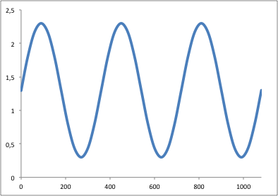
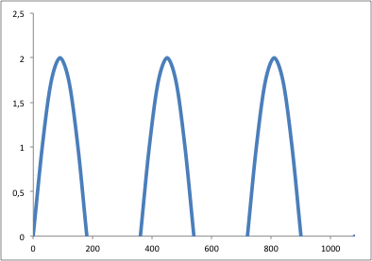
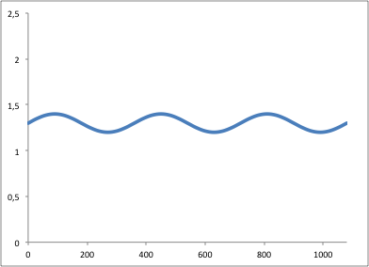
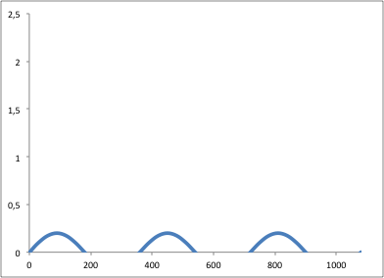
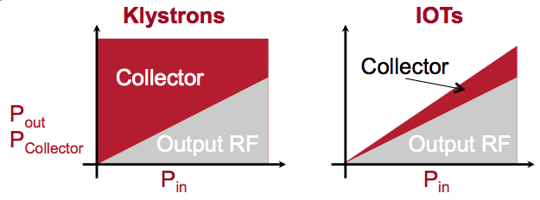
Klystrons
IOTs
Power delivered to beam
Cartoon!
Power delivered to beam
High Beam Current
Electrical Power Consumed
Low
Beam Current

Slide 7
The IOT Advantage
Small and high efficiency (at operating point below saturation)
Cost typically does not scale with output power
Advantage at high power
Low power consumption in standby or for reduced output power
No need to pulse HV for pulsed operation
Multiple vendors for:
Medium power devices to 60-90 kW cw
Peak power for pulsed to 130 kW
Used for broadcast, military and accelerators
Frequency tunable (e.g. 470 – 810 MHz for broadcast)
Broadband (use of double output cavity)

Slide 8
Selection of Laboratories currently using IOTs
Accelerator | Type | Number of IOTs in use | IOTs in use | Typical operation
Diamond Light Source | Synchrotron Light Source | 8 in use 4 on test stand 1 on booster | TED e2v L3 | CW operation (500 MHz) Typically 50-60 kW each Combined in groups of 4
ALBA | Synchrotron Light Source | 12 in use 1 on test stand | TED | CW operation (500 MHz) Typically 20-40 kW each Combined in pairs
Elettra | Synchrotron Light Source | 2 in use | TED e2v | CW operation (500 MHz) Initially ~ 65 kW with one tube, now ~ 35 kW
CERN | Injector for LHC | 8 (planned) Currently on test | TED | CW operation (801 MHz) 60 kW each
BESSY | Synchrotron Light Source | 1 | CPI | CW operation Up to 80 kW
NSLS II | Synchrotron Light Source | 1 on booster | L3 | CW tested Up to 90 kW Normal 1 Hz cycle 1 - 60 kW
ALICE and EMMA (Daresbury Laboratory) | Technology Demonstrator | 3 on test | TED CPI e2v | Pulsed (18 ms) 1.3 GHz 16-30 kW
and more …

Slide 9
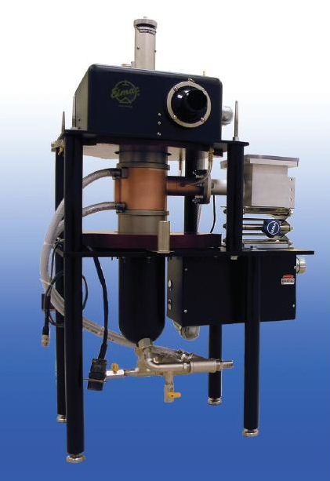

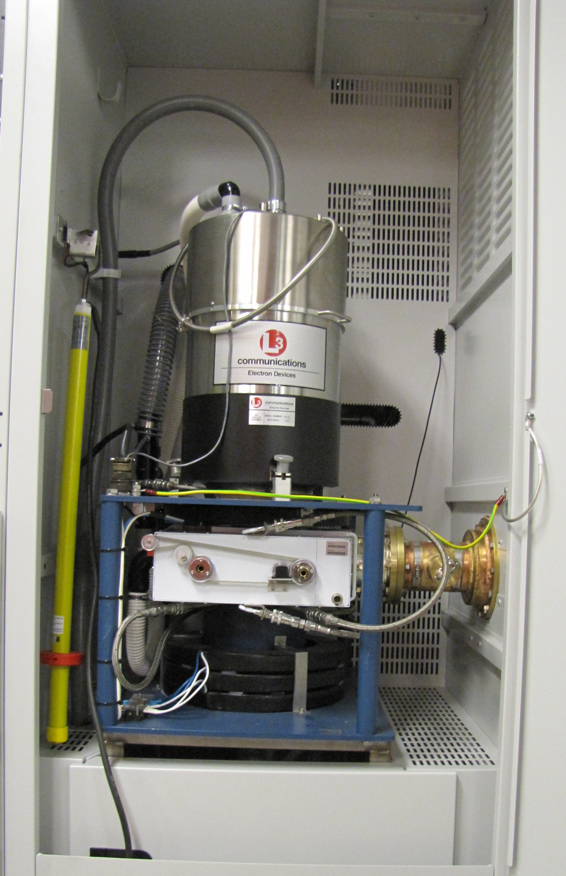
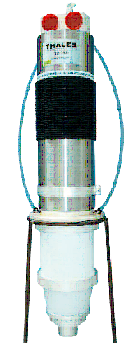
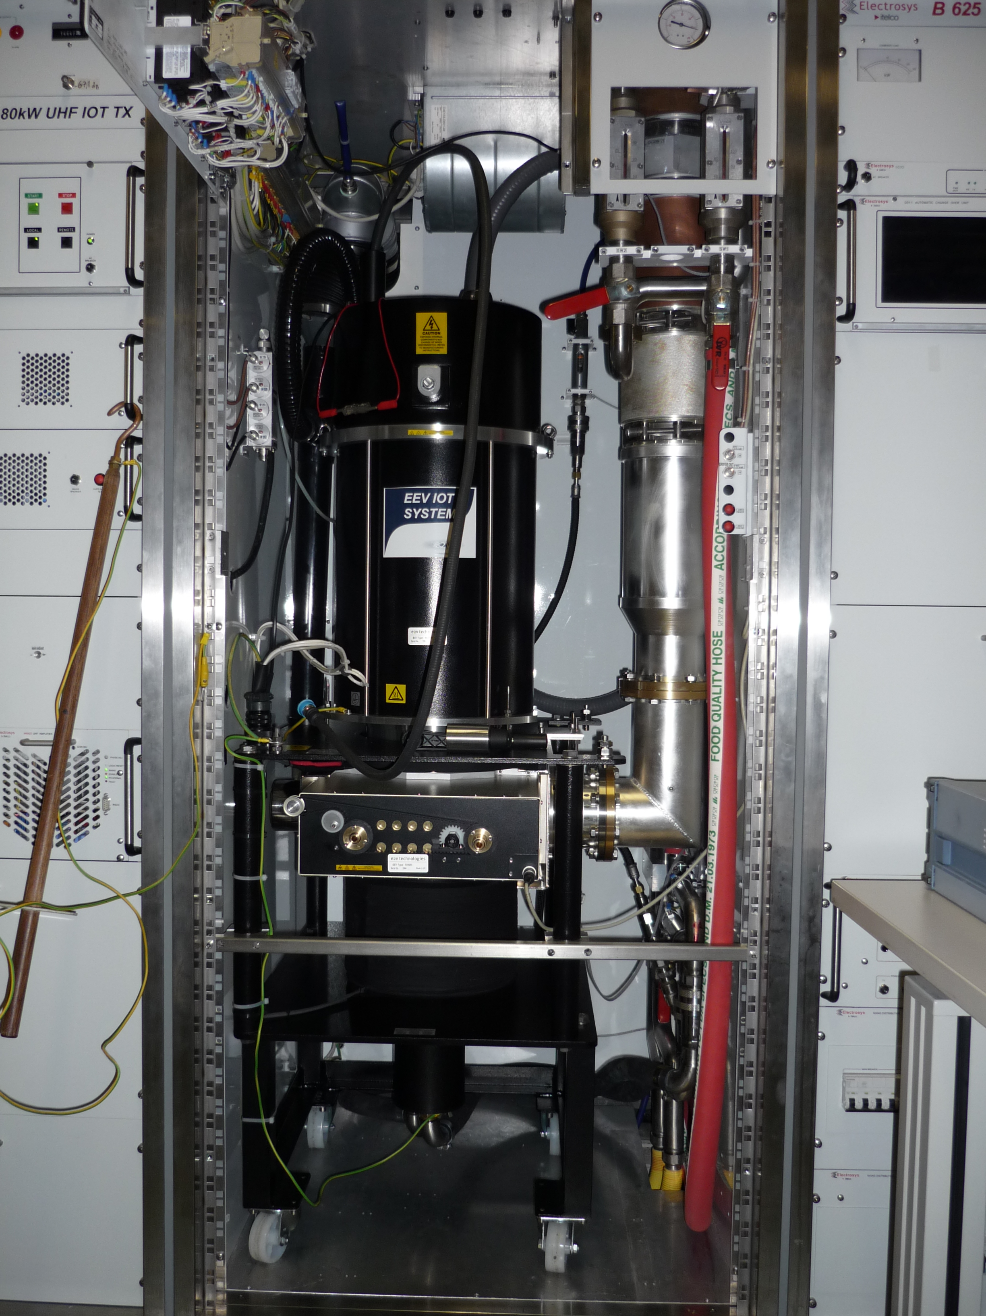
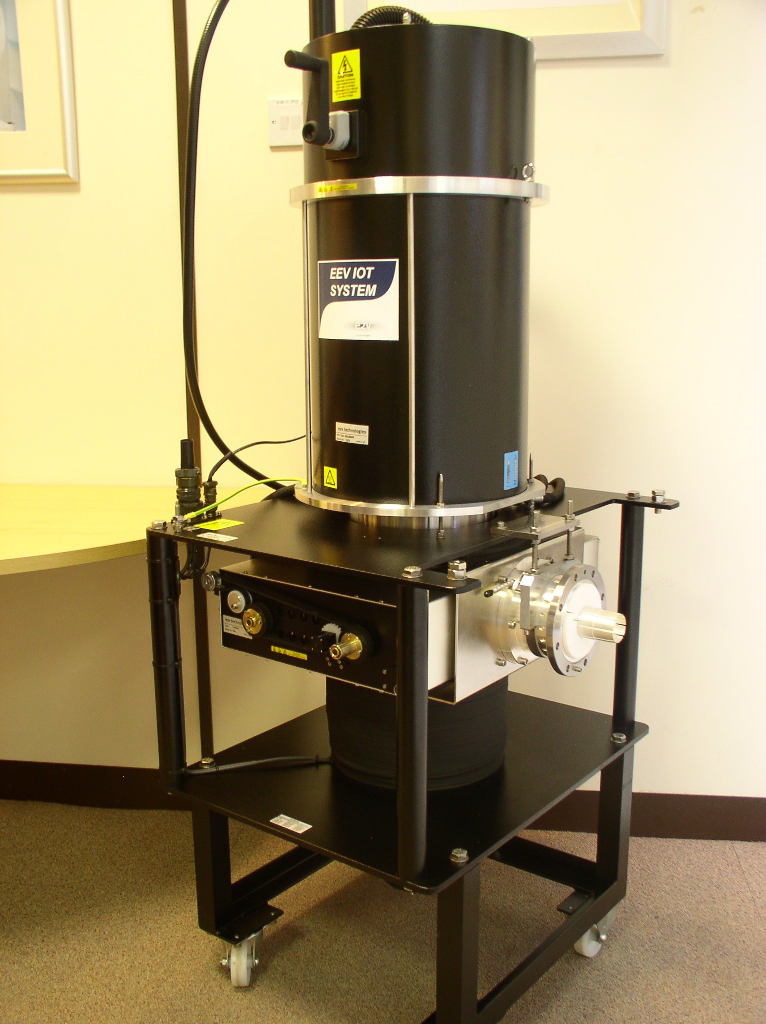
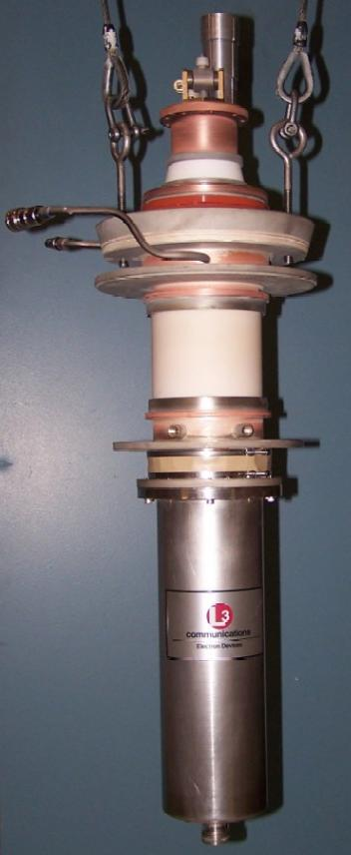
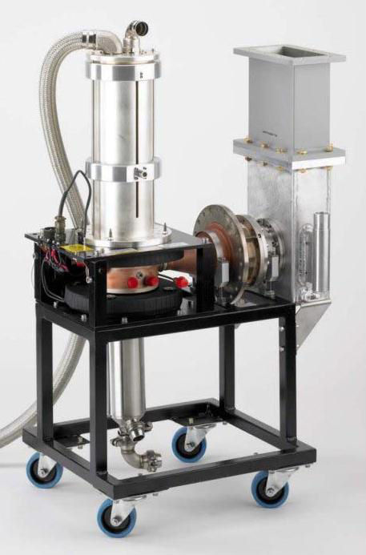
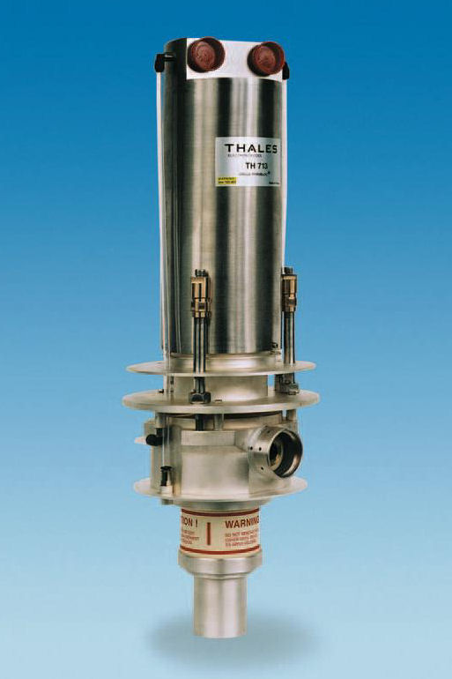
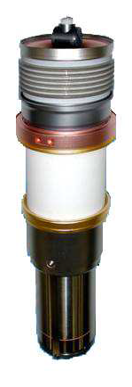
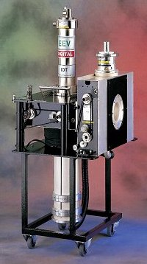
Some summary of suppliers and list of IOTs
TED 85 kW CW
400-800 MHz

Slide 10

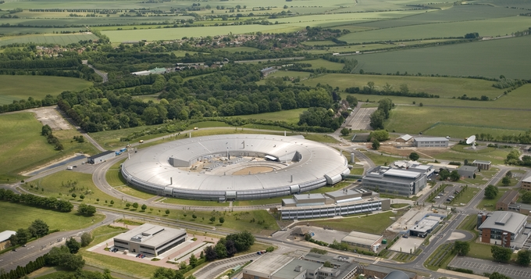
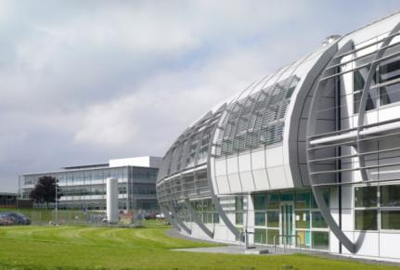
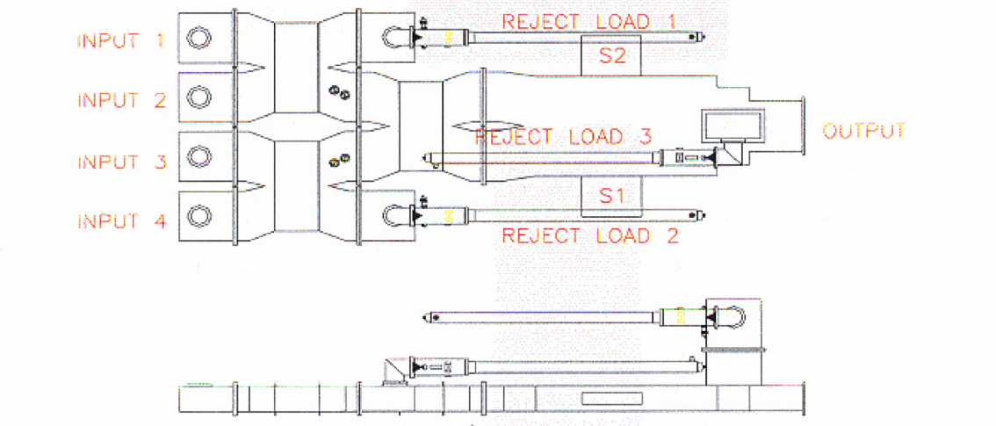
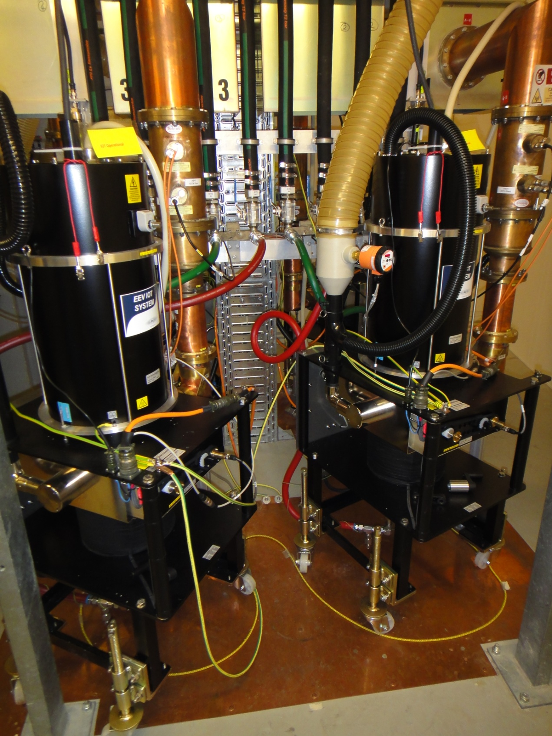
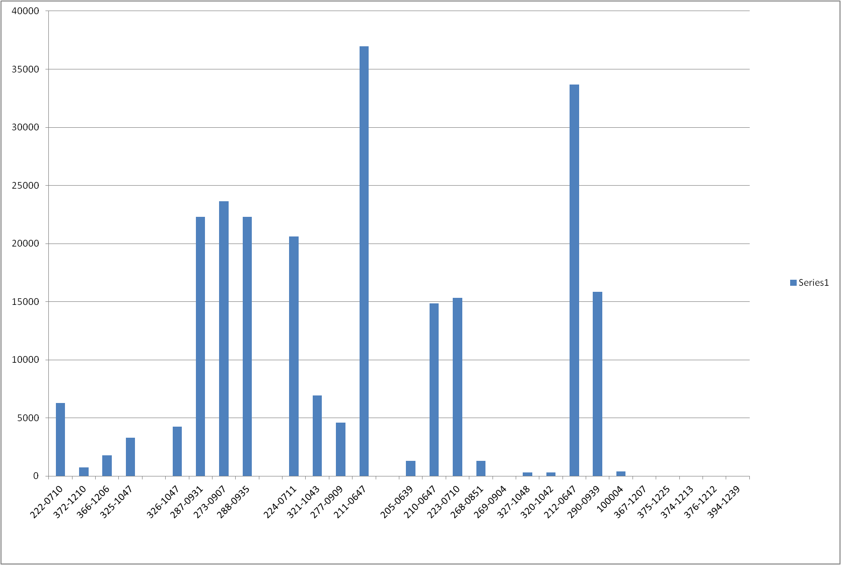
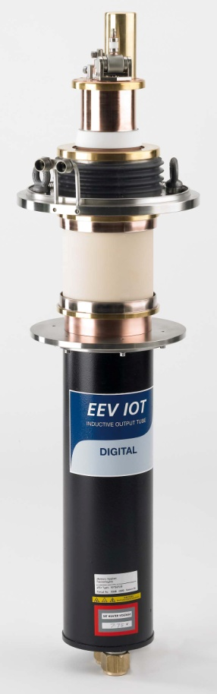
3rd Generation Light Source
Storage Ring
Three 500 MHz 300 kW amplifier for SR
- 4 x 80 kW IOT combined
One 80 kW for the Booster
Operational Hours at Diamond
30000
20000
Filament Hours
10000
Test system
Serial Number
In Operation
Peter Martin, Diamond

Slide 11

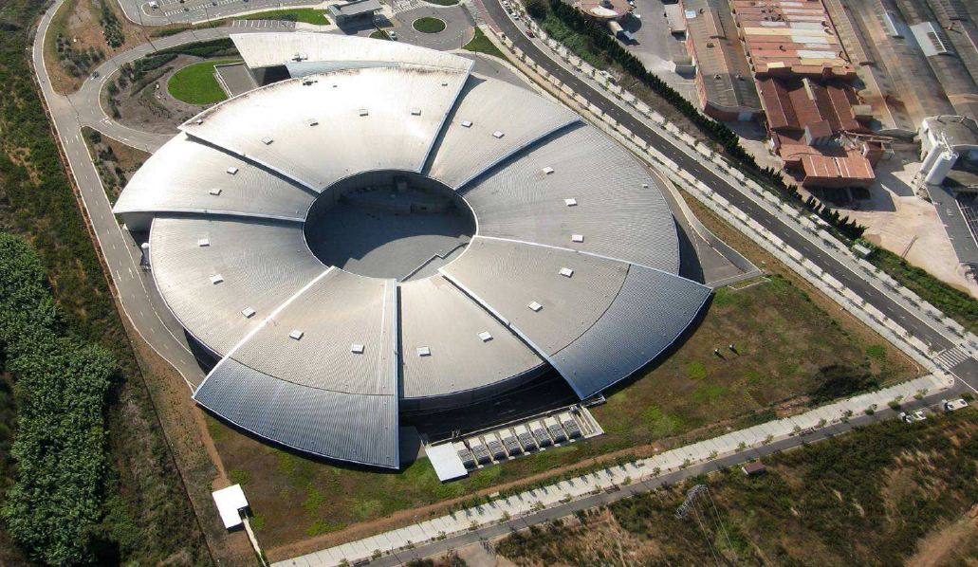
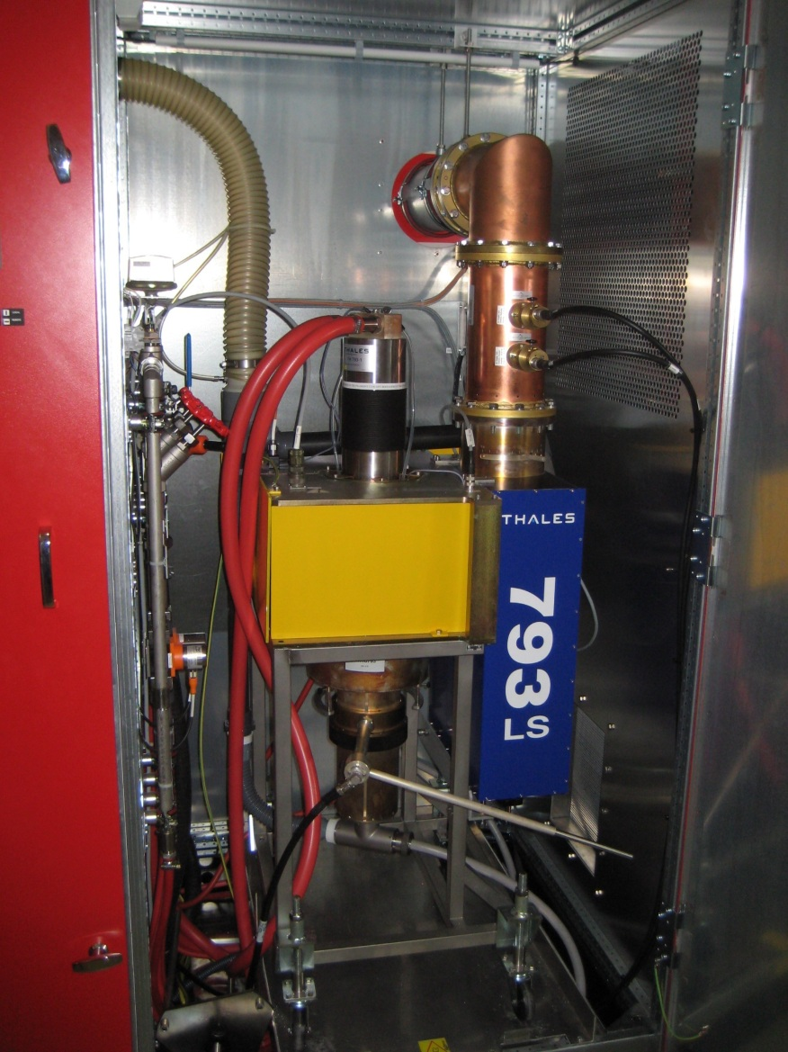
3rd Generation Light Source
Storage Ring
Normal conducting cavities
IOTs combined in pairs
(cavity combiner)
6 RF plants of 160 kW
500 MHz
2 IOTs combined per cavity
IOTs from Thales Electron Devices
Currently 13 IOT in operation (12 on SR, one on test stand)
with an average of 9700 hrs

Slide 12
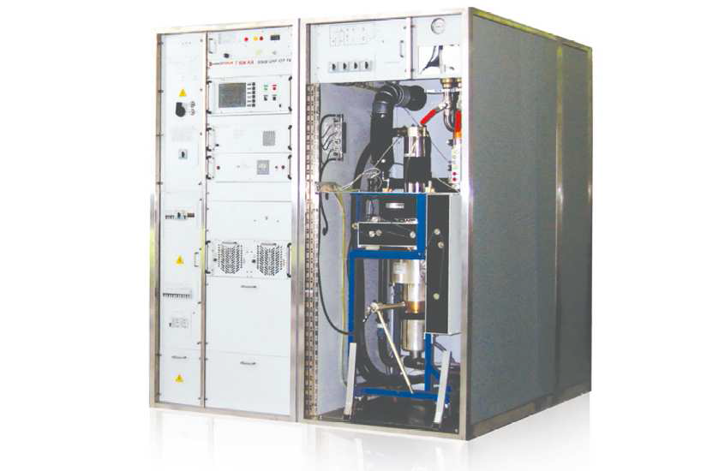
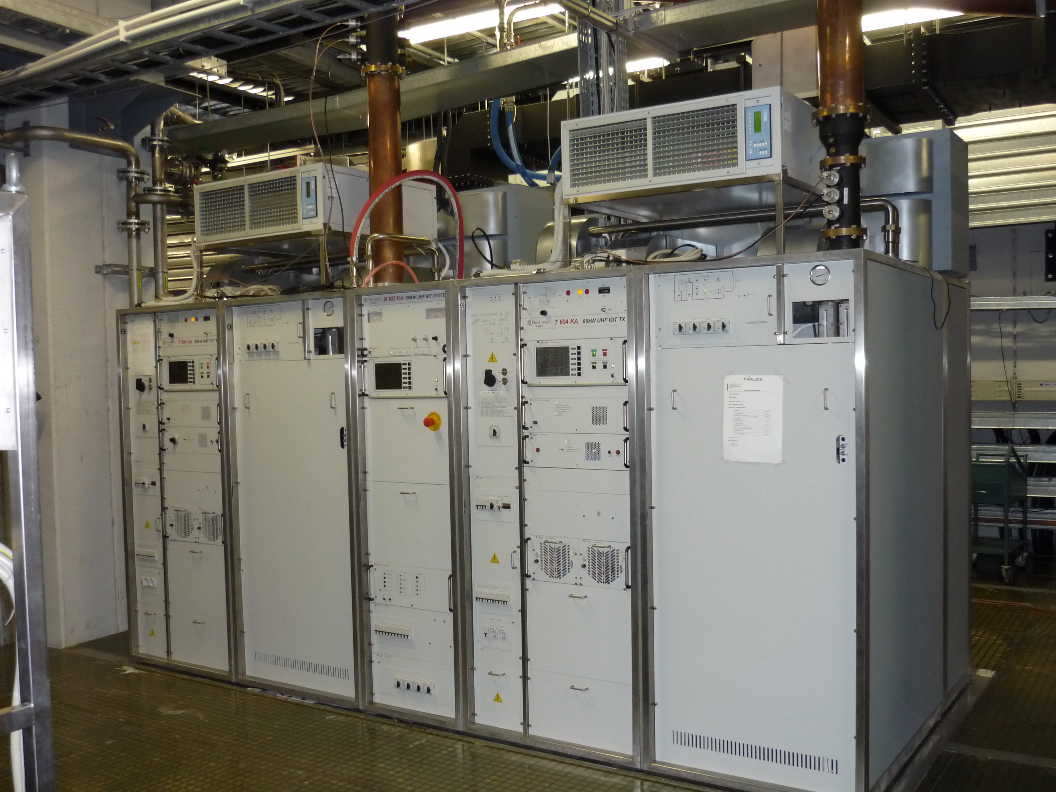
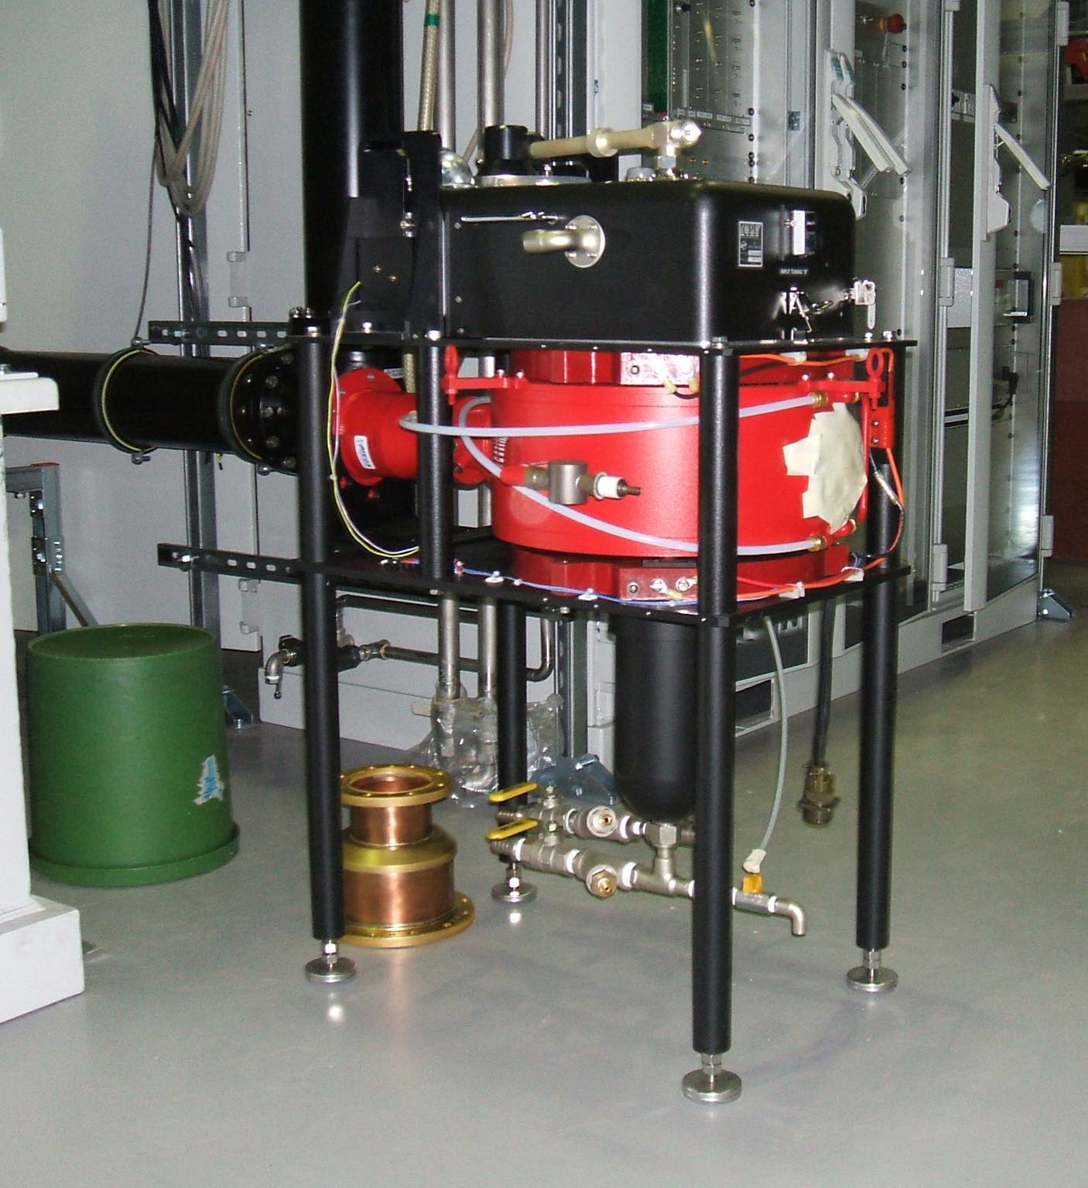
Other Facilities using IOTs
CERN
800 MHz
60 kW
Metrology Light Source
(Willy Wien Laboratory)
CPI 90 kW IOT (K5H90W1)
> 33 000 operating hours
Elettra
500 MHz
150 kW IOT based amplifier for Combination of 2x80 kW

Slide 13
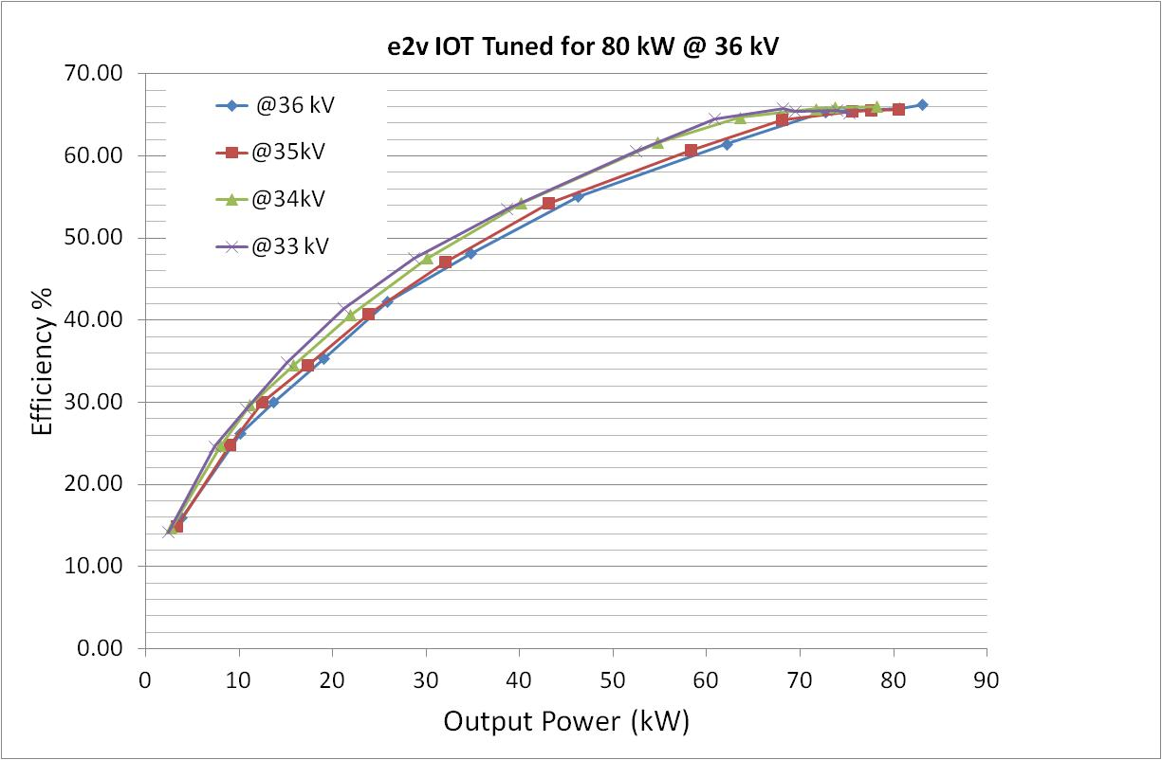
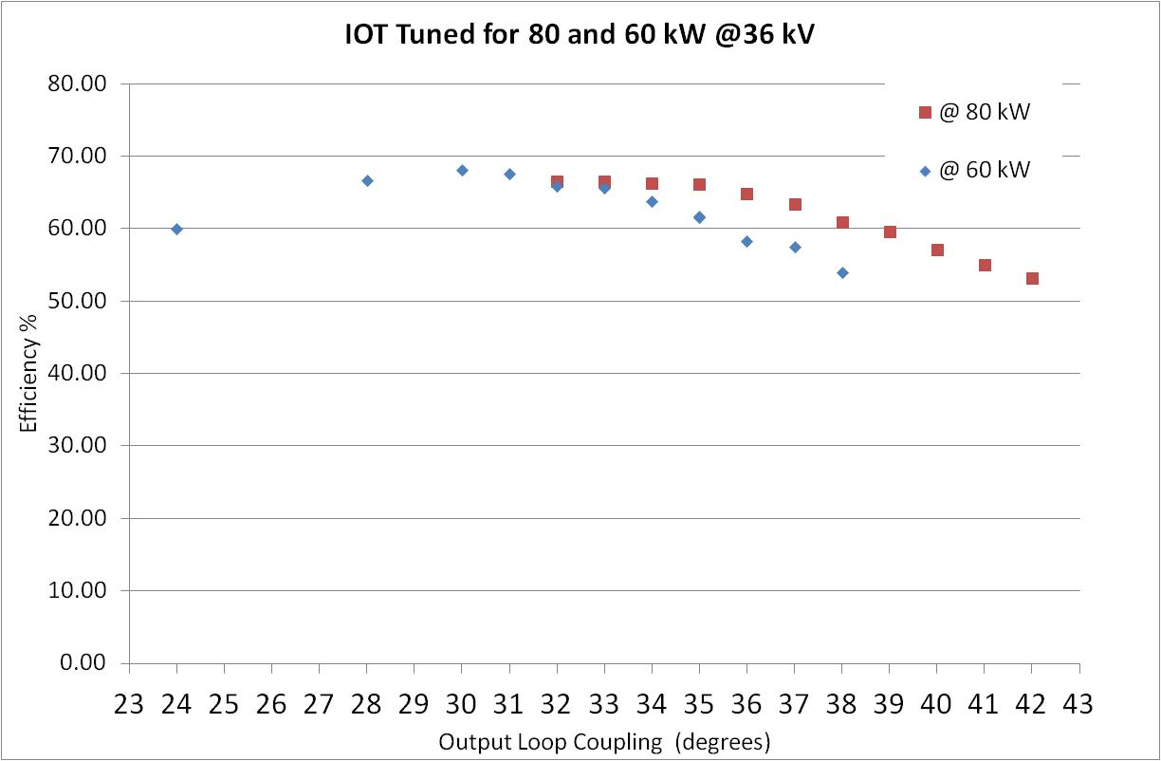
Typical Results
IOTD2130 phase shift at 500MHz
9 deg over 80 kW
500 MHz
Phase shift
Courtesy of e2v
800 MHz
500 MHz operation confirmed at Diamond
500MHz at 36kV
85 kW, 65%
45 kW, 55%
66% Efficiency
Efficiency
Only 10% reduction in efficiency for reduction in output power from 85 kW to 45 kW
Reduced HV -> no reduction in efficiency
Enables quick, easy and remote optimisation.
Tuning of output Q to optimum efficiency for constant HV
Output Power (kW)
Loop Coupling Angle

Slide 14
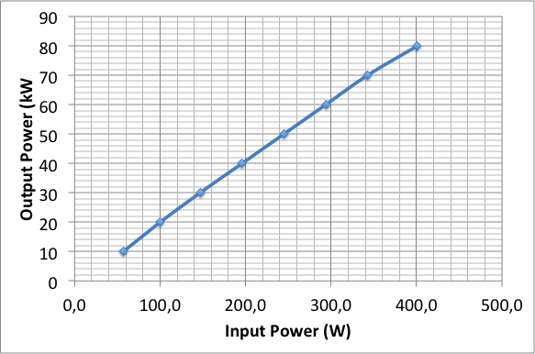
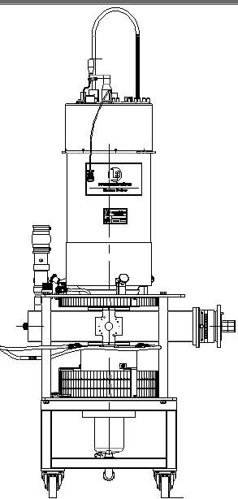

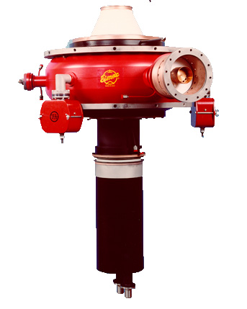
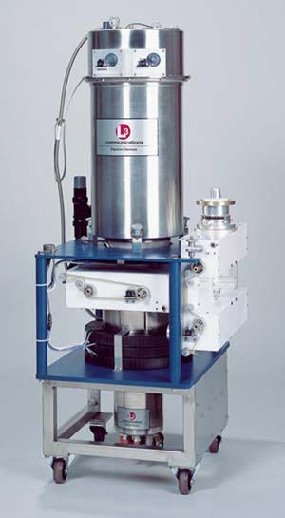
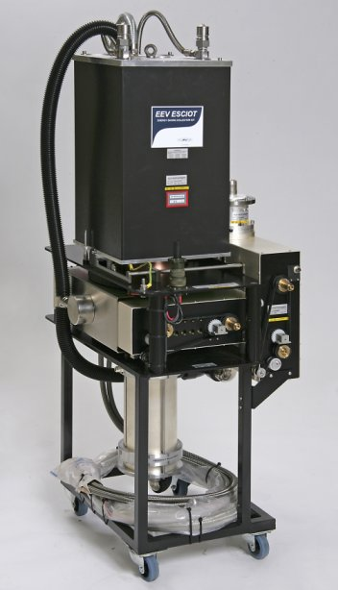


Selection of other IOTs
CW test at 700 MHz
Tuning Range: 325 – 400 MHz
Peak Output up to 130 kW
Pulse widths up to 3.25 msec
Duty Cycle up to 10%
CW Rating up to 90 kW
TED
TH794/795
CPI
267 MHz
300 kW cw
L3 wide band IOT
Pulse testing at 402.5 MHz
to 130 kW
IOTD2130
e2v
Depressed collector IOTs

Slide 15
For high power accelerators:
Power requirement for 500 kW – 1.5 MW
Narrow band (single output cavity)
Single beam – Large cathode
High voltage
High cathode loading
Oil in the modulator and gun
Multi beam - Several smaller cathodes
Higher total perveance
-> Lower voltage
Lower cathode loading
Scalable for higher power levels
(100-140 kW per cathode)

Slide 16
The Super Power IOT Challenge
The need for more Current
Multi-beam considerations
Gun arrangement:
Individual spherical cathodes
Distribution of cathodes
All need consideration on how to get RF into the cathode/grid space
Phase and amplitude matching of each cathode
Management of variation in individual cathodes (common HV)
Mechanical Integrity
Output cavity:
Cavity design to interact with multiple beams
External vs integral cavity
External: Easily tunable, good for broadcast, but needs RF window in the cavity, contact fingers in air.
Integral: No ceramic heating, brazed joints, less tunable, high power couplers possible
Potentially suitable from 200 MHz to 1.5 GHz or higher

Slide 17
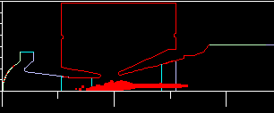
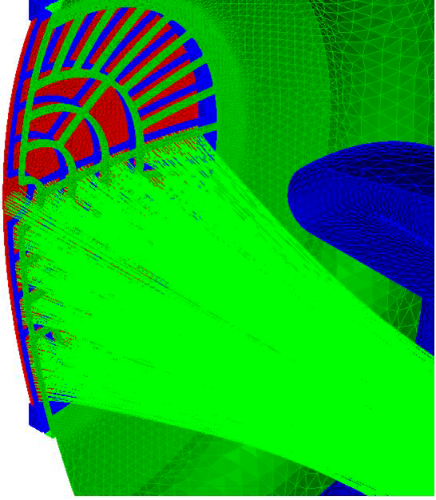
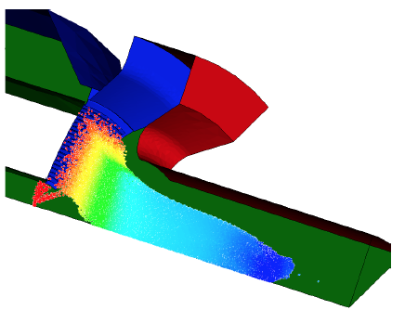
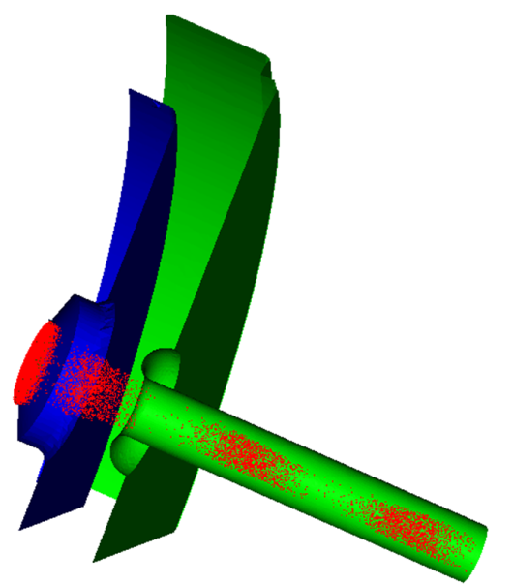
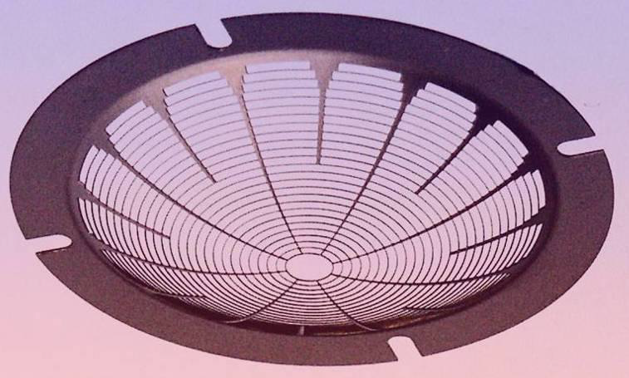
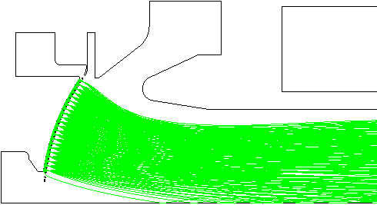

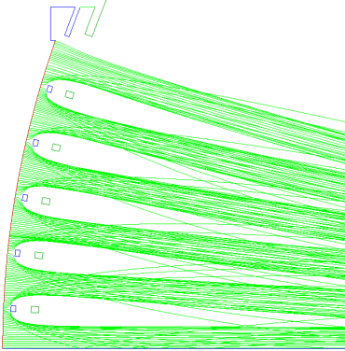
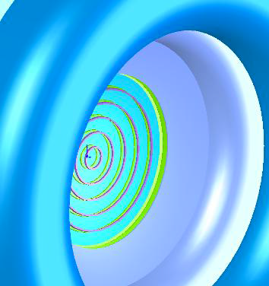

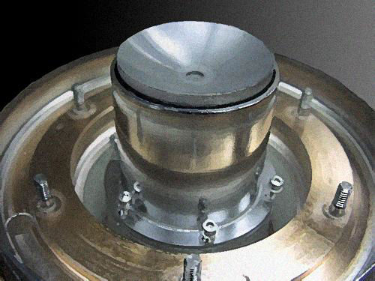
Design and Simulation
Analytical and Numerical codes available
Commercial codes well developed in addition to manufacturers own
Increased computing power allows improved simulation of grid structures, trajectory and PIC modeling
Gun simulation
TED
CPI
IVEC 2009
CPI

Slide 18
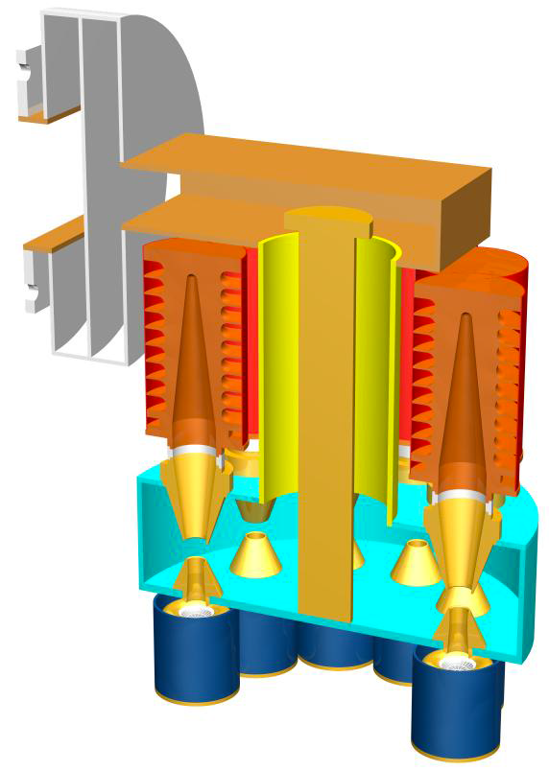
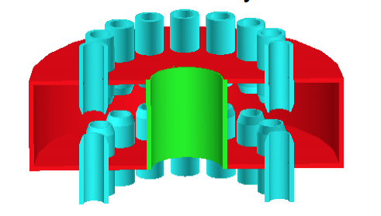
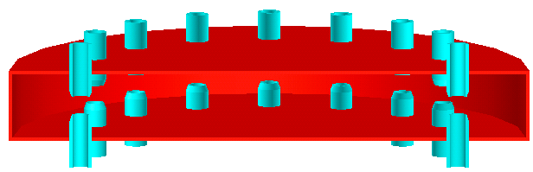
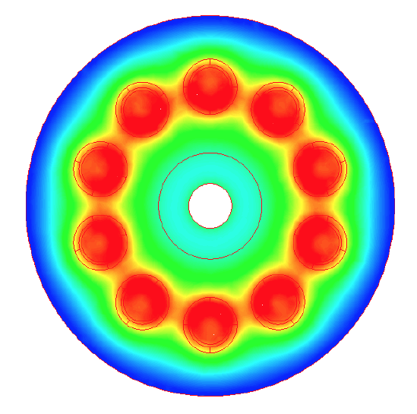
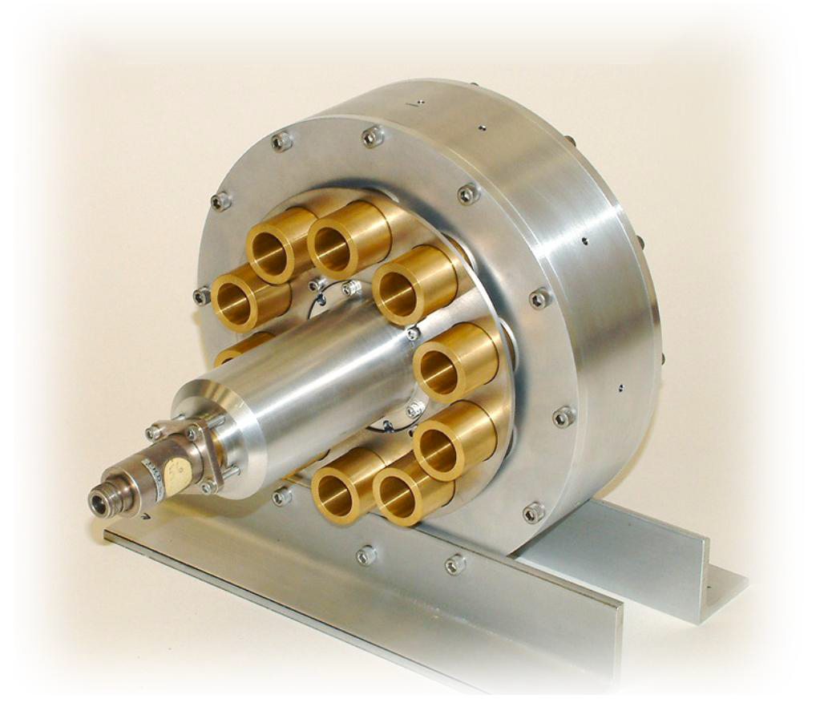
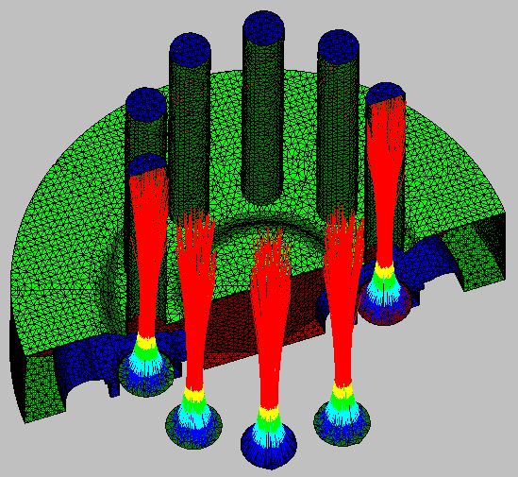
Output cavity considerations
Higher order mode pillbox cavity or toroidal
Individual beam pipes
Coaxial output coupling
Simulations include:
Field (static and RF)
Trajectory
Particle

Slide 19





Some components being prepared for test in late 2013
Calabazas Creek Research, Inc. – 352MHz, 200 kW CW

Slide 20

704 MHz HOM IOT Experience
CPI
  VHP-8330A IOT
RF Input
Design Parameters value units
Power Output 1000 kW (min)
Beam Voltage 45 kV (max)
Beam Current 31 A (max)
Frequency 700 MHz
1dB Bandwidth ± 0.7 MHz (min)
Gain 23 dB (min)
Efficiency 71 % (min)
Diameter 30/76 in/cm
Height 51/130 in/cm
Weight 1000/450 lbs./kg
Collector Coolant Flow 220 gpm
Body Coolant Flow 10 gpm
O/P Window Cooling (Air) 35 cfm
Gun
Solenoid,
O/P Cavity
RF Output
Collector
Test Results
(pulsed)
@ 31kV

Slide 21
Recent IOT publications by Laboratories
(not a comprehensive review)
Many Labs are still thinking about IOTs but we need Industry
Applications of High Power Induction Output Tubes in High Intensity Superconducting Proton Linacs
Testing of Inductive Output Tube based RF amplifier for 650 MHz SRF Cavities, A. Mandal et al, PCaPAC2012
90 kW CW IOT development at L3 Communications Electron Devices, M Boyle et al, CWRF Workshop, 2012
Development of a 402.5 MHz 140 kW IOT, M Read et al, PAC2011
The first continuous wave and long pulse operation, DESY, 2011
Simple Model of an Inductive Output Tube, R. Carter, IEEonED 2010
CPI’s 1.3 GHz, 90 kW Pulsed IOT Amplifier, M. Marks et al, IPAC2010
Modelling and Design of High-Power Inductive Output Tubes, E. Wright et al, PAC2009.
Highly stable IOT based 1.3 GHz/16kW RF Power Source for CW operated SC Linacs, SRF2009
The ALBA RF Amplifier System based on IOTs, P. Sanchez et al, EPAC2008
Installation and Commissioning of the new 150 kW plant for the Elettra RF System Upgrade, A Fabris et al, PAC07
Grid less IOT for Accelerator Applications, C. Wilson et al, PAC2007
IOT testing at the ERLP, J Orrett at al, EPAC2006
First Results of the IOT Based 300 kW 500 MHz Amplifier for the Diamond Light Source, M. Jensen et al, EPAC05
IOT RF Power Sources for Pulsed and CW Linacs, H. Bohlen et al, Lunac2004
Comparison of Klystron and Inductive Output Tubes Vacuum-Electron Devices for Amplifier service in Free-Electron Laser, EPAC04

Slide 22

Where next?
The ESS Requirement
Proton linac to be constructed in Lund
Carbon Neutral
Innovative
Green
Time to develop Super Power IOT
Accelerating Structure | Freq. (MHz) | Quantity | Max Power (kW)
RFQ, DTL | 352 | 5 | 2200**
Spoke | 352 | 30 | 240**
Elliptical Medium Beta | 704 | 32 | 800**
Elliptical High Beta | 704 | 88 | 1200**
High beta amplifier decision not before 2017
** Plus overhead for control

Slide 23
Preliminary Functional Specification for ESS IOT Development
Parameter |  | Comment
Frequency | 704.42 MHz | Bandwidth > +/- 0.5 MHz
Maximum Power | 1.2 MW | Average power during the pulse
RF Pulse length | Up to 3.5 ms | Beam pulse 2.86 ms
Duty factor | Up to 5% | Pulse rep. frequency fixed to 14 Hz
Gain | > 20 dB | At max. rated power.
Overhead margin for control | 30% | Short pulse excursion on top of rated power.
Idle current | Very low or zero | Current drawn between pulses. Gating of the grid bias is being considered.
Efficiency | Target > 65%
High Voltage | Low | Expected < 50 kV
Design Lifetime | > 50,000 hrs
Target: Approval for ESS series production in 2017
Work is being carried out in collaboration with CERN
ESS to procure prototypes
CERN to make space and utilities available for testing

Slide 24


A 700 MHz Comparison
 | Single Beam Klystron | MB IOT
Peak output Power | 1 | 1 | MW
Cathode Voltage | 95 | 50 | kV
Beam Current | 21 | 31 | A
Efficiency at saturation | 65 | 65 (min) | %
Est. efficiency for operation | <45 | >60 | %
Gain | 48 | 23 | dB
0.6 m
1.3 m

Slide 25
Thanks to
Contributions from many people from ESS and other organisations including
Bessy
Thomas Westphal
Wolfgang Anders
L3
Michael Boyle
Mark Kirshner
Elettra
Cristina Pasotti
Calabazas Creek Research
Lawrence Ives
Diamond
Peter Marten
NSLS-II
Jim Rose
Goel Aditya
Alba
Francis Perez
CPI
Robin Stewart and collagues
Thales
Stephane Bethus
Armel Beunas and colleagues
CERN
Eric Montesinos
ASTEC
Alan Wheelhouse
and colleagues
e2v
Martin Edwards and colleagues

