Slide 1
Prospects for developing new tubes
I. Syratchev, CERN

Slide 2
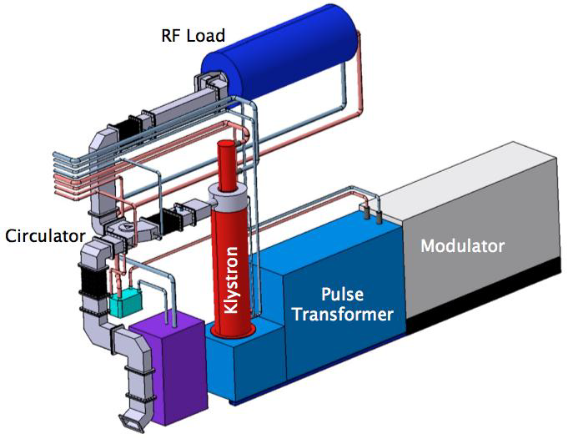
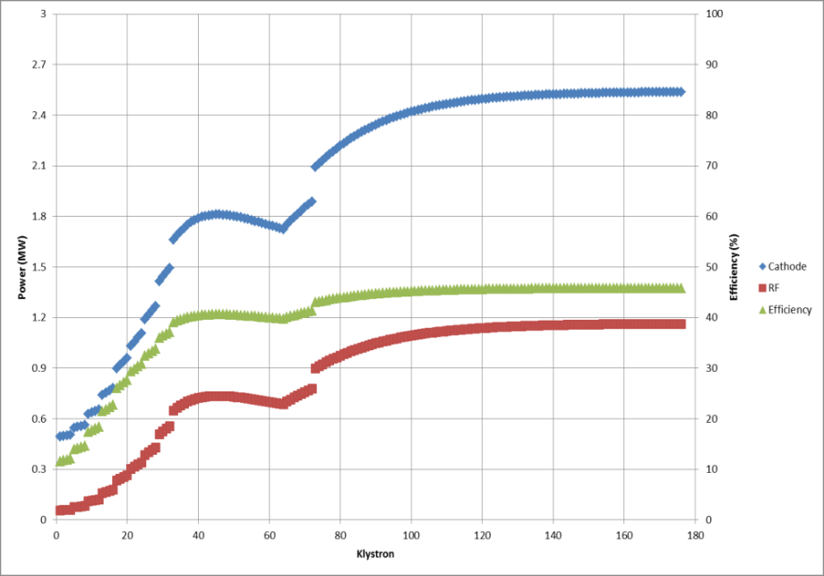
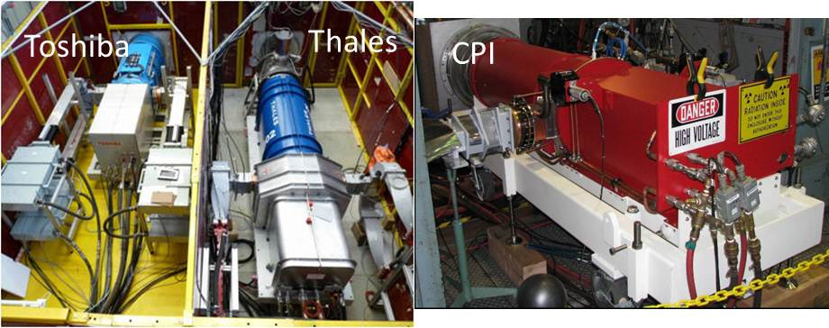
Theme: RF power sources for the future ‘Big’ science.
(It should become ‘Big’, when the number of sources exceeds few hundred)
ESS. Conventional single beam klystrons
Mostly 704 MHz, ~3msec, 14 Hz.
~50 kW average
CLIC MBK (specifications).
Frequency: 1.0 GHz
Peak RF power: 20 MW
Efficiency: >70%
Pulse length: up to 150 sec
Rep. rate: 50 Hz
P average: up to 150 kW
ILC MBK (demonstrated).
Frequency: 1.3 GHz
Peak RF power: 10 MW
Efficiency: ~69%
Pulse length: up to 1.50 msec
Rep. rate: 10 Hz
P average: ~150 kW
The L-band klystron development is amongst the most strong synergies between CLIC and ILC.

Slide 3
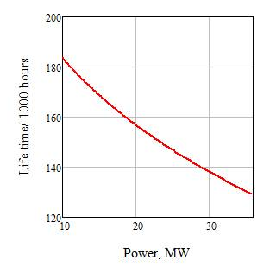
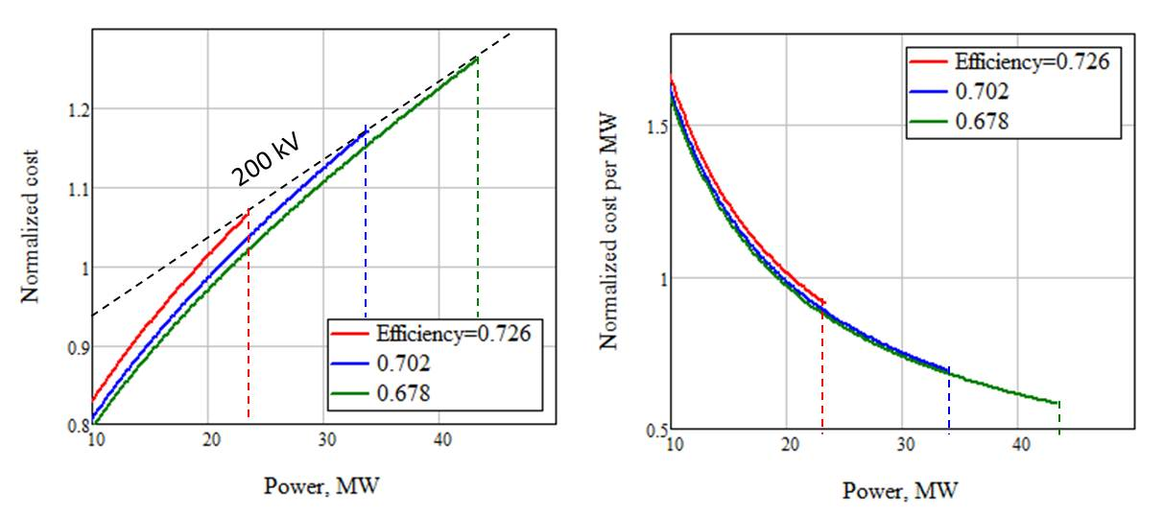
What kind of performance we need to improve ?
Targeting the higher voltages brings many benefits. But for the long pulses it soon will be limited at about 160-180 kV.
The most efficient way out is to use Multi-Beam technology.
New cathode topology/technology
⇑ High voltage
(space charge limited)
⇑ High voltage
(space charge limited)
⇑ High voltage
(space charge limited)
⇑ Beam power
⇓ Perveance
We need all of it !
⇓ Current density
Peak power
Efficiency
Cost (per MW)
Life time
RF circuit topology
CLIC MBK#6
RF breakdown limited
⇑ Peak power
CLIC MBK#6
Klystron cluster
PPM focusing
/SC solenoid
Max. 180 kV
Similar scaling for modulator cost
Depressed collector
Modulator
The subjects for the new tubes development

Slide 4
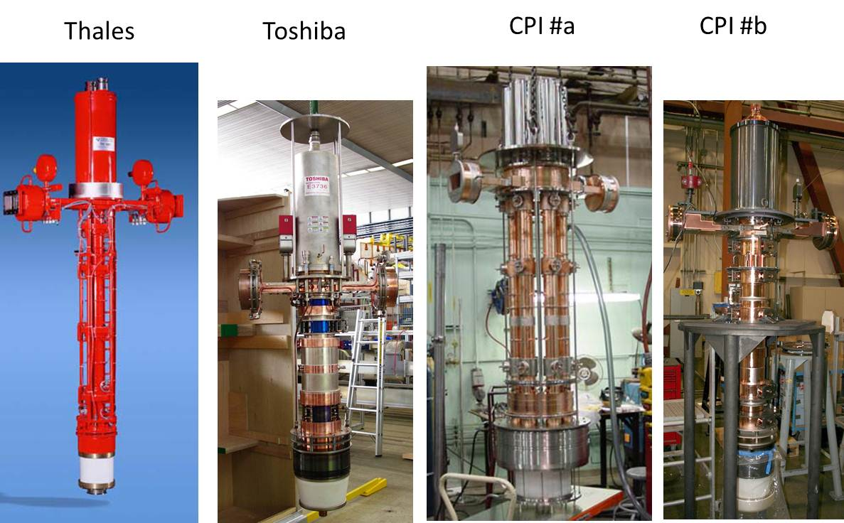
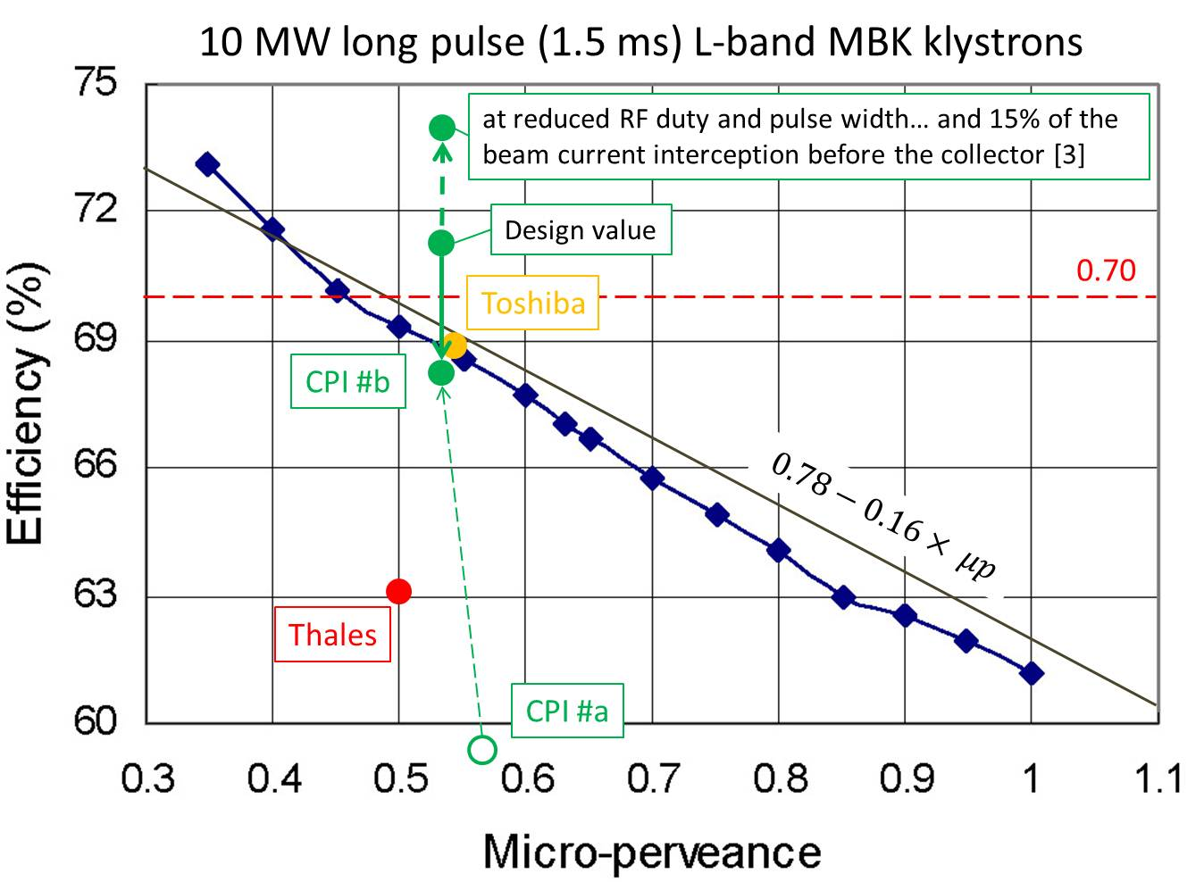
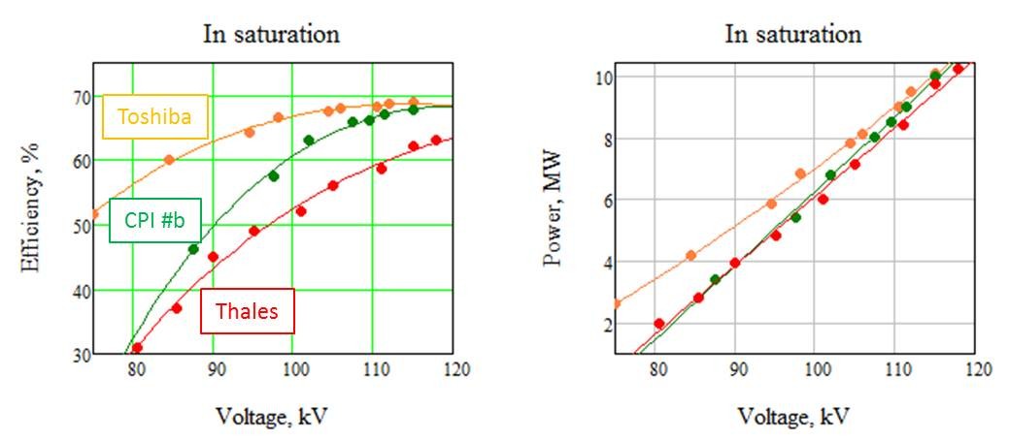
State of art: L-band 10 MW MBK klystrons for ILC.
In terms of achieved efficiency at 10 MW peak RF power level, the existing MBK klystrons provides values very close to the 70%, as is specified in CLIC CDR.
Minimizing the cost and increasing peak RF power still remain for CLIC as an important objective towards TDR phase

Slide 5
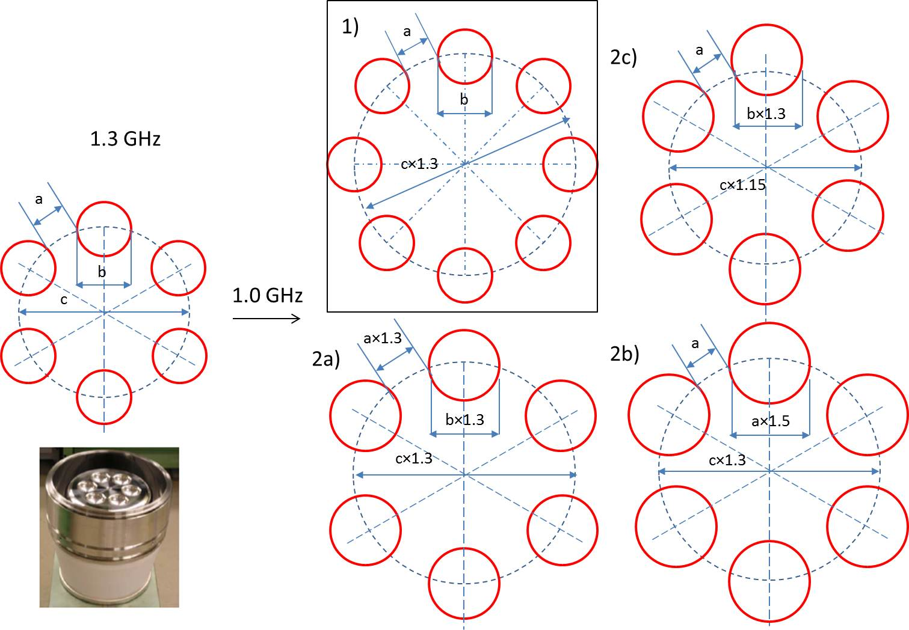
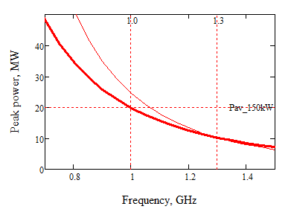
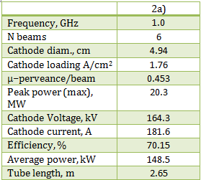
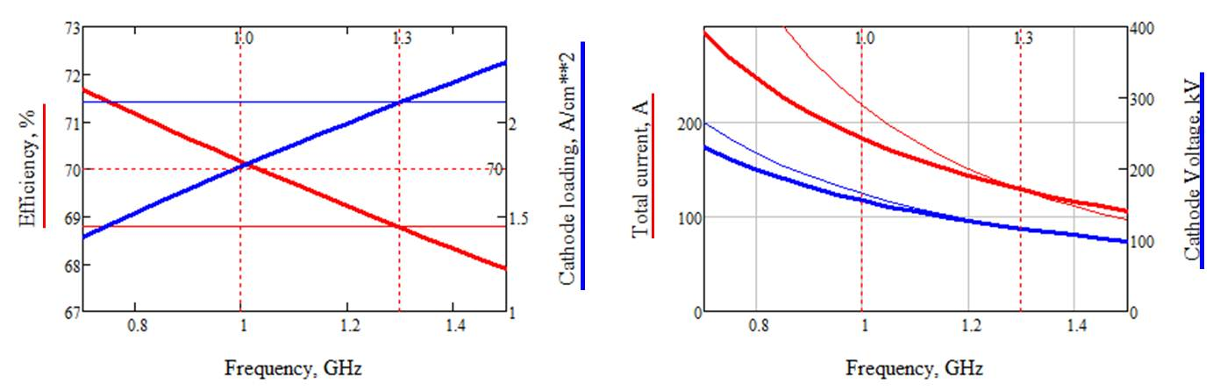
Extending technology: L-band 20 MW MBK klystron for CLIC.
We made a study which indicates that the scaling of existing tubes down in frequency may end up in rather powerful (>20 MW) and efficient (>70%) MBK.
Currently we are in process of preparing “call for tender” for fabrication of such a tube.

Slide 6
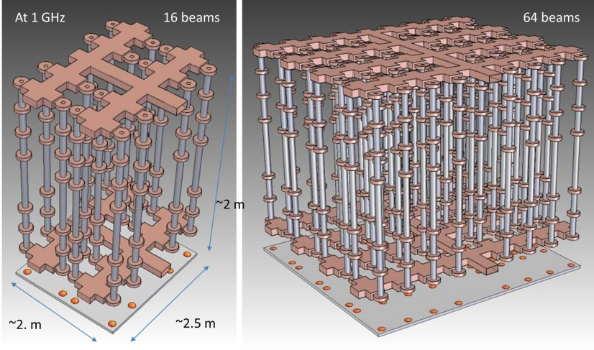
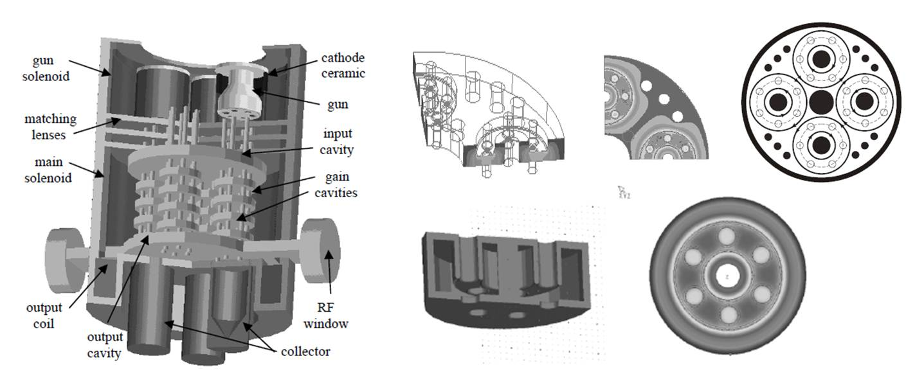
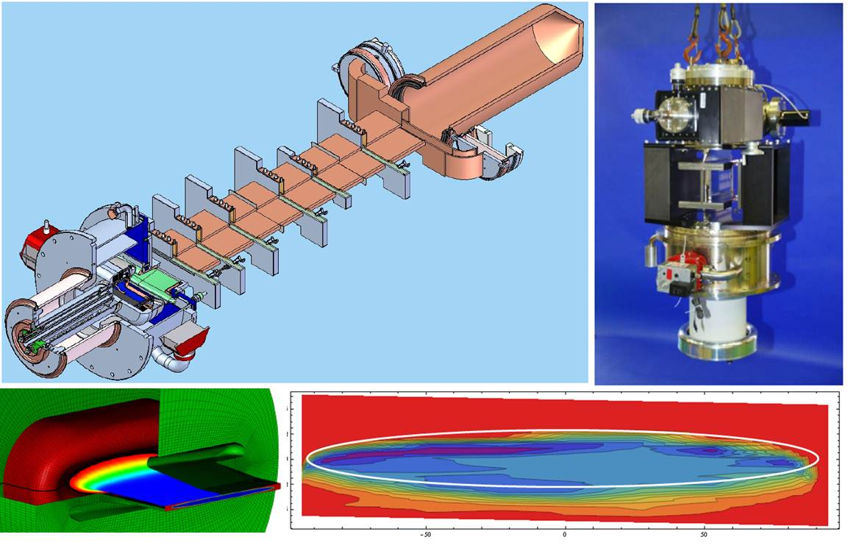
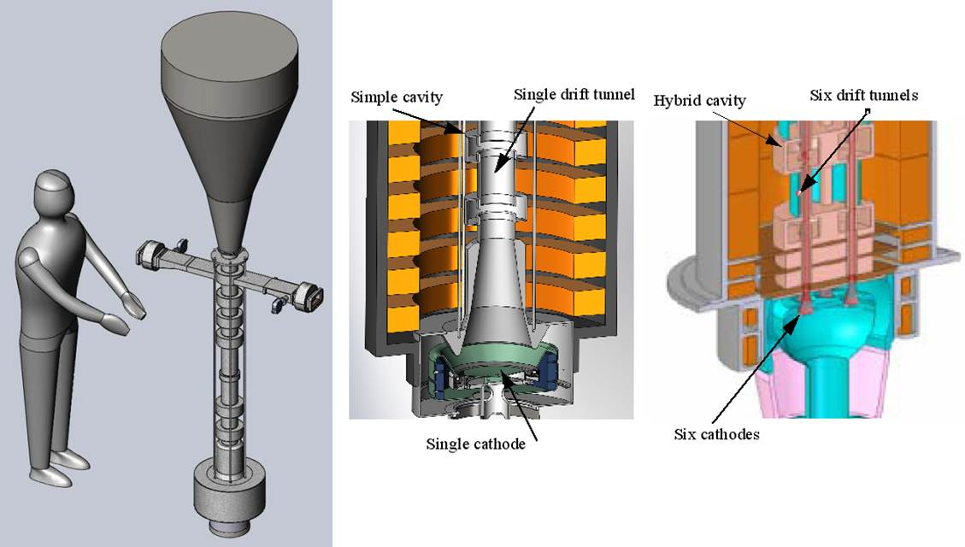
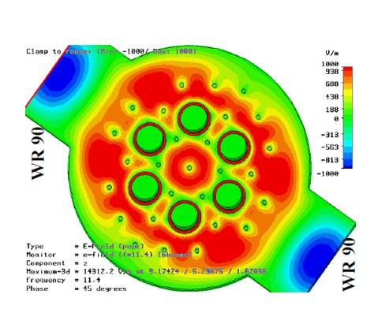
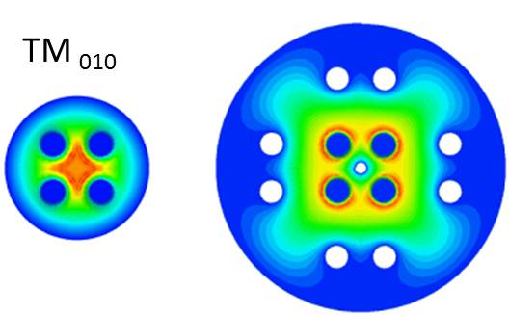
What else people are working at?
Cluster X-band (SLAC)
Super MBK (KEK)
http://indico.cern.ch/confRegistrantsDisplay.py/list?confId=204269
http://accelconf.web.cern.ch/accelconf/pac2009/papers/tu5pfp093.pdf
PBGK
ABK (CCR)
SBK (SLAC)
http://www.osti.gov/bridge/servlets/purl/1045838/1045838.pdf
http://accelconf.web.cern.ch/accelconf/IPAC10/papers/thpeb066.pdf
None of them have clear advantages compared to the existing MBK technology.

Slide 7
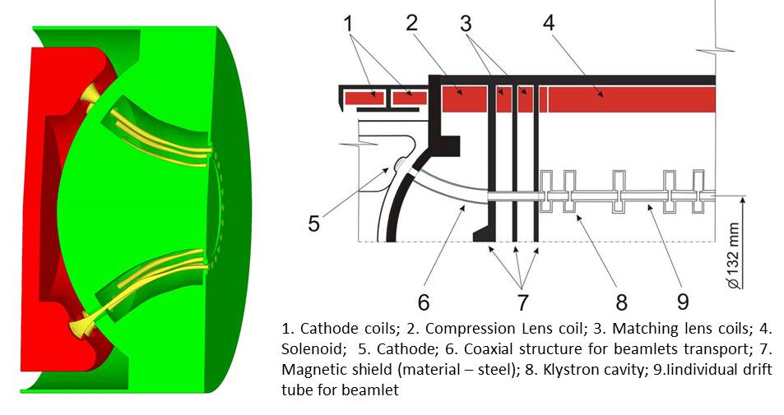
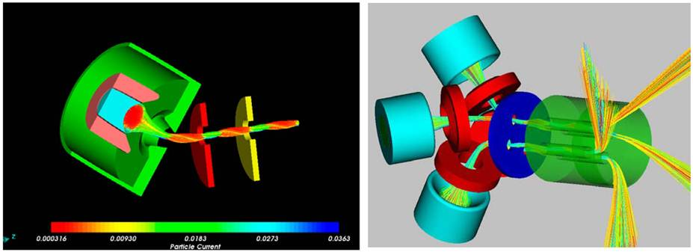
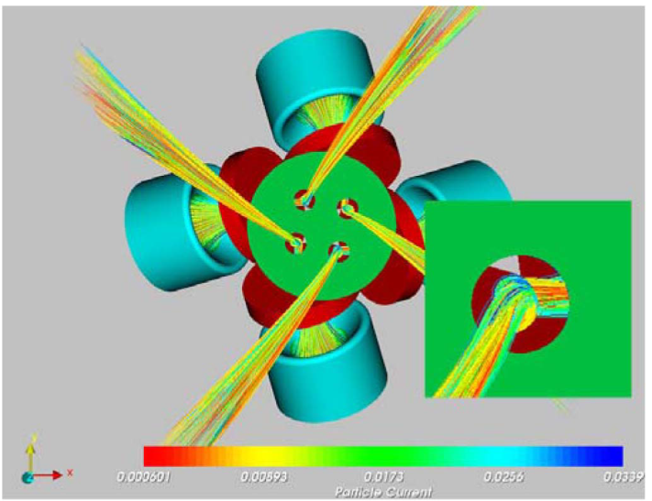
New cathode topology
Doubly Convergent Multiple-Beam Electron Guns
The multiple beam guns with two stages of compression opens a wide range of opportunities. Even existing MBK designs can be improved in terms of peak power, beam voltage, efficiency and life time.
http://ieeexplore.ieee.org/stamp/stamp.jsp?tp=&arnumber=4283375
http://ieeexplore.ieee.org/stamp/stamp.jsp?tp=&arnumber=5452975

Slide 8
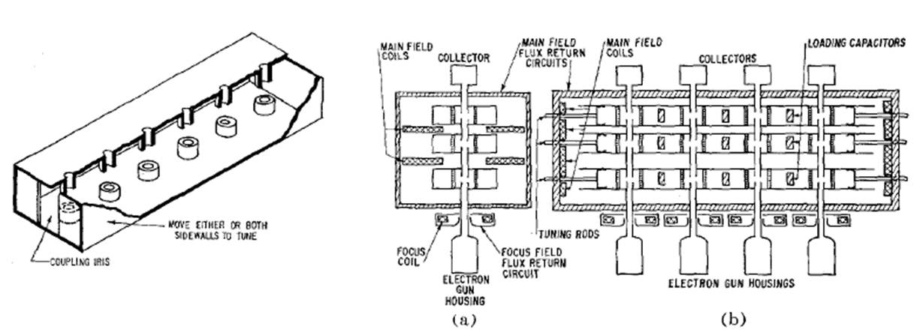
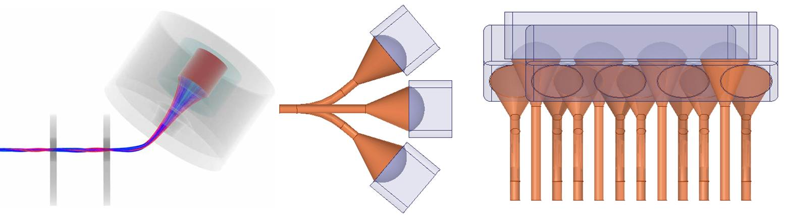
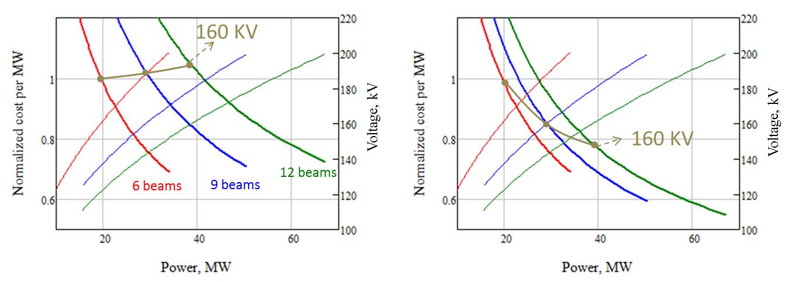
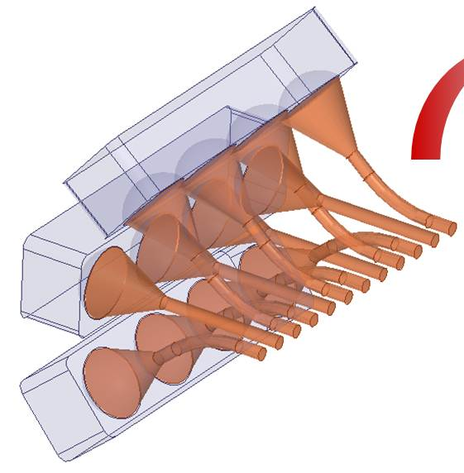
Planar RF topology combined with doubly convergent gun.
Planar MBK with ‘pencil’ beams. Build and tested in 1961
New guns with double compression, being combined with planar technology might be an attractive solution. It allows integration of the individual (for each beam) drift channels.
The use of this technology naturally suggests application of PPM focusing and relatively ‘simple’ fabrication processes, thus substantial cost reduction:
http://ieeexplore.ieee.org/stamp/stamp.jsp?tp=&arnumber=1473207&tag=1
ILC–type MBK
Planar MBK

Slide 9
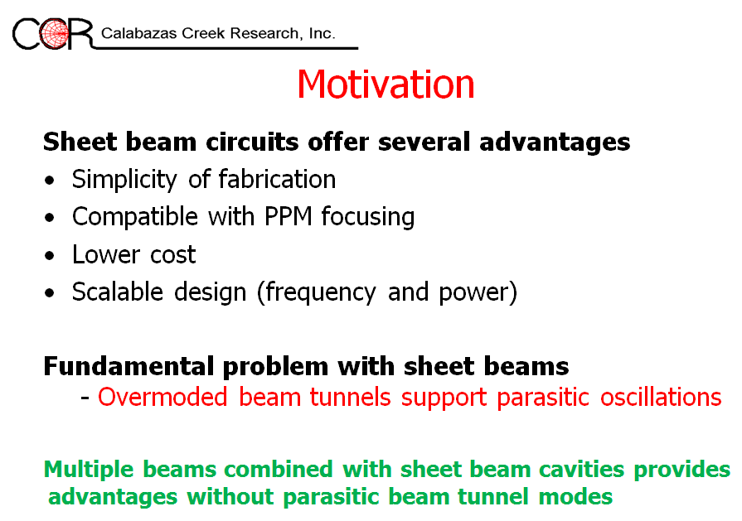

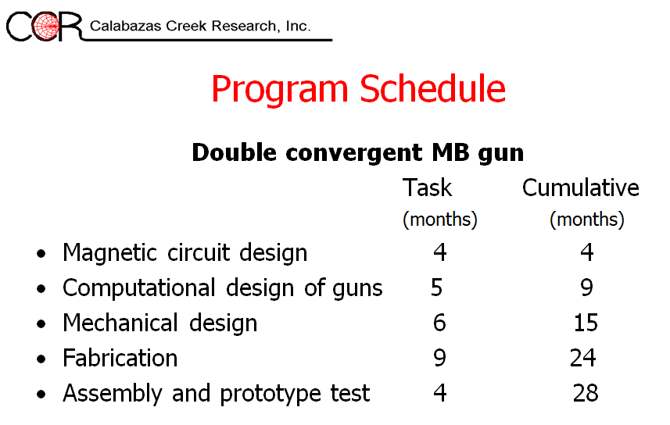
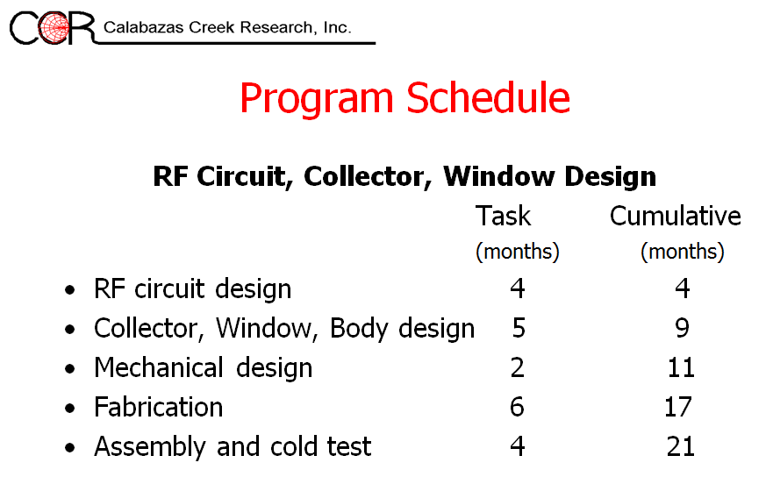

Slide 10
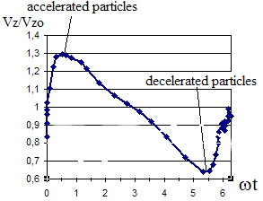
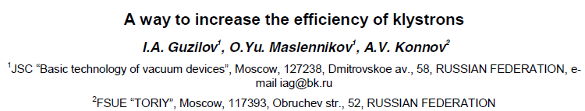

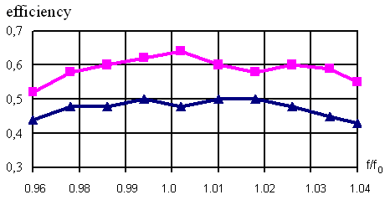
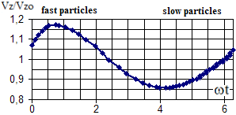
Efficiency and klystron RF circuit design
Harmonic cavities
IVEC 2013
Implementation of higher (2nd, 3rd ) harmonic cavities is a well established technique which allows to increase efficiency and reduce the cost (length) of the tube.
(see also presentation by Chiara Marrelli)
New method of increasing efficiency in klystrons has been developed and tested. Method is based on the velocity re-distribution of electrons in a bunch prior to its deceleration in the output cavity.
One also may expect, that spent beam velocity spread can also be reduced, thus depressed collector (if used) will require less stages.

Slide 11
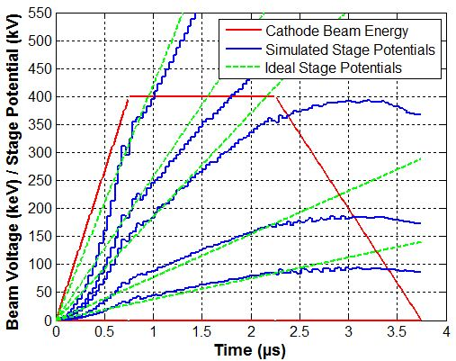

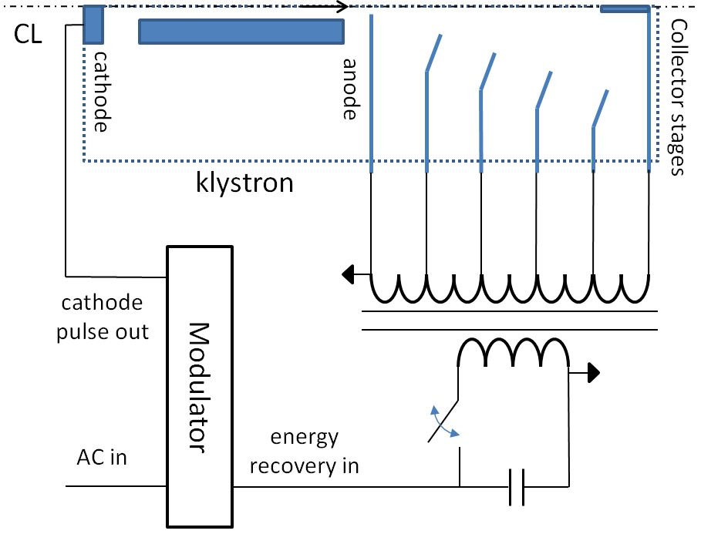
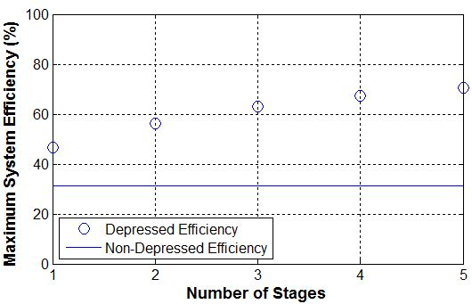
Efficiency and depressed collector
IVEC 2013
A pulsed depressed collector which uses a novel feed-forward energy recovery scheme. It also allows to recover the rise and fall time of the modulator pulse (opens a potential to reduce modulator price).
Simulated with 2D-PIC code efficiency using a five-stage, un-optimized collector was as high as 55%.

Slide 12

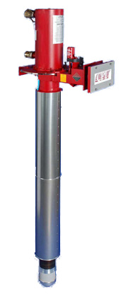
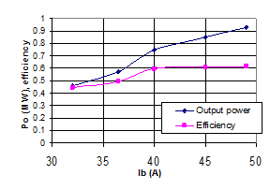
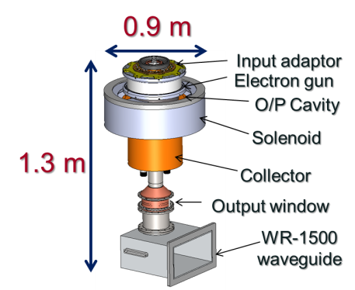

704 MHz MBIOT vs. MBK
Predicted Performance
Output Power, MW | 1.0 | 1.5 | 1.0 | 1.0
Frequency, MHz | 704 | 704 | 704 | 704
Beam Voltage, kV | 50 | 113 | 51 | 43.3
Beam Current, A | 32 | 20.8 | 27.6 | 32.4
Efficiency, % | >65 | >65 | >71 | >73
Gain, dB | 22 | 46 | 50 | 50
Bandwidth (1dB),MHz | 3 | 4 | >4 | >4
Hypothetical 6 beams MBK
(microperveance / beam=0.4)
Hypothetical 12 beams Planar MBK
(microperveance / beam=0.3) + R&D
VHP-8330A HOM IOT
Objectively, MBK performance at this RF power level and frequency can be even better, compared to MBIOT.
It does not require dedicated R&D (low risk).
It provides high power gain (driver cost)
But it might be more expensive.
Scaled VKP-8291
MBIOT

Slide 13

Given enough attention and resources, the battle for efficiency (more general for PECL) can gain enough momentum, so that in 5 years we will operate MW(s) RF power stations with overall efficiency above 70%!
John Lennon

