Slide 1





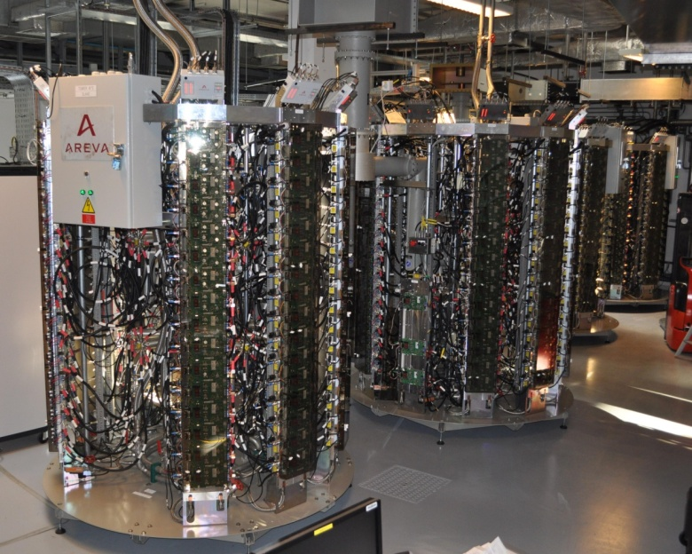
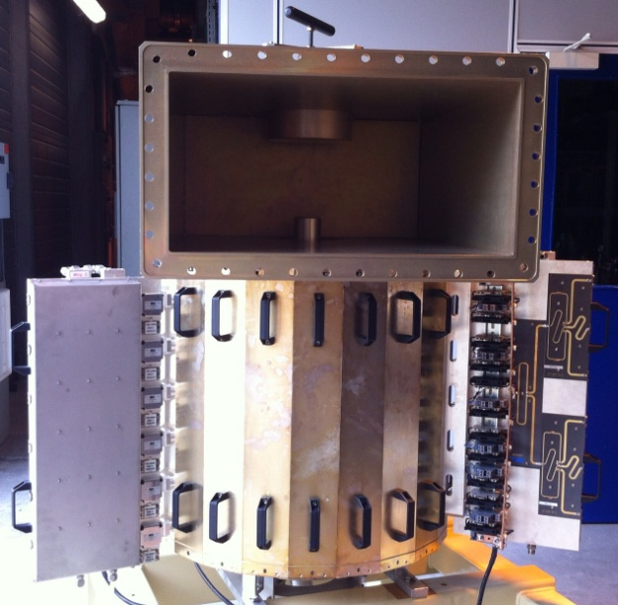
TIARA Workshop on RF Power Generation Uppsala, 17-19 June 2013
Implementation of high power RF Solid State Amplifiers (SSAs) & development of innovative concepts at the ESRF
Jörn Jacob, Jean-Maurice Mercier & Michel Langlois
ESRF
[ELTA]
7 x 150 kW – 352 MHz SSAs from industry
In house development of SSAs using cavity combiners
In house development of fully planar RF modules

Slide 2
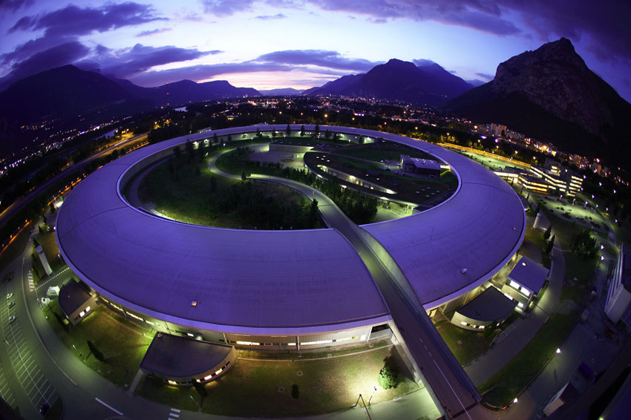
ESRF = first 3rd generation high brilliance light source
Existing facility 2019 upgrade under study
Storage Ring 6 GeV 6 GeV
Small emittances ε_{x} / ε_{z}: 4000 pm / 4 pm 150 pm / 3 pm
Current 200 mA 200 mA
Loss per turn (incl. ID’s) 5.4 MeV 3.8 MeV
Nominal RF voltage 9 MV 6 MV
Beam power 1100 kW 700 kW
RF Cavities 352.2 MHz: 6 five-cell cavities 12 HOM damped single cells
Copper losses 300 kW 500 kW
RF Power sources Klystrons Klystrons & SSAs
(3 new cav’s + SSAs in test)

Slide 3
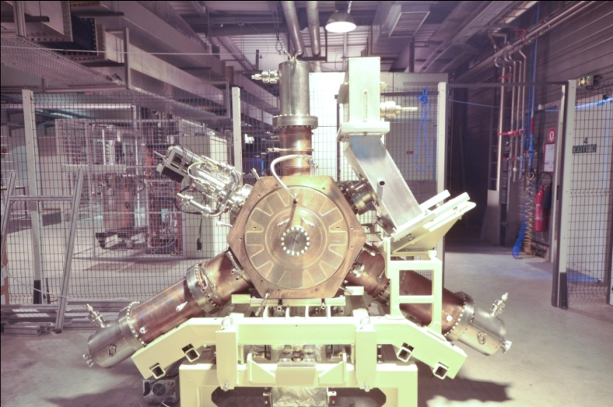
Cell 5
Cav 1 & 2
Cell 7
Cav 3 & 4
RF upgrade phase 1
well in progress
Storage Ring
Replacement of Booster Klystron by:
4 X 150 kW SSAs from ELTA / AREVA:
  In operation since March 2012
  10 Hz pulses / 30 % average/peak power
  1 common 280 V dc / 400 kW power supply
  3.2 F anti-flicker & smoothing capacitor banks
Klys1
Klys2
Teststand
3 X 150 kW SSA from ELTA
Powering 3 new HOM damped cavities on the storage ring
1st SSA to power 1 cavity in August 2013:
  Successful SAT on variable SWR load last week !
Next SSAs: December 2013, March 2014
150 kW
SY Cav 1 & 2
150 kW
pulsed
150 kW
150 kW
Booster
150 kW
2 prototype HOM damped cavities …
  Tested with beam one by one on cell 25 with klystron transmitter TRA3:
150 kW
150 kW
Klys3
… 3 prototype HOM damped cavities
  August 2013: all 3 cavities in new 7 m section/cell 23
ID
ID
Cell 25
Cav 6 & new cavity for test
Cell 23, length 5 m → 7 m

Slide 4

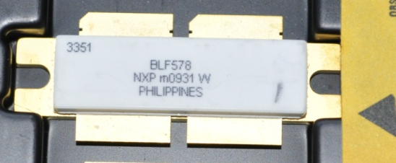
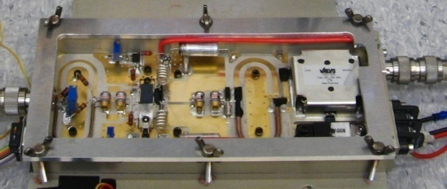
150 kW RF SSA at 352.2 MHz
Initially developed by SOLEIL
Transfer of technology to ELTA / AREVA
Pair of push-pull transistors
x 128
x 2
650 W RF module
6th generation LDMOSFET (BLF 578 / NXP), V_{ds} = 50 V
Efficiency: 68 to 70 %
75 kW Coaxial combiner tree
with λ/4 transformers
150 kW - 352.2 MHz Solid State Amplifiers for the ESRF booster
Efficiency: > 55 % at 150 kW
> 45 % at 100 kW

Slide 5
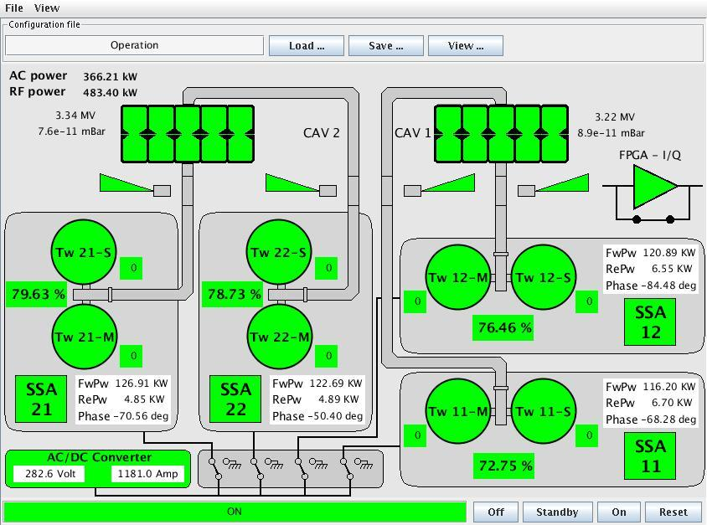
Main synoptic of the booster SSA transmitter
Thanks to anti-flicker system ⇒ reduced electrical power:
366 kW ac
334 kW dc
(instead of ≈1100 kW with former klystron transmitter)
Peak RF power:
483 kW
n_{missing} modules
Load factor:

Slide 6
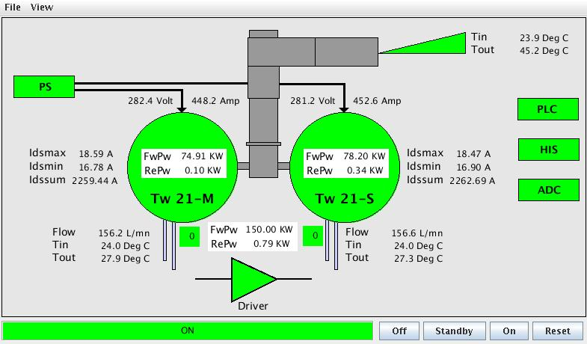
Synoptic of SSA-21
Here in CW operation on dummy load, allows checking efficiency regularly:
η_{RF/DC-280V} ≈ 58 % at 150 kW

Slide 7
Operation experience with booster SSAs in nominal operation on matched cavities
After 1 year / 1100 hours operation and some early debugging in spring 2012:
Excellent reliability (only 3 injections postponed)
Most early failures: control hard & software, flow controllers, …
Only 1 RF module and 1 DC/DC converter failure (without interruption of operation thanks to built in redundancy)
4 x Fuse blown on local controllers
March 2013 shut down: 6 RF modules damaged by water supply leakage above one SSA (ESRF responsibility)

Slide 8
Test results under specified extreme conditions (1)
Avoid overdrive conditions
  High peak drain voltage can damage the transistor [according to NXP]
  Explains gain and efficiency degradation observed on first 75 kW under test at ESRF, according to ELTA *⁾
  Taken into account by ELTA for the fabrication of the 2nd batch of 3 x 150 kW SSA for the ESRF storage ring:
    No degradation observed after 3500 hours of fatigue test with 8 amplifier modules at maximum power *⁾
    Paid with 1 to 2 % less efficiency of the RF modules and about 1 % less efficiency at nominal power for a complete SSA
Short pulses (20 μs)
  Transient gain increase up to ≈1.3 dB
  Risk of overdrive
  Overdrive protection needs to be adjusted carefully
* [J.-P. Abadie & A. Cauhepe, ELTA / AREVA]

Slide 9
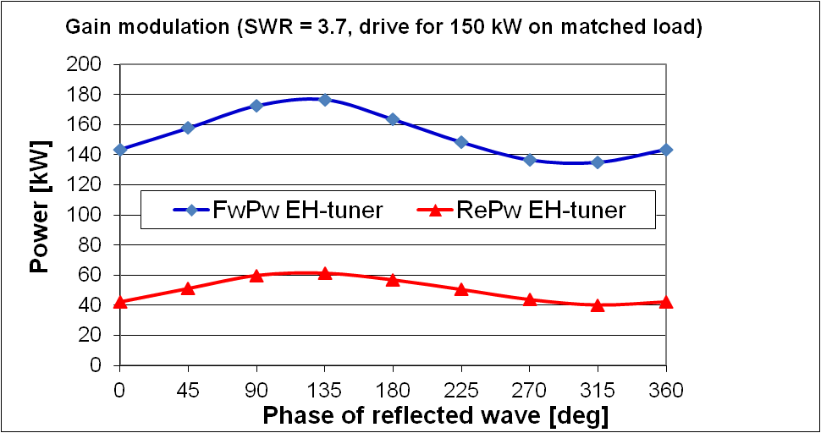
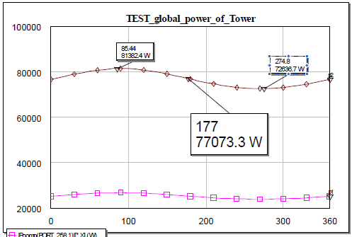
Test results under specified extreme conditions (2)
SWR = 3.7 → P_{refl} / P_{fwd} = 50 kW / 150 kW, all phases ( EH – tuner)
  Reflected power well absorbed by circulator loads on RF modules
  But: gain modulation with phase of high power EH-tuner, intrinsic to coaxial combiner tree (non directive) ⇒ overdrive at certain phases!
FwPw
RePw
Measurement on 5th SSA during SAT at ESRF for constant drive giving 150 kW on matched load [ELTA, ESRF, 10 June 2013]  ± 20 kW on FwPw
Computation for a 77 kW tower driven by ideal constant power RF modules [A. Cauhepe, ELTA]  ± 4.5 kW on FwPw

Slide 10

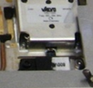
Test results under specified extreme conditions (3)
Operation with up to 6 RF modules OFF (tested in 2011 on batch1)
  On matched load: 150 kW obtained without problem (slightly higher drive) OK
  But with SWR = 3.7 (RePw = 50 kW) → Arcing at output of passive modules!
  Up to 1700 W reverse power on the circulator loads of passive modules
  Destruction of load circuit, arcing propagating along cable towards combiner
Solutions for batch 1 on the booster:
  Booster in pulsed operation → no overheating → OK !
Solutions for batch 2 for the storage ring:
  150 kW power circulator and load at SSA output not retained by ELTA
  Replace 800 W loads by 1200 W loads (also for booster spares) implemented on batch 2
  Optimum phase between 1st (6kW) and 2nd (50 kW) combiners implemented on batch 2
  Additional interlock: P_{reverse} < 3.5 kW at output of 1st x8-combiner implemented on batch 2
  Flame retardant RF cables between RF modules and 1st combiner implemented on batch 2
Delivery of batch 2 delayed by 1 to 1.5 years

Slide 11
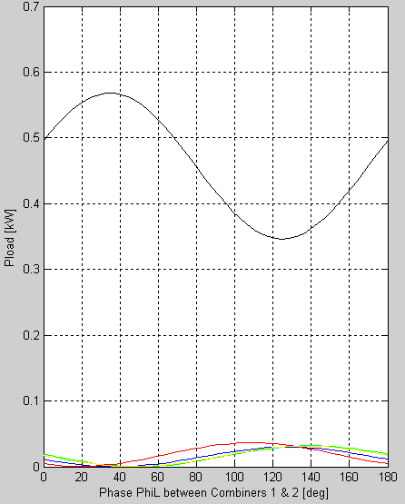
Adjustment of phase between 1st and 2nd 8x-Combiner stages
SSA matched: r = 0
1 module OFF experiences:
High P_{reverse} coming from other modules ⇒ interference between 7 neighbours of same combiner and power from other combiners
ΔΦ_{L}
Interference of reverse signals on the module
7 neighbours of same combiner ON: ⇒ see only small P_{reverse}
ΔΦ_{L}: proposed by SOLEIL
ΔΦ_{L}

Slide 12
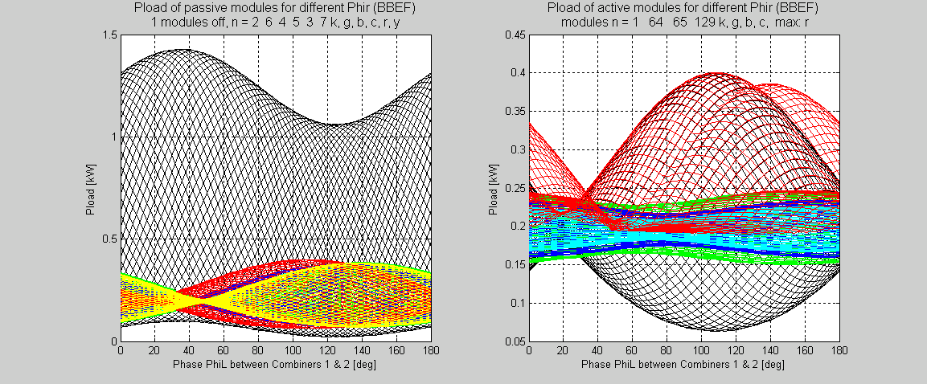
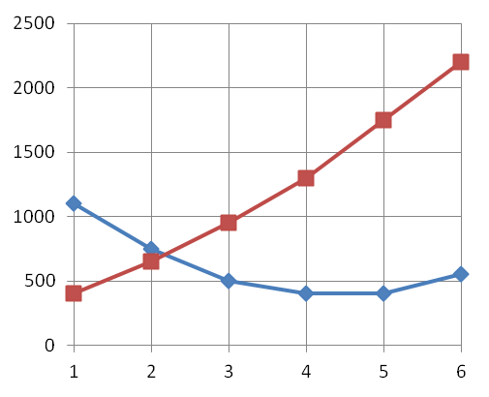
Adjustment of phase between 1st and 2nd 8x-Combiner stages
Additional interference with reflection for mismatched operation: |r| = 1/√3 (ESRF spec)
P_{rev}^{max} for best ΔΦ_{L}
1 passive module
Passive modules
90º ≈ 20 cm
P_{rev}^{max} [W] →
Active modules
active modules
φ(r): 0°…360 °
n_{OFF} on same same combiner →
Not more than 3 modules OFF on the same combiner !
ΔΦ_{L}
1 module OFF: depending on ΔΦ_{L} the circulator load receives
  P_{rev}^{max} = 1400 W for worst ΔΦ_{L}
  P_{rev}^{max} = 1100 W for best ΔΦ_{L}
Active modules receive the remaining power: maximum of 400 W for best ΔΦ_{L}

Slide 13
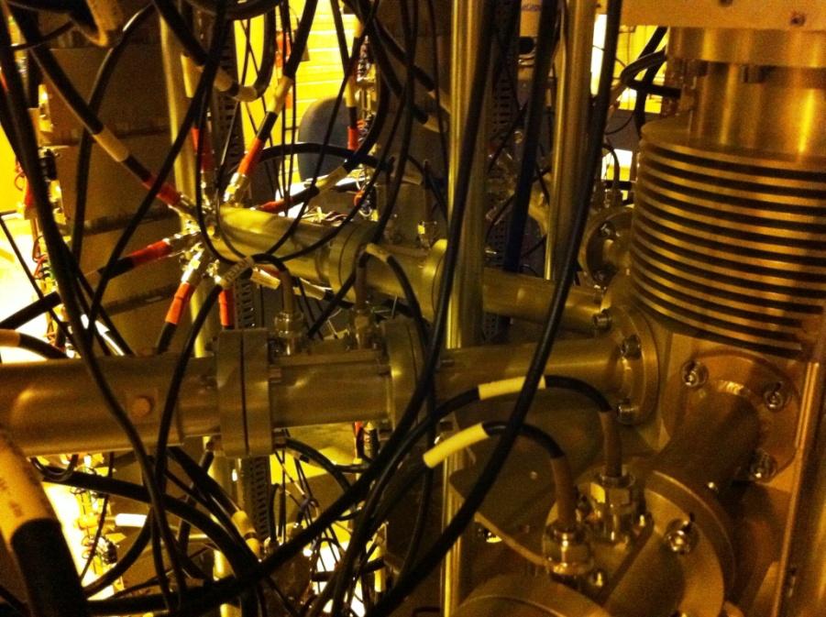
Successful test of 1st improved SSA of batch 2
170 mm
Efficiency still well above spec:
  η ≈ 58 % at 150 kW
  η ≈ 48 % at 100 kW
P_{refl} / P_{fwd} = 50 kW / 150 kW:
  Acceptable limitation to 145 kW by overdrive for some load phases
  Successful test with 1 and 6 modules OFF -> no damage on circulator loads !
Full reflection:
  Specified P_{refl} / P_{fwd} = 80 kW / 80 kW not reached due to 3 kW interlock on 6 kW combiner arms
  Instead P_{refl} / P_{fwd} = 60 kW / 60 kW successfully tested and accepted, as being operationally sufficient
Drawback: more heating of prolonged 1-5/8” lines in mismatched conditions → to be followed up

Slide 14
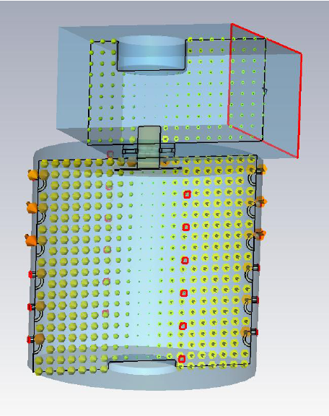
In house R&D of SSA using Cavity Combiners
improvement
H field
Homogenous magnetic coupling of all input loops
E field
Strong capacitive coupling to the output waveguide
75 kW Coaxial combiner tree
with λ/4 transformers
Strongly loaded E₀₁₀ resonance
Modest field strength
Cavity at atmospheric pressure
1 dB - Bandwidth ≈ 500 kHz

Slide 15
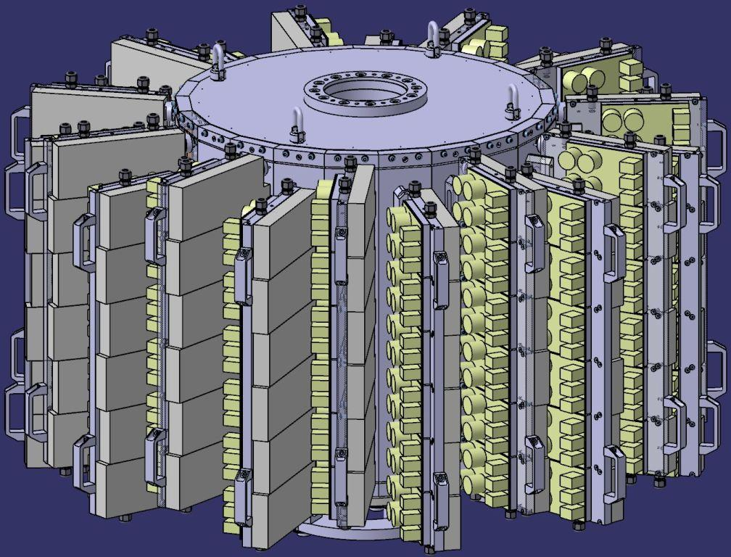
Cavity combiner for the ESRF
For 352.2 MHz ESRF application:
6 rows x 22 Columns x 600 … 800 W per transistor module
75 … 100 kW
More compact than coaxial combiners
ß_{waveguide} ≈ n_{module} x ß_{module} >> 1
Easy to tune if n_{module} is varied
Substantial reduction of losses ⇒ higher η
Direct coupling of RF modules to the cavity combiner
No coaxial RF power line
Very few, sound connections
EU funded FP7/ ESRFI/CRISP project
Work package WP7 → ESRF implements:
10 kW demonstrator at 352 MHz
75 kW prototype at 352 MHz
Feasibility studies for partner labs: CERN, GSI and ESS, at various frequencies

Slide 16
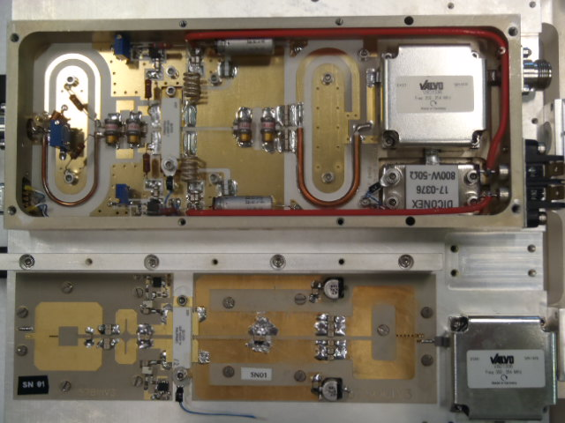
ESRF: In house development of RF transistor module
ESRF design:
Printed circuit baluns
RF drain chokes replaced with “quarter wave” transmission lines.
Very few components left, all of them SMD and prone to automated manufacturing
Fully adequate for 10 kW prototype
Still room for improvement
  Ongoing R&D
  Collaboration contract with Uppsala University for optimization of circuit board
SOLEIL/ELTA
ESRF
18 modules incl. output circulator | Average Gain | Average Efficiency
at P_{RF}^{out} = 400 W | 20.6 dB | 50.8 %
at P_{RF}^{out} = 700 W | 20.0 dB | 64.1 %

Slide 17

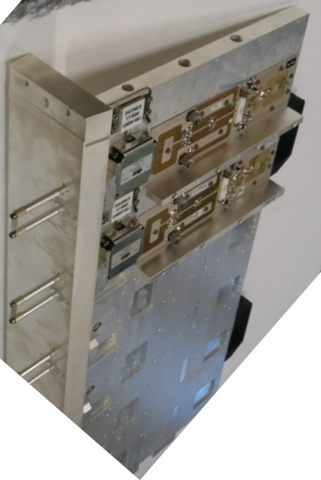
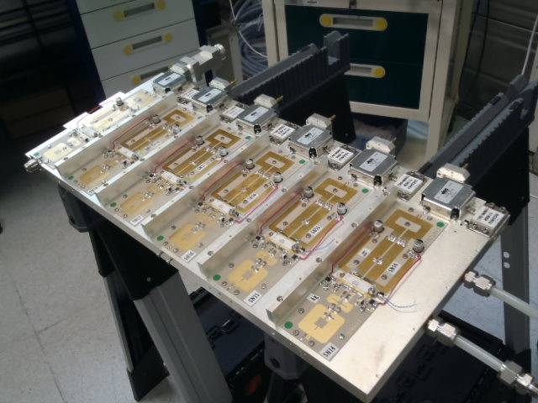
10 kW prototype cavity combiner
STATUS
All 18 RF modules on wings and tested
3 PS’s ready (one 10 kW PS per wing)
RF input distribution via planar Wilkinson splitters on the rear sides of the wings
Collective shielding of RF modules
Water cooling skid ready
Interlock and control system in progress
Power tests start end of June 2013
Only 3 active water cooled “wings”:
3 x 6 modules x 600…700 W / module
→ 10…12 kW

Slide 18
To conclude, high power circulator: yes or no ?
Pro
Power combining efficiency can drop substantially when SSA sees a mismatch.
RF module circulators protect transistors against internal coupling from other RF modules. They must be over-dimensioned to take additional power from mismatch on high power end.
Coaxial structure also needs to be over-dimensioned
On cavity combiner: no way to minimize module return power
Well defined SSA operation conditions for any load mismatch
Contra
On coaxial tree, module return power can be limited by optimizing the length of the first combiner stage
High cost and large space requirement as compared to total SSA power
Not required if reasonable load match can be guaranteed at high output power
Protection by reverse power interlock cheaper
… further discussion is left to the audience …

Slide 19
Thank you !!
Acknowledgement
SOLEIL team
  for having pioneered highest power SSAs on accelerators,
  for their design and development work on the ESRF SSAs manufactured by ELTA,
  for their support to the ESRF on this challenging project,
ELTA / AREVA team
  for the delivery of already 5/7 operational 150 kW SSAs,
  for their investigations around encountered problems and the implementation of corrective measures,
  for providing valuable information for this presentation

