Slide 1
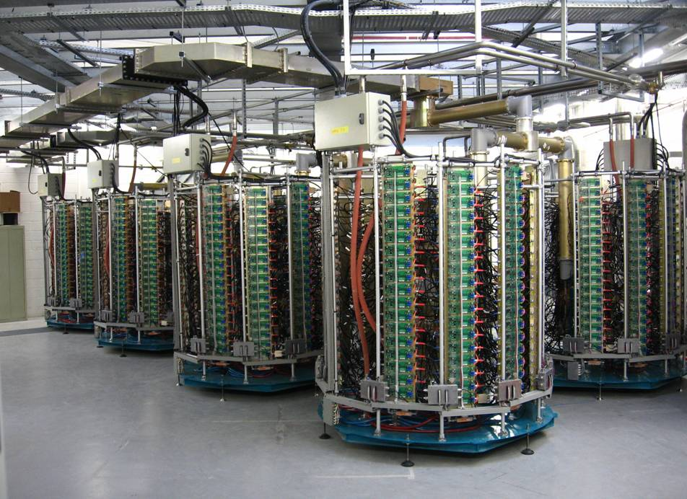
TIARA Workshop on RF Power Generation for Accelerators
DEVELOPMENTS OF HIGH POWER
CW SSAs at SOLEIL
Uppsala, June 17th - 19th, 2013
Massamba DIOP, R. LOPES, P. MARCHAND, F. RIBEIRO

Slide 2
OUTLINE
SSA operation at SOLEIL
BOOSTER 35 kW
STORAGE RING 180 kW
SOLEIL 352 MHz SSA State of the Art
500 MHz SSA R&D and new projects
LNLS : 2 x 45 kW (476 MHz)
SESAME : 2 x 75 kW
THOM-X : 50 kW
R&D at other frequencies

Slide 3
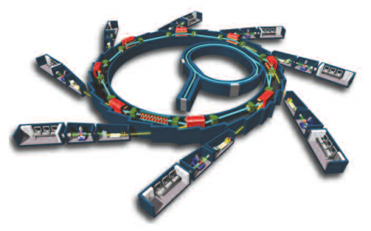
SOLEIL OVERVIEW
S-Band (3 GHz) LINAC
BOOSTER: 100 MeV => 2,75 GeV (3 Hz)
2,75 GeV STORAGE RING (500 mA)
Opened to users since 2007
26 beamlines funded: 18 with insertion devices and 8 with bending magnets
2012: 22 beamlines opened to users

Slide 4
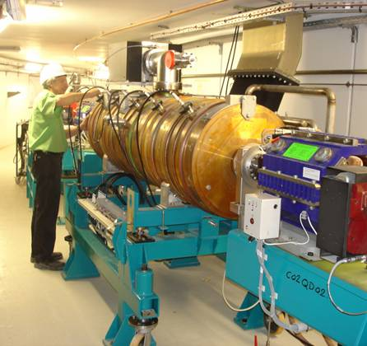
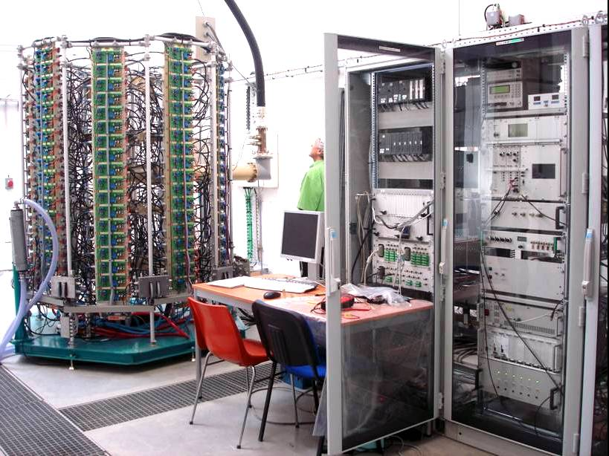
BOOSTER (BO) RF SYSTEM
E_{n} : 100 MeV → 2.75 GeV (rep. 3 Hz) ; V_{cav} : 100 → 900 kV @ 352 MHz
1 x 5-cell Cu cavity (CERN LEP) → P_{tot} : 20 kW (P_{dis} : 15 kW, P_{beam} : 5 kW)
1 x solid state amplifier → 35 kW CW @ 352 MHz (developed in house)
Cavity in the BO ring
BO RF room (amplifier & LLRF)

Slide 5
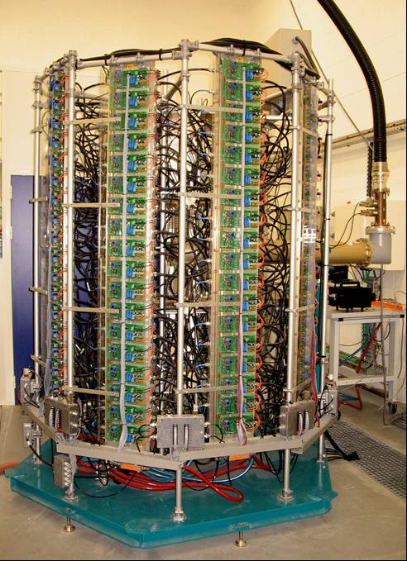
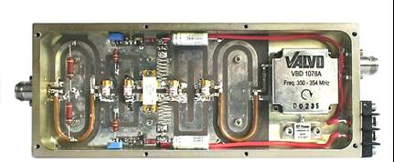
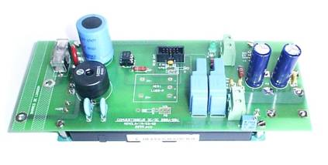
35 kW SSA OF THE SOLEIL BOOSTER
147 amplifier modules and power supplies on 8 water-cooled dissipaters
330 W amplifier module -
(VDMOS Transistor - Semelab D1029UK05)
600 W, 300 Vdc / 30 Vdc converter

Slide 6
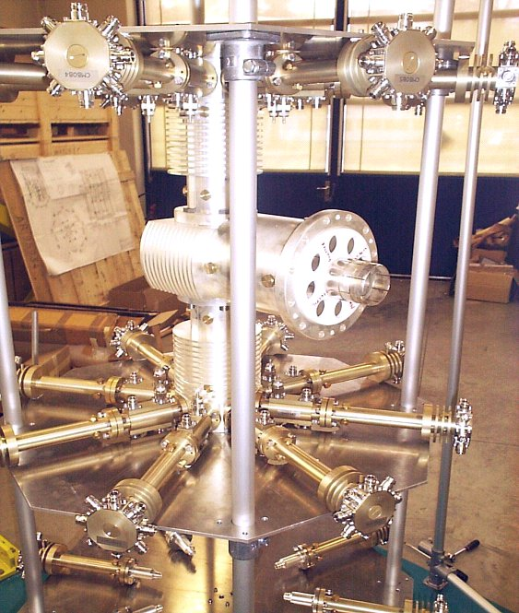
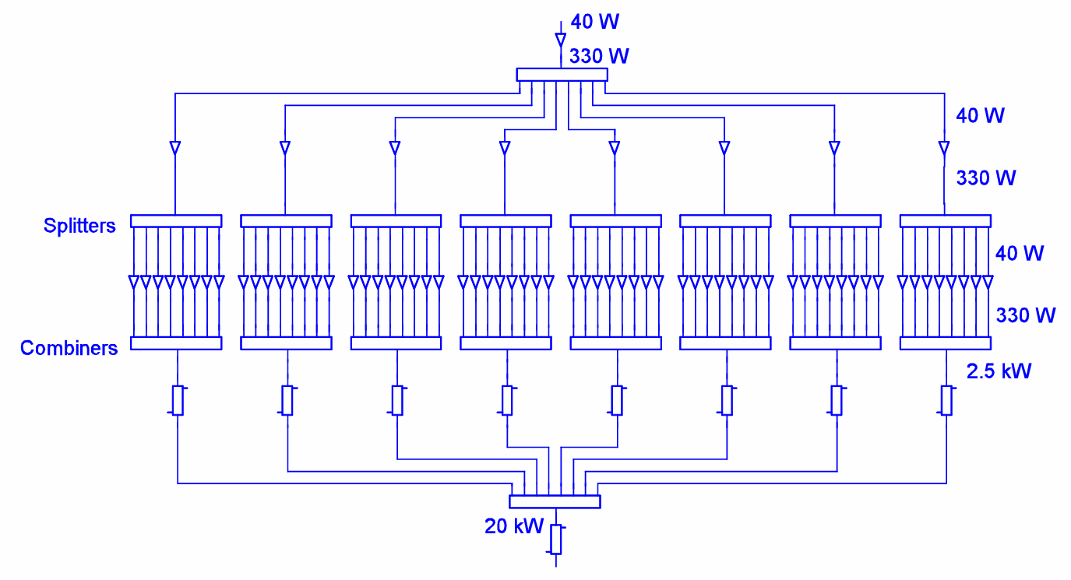
35 kW SSA POWER COMBINATION
19 W
192 W
24 W
240 W
30 W
64 x
330 W
2.5 kW
20 kW
x 2 → 40 kW

Slide 7
DIAGRAM OF THE BO RF CONTROL SYSTEM
Water flows,
Temperatures, …
CAVITY
AND LLRF
AMPLIFIER
P_{ref}
I x 2 x 147 modules
Pi, Pr x 16
MULTIPLEXING
Vacuum
An. & dig. I / O
PSS
Machine intlk
PC
AI
Cmd
SOLEIL
CONTROL
« TANGO »
PLC
µcontroller
Hardwired
fast interlock
Ethernet
CPCI
RS232
Power supplies off
Pin
Pout
to amplifier
LLRF : Low Level RF Electronics
(amplitude, phase & frequency loops)
RF switch

Slide 8
OPERATIONAL EXPERIENCE WITH THE BO RF SYSTEM
The Booster RF plant is in operation since mid 2005.
Up to date, after 7 years operation (> 44 000 running hours),
only a single trip in operation, due to a human mistake (2006)
The 35 kW solid state amplifier has proved to be very reliable.
Only 8 (out of 150) module failures: 5 bad solder quality and 3 broken transistors,
which did not affect at all the operating conditions
and could be quickly repaired during scheduled machine shutdowns.
→ Advantage of the high modularity and redundancy

Slide 9
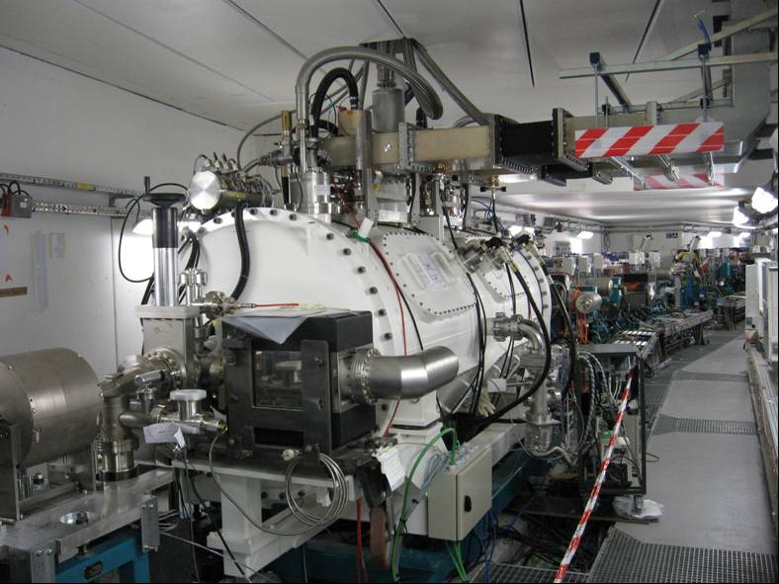
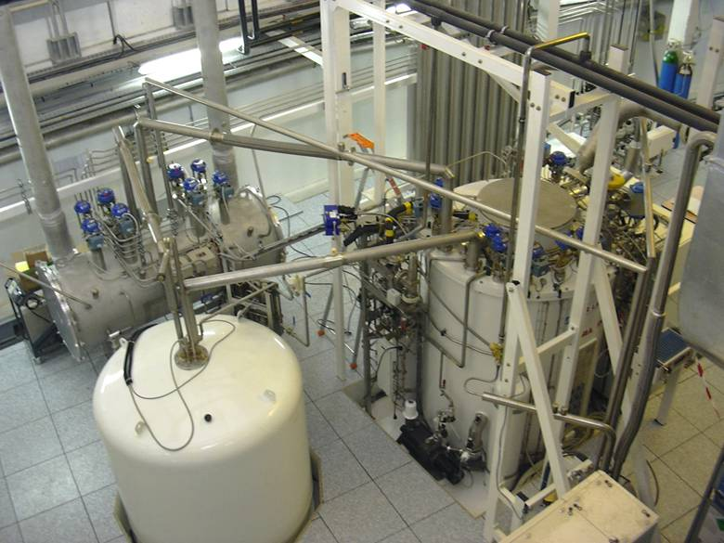
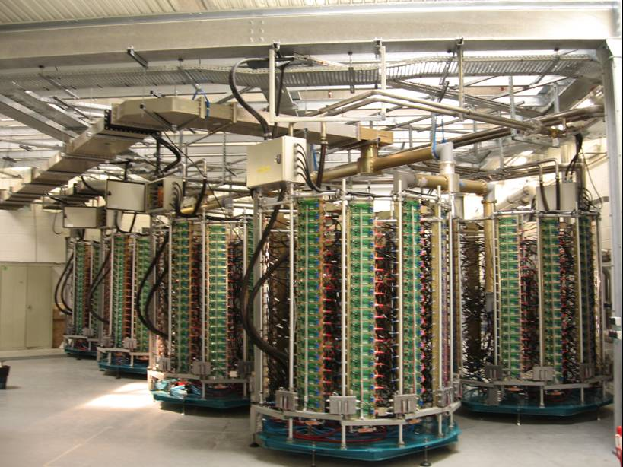
STORAGE RING (SR) RF SYSTEM
E = 2.75 GeV, ΔE = 1.2 MeV, I_{b} = 500 mA
→ P_{RF} = 600 kW & V_{RF} = 4 MV @ 352 MHz
2 cryomodules (CM), each containing a pair of single-cell s.c. cavities
Each cavity is powered with a 180 kW solid state amplifier
Both CM supplied with LHe (4.2 K) from a single cryo-plant

Slide 10
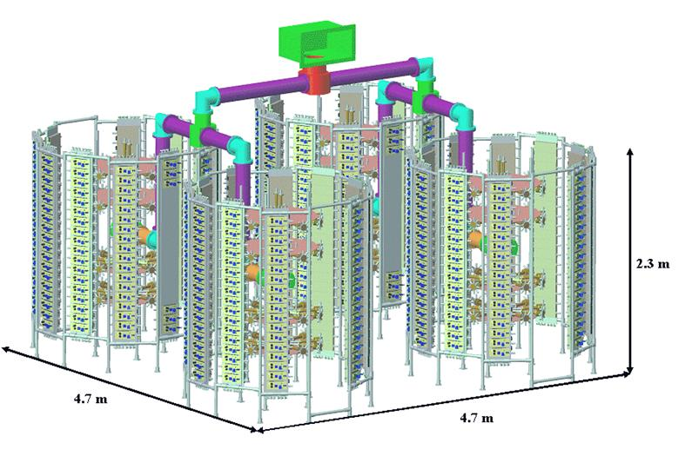
SR 180 kW RF SYSTEM
Same principle as for the BO one, extended to 4 towers of 45 kW
→ 726 modules / amplifier x 4 cavities → 16 towers & ~ 3000 modules

Slide 11
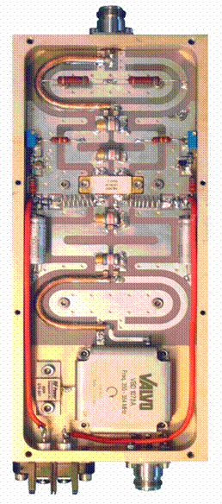
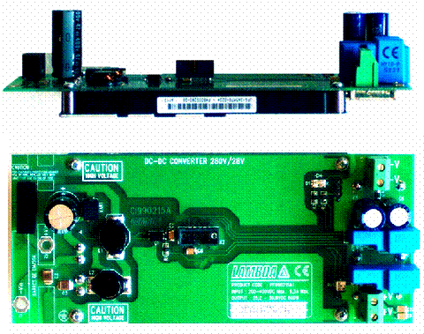
COMPONENTS OF THE SR AMPLIFIER
600 W – 280 Vdc / 28Vdc converter
352 MHz - 315 W amplifier module
(LDMOS transitor - Polyfet LR301)

Slide 12
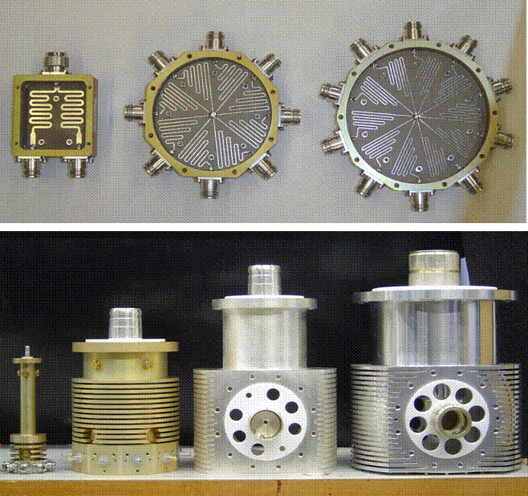
COMPONENTS OF THE SR AMPLIFIER
Power splitters
2 , 8 and 10 ways (90, 350 & 20 pcs, respectively)
Power combiners
2.5, 25, 100, 200 kW; 320, 34, 26 & 6 pcs, respectively
(S11 < - 30 dB)

Slide 13
AMPLIFIERS 1 & 2 => 2 CAVITIES OF CM1

Slide 14
DIAGRAM OF THE SR RF CONTROL SYSTEM
Water flows,
Temperatures, …
CAVITY
AND LLES
AMPLIFIER
I x 2 x 680 modules
Pi, Pr x 80
MULTIPLEXING
P_{ref}
Vacuum
An. & dig. I / O
PSS
Machine intlk
AI
Cmd
SOLEIL
CONTROL
« TANGO »
PLC
PC
µcontroller
Hardwired
fast interlock
Ethernet
CPCI
RS232
PLC
Cryo
Power supplies off
Pin
Pout
to amplifier
RF switch

Slide 15
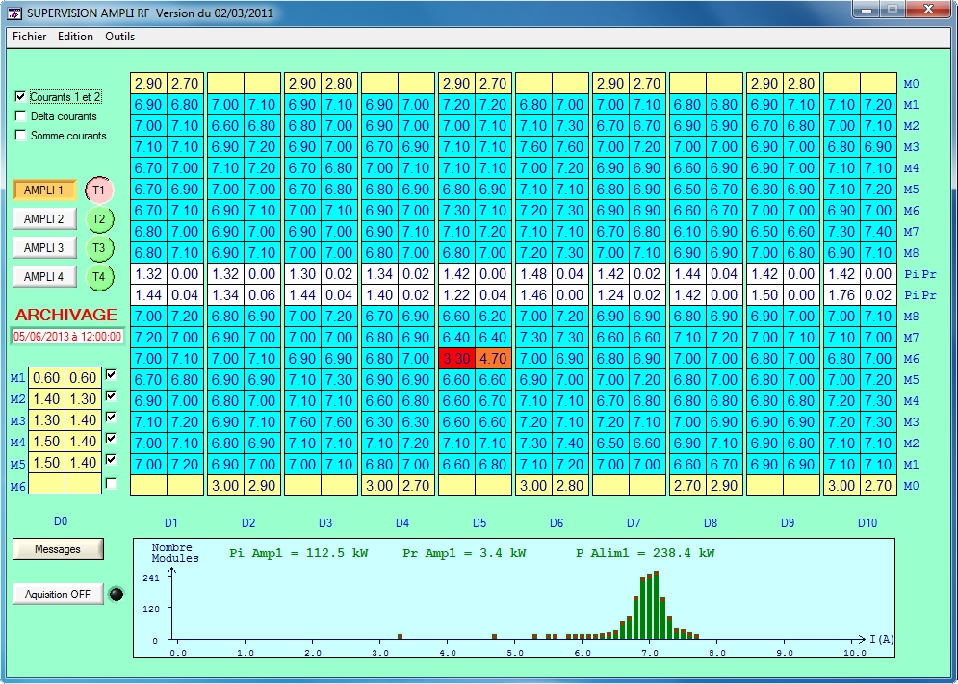
AMPLIFIER CONTROL via the UCONTROLLER
Transistor Currents, Pi, Pr For A Tower

Slide 16
STORAGE RING
OPERATIONAL EXPERIENCE
RF power amplifiers
- Proved to be very reliable : after > 38000 running hours over ~ 7 years,
only 5 short beam dead times → ~ 100 % operational availability, MTBF > 1 year
- Module failure rate of ~ 3.5 % per year → ~ no impact on the operation
→ Matter of maintenance : 1 hour @ each shutdown for ~ 10 mod. change
→ Yearly repair cost of ~ 5 k€ (for the four 200 kW amplifiers)
Soldering preventive maintenance
Significant improvement expected from the new generation modules
with more robust transistors and less thermal stress

Slide 17
SOLEIL RF STATUS
After 7 years of operation, SSA innovative design has proved itself and demonstrated that it is an attractive alternative to the vacuum tube amplifiers, featuring an outstanding reliability and a MTBF ( > 1 year).
Thanks to the acquired expertise and the arrival of the 6th generation LDMOS, SOLEIL has carried out developments which led to doubling the power of the elementary module (650 W) while improving the performance in terms of gain, linearity, efficiency and thermal stress.
Advantages of SSA technology: low phase noise, good linearity, high reliability, long life time, easy maintenance, simple spare parts, no HV, no X ray.
=> UPGRADE to benefit from 6th generation improvements

Slide 18
Why SSA upgrade at SOLEIL?
Easier maintenance, better performances
Low gain and phase dispersion (+/-0,2dB and +/-5° instead of +/-1,5dB and +/-7,5°)
More power capability => optional operation with 2 or 3 amplifiers out of 4
More robust transistors
Transistor supply made easier (NXP, Freescale…)
Cost savings
6% increase in module efficiency => less modules => electrical power savings
=> compensation for upgrade costs within 4 years
Old PCB re-used and only transistors are changed => less than 10% of the amplifier cost
At the beginning, we thought about replacing only the damaged modules with new transistors. But the very strong performance and cost advantages made us change our strategy for a controlled and planned massive upgrade.

Slide 19
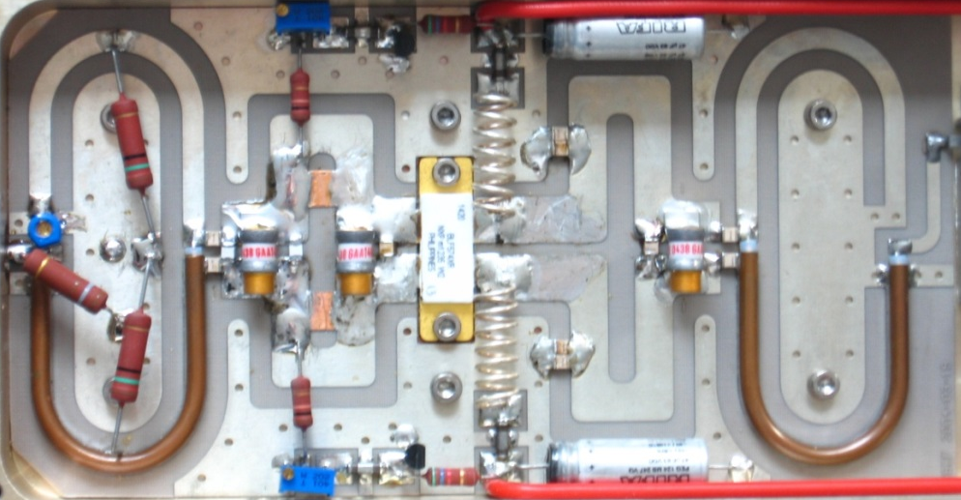
SSA upgrade at SOLEIL in details
Transistor LR301 replaced by BLF574XR
Same footprint as LR301
Up to 500W CW (high power margin)
Better robustness and relialibity
Add gain and phase compensation circuits
Components change for matching
Inner
circuit
Outer
circuit
Gain & phase
compensation
Comparison LR301 vs BLF574XR
RF parameters | LR301 | BLF574XR | Advantages of BLF574XR
Gain | 13,7 | 20 | Less drivers (+0,5% for overall efficiency)
Efficiency | 62% | 68% | Better efficiency ( +4,5% for overall efficiency)
Output power | 315W ( 350W tested) | 330W (450W tested) | More Power Margin
Gain Dispersion | +/-0,8dB at Pnom | +/-0,2dB at Pnom | No sorting
Phase Dispersion | +/-7,5° at Pnom | +/-5° at Pnom (+/-2,5° expected) | Better combining efficiency
Test of 10 BLF574XR samples:
Assembling and test of 2,5kW unit based on BLF574XR modules during 4000h on dummy load
Mounting them in our amplifier (AMP1) since one year in operation without any problem

Slide 20
SSA upgrade at SOLEIL in details
Distribution of 100 first BLF574XR modules
Gain Dispersion
Phase Dispersion
Number of modules
Number of modules
Gain
Phase
Jan-Feb 2013: Supplying all components (RF capacitors, transistor, etc…)
March & April 2013 : Modifications and adjustments of 100 modules
May 2013 : Replacement of 90 drivers on two 180kW amplifiers
Oct 2013 : Replacement planned of 90 drivers on two last 180 kW amplifiers
Replacement of last stage modules ~ 4-8 years (1 or 2 tower per year)

Slide 21
SOLEIL 352 MHz SSA STATE OF THE ART
6th generation transistors (V_{dc} = 50 V) + SOLEIL expertise → fast progress
→ At 352 MHz, P_{mod} ~ 700 W, G > 20 dB, η > 70%
[ Current LR301 mod. (V_{dc} = 28 V) : P = 315 W, G = 13 dB, η = 62 % @ 352 MHz ]
→ Huge improvement : P_{mod} x 2.2 , better performance (G , η , linearity)
& thermal stress strongly reduced (ΔT : - 60 °C) → longer lifetime
→ Beg. 2009, transfer of technology agreement concluded with ELTA-AREVA
ESRF contract for 7 SOLEIL type amplifiers of 150 kW (14 x 75 kW towers)
June 2010 : A 10 kW unit (16 modules) successfully tested at SOLEIL
June 2011 : Commissioning of the first 75 kW tower at ESRF
March 2012 : Commissioning of the 4 x 150 kW amplifiers for the booster,
which, up to now, have run quite satisfactorily for 1.5 year
2013 – 2014 : Delivery of the 3 amplifiers for the SR, slightly modified as compared to the Booster for handling high CW VSWR (→ Jorn Jacob)

Slide 22
SOLEIL 352 MHz SSA STATE OF THE ART
 | Transistor type | Power supply per module | Module Parameters at nominal conditions | Amplifier design & nominal power | VSWR limitation * | Comments
SOLEIL Booster | D1029UK05 ◊ SEMELAB | 1 x 600 W 280/28 Vdc | P_{1dB} = 330 W, G = 11 dB η = 60 % , T_{max} = 130°C | 1 tower of 8 dis P_{nom} = 35 kW modulated | No limit with SOLEIL Booster duty cycle | 1 trip over 7 years due to a human mistake
SOLEIL SR (actual) | LR301 Polyfet | 1 x 600 W 280/28 Vdc | P_{1dB} = 315 W, G = 13 dB η = 62 % , T_{max} = 130°C | 4 towers of 10 dis P_{nom} = 180 kW cw | 70 kW full reflection Pr = 35 kW @ 180 kW | MTBF > 1 year
SOLEIL SR (upgrade) | BLF574XR NXP | 1 x 600 W ♯ 280/48 Vdc | P_{1dB} = 350 W, G = 22 dB η = 69 % , T_{max} = 90°C | 4 towers of 10 dis P_{nom} = 200 kW cw | 70 kW full reflection Pr = 32 kW @ 200 kW | Much more robust than LR301
ESRF Booster (800W load) | BLF578 NXP | 2 x 600 W 280/48 Vdc | P_{1dB} = 650 W, G = 20 dB η = 71 % , T_{max} << 75°C | 2 towers of 8 dis P_{nom} =150 kW modulated | No limit with ESRF Booster duty cycle | In CW Pr limited at 5 kW for Pi = 150 kW
ESRF SR V2 (1.2kW load) | = | = | = | 2 towers of 8 dis P_{nom} = 150 kW cw | 85 kW full reflection Pr = 50 kW @ 150 kW | → modified combination → + 1.2 kW load
ESRF SR V3 (power circul) | = | = | = | → P_{nom} = 140 kW | 140 kW CW full reflection | + 5% power loss - 3% on efficiency Extra costs
* VSWR limitation: when operating the amplifier at high CW incident power, Pi, with a high VSWR and the worst phase condition, an unpowered module (ie, both of its power supplies, or both sides of its push-pull broken) can see a power on its circulator load, Pload > Pi
Rem: full reflection for a short time (~10 ms) is not a problem (→ Pr interlock)
♯ 2 PS in series on 2 modules in //
◊ VDMOS ; all the other cases are LDMOS

Slide 23
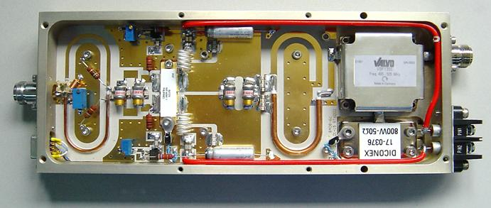
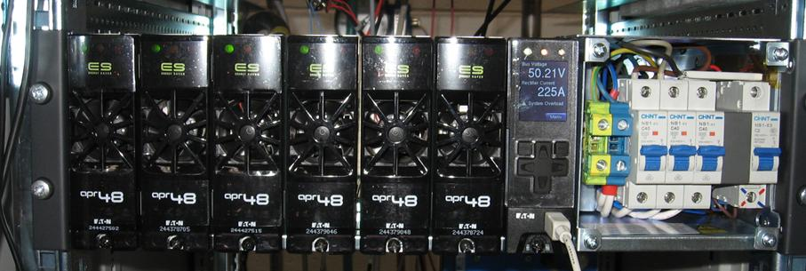
500 MHz R&D ON SSA
6th generation LDMOS → BLF578 : 650 W modules
RF characteristics:
RF Output Power: 650 W CW at 1 dB
Gain : 17dB
Efficiency: > 60% at P_{n}
Gain dispersion : +/- 0.2 dB at P_{n}
Phase dispersion :+/- 5° at P_{n}
Input Return Loss : < - 40 dB at P_{n}
Unconditional stability (K>10 dB)
High efficiency (96%) 230 V_ac / 50 V_dc power converters

Slide 24
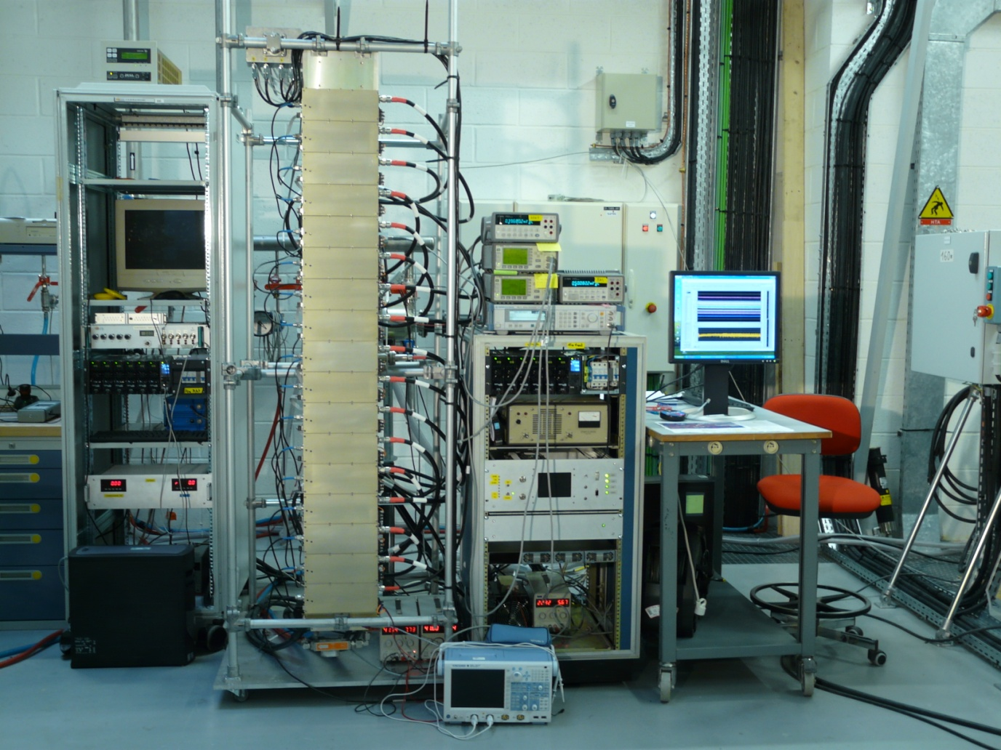
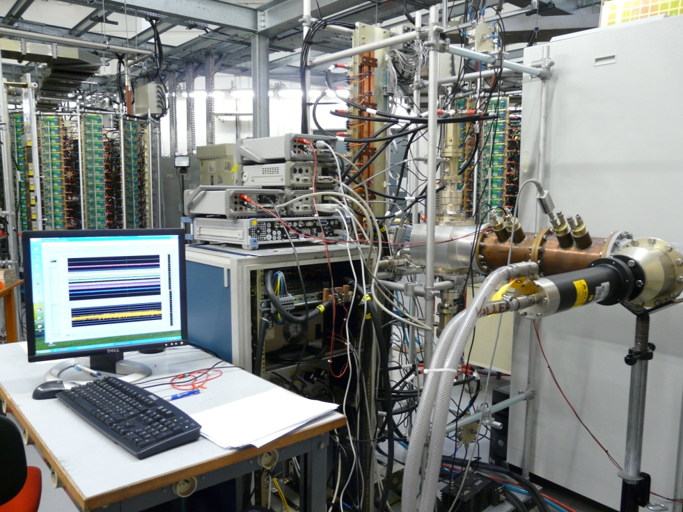
500 MHz R&D ON SSA
10 kW unit prototype for long term test (> 500 hours)
Efficiency ~ 55%

Slide 25
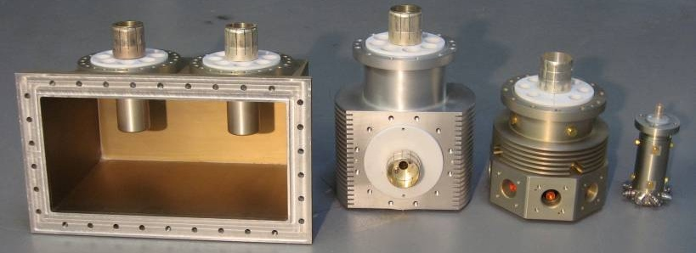
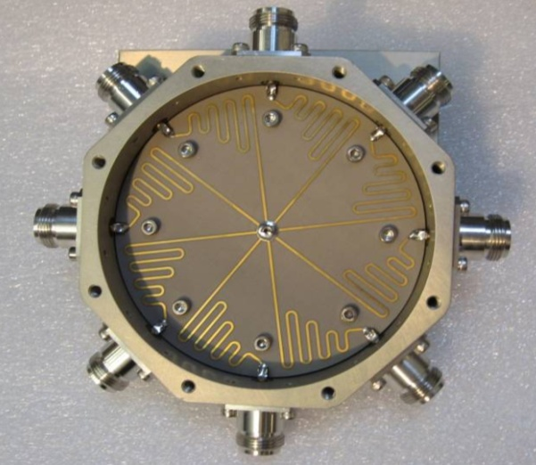
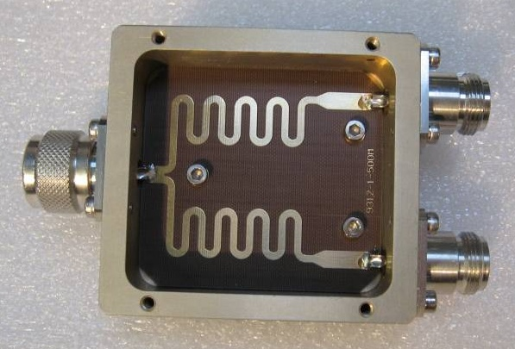
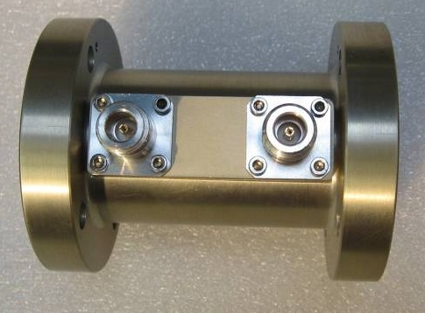
500 MHz R&D ON SSA
Power combination components
2 x 80 kW
2 x 40 kW
8 x 5 kW
8 x 650 W
2-way splitter
8-way splitter
P_{i} - P_{r} monitoring coupler

Slide 26
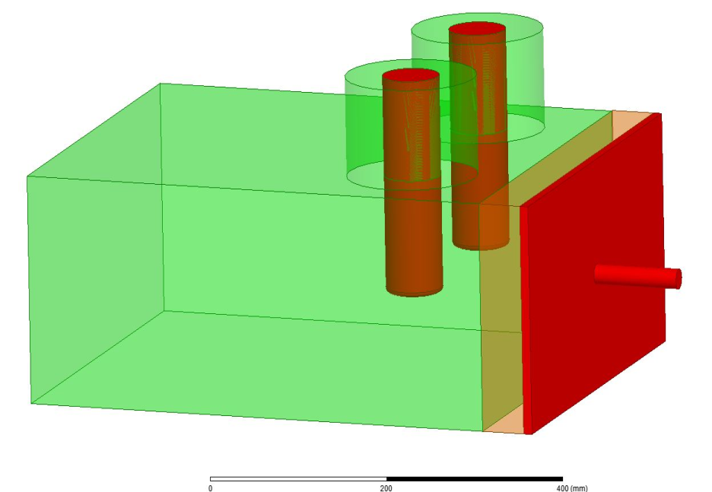
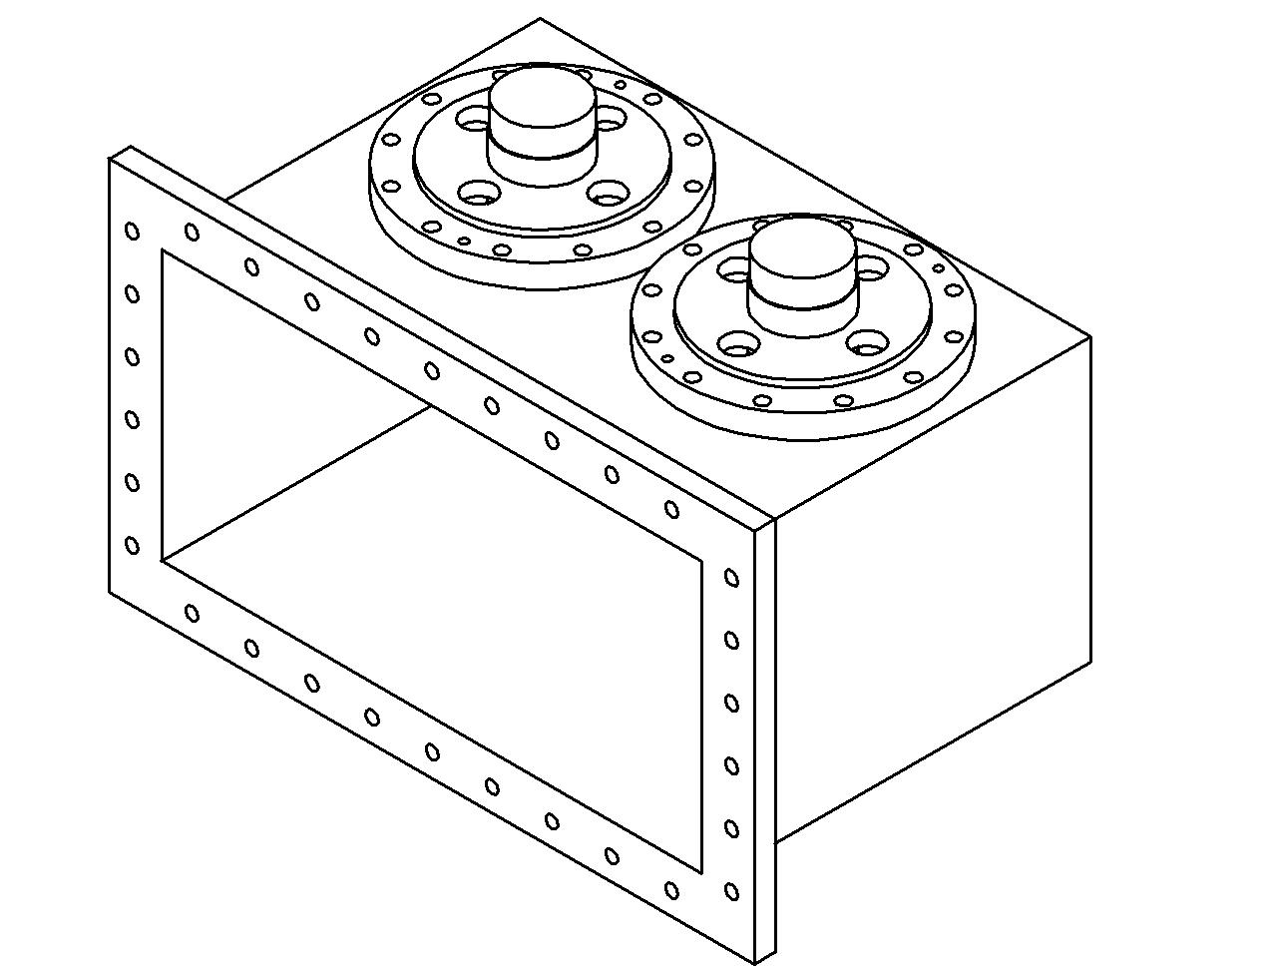
WAVEGUIDE-to-COAXIAL COMBINER (WaCCo)
2 coaxial inputs
δl
WG
output
Two 6 inches coaxial input ports (2 x 80 kW) → 1 WG output
Replace a coaxial combiner + a coaxial-to-WG transition
Design optimization with HFSS and Microwave Studio
→ A 500 MHz prototype has been validated at signal level
Movable SC → can ensure a good matching for different configurations with diff nb of dissipaters per tower or diff nb of modules per dissipater

Slide 27
SOLEIL R&D ON SSA
Collaboration agreements
LNLS (Brazilian LS) : 2 x 45 kW @ 476 MHz, in operation
SESAME (LS in Jordan) : 4 x 150 kW @ 500MHz
THOM-X (Compact source of hard rays): 50 kW @ 500MHz
R&D at other frequencies
FM band (88 – 108 MHz) → 1 kW module with G > 25 dB and η ~ 80 %
L band (1.3 & 1.5 GHz) for 4th generation LS → P_{mod} > 400 W
LUNEX5 : 20kW @ 1.3 GHz – R&D for the TDR
The SSA technology is ideally suited to the ERL requirement, which is typically of a few tens of kW at 1.3 – 1.5 GHz.

Slide 28
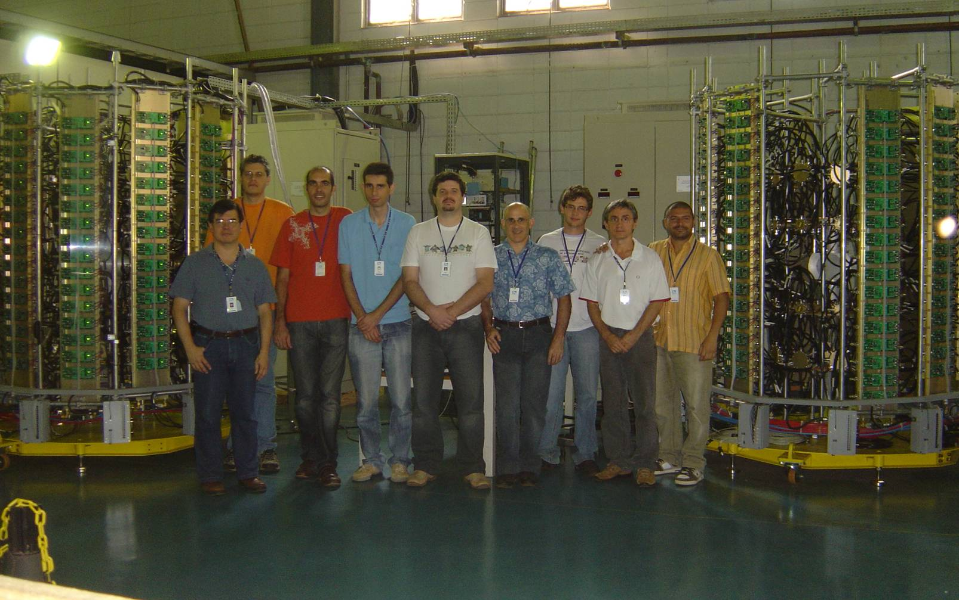
SOLEIL-LNLS COLLABORATON
Two amplifiers of 50 kW @ 476 MHz for the LNLS storage ring with components designed by SOLEIL (400 W RF modules with BLF574)
April 2010 : the SOLEIL - LNLS team in Campinas-Brazil,
after successful tests of the amplifiers

Slide 29
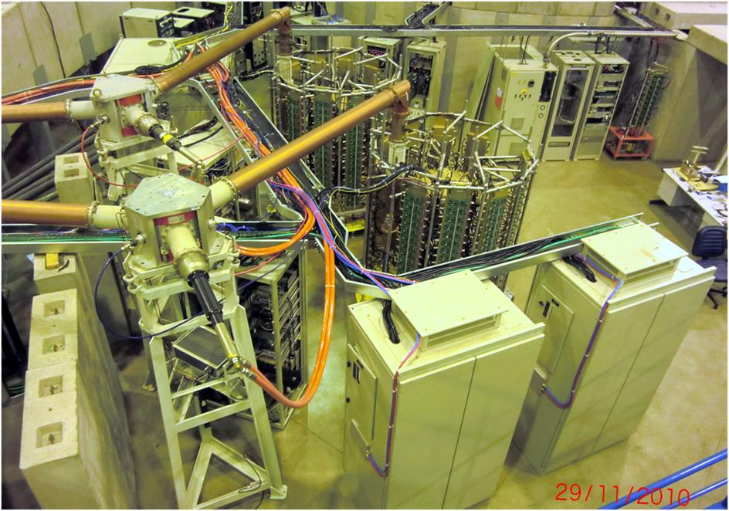
LNLS 50 kW RF PLANTS
The two 50 kW SSA have run satisfactorily on the LNLS SR for ~ 3 years

Slide 30
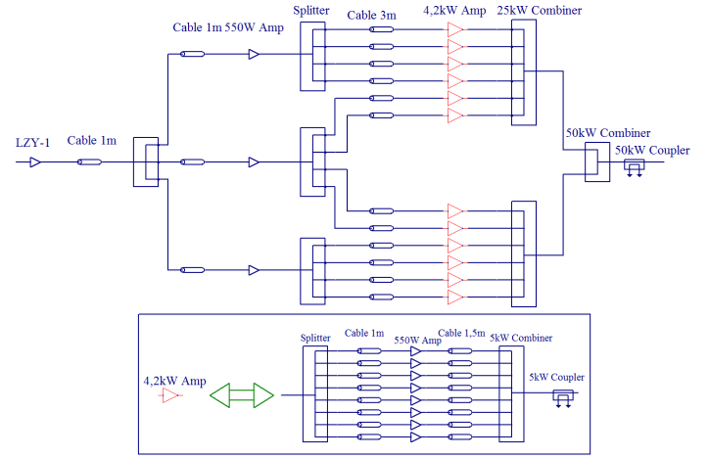
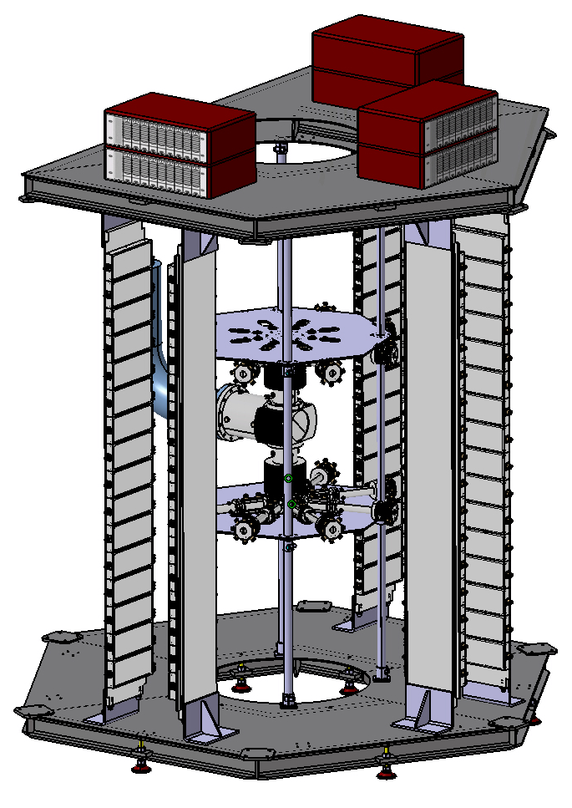
THOM-X 500 MHz 50 kW AMPLIFIER (PRELIMINARY DESIGN)
Tower Design
Cabinet Design
AC-DC Power Supplies
16 Amplifiers per Dissipator
2 m
2 m
High Power Combination
2 m
2 m

Slide 31
PROPOSAL FOR THOM-X AMPLIFIER CONTROL SYSTEM
6 MUX Esclaves
RS-485
MUX
Maitre
Ethernet
MUX D1
µC
MUX D2
µC
MUX D3
µC
MUX D4
µC
MUX D5
µC
MUX D6
µC
4 préampli
PC local
supervision
TANGO
16 modules
16 modules
16 modules
16 modules
16 modules
16 modules
MUX D numérique
(1 par dissipateur de 16 modules)
Interlock RF
8 x (2 courants + 1 temp. )
½ dissipateur haut
Interlock alims
Multiplexeur
Comparateurs
P_incidente
½ dissip. haut
(8 mod.)
I/O
ADC
ADC
P_réfléchie
µC
Bus RS-485
RS485
ADC
I/O
ADC
ADC
ADC
P_incidente
½ dissip. bas
(8 mod.)
adresse
P_réfléchie
Multiplexeur
8 x (2 courants + 1 temp.)
½ dissipateur bas
Débit eau
Thermo-switch

Slide 32
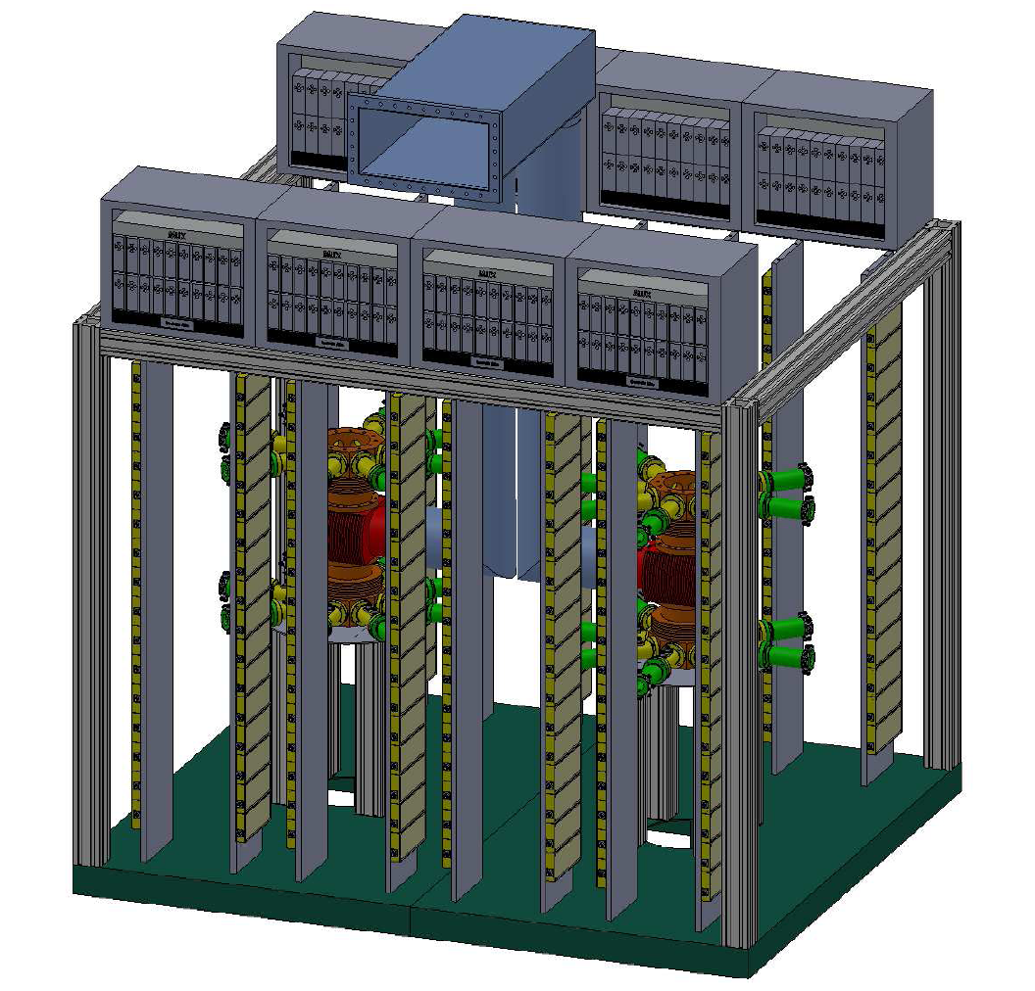
SESAME 500MHz 140kW AMPLIFIER (PRELIMINARY DESIGN)
AC-DC Power Supplies
(160 x 2kW modules)
1 Waveguide Combiner (WaCCo)
2 x 75 kW RF combination
64 8-way splitters
16 dissipators
256 amplifier modules
2 m
3 m

Slide 33
SUMMARY & CONCLUSIONS
BOOSTER 35 kW SSA (D1029UK05)
STORAGE RING 180 kW SSA (LR301)
Operation and upgrade to 6th generation BLF574XR
SOLEIL 352 MHz SSA State of the Art
P_{mod} ~ 700 W, G > 20 dB, η > 70%
500 MHz SSA R&D (BLF578)
P_{mod} ~ 650 W, G ~ 17 dB, η > 60%
500 MHz SSA based projects
LNLS : 2 x 45 kW (476 MHz)
SESAME : 2 x 75 kW
THOM-X : 50 kW
R&D at other frequencies
FM band (88 – 108 MHz) → 1 kW module with G > 25 dB and η ~ 80 %
L band (1.3 & 1.5 GHz) for 4th generation LS → P_{mod} > 400 W
LUNEX5 : 20kW @ 1.3 GHz

Slide 34
Thank you for your attention

