Slide 1
RF control for free electron lasers
Christian Schmidt
TIARA Workshop on RF Power Generation for Accelerators
17 - 19 June 2013

Slide 2
Outline
(Soft) X-Ray Free Electron Lasers
  Introduction and general layout
  Disturbance classification and control type systems
LLRF regulation of a SC accelerator
  Planned setup for the European XFEL
  Beam based feedback systems
Control of NC acceleration structures
  Stability requirements to the amplifiers
  Example: REGAE facility at DESY
Conclusion

Slide 3
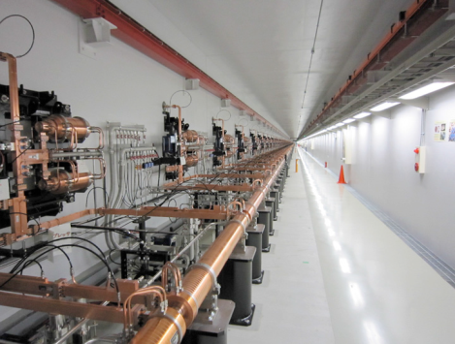
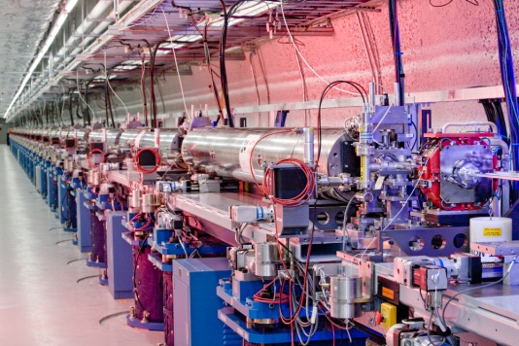
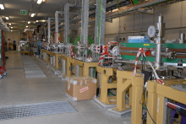
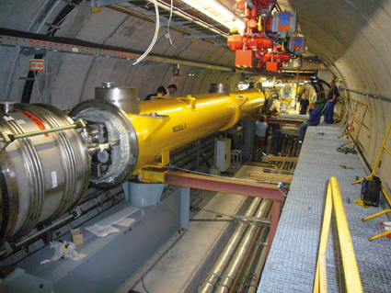
(Soft) X-Ray free electron lasers
Among other FEL facilities in lower frequency region
Facility | ACC Type | f (Hz) | E (Gev) | Max N bunches pP | RF stability requirements
LCLS,SLAC | NC | 120 | 15.4 | 1 | 0,1%, 0,1 deg
Fermi@Elettra | NC | 50 | 1.5 | 1 | 0,1% , 0.1 deg
SACLA, Riken | NC | 60 | 8.5 | 1 | 0,1%, 0,1 deg
FLASH, DESY | SC | 10 | 1.2 | 800(2400) | 0,01% , 0.01 deg
J. Blau, FEL2011 TUPB09
Upcoming: E-XFEL, Swiss-FEL, PAL X-FEL (Pohang), SXFEL (SINAP),…
SACLA
LCLS
FERMI
FLASH

Slide 4
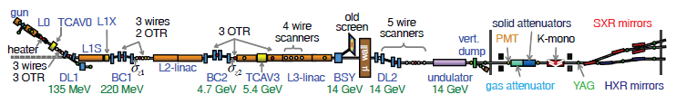
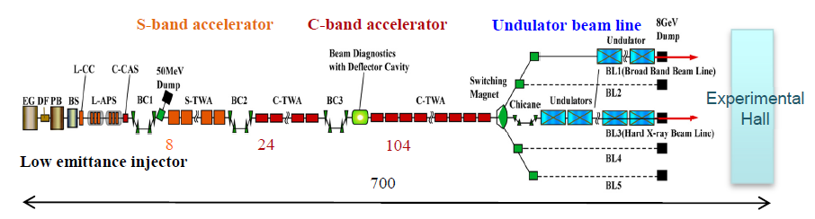
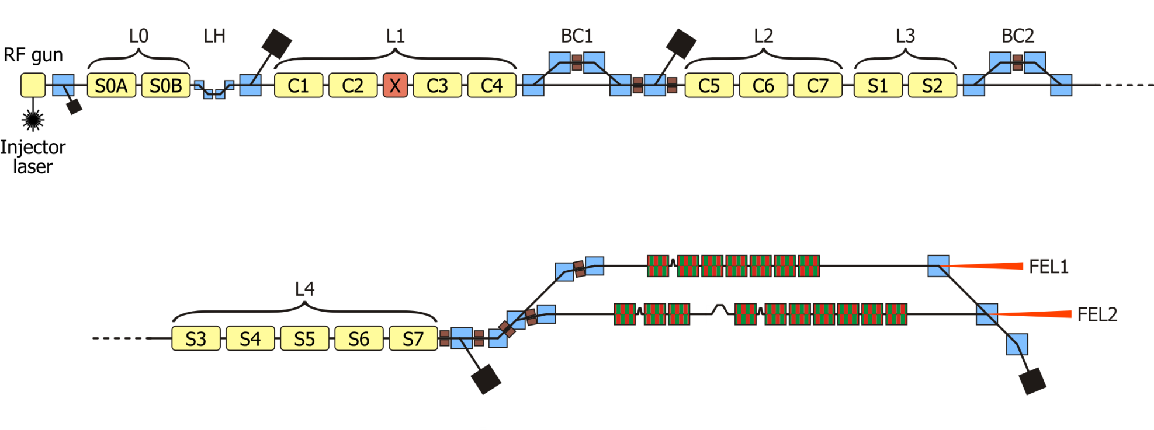
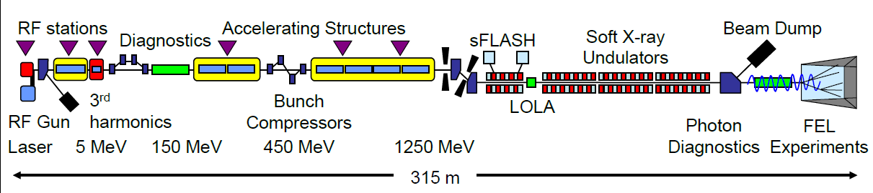
Facility overview
LCLS
J.L.Turner, PAC2011
SACLA
Y.Otake, LINAC 2012, TU2A02
Fermi@ Elletra
L.Froehlich, BBS 2013
FLASH
S.Schreiber, FEL 2011

Slide 5
Standard linac approach for FEL
Accelerate off-crest in L1 to induce a phase-energy correlation along the bunch
Use harmonic RF to linearize the longitudinal phase space (Extract energy from beam)
Implement a laser heater (LH) to increase intrinsic energy spread (optional)
Partially compress the bunch in BC1
Intermediate acceleration in L2
Fully compress the bunch in BC2
Accelerate to final energy and de-chirp in L3
C. Tennant, IPAC 2011

Slide 6
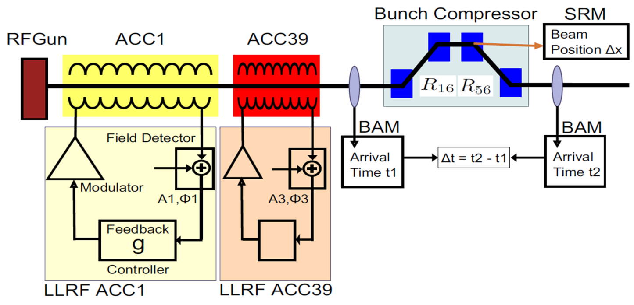
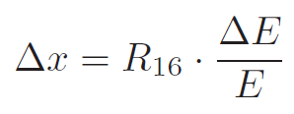
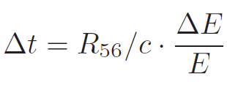

Bunch compression stage at FLASH
Timing jitter behind BC
Voltage
Phase
Incoming
Energy chirp in ACC ➔ different path length in BC
3rd harmonic structure used to linearize phase space
Multiple compression stages
AP variations propagate
next RF station dt ➔ dP
RF stability requirements max at linac start
XFEL: 3.3 ps/%
FLASH: 5.5ps/%
2 ps/deg
L-band
0.05 ps/ps
C=20
R₅₆=180mm
Compression factor C ~5 … 20

Slide 7
Synchronization - reference distribution schemes …
Various approaches:
Δt Δf
=
t f
1) RF distribution
standard
reflectometer
interferometer
SLAC
FLASH
E-XFEL
~
f ~ 100MHz …GHz
LO
~
MO
2) Carrier is optically
f ~ GHz
SwissFEL
MZT
~
3) Carrier is optically + detection
SLAC
FERMI
(LBNL)
SACLA
f ~ 200 THz
4) Pulsed optical source
FERMI
FLASH
E-XFEL
SwissFEL
Δf ~ 5 THz
Mode locked
Laser
OXC
Notes:
Before you start editing the slides of your talk change to the Master Slide view:
Menu button “View”, Master, Slide Master:
Edit the following 2 items in the 1st slide:
1) 1st row in the violet header:
Delete the existent text and write the title of your talk into this text field
2) The 2 rows in the footer area: Delete the text and write the information
regarding your talk (same as on the Title Slide) into this text field.
If you want to use more partner logos position them left
beside the DESY logo in the footer area
Close Master View

Slide 8
Disturbance source / types inside RF control
General control loop
  LLRF -> RF control
  HPRF -> amplifier, klystron, waveguide, cavities
  FB or adaptive FF
LLRF
HPRF
u
d
y
+
e
u
+
y
+
r
C
G
y‘
-
+
+
Contributions at plant input [u]:
  Amplifier chain : thermal drifts, non-linearity,
  saturation, high frequency noise
Plant [d]:
  Cavity detuning (thermal, mechanical), beam itself (long pulse), further modes
Measurement system [y]:
  Noise contributions from pick-up, cross-talk,
  field detection, thermal drifts
Control loop (digital):
  accuracy, fixed point data processing,
  up conversion (detection scheme)
Accelerator technology
Normal-conducting (nc)
Super-conducting (sc)
high | bandwidth | low
short ~ us | pulse length | long ~ms
(no), yes | feedback, adaptive FF | yes, yes
1-2 | bunches in puls | 1- >1000
puls to puls | beam based FB | intra pulse puls to pulse
sensitive | amplifier distortions | cavity filters
phase slippage | VS control | gradient tilts

Slide 9
Outline
(Soft) X-Ray Free Electron Lasers
  Introduction and general layout
  Disturbance classification and control type systems
LLRF regulation of a SC accelerator
  Planned setup for the European XFEL
  Beam based feedback systems
Control of NC acceleration structures
  Stability requirements to the amplifiers
  Example: REGAE facility at DESY
Conclusion

Slide 10
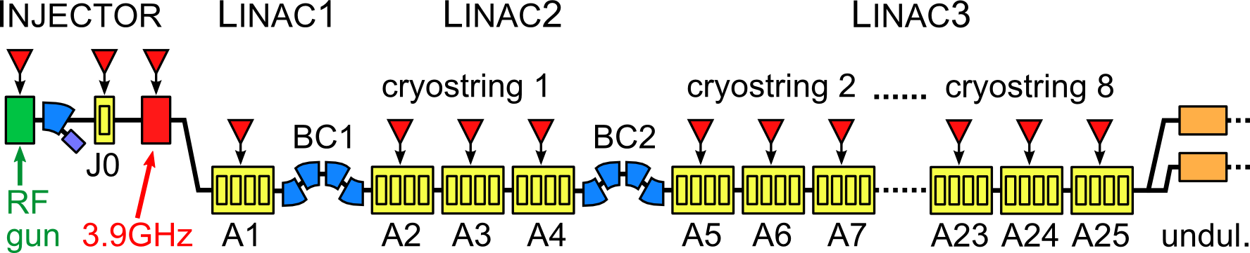
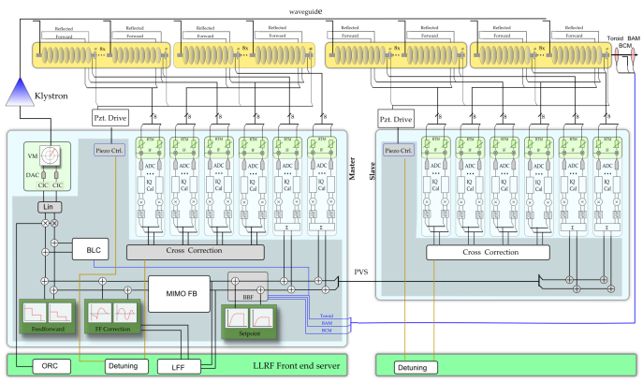
XFEL LLRF System
808 SC 1.3 GHz TESLA RF cavities
101 cryomodules (8 cavities)
25 RF stations (4 cryomodules)
1 LLRF system / RF station (i.e. per klystron)
Control loop layout
CM1
CM2
CM3
CM4
LLRF master
KLYSTRON
LLRF slave

Slide 11
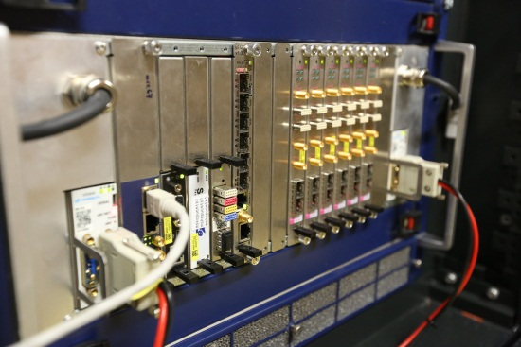
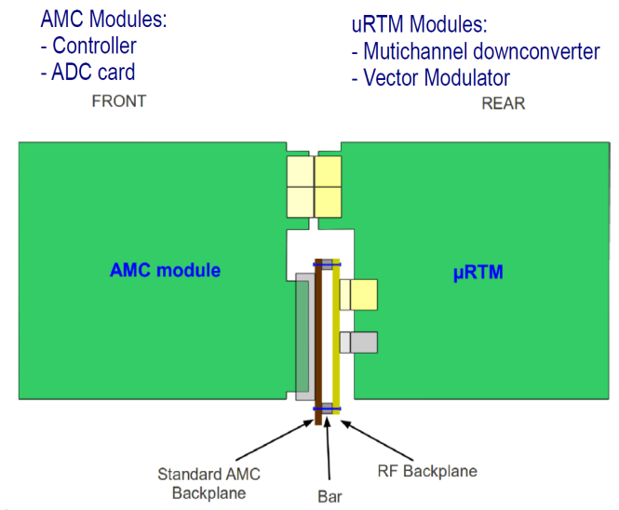

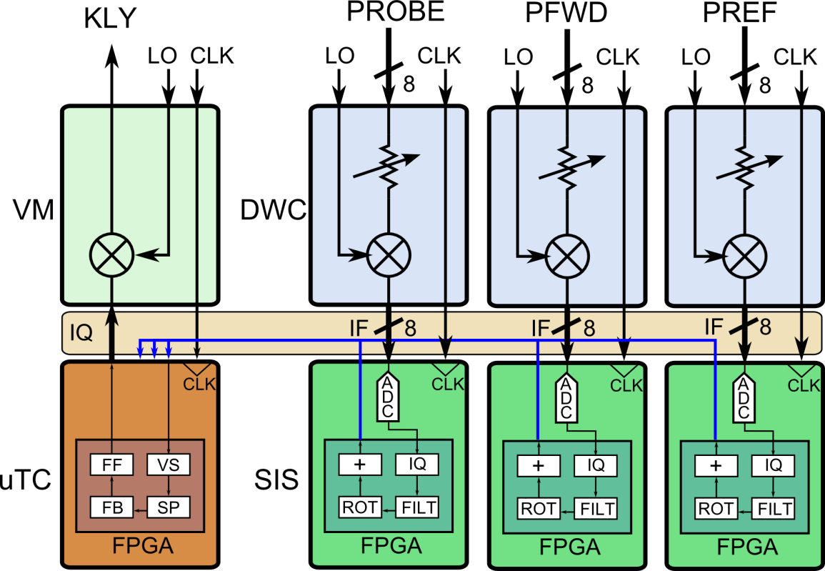
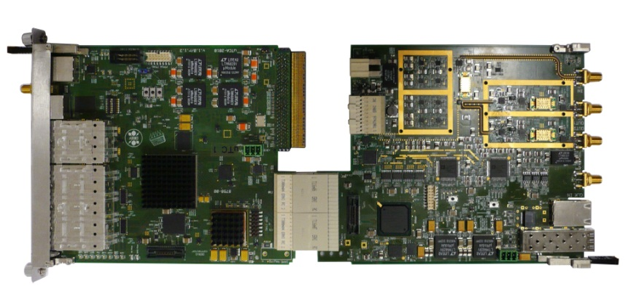
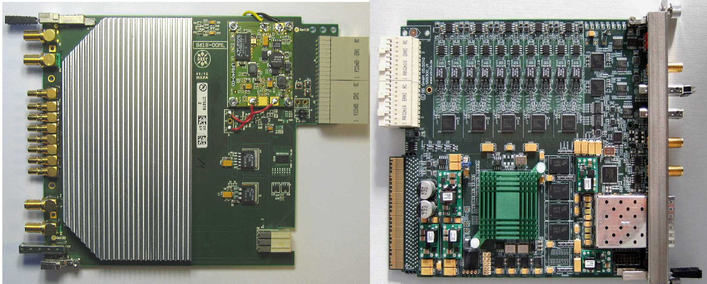
New HW standard to be used for FLASH/E-XFEL
AMC: Advanced Mezzanine Card
RTM: Rear Transition Module
12 slots, hot swap
Redundant power supply
Back
Front
Zone 3
RTM
AMC
Analog
AMC backplane
Digital
PREF
PFWD
PROBE
BACK
uVM
Vector Modulator (uVM)
LLRF Controller (uTC)
FRONT
uDAQ
Down Converter (DWC)
Digitizer (uDAQ)

Slide 12
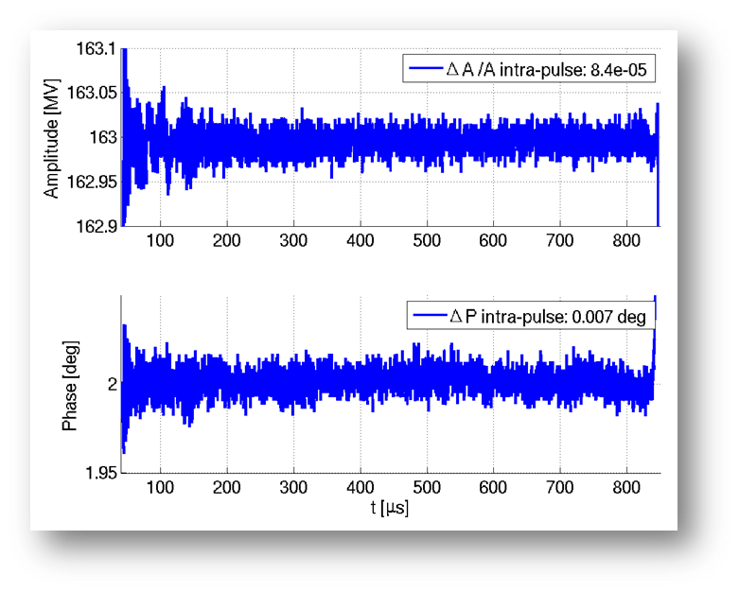
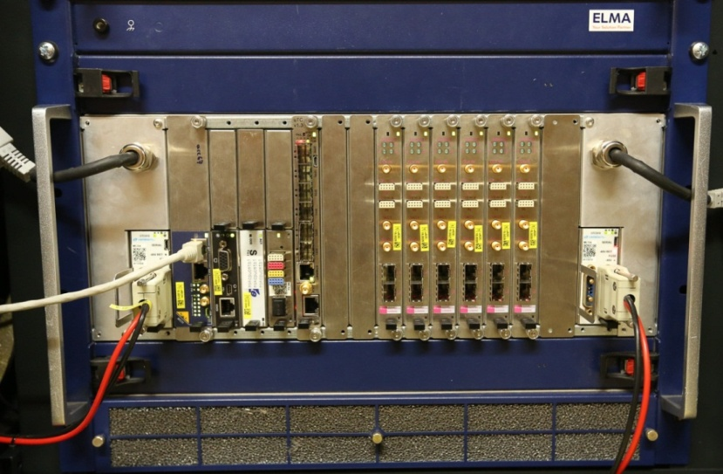

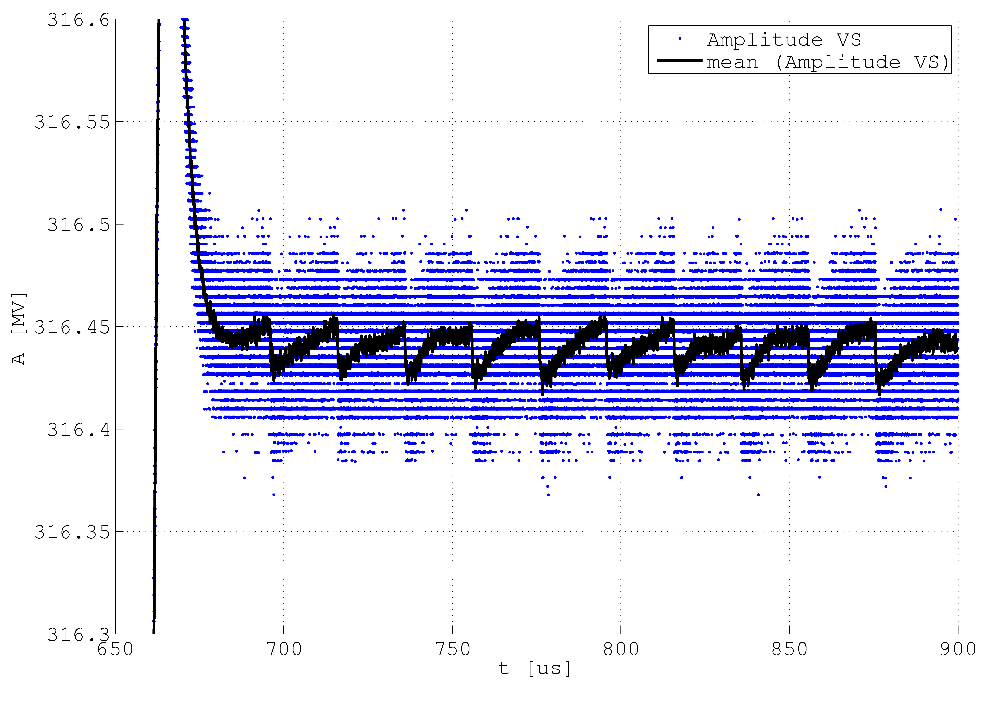
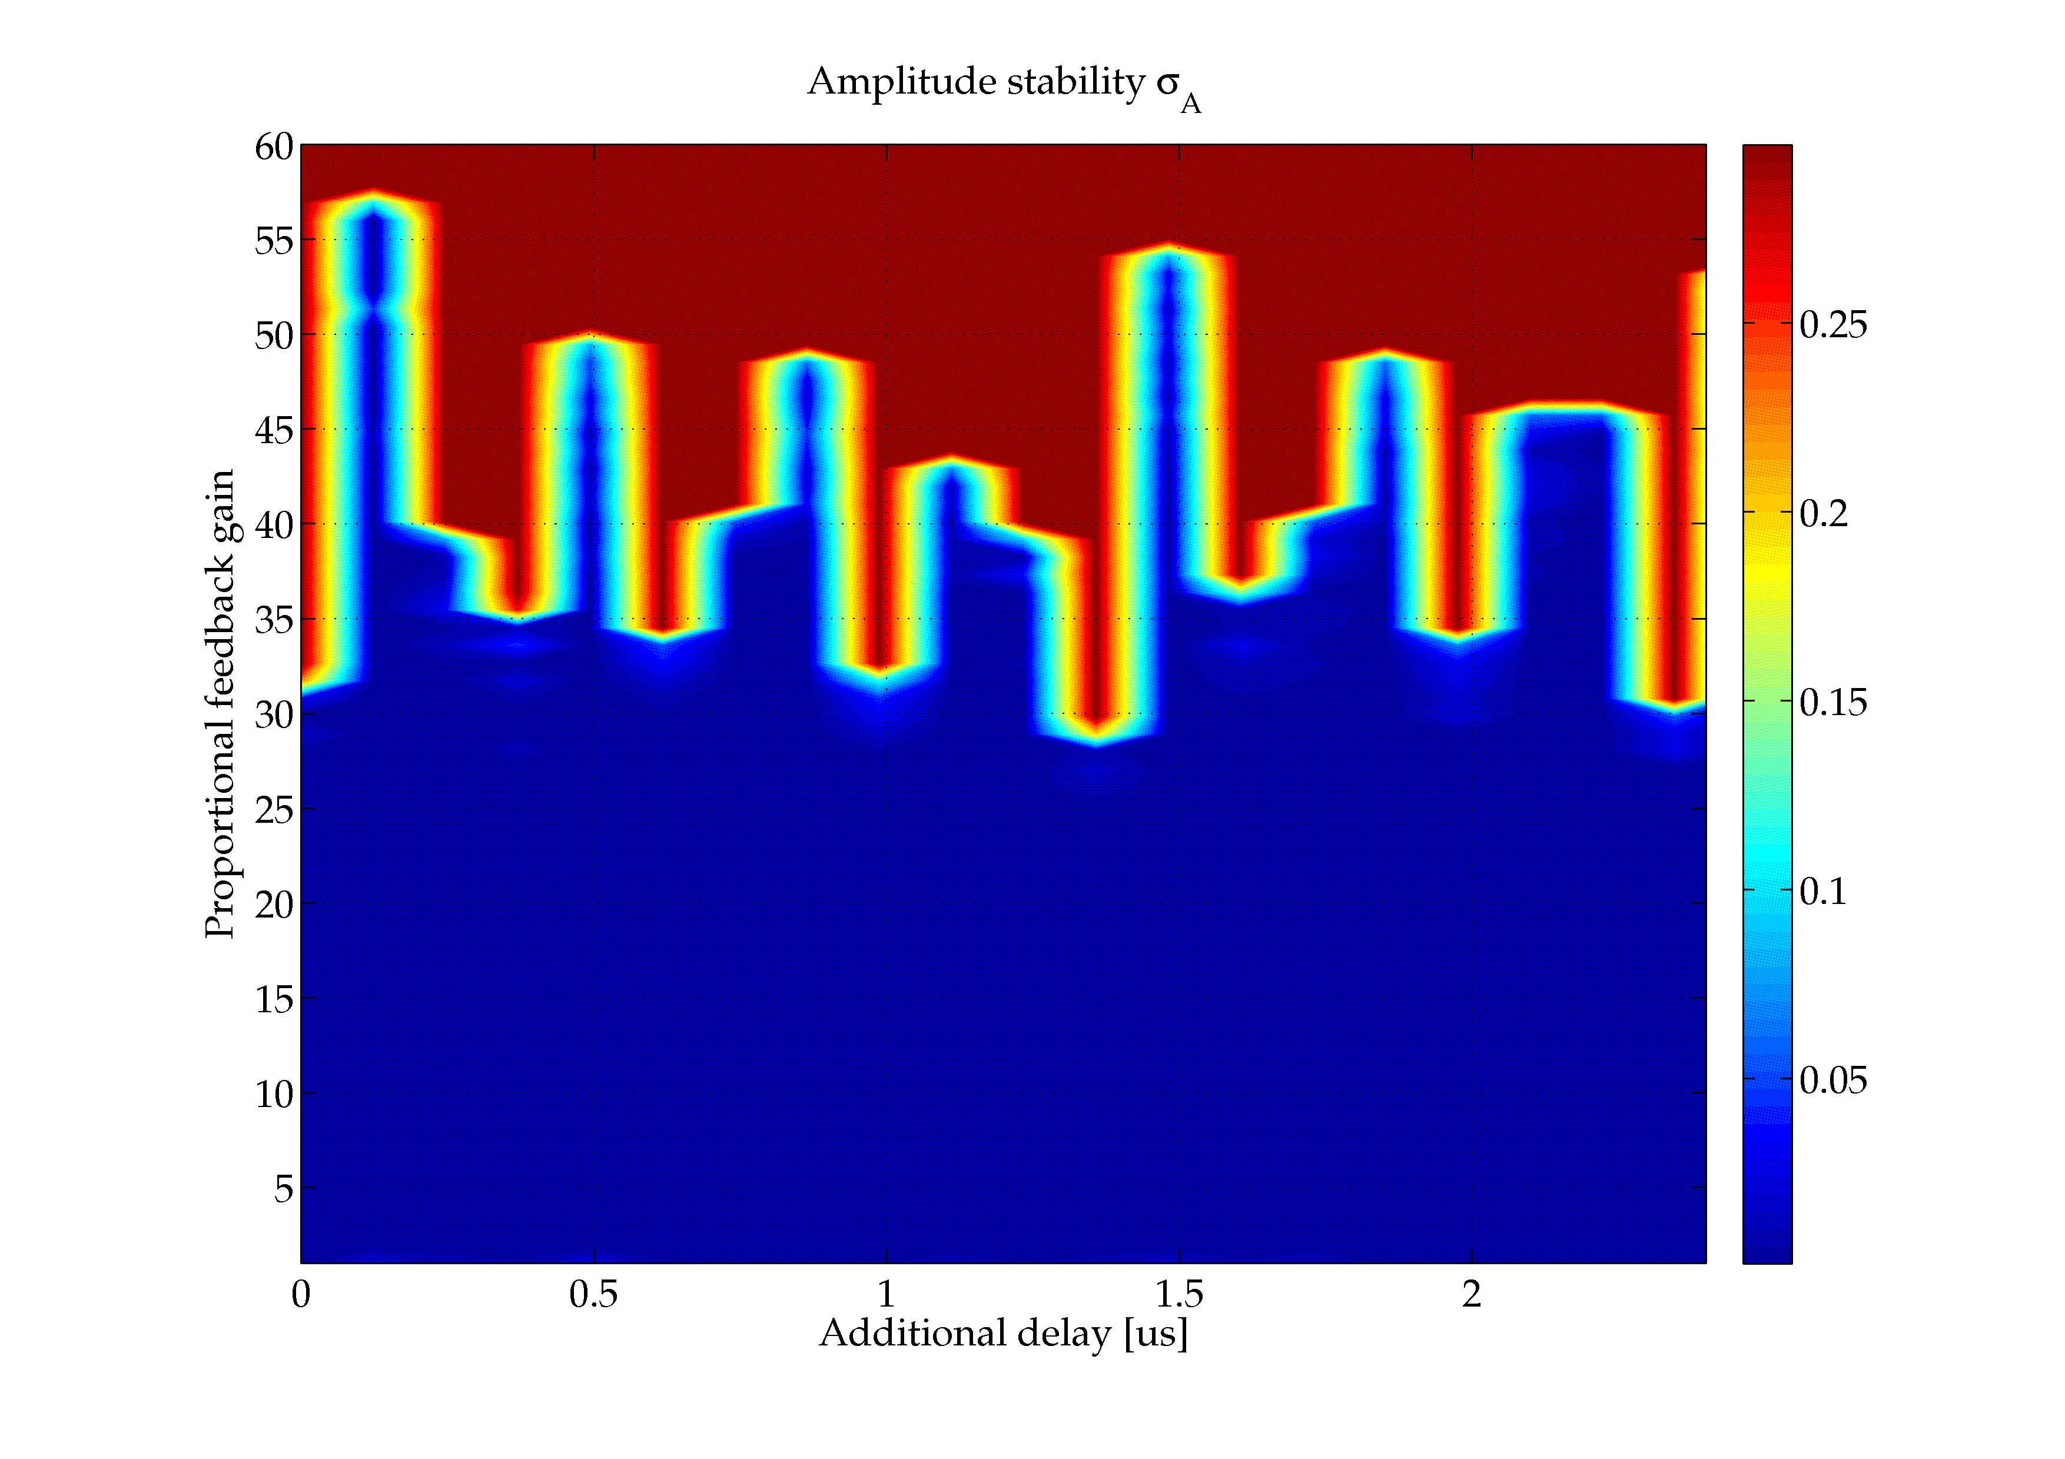
MTCA.4 based LLRF measurements at FLASH
POWER
MODULE
ADC boards
LLRF CTRL
Timing
CPU
MCH
New (old) challanges
but
1 RF station, 8 cav.
dA/A ~ 1e-4
Energy stability
dE/E = 5E-5.
f = 200kHz

Slide 13
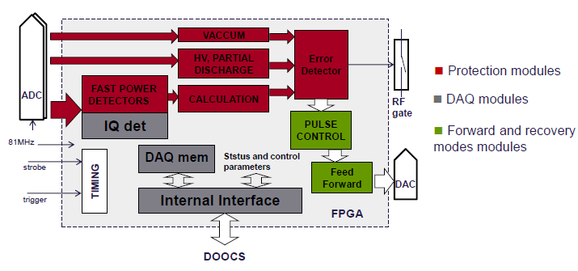
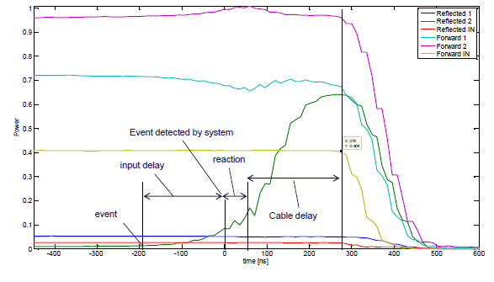
Klystron protection system tested at DESY
Klystron expensive device ➔ maximize lifetime
Fast interlock system ~200 – 300 ns
Functionality test done
Fast meas./processing of:
  HV, Current, vacuum, …
  Pforw, Prefl, …
To be used in E-XFEL
Courtesy L. Butkowski

Slide 14
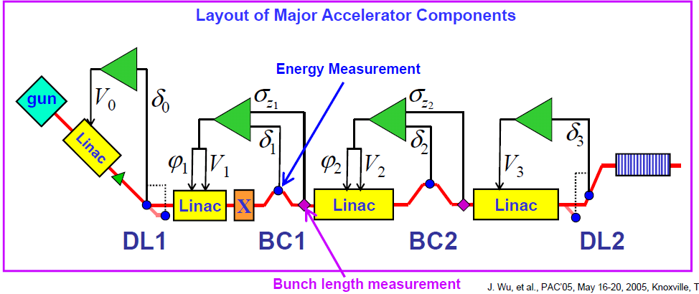
Pulse to pulse beam based feedback
Example: LCLS
6 parameters for energy (δ) & bunch length (σ)
Typical bandwidth 10Hz @ 120 Hz rep-rate
>10Hz … dedicated FB network!
Courtesy: D. Fairley
Example: FLASH
Toroid
BAM
BCM
BAM
BCM
Energy
GUN
ACC1
39
ACC23
ACC45
ACC67
Q
A
φ
A
φ
A
A
PI controller, running up to 10 Hz, full coupled response matrix
Designed to run full coupled RM, scalable for E-XFEL
Similar: FERMI, Swiss-FEL

Slide 15
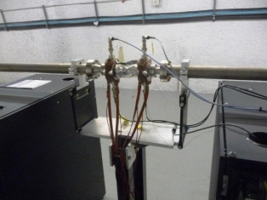
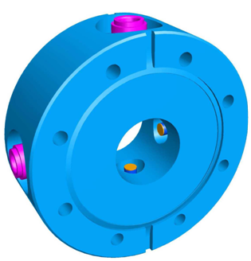
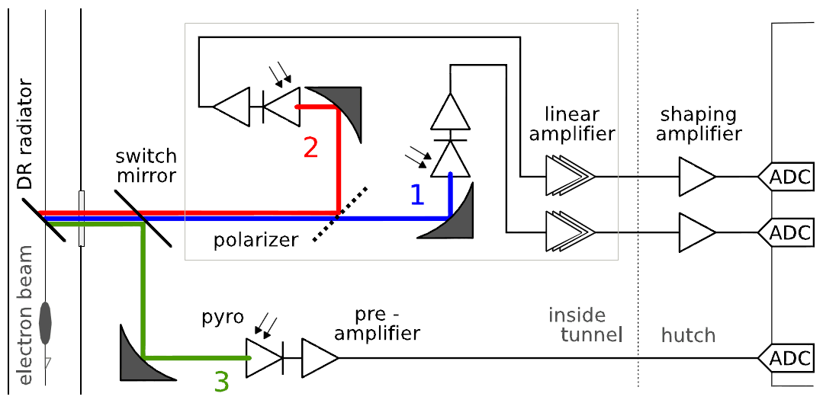
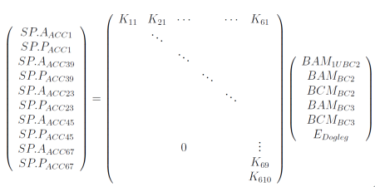
Bunch diagnostic required for beam based feedback
Bunch arrival time measurement
  Phase detection based (resonant): LCLS
  Ampl. Det (bb).: FLASH, XFEL, Fermi, Swiss-FEL
Bunch compression monitor
  Detectors: Pyro / 0.1-1THz photo-detectors
  Problem: pulse shape variation not detected
    Correction 3rd harmonic or X-band structure?
Bunch charge and position
Cavity
BAM
Arrangement at FLASH (Coh. Diff.)
Beam based feedback principle:
V_{mon} = M_{resp}⋅V_{act}
V_{act,n+1} = V_{act,n} + G⋅(M_{resp}) ⁻¹⋅V_{mon,n}
Measurement of response matrix actuator (RF) → monitor (arrival time)
Linear fit of proportional factor [C = ps /MV]
Inversion of response matrix (SVD), eventually pick dedicated monitor
Apply from RF pulse to RF pulse SP corrections to compensate drifts

Slide 16
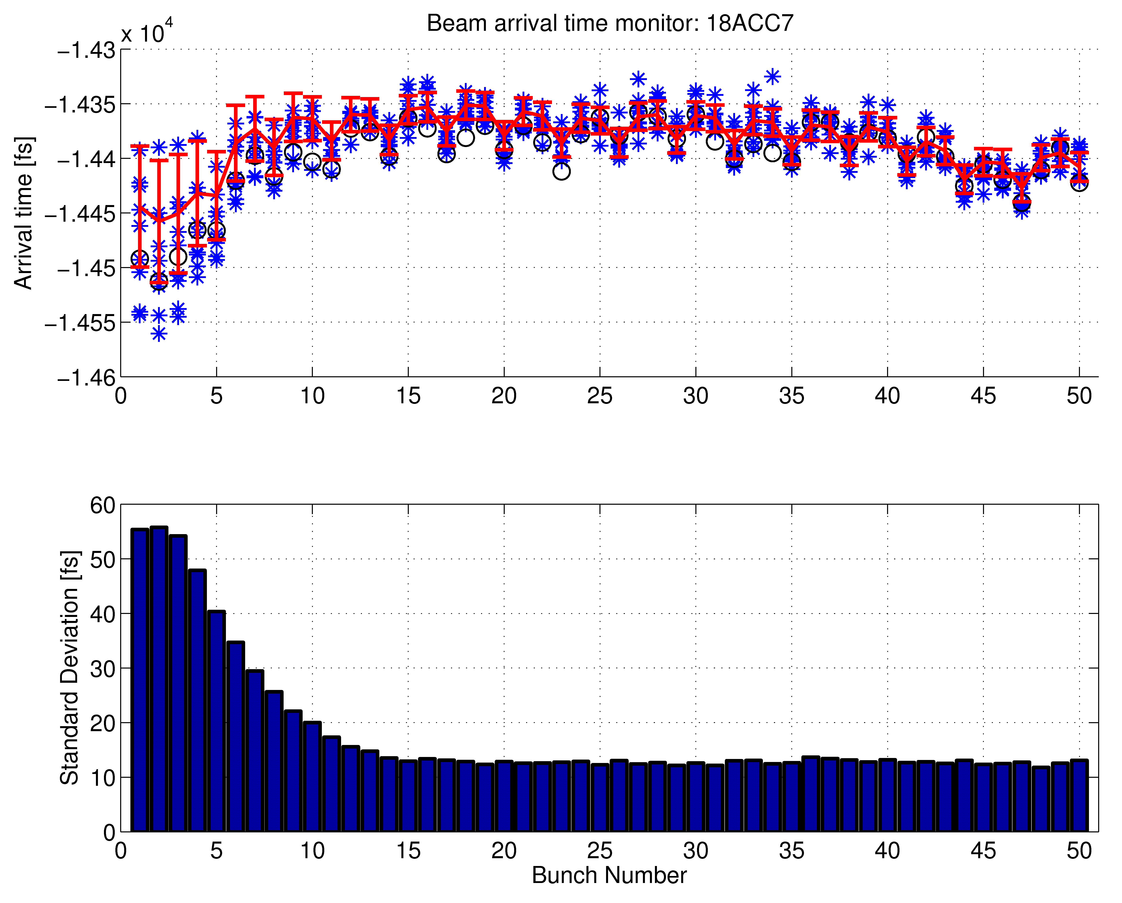
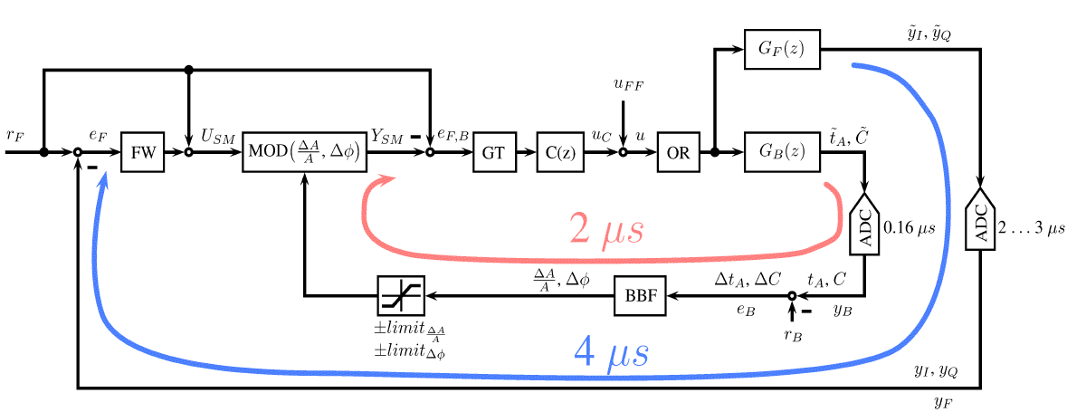
Bunch train allows for intra-train FB
Laser
BC2
~
BC3
~
Gun
ACC1
3rd
ACC2
ACC3
ACC4
ACC7
Toroid
A φ
Toroid
A φ
Toroid
φ
A φ
BAM
BAM
BAM
BCM
BAM
BCM
Exit of linac
& out-of-loop
LLRF
LLRF
LLRF
LLRF
LLRF
LLRF
LLRF
LLRF
Phase in RF-Gun
Ampl. and phase ACC1&ACC39
Ampl and phase ACC23
LLRF
Improved FPGA algorithm
Loop delay
2011
System Bandwidth
~ 12 fs (rms)
Cascade RF and beam based FB loop
Latency optimization

Slide 17
Outline
(Soft) X-Ray Free Electron Lasers
  Introduction and general layout
  Disturbance classification and control type systems
LLRF regulation of a SC accelerator
  Planned setup for the European XFEL
  Beam based feedback systems
Control of NC acceleration structures
  Stability requirements to the amplifiers
  Example: REGAE facility at DESY
Conclusion

Slide 18
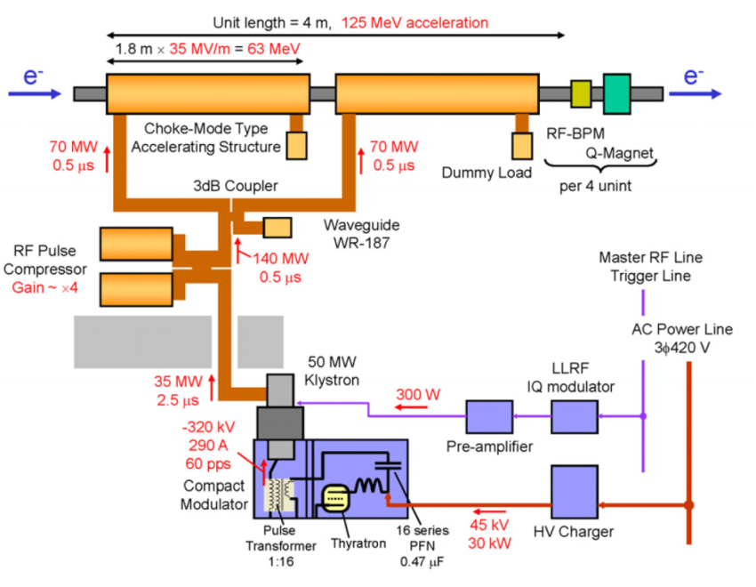
RF control of short RF pulses (NRF)
RF System @ SACLA
For RF pulse duration ~ 2-3 us
  feed forward control define RF stability
Main factors:
  Temperature stability acc. Structure < 0.01K
  Stability of HV modulator
Feedback applied pulse-to-pulse
  Using For/Ref/Probe signal to remove
  temp. drifts of cavities/waveguides..
  Multi-cavities ⇒ vector sum control
dV/V~3⋅10⁻⁴
dφ ~ 0.03°
T. Inagaki, IPAC11, MOPC018
Pohang RF stab requirements
Main accelerating structure | Quasi-type (S-band normal conductor)
Operating frequency | 2,856 MHz (S-band), 11.424 GHz (X-band)
No. of Acc. structures | 180 ea (S-band) , 1 ea (X-band)
No. of klystrons | 49 ea (S-band) , 1 ea (X-band)
Modulator | Voltage stability: < 50 ppm rms
Linac microwave | Phase stability: <0.05 deg, 0.05% rf voltage Jitter
Fermi X-Band LLRF
H. Soo Lee.: PAL-XFEL
G. D’Auria, IPAC 2012, TUPPP054
Notes:
Before you start editing the slides of your talk change to the Master Slide view:
Menu button “View”, Master, Slide Master:
Edit the following 2 items in the 1st slide:
1) 1st row in the violet header:
Delete the existent text and write the title of your talk into this text field
2) The 2 rows in the footer area: Delete the text and write the information
regarding your talk (same as on the Title Slide) into this text field.
If you want to use more partner logos position them left
beside the DESY logo in the footer area
Close Master View

Slide 19
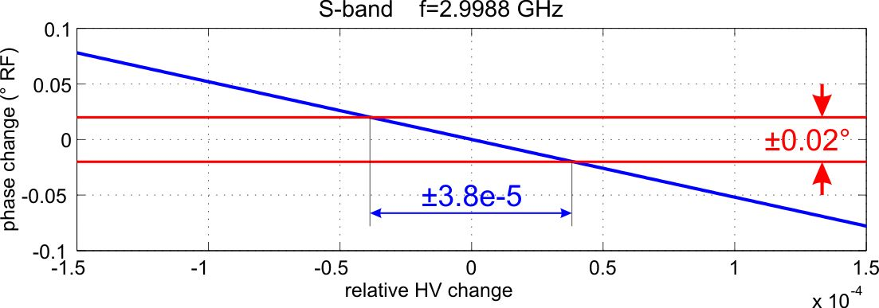
Swiss-FEL RF stability requirements
pulse-to-pulse stability
short RF pulse length
→ no (digital) intra-pulse feedback possible
→ pulse-to-pulse stability is solely
determined by actuator chain
example: klystron HV vs. RF phase change
⇒ modulator HV stability of few 1e-5 necessary
medium term stability
reliable measurements of RF parameters (ampl./phase)
with minimum systematic errors and sufficient resolution necessary
→ modify drive signal in actuator chain to correct drifts
⇒ pulse-to-pulse RF-feedback and adaptive feed-forward
pulse rep. rate: 100 Hz
→ ‘drifts’ can be corrected to max. f_{rep}/10 = 10 Hz
apply beam based feedbacks (energy feedback, beam arrival time feedback, …)
Courtesy T. Schilcher

Slide 20
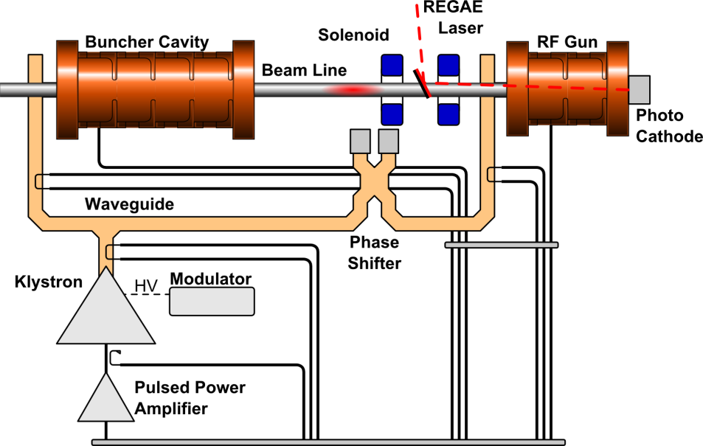
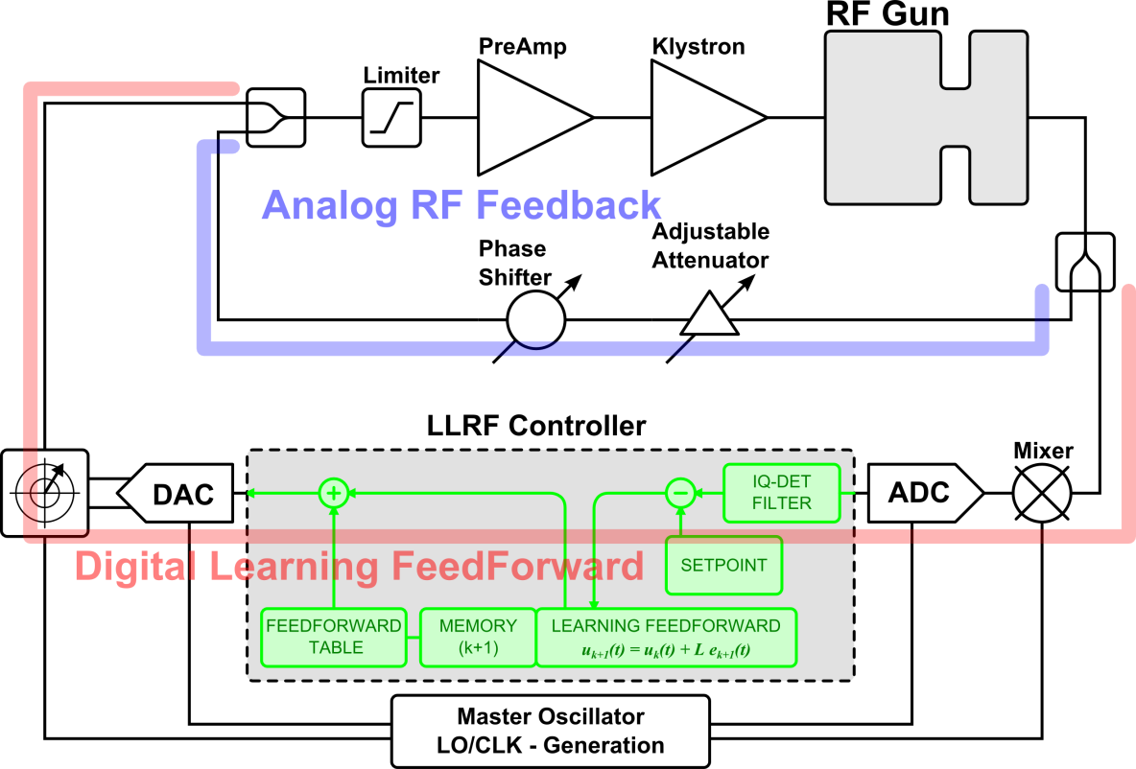
HPRF and LLRF at REGAE
Two S-Band Structures (3GHz, NC)
  RF Gun (on-crest) , Buncher (90º off crest)
Single Klystron / Modulator, no circulator
  Coupling of the structures
  Crosstalk
Based on new MTCA.4 crate standard
RF field detection (sliding window)
  125 MHz Clock
  25 MHz IF
Analog FB and digital learning FF
Regulation requirements:
  0.01% amplitude, 0.01 deg phase (3GHz)
  synchronized with LASER contr. system

Slide 21
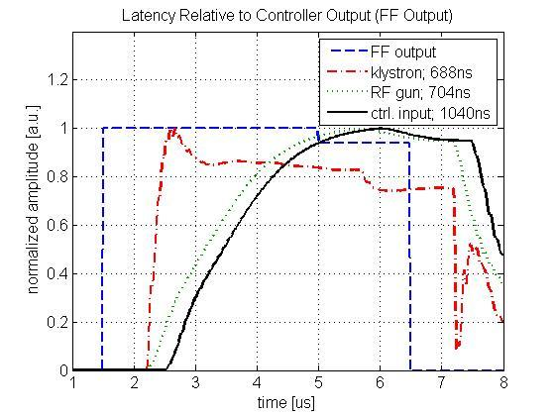
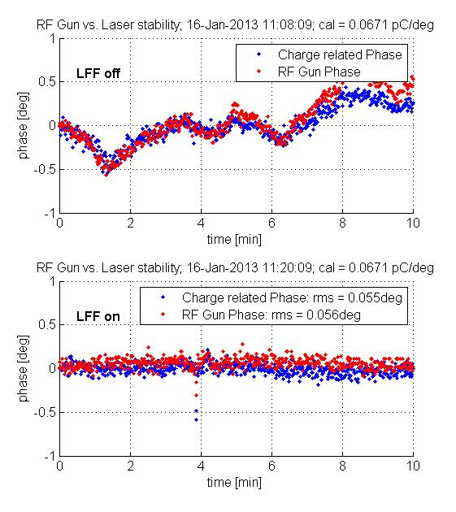
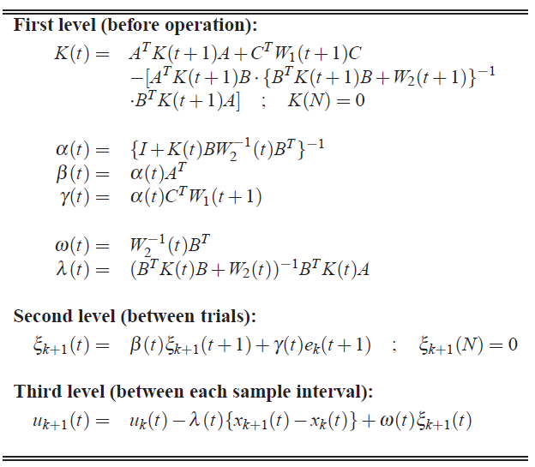
REGAE LLRF measurements
Adaptive algorithms essential
  Learning from previous pulses (non-causal)
  Only repetitive disturbances / drifts can be controlled
Decrease processing delay (digital)
  Feedback possible, delay < 1us (pulse 5us)
Algorithm baseline
New digital control development
  500 ns latency reduction (LLL)
  Dedicated for NC control applications
Δφrms = 0.055 deg = ~ 55 fs (at 3 GHz)

Slide 22
Summary & Conclusion
Current X-ray Free electron lasers many more will come
  RF Amplitude and phase control is essential for high quality photon generation
  Regulation requirements and strategies different for NC and SC facilities
Electron beam is the regulation target!
  High reliable and accurate field and bunch detection methods
  Bunch based RF control from pulse to pulse
  Intra pulse bunch feedback
NC machines with short RF pulses
  Strong demands to actuator chain, stability requirements in are < 1e-5
  Digital and analog feedback loops, analog modulator/klystron stabilization
  Example: REGAE facility at DESY

Slide 23
Acknowledgment
Thanks to:
H.Schlarb, M.Hofmann, J. Branlard, S. Pfeiffer, M.K. Czwalinna (DESY),
T.Schilcher (PSI)
Thanks for your attention

