Slide 1
Thermal Cycling of Power Semiconductors in Long Pulse Applications
Impact on Solid State Amplifiers’ lifetime
Carlos A. Martins
European Spallation Source – Accelerator Division, RF Group
Lund Technical University – Industrial Electronics and Automation

Slide 2
Synopsis
Power cycling and thermal cycling of semiconductors are phenomena resulting from the variation of temperature on the semiconductors’ junction and baseplates (cases) due to their operation in pulsed power conditions;
In the power electronics domain, these phenomena are now well understood, but 15 years ago many mistakes were still made on the design of power supply systems leading to premature failure;
A power supply operating under pulsed power (long pulses, i.e. >> 0.1 ms) is usually subjected to much more severe conditions than one operating in CW, requiring oversizing of semiconductors in the first case for acceptable lifetimes;
Very little information is made available by the semiconductor manufacturers and are almost inexistent in datasheets;

Slide 3
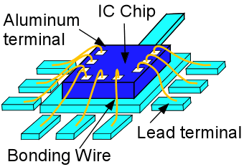
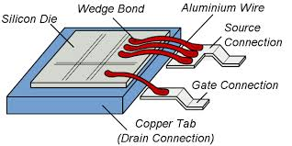
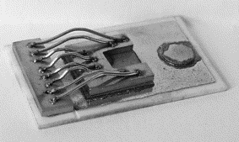
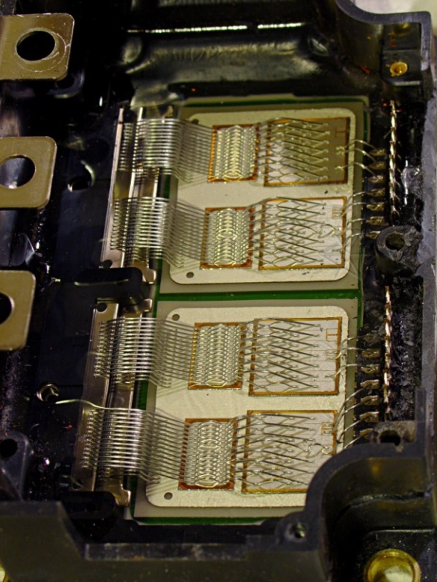
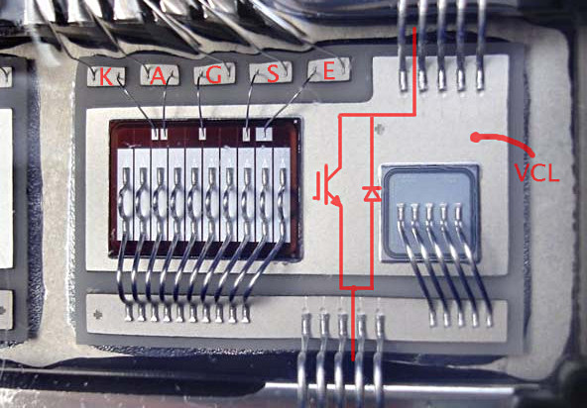
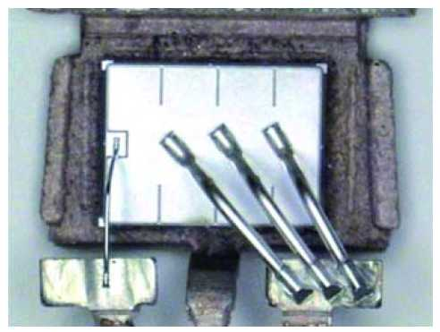
Bonding wires in power semiconductors (standard MOSFET’s)

Slide 4
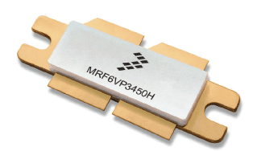
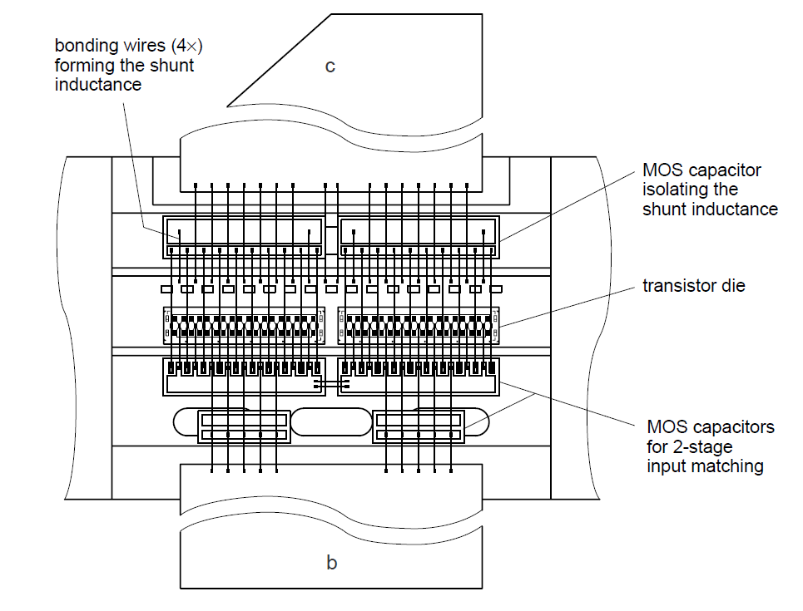
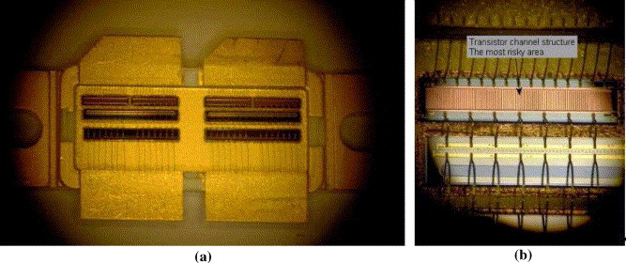
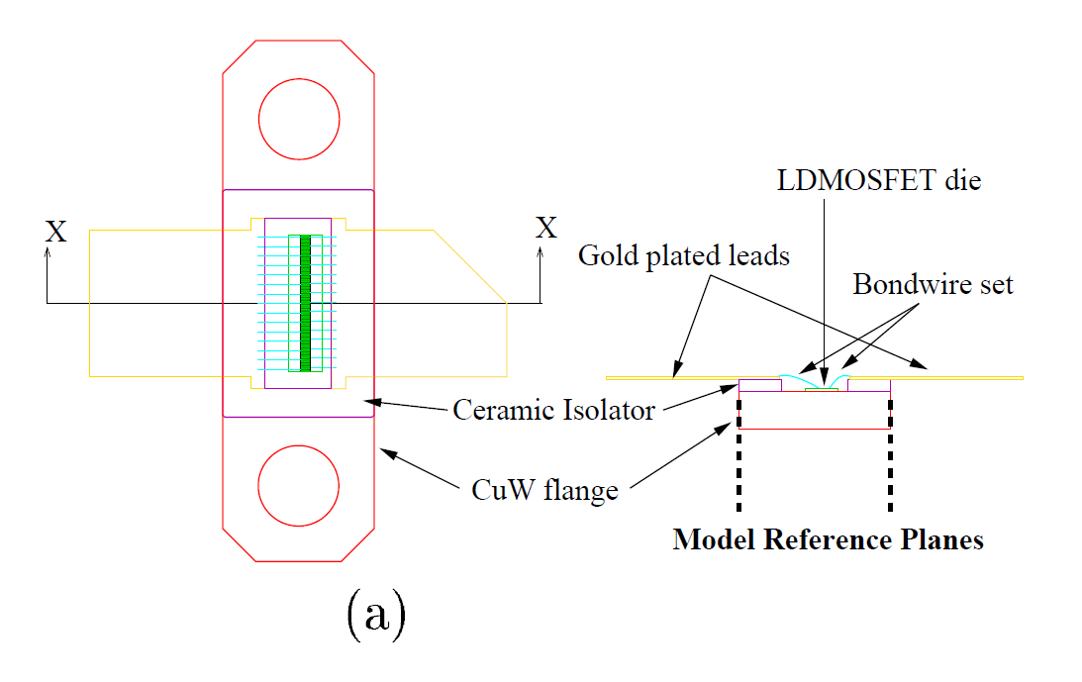
Bonding wires in RF LDMOSFET’s

Slide 5
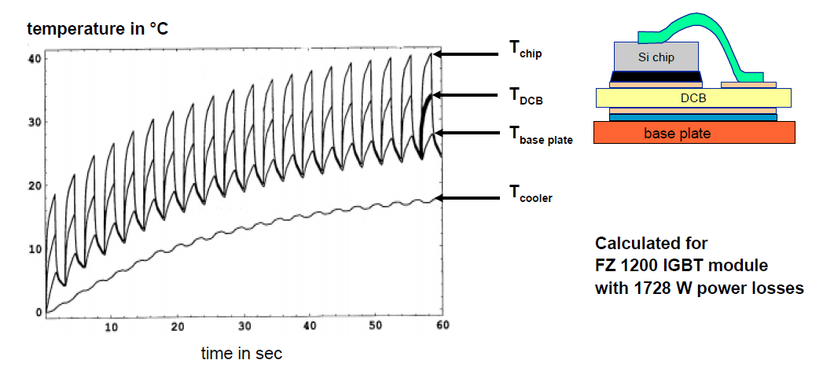
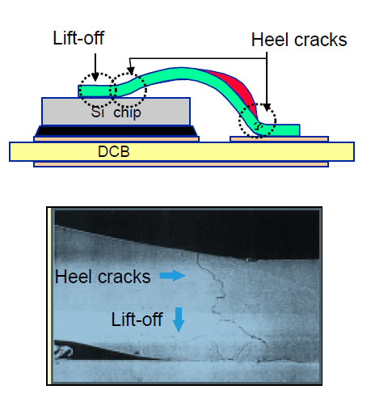
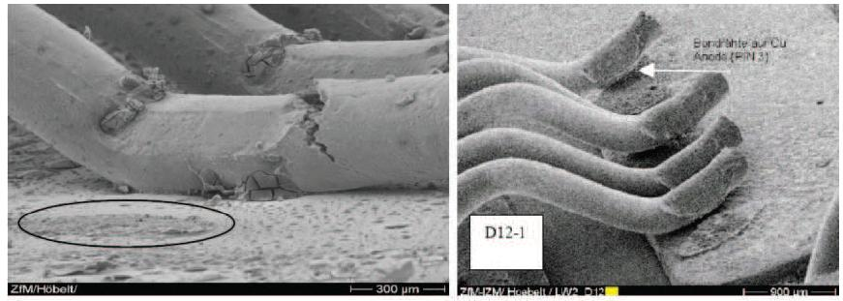
Power and thermal cycling of semiconductors
Power cycling:
- whenever the temperature of the junction does cycles but not the baseplate (case) one;
Thermal cycling:
- whenever the temperature of the baseplate (case) does cycles;
(very long pulses and low pulse repetition rates)

Slide 6
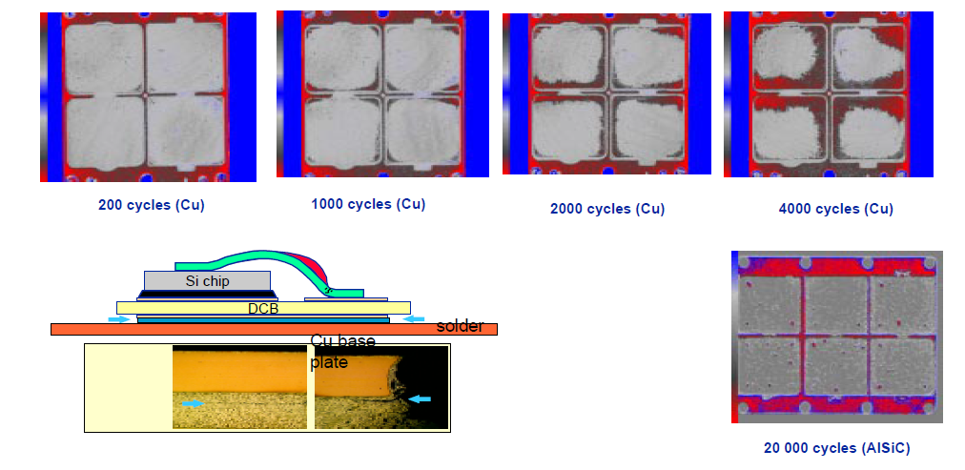
Effect of thermal cycling in semiconductors
Quality of DCB solder pads after a given number of thermal cycles
(IGBT semiconductor; copper versus AlSiC baseplates)

Slide 7
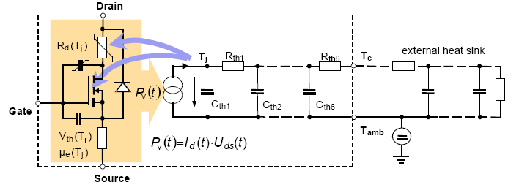
Thermal model of power semiconductors
P_{v}(t)
CW
P_{v}(t)
High frequency cycling
P_{v}(t)
Low frequency cycling
t
t
t
T_{j}(t)
T_{j}(t)
T_{j}(t)
ΔT_{j}=0
ΔT_{j}
t
ΔT_{j}
t
t
T_{c}(t)
T_{c}(t)
T_{c}(t)
ΔT_{c}=0
ΔT_{c}≈0
ΔT_{c}
t
t
t
No power cycling
No thermal cycling
Power cycling
No thermal cycling
Power cycling &
Thermal cycling

Slide 8
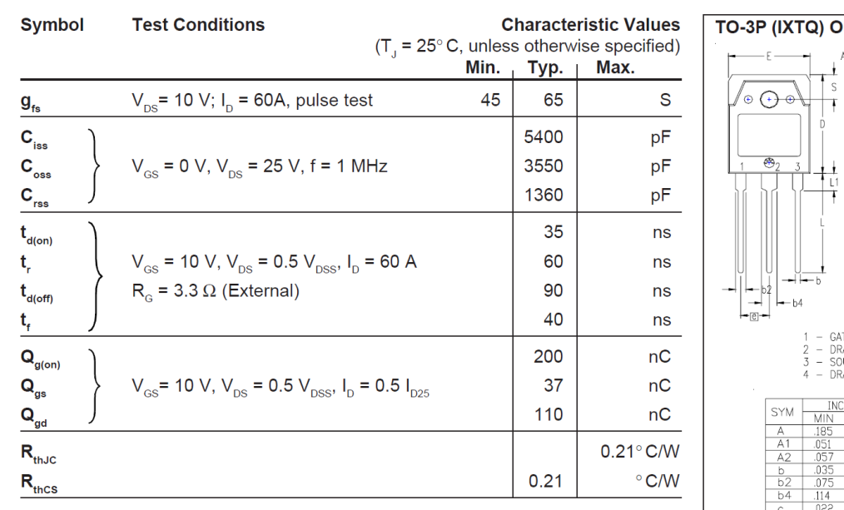
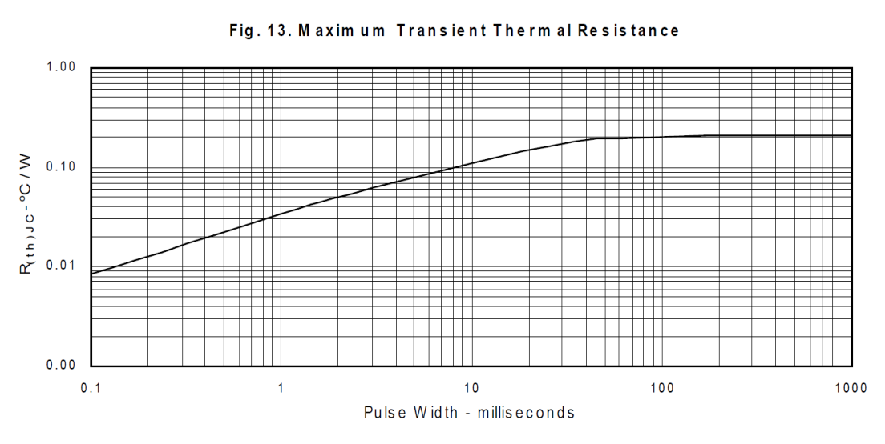
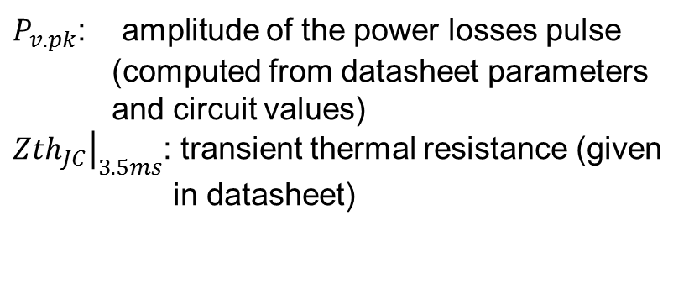
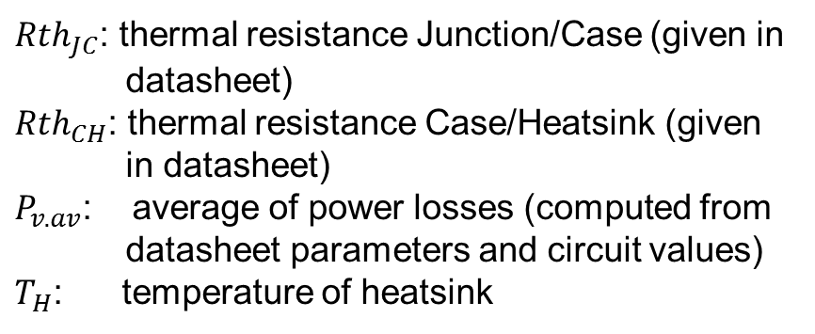
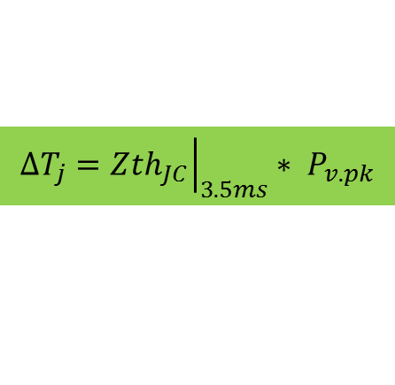

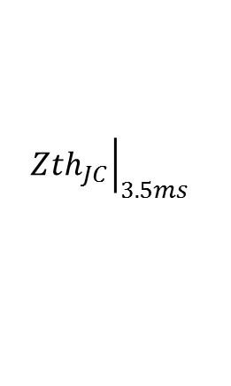
How to compute T_{j.av} and ΔT_{j} ?
T_{j.av} : average junction temperature
ΔT_{j} : junction temperature excursion
Standard MOSFET: 60V / 200A
$T_{j.av}={(Rth}_{JC}+{Rth}_{CH}$) $∗P_{v.av}+T_{H}$
${Rth}_{JC}$: thermal resistance Junction/Case (given in datasheet)
${Rth}_{CH}$: thermal resistance Case/Heatsink (given in datasheet)
$P_{v.av}$: average of power losses (computed from datasheet parameters and circuit values)
$T_{H}$: temperature of heatsink
Standard MOSFET: 60V / 200A
$${ΔT}_{j}={\left.{Zth}_{JC}\right|}_{3.5ms}∗ P_{v.pk}$$
$P_{v.pk}$: amplitude of the power losses pulse (computed from datasheet parameters and circuit values)
${\left.{Zth}_{JC}\right|}_{3.5ms}$: transient thermal resistance (given in datasheet)
$${\left.{Zth}_{JC}\right|}_{3.5ms}$$

Slide 9
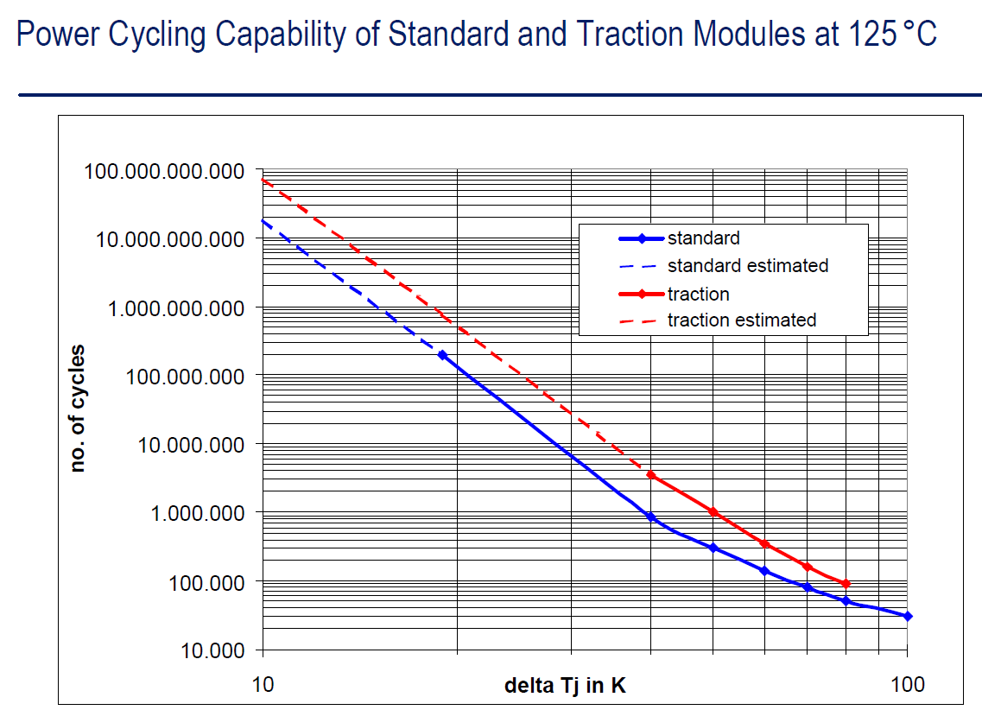
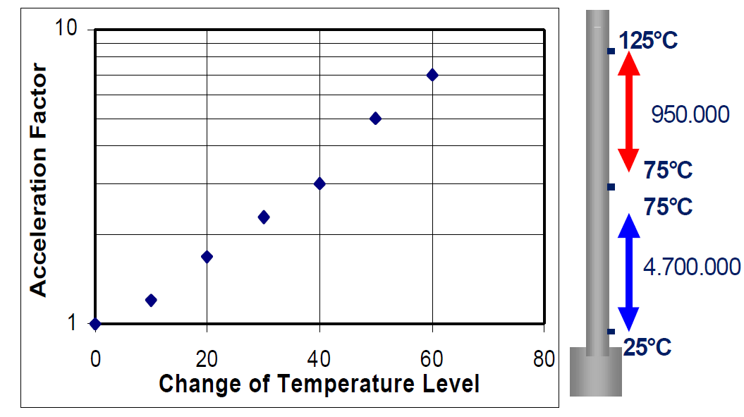
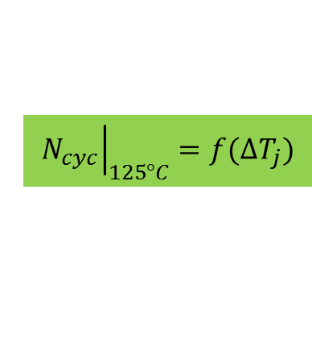
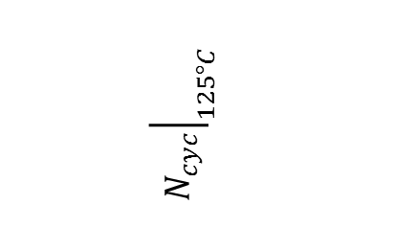

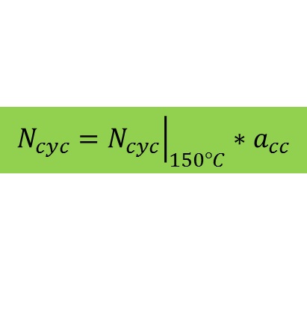
Models for lifetime calculation:
Estimation of allowed number of cycles and lifetime
Hypothesis:
Only power cycling;
No thermal cycling;
Pulse duty cycle, δ <<1;
Pulse rep. freq., 1Hz<f_{rep} < 20 Hz;
P_{v}(t)
IGBT’s (courtesy of Infineon)
P_{v.pk}
$${\left.N_{cyc}\right|}_{125°C}$$
P_{v.av}
t
T_{j}(t)
ΔT_{j}
ΔT_{j}=15°C
N_{cyc}=10⁹
t
ΔT_{j}=20°C
N_{cyc}=10⁸
T_{c}(t)
ΔT_{j}=30°C
N_{cyc}=6*10⁶
ΔT_{c}≈0
ΔT_{j}=40°C
N_{cyc}=8*10⁵
T_{C}
t
a_{cc}
$${\left.N_{cyc}\right|}_{125°C}=f({∆T}_{j})$$
$${\left.{N_{cyc}=N}_{cyc}\right|}_{150°C}∗a_{cc}$$
$$lifetime(hours)=\frac{N_{cyc}}{f_{rep}∗3600}$$
( = 125°C – T_{j.max})
with: T_{j.max} = T_{C}+ ΔT_{j}

Slide 10
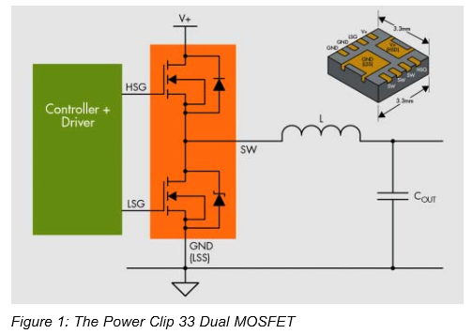
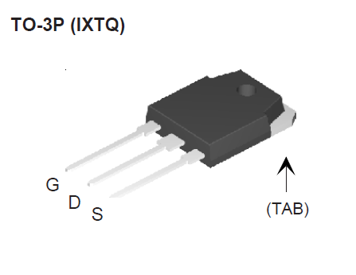


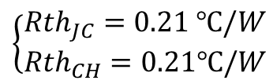
Example of lifetime calculation:
MOSFET in CW mode
P_{v}(t)
t
T_{j}(t)
ΔT_{j}=0
t
T_{c}(t)
ΔT_{c}=0
Parameters:
Output power, P_{L}= 6 kW;
Efficiency of 1 MOSFET, η = 96.7 %;
Power losses on 1 MOSFET, P_{v.av}= 200 W;
Heatsink temperature, T_{H}= 40°C;
t
$$T_{j.max}=T_{j.av}=\left({Rth}_{JC}+{Rth}_{CH}\right)∗P_{v.av}+T_{H}$$
$$T_{j.max}=124℃$$
$$\left\{\begin{matrix}{Rth}_{JC}=0.21 ℃/W \\ {Rth}_{CH}=0.21℃/W\end{matrix}\right.$$
No power cycling
No thermal cycling
No lifetime impact

Slide 11

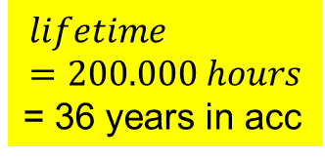
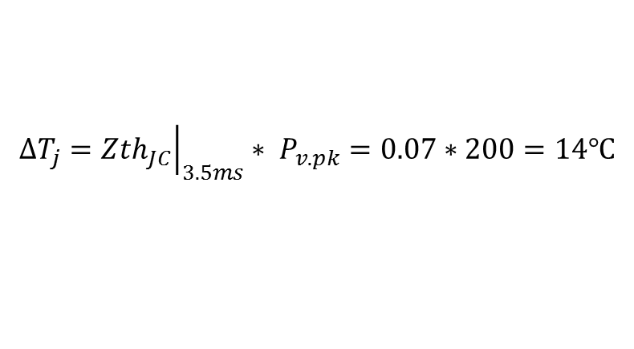

Example of lifetime calculation:
MOSFET in PULSED mode #1
P_{v}(t)
L
1. xx
P_{v.pk}
P_{v.av}
t
T_{j}(t)
ΔT_{j}
t
T_{c}(t)
ΔT_{c}≈0
T_{C}
t
Parameters:
Output pulse power, P_{L}= 6 kW;
Efficiency of 1 MOSFET, η = 96.7 %;
Pulse power losses, P_{v.pk}= 200 W;
Average power losses, P_{v.av}= 10 W;
Heatsink temperature, T_{H}= 40°C;
δ = 5%; f_{rep} = 14 Hz; L= 3.5ms
$$T_{j.max}=56℃$$
$${ΔT}_{j}={\left.{Zth}_{JC}\right|}_{3.5ms}∗ P_{v.pk}=0.07∗200=14℃$$
$$lifetime=200.000 hours$$
= 36 years in acc
$$N_{cyc}={10}^{10}$$
Extra long life

Slide 12

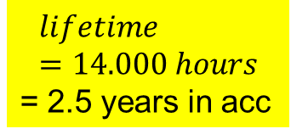


Example of lifetime calculation:
MOSFET in PULSED mode #2
P_{v}(t)
L
1. xx
P_{v.pk}
P_{v.av}
t
T_{j}(t)
ΔT_{j}
t
T_{c}(t)
ΔT_{c}≈0
T_{C}
t
Parameters:
Output pulse power, P_{L}= 9 kW;
Efficiency of 1 MOSFET, η = 96.7 %;
Pulse power losses, P_{v.pk}= 300 W;
Average power losses, P_{v.av}= 15 W;
Heatsink temperature, T_{H}= 40°C;
δ = 5%; f_{rep} = 14 Hz; L= 3.5ms
$$T_{j.max}=64℃$$
$${ΔT}_{j}={\left.{Zth}_{JC}\right|}_{3.5ms}∗ P_{v.pk}=0.07∗300=21℃$$
$$lifetime=14.000 hours$$
= 2.5 years in acc
$$N_{cyc}={7∗10}^{8}$$
Short life

Slide 13


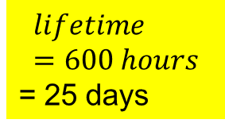


Example of lifetime calculation:
MOSFET in PULSED mode #3
P_{v}(t)
L
1. xx
P_{v.pk}
P_{v.av}
t
T_{j}(t)
ΔT_{j}
t
T_{c}(t)
ΔT_{c}≈0
T_{C}
t
Parameters:
Output pulse power, P_{L}= 12 kW;
Efficiency of 1 MOSFET, η = 96.7 %;
Pulse power losses, P_{v.pk}= 400 W;
Average power losses, P_{v.av}= 20 W;
Heatsink temperature, T_{H}= 40°C;
δ = 5%; f_{rep} = 14 Hz; L= 3.5ms
$$T_{j.max}=72℃$$
$${ΔT}_{j}={\left.{Zth}_{JC}\right|}_{3.5ms}∗ P_{v.pk}=0.07∗400=28℃$$
$$lifetime=600 hours$$
= 25 days
$$N_{cyc}={3∗10}^{7}$$

Slide 14
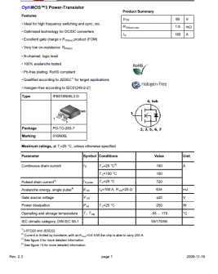
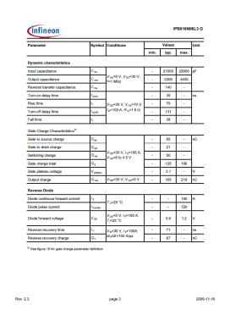
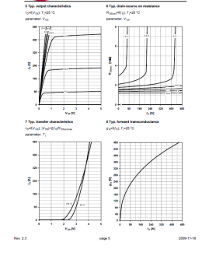
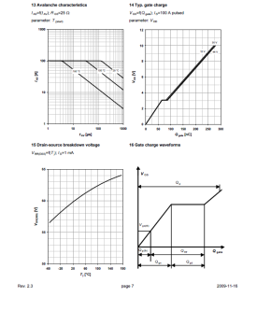
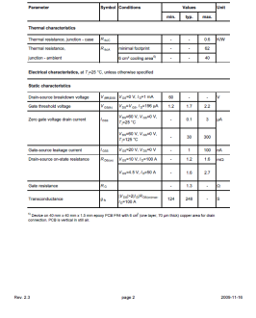
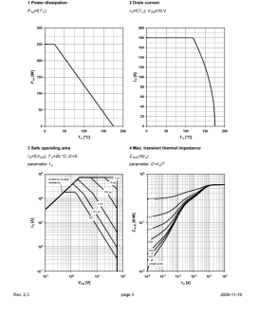
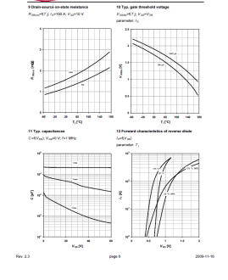
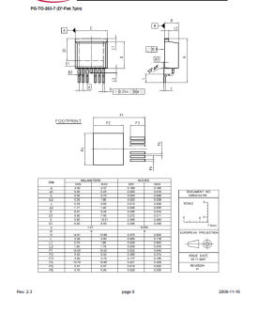
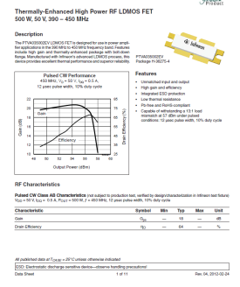
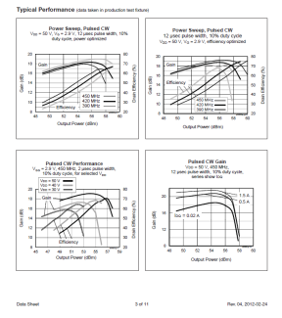
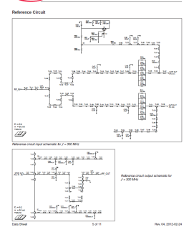
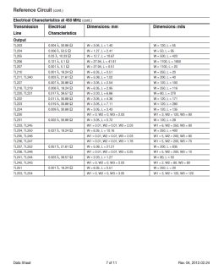
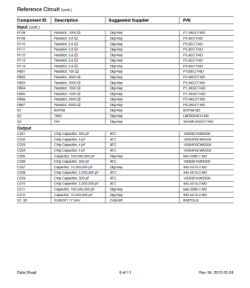
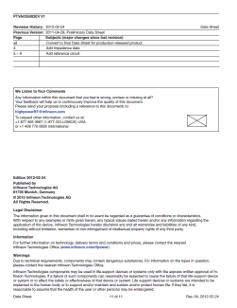
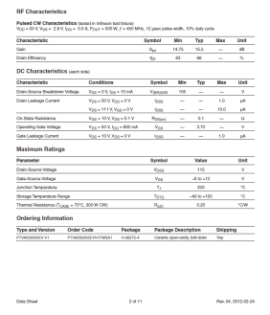
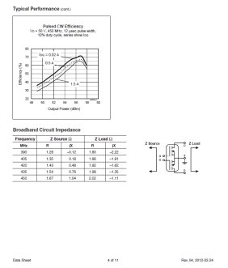



Which data should be made available by semiconductor manufacturers for a thorough design ?
Conventional MOSFET datasheet
Transient thermal impedance graph;
Power cycling, thermal cycling graphs and calculation method for number of cycles;
RF LDMOSFET datasheet

Slide 15






Can bonding wires be avoided ?
The press pack IGBT’s
The “flip chip principle”
Literature (introductory level)
Semiconductor die terminals in contact with external terminals via resort based contacts;
No bonding wires -> better reliability in pulsed mode
Semiconductor die terminals in contact with external terminals via solder bumps;
No bonding wires -> better reliability in pulsed mode ?
Chip Scale Review, July/August 2000

Slide 16
Conclusions
Any power semiconductor operating in long pulsed power regime may be subjected to thermal cycling and/or power cycling;
The allowed number of cycles, defining the semiconductors’ lifetime for a given pulsed regime, depends strongly on ΔT_{j};
Typically, a ΔT_{j} of 15°C has negligible impact on the lifetime with respect to a CW application (no cycling) . A ΔT_{j} of 30°C may lead to prohibitive short lifetimes (days or months …);
The way to increase lifetime in long pulsed regimes is by reducing ΔT_{j}, therefore reducing the pulse power per semiconductor (i.e., increasing the number of semiconductors for power de-rating);
Manufacturers of RF MOSFET’s should provide relevant data for calculation of lifetime in pulsed power mode. Could independent research labs build test stands to provide this information ?

