Slide 1
Practical experience with the AD Stochastic Cooling
Murphy’s Law
R. Louwerse

Slide 2
Water Cooling Systems 1. Power Amplifiers.
The power amplifiers are water cooled.
This allows them to be built in a compact way.
What can go wrong ?
1. Taps can accidentally be forgotten after maintenance.
2. The water flow can be blocked by dirt.
Therefore a flow meter with an interlock must protect the amplifiers by turning of the power supply and give an alarm to the operators.

Slide 3
Water Flow Surveillance

Slide 4
Water Pressure Monitoring

Slide 5
Water cooling systems Power Amplifiers 2
In practice : a flat seal between the water hoses got compressed too much and the central hole became too small.
Solution : each amplifier has a visual indication of the flow with a steel ball in a glass tube.
A thermostat on the heatsink gives additional protection by turning of the amplifier when it overheats.

Slide 6
Water Flow Monitors

Slide 7
Water cooling systems The kicker tanks 1
The kicker tanks which deflect the beam have internal loads to absorb the RF power. External loads are not practical because of the large amount of vacuum feedtrhoughs that would be needed.
In a vacuum only water cooling can carry away all the heat.
Because the electrodes can move in the vacuum mechanical stress and wear occur.

Slide 8
Setting up the system
Stochastic cooling works by measuring the average position of a group of particles and applying feedback to this group of particles.
It only works when the bandwidth of the system is very large, and perfect synchronisation is required. This requires measurement of the beam transfer function with each individual amplifier and making the delay of the signals equal for each amplifier.
Phase errors due to non-ideal amplifiers and transmission lines must be corrected.

Slide 9
Water cooling systems The kicker tanks 2
At some time micro fissures ocurred in the water tubes inside the vacuum. This ruins the vacuum.
To avoid dismantling the tank a repair was tried with liquid epoxy resin. This worked and is still holding
When the machine is stopped for maintenance, the water must be drained, to avoid damage during bake-out.
Also here a flow interlock is needed to switch of the power when there is no water.

Slide 10
The Kicker Tank

Slide 11
Other issues
The power amplifiers are suspended with springs to allow for some movement in the connections for the RF signals. Otherwise the connectors might become very stressed.
A circulator has been inserted between each amplifier and the kicker tank to protect from reflected power.
The DC resistance of the load is monitored for additional protection. This also gives a means to detect a broken load resistor and generate an alarm.

Slide 12
Spring Suspension

Slide 13
Spring Suspension Close Up

Slide 14
The devil is in the detail
Relays that do not close.
Bad connectors.
Badly mounted components. A voltage regulator that was badly attached to a heatsink would switch off on thermal overload after some time. When the system was switched on again, everything worked for some time again. Such faults are hard to find.
Water that got into the air-filled transmission lines.
Bad beam quality / RF parameters.

Slide 15
The «Platform Fritz»
In the real world, setting-up the stochastic cooling needs some adjustment of the gain and delay settings, because of changes caused by thermal drift, ageing components or changes in the beam or other parts of the machine. (Magnet re-alignment, changes in the magnetic field)
Some settings only need to be changed rarely and are «static», others are «dynamic» aand need to be driven by a function generator.
Switching of signals is sometimes necessary for setting-up with a network analyzer.
All these functionalities are implemented on the «Platform Fritz»

Slide 16
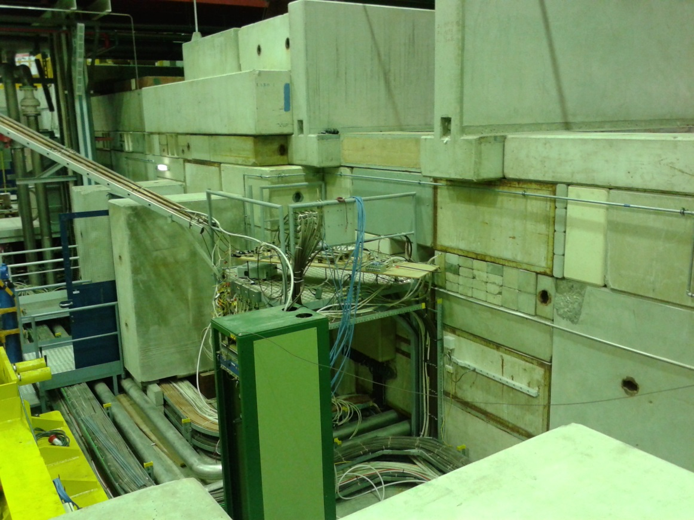
Platform Fritz (1)

Slide 17
Platform Fritz (2)

Slide 18
Platform Fritz (3)

Slide 19
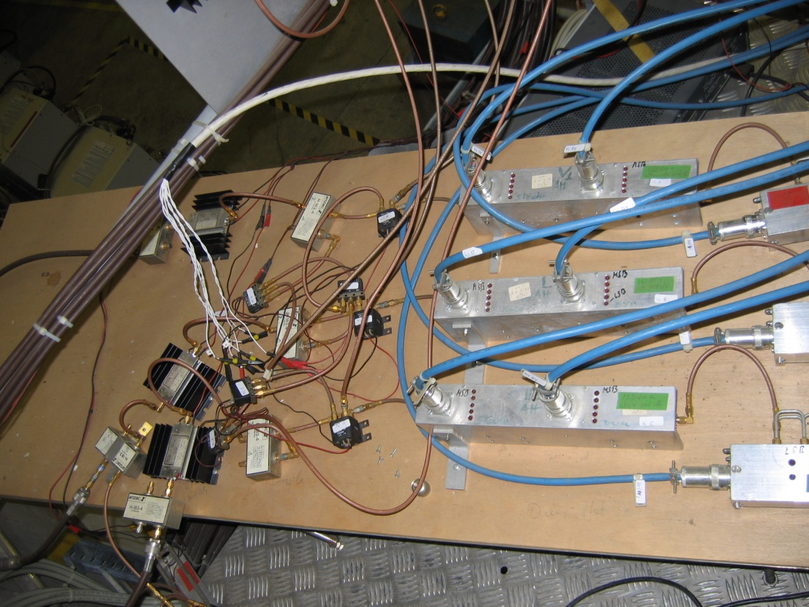
Platform Fritz (4)

Slide 20
New Controls of Platform Fritz

Slide 21
Power supply considerations.
Each power amplifier draws 40 A at 16 V. There are 2 groups of 24 amplifiers. With a common power supply as was used in the past, problems can result from the large amount of inductively stored power when the system switches of in an uncontrolled way (mains failure or other)
After renovation of the system, each amplifier now has an individual power supply. This has become possible because high power switched mode supplies are now available. This reduces the risk of accidents with high power and makes it possible to change a broken power supply without the need to switch of the whole installation.

Slide 22
Pick-ups
In order to obtain low noise levels the pre-amplifiers are cooled to about 50 K. Monitoring of the temperature must be done to detect problems with the cooling.
The pick-up electrodes can be moved closer to the beam as the beam size shrinks, to increase the efficiency. This requires motor control driven by a function generator, and also compressed air to cancel the pulling effect from the vacuum bellows. Otherwise the static torque on the motor would be excessive. Readback of the position with a resolver allows ro check the proper functioning.

